Slide 1
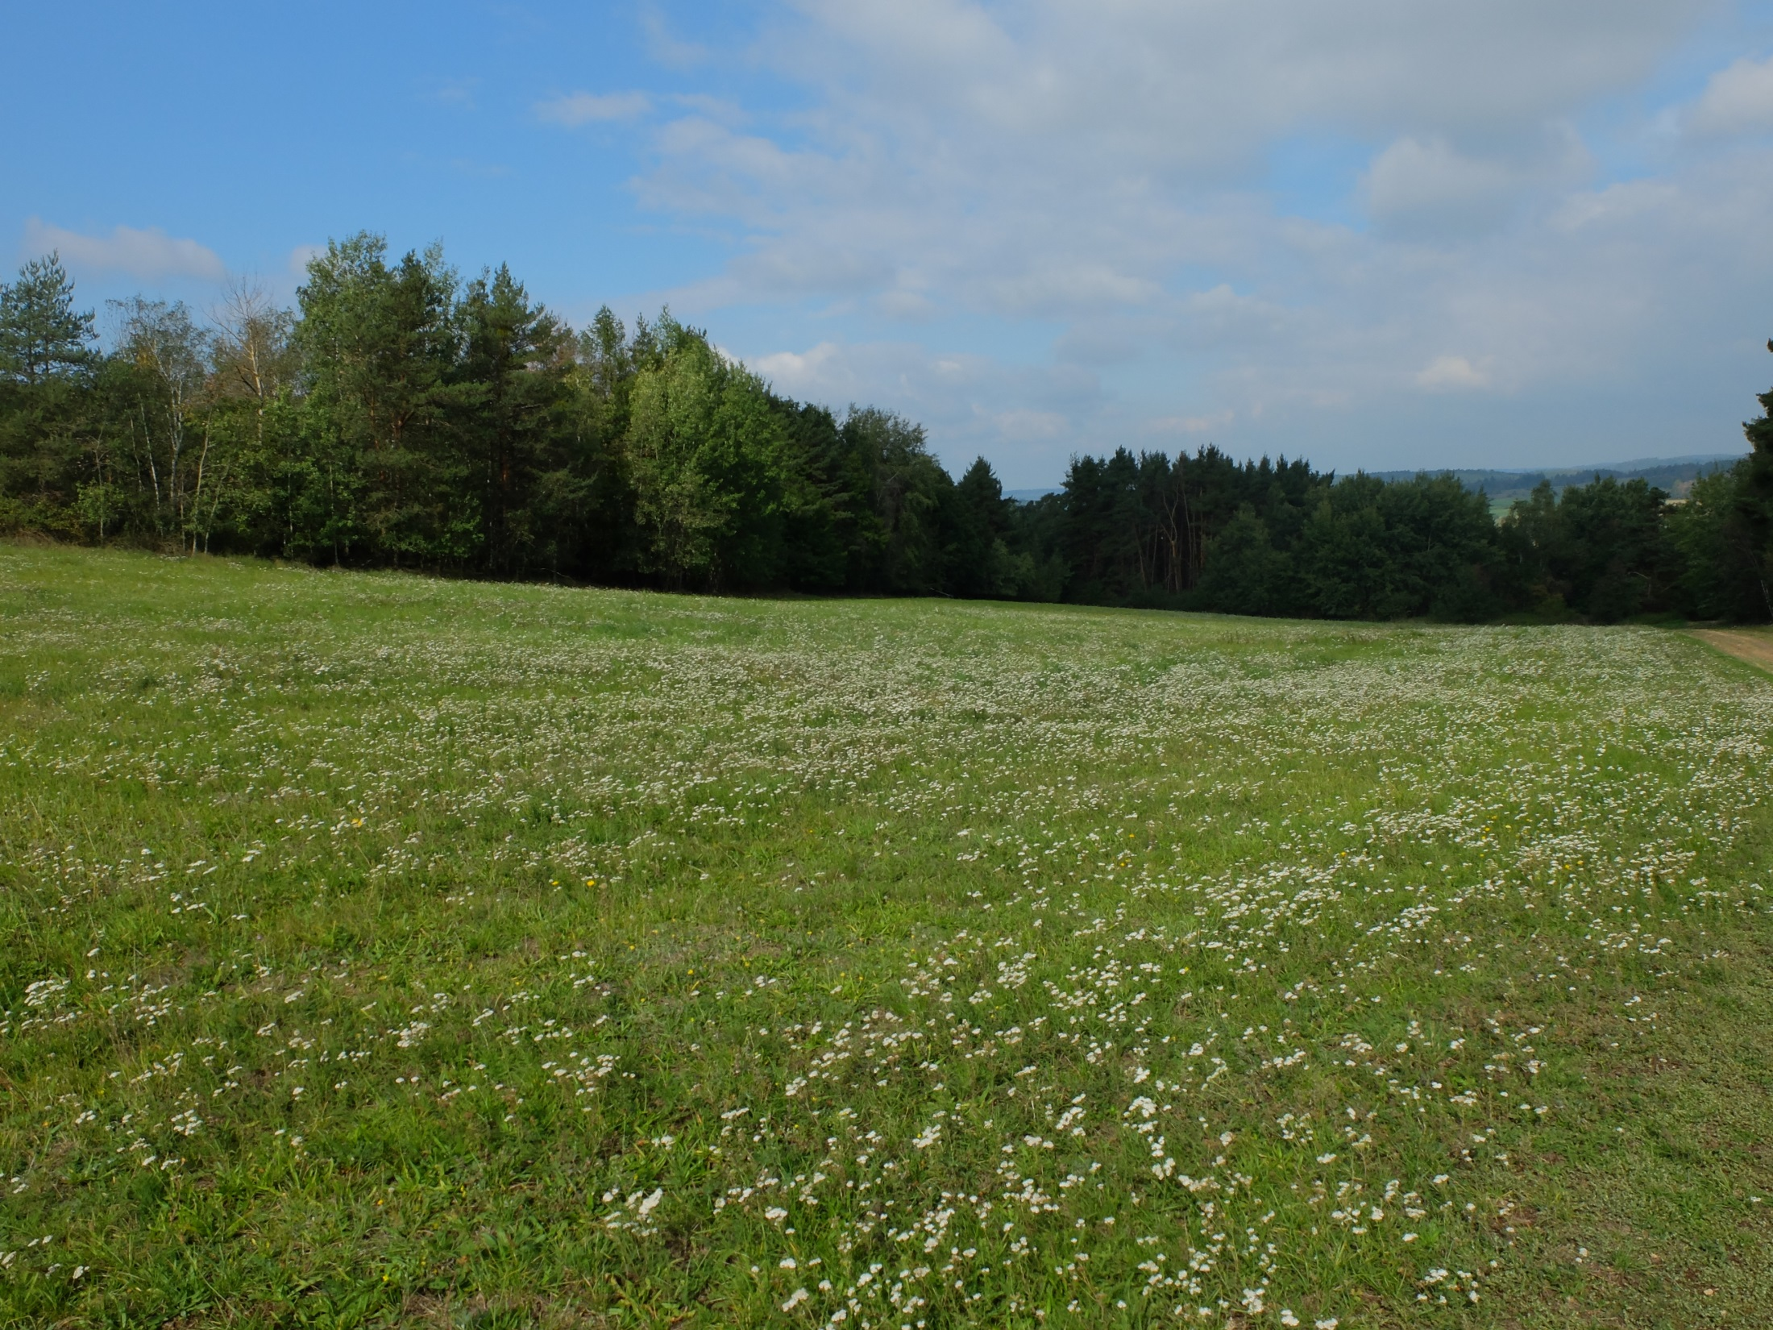
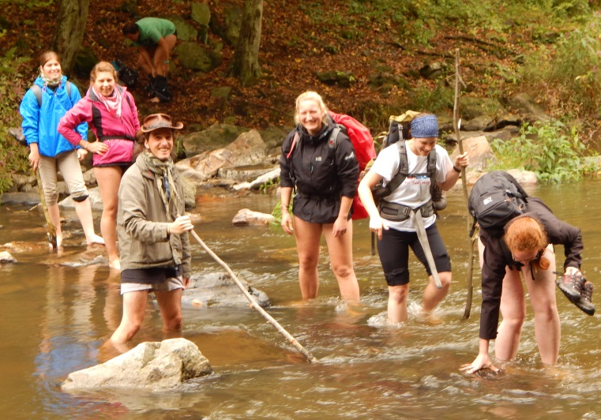
Species-area relationship
field-trip to Mohelno
17.-22.9.2017
Nina Fahs, Janez Kermavnar,
Ildikó Orbán, Zita Zimmermann
FBI / 191
Terénní praxe III. – 2
Field Work III - 2
9.11.2017
Foto: Šuspa
Foto: Nina Fahs

Slide 2
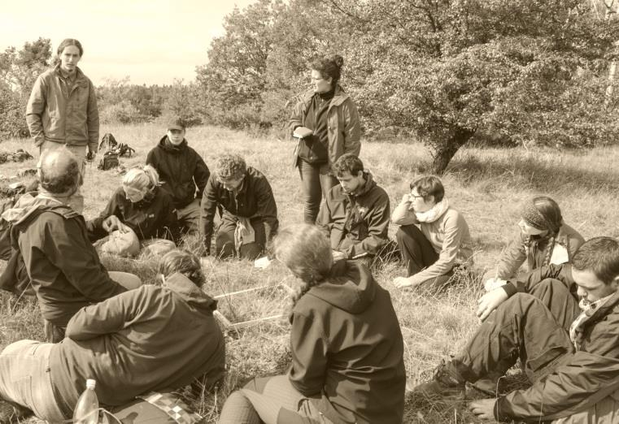
Introduction
The number of species increases
with area observed.
http://botlib.huh.harvard.edu/libraries/
fieldwork_exhibit/photos_22.htm [8.11.17]
influenced by different geographical, evolutionary and ecological factors
mainly used to investigate species aggregation
Foto: Alexandra Telea

Slide 3
Introduction: Questions
How do species accumulation curves differ between habitats?
How similar are quadrats of the same size in the same habitat?

Slide 4
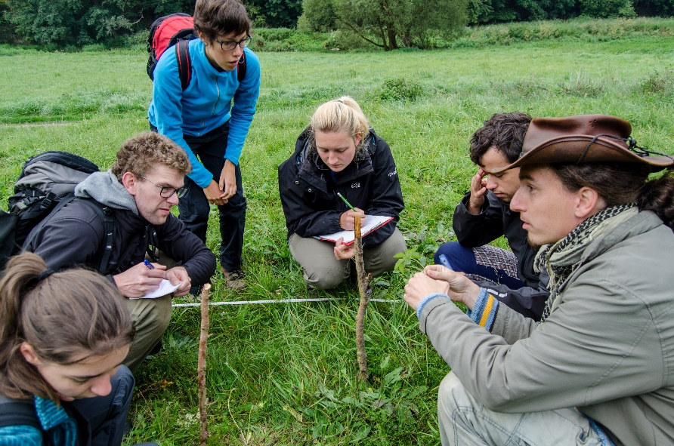
Methods
16m
Foto: Alexandra Telea
8m
recording species richness in nested quadrats of different sizes
four different habitat types
two records/ habitat
4m
2m
1m
0.5m

Slide 5
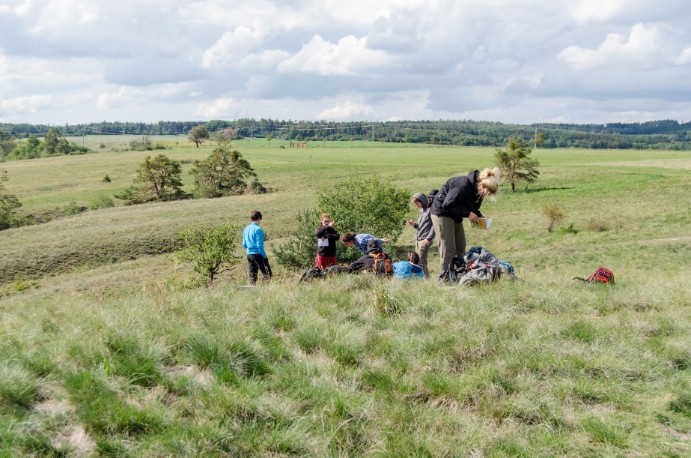
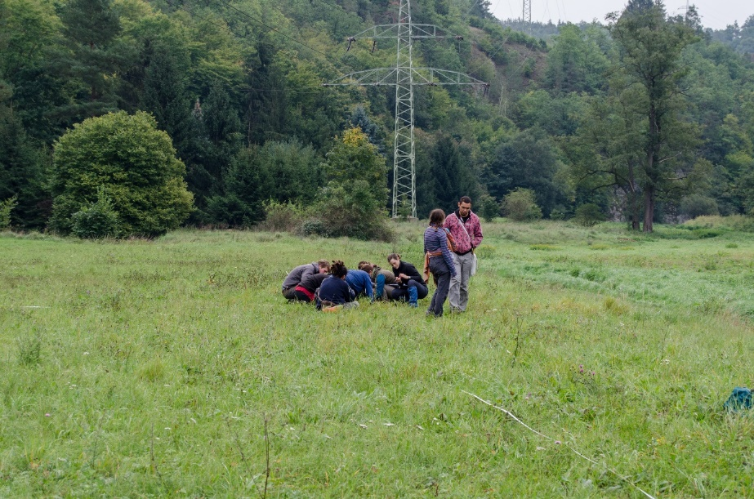
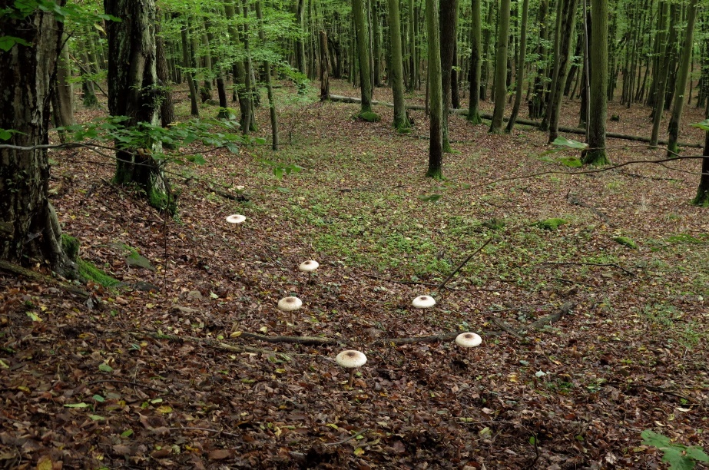
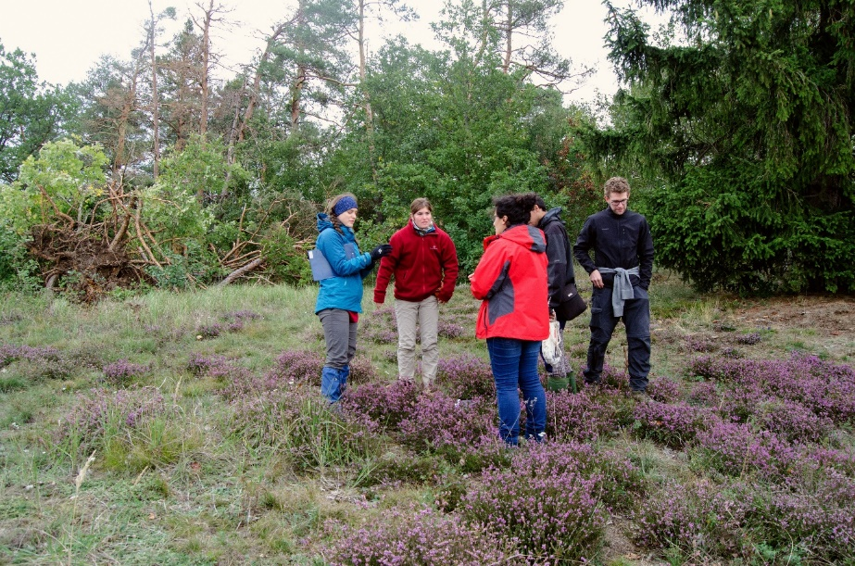
Methods: habitat types
Foto: Alexandra Telea
Foto: Alexandra Telea
dry STEPPE
wet MEADOW
Foto: Alexandra Telea
Foto: Alexandra Telea
hornbeam-oak FOREST
oligotrophic, sandy GRASSLAND

Slide 6
Methods
S = c*A^{z}
S = c₁+z*log(A) = log(c₂*A^{z})
Jaccard similarity coefficient $=\frac{A}{A+B+C}$

Slide 7
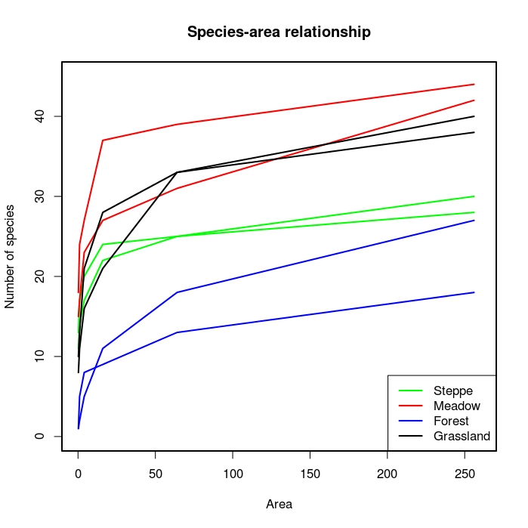
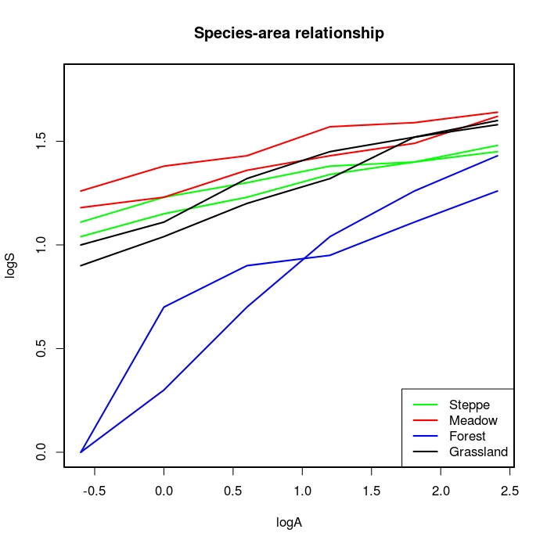
Results: species area relationship
z-values (mean):
steppe: 0.1257 meadow: 0.1376
forest: 0.4256 grassland: 0.2203

Slide 8
Results: species area relationship

Slide 9
Results: similarity

Slide 10
Summary and conclusions
We did not only focus on the number of different species, but also on the species themselves. This allowed us to compare plot pairs according to their species composition similarity.
How do species accumulation curves differ between habitats?
→ The SAR curves of the forest plots were different compared to the grassland vegetation (it had the steepest slope).
How similar are quadrats of the same size in the same habitat?
→ All habitats showed an increasing compositional similarity with increasing plot size, indicating that the same (similar) additional species were observed on both plots.

Slide 11
References
Connor, E.F. & McCoy, E.D. (2001): Species-area relationship. Encyclopedia of Biodiversity 5, 397-411.
Franzén, M., Schweiger, O. & Betzholtz, P.E. (2012): Species-area relationships are controlled by species traits. PLoS ONE 7
Gillespie, R. & Clague, D. (2009). Encyclopedia of islands. Berkeley [Calif.]: University of California Press, pp.857-861.
Scheiner, S.M., Cox, S.B., Willig, M., Mittelbach, G.G., Osenberg, C. & Kaspari, M. (2000): Species richness, species-area curves and Simpson’s paradox. Evolutionary Ecology Research 2, 791–802.
Kallimanis, A.S., Mazaris, A.D., Tzanopoulos, J., Halley, J.M., Pantis, J.D. & Sgardelis, S.P. (2008): How does habitat diversity affect the species-area relationship? Global Ecology and Biogeography 17, 532–538.

Slide 12
Thank you for your attention!
Foto: Nina Fahs

