Slide 1
Functional traits – their use in community ecology
And using patterns to infer mechanisms / using the null models

Slide 2
“Classical” community ecology
“All species are equal” – i.e. basic community characteristics is quantified composition of species, and so also “classical” diversity indices
Typical tasks
  how the species community richness, diversity and composition changes along environmental gradients
  How do these characteristics affect “ecosystem functioning”

Slide 3
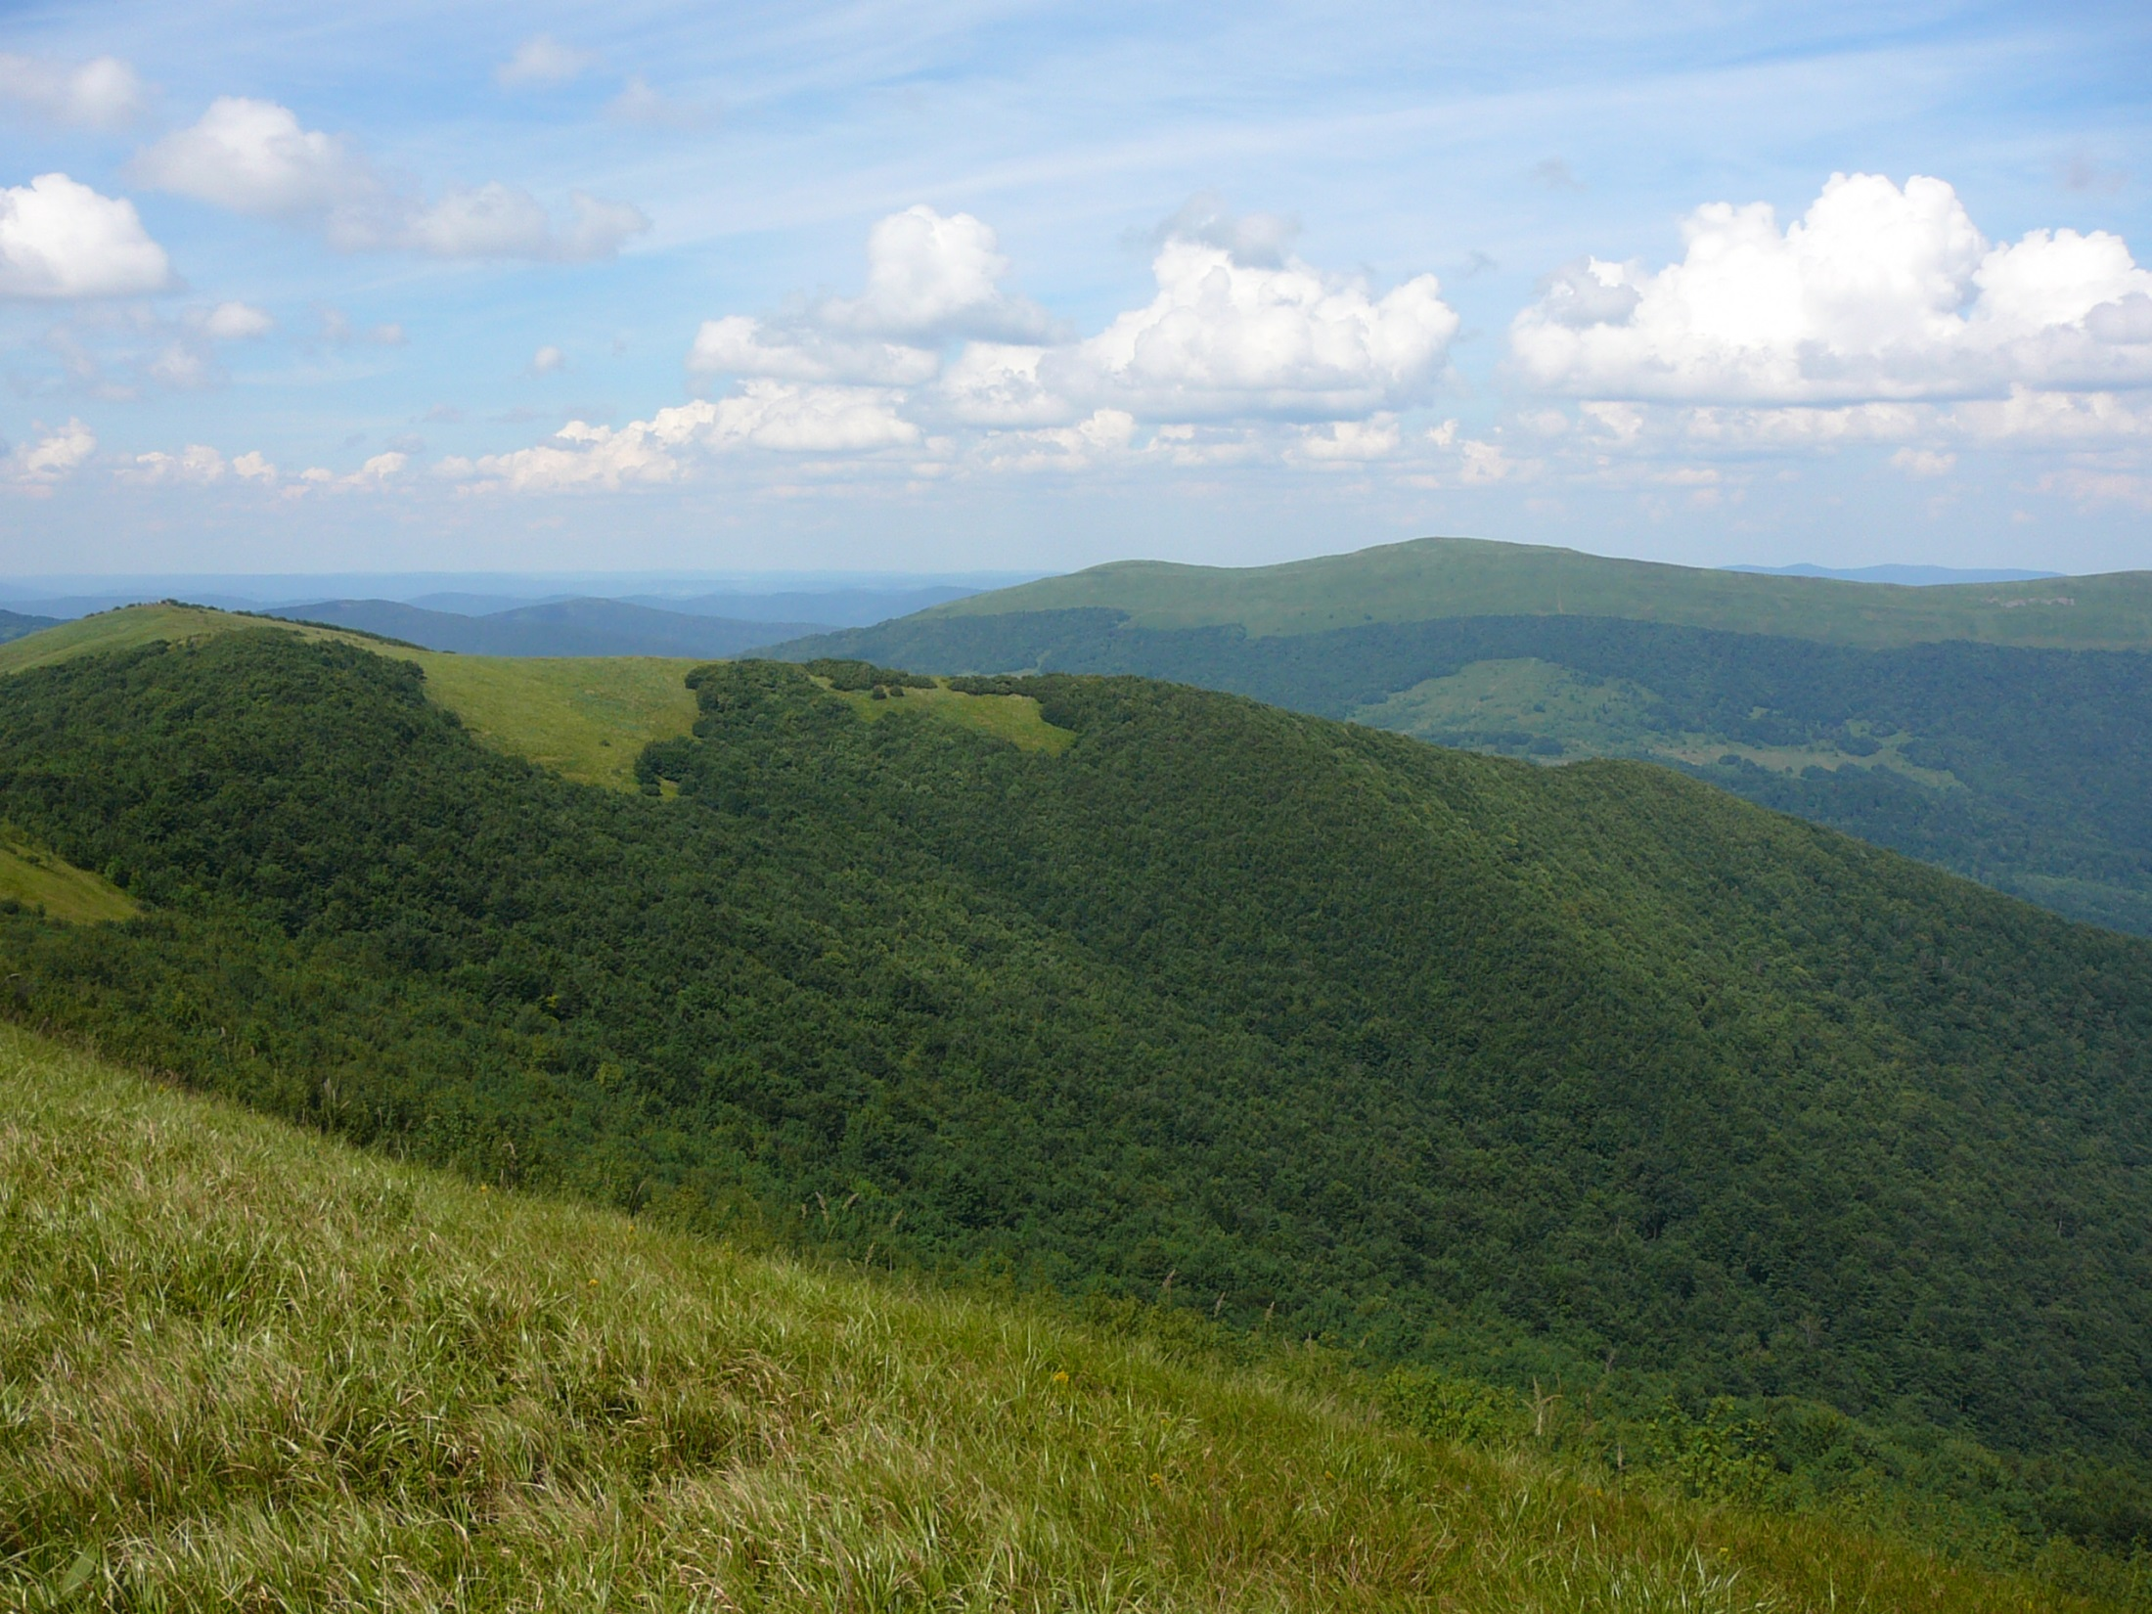
Changes on elevational gradient

Slide 4
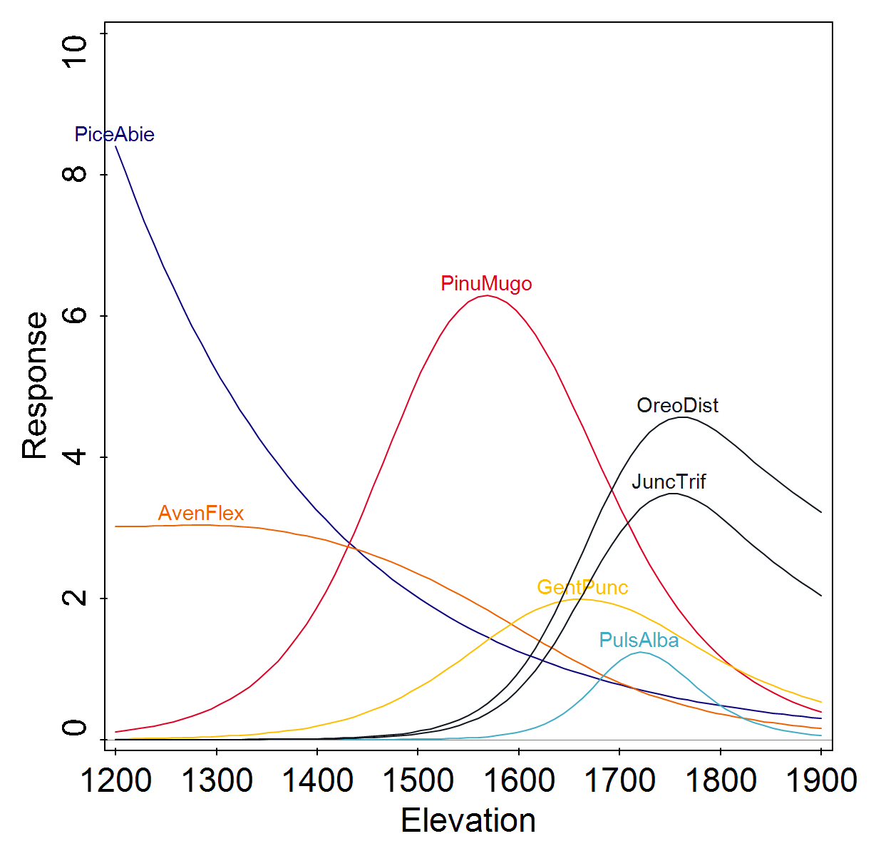
Classical results

Slide 5
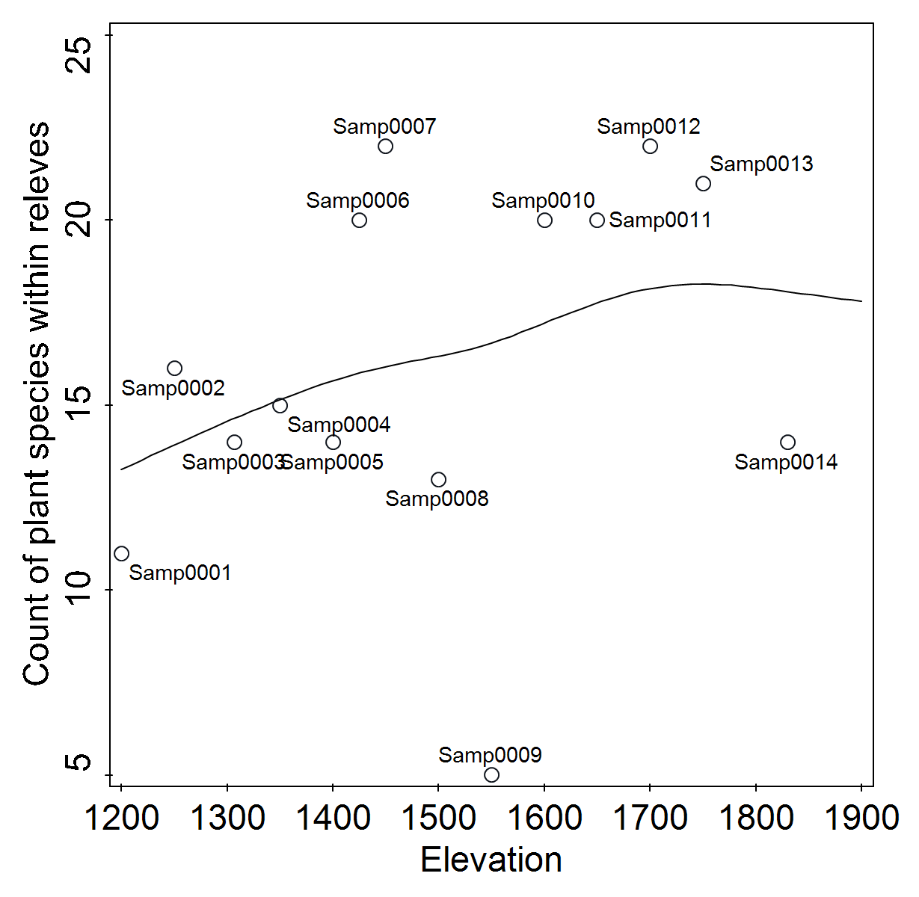

Slide 6
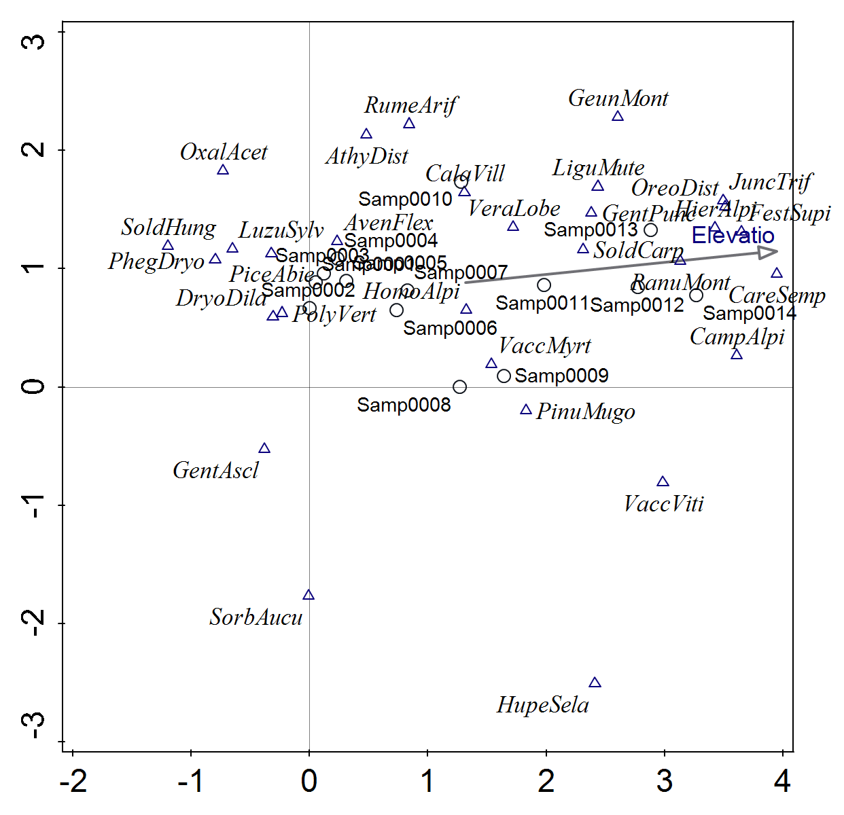

Slide 7
Some disadvantages
Results are site specific (here for the Low Tatras)
Is there any pattern that is more general?
Typical questions to be solved
Are we able to compare the elevational changes in the Carpathians and the Rocky Mountains?
Are there any rules, which species can coexist?

Slide 8
If I use functional traits - I can compare or generalize, e.g.
The representation of woody plants decreases with elevation
Plant height decreases with elevation
Very probably, also changes in other traits (probably, less trivial)
Species diversity increases, but the functional diversity will probably decrease (but what is functional diversity)
I can (hopefully) infer some assembly rules

Slide 9
Multivariate data analysis
(more in Design and analysis of ecological data)
Ecologists increase number of analysed matrices
60ties – classical (unconstrained) ordinations (PCA, DCA, NMDS) – one matrix (samples x species)
80ties – Cajo ter Braak writes CANOCO – (CCA, RDA) – matrix Samples x Environmental characteristics is added
Around 2000 - third matrix added (species x traits)
  Availability of trait databases (LEDA, BiolFlor, TRY, Pladias)

Slide 10
What are functional traits
Is morphology a good enough to characterize a function (e.g. resource acquisition)
  Animals (beak depth), plants (SLA)
  In population studies, I can investigate directly birds food, in community with many species, traits are useful surrogate
  Hard traits x soft traits
    I need functional traits, but I also need matrix without gaps
Response traits x effect traits (distinction often problematic)
  Response – respond to environment
  Effect – affect the ecosystem functioning
Measured data vs. Database data / intraspecific variability of traits

Slide 11
Analysis of three matrices
Which traits predict ecological behavior of species?
How does the trait composition change along gradients (community weighted means and Functional diversity)

Slide 12
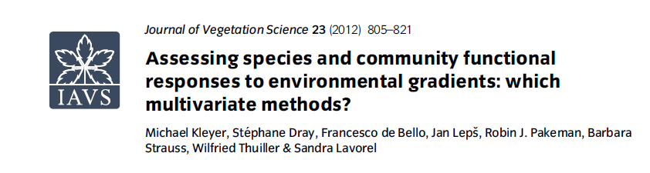
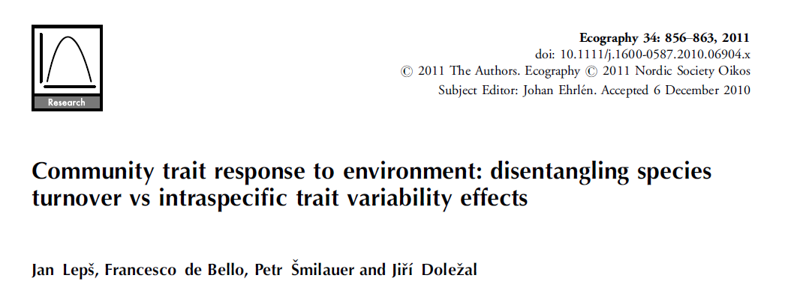
Šmilauer and Lepš 2014. Multivariate analysis of ecological data using CANOCO5. – Cambridge Univ. Press

Slide 13
Species response to fertilization (RDA score, positive values mean that the species gains from fertilization) – need for „phylogenetic correction“?

Slide 14
It is believed that the traits have ecophysiological meaning
E.g. Plant height – competition for light – taller plants outcompete the low ones
SLA – high SLA means high photosynthesis efficiency, but low resistance to drought
So, we can have mechanistic explanations and predictions, which could be tested: in this case, if increased nutrients cause switch from competition for nutrients to competition for light, then height should be good predictor of species response
But see: Májeková, M., Hájek, T., Albert, A.J., de Bello, F., Doležal, J., Götzenberger, L., Janeček, Š., Lepš, J., Liancourt, P. and Mudrák, O., 2021. Weak coordination between leaf drought tolerance and proxy traits in herbaceous plants. Functional Ecology, 35(6), pp.1299-1311.

Slide 15
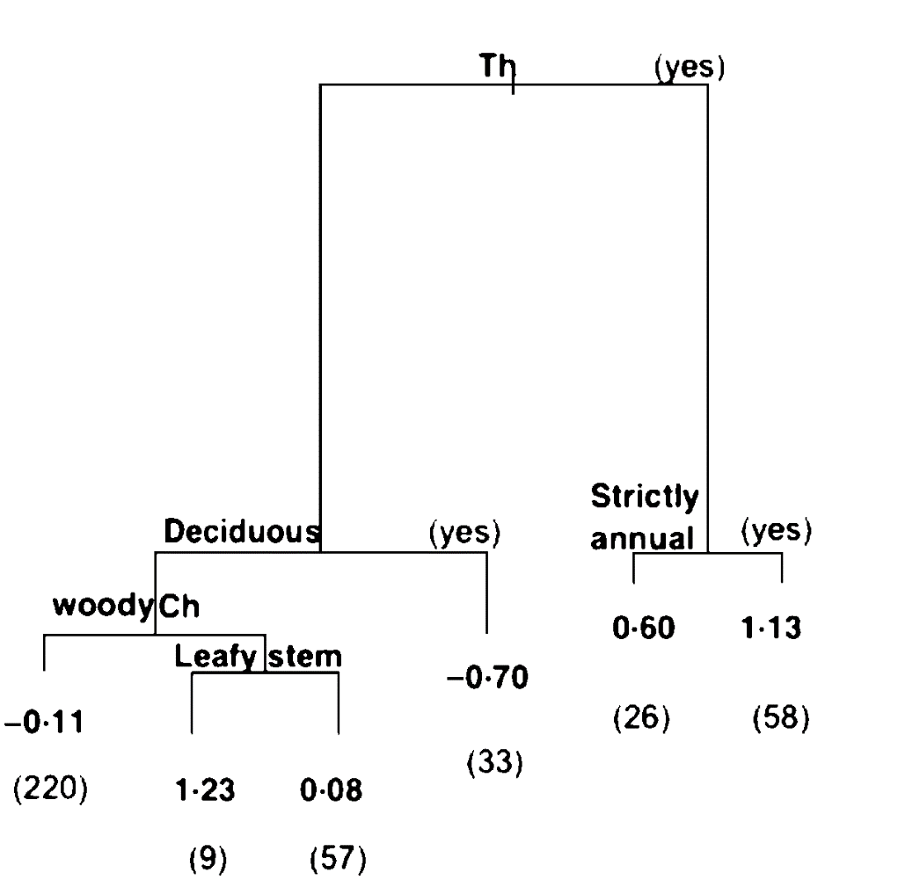
Species traits that predict species response to grazing?
FRANCESCO DE BELLO, JAN LEPS, and MARIA-TERESA SEBASTIÀ 2005 Predictive value of plant traits to grazing along a climatic gradient in the Mediterranean. - Journal of Applied Ecology

Slide 16
Concept of Community Weighted Mean
(Weighted) average of trait values of all the species in the community
Weighted – the dominants are more important - if weighted by number of individuals, it is average of all individuals in a community (Grime’s mass ratio)

Slide 17
CWM
CWM – its significant change can be a result of reaction of a single dominant species
If dandelions will prevail in fertilized plots, we will have positive response of yellow flowering species as a response to fertilization
Also, decrease of CWM of plant height from 1100 m a.s.l. to 1500 m, a.s.l. is caused by the decrease of cover of spruce in most Czech mountains

Slide 18
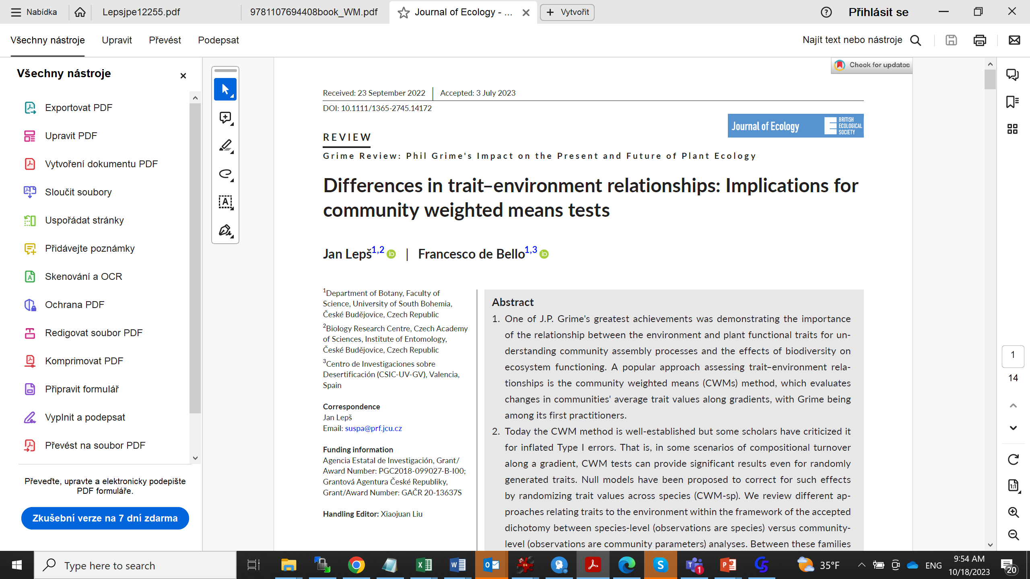
Recently
Controverses regardin the use of CWM
Depends on the questions asked – change in CWM is not indication that given trait has addaptive significance (for this, you need species based approaches)
Analyses of CWM should be accompanied by coresponding analyses of FD

Slide 19
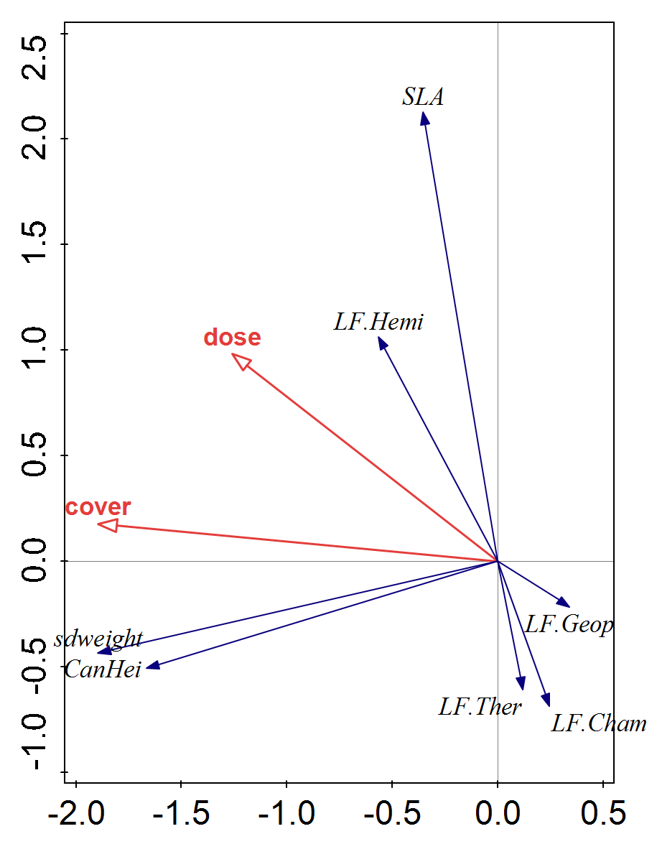
Changes of cwm along fertilization gradient?
Re-analysis of data from Pyšek P. & Lepš J. (1991): Response of a weed community to nitrogen fertilizer: a multivariate analysis. J. Veget. Sci. 2: 237-244.
Does not necessarily mean that high seed weight has adaptive value under high cover of the crop. (Nevertheless, it is still possible.)

Slide 20
Traits, strategies, indicator values
Databases include all of them, but their use and particularly interpretation is different
Differentiate – characteristics directly measured, and characteristics derived from species behavior in nature
Grime CSR, i Ellenberg indicator values are derived from intimate knowledge of their ecological behavior in nature – if used as explanation of species ecological behavior, danger of circular reasoning

Slide 21
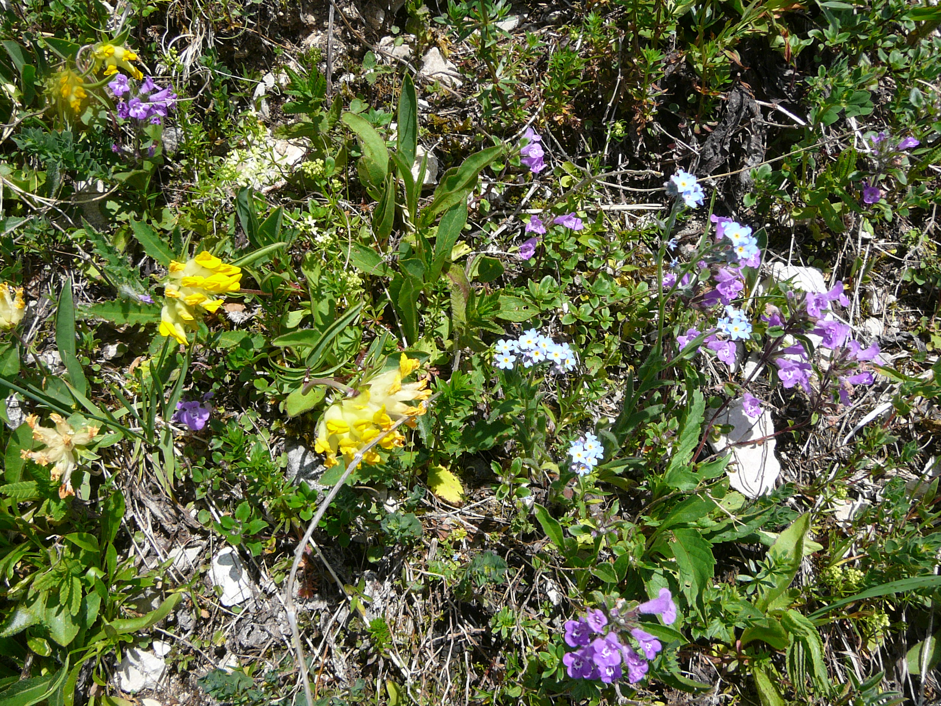
Diversity

Slide 22
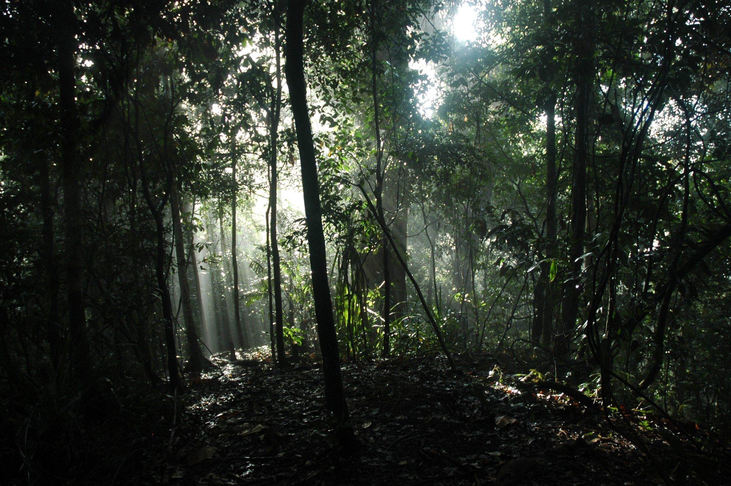

Slide 23
Diversity just by species proportions

Slide 24
Functional diversity
All the theories connected with diversity are based on the assumption that species are different
Limiting similarity concept
Biodiversity experiments (BEF – Biodiversity – Ecosystem function) explicitly expect that the species are different (only then they can be, e.g. complementary in the resource use)

Slide 25
Functional and phylogenetic diversity
Representation of life forms
Diveristy of genera, families etc.
Example: community composed of 37 species of dandelions Taraxacum officinale agg. will have lower phylogenetic and functional diversity of community composed of “normal” species.
Functional diversity should not be affected by the ability of “splitters taxonomists” to distinguish several functionally identical species

Slide 26
First posibility – Functional groups
Problem – how to define functional group, what to do with hierarchical classifications, relevance of traits used for functional classification

Slide 27
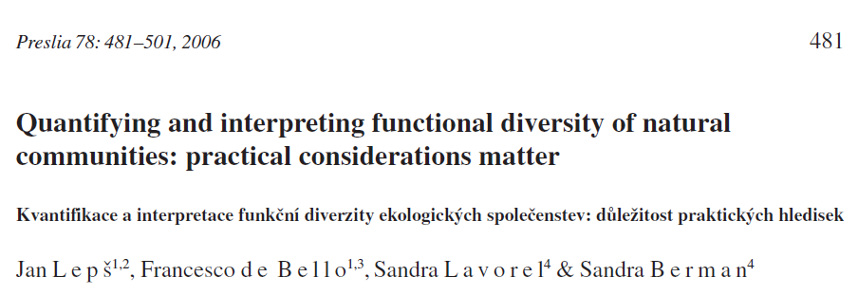
Functional diversity
Rao (entropy)
q_{ij} - difference of two species (calculated from traits)
- Selection of traits – and how to calculate the difference on the basis of traits

Slide 28
q_{i,j} – dissimilarity of two species
p_{i} – relative representation of a species
If q_{i,j} = 1 for all species pairs, FD equals to Simpson diversity, i.e.. 1-Simpson dominance
If p is proportion of individuals, then FD is expected dissimilarity of two randomly chosen individuals
Macro at http://botanika.bf.jcu.cz/suspa/FunctDiv.php (now mainly for educational purposes, otherwise it is more handy to use R)
See also: Leps J., de Bello F., Lavorel S., Berman S. (2006): Quantifying and interpreting functional diversity of natural communities: practical considerations matter. Preslia 78: 481-501.

Slide 29
Note that
For 3 species
1-2, 1-3, 2-3
Multiply by 2
For 3 species
1-1, 1-2, 1-3,
2-1, 2-2, 2-3
3-1, 3-2, 3-3
q_{ii}=0 by definition

Slide 30
Functional diversity
Rao (entropy)
In fact, we get the “morphological diversity” – how “functional” it is depends on our selection of traits
Rao formula is very general, d_{ij} can be phylogenetic distance (we will get phylogenetic diversity)
There are other formulas (e.g. mean pairwise distance) but the results are mainly affected by the way how we define the difference of two species (i.e. species dissimilarity)

Slide 31
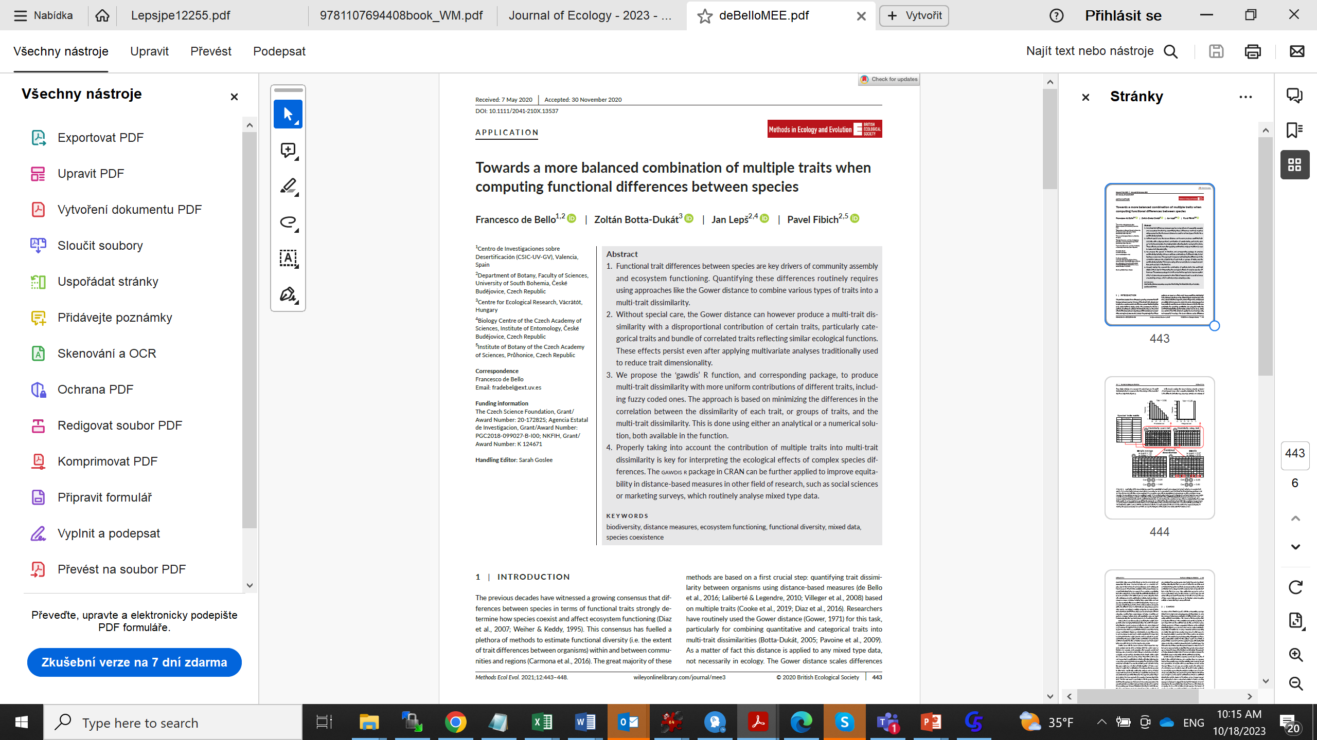
[technical?] Problem – the traits are correlated, some redundant, have different distribution
How to assure that all the traits have the same weight

Slide 32
Usually [but not necessarily]
Two functionally identical species: q=0
Two completely different species: q=1
(you can always standardize the dissimilarity so, that the maximum value is one and minimum zero)
Acceptable dissimilarity measure [qualitative traits]
1-(no. of identical traits/no. of all traits)
Use of multiple traits is often a challenge (Gower distance is available for mixture of qualitative and quantitative traits, but scaling is often a problem)
Similar scaling useful also for phylogenetic dissimilarity (question – how to derive phylogenetic dissimilarity from the phylogenetic tree – importance of scaling)

Slide 33
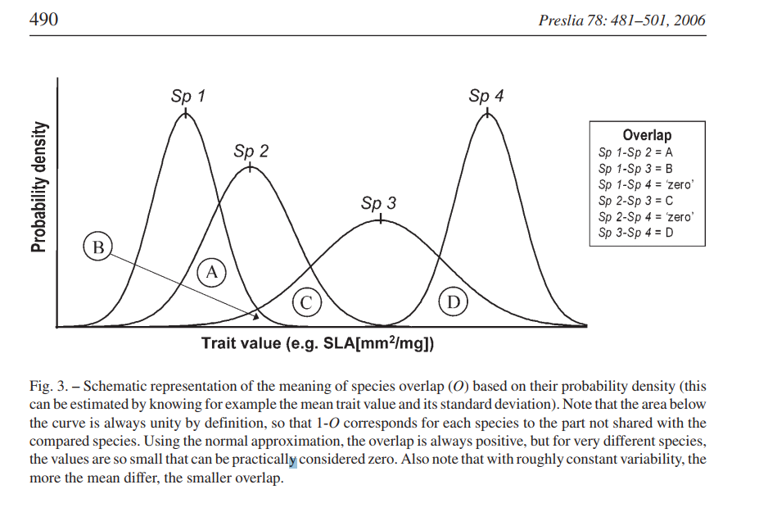
Distance based on the trait values overlap

Slide 34
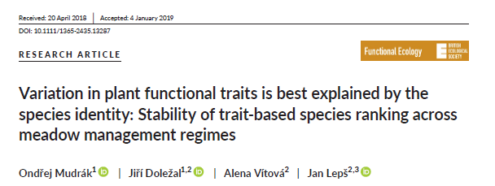
Intraspecific Trait Variability (ITV)
Part of the trait variability
Ignored by some approaches (one species -> one trait value)
Assumption: Interspecific trait variability is larger than intraspecific TV

Slide 35
Similarly as with a species diversity
Functional diversity can be partitioned into
Alpha
Beta
Gama diversity
Relatively low alpha diversity and high beta diversity (trait convergence) suggests environmental filtering
Relatively high alpha (trait divergence) and low beta diversity suggests limiting similarity

Slide 36
If environmental filtering works, and we have dry and wet sites
All species in dry sites will have high LDMC
All species in wet site will have low LDMC
Species will be similar within sites but dissimilar between sites (trait convergence)

Slide 37
Limiting similarity concept
MacArthur, R and R Levins. 1967. The Limiting Similarity, Convergence, and Divergence of Coexisting Species. The American Naturalist 101(921): 377–385.
Derived from Gausse competitive exclusion principle
If species have completely overlapping niches, they cannot coexist
Within site, the species cannot be too similar to avoid competitive exclusion

Slide 38
Does not work very well, (but is still used)
Weaker competitor exclusion:
In more productive sites – the species with low competitive ability for light will be outcompeted – they will be present in the less productive sites
This will lead to trait convergence
Spatial scale dependence of convergence/ divergence - extend and grain

Slide 39
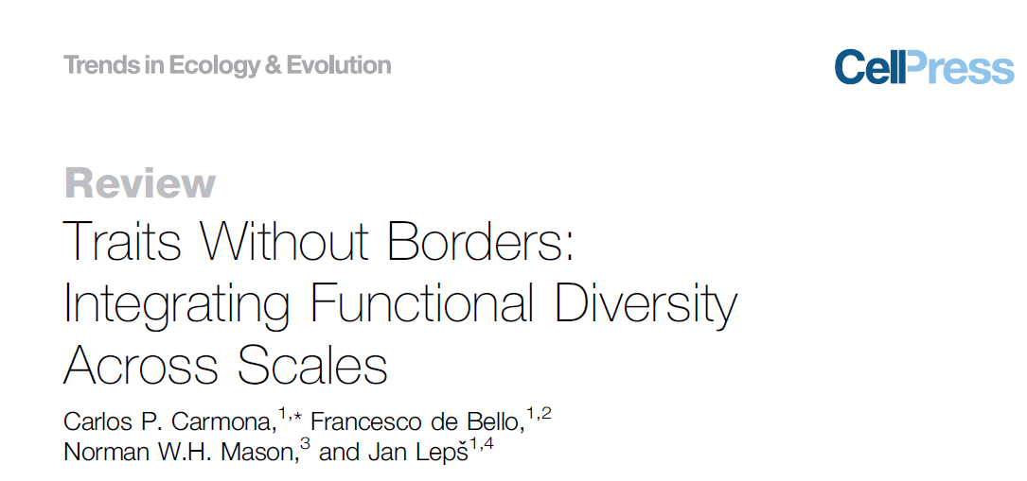
TPD – Trait Probability Density
An integrative concept enabling to describe various levels of trait variability, and to partition it into inter- and intraspecific part, and also to describe its spatial components

Slide 40
Null models in community ecology
Attempts to test for the mechanisms
(as a counterpart to tests using the manipulative experiments)

Slide 41
Null models – testing for mechanisms governing assembly of communities
The basic idea – construct a model, which includes only other mechanisms than the tested one(s) [=null model]
Predict a community pattern with the null model
Compare predicted and real patterns - Pattern different from the predicted one suggests that the tested mechanism has some effect [but…. There are many mechanisms not included in the null model]

Slide 42
Classical example – “variance deficit”
One matrix only is available – species x samples
Null model – the species are assembeld completely randomly (but there must be some constraints – in this case, usually the frequency of the species is kept constant)
Pattern (the criterion) – variance of the number of species in individual samples

Slide 43
The hypotheses
If there is a mechanisms limiting number of niches at a site, then the number of species should be less variable than without this mechanism
If there are positive relationships between species, then presence of one species will increase the probability of presence of another species, and thus, the variability (variance) in species number should be high. The same effect might have environmental heterogeneity, with favourable and unfavourable spots.

Slide 44
 | spec1 | spec2 | spec3 | spec4 | nsp
Sample1 | 0 | 1 | 0 | 1 | 2
Sample2 | 1 | 1 | 0 | 1 | 3
Sample3 | 1 | 1 | 1 | 1 | 4
Sample4 | 0 | 1 | 0 | 0 | 1
Sample5 | 1 | 0 | 0 | 0 | 1
Sample6 | 0 | 0 | 1 | 1 | 2
Sample7 | 1 | 0 | 1 | 0 | 2
Sample8 | 0 | 1 | 0 | 1 | 2
Sample9 | 1 | 0 | 0 | 1 | 2
Sample10 | 0 | 1 | 1 | 0 | 2
spec freq | 5 | 6 | 4 | 6 | 0.766667
Var nsp

Slide 45
Basic idea if no. of species is limited by no. of niches, then var is low
 | high nsp variance | low nsp variance
 | no. of species | no. of species
Sample1 | 10 | 5
Sample2 | 9 | 5
Sample3 | 1 | 4
Sample4 | 2 | 6
Sample5 | 1 | 5
Sample6 | 8 | 5
Sample7 | 6 | 4
Sample8 | 0 | 5
Sample9 | 1 | 5
Sample10 | 11 | 6
variance | 18.76666667 | 0.444444444

Slide 46
Compared against the “null model”
 | spec1 | spec2 | spec3 | spec4 | nsp
Sample1 | 0 | 1 | 0 | 1 | 2
Sample2 | 1 | 1 | 0 | 1 | 3
Sample3 | 1 | 1 | 1 | 1 | 4
Sample4 | 0 | 1 | 0 | 0 | 1
Sample5 | 1 | 0 | 0 | 0 | 1
Sample6 | 0 | 0 | 1 | 1 | 2
Sample7 | 1 | 0 | 1 | 0 | 2
Sample8 | 0 | 1 | 0 | 1 | 2
Sample9 | 1 | 0 | 0 | 1 | 2
Sample10 | 0 | 1 | 1 | 0 | 2
spec freq | 5 | 6 | 4 | 6 | New var
Any species can be anywhere, the species frequencies are kept constant – (in this null model)

Slide 47
Null model generated many times
(e.g. 1000 time)
I will get – average of criterion (variance in nsp) here - expected value
Quantiles – 25th value and 975th value provide 95% envelope
The real value is compared with the average (is it higher or lower than expected under the null model) and with quantiles (statistical test of the null model)
Standardized effect size
SES =(observed – expected)/s.d.(expected)

Slide 48
Variance deficit
Real variance

Slide 49
Variance excess
Real variance

Slide 50
Variance not distinguishable from the null model
Real variance

Slide 51
SES =(observed – expected)/s.d.(expected)
Real variance = observed
s.d.
Expected (mean of the null model generated values)

Slide 52
Variance excess/deficit
Can be explained by many possible biological mechanisms
Variance excess (SES>0) – environmental heterogeneity, positive species relationships
Variance deficit – competition
But there is still question, which mechanisms ARE still reflected in the null model (low frequency of some species is very probably result of competition)

Slide 53
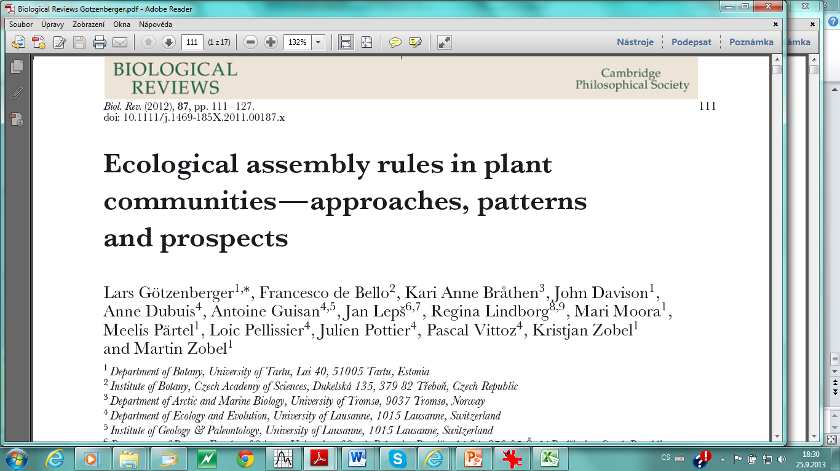
Traits available
Renewed interest in the „assembly rules“
Are there any rules, which species are able to coexist? (Classical zoologist idea, e.g. J. Diamond and his birds)
Two matrices available (species x samples, species x traits) – various null models can be generated

Slide 54


Slide 55
What can be tested?
Limiting similarity concept – niche differentiation enables species coexistence → trait divergence coexiting species are less similar than expected by chance (but is trait differentiation really the same as niche differentiation?)
Environmental filtering – causes the trait convergence
„Scale dependence“ of results (divergence at smaller spatial scales)
Similar concepts for phylogenetic similarity

Slide 56
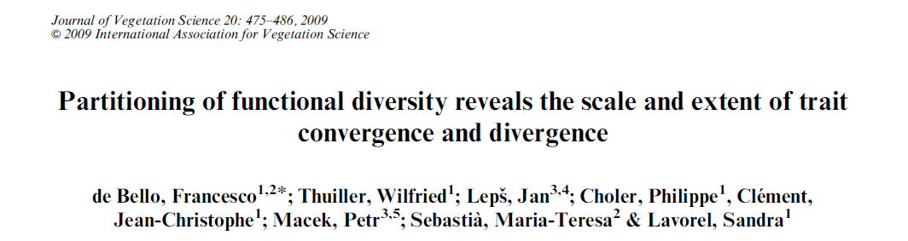
If locally coexisting species are more similar to each other than expected by chance (trait convergence due to environmental filtering), then functional beta diversity is higher than expected
If locally coexisting species are less similar to each other than expected by chance (limiting similarity -> trait divergence), then functional beta diversity is lower than expected
What is expected → use the null models

Slide 57
With two matrices, you have plethora of randomization possibilities
E.g., composition table is fixed, and the traits are randomly assigned to individual species.
However, the traits are usually also determinants of species frequency, and this dependence is interupted.
So, it is always a problem, which relationships are included, and which excluded from the null model

Slide 58
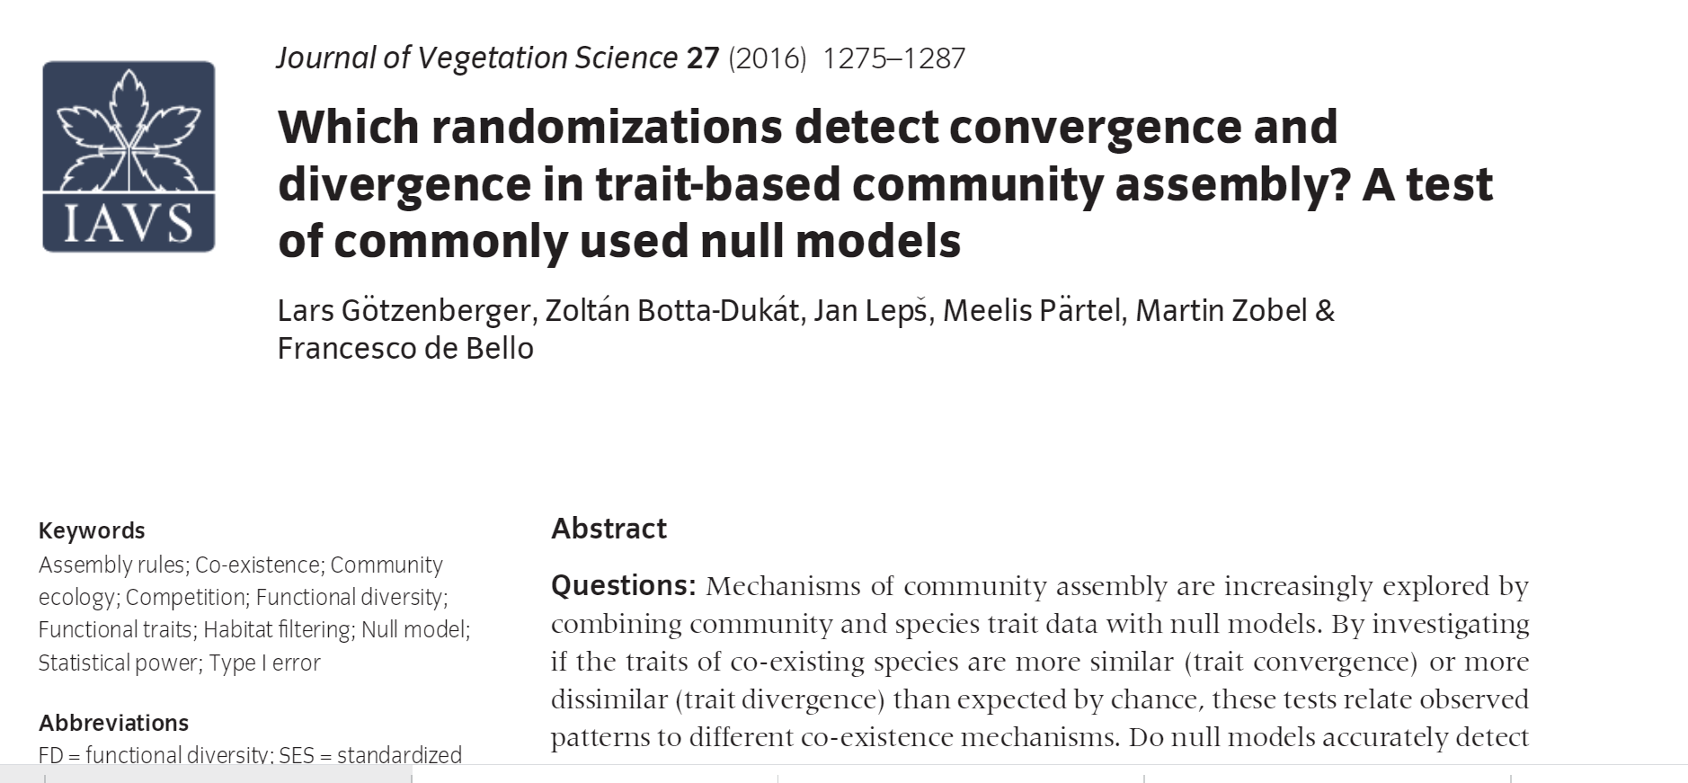

Slide 59
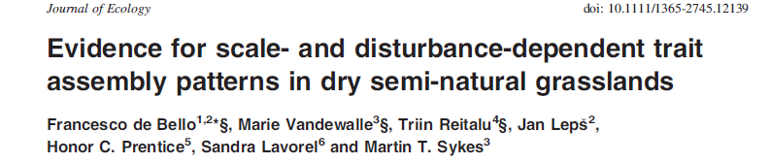
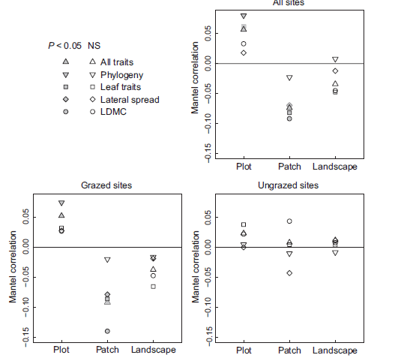
Direct test whether species similarity (in traits) is correlated with their „interspecific associations“ – using the Mantel test

Slide 60
Besides Functional Diversity
Phylogenetic diversity is also used
Questions>
  How much does the phylogenetic diversity reflect functional diversity / overlaps with functional diversity measured using classical traits?
  Is it a good surrogate for the unmeasured traits?

Slide 61
Use of phylogenetic diversity
The same formula as for Functional diversity can be used also for phylogenetic diversity, just q in the formula
is not functional, but phylogenetic distance

Slide 62
In addition to FD
In characterization of phylogenetic variability (but similar can be used also for functional variability), also the MPD is used. – Mean pairwise distance – in fact, similar to FD, just the diagonal is not used. It is expected distance of two heterospecific individuals - most often used without weighting by frequency of individual species, i.e. on the basis of presence data – then, the expected dissimilarity of two species in a community.

Slide 63
The phylogenetic convergence/divergence
Are the species within communities more similar / dissimilar than expected by chance? (i.e. instead of functional, phylogenetic divergence / convergence)
Why should phylogeny matter? – Phylogenetic conservativism – phylogenetically similar species share the common ancestor and thus also common pre-adaptations.

Slide 64
Traits vs. phylogeny
Spatial scale (particularly extent). The larger the extent, the more it is likely that the functional traits will be determined by local environmental variation, whereas the phylogenetic differences will correspond to geographical distances reflecting the migrational patterns.
E.g. in the mammal communities studied, adding New Guinea to the Sunda Islands west of Wallace line will result in very pronounced increase in the phylogenetic beta diversity, and probably not so much of the functional beta diversity.

Slide 65
Phylogenetic distance – derived from the phylogenetic tree
Usually total length of branches from one species to another, or time when the branches split
Importance of scaling – what the length of the branches means
Does the higher levels the phylogeny reflect some functional similarity?

Slide 66
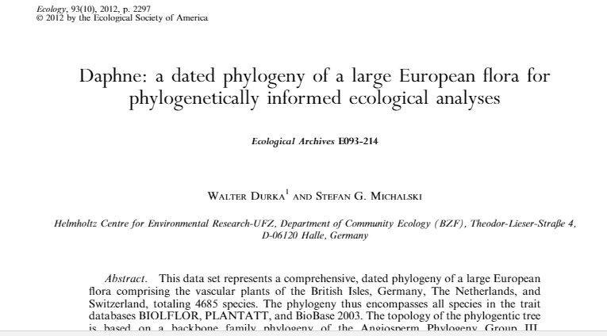
For the Europe, the vascular plants phylogeny is available
(Cited 67 times)
However, the APG probably revised some phylogeny in meantime

Slide 67
Tracheophyta
PPG 1 (2016)

Slide 68
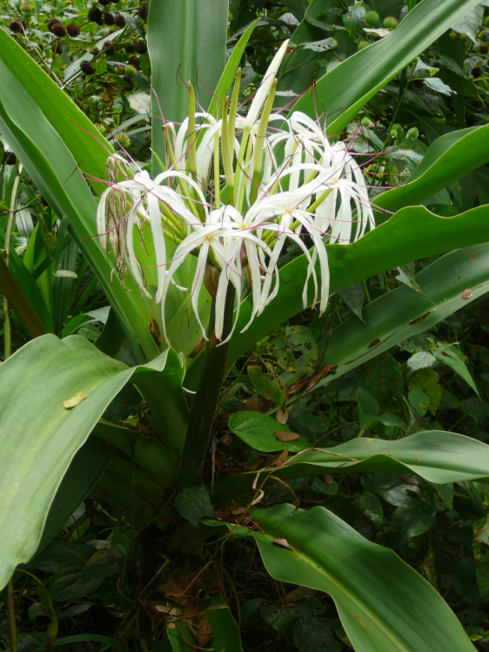
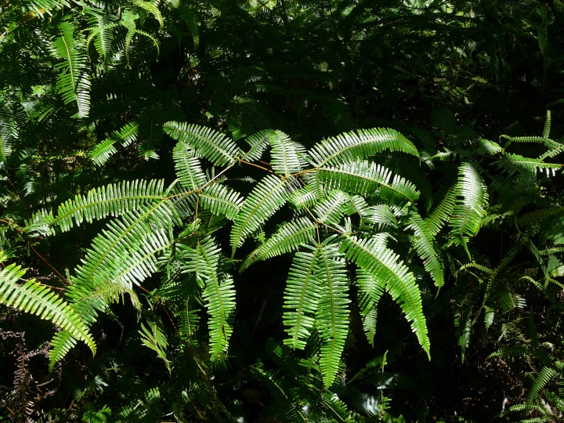
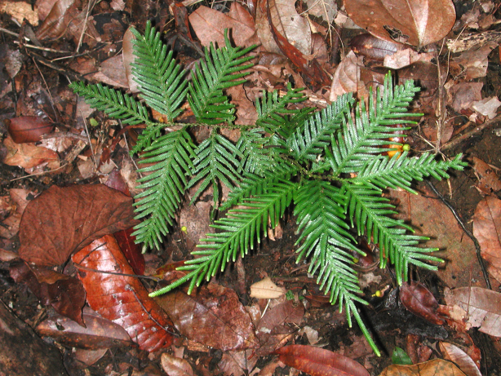
Sometimes it looks rather counterintuitive
Dicranopteris (Gleicheniaceae)
Selaginella
Crinum (Amaryllidaceae)

Slide 69
The phylogeny (i.e. the phylogenetic tree) is changing, even at the highest levels, as more analyses are available

Slide 70
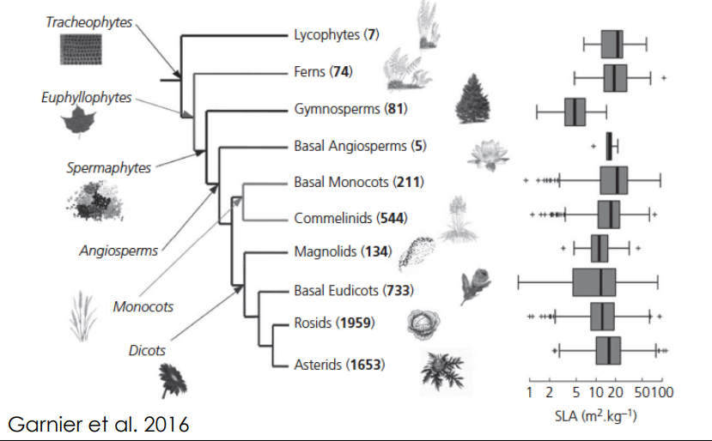
Within dicots (and not only within them), most of the functional variability is within clades

Slide 71
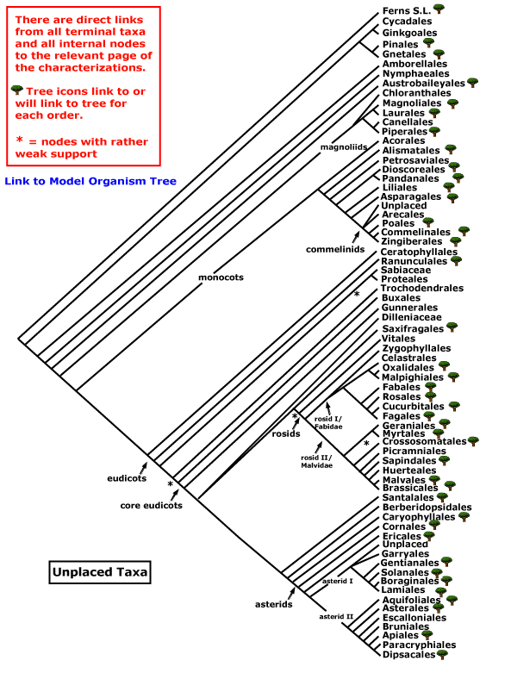

Slide 72
Phylogenetic dissimilarity matrix from DAPHNE
 | Lycopodium_clavatum | Lycopodium_annotinum | Equisetum_arvense | Polypodium_vulgare | Asarum_europaeum | Ranunculus_repens | Vicia_sativa | Lathyrus_sylvestris | Lathyrus_pratensis | Rosa_canina | Campanula_persicifolia | Aster_alpinus
Lycopodium_clavatum | 0 | 152 | 851 | 851 | 851 | 851 | 851 | 851 | 851 | 851 | 851 | 851
Lycopodium_annotinum | 152 | 0 | 851 | 851 | 851 | 851 | 851 | 851 | 851 | 851 | 851 | 851
Equisetum_arvense | 851 | 851 | 0 | 719.2 | 826.2 | 826.2 | 826.2 | 826.2 | 826.2 | 826.2 | 826.2 | 826.2
Polypodium_vulgare | 851 | 851 | 719.2 | 0 | 826.2 | 826.2 | 826.2 | 826.2 | 826.2 | 826.2 | 826.2 | 826.2
Asarum_europaeum | 851 | 851 | 826.2 | 826.2 | 0 | 300.2 | 300.2 | 300.2 | 300.2 | 300.2 | 300.2 | 300.2
Ranunculus_repens | 851 | 851 | 826.2 | 826.2 | 300.2 | 0 | 270 | 270 | 270 | 270 | 270 | 270
Vicia_sativa | 851 | 851 | 826.2 | 826.2 | 300.2 | 270 | 0 | 48.64 | 48.64 | 195.4 | 236.4 | 236.4
Lathyrus_sylvestris | 851 | 851 | 826.2 | 826.2 | 300.2 | 270 | 48.64 | 0 | 33.67 | 195.4 | 236.4 | 236.4
Lathyrus_pratensis | 851 | 851 | 826.2 | 826.2 | 300.2 | 270 | 48.64 | 33.67 | 0 | 195.4 | 236.4 | 236.4
Rosa_canina | 851 | 851 | 826.2 | 826.2 | 300.2 | 270 | 195.4 | 195.4 | 195.4 | 0 | 236.4 | 236.4
Campanula_persicifolia | 851 | 851 | 826.2 | 826.2 | 300.2 | 270 | 236.4 | 236.4 | 236.4 | 236.4 | 0 | 154
Aster_alpinus | 851 | 851 | 826.2 | 826.2 | 300.2 | 270 | 236.4 | 236.4 | 236.4 | 236.4 | 154 | 0

Slide 73
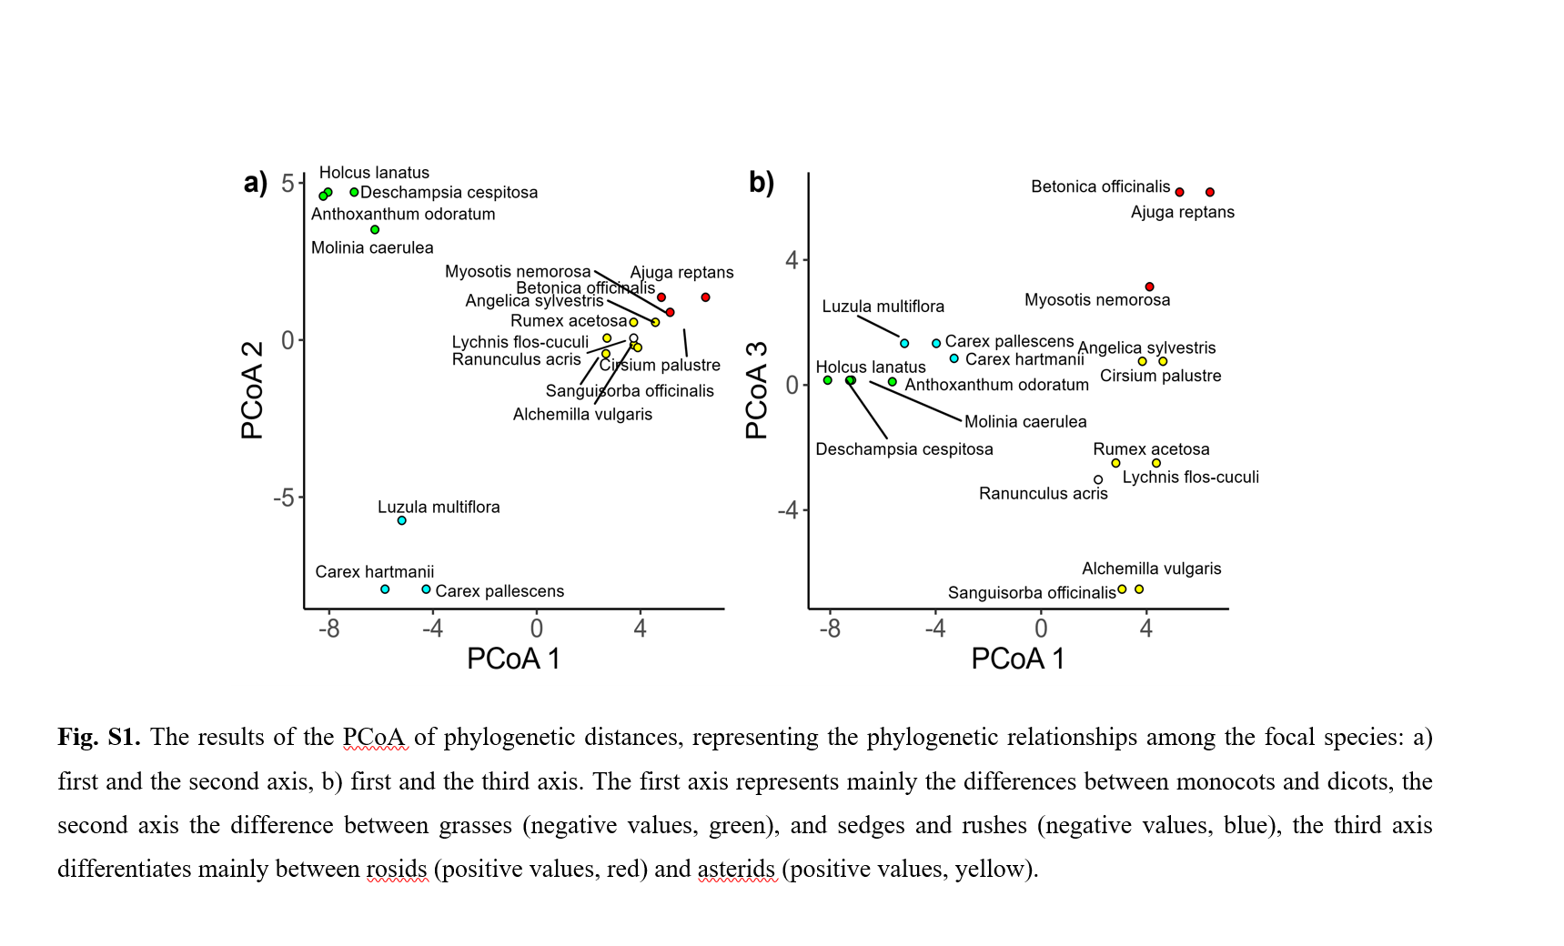
Possibility (?) Desdevides phylogenetic eigenvectors (from Hruba et al. 2022. Effects of phylogeny, traits, and seasonality on invertebrate herbivory damage in a meadow community. Acta Oecologica)

Slide 74
Also
What probably matters is the relatedness in the low levels (i.e. species within genus are similar, but the functional differentiation on higher levels is not always clear). To stress the differentiation on low levels, the distances are sometimes square root transformed. See Letten, A. D., & Cornwell, W. K. (2015). Trees, branches and (square) roots: why evolutionary relatedness is not linearly related to functional distance. Methods in Ecology and Evolution, 6(4), 439-444.
I am not sure that Mean Nearest Taxon Distance (MNTD) solves the matter.

Slide 75
Examples of phylogenetic convergence
Species are more phylogeneticall similar than one would expect by chance, if formed from the local species pool
Often, it corresponds to some similarity, not always represented by traits –
e.g. Orchideaceae – initial stages are partially or fully mycotrophic and also extremely competitively weak
Ericales – ericoid mycorrhiza, whereas some other traits, e.g. SLA very different – Vaccinium myrtillus and uliginosum – high, V. vitis-idea, Empetrum - low

Slide 76
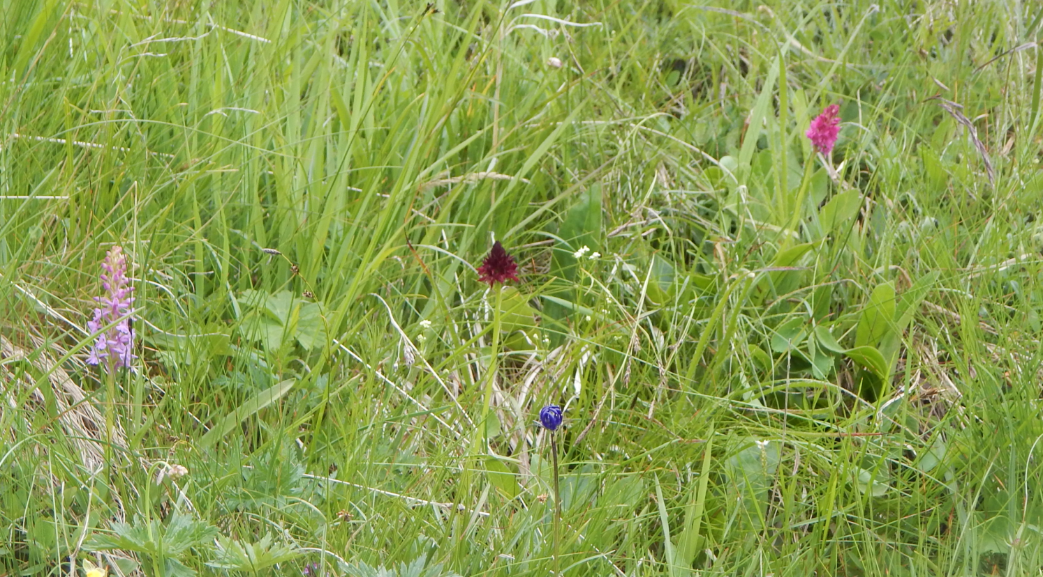
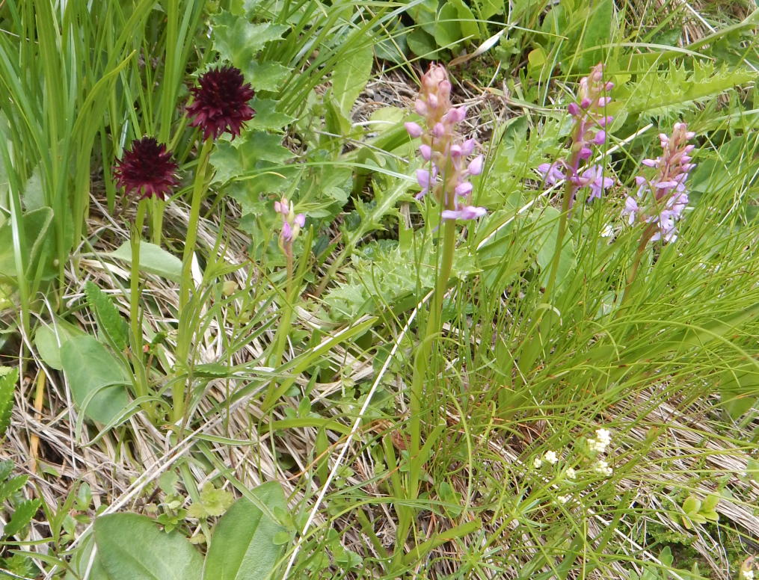
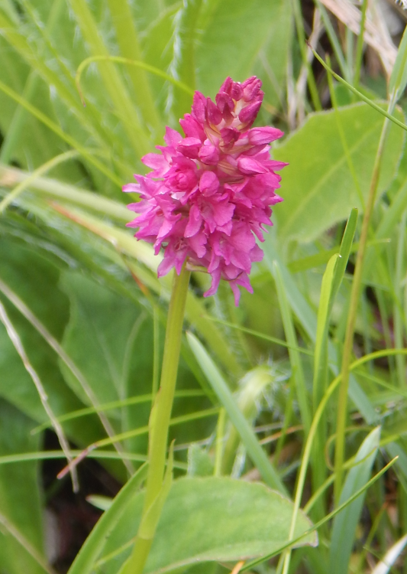
Phylogenetic convergence (underdispersion) – three out of ca 30 species in the plot are Orchideaceae (Hohe Tauern, Alps)

Slide 77
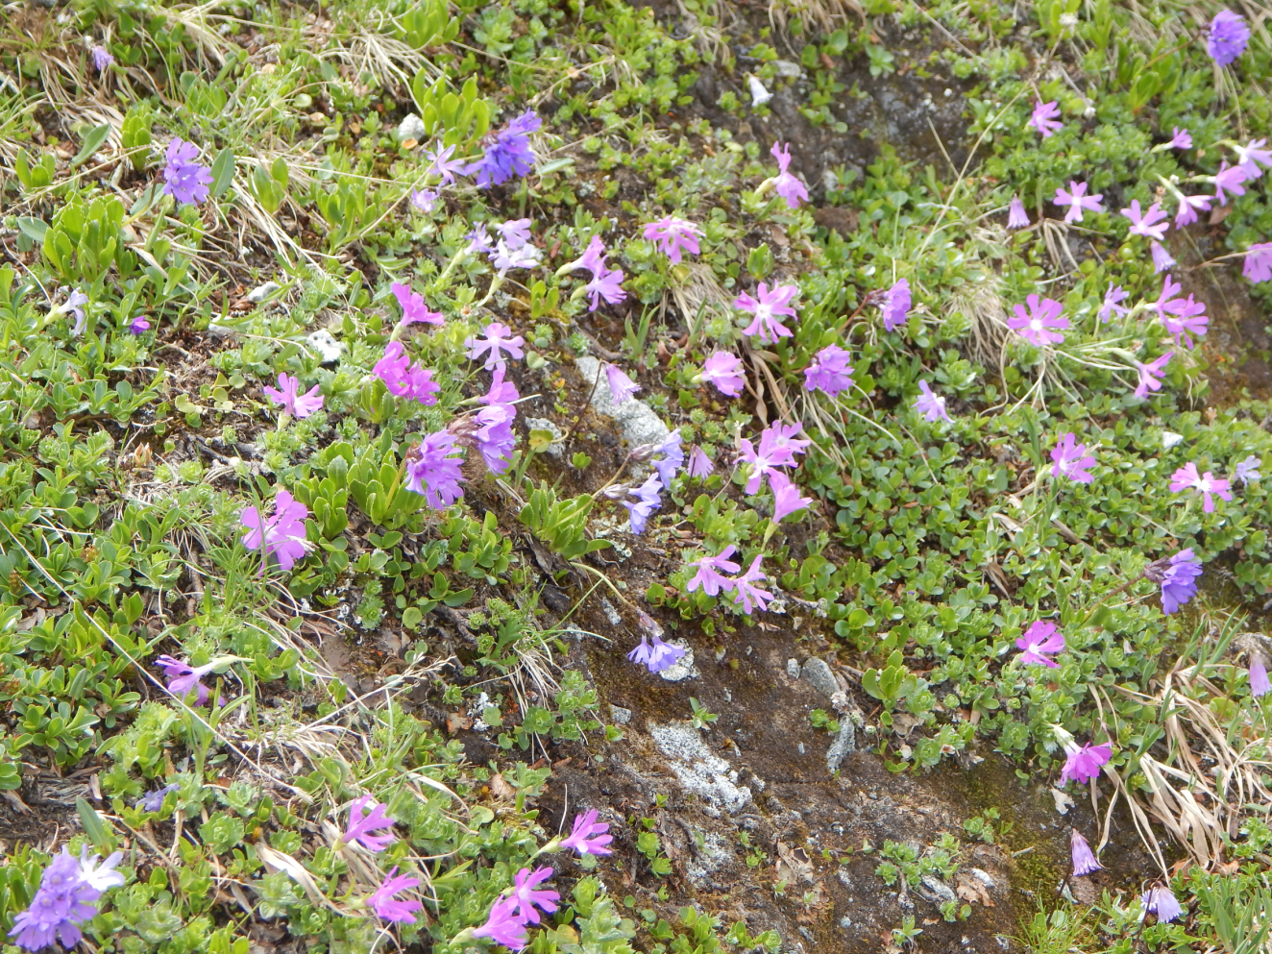
Community formed nearly exclusively by two Primula species – P. minima and P. glutinosa
(Hafner area, Tauern, Austria, Alps).

Slide 78
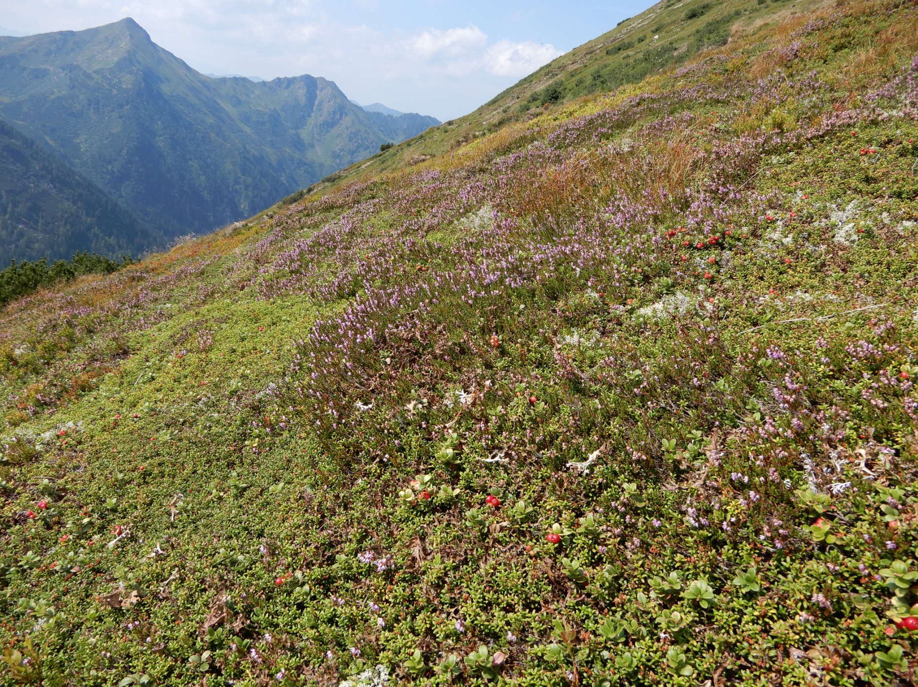
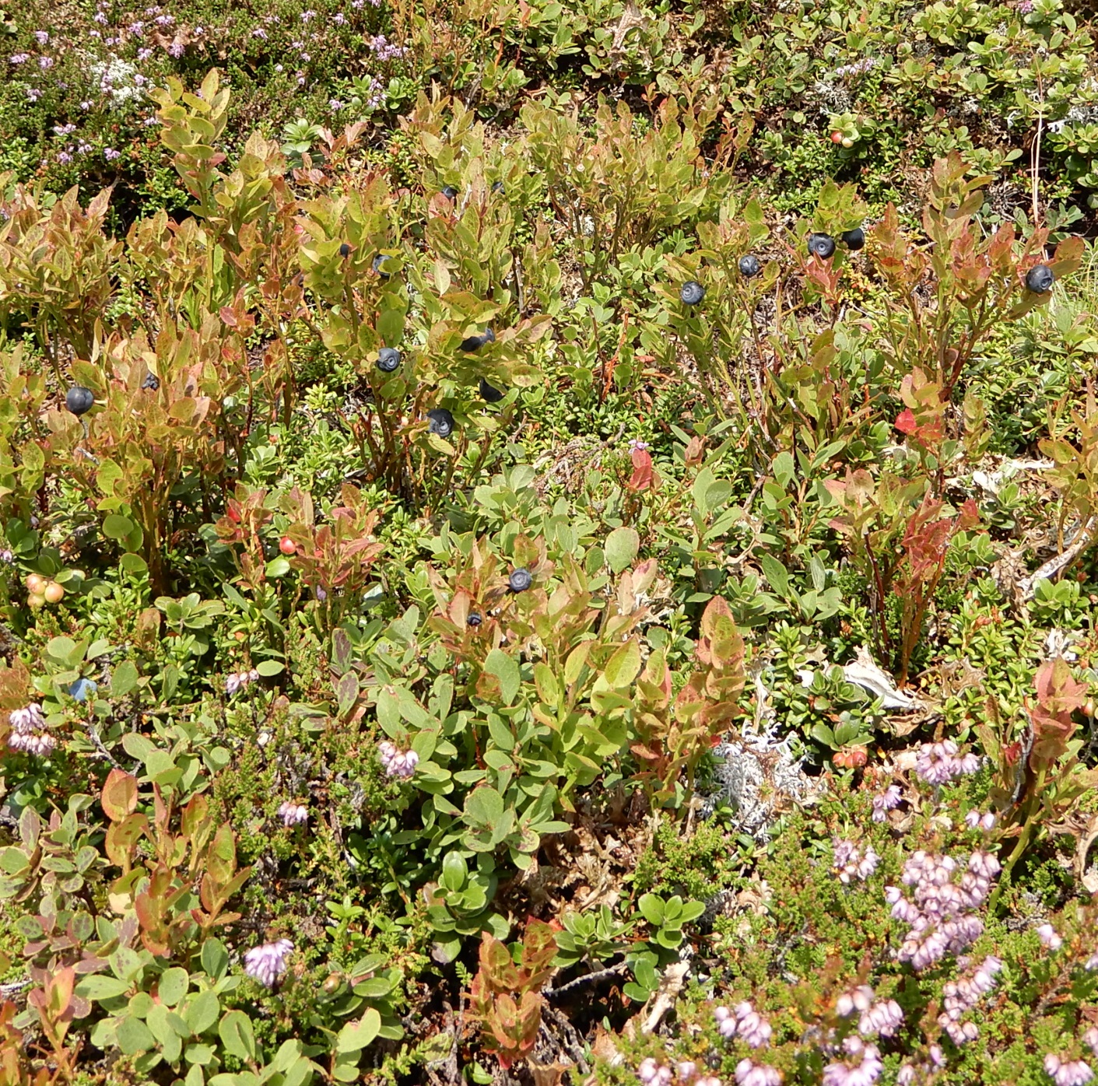
Community of Ericales on nutrient poor soil in acidic Tauren (Alps, Austria): Calluna vulgaris, Loiseleuria procumbens, Vaccinium vitis-idea, V. mytillus, V. uliginosum, Empetrum nigrum.

Slide 79
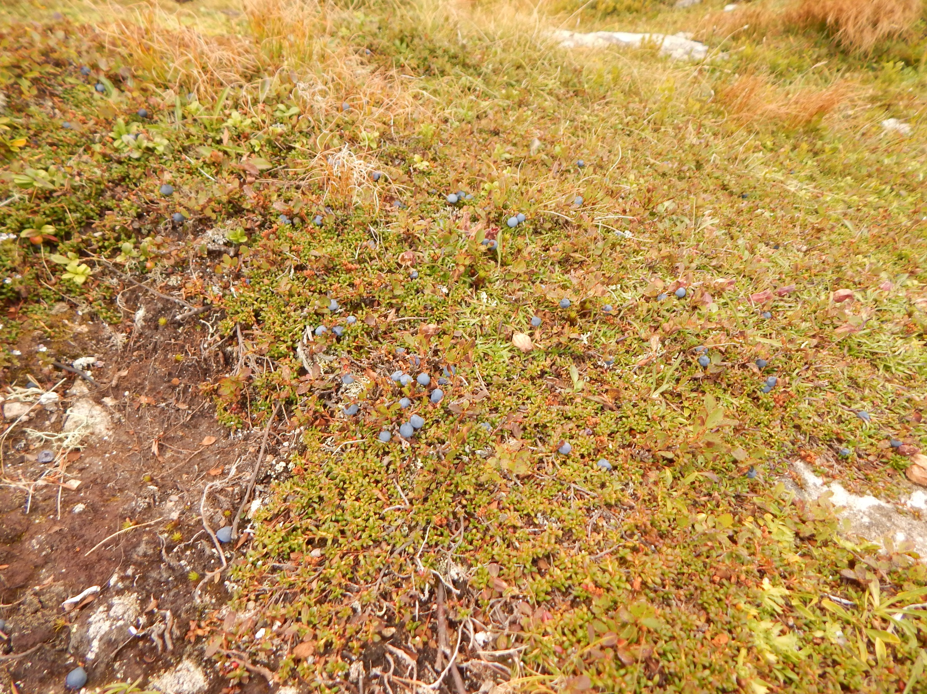

Slide 80
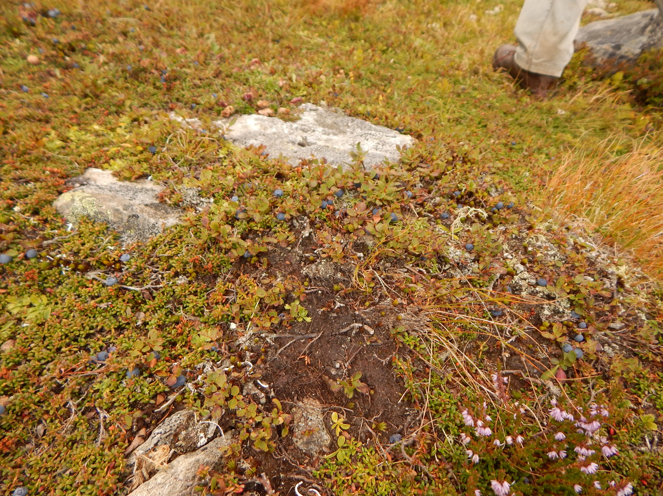

Slide 81
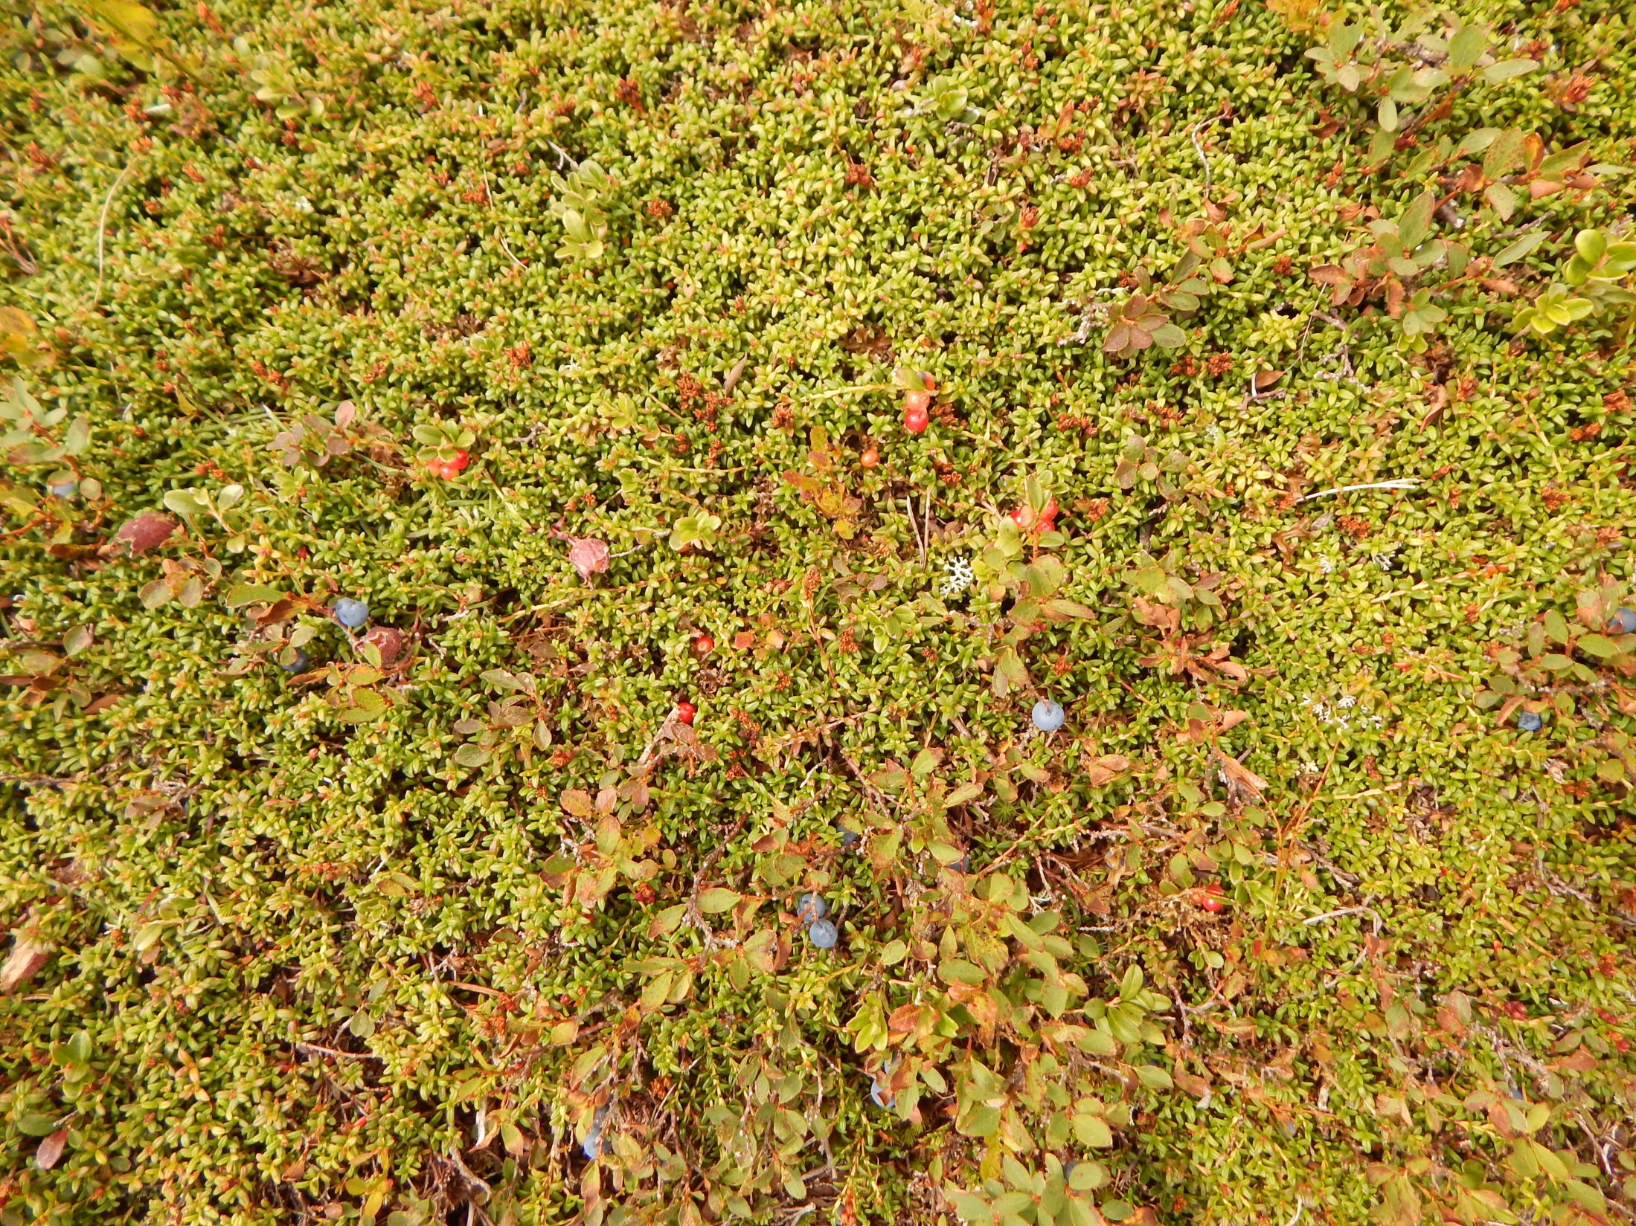

Slide 82
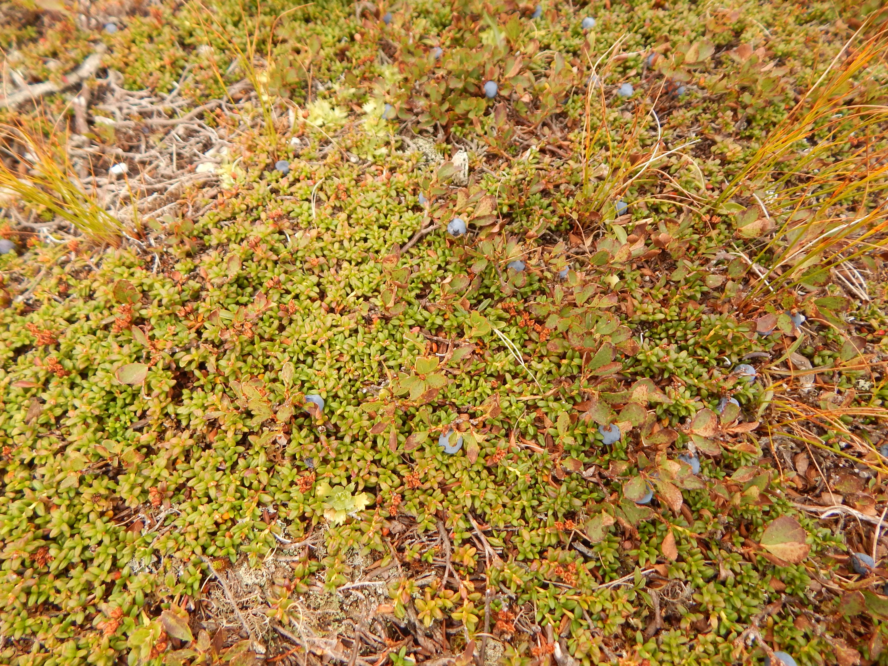
Vaccinium gaulterioides / uliginosum s.l. – Vacciniaceae/Ericaceae - Ericales
Loiseleuria procumbens – Ericaceae, Ericales

Slide 83
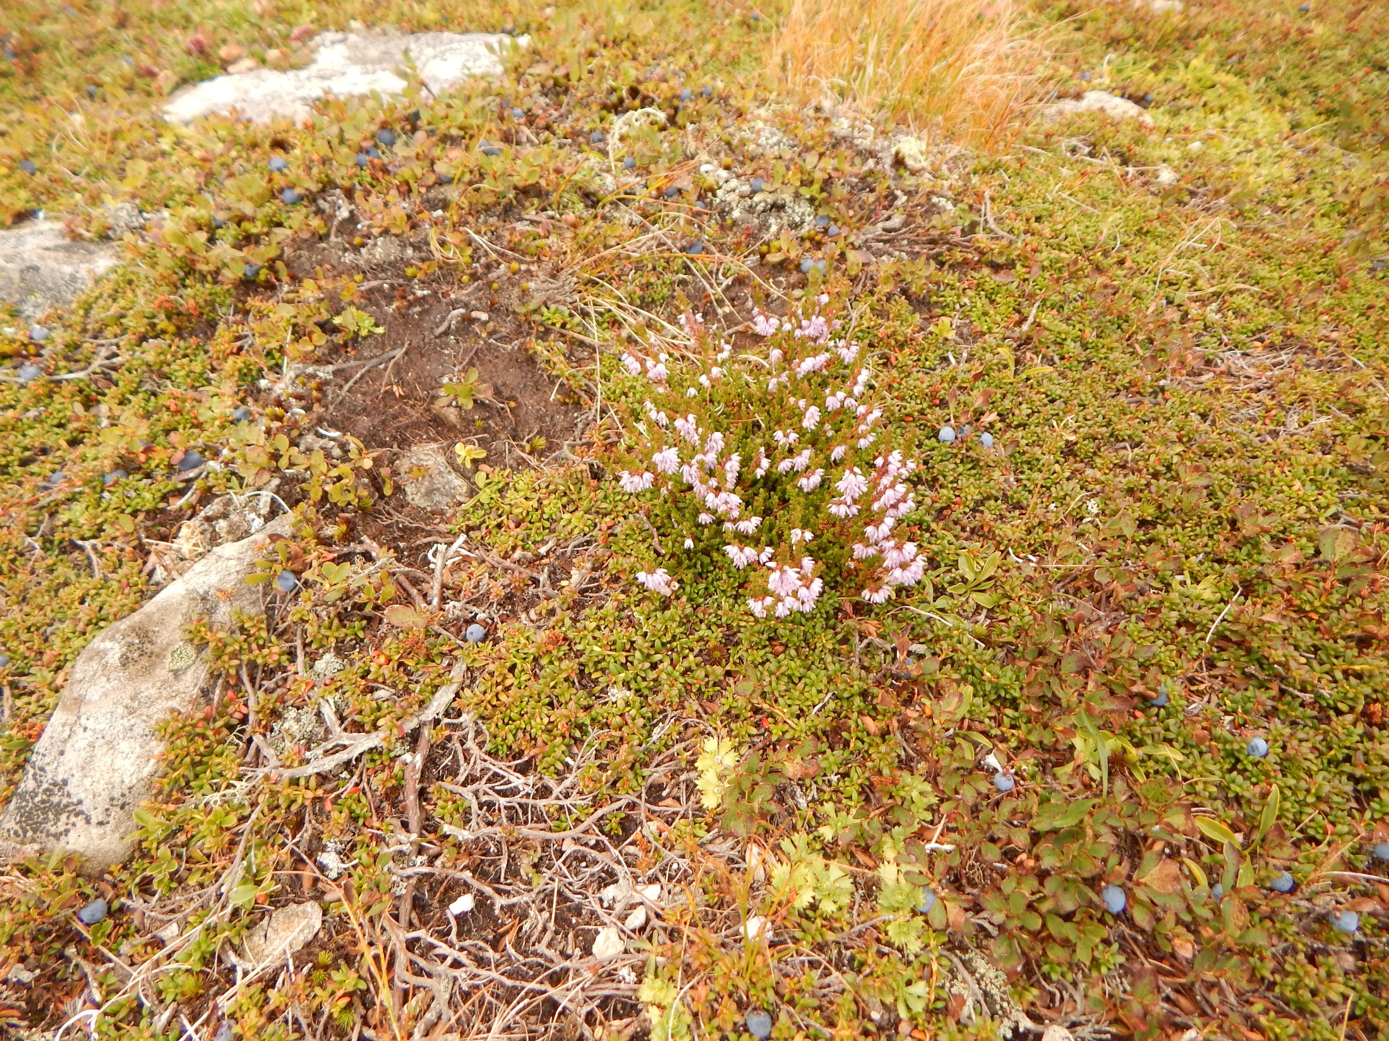
Calluna vulgaris – Ericaceae, Ericales

Slide 84
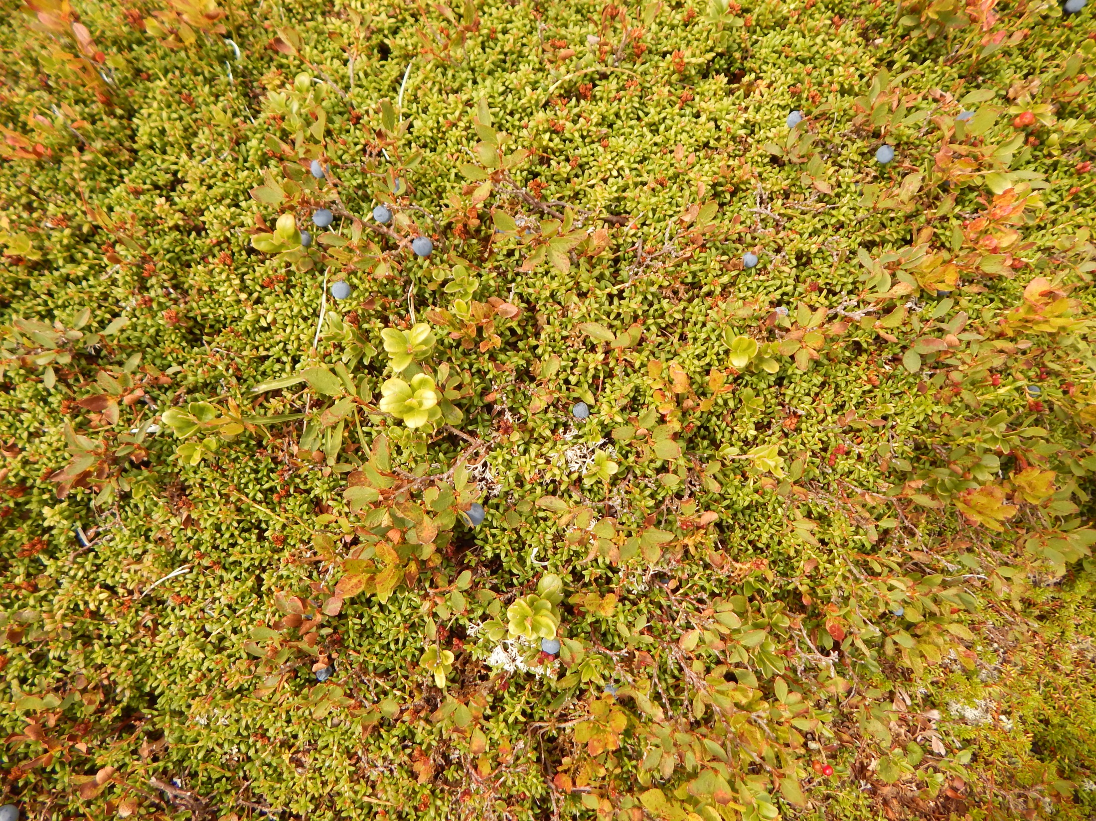
Vaccinium vitis-idea – Vacciniaceae/Ericaceae, Ericales

Slide 85
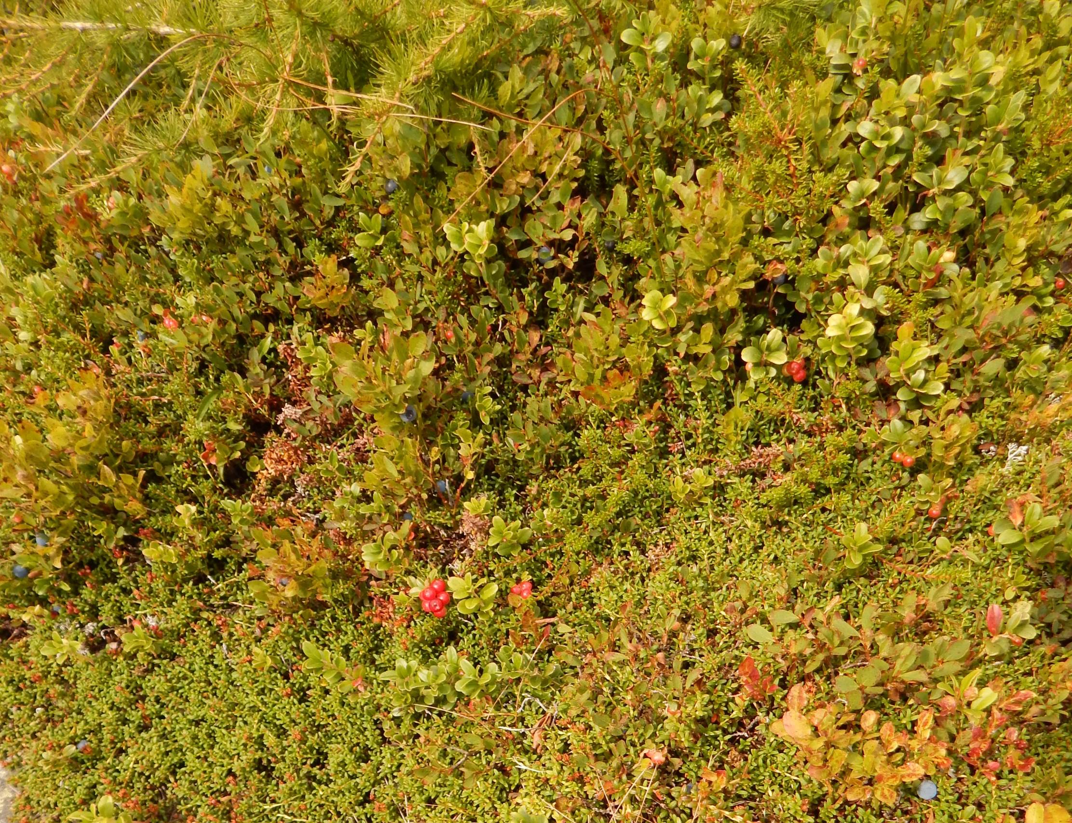
Empetrum nigrum – Empetraceae/Ericaceae, Ericales
Vaccinium mytillus – Vacciniaceae/Ericaceae, Ericales

Slide 86
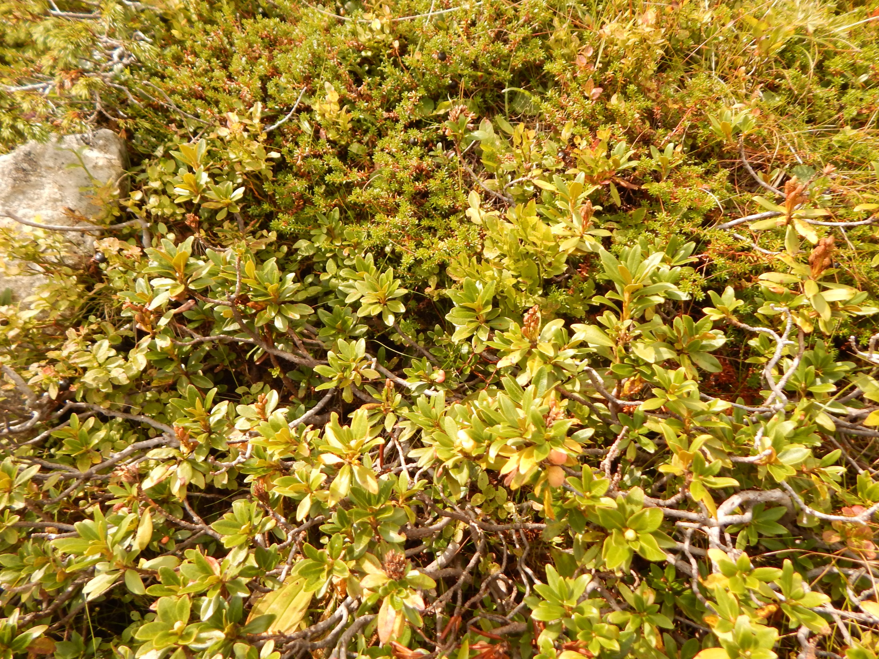
Empetrum nigrum – Empetraceae/Ericaceae, Ericales
Rhododendron ferrugineum – Ericaceae, Ericales

Slide 87
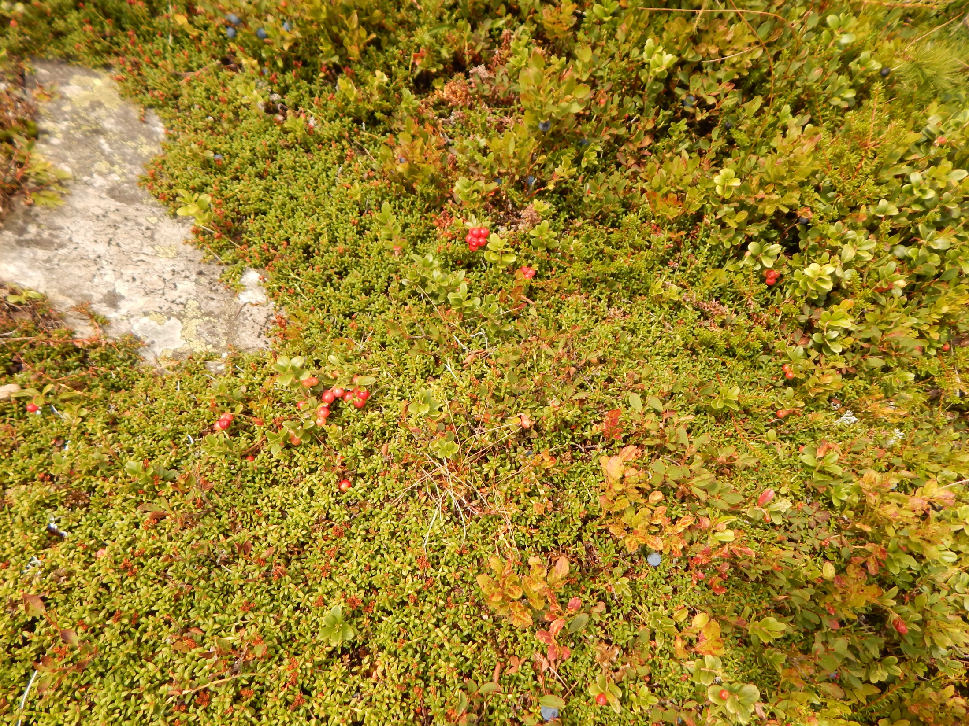
Trait shared by all Ericales - ericoid mycorrhiza

Slide 88
Whatever species pool we will consider
The chance that you randomly select seven species, and all will be from the same family is close to zero – species are phylogenetically closer then might happen by chance.

Slide 89
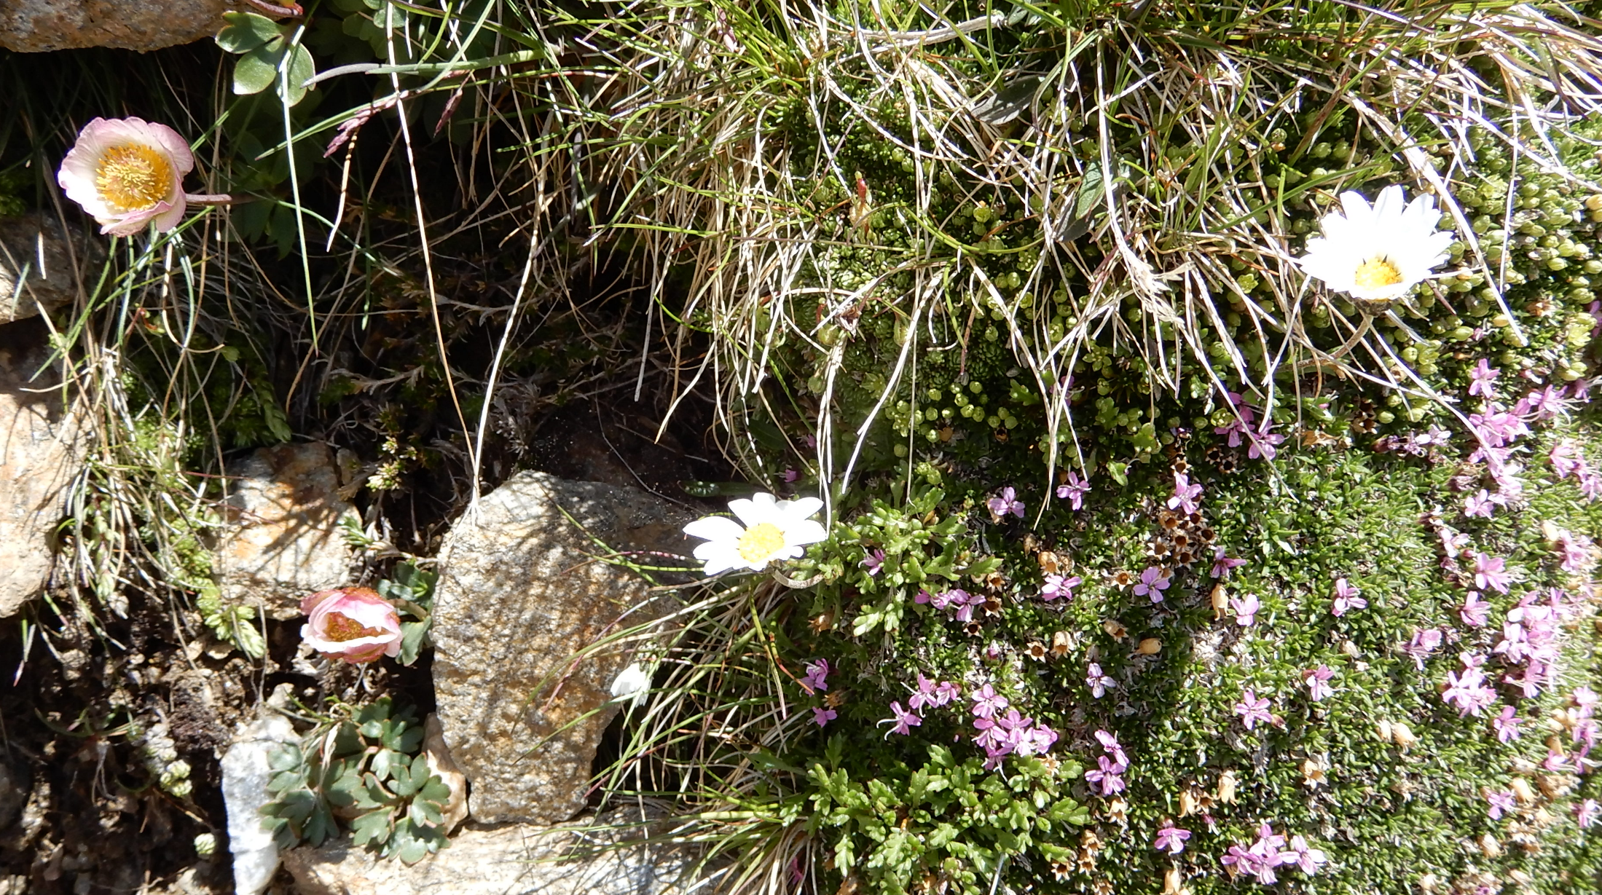
Is this phylogenetic divergence?
Grass – (i.e. monocots)
Ranunculus glacialis - ranunculids
Leucanthemopsis alp.- asterids
Silene acaulis – rosids (Caryophyllaceae)

Slide 90
Four species, each from a different clade of angiosperms – could this happen just by chance?
Grass – (i.e. monocots)
Ranunculus glacialis - ranunculids
Leucanthemopsis alp.- asterids
Silene acaulis – rosids (Caryophyllaceae)

Slide 91
Important, what we will consider a species pool
Species absent from the site (say to the distance of 50m), but present in wider area (to 1km)

Slide 92
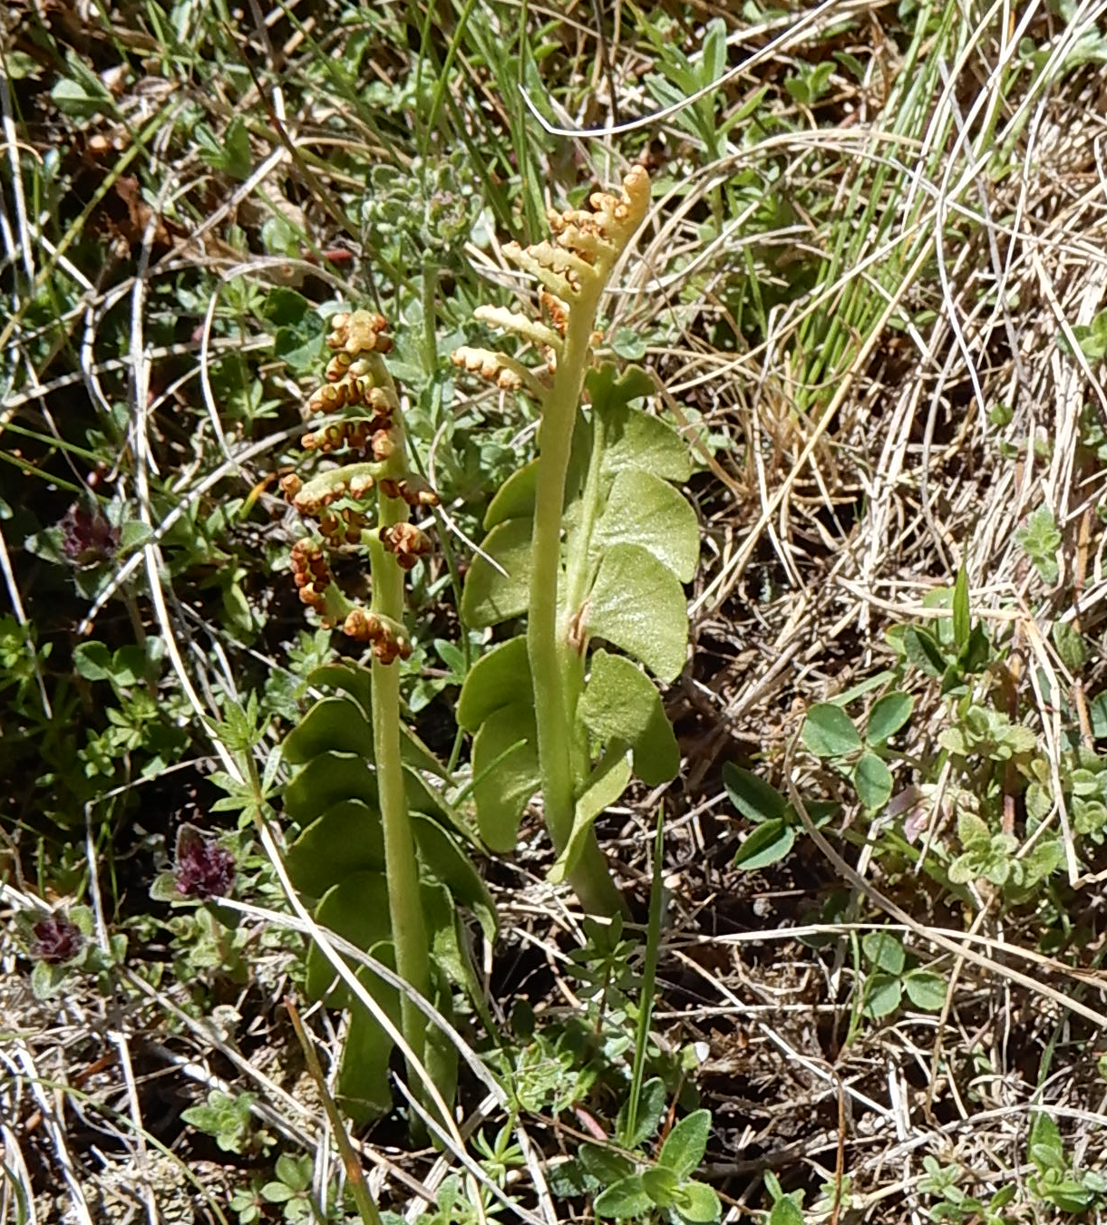
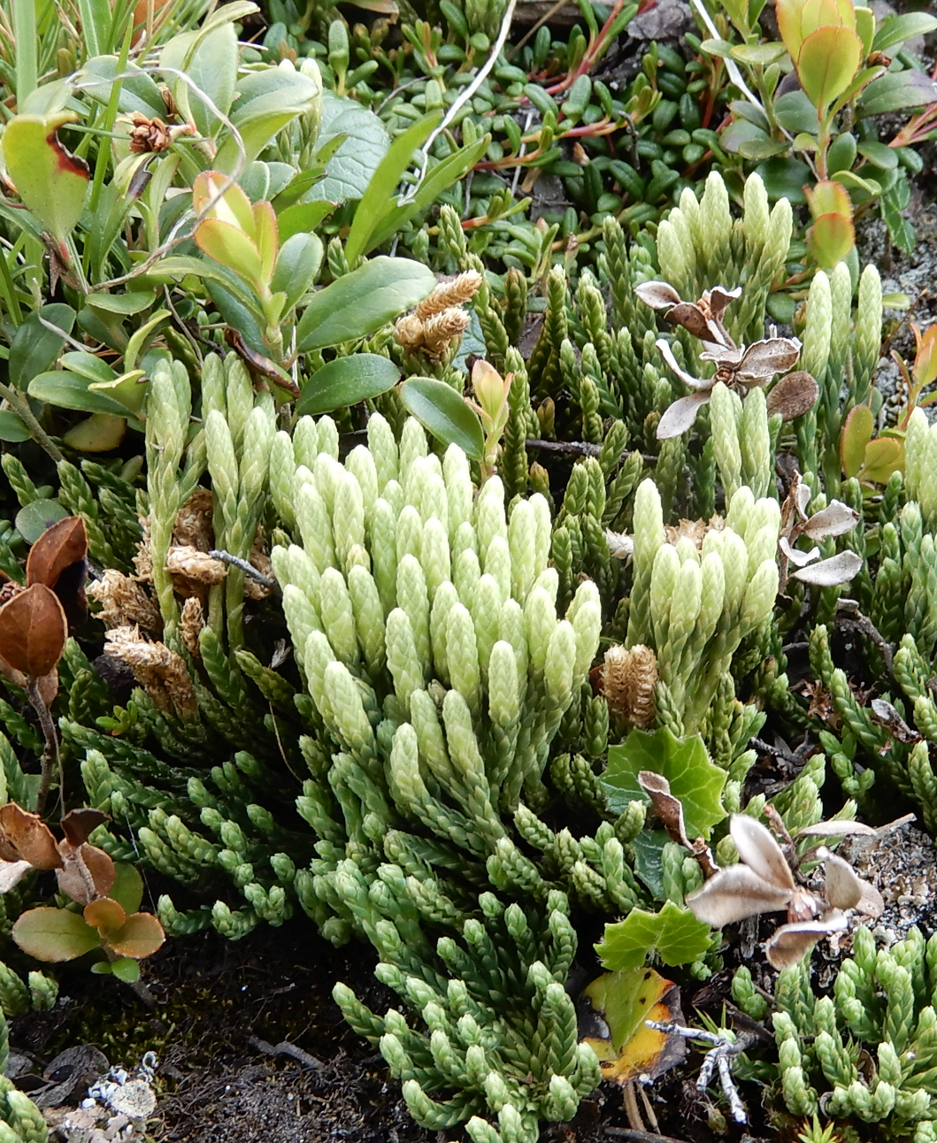
Botrychium lunaria - fern
Diphasiastrum alpinum - clubmoss
Phylogenetic distance of these species to angiosperms (but also to each other) is much larger than distance between angiosperm groups – so the average distance in random selection from pool that includes them would be also large (the role of outliers, and possibility of square root transformation of distances)

Slide 93
And finally, at closer look, we realize that we have overlooked a species – Minuartia sedoides (Caryophyllaceae) – so we have two species from the same family – thus, the average distance between species further decreases
Grass – (i.e. monocots)
Ranunculus glacialis - ranunculids
Leucanthemopsis alp.- asterids
Silene acaulis – rosids (Caryophyllaceae)

Slide 94
Use of traits
Makes the community ecology more functional
On the other hand, is often based on the believe that traits reflect the functionality
Can not replace manipulative experiment
Trait databases – extremely valuable, but use with caution

