Slide 1
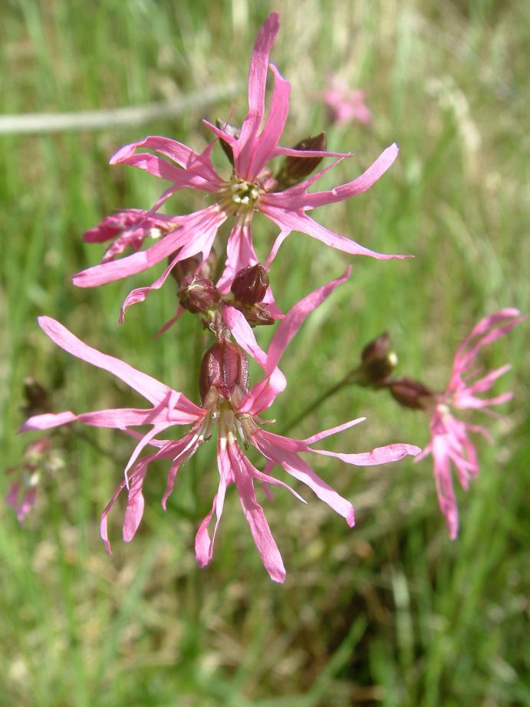
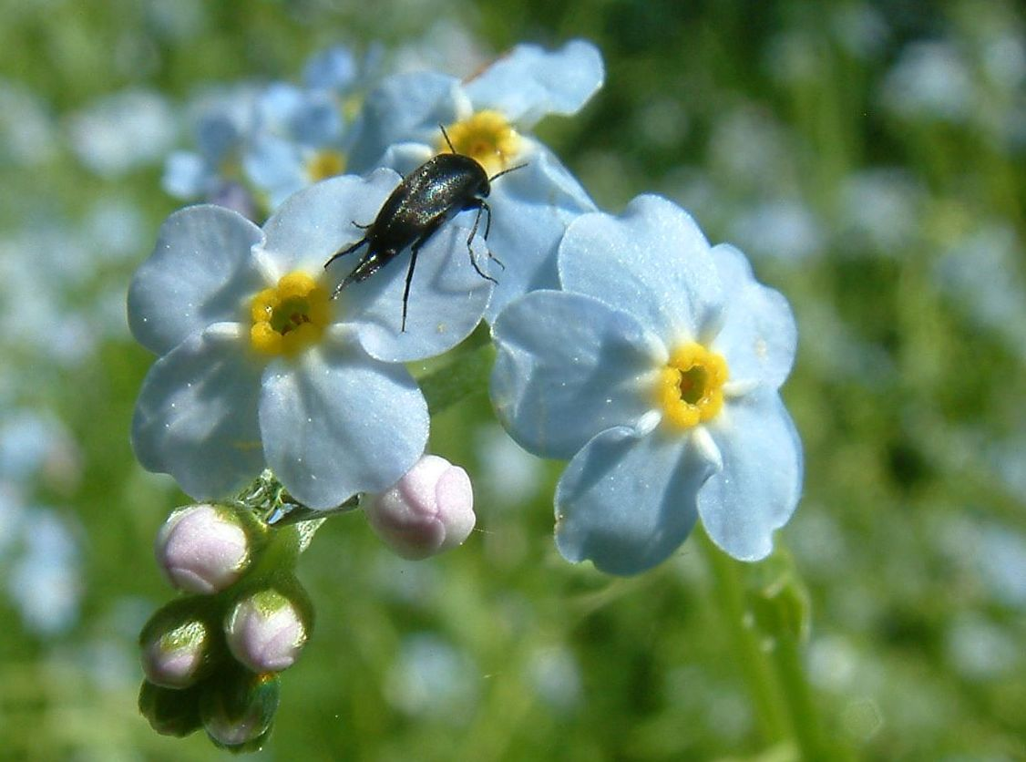
Biodiversity – Ecosystem Function (BEF) experiments – what do their results say about consequences of species loss in real world
Jan Leps, Department of Botany, University of South Bohemia, Ceske Budejovice
http://botanika.prf.jcu.cz/suspa/

Slide 2
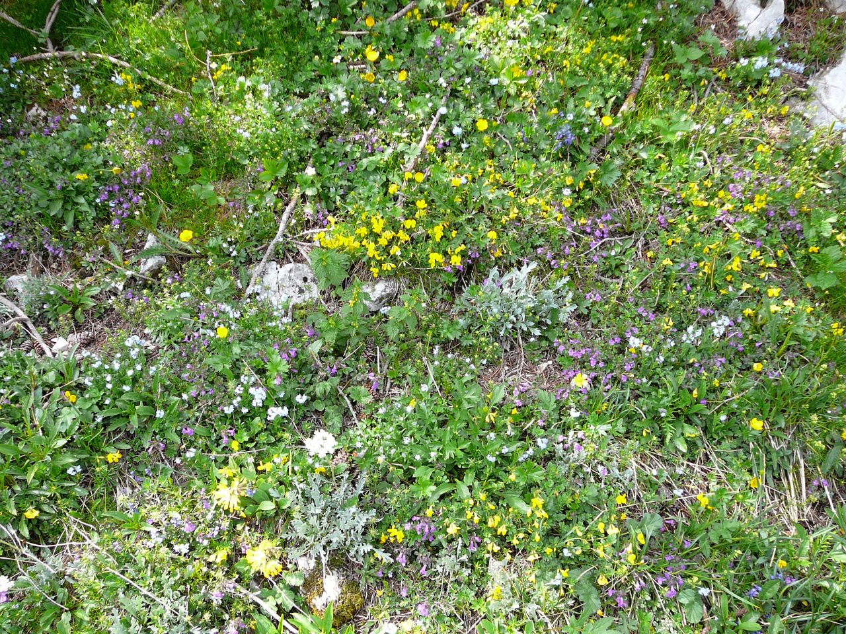

Slide 3
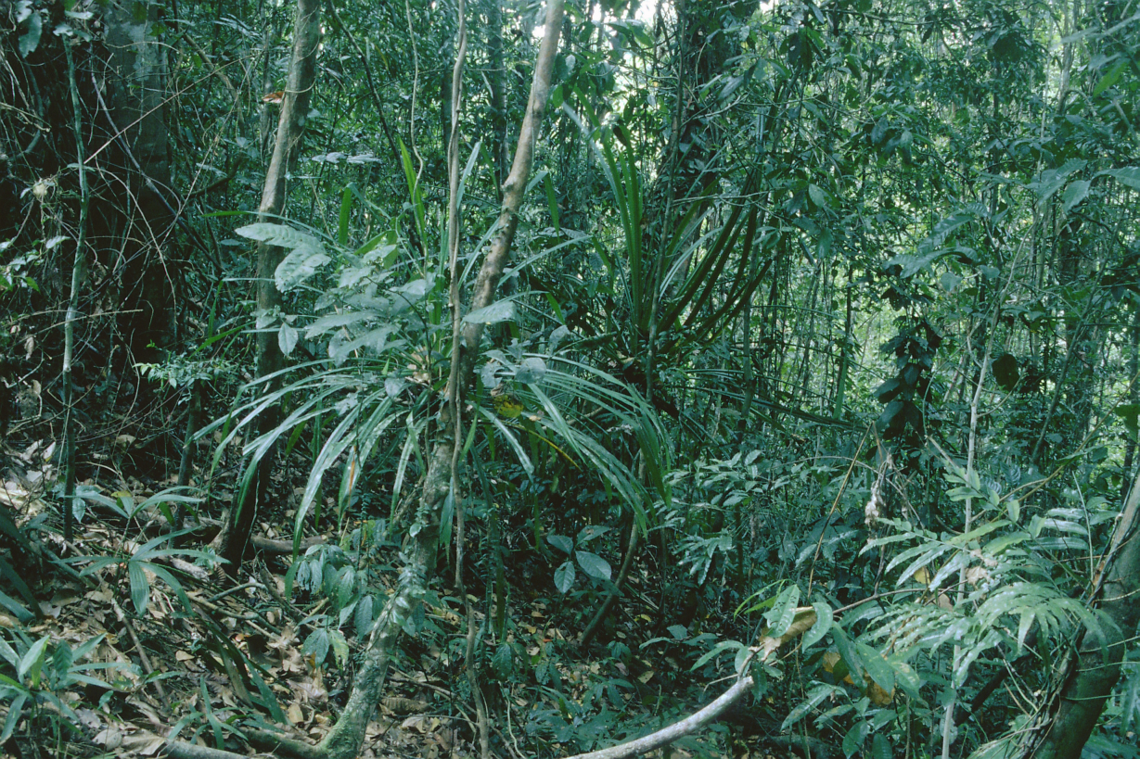

Slide 4
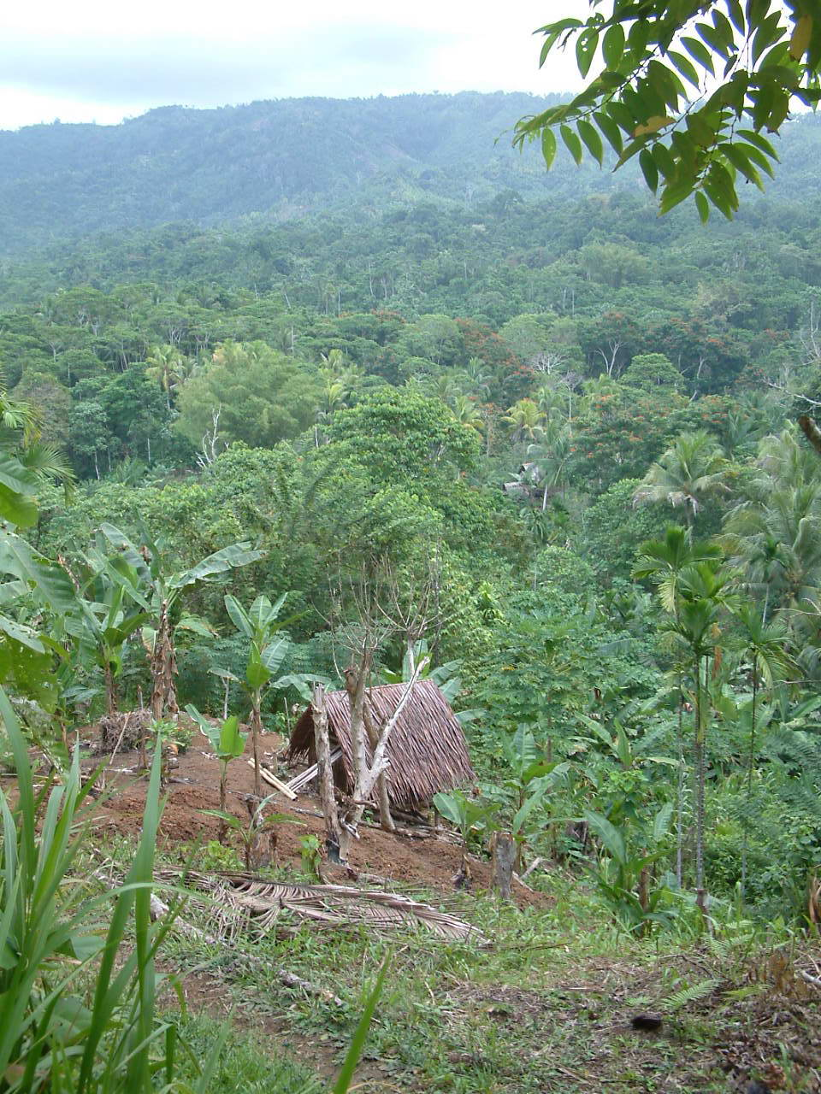
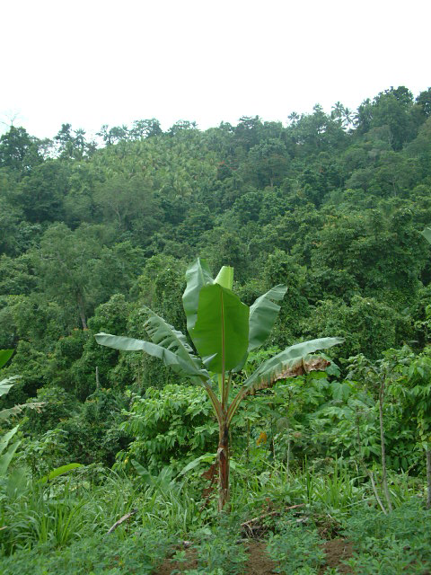

Slide 5
Species are continuously lost from communities and ecosystems
And we can register continuous diversity decline in many communities of our landscape.

Slide 6
Loss of species from ecosystems
Can the loss of species change ecosystem functioning. Do the species rich ecosystems function better?
Can be the better functioning of species rich ecosystems used as conservation argument?
Are we able to demonstrate the dependence of function on diversity with sufficient scientific rigor?

Slide 7
What is better function?
Very often, just productivity (and so connected use of resources)
[the possibility to use the older agricultural literature]
“Ecosystem services”
Stability (incl. resistance to invasions)

Slide 8
Why should be the functioning better?
Having more species available, the chance that a species able to „do the job“ will be present increases
=Sampling effect, Selection effect
Niche complementarity - more subjects are able to use better the variable resources (e.g. by variability of the rooting depths) = Complementarity effect
Higher stability - if one species is lost, the others can use the empty space and „fill the gap“ – the more species in a community, the more likely this mechanism works (generally, the idea of MacArthur 1955 – also known now as insurance hypothesis)

Slide 9
Excursion to history
Diversity begets stability
S= -Σp_{i} log p_{i}
MacArthur (1955): Fluctuations of animal populations and a measure of community stability. – Ecology 36: 533-536.
Shannon formula for diversity first suggested as index of stability

Slide 10

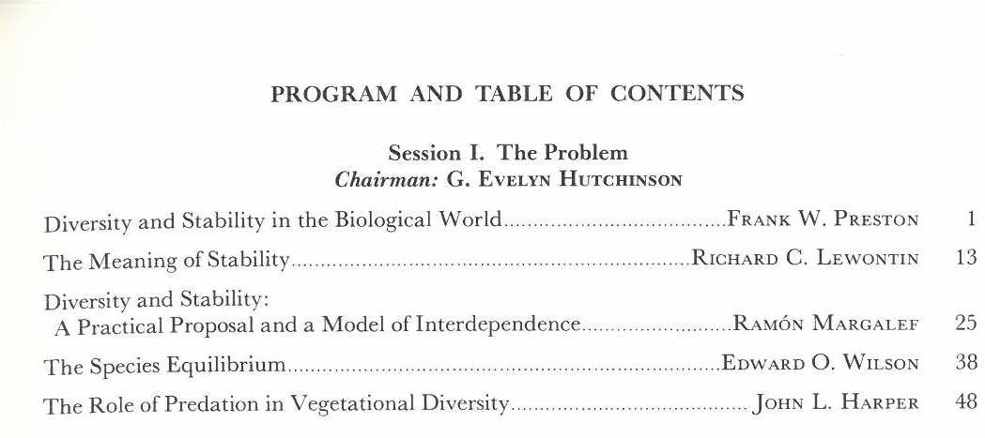
1969

Slide 11
Classical evidence
50.-70. ‘Diversity begets stability’ belief
Observations: Population outbreaks are more common in species poor polar regions than in speecies rich tropics
In arable field monocultures than in natural species rich communities
=> “confounding factor”
But Reed communities on the shores are very stable

Slide 12
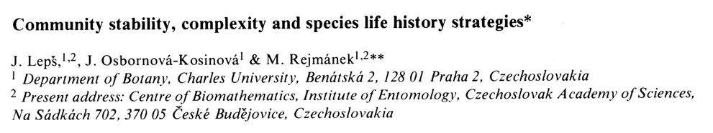
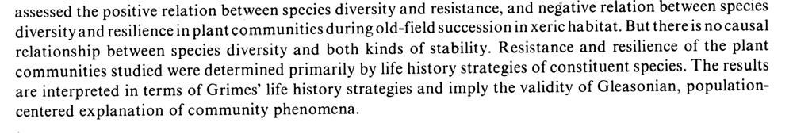
Vegetatio 1982:
We

Slide 13
Vegetatio 1982:
We

Slide 14
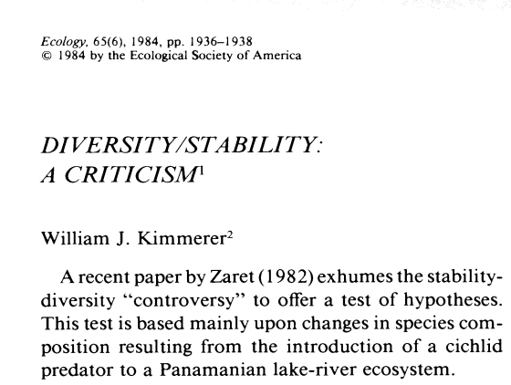

Slide 15
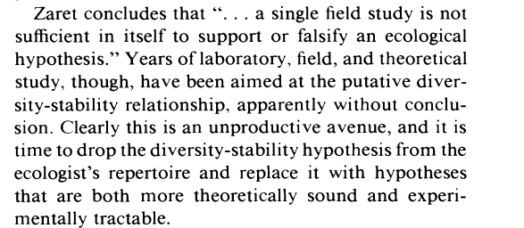
Kimmerer’s conclusion:

Slide 16
In nature, we have always some confounding factor
To investigate the pure effect of diversity, let’s manipulate it.
BIODIVERSITY – ECOSYSTEM FUNCTIONING (BEF ) EXPERIMENTS
But HOW and what does the manipulations say about real world?

Slide 17

Interestingly, the older (agricuture) literature on intercropping was mostly overlook by the proponents of BEF
1989

Slide 18
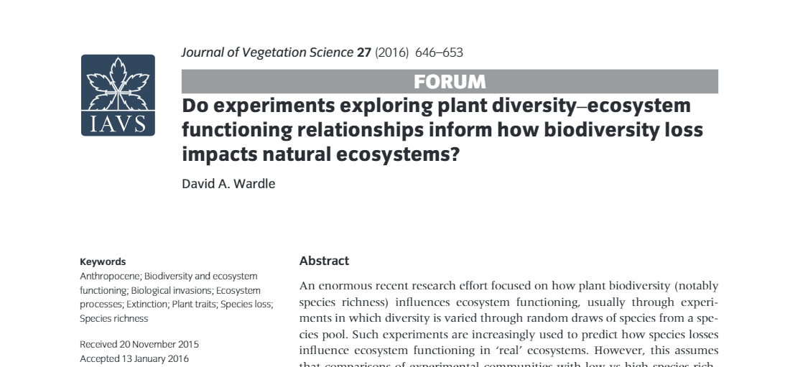
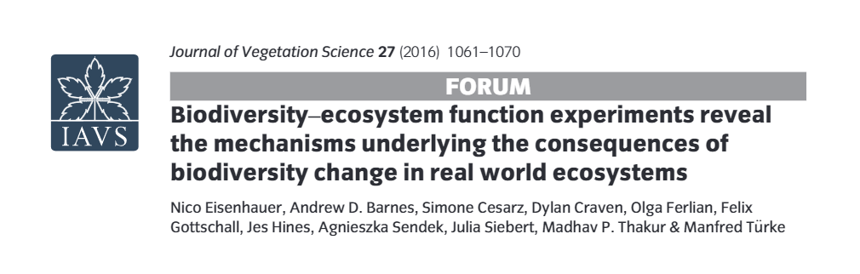
Conclusions and a way forward
There is significant doubt about the validity of a widely held assumption that rates of ecosystem processes in randomly assembled experimental plant communities varying in species richness can predict how biodiversity loss affects ecosystem functioning in real ecosystems.

Slide 19
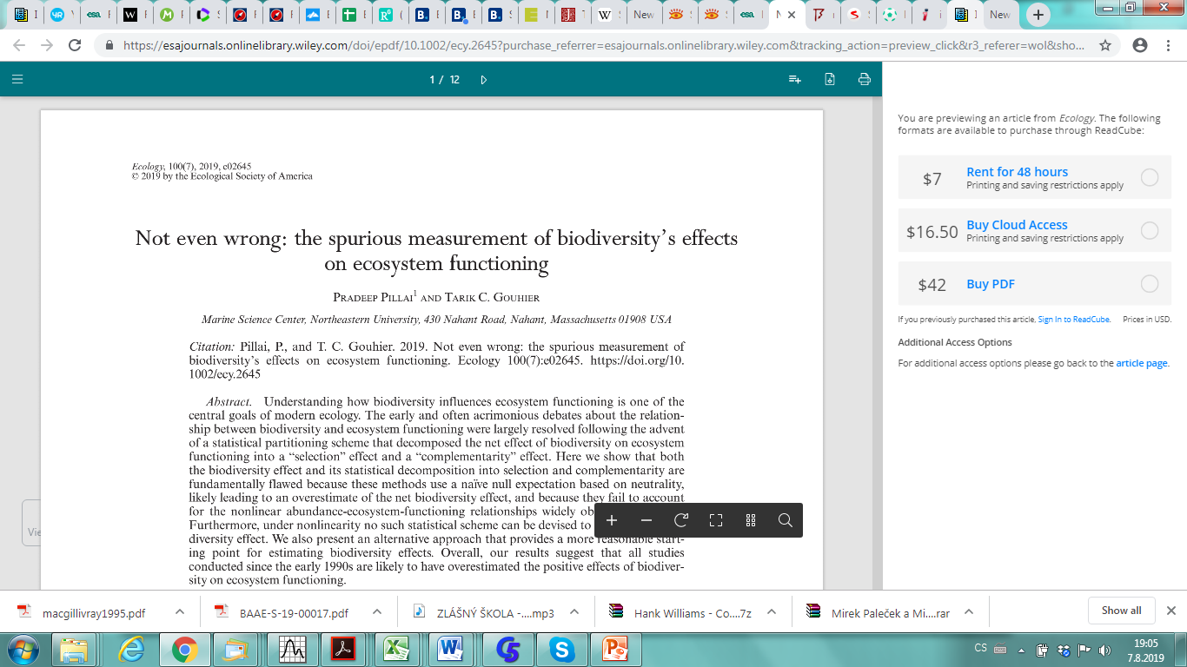
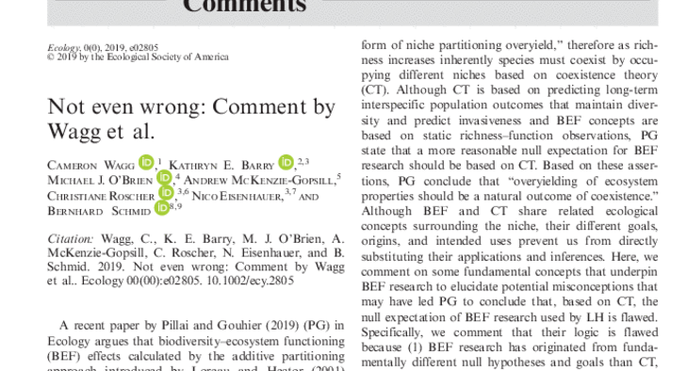
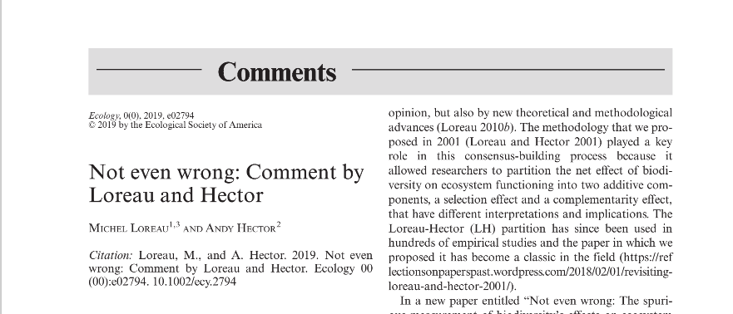

Slide 20
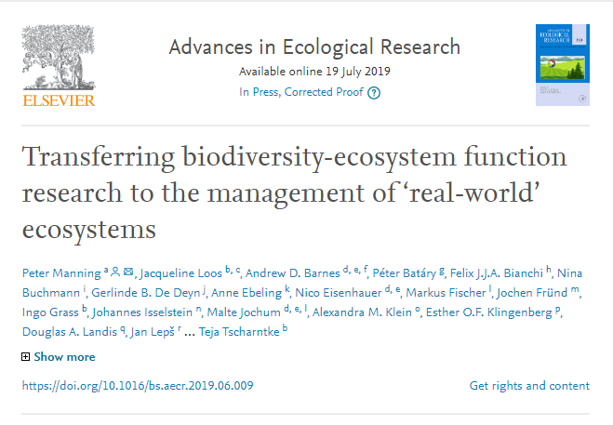
Lepš, J. (2004). What do the biodiversity experiments tell us about consequences of plant species loss in the real world?. Basic and applied Ecology, 5(6), 529-534.

Slide 21
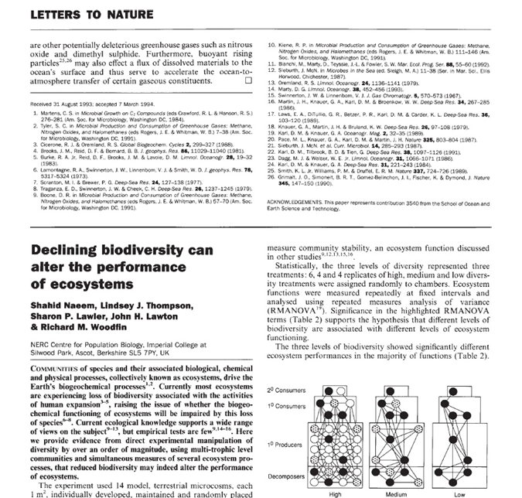
Naeem et al. 1994
1000+ SCI citations
Another classical experiments: Tilman: Cedar Creek
BIODEPTH (Loreau, Hector)

Slide 22
Naeem et al. 1994
1200+ SCI citations
Another classical experiments: Tilman: Cedar Creek
BIODEPTH (Loreau, Hector)

Slide 23
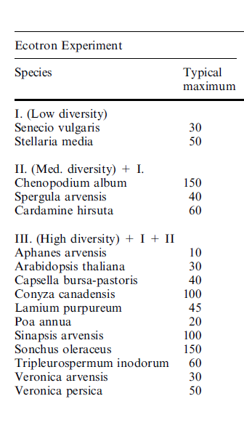
(From Huston 1997)
neophyte
neophyte

Slide 24
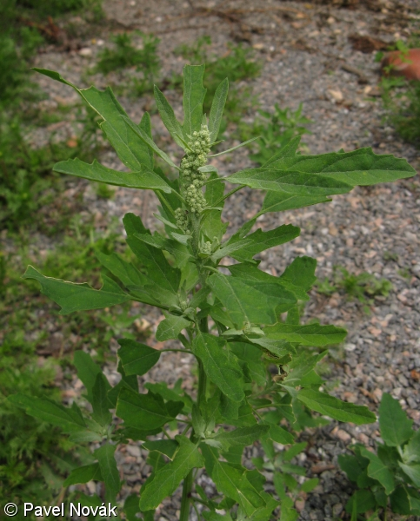
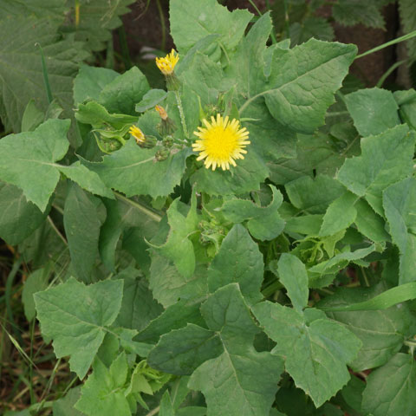
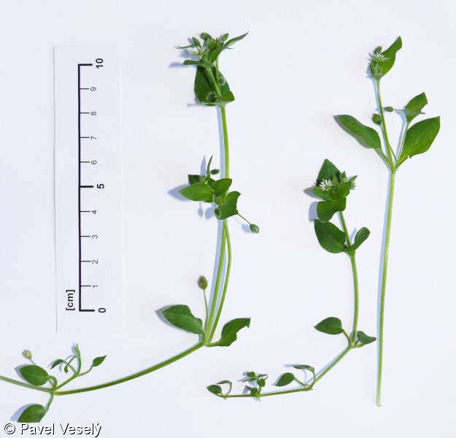

Slide 25
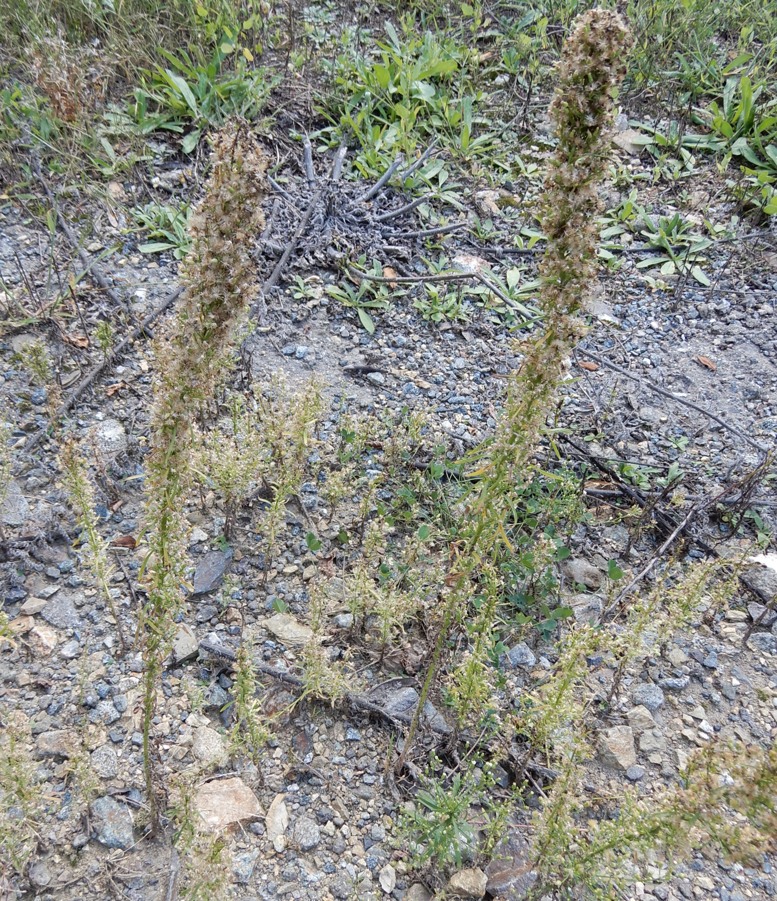
Conyza canadensis – nasty difficult weed, invader from North America

Slide 26
Biodiversity experiments
Type „Naeem 1994“ – do not use, clear confounding of diversity and species identity
Richness =1
A
A
A
A
Richness = 2
AB
AB
AB
AB
Richness = 3
ABC
ABC
ABC
ABC
Richness = 4
ABCD
ABCD
ABCD
ABCD
Naeem et al. 1994 (Nature).

Slide 27
Biodiversity experiments – probably, the “best” design
All monocultures available (necessary?), all species equally represented in all diversity levels (Other species weeded!!!!)
Richness =1
A
B
C
D
Richness = 2
AB
BC
CD
AD
Richness = 3
ABD
ABC
BCD
ACD
Richness = 4
ABCD
ABCD
ABCD
ABCD

Slide 28
Constant total sowing (planting) densities (de Witt replacement series)
 | A | B | C | D
Monoculture | 100 | 0 | 0 | 0
Monoculture | 0 | 100 | 0 | 0
Monoculture | 0 | 0 | 100 | 0
Monoculture | 0 | 0 | 0 | 100
2species | 50 | 50 | 0 | 0
2species | 0 | 0 | 50 | 50
2species | 50 | 0 | 50 | 0
2species | 0 | 50 | 0 | 50
4species | 25 | 25 | 25 | 25
4species | 25 | 25 | 25 | 25
4species | 25 | 25 | 25 | 25
4species | 25 | 25 | 25 | 25

Slide 29
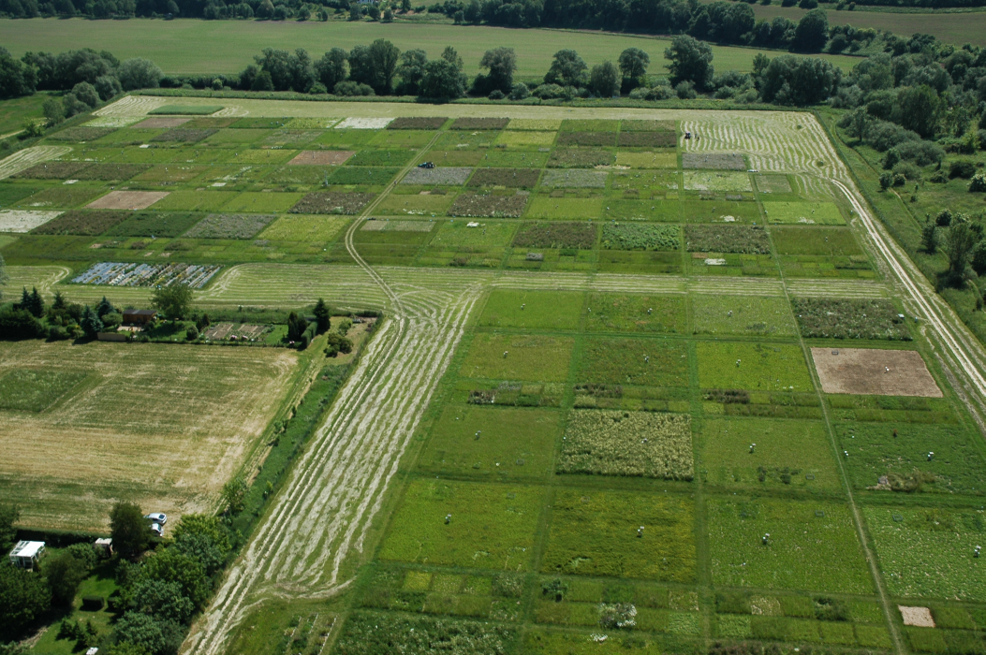
Jena experiment

Slide 30
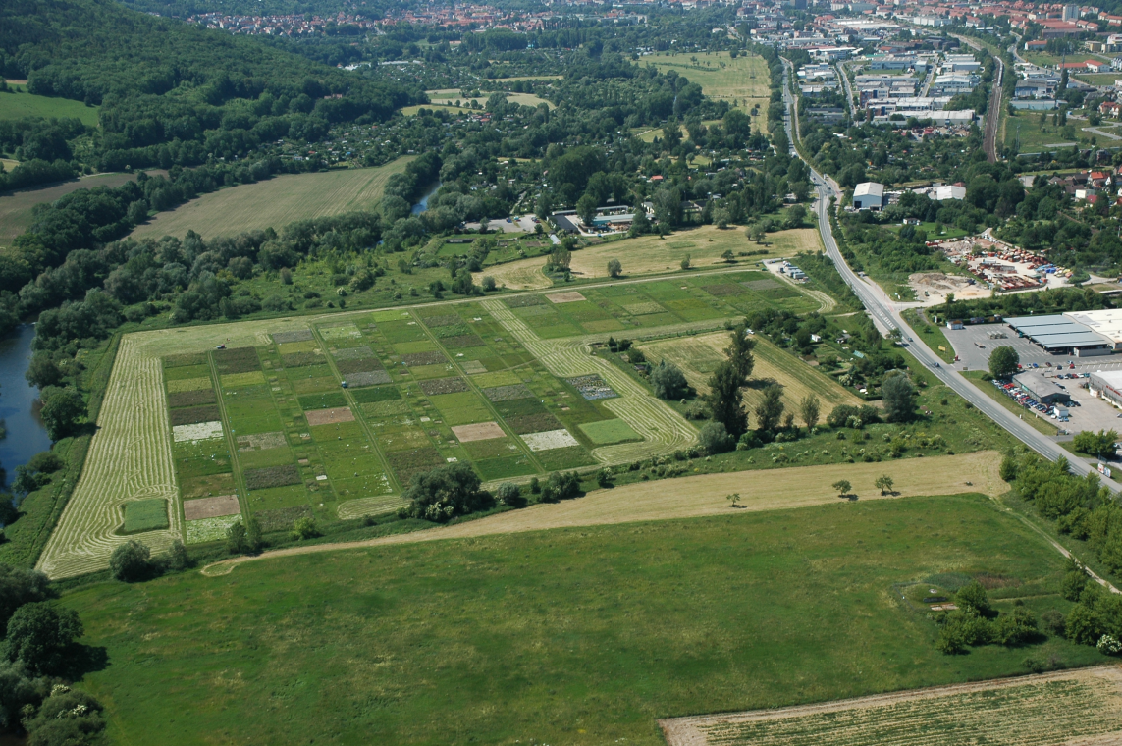

Slide 31
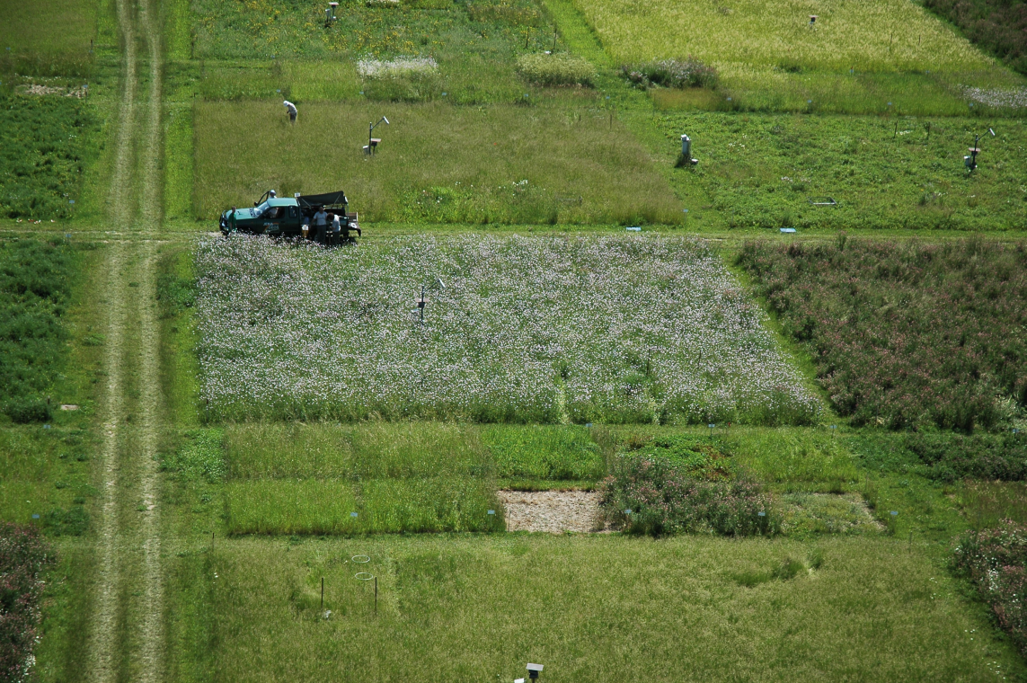

Slide 32
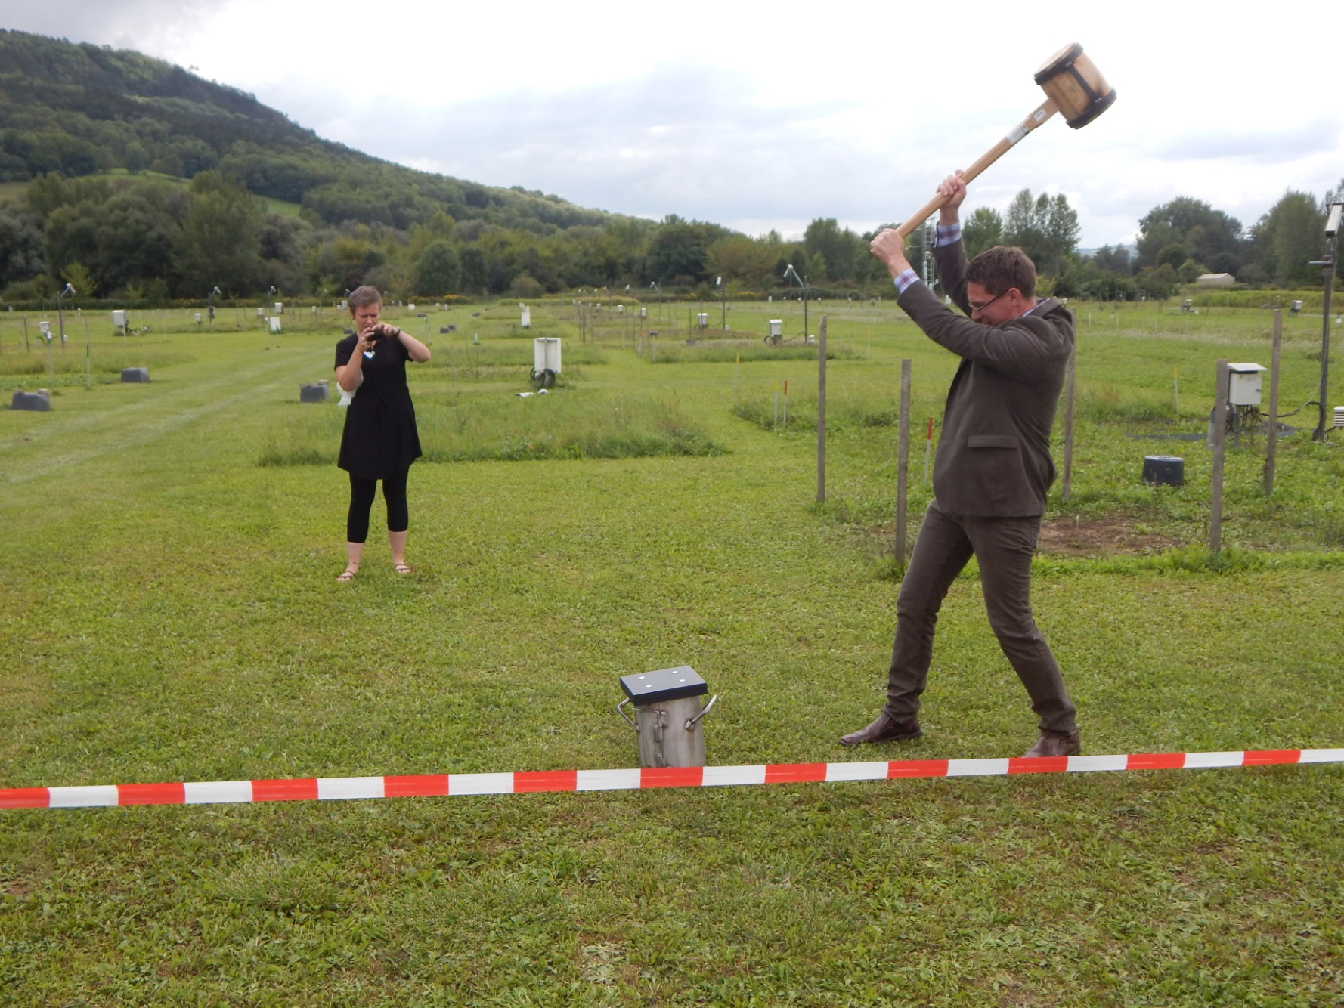
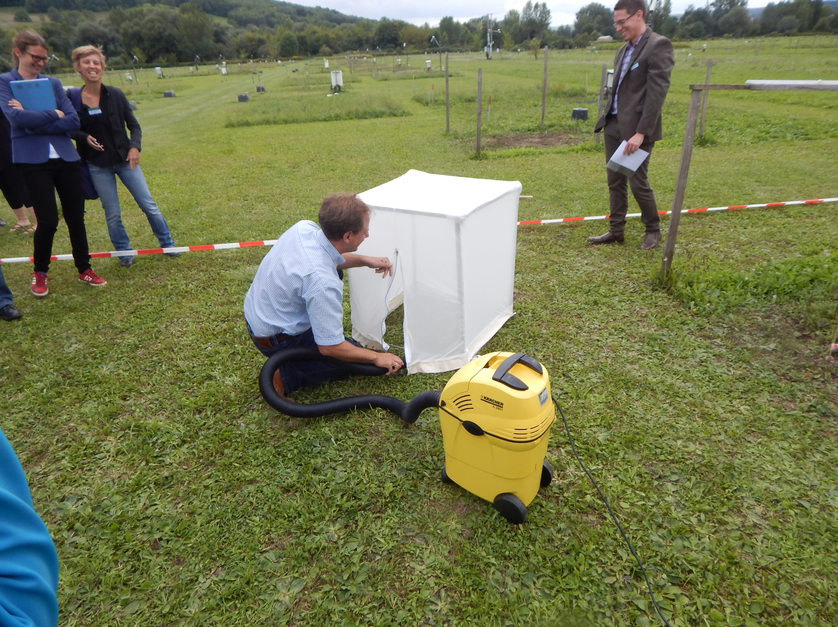
Nico Eisenhauer getting soil samples in the Jena experiment

Slide 33
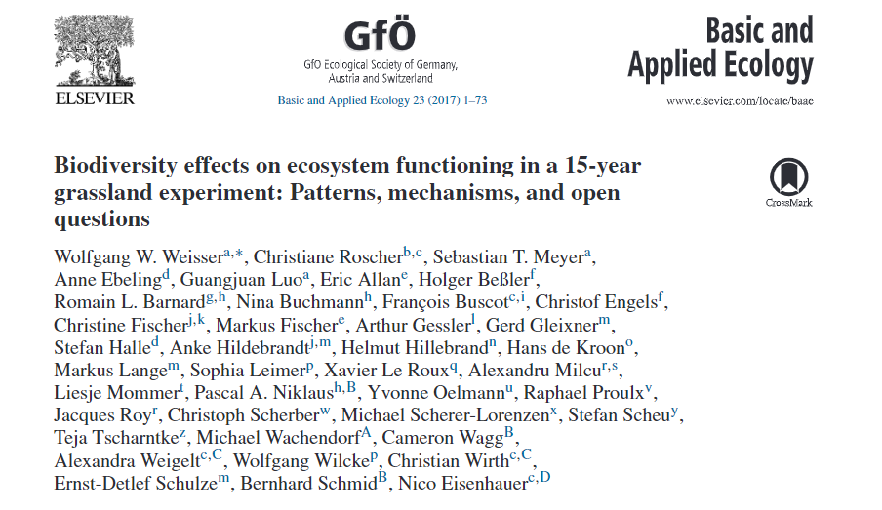
In the Jena experiment
Incredible amount of work done, including soil feedbacks, all the trophic levels etc., and the results provided perfect view into the functioning of ecological communities
The species composition used is more realistic than in other BEF experiments
However, what is the relationship to real species loss?

Slide 34
Typical result
Biomass increases with the number of species sown (planted, introduced).
If some „ecosystem processes“ are measured (like nutrient uptake), they are usually correlated with standing biomass, so that they also increase
If there is a temporal series available, the higher diversity has usually also higher constancy (of total biomass)

Slide 35
Nearly universal result – productivity (and related functions) increase with the number of sown species
Correct conclusion for the statistical universe, where all the possible species combinations are equally represented. (Or from which our experimental plots might be, at least roughly, considered a random sample.)
Problem for conservation implications

Slide 36
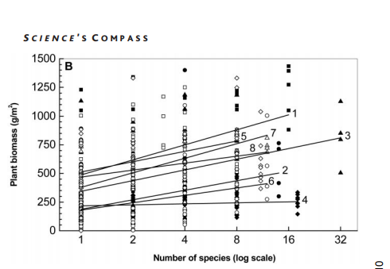
BIODEPTH
From Loreau, M., Naeem, S., Inchausti, P., Bengtsson, J., Grime, J. P., Hector, A., ... & Tilman, D. (2001). Biodiversity and ecosystem functioning: current knowledge and future challenges. Science, 294(5543), 804-808 / based on data from original Hector, A., et al. 1999. Science, 286(5442), 1123-1127.

Slide 37
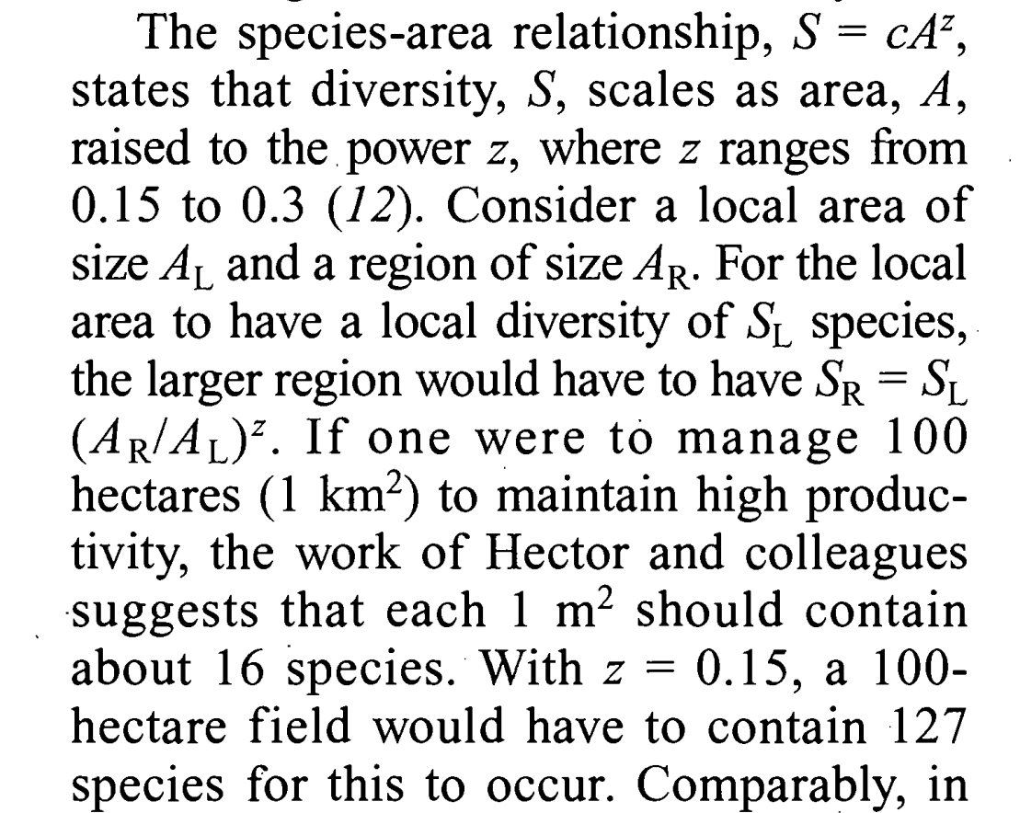
Tilman, D. (1999) Diversity and production in European grasslands. Science 286, 1099–1100.

Slide 38
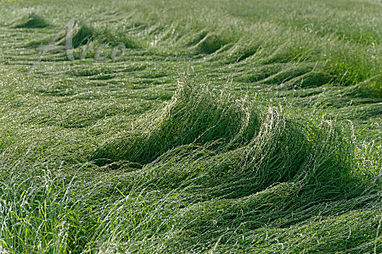

Slide 39
From Loreau, M., Naeem, S., Inchausti, P., Bengtsson, J., Grime, J. P., Hector, A., ... & Tilman, D. (2001). Biodiversity and ecosystem functioning: current knowledge and future challenges. Science, 294(5543), 804-808 / based on data from original Hector, A., et al. 1999. Science, 286(5442), 1123-1127.

Slide 40
If a farmer will grow a monoculture for production, he will not try monocultures of Aphanes arvensis or Arabidopsis thaliana, but will go for Lolium perenne directly
    Conservationists in several European countries have tried for decades to persuade farmers to keep productivity of species rich grasslands low in order to keep diversity high. Under those circumstances, the use of the argument that keeping diversity high might be economical because of increased productivity (as suggested by Tilman 1999) might be contra-productive. [Lepš 2013. Veg. Ecology]

Slide 41
We can expect that various ecosystem characteristics will be affected by total community biomass
E.g., the following will increase with biomass (and thus also with richness)
  Carbon in soil
  Nutrient uptake
  Photosynthesis
  But also higher trophic levels (e.g. soil organisms)

Slide 42
Competition determines often also characteristics of individual species
And intensity of competition is highly affected by the standing biomass, thus even individual populations characteristics could be statistically dependent on richness
  E.g. age structure
  Trait values

Slide 43
Random species composition of communities
Looks correct from statistical point of view
!!! But from the point of view of species loss simulates the situation, when species are lost from communities at random
Back to basics of statistical testing – what is the statistical universe? Random species composition implies that in the corresponding statistical universe, all the species combinations are equally likely.

Slide 44
PROBLEM
In nature, diversity is a response to site conditions (and species pool) - can it be treated as “independent variable”?
Real world
BEF experiments
Species pool
Environment
Manipulated composition
Richness
Species composition
Richness
Productivity
Productivity

Slide 45
And empirical results with productivity being the predictor and species richness the response are rather different

Slide 46
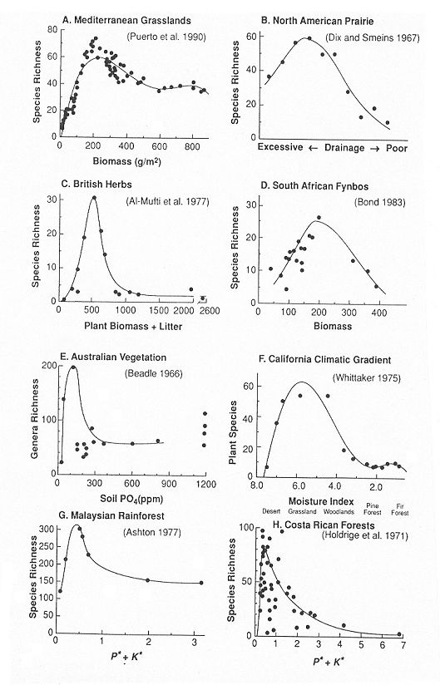
Examples of unimodal relationships between species richness and measures of habitat productivity in plant communities. P* and K* are normalised concentrations of soil phosphorus and potassium, which were summed to give an index of soil fertility. From Tilman and Pacala (1993), where also the references to original source can be found.

Slide 47
Lisner et al. 2021 Oikos. – The relationship (in grasslands) is very variable, depending on the spatial scale (grain and extent), and on the characteristics of productivity used
Two regions (analyzed either each separately, or together) – i.e. various extents, with various plot sizes (grains), and various characteristics of productivity used as predictors. In no case,the relationship was unimodal.

Slide 48
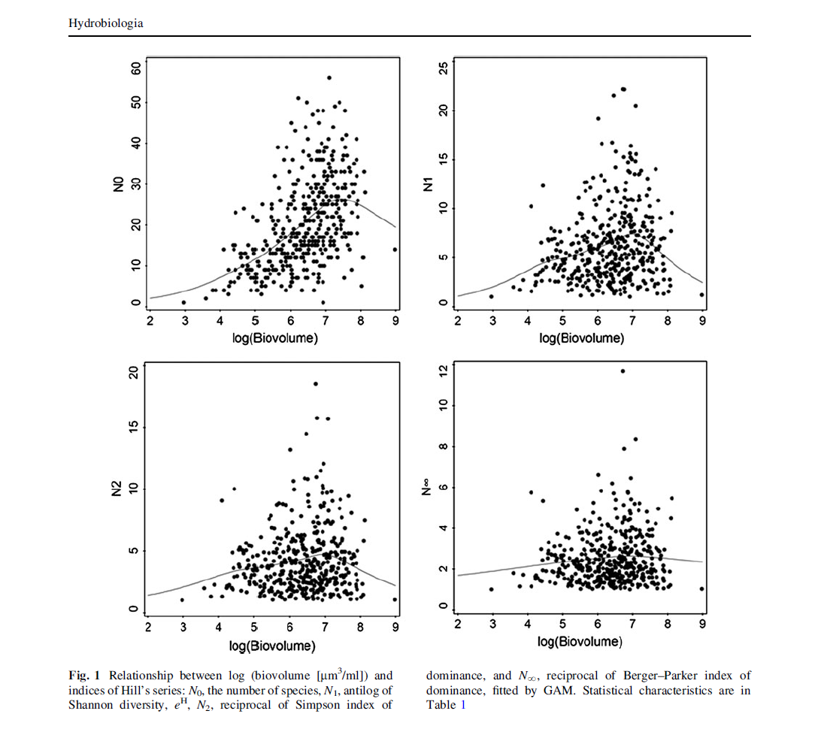
Skácelová, O., & Lepš, J. (2014). The relationship of diversity and biomass in phytoplankton communities weakens when accounting for species proportions. Hydrobiologia, 724(1), 67-77.

Slide 49
In mown plots, increase of the number of species during first six years, regardless of removal of Molinia, in unmown plots, removal has positive effect on species richness
NSP of vascular plants

Slide 50
In unmown plot, continuous decrease. Initial positive effect of removal ceased after 10 yrs. In mown plots, initial increase (5 years) followed by decrease, no effect of removal.

Slide 51
Well known discrepancy between observational studies and BEF experiments (regarding productivity)
Observational: Sample communities in a delimited part of landscape, measure their productivity (or other characteristics of functioning) and diversity and analyse the relationship.
Advantage: Well defined and realistic statistical universe
Disadvantage: Unclear causality

Slide 52
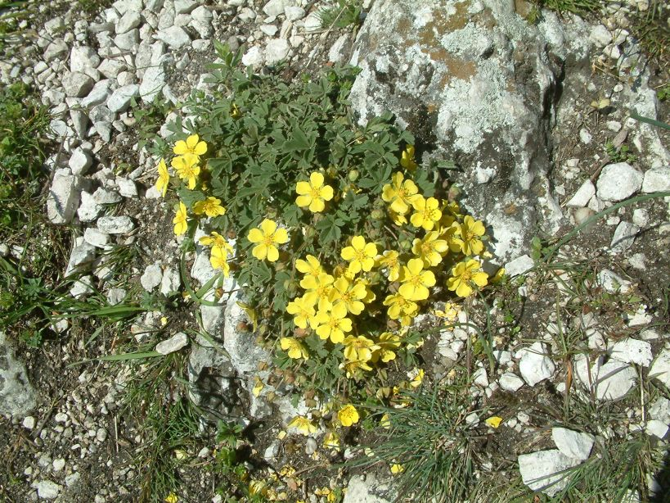
Species richness is limited by
Species pool
Environmental filter
Biotic filter (i.e. ability not to be competitively excluded)
Even more complicated, some species need others

Slide 53
Why are communities species poor?
Species pool limitation (e.g. islands)
Harsh environment - few species are able to survive (e.g. sand dunes)
Highly productive environment - many species are competitively excluded from the community

Slide 54
Why are species being lost from communities?
Increased landscape fragmentation and resulting loss of diaspore input (sink populations or transient populations)
Increased harshness of environment (e.g. increased SO₂ as a consequence of acid rain)
Increased nutrient input (eutrophication) or decreased disturbance (abandonment)

Slide 55
In biodiversity experiments
Species poor communities correspond only to real communities which are poor because of species pool limitation
Species composition is random, all species are equally likely to be lost

Slide 56
Red list categories of meadow species in Czechia and Ellenberg’s indication values (s.e. and confidence intervals)
The most endangered meadow species are those with the lowest N indicator value
The species lost are NOT a random selection of species
Lepš, J. (2004). What do the biodiversity experiments tell us about consequences of plant species loss in the real world?. Basic and applied Ecology, 5(6), 529-534.

Slide 57
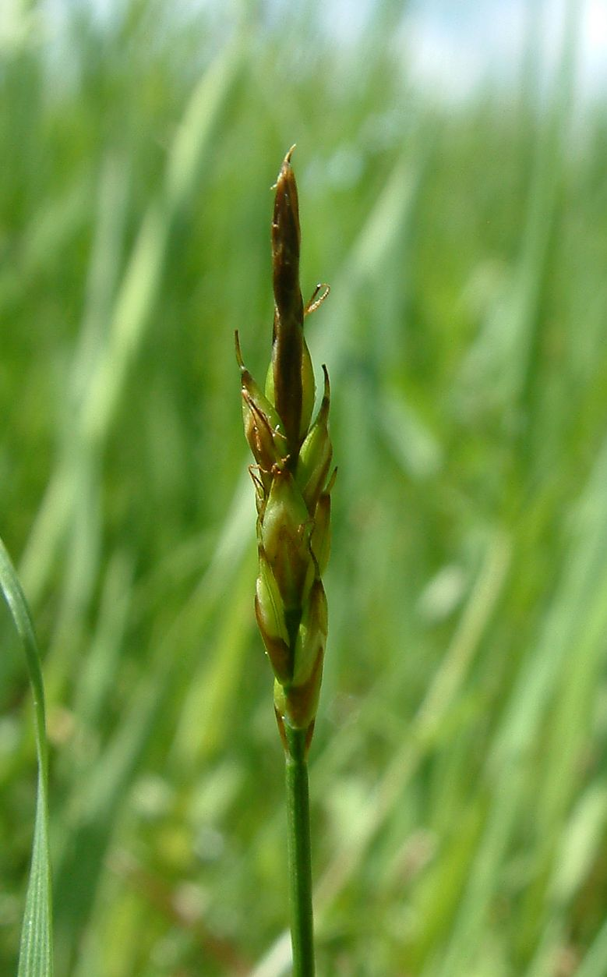
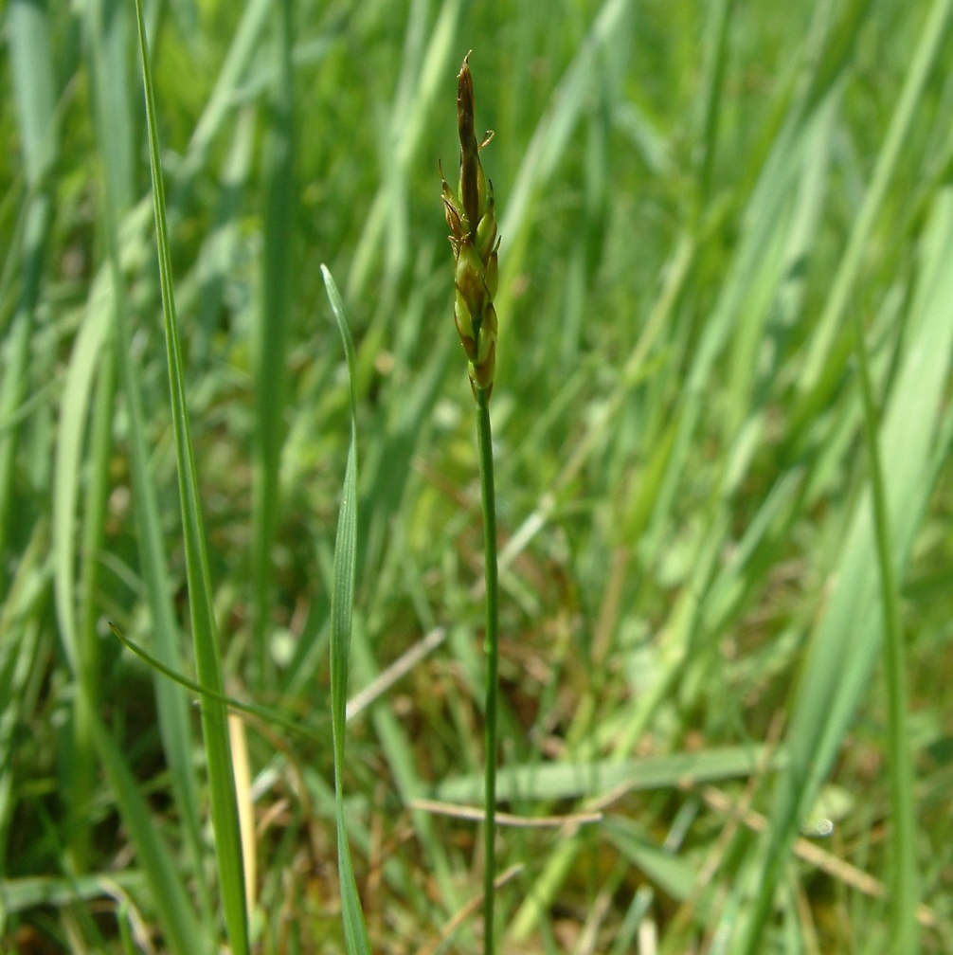
Carex pulicaris
less than 10 cm tall
competitively excluded by any nutrient increase

Slide 58
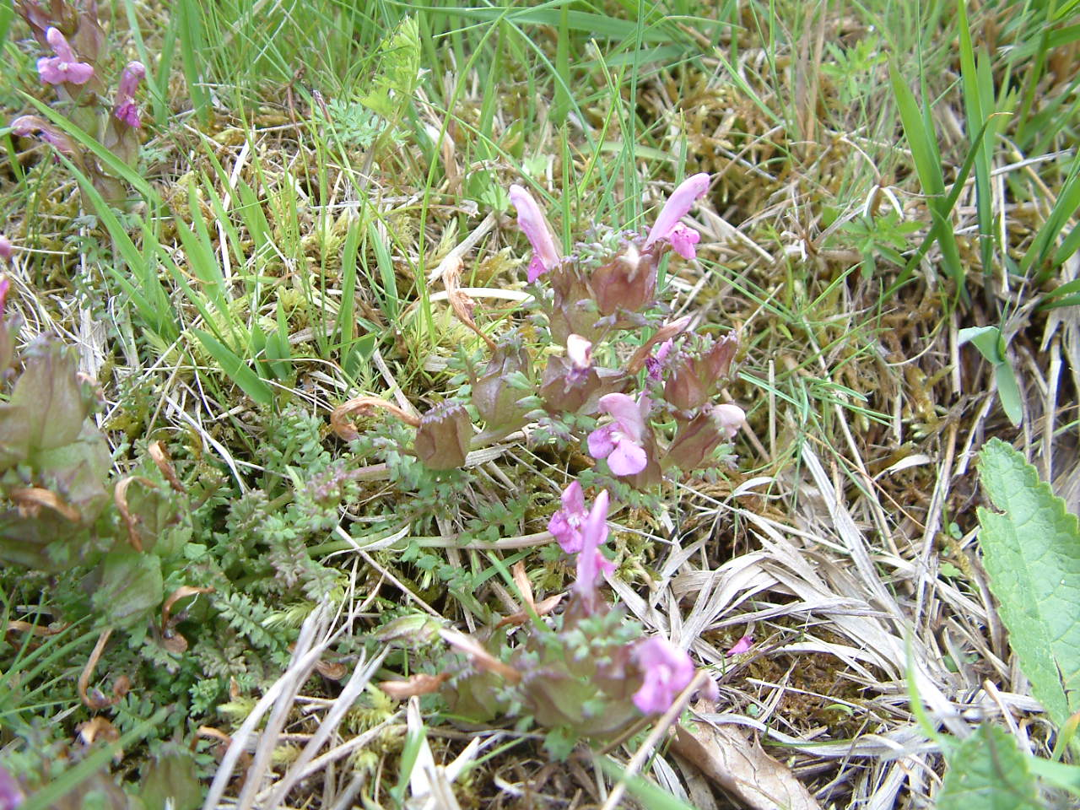
Pedicularis sylvatica

Slide 59
In nature
Species richness change is nearly always connected with the change in species (and functional trait) composition (usually a consequence of change of environment)

Slide 60
Two basic “mechanisms” in biodiversity experiment
Selection (Sampling, Chance) effect
Complementarity (includes usually facilitation)

Slide 61
Biodiversity experiments
Sampling effect – is this real biodiversity effect?
Richness =1
A
B
C
D
Richness = 2
AB
BC
CD
AD
Richness = 3
ABD
ABC
BCD
ACD
Richness = 4
ABCD
ABCD
ABCD
ABCD
A –Arabidopsis (10 cm) B – Bellis (15 cm)
C – Chenopodium (100 cm) D – Draba – (10 cm)

Slide 62
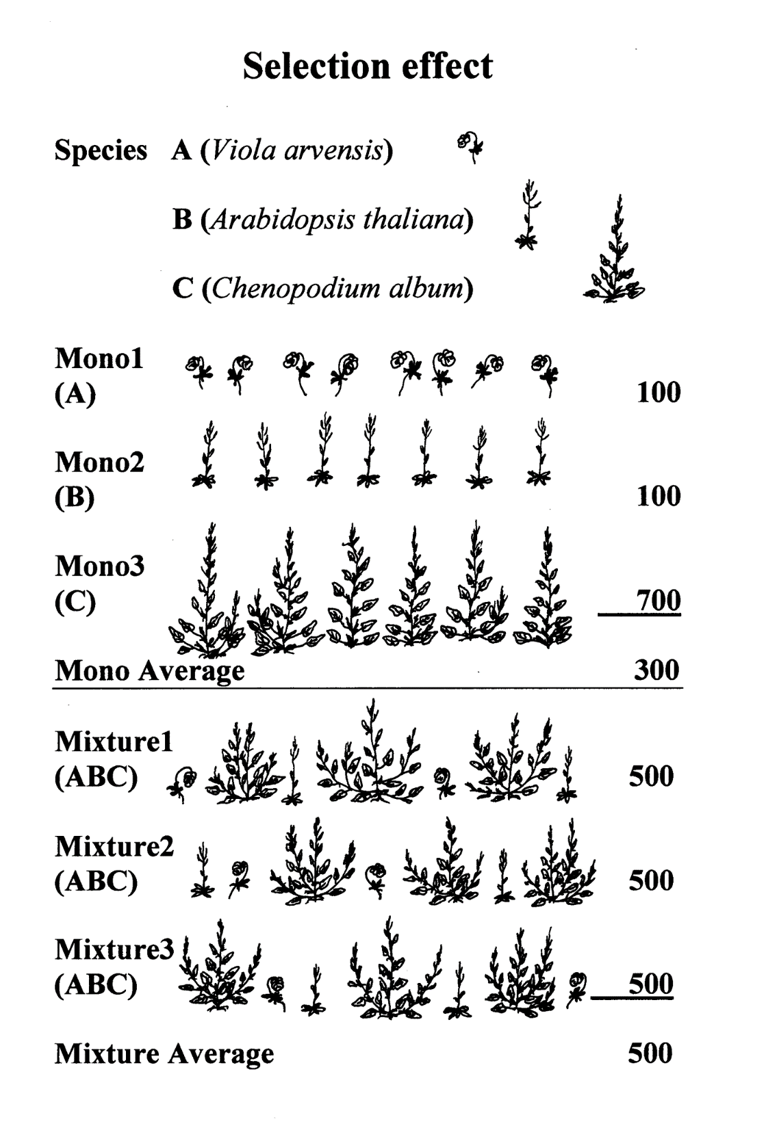
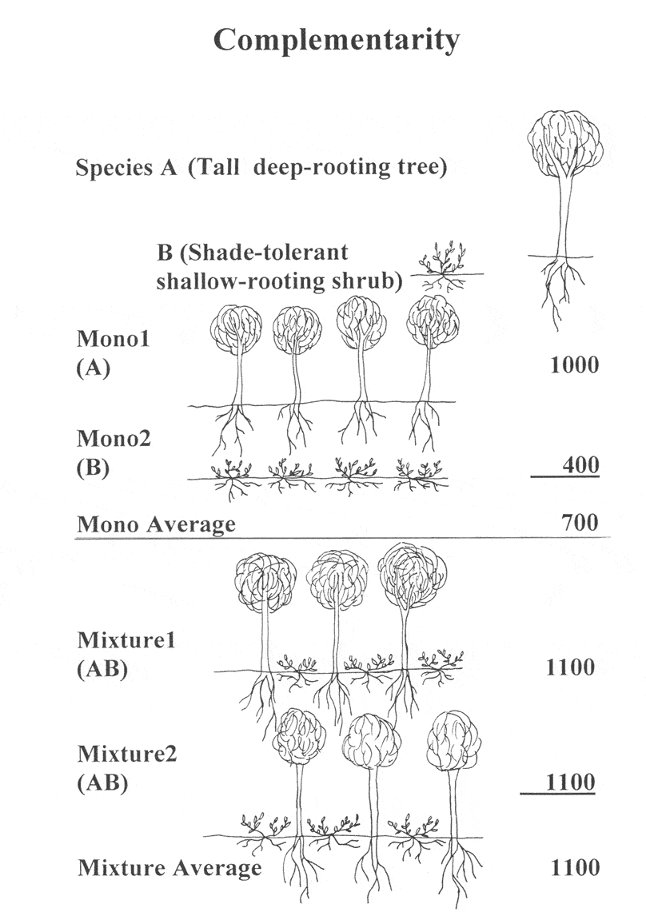

Slide 63
Problem - realisms
Some species and environment combinations are extremely unlikely (e.g. monoculture of Arabidopsis thaliana in soil fertility where Chenopodium album is able to grow). More unrealistic combinations are at low richness level (Weeding necessary!)
{What is the statistical universe? All the possible species combinations?}
Is sampling effect real “biodiversity effect” or just experimental design artefact?

Slide 64
Graphical presentation of results
How the graphical presentastion of the results can make a „correct impression“

Slide 65
Špačková & Lepš 2001 Ecol. Letters.
Pot experiment, mixtures of 1 to 6 species
The same results can be presented in very different way

Slide 66
How the results of the experiments are usually presented – s.e.m
Mean and standard error - the average biomass increases with number of species, there is some saturation

Slide 67
Showing the full variability of the data
Box and whisker plot - median increases, but the best monocultures are as good as the best mixtures - the lower mean for low species richness is caused by unsuccessful species combinations

Slide 68
Holcus lanatus was the most productive species in the mixture
For mixtures containing Holcus lanatus (+) the biomass slightly decreases with richness, for those missing H.l., biomass increases (according whether the second most productive species is present)

Slide 69
Transgressive overyielding
OI=Y/MAX(M_{i})
i.e., is the mixture better (more productive) than the best of its constituent monocultures?
If yes, it cannot be a sampling effect.
Non-transgressive overyielding (is the mixture better than the average of yields of constituent species) can be partitioned (Hector and Loreau 2001)
complementarity
selection
where ΔRY_{i} is the deviation from expected relative yield of species i in the mixture, calculated as the difference between observed and expected relative yields, M is monoculture yield.

Slide 70
Vast majority of biodiversity effect studies, claiming to demonstrate complementarity demonstrated it by the statistical method of Hector Loreau, not by demonstrating real resource partitioning - aware of the results of meta-analyses

Slide 71
PROBLEM
Naive expectations for the calculation of biodiversity effects

Slide 72
The BEF experiments use naive expectations (null models), and consequently, what is their biodiversity effect is rather trivial.
The most naive – yield is linearly dependent on the sowing density
See also: Stachova, T., Fibich, P., & Lepš, J. (2012). Plant density affects measures of biodiversity effects. Journal of Plant Ecology, 6(1), 1-11.

Slide 73
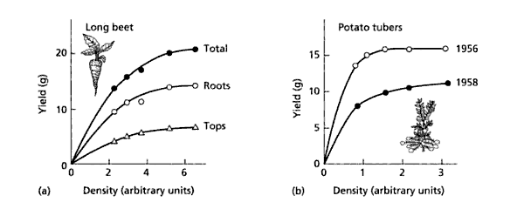
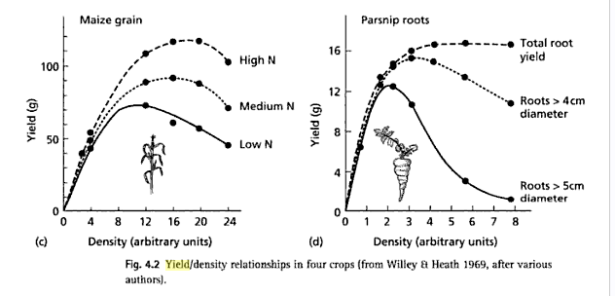
Law of constant final yield (but in some cases, the yied could even decrease with sowing density)

Slide 74
Monocultures | sowing density/m² | Productivity [g/m²]
Daisies | 50 | 50
Sunflowers | 50 | 1000
Mixtures |  |  | Expected yield
Daisies | 25 | 5 | 25
Sunflowers | 25 | 950 | 500
Total | 50 | 955 | 525
 |  | Biodiversity effect
 |  | Real - Expected | 955-525=430

Slide 75
PROBLEM
The explanatory variable is the number of sown species, not the realized species richness – again – correct from statistical point of view – only sown species richness is directly manipulated, but in nature (and observational studies), we measure the realized species richness.

Slide 76
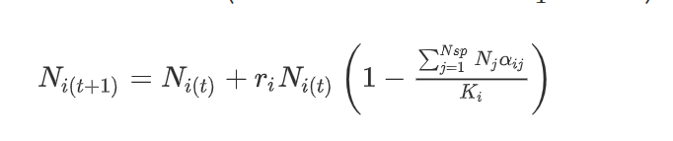
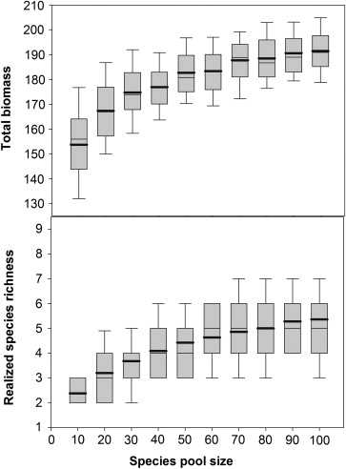
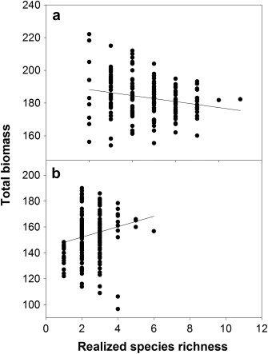
Modelling study - Lotka - Volterra model
(realized species richness – survivors after competitive exclusion – modification of L-V: difference eq., negative values mean extinction)
Within fixed species pool
Species pool = 60
Species pool = 10
Stachová, T., & Lepš, J. (2010). Species pool size and realized species richness affect productivity differently: A modeling study. Acta Oecologica, 36(6), 578-586.

Slide 77
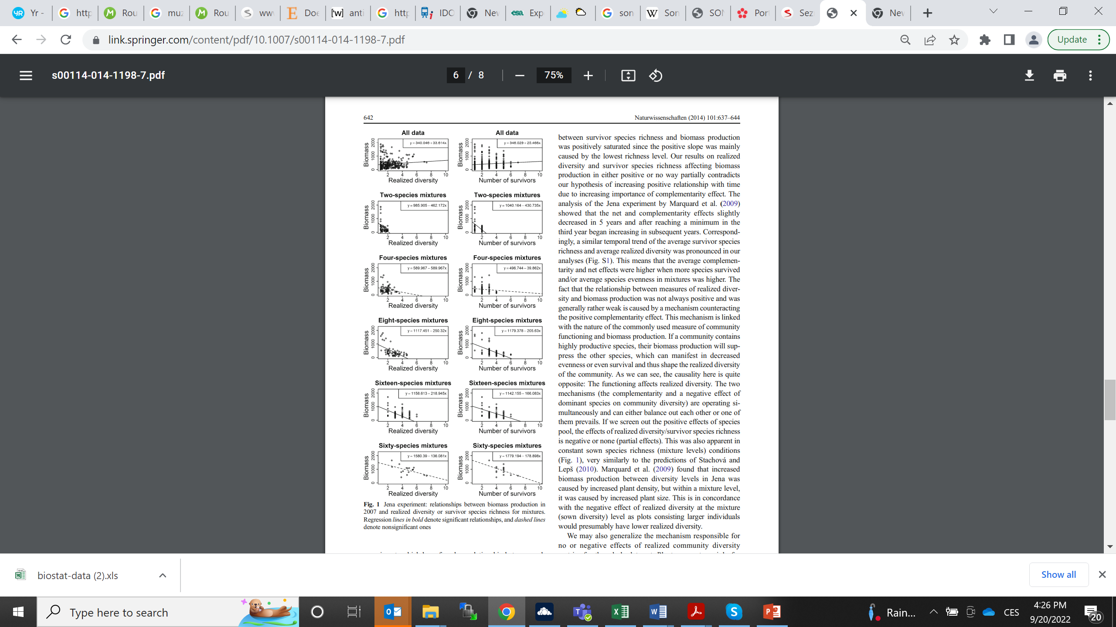
Jena experiment results
Rychtecká, T., Lanta, V., Weiterová, I., & Lepš, J. (2014). Sown species richness and realized diversity can influence functioning of plant communities differently. Naturwissenschaften, 101(8), 637-644.
Analyses based on 0.2 x 0.5 m subplots
Realized diversity = 1/Simpson dominance
General pattern:
Overal relationship always positive
Within sowing richness always negative

Slide 78
The way how the (realized) richness gradient originates matters
(concordantly by modelling and by results of Jena experiment)
Even for the case when we keep the environmental conditions fixed
If we create richness gradient by sowing mixtures of different richness, positive diversity – productivity richness is expected.
If we sow different mixtures of the same species richness and permit competitive exclusion, the realized diversity is often negatively correlated with productivity (the presence of highly productive species increases total biomass, but also speeds the competitive exclusion)

Slide 79
Problem for nature conservation argument: If we accept that high productivity is the goal function and what is important is the number of available species (i.e. the species pool)
Then the alien (and sometimes also dangerous invasive weeds) are as useful for functioning as the native species
And thus, invasions are in fact enrichment of species richness

Slide 80
New species are gained (i.e. the species pool is increased)
Invasion of alien species, e.g.
Reynoutria japonica & sachalinensis
Heracleum mantegazzianum
Impatiens glandulifera
Remember: the two classic biodiversity experiments (Ecotron, Cedar creeck) used alien species (even difficult weeds)

Slide 81
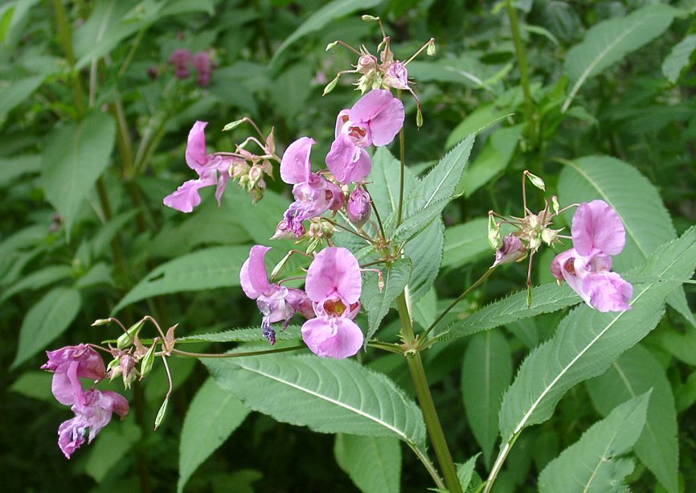
and those species are highly productive….indeed, the invaded communities are often highly productive (even thought the realized diversity is low)

Slide 82
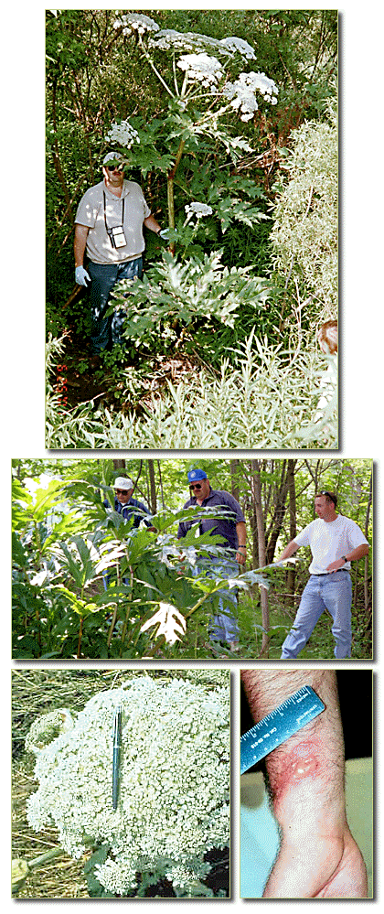
Exactly as predicted by biodiversity experiments
Increasing the species pool by the newly arriving species leads to highly productive communities - is this desirable?
http://el.erdc.usace.army.mil/pmis/plants/html/heracle0.html

Slide 83
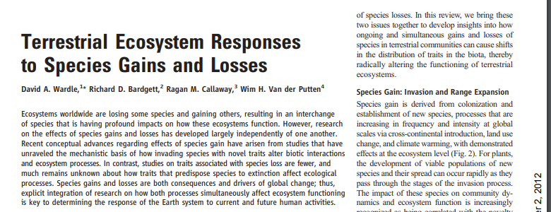
Should the number of species in the species pool positively affect the functioning, then invasions are species gains and have a positive effect – it is not so
Science 2011

Slide 84
Long term CLUE experiment
Sown mixtures, no weeding – High Div, Low Div, Natural Colonization
After ten years
Biomass decreases HD>LD>NC (according to „species pool“)
Realized species richness NC>HD>LD
Biomass correlated with „species pool“, but not with actual species richness
Lepŝ, J., Doležal, J., Bezemer, T. M., Brown, V. K., Hedlund, K., Igual Arroyo, M., ... & Rodríguez Barrueco, C. (2007). Long‐term effectiveness of sowing high and low diversity seed mixtures to enhance plant community development on ex‐arable fields. Applied Vegetation Science, 10(1), 97-110.

Slide 85
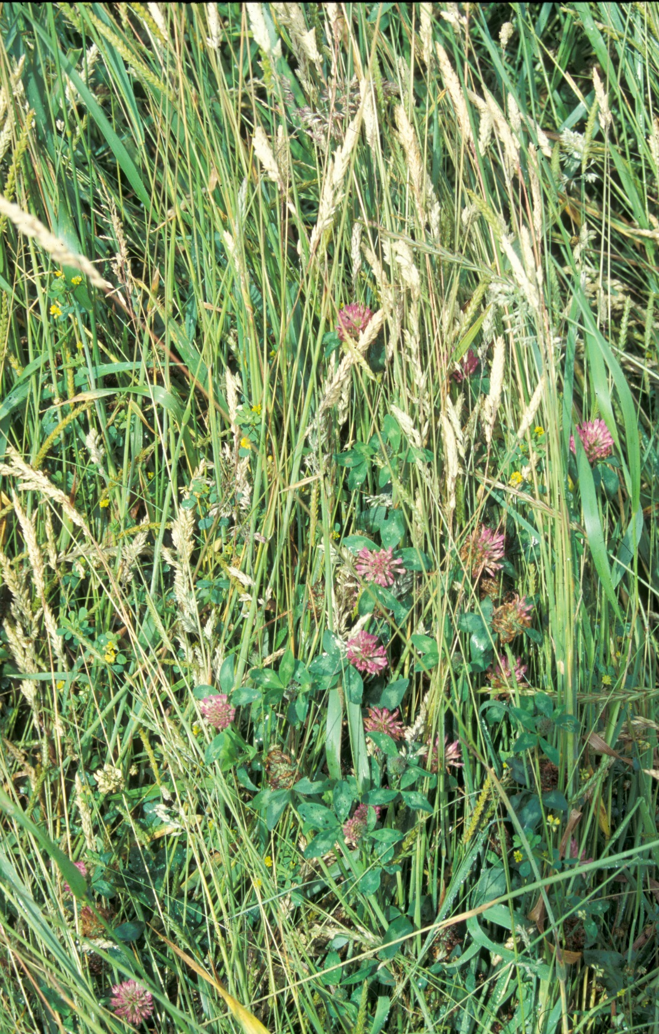

HD
LD

Slide 86
Some problems
In biodiversity experiments, it is the introduced species richness (e.g. sown species richness) that is usually reported – in European grasslands, the richness often decreases with productivity as a consequence of competitive exclusion

Slide 87
Species richness of a community on ex-arable land (averaged over five countries, CZ, UK, NL, SE, ES. Leps et al. 2007 AVS)
High sown diversity
Low s.d.
NC

Slide 88
Biomass is still highest in HD
HD
LD
NC

Slide 89
Sowing the highest species diversity
Assures the highest productivity, even after ten years
But hinders further colonization, leading to the low species diversity in the High Sown Diversity plots

Slide 90
Species identity is more important than the number of species lost
But each species loss means loss of some traits that are unique for that species and (if repeated many times) restriction of the ecosystem functioning

Slide 91
Realistic scenario – the least abundant species are lost
Removal experiment (Aleš Lisner, in Ohrazení)
Baseline data (2016, before removal) used to decide, which least abundant species will be removed
Remaining species in plots are those with highest biomass in 2016
Richness gradient 1, 3, 6, 12 species and two controls (intact, and disturbed) – in 5 replication in block design

Slide 93
Molinia

Slide 94
Molinia, Festuca, Cirsium, Danthonia, Betonica, Holcus

Slide 96

Remaining species

Slide 97
Ohrazení experiment
Stability (of total biomass)
Characterized by Coefficient of Variation
CV = s.d. / mean
s.d. and mean calculated for individual plots over time
(years 2017 – 2022)

Slide 98
Error bars are confidence intervals
The monocultures are less stable, but three species mixtures are enough to stabilize the total biomass

Slide 99


Slide 100
BEF experiments
Reveal many mechanisms behind functioning of ecological communities
But
Their relationship to species loss in real communities is vague
It would be dangerous to use them as a conservation argument

Slide 101

Thank you for your attention

Slide 102
Realized species richness vs. speciess pool
In biodiversity experiments, the number of sown species is the independent variable (species pool)
Simulations show (Stachová & Lepš 2010) that there is strong relationship of productivity with the size of Species pool, relationship with actual (realized) richness less clear

Slide 103
Diversity begets stability -reminder
The Shannon formula for diversity was first used in ecology as an index of stability
S= -Σp_{i} log p_{i}
MacArthur (1955): Fluctuations of animal populations and a measure of community stability. – Ecology 36: 533-536.

Slide 104

What is ecological stability?
* being in “equilibrium”?
* Constancy (variability)
* resilience
* resistance
*persistence

Slide 105

Comparison of stability of young and old fallow (as a response to an extreme drought):
the response is determined by the prevailing life history

Slide 106


Slide 107
Stabilizing effect of diversity
(A)synchrony of temporal fluctuations

Slide 108

Communities with fast and pronounced response to weather fluctuation will have higher temporal variability
Temporal variability: measured by coefficient of variation
CV = s.d./mean

Slide 109



Slide 110
The coefficient of variation of biomass of community composed of k species is then

Slide 111
The effect is strengthened by negative (temporal) correlation between species, and weakened by positive correlation between species. However, CV_{community} never exceeds CV_{species}, and reaches the same value only when the species variation is perfectly positively correlated.
Deviation from perfect correlation is called asynchrony, and stabilizes the community biomass fluctuation

Slide 112


Other measures of asynchrony were also suggested (here Gross et al. 2014) – better is weighted form

Slide 113
Suggested merasure φ
Loreau and Mazancourt 2008
Doe not provide any possibility to compare with the null model of independence
In the case of of indepednence, its value decreases with number of species

Slide 114
(A)Synchrony caused by
Synchronization – concordant response to temporal changes in environment (probably mostly weather in individual years)
Asynchrony – discordant response to temporal changes in environment and / or competition

Slide 115
Term „asynchrony“ is used inconsistently
Some use it as any deviation from synchrony (so, everything is then asynchronous, because perfect synchrony does not exist)
Some just for the situation when the correlations are on average negative (or better, sums of covariances are negative) – perhaps, for this it is better to use compensatory dynamics

Slide 116
Compensatory dynamics caused by
– discordant response to temporal changes in environment (extremely unlikely, all plants love similar weather – in grassland warn and wet spring)
Competition – if the dominant is harmed by dry spring, less competitive plants can profit
Neglected role of enemis (pathogens)

Slide 117
Effect of Asynchrony/Compensatory dynamics depend on
Total number of species
Equitability - (species that form 0,01% of the community has negligible effect on the total biomass)
Whether the abundant and rare species fluctute in the same extend

Slide 118
Taylor’s power law (TPL)
var = a . mean^{b}
log(var) = log a + b .log(mean)
Both, var and mean are random variables, and after log transformation will have roughly the same “error” –> classical OLS underestimated the value of b

Slide 119
We use TPL for temporal variation, but the same basic rules apply for temporal and spatial variation
TPL was used to describe relationship of var and mean of the same species in various sites
TPL can be equally well used to describe mean and var of a set of species within a single community
[both can describe spatial and temporal variation]
Can be used for counts of individuals, but also for any other quantity – does not work for individuals, when the density is low ~ <1, would not work for 0 / 1 , i.e. presence absence data
Generally, there is no theory behind, log – log linearizes quite a lot of various relationships

Slide 120
The classics
If data have Poisson distribution (valid just for the counts), then var = mean
P.d. assumes independence of individuals
Var/mean ratio as the spatial aggregation measure, and after multiplying by df as a test criterion (chi-square distribution), the same theoretically can be used for temporal variation (practically not used)

Slide 121
Poisson distribution
If two variables with Poisson are summed up, their distribution is again Poisson mean = mean1 + mean2, var = var1+var2
In this case, TPL holds, and b=1
Generally, never happens (would be the case, if the population is constant, large, and each individual has some constant probability to fall in the trap, and x is the number of trapped individuals)

Slide 122
Poisson distribution is extremely rare
In fact, in most cases, we have (both temporal and spatial) variability in data corresponding to contagious distributions (clumps of clumps)
Negative binomial, or Neyman distributions
In these cases, b > 1

Slide 123
If b=2
CV (s.d./mean) is independent of mean
var (log(x)) is independent of mean
– but var (log(x+1)) decreases with mean
If 1 < b < 2 (generally, vast majority of cases)
both CV and var (log(x)) decrease with the mean

Slide 124
The fact that b<2
Makes the portfolio effect uncertain (the very abundant species will have low CV).
If I have variability of individual units within a species, then b<2 means that the individual units are not perfectly synchronized. (Thanks to this, there is some asynchrony within population.) Portfolio effect works, if the units within a species are better synchronized (less asynchronous), than units among species.

Slide 125

Some species are regularly found below the line, i.e. are less variable:
life history strategies
Unfertilised control plots

Slide 126
Functional redundancy as insurance
The effect of specialised pathogens, herbivores etc. usually affects one or limited number of species only
Species diversity can then serve as insurance for ecosystem functioning

Slide 127
If we go back to the MacArthur 1955 paper, this is exactly the mechanisms he had suggested for stabilising effect of diversity.

