Slide 1
Interactions among organisms
(often presented as interactions among populations)

Slide 2
Classical “system“ of interaction
(effect of A on B and B on A)
Effect of A on B | Effect of B on A | relationship
- | - | Competition
- | + | Usually, A “eats” B (exploatation): Predation s.l. Parazitism s.l. (+parazitoids) (but there are also different + - relationship)
+ | + | Mutualism
0 | + | Commensalism
0 | - | Amensalism
0 | 0 | Neutralism (?)

Slide 3
As each classification, this one is also simplification
Individual organisms interact (interaction of populations is abstraction)
Interaction of individuals of the same species (intraspecific), of different species (interspecific)
In practice, it is used mostly for competition; intraspecific predation is canibalism, intraspecific mutualism is somehow expected and thus not studied separately (but see the parent offspring conflict)

Slide 4
Quite a few interactions do not completely fit this scheme
There are many + - interactions, where one organisms does not directly “feed” on the other one (e.g. epiphytes and climbers harm their hosts and usually are not subsumed under “parasitisim”); classification of interactions where one feed on the other is also more complicated
If competition is defined are common use of the same resource, then it does not include many - - interactions

Slide 5
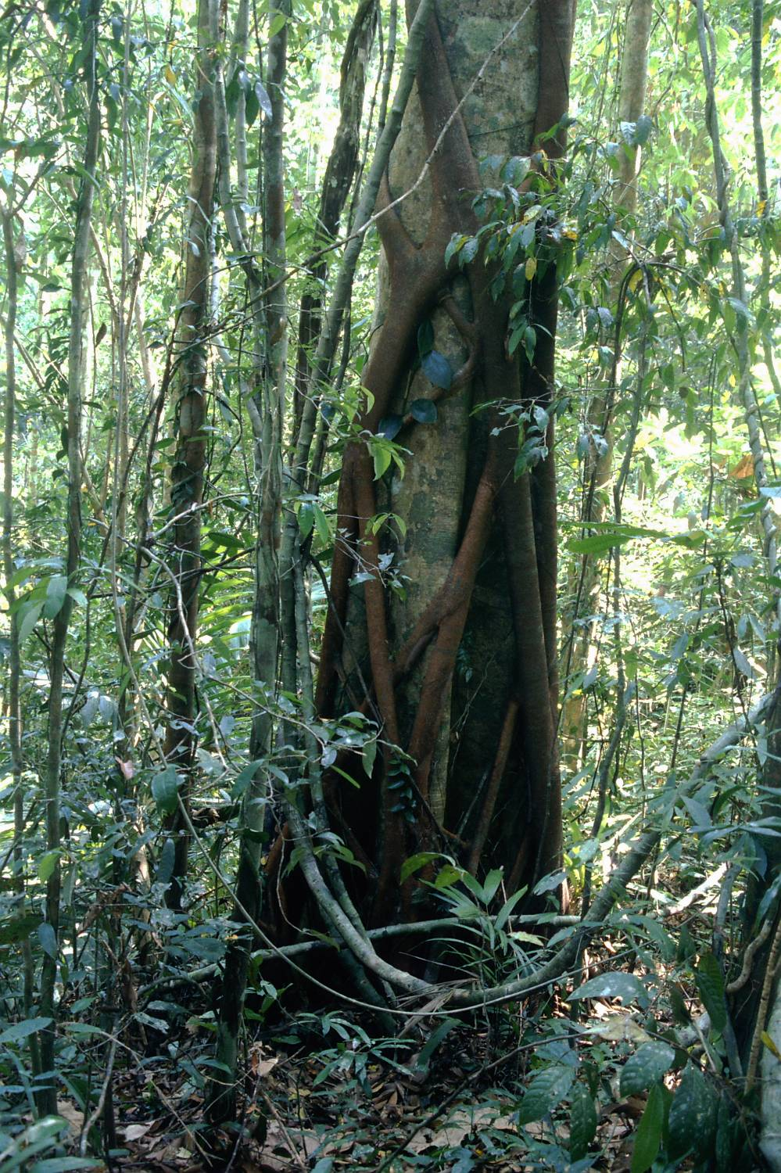
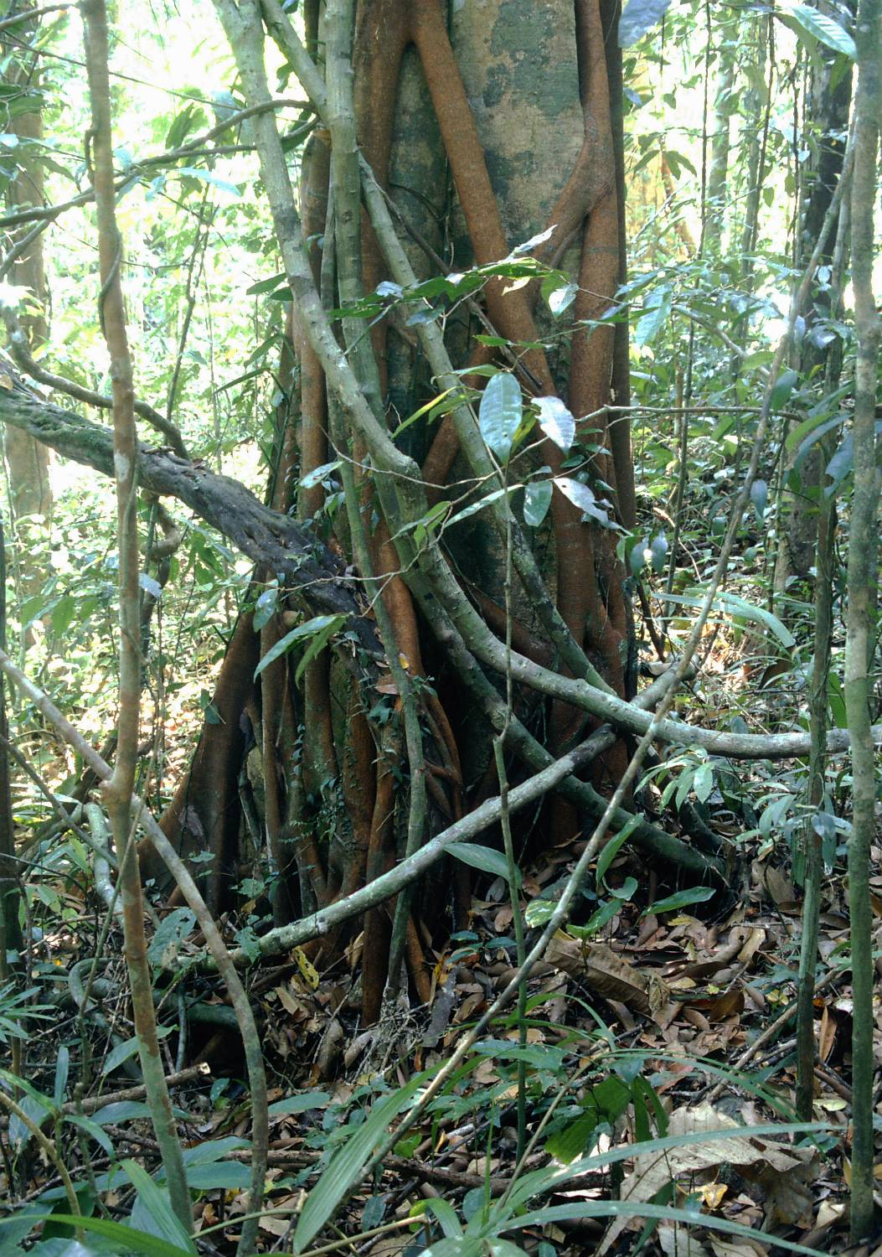
Stranglers –often Ficus

Slide 6
It is not possible to say unequivocally whether the other organisms is beneficial or harmful to me
Shading by a taller individual might (based on the immediate situation) mean decrease of PhAR and the of photosynthesis (competition), or protection against overheating and desiccation (facilitation)
The effect of seed predators need not be so negative, if they also disperse the seeds (squirrels)

Slide 7
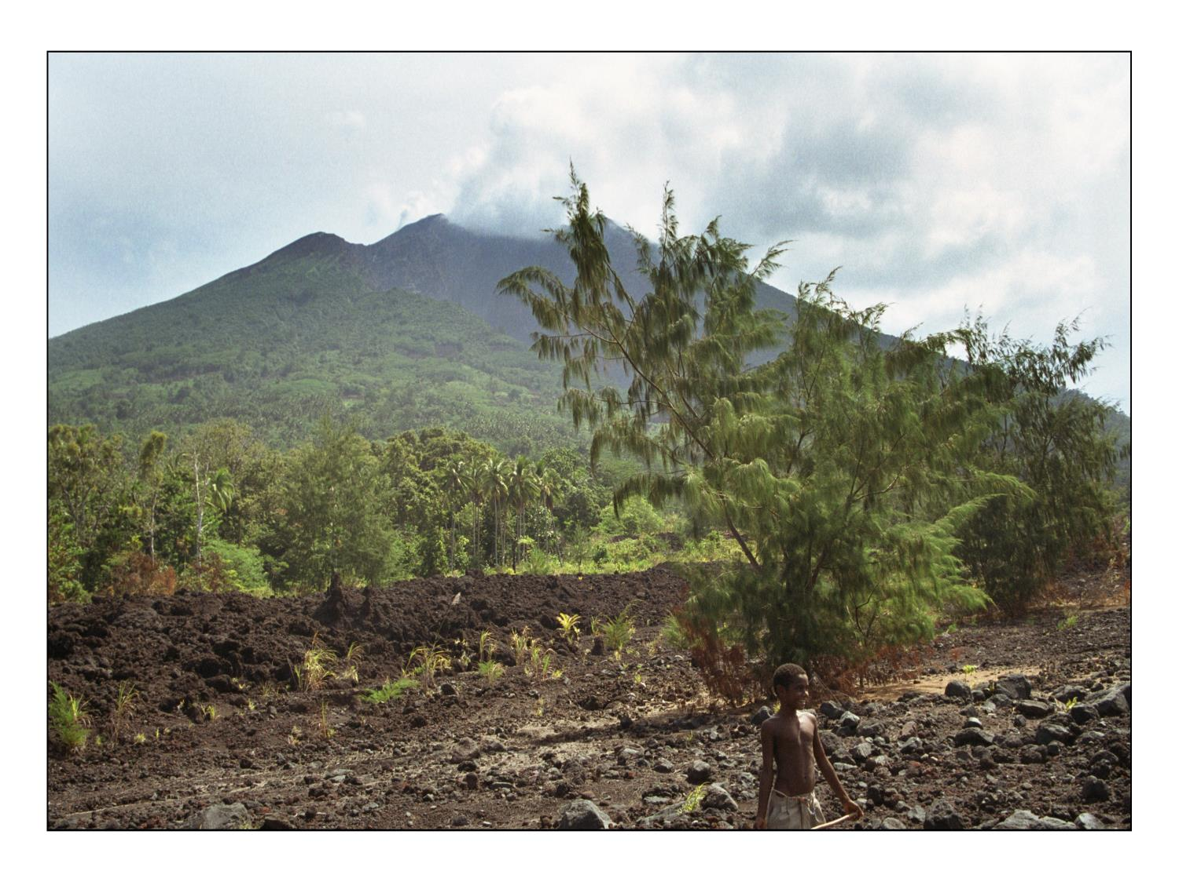

Slide 8
In nature, everything is more complicated than in textbooks
Interactions change in space and time (hemiparasitic plant is belowground parasite, but aboveground it is classical competition for light with the host).
Liana – host tree is typical + (liana profits) - (host suffers), but in the crown, we see typical competition for light (host also shades the liana) etc.

Slide 9
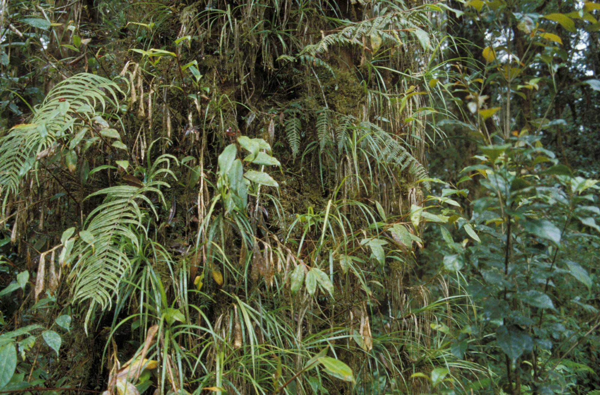
Three trunk in cloud forest in PNG mountains – mosses, ferns Zingiberaceae – take advantage of the host tree, but how much harm it?

Slide 10
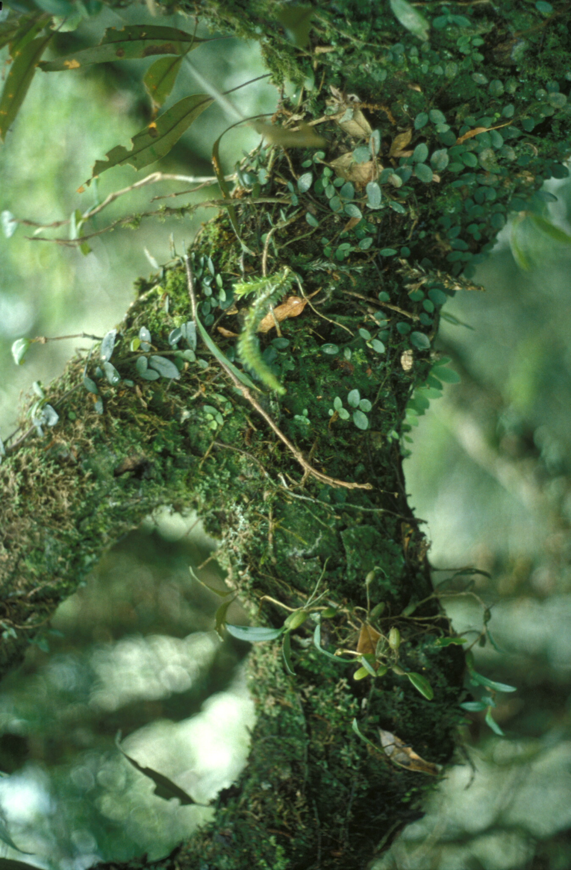
Epiphytes in cloud forest

Slide 11
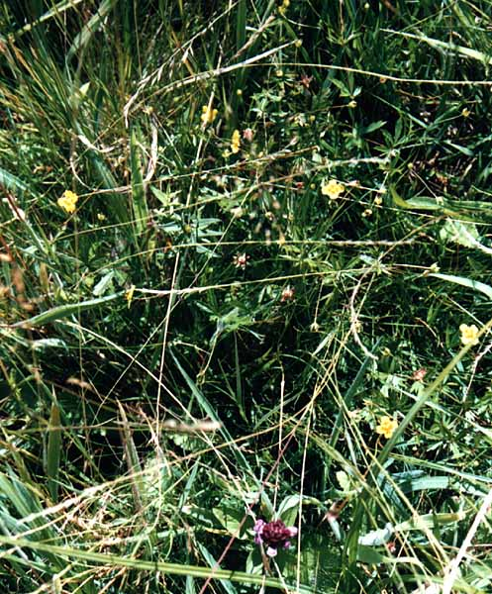
Competition

Slide 12
How to define competition?
Grace (1990): “The variety of possible definitions of competition were discussed and it is safe to say that there is no universally accepted definition.”
Possibilities:
By the effect: - - interaction (very broad definition)
By the mechanism: e.g.. Grime (for plants): The tendency of neighbouring plants to use the same resources (very narrow definition) – he speaks even about the tendency to use the same molecule
Other definition somewhere in between

Slide 13
Individuals compete – competition of populations is our abstraction
Intraspecific competition (individuals of the same species) interspecific competition (individuals of different species)
Mechanisms are very similar, but: for interspecific competition, differences between individuals might decrease the competition strength

Slide 14
Intraspecific
Individuals of my species use the same resources as me – competition. But I (sometimes) need individuals of my own species (e.g. for reproduction, for common hunting) – mechanisms to reduce the intraspecific competition evolved
Parent offspring conflict – evolutionary dilemma: how long should I support my offspring (they bear [half of] my genes, helping increases my own fitness), or should I suppress (deter) them, to prevent competition with me - it decreases my ability to produce more offsprings
Particularly in plants (resp. Modular organisms) – also competition among modules within an individual (among ramets within a genet)

Slide 15
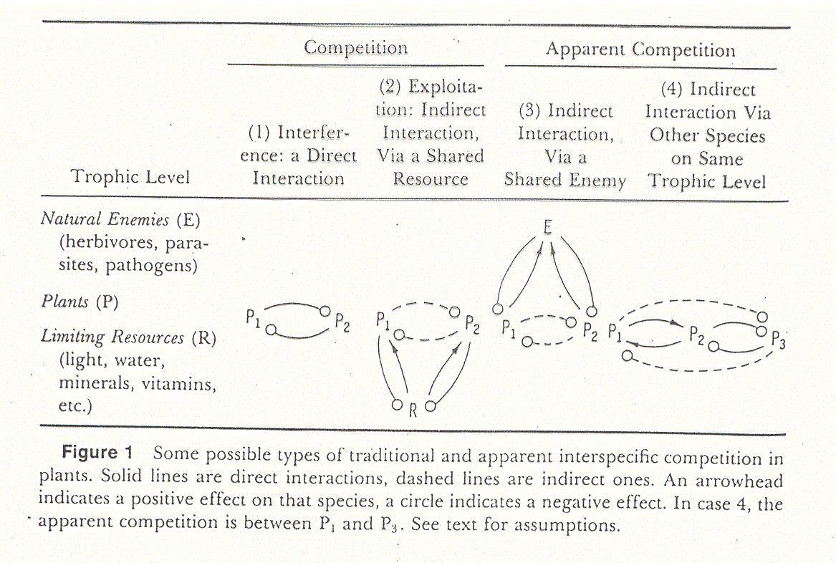
Interference and exploitation competition, apparent competition
Obr. Connell
From Goldberg

Slide 16
Interferrence competition
Protect your resources, do not allow the competitors to access them
  Direct aggression (typically animals) –chasing the competitors (both intra- and interspecific)
  Dead competitor is the best competitor – kill, deter, do not allow competitor to grow close to you (plants)

Slide 17
How can plants harm the competitors
And protect in this way their resources

Slide 18
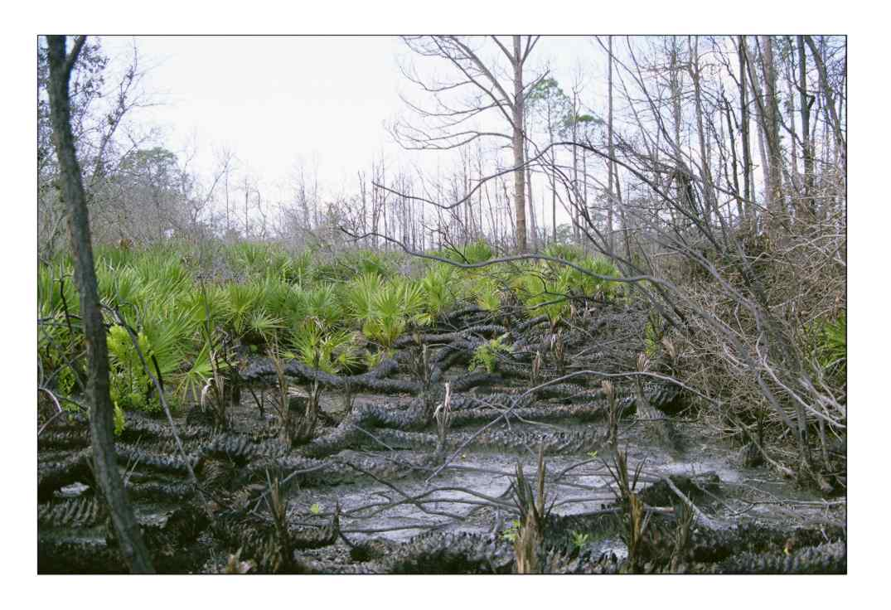
Negative effects mediated by fire (strategy: No problem if my goat dies, if the neighbours’ cow will die also )
Palm Serenoa repens

Slide 19
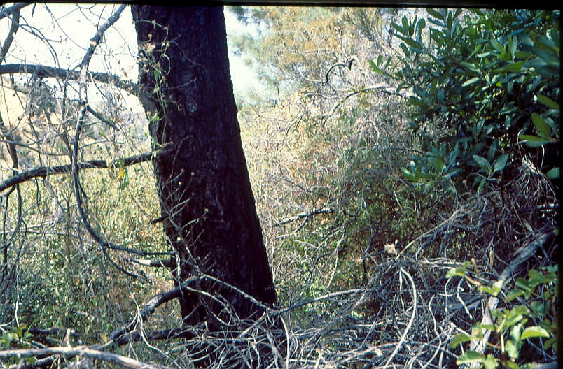
Pinus sabiniana

Slide 20
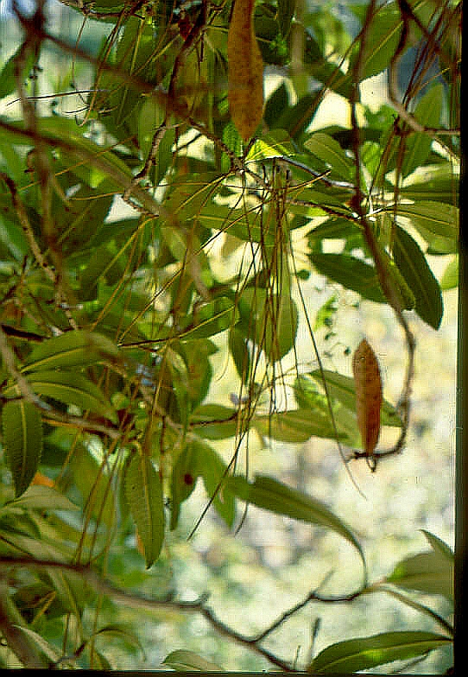

Slide 21
Allelopathy
Production (or leaching from dead biomass) of compounds affecting [mostly negatively] other organisms
Most often studied in plants, reported also in fungi, algae, cyanobacteria, corals
For plants, most often effect reducing germination (best competitor is the one that had not germinated) – sometimes even the effect on my own species (and thus probably on my progeny)

Slide 22
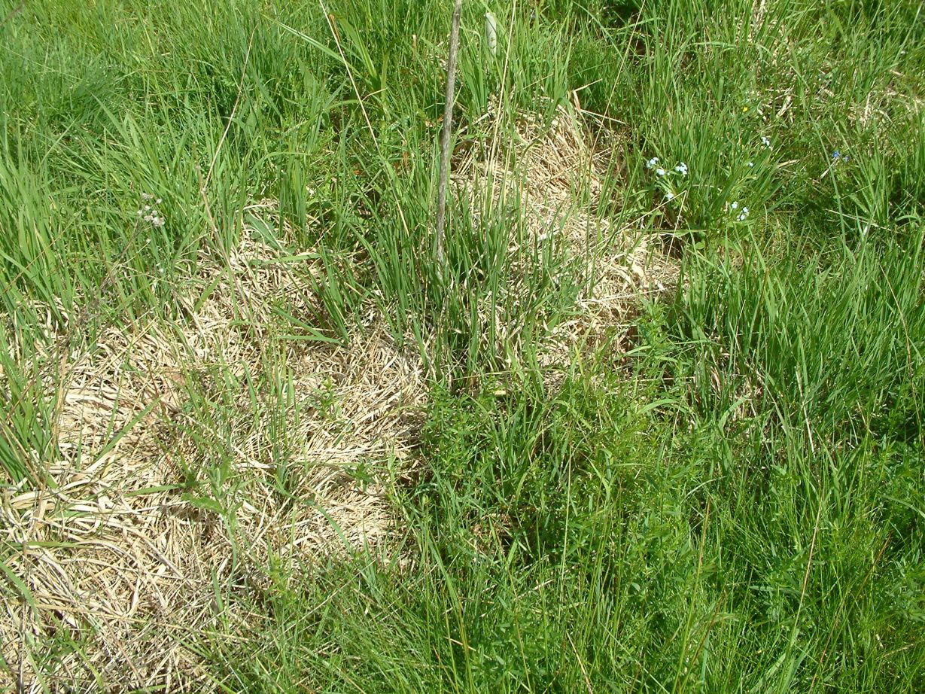
Molinia caerulea produces slowly decomposing litter, which harms more other species (Molinia is able to grow through it due to resources in basal internodia)

Slide 23
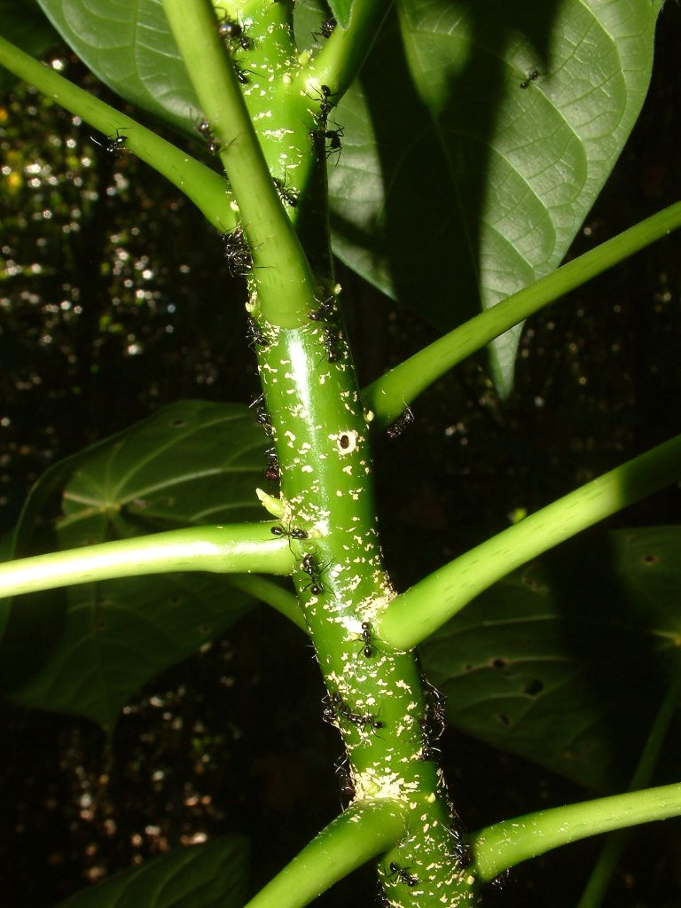
Domatia for ants – ants not only defend agains herbivors, but also are reported to be able to harm competitors (by their formic acid)

Slide 24
Exploatation competition
Direct contact is not needed
The competitor is affected only via the decreased level of the resource
Resource competition

Slide 25
Resource competition
For competition to occur, the resource must be limiting (i.e. lack of it decreases the fitness), must be available in limited supply and must be used by both the competing organisms

Slide 26
Competitive effect is composed of two processes
Decrease of the resource level for the competitor
Negative effect of the decreased level on fitness

Slide 27
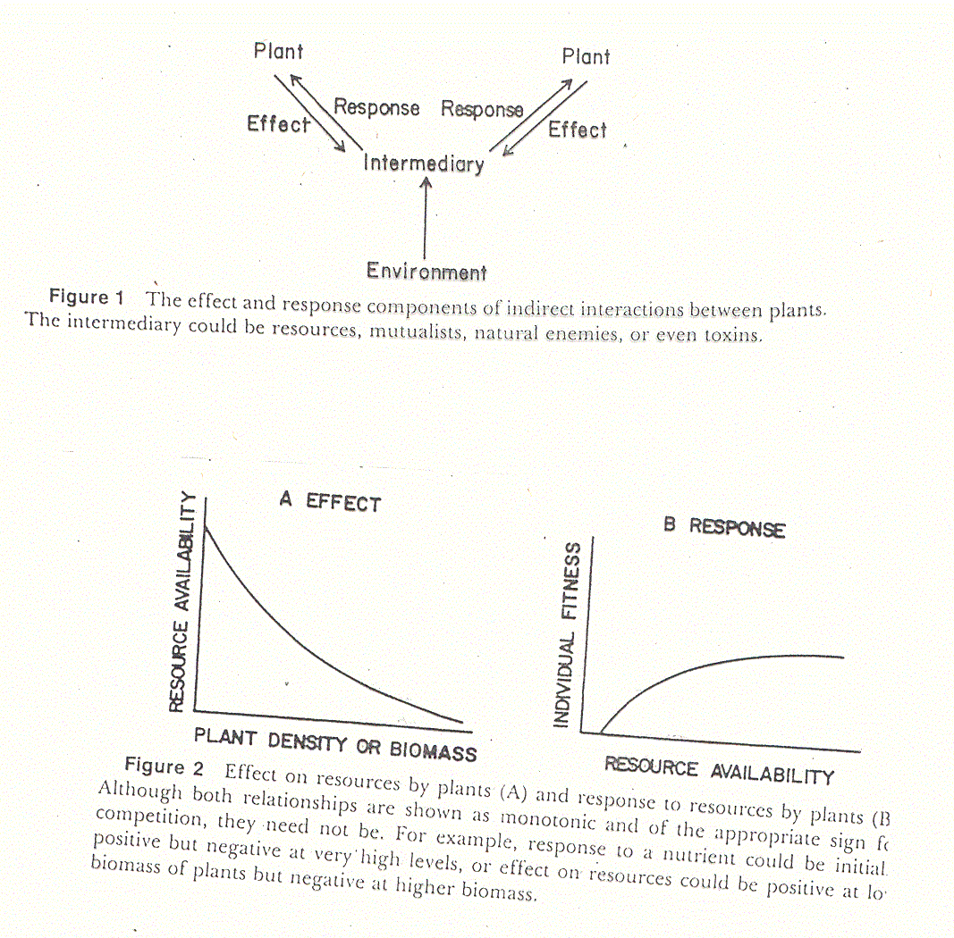
Components of resource competition (Goldberg)

Slide 28
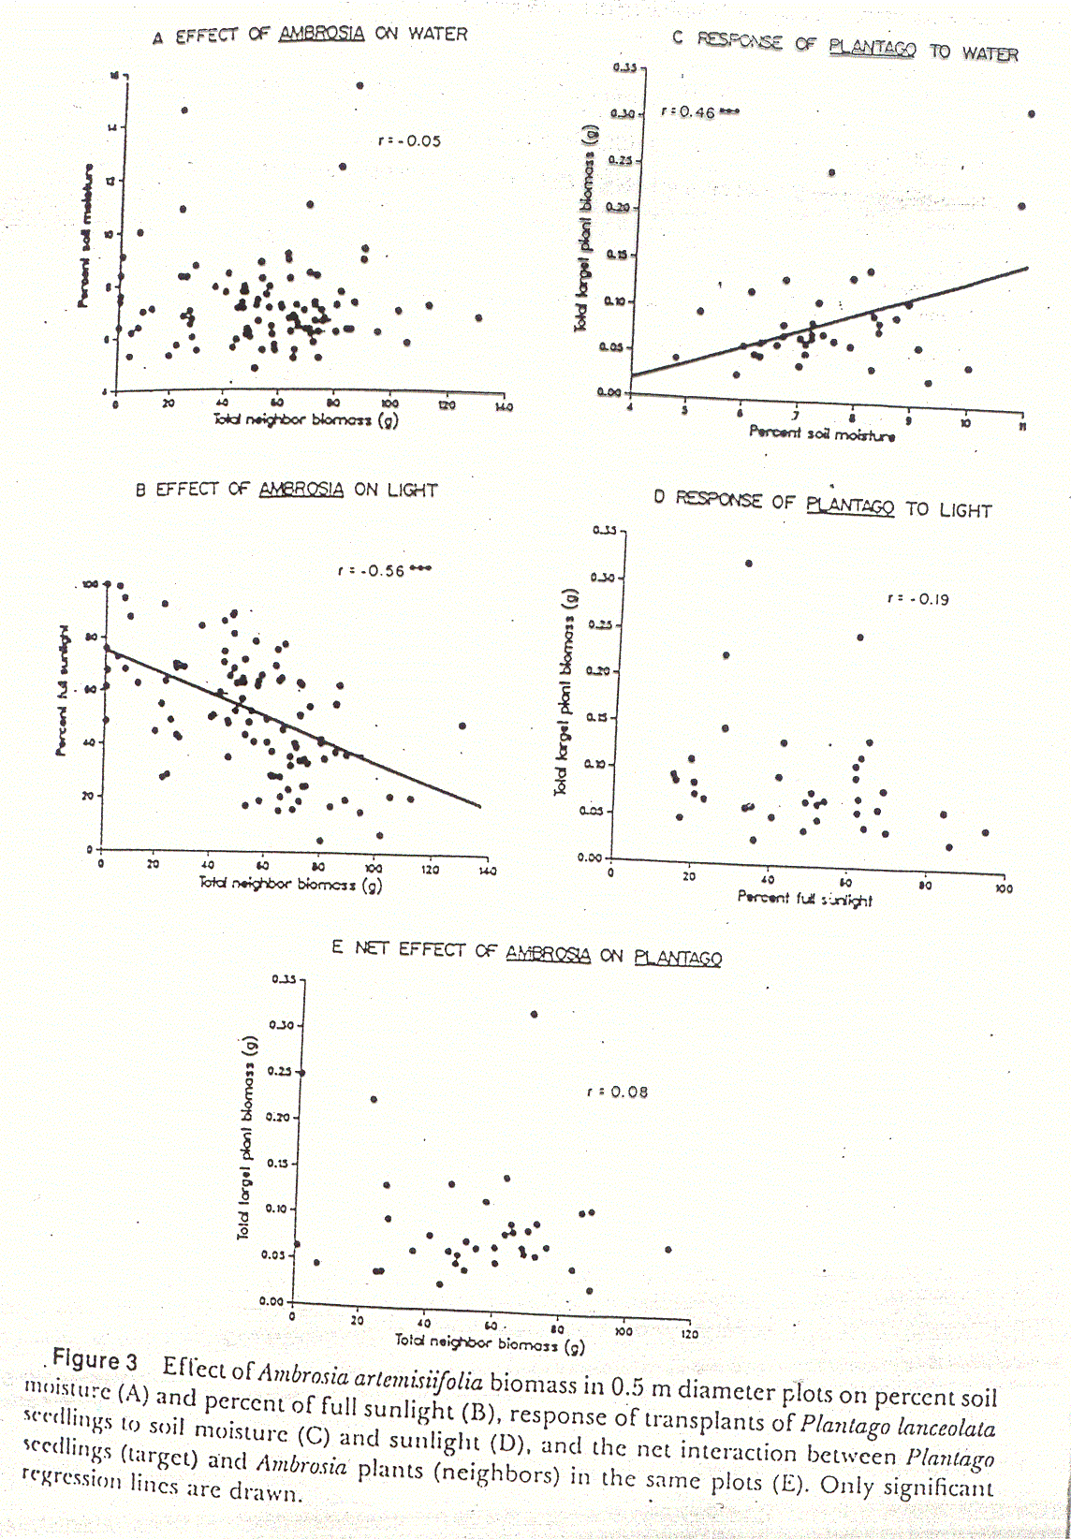
For competition to occur, both processes must operate simultaneously.

Slide 29
Plants affect both, the resources and the (non-resource) conditions (shade of tree decreases PhAR, but might also protect from overheating)
Final effect need not be necessarily negative.
Facilitation (more frequents under stress conditions)
[Seedling growing in a “gap” – advantage in wet years, but might be fatal in the case of drought.]
Ontogenetic shifts

Slide 30
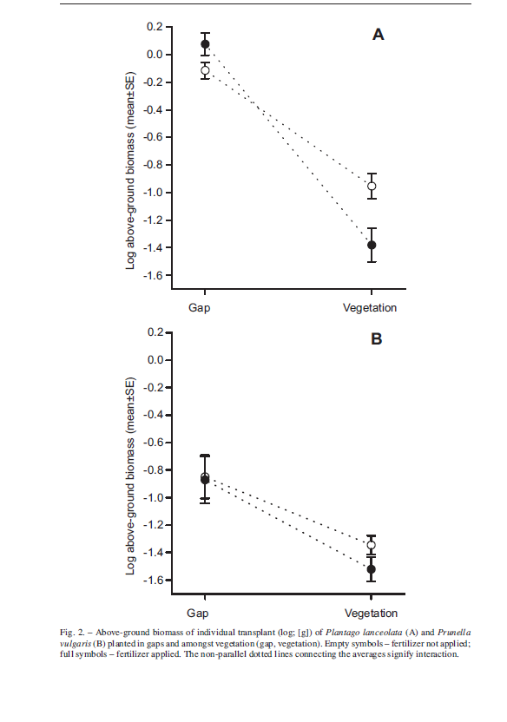
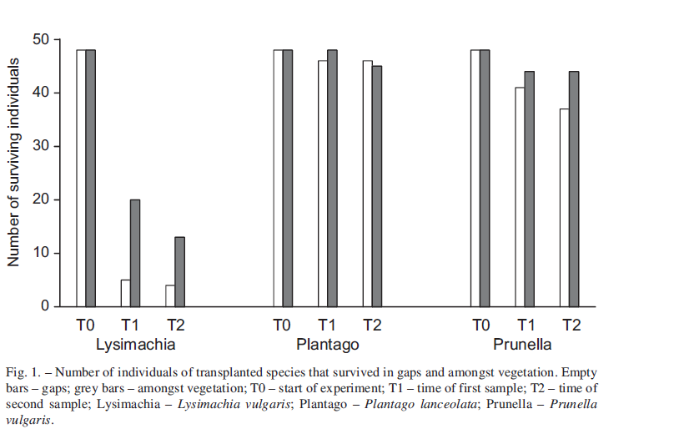
Kelemen et al. 2015. Preslia: The survival of seedlings is better in vegetation than in gaps, later on, the individuals grow better in gaps than in vegetation.

Slide 31
Consumer – resource dynamics
Tilman’s model of competition
For a single population: there is a constant Supply of the resource, and the resource is used in a rate that is proportionally decreased to the Level R
R= S-QN; S-supply, N- population size (better density) i.e. the reduction of Supply is dependent on the immediate size of the population (parameter Q determines the decrease of the resource immediate availability by given population. With N being number of individuals, then Q is decrease of supply rate by one individual).

Slide 32

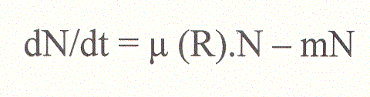
Population growth described by
In fact exponential growth, just instead of growth rate r we have μ(R) – i.e. the growth rate is function of Resource availability }which is function of population size and Supply rate R=S-QN
Mortality – is constant, independent of the resource (according to the model, hunger will not increase your mortality

Slide 33
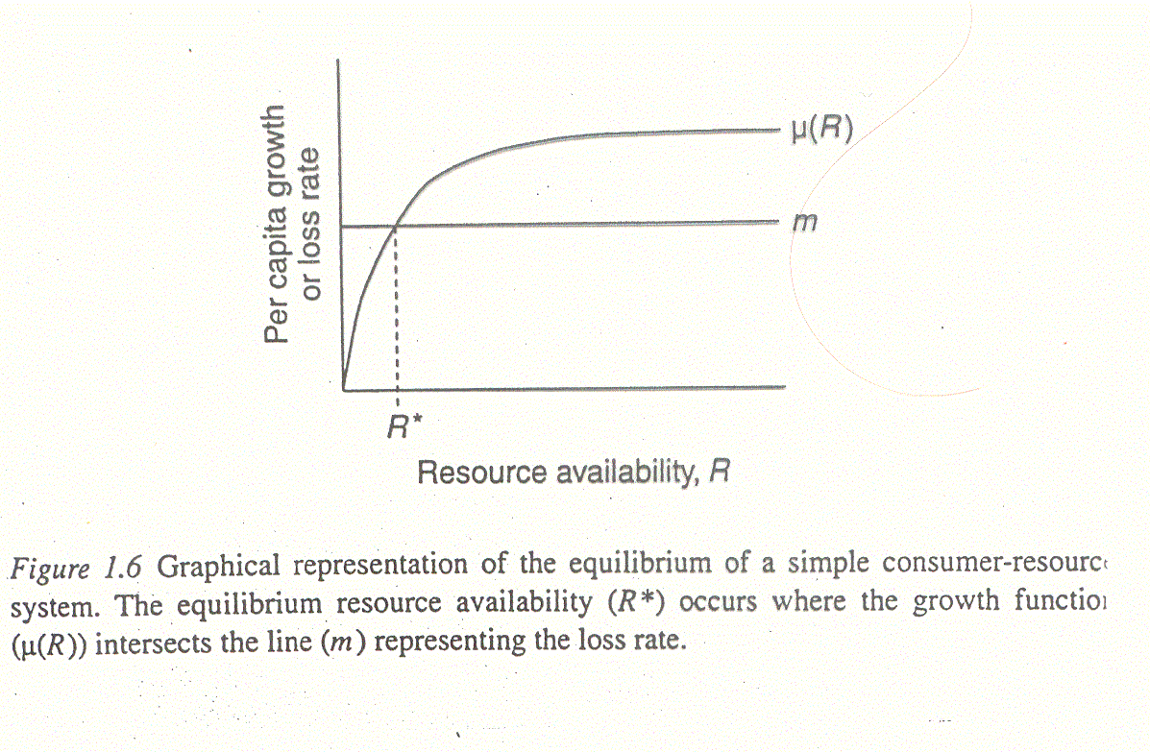
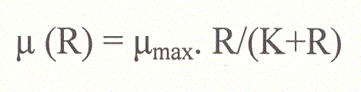
The dependence of vital rates on R. (mortality is independent, growth rate μ(R) increases with Resource availability
μ(R)= μ_{max} for very (infinitely) large R. K is the Resource availability, when the grow rate is reduced to half.
Note the famous R*
Determined for each species by μ_{max} , m, and K.

Slide 34

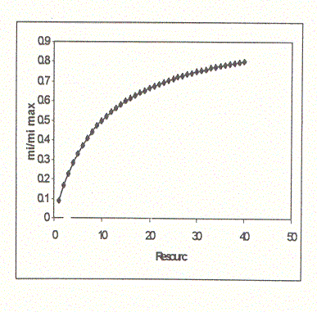
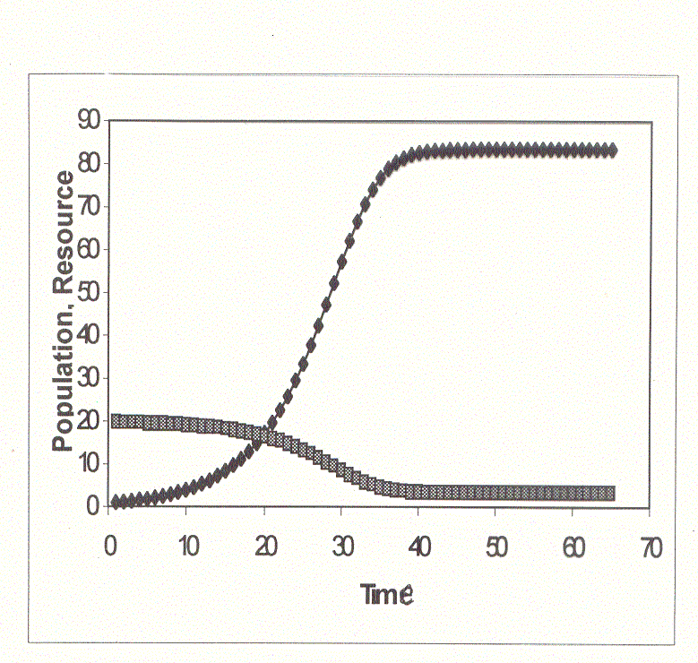
Population
Supply
Resource

Slide 35
In the case of unlimited supply, we can consider R being ∞
μ(∞)= μ_{max}
The equation is then dN/dt= μ_{max} .N - m.N= (μ_{max} – m) . N
Thus, under unlimited Supply, the population growth exponentially, with r = (μ_{max} – m)

Slide 36
Population
Supply
Resource
The equilibrial population density (~carrying capacity, K in logistic equation, not K here) is determined by the four parameters: it increases with μ_{max} and S, and decreases with K, m, and Q

Slide 37
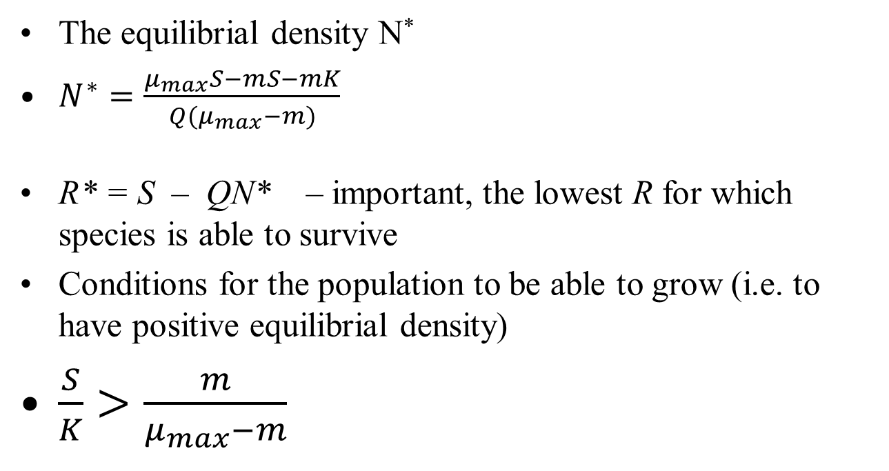
From the parameters, you can calculate (I have calculated them, nobody checked this)

Slide 38
In comparison with logistic equation
It is much more mechanistic (the logistic shows that the population is affected by the density dependence [which might but need not be caused by resource competition], Tilman’s equation shows mechanisms for resource competition)
It has five parameters (logistic equation only two) – it is generalizable (more species, more resources
But you can change S, and see how the growth characteristics will change if you change the Supply (e.g. change of carrying capacity with increasing S)

Slide 39
Population
Supply
Resource R*
Mechanisms: Note, that there is some stable S, i.e. Supply which is reduced the instant size of the population. There is nothing like e.g. nutrients that would be returned

Slide 40
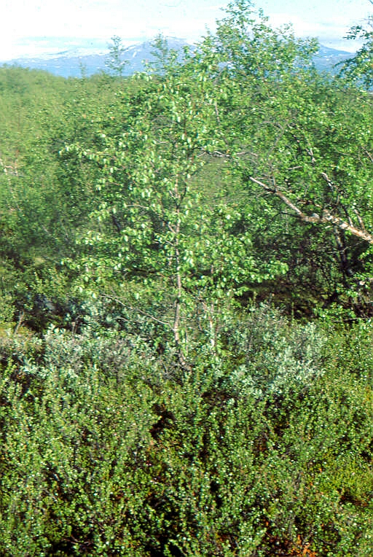
Apparent competition
Abisko:
Dwarf birch (Betula nana) is under higher herbivory pressure when growing under congeneric tall birch - (Betula pubescens ssp. czerepanovii) than under tall willows
(Regular outbreaks of indigenous geometrids Operophtera brumata and Epirrita autumnata – causing defoliation)

Slide 41
Apparent competition
Your pathogens can help you in the competition, if you share them with the competitor, and you are more resistant than the competitor
Aphanomyces astaci (Oomycetes) is “fungal” parasite of crayfish, causing crayfish plague. The invasive American species are resistant hosts, and the indigenous European species are susceptible.

Slide 42
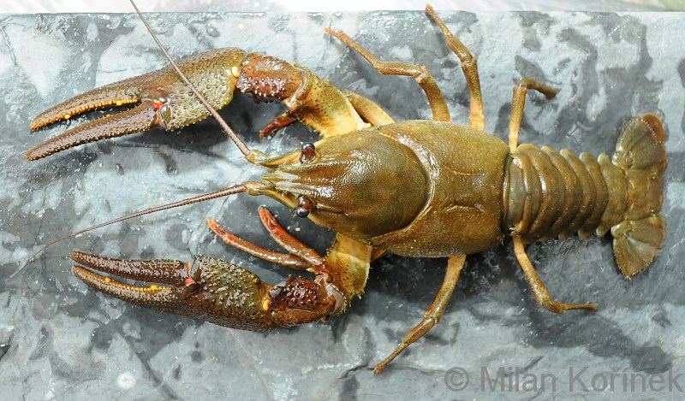
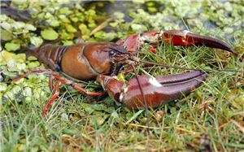
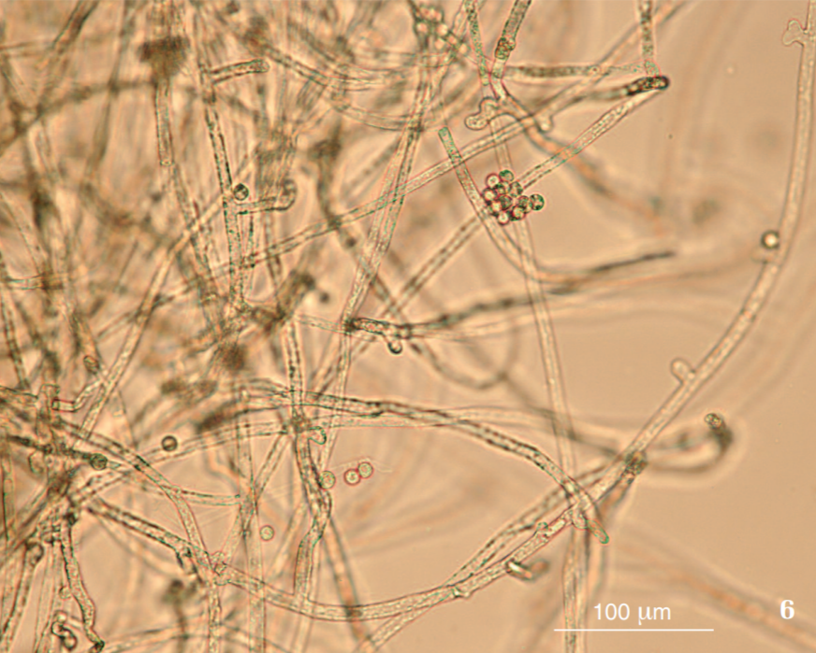
(Pacifastacus leniusculus) – American signal crayfish
Astacus astacus – European crayfish
Aphanomyces astaci
Svoboda, J., Mrugała, A., Kozubíková‐Balcarová, E., & Petrusek, A. (2017). Hosts and transmission of the crayfish plague pathogen Aphanomyces astaci: a review. Journal of fish diseases, 40(1), 127-140.

Slide 43
Competition types according to the symmetry of competitive effects:
Contest (winner takes all) vs. scramble (sharing out).
Contest is absolutely asymmetric competition
Teritoriality as an example of contest (mostly though interference competition)
Advantages must overweight the energy “invested”.
Advantage – the resource is not exhausted so much
Disadvantages – energy effort to defend the territory, danger of injury (and you need not always win)

Slide 44
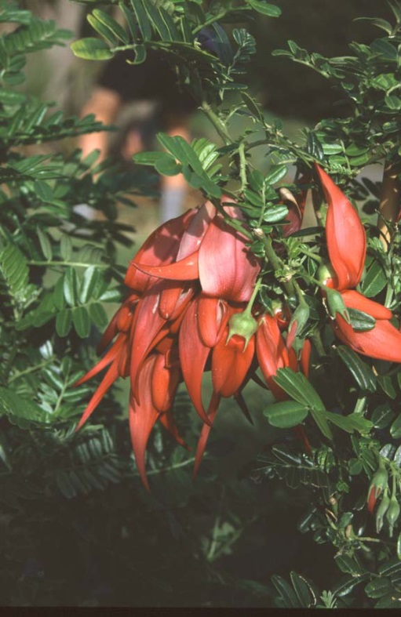
Plant competition:
Plants are sedentary, thus:
Only neighbours compete – importance of spatial pattern and spatial heterogeneity
“Competition for space” – space is not limiting – only small proportion of space is filled
– the concept is used to describe the monopolization of resources
Effect of spatial heterogeneity on individuals (and high phenotypic plasticity as a consequence)

Slide 45

Plant competition (cont.):
Remain for the whole life cycle on a single place
Size is more important than species identity (large mature spruce is able to suppress the grass Calamagrostis villosa, but the grass easily kills a spruce seedling)
Competition is usually highly asymmetric (particularly the competition for light) – both intra- and interspecific
Plants are sedentary – so they compete also for pollinators and seed dispersers

Slide 46
Resources for plants
Aboveground c.: Light (PhAR) – (Taller individuals are winners – competition is size dependent and highly asymmetric (the taller individual cannot be shaded)
Belowground c. : Water and nutrients (often considered together) – even smaller individuals can successfully compete (i.e. more symmetric than aboveground) – better possibility for niche differentiations [rooting depth]

Slide 47
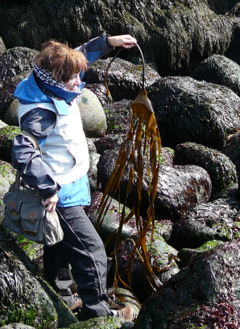
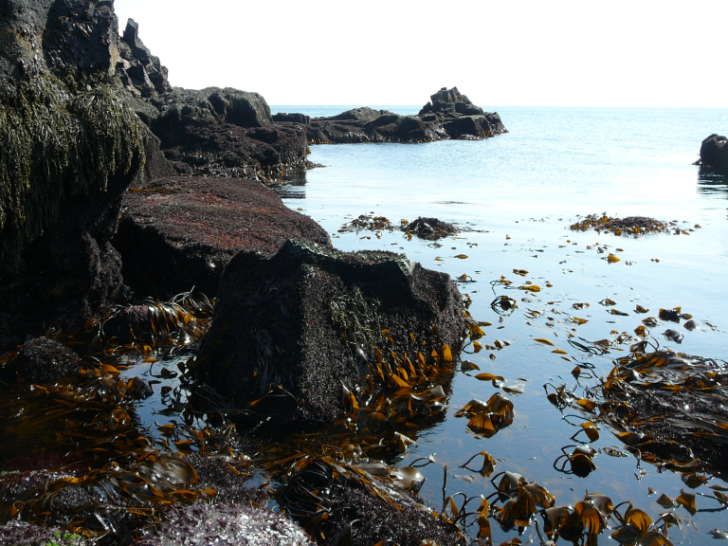
Competition for light in aquatic and terrestrial environments
Kelp forests in water (Iceland)
No mechanical support needed to reach close to the light

Slide 48
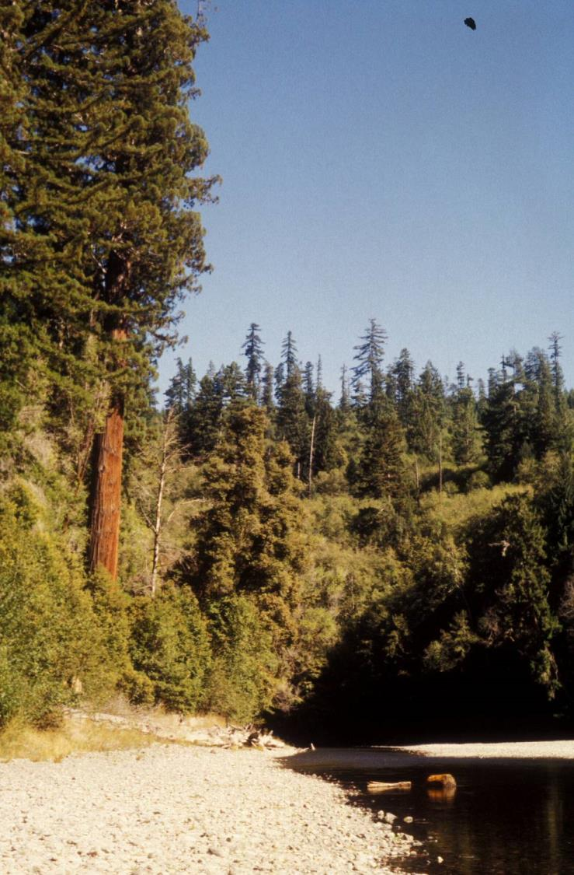
Terrestrial – growing tall means to have strong mechanical support
Sequoia sempervirens redwood forest California
Consequences for the ecosystem processes
Lignin in mechanically strong tissues – lower palatability. In aquatic system much more energy from primary production flows through the herbivores.

Slide 49
Resources for plants
CO₂ -- not terribly high concentration (~400 ppm [now]), but fast diffusion – in the air, plants usually do not compete for CO₂
If the pollinators and seed dispersers are in limited supply, plants compete for them

Slide 50
Intraspecific competition
Most important factor causing negative density dependence
K - the carrying capacity is mostly determined by intraspecific competition (remember calculation of N*)

Slide 51
Two laws of manifestation of intraspecific plant competition
Effect of competition on individual level
Self-thinning the 3/2 law
Law of constant final yield

Slide 52
Plants change their geometry
Without competition
With competition
Clonal plants – changes in the length of spacers

Slide 53
Selfthinning
Manifestation of strong intraspecific competition in plants (but see Latto, J. (1994). Evidence for a self-thinning rule in animals. Oikos, 531-534.)
YODA K. ,T. KIRA, H. OGAWA and K. HOZUMI. 1963. Self-thinning in overcrowded pure stands under cultivated and natural conditions. (Intraspecific competition among higher plants XI). J. Biol. Osaka City Univ.14: 107–129.

Slide 54
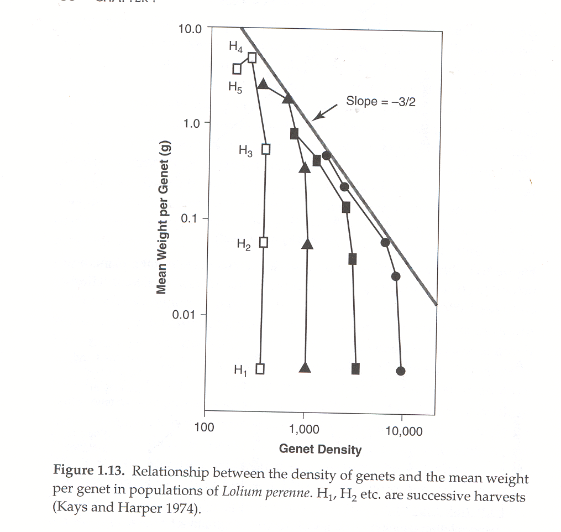
Changes in density and mean weight of an individual in the course of self-thinning

Slide 55
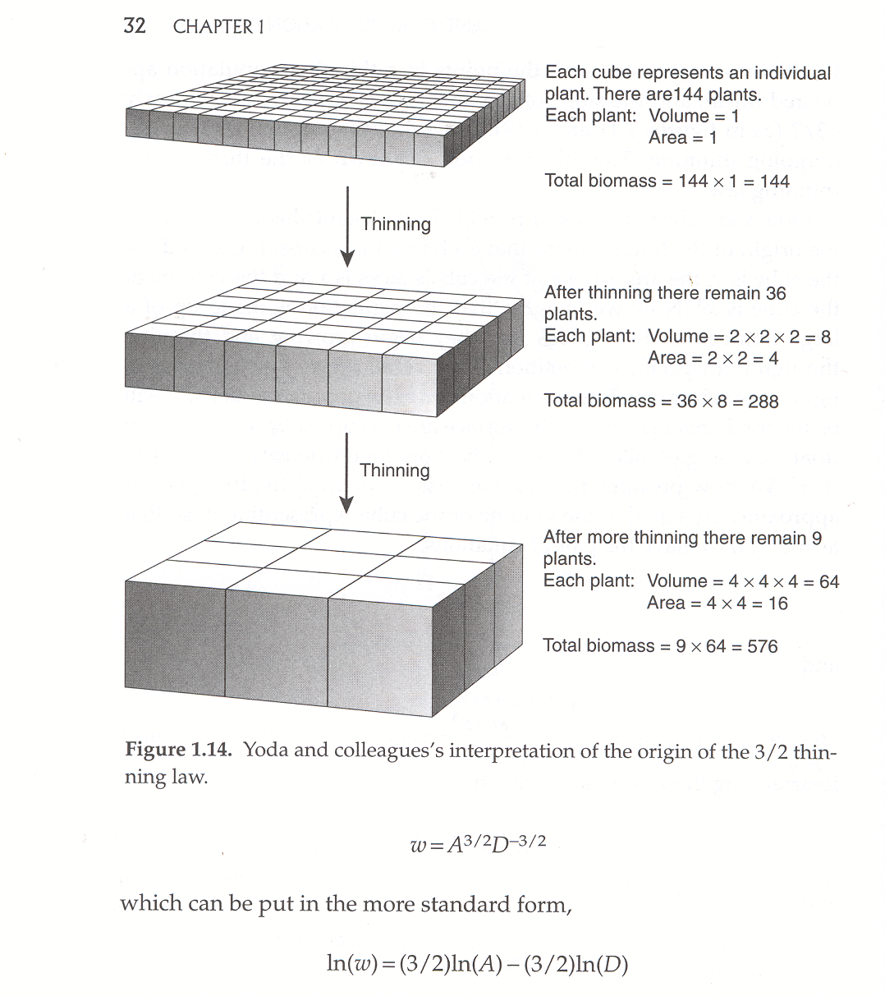
Yoda et al. 1963

Slide 56
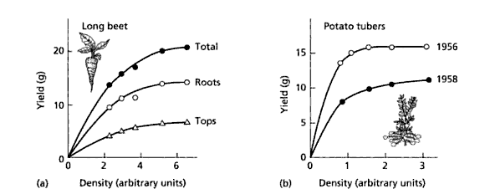
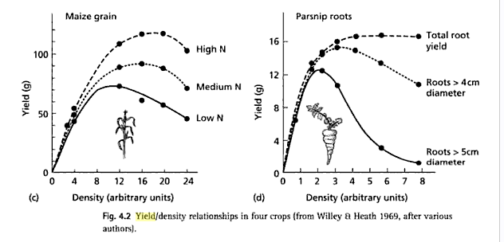
Law of constant final yield yield initially increases with the sowing density, but finally should reach an asymptote –

Slide 57
We tried to model this
Could be a population harmed by large density of its own seeds? (Fibich, P., Lepš, J., & Weiner, J. (2014). Individual variability and mortality required for constant final yield in simulated plant populations. Theoretical ecology, 7(3), 263-271.)
Questionable

Slide 58
Selfthinning - thinning
Thinning in forestry – modulating effect of competition
Constant final yield, but:
  The yield of usable parts might decrease with density (forestry – trunks)
  But we need high density to suppress “the weeds”
  Planting at high density, and then thinning (use of mathematical models)

Slide 59
Interspecific competition

Slide 60
Basic model based on the concept of logistic growth – two species
Logistic equation
Lotka-Volterra model
System of logistic equations, where the K for each species is decreased by the presence of the competitor
α, β – competition coefficients – comparative meaning – ratio of competitive effect of one individual (or other unit) of the competitor and own species

Slide 61
Basic model based on the concept of logistic growth – two species
Classic Lotka-Volterra model
Stable equilibrium (species are able to coexist) if
and
For the same carrying capacities, i.e. K₁ = K₂ if α<1. β<1
i.e., if the negative effect on my own species is bigger then the negative effect on the competitor (for different K, scaled to the K). => niche differentiation

Slide 62
Model analysis
Stable equilibrium
Population sized do not change if
dN₁/dt=0 and dN₂/dt=0
Leads to a system of two algebraic equations, solution is N₁ and N₂
Need to know, when is the equilibrium stable
Graphical solutions

Slide 63
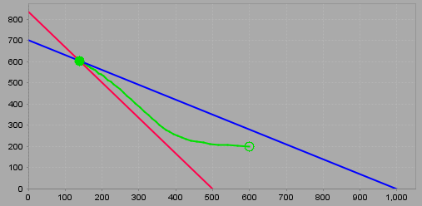
Isolines, their intersection is equilibrium. If in simulations, the system approaches the equilibrium poin from anywhere (roughly), equilibrium is stable
Mathematical concept of Liapunov stability

Slide 64
Other possible results
Unstable equilibrium – each harms the competitor more than its own population (for K₁ = K₂ if α>1 and β>1) – the result is dependent on the initial conditions, (preemption effect) – the initially abundant species wins
One strong and one weak competitor, e.g. (for K₁ = K₂ if α>1 and β<1), the stronger always wins.

Slide 65
L- V model is not very mechanistic – species compete, but how?
It is based on the logistic equation, ignores age structure, spatial structure etc.
Values of parameters α a β are difficult to estimate.
Can be generalized to many species, but the number of parameters to estimate increases quadratically with the number of species.
But provides the important conclusion: Not the absolute strength of the competition, but the relative size of interspeciefic to intraspecific competition determines the possibility of coexistence – again, niche differentiation.

Slide 66
Multiple species in the resource competition models
Population
Supply
Resource
I can add more species, and each species will be characterized by its μ_{max} , m, K, and Q. (Note, the number of parameters is initially higher than for LV, but then it grows linearly with the number of species.)

Slide 67
For one (homogeneous) resource, we get
Each species is characterized by the resource level, at which it is able to survive (dN / dt = 0) - R*
Species with the lowest R* is the only survivor in the competition ( orther species are already decreasing at the R level)
Nicely fits for Tilman’s experiments with algae, for vascular plant not so much.
Note that the result of competition is independent of S.

Slide 68
For more resources
More species can coexist, if each is limited by a different resource
The number of permanently coexisting species is equal or lower than the number of potentially limiting resources
Theoretical basis of the Gausse principle of competitive exclusion.

Slide 69
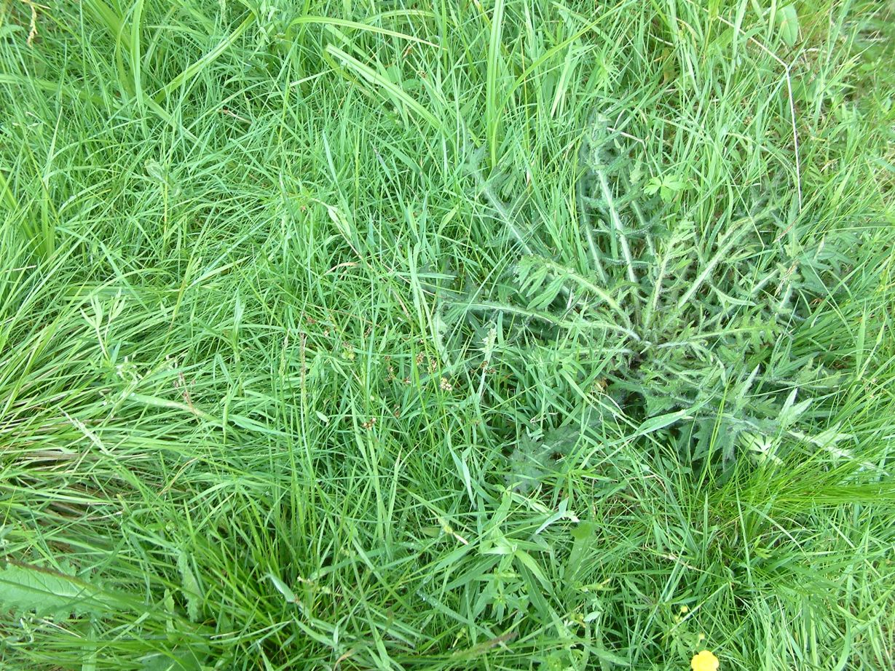
But:
In my Ohrazení plot, in 1m² we have up to 40 vascular plant species, and the number of limiting resources is low – light, nutrients, water.

Slide 70
Grime vs. Tilman
What is success in competition, where is the competition stronger?
Tilman – the lowest R*, i.e. the ability to grow at low Resource levels
Grime – the ability to draw the resources fast
Clear mismatch of time scales
Competition for space (in vascular plants) – monopolizing the space (e.g. by competition for light) are also defend my belowground resources.

Slide 71
Empirical studies
1. (Indirect, observational) From (spatial) pattern (including sizes of individuals etc.)
2. (Direct) Manipulative experiments
a) monocultures and mixtures
b) transplanting (e.g. into various communities or microhabitats ), species introductions (using the data from invasions)
c) removal experiments (of vegetation around target individuals)
d) removal of species from a community

Slide 72
Spatial pattern
Uniform (regular) spatial pattern is usually caused by intraspecific competition – most often increased mortality or decreased chance to establish. Uniform pattern is usually taken as consequence of competition.
Clumped (aggregated) spatial pattern can be caused by many factors, most often environmental heterogeneity, or dispersal. It is expected, particular for young individuals, and we cannot deduce anything from it.
Changes in time can suggest – e.g. decrease of the intensity of clumping is probably caused by density dependent mortality.

Slide 73
It is useful to combine the spatial pattern with properties of individuals. (But still, there is a danger of confounding effects.)

Slide 74
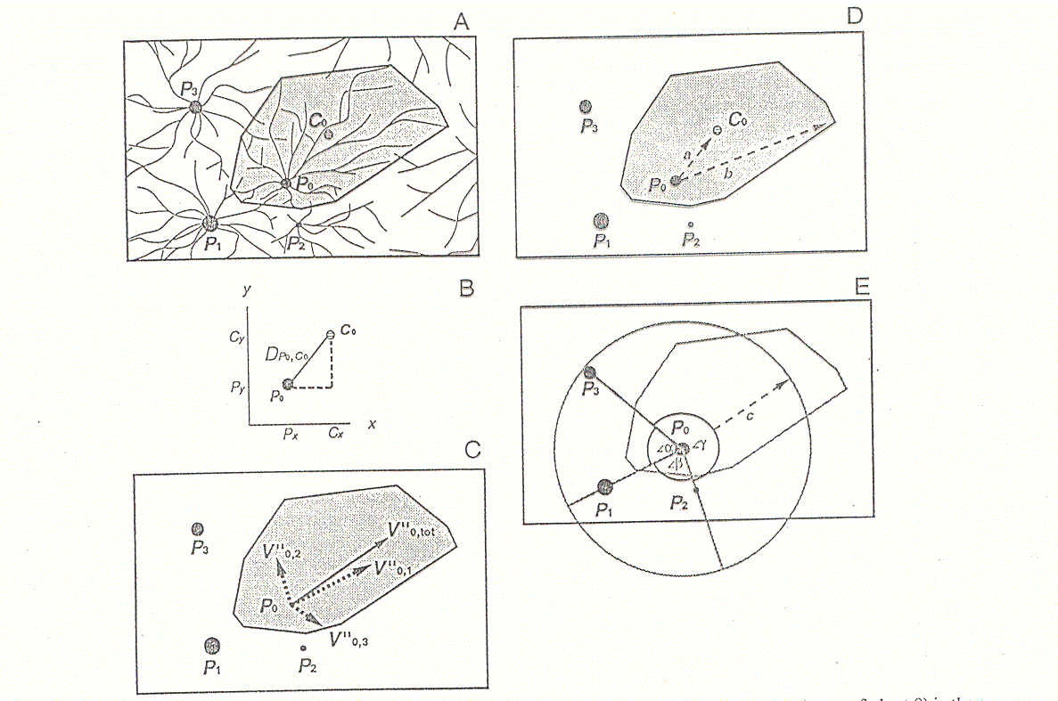
Example: Eccentricity of the root system. Individuals put their root to the competition free space.

Slide 75
Repeated measurements provide more information than static pattern
But the dynamic of the system can be surrogated by the tree-ring analysis sequence of tree rings provides info on the tree growth in the past
Examples: Altman, J., Fibich, P., Leps, J., Uemura, S., Hara, T., & Dolezal, J. (2016). Linking spatiotemporal disturbance history with tree regeneration and diversity in an old-growth forest in northern Japan. Perspectives in Plant Ecology, Evolution and Systematics, 21, 1-13.
Fibich, P., Lepš, J., Novotný, V., Klimeš, P., Těšitel, J., Molem, K., ... & Weiblen, G. D. (2016). Spatial patterns of tree species distribution in New Guinea primary and secondary lowland rain forest. Journal of Vegetation Science.

Slide 76
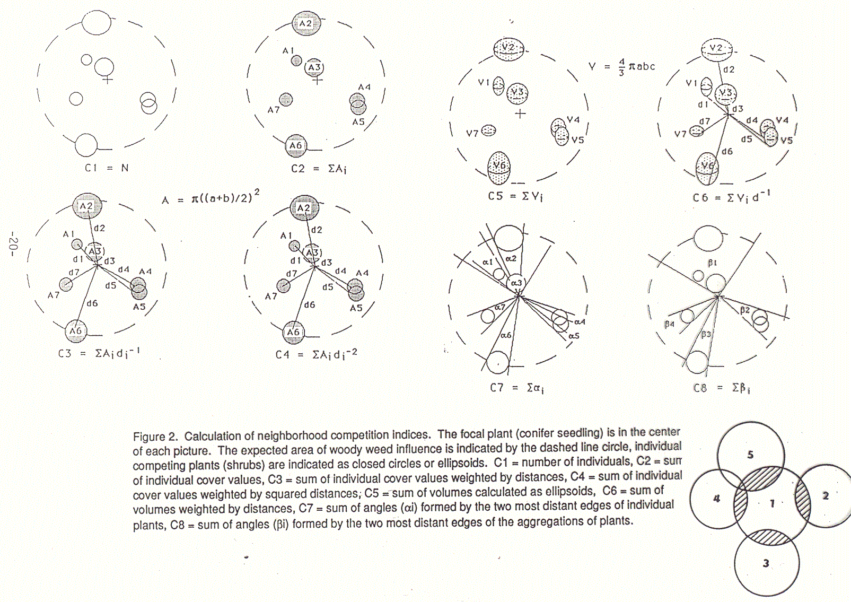
Neighbourhood competition indices can be correlated with the (properly standardized) width of tree rings

Slide 77
Community structure consequences of competition (Community ecology course)
Limiting similarity concept (MacArthur & Levins 1967)
Diamond studies on birds in PNG
Renewed interest in the assembly rules
Use of the null models

Slide 78
Experimental studies

Slide 79
Experimental monocultures and mixtures of species
Long tradition in agricultural research (weed-crop competition)

Slide 80
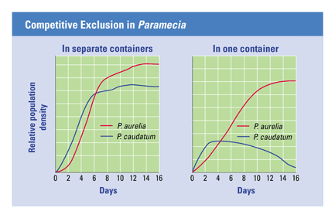
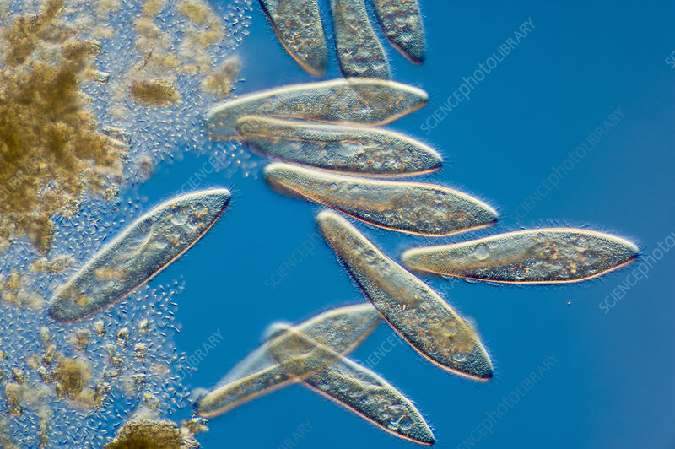
The most classical experiment of J.F Gause (1934) with Paramecium species
https://www.sciencephoto.com/media/454874/view
https://bodell.mtchs.org/OnlineBio/BIOCD/text/chapter35/concept35.4.html

Slide 81
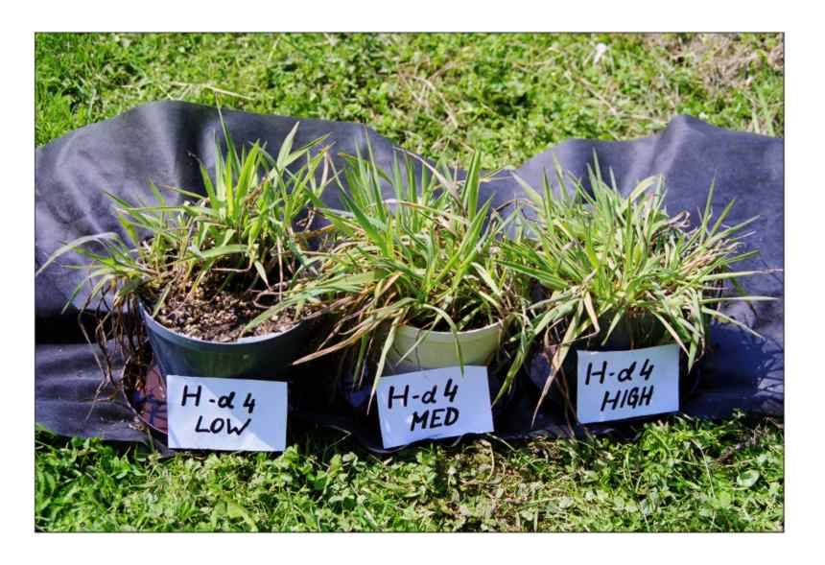
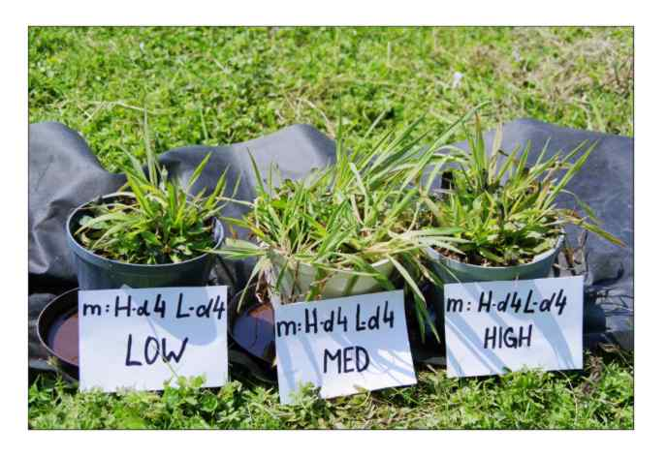
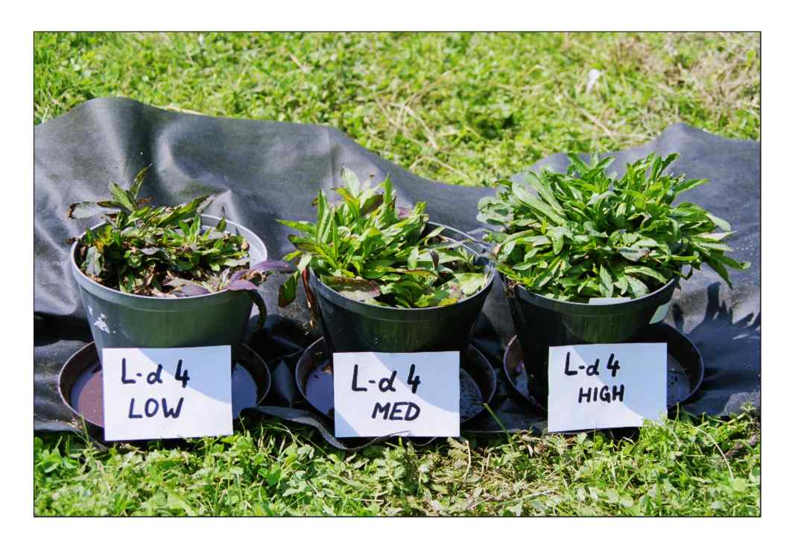
Pot experiment
with Holcus lanatus,
and Lychnis flos cuculi
And their mixtures at various nutrient levels

Slide 82
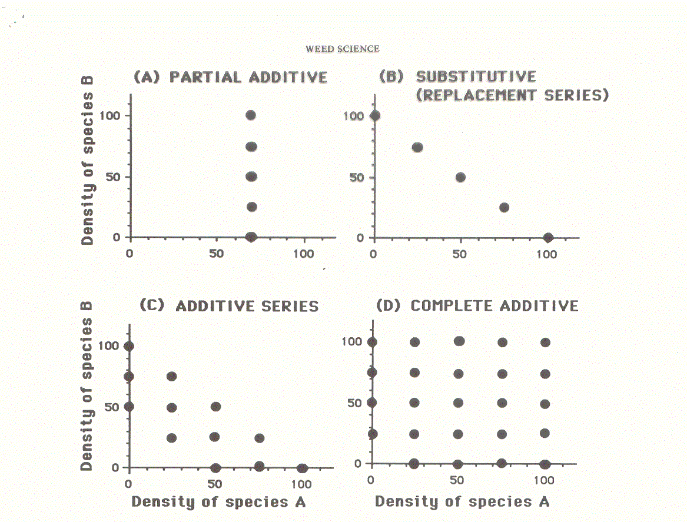
Design of competition experiments
Additive design vs. replacement series

Slide 83
Competition can be estimated for the complete additive or additive series
Basic model:
Size_{A} = Size_{A without comp.} – intraspecific c. – interspecific
Similarly for B
Can be solved using regression, usually (appropriate transformation)
1/Y_{A} = a + b₁ dens_{A} + b₂ dens_{B}
(Y is average weight of an individual, dens is density of individual species)
And similarly for B
b₁ is measure of the intraspecific competition, b₂ measure of the interspecific competition (scaling effect of dens_{B} on 1/Y)

Slide 84
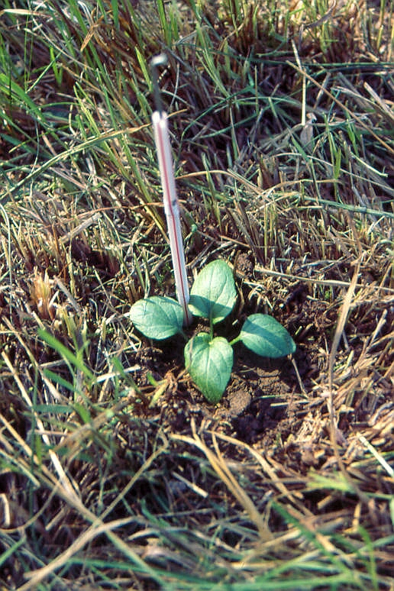
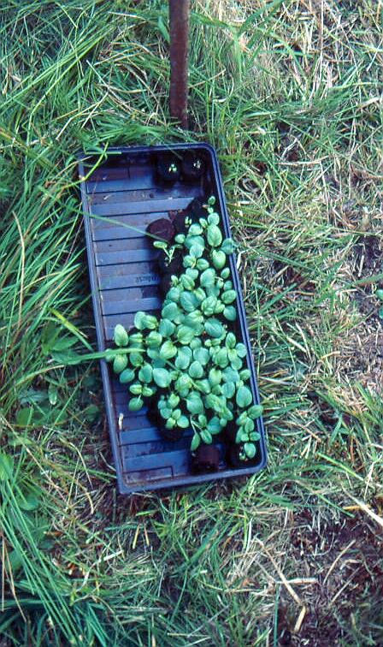
Transplant experiments (trans[planting into various microhabitats) - Prunella vulgaris

Slide 85
Clonal plants react to the competition by changing its morphology – direction and length of spacers
Macek, P., & Lepš, J. (2003). The effect of environmental heterogeneity on clonal behaviour of Prunella vulgaris L. Plant Ecology, 168(1), 31-43.

Slide 86
Transplant experiment with Lychnis flos cuculi
Tradeoff between flowering (in competitive environment) and production of secondary rosettes (in gaps)
Chaloupecká, E., & Lepš, J. (2004). Equivalence of competitor effects and tradeoff between vegetative multiplication and generative reproduction: case study with Lychnis flos-cuculi and Myosotis nemorosa. Flora-Morphology, Distribution, Functional Ecology of Plants, 199(2), 157-167.

Slide 87
Transplants and ontogenetic shifts
Kelemen, A., Lazzaro, L., Besnyői, V., Albert, Á. J., Konečná, M., Dobay, G., ... & Le Bagousse-Pinguet, Y. (2015). Net outcome of competition and facilitation in a wet meadow changes with plant’s life stage and community productivity. PRESLIA, 87(4), 347-361.
Young transplant established better in vegetation than in gaps, were they dried out (facilitation), but later, competition prevails

Slide 88
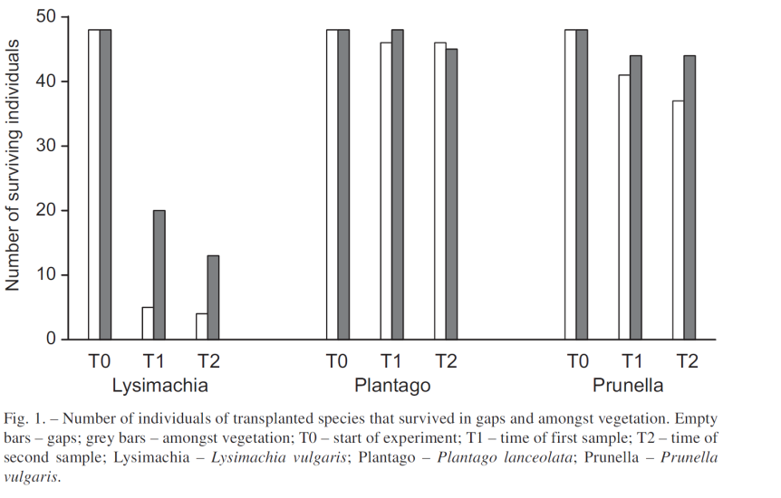
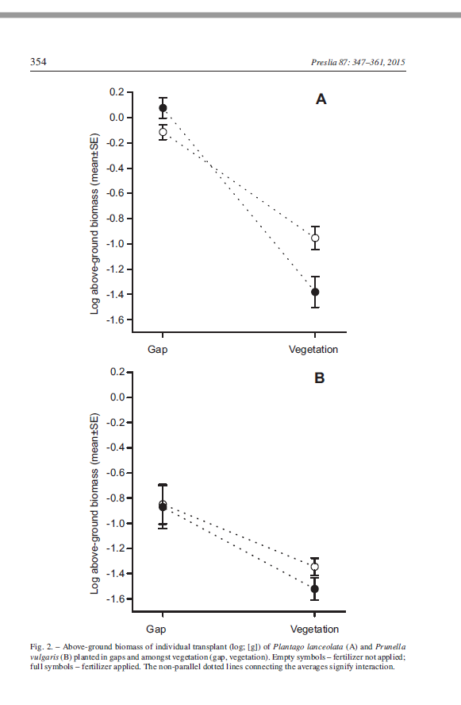
Survival (for Prunella ) higher in vegetation, the survival grow better in gaps
Kelemen, A., Lazzaro, L., Besnyői, V., Albert, Á. J., Konečná, M., Dobay, G., ... & Le Bagousse-Pinguet, Y. (2015). Net outcome of competition and facilitation in a wet meadow changes with plant’s life stage and community productivity. Preslia, 87(4), 347-361.

Slide 89
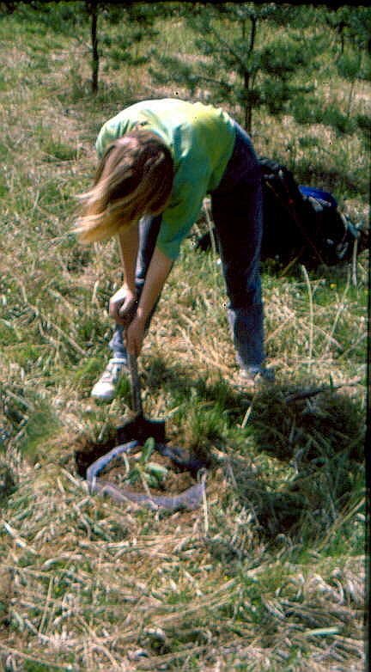
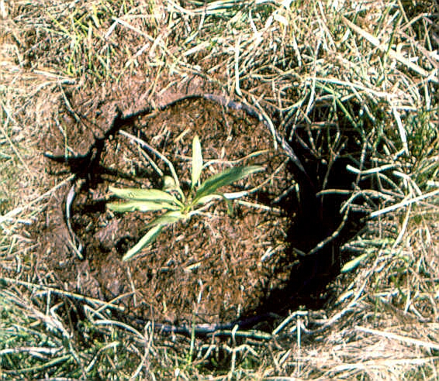
Effect of competition on established individuals
Trenching and separation of above- and belowground competition

Slide 90

Removal of dominant species from a community

Slide 91

Seedling of Gentiana pneumonanthe
Seedlings (and saplings) are more sensitive to competition than adults
1 – mown, 2- burned, 3 gap, 4 unmown

Slide 92

Removal of seed predator mouse increased the populations of other seedeaters, but have no effect on insectivorous Onychomys.

Slide 93


Removal of reodents and ants in Sonoran desert – both eat seeds, but and eat smaller seeds, partial overlap

Slide 94

The higher density of plant, the higher proportion of infected plants by a fungus (probably leading to negative density dependence in the plant). But rodents in fact compete for the plant with fungus.

Slide 95

Removal of rodents – Increase of large-seeded plants, but the small-seeded plants were surpressed due to competition with the large-seeded ones.

Slide 96


Net effect of rodents on ants might be dependent on the time scale

