Slide 1
Mechanism of species coexistence
Why there are so many species in communities? How are they able to escape the competitive exclusion?
(i.e. species already arrived to the community - so they already overcome the dispersal limitation)
and are not filtered out by the abiotic filter

Slide 2
Capacity of the exponential growth
N_{t} = N₀.2^{t} - t is the number of generations
If each bacterial cell divides into two each 20 minutes, the whole Earth would be covered by kilometers’ layer of bacteria withim two days
Population of Papua New Guinea (roughly) doubled during 25 years (corresponds to generation time 25 years and 4 childern per a couple – standard in more countries, corresponds to 2.8% increase per year). With this rate of increase, single pair would give in 1000 years populate Earth with 2⁴⁰ ~10¹² individuals (now, we have roughly 8.10⁹)

Slide 3
Capacity of exponential growth
Insect with clutch size 200 eggs (expected sex ratio 1:1) – 100 female
In five generations, 100⁵ ,i.e. 10¹⁰ individuals
One inflorescence of Typha ca 100 000 seeds, each genet 10 inflorescences
Many species has the capacity to fully populate the Earth alone – so what are the mechanisms that so many species coexist?

Slide 4
Competitive exclusion principle
Several formulations, also before Gausse
Two species with identical niche can not co-exist
Two species with identical ecology can not co-exist
If two species co-exist, there must be some niche differentiation
Based on this principle, we can expect that the number of coexisting species cannot exceed number of limiting resources
BUT MULTISPECIES COMMUNITIES EXIST

Slide 5
Equalizing and stabilizing mechanisms
Chesson, P. (2000). Mechanisms of maintenance of species diversity. Annual Review of Ecology and Systematics, 343-366.
Wilson, J. B. (2011). The twelve theories of co‐existence in plant communities: the doubtful, the important and the unexplored. Journal of vegetation Science,22(1), 184-195.

Slide 6
Palmer MW 1994
Variation in species richness: towards a unification of hypotheses. Folia Geobot Phytotax. 29: 511-530.
Analogy with Hardy-Weinberg equilibrium of population genetics. The equilibrium has teoertical assumptions, conditioning the situation that there is no change but evolution clearly happens.
Similarly here, the coexistence is generally caused by violation of competitive exclusion principle.

Slide 7
Coexistence mechanisms
Stabilizing – increase-when-rare
Suppose CNDD – conspecific negative density dependence and is stronger than heterospecific NDD
Typically, niche differentiation, Janzen-Connell
Equalizing – just decrease the fitness differences among species
Typically, environmental variation, medium disturbance

Slide 8
Only stabilizing mechanisms lead to permanent stable coexistence Equalizing mechanisms just postpone competitive exclusion – but they can support weak stabilizing mechanisms (based on theory – i.e. mathematical models)

Slide 9
Three most popular (classical) explanations
[Stabilizing] Niche differentiation: each of the species uses different part of the niche space
[Stabilizing] Pathogens and predators: the most abundant species suffers the most, probability of pathogen spread increases with density (Generalization of Janzen [Janzen-Connell] hypothesis).
[Equalizing] Medium disturbance hypothesis and/or environmental variability. Steady changes in competition equilibria prevent (or slow down) final competitive exclusion.

Slide 10
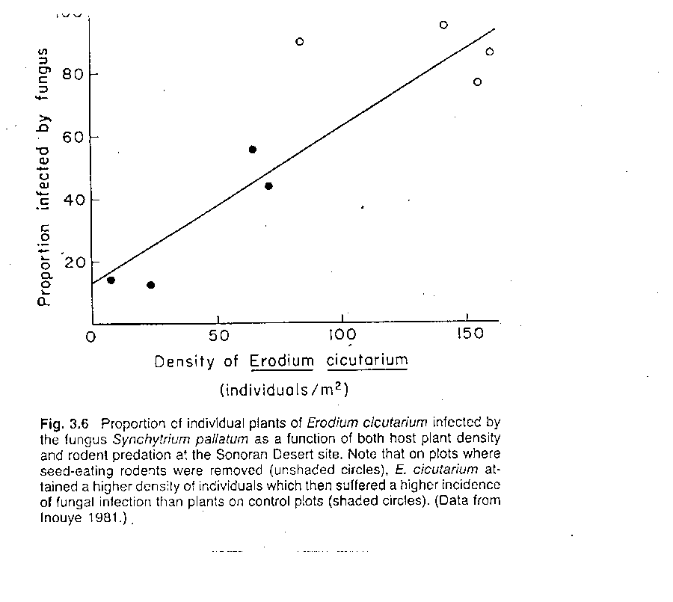
Specialized pathogens, predators [the more common I am, the better my infection / enemy will spread]
Janzen-Connell hypothesis
Clearly stabilizing
Will be treated later

Slide 11
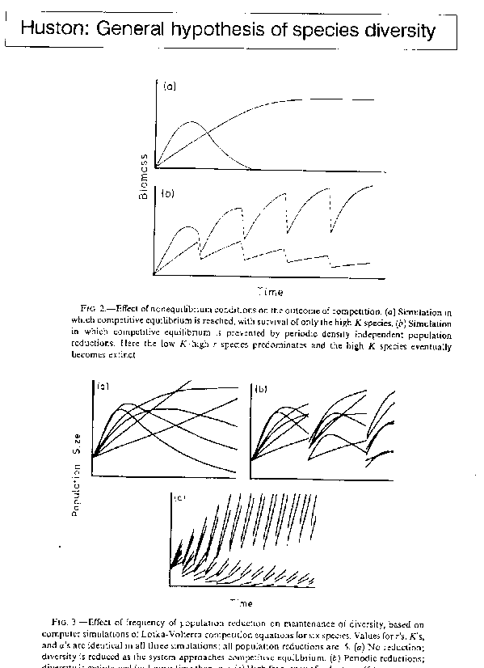
Medium disturbance hypothesis
Just equalizing –
Even the original graphs show gradual increase of some species and decrease of others - but can help to postpone competitive exclusion

Slide 12
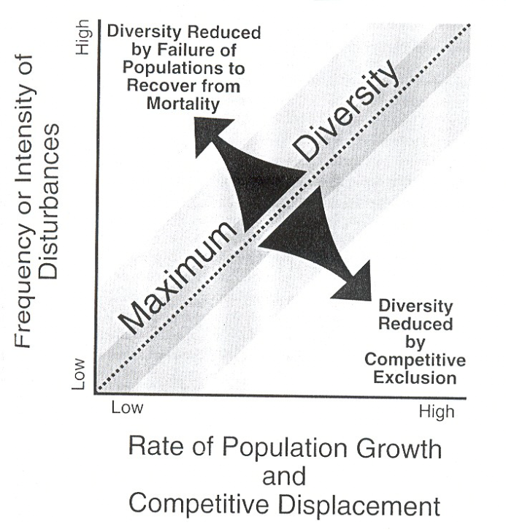
What is medium depends on productivity of environment

Slide 13
Disturbance has at least three characteristics: Intensity (% of biomass destroyed), frequency (how often, time from last disturbance), and grain (size of disturbed plots). Can be also – medium disturbance leads to large spatial heterogeneity.
ower 100 years
Low
10-100 years
Medium
Less than 10 years
High

Slide 14
Note that in this definition, the disturbance can be considered stabilizing - because it destroys more the common species than the rare ones.
Similarly, mowing of grasslands – mowing does not mean that the equal proportion from each species is removed. E.g. dominant species (Molinia) looses 90% of biomass, Potentilla erecta (7 cm tall) 50%, and mosses up to 5%.
ower 100 years
Low
10-100 years
Medium
Less than 10 years
High

Slide 15
Palmer MW 1994
Variation in species richness: towards a unification of hypotheses. Folia Geobot Phytotax. 29: 511-530.
Analogy with Hardy-Weinberg equilibrium of population genetics. The equilibrium has teoertical assumptions, conditioning the situation that there is no change but evolution clearly happens.
Similarly here, the coexistence is generally caused by violation of competitive exclusion principle.

Slide 16
Vellend 2016: The theory of ecological communities (Princeton Monographs)
Another theory inspired by population genetics:
Four “High level processes”
Speciation, Immigration, Drift, Selection
(Speciation and immigration – form the species pool, selection then selects species that will survive in the community)

Slide 17
Analogy with Hardy-Weinberg equilibrium conditions – based on Palmer 1994
Infinite population size
No net mutation of alleles
Mating is random (no sexual selection)
All genotypes equally viable, fertile and fecund (no natural selection)
Gametes are equally capable of forming zygotes
No immigration or emigration
The speed of evolution is positively dependent on the size of violation of above conditions

Slide 18
Competitive exclusion principle
Several formulations, also before Gausse
Two species with identical niche can not co-exist
Two species with identical ecology can not co-exist
If two species co-exist, there must be some niche differentiation
What is the testable hypothesis? Beware of circular reasoning!

Slide 19
Theory based on “Tilman” type model
The number of co-existing species can not exceed the number of limiting resources
Well achievable in many herbivores – so many plant species, and each provides plethora of different resources.
Much more difficult for plants

Slide 20
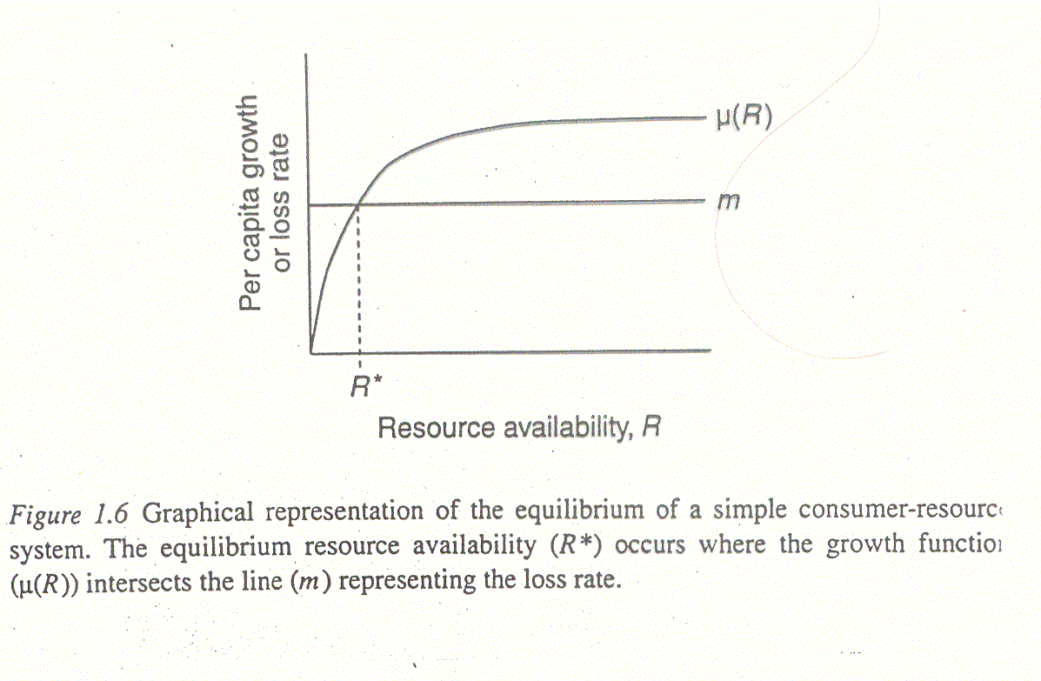
Species with the lowest R* is the only survivor in the competition
m – mortality, μ is growth rate - m is expected to be independent of the resource availability
One population, one resource:

Slide 21
Similar equation for unlimited number of species
Population
Supply
Resource
Resource availability determined by “Supply” and instant size of population(s) – R^{* -} In multispecies systems, the lowest R* is the winner

Slide 22
But multispecies communities exist
And number of species exceeds considerably number of limiting resources we are able to invent for explanation
Plants compete for light, for water and dissolved nutrients – and that’s it… - OK, there might be some spatial, or seasonal variability, but…

Slide 23
Niche
Various definition, elegant, but not very practically usable: by n-dimensional hyperspace, each axis is one “resource” (=Hutchinsonian niche)
Fundamental & Realized Niche
For survival, a species have to have a realized niche in a community (again, beware of circular reasoning)

Slide 24
Competitive exclusion principle (CEP) – Given a suit of species, interspecific competition will results in exclusion of all but one if:
1. Time has been sufficient to allow exclusion
2. Environment temporarily constant
3. No spatial variation
4. One limiting resource
5. Rarer species are not favored
6. Species have the opportunity to compete
7. No immigration
The higher degree of violation, the higher number of species can coexist, or the longer it takes to achieve the exclusion

Slide 25
(Palmer listed ca 120 hypotheses, and then states the condition of CEP violated)
Animals – very high number of plant species (for herbivores), each species different, each species posses several parts as different resource. Similarly for predators
Plants – competition for limited number of resources (but they are sedentary)

Slide 26
1. Time has been sufficient to allow exclusion
2. Environment temporarily constant
3. No spatial variation
4. One limiting resource
5. Rarer species are not favored
6. Species have the opportunity to compete
7. No immigration
1. Time is not sufficient. Time needed to reach equilibrium, i.e. the exclusion, is dependent on the dynamics of the process. Rate of exclusion is dependent on growth rate (and so on productivity), and intensity, but mainly asymmetry of competition. (Relationship with condition 2 – variable environment, time for exclusion is not sufficient)

Slide 27
In mown plots, increase of the number of species during first six years, regardless of removal of Molinia, in unmown plots, removal has positive effect on species richness
NSP of vascular plants

Slide 28
In unmown plot, continuous decrease. Initial positive effect of removal ceased after 10 yrs. In mown plots, initial increase (5 years) followed by decrease, no effect of removal.
In mown plots, the real competitive exclusion starts after 6 years.

Slide 29
1. Time has been sufficient to allow exclusion
2. Environment temporarily constant
3. No spatial variation
4. One limiting resource
5. Rarer species are not favored
6. Species have the opportunity to compete
7. No immigration
Depends also on spatial scale, but there is always some spatial heterogeneity on whatever spatial scale
Enables “spatial mass effect” - (compare “transitional species” [Grime])

Slide 30
Classical differentiation of resource use. Seed-eating and insectivorous paserines can easily co-exist. Classical Tilman’s diatom experiment. Different rooting depth. Phenological differentiation. Ability to use decreased levels of PhAR. Or:
1. Time has been sufficient to allow exclusion
2. Environment temporarily constant
3. No spatial variation
4. One limiting resource
5. Rarer species are not favored
6. Species have the opportunity to compete
7. No immigration

Slide 31
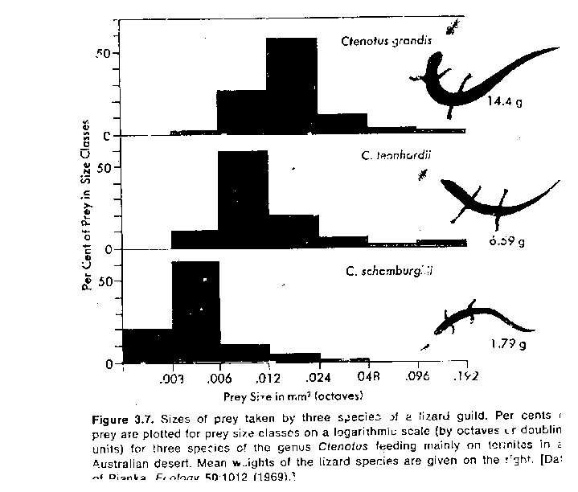
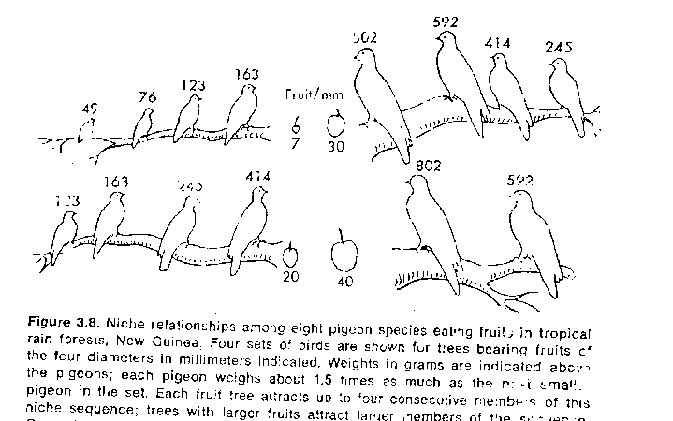
Classical niche differentiation

Slide 32
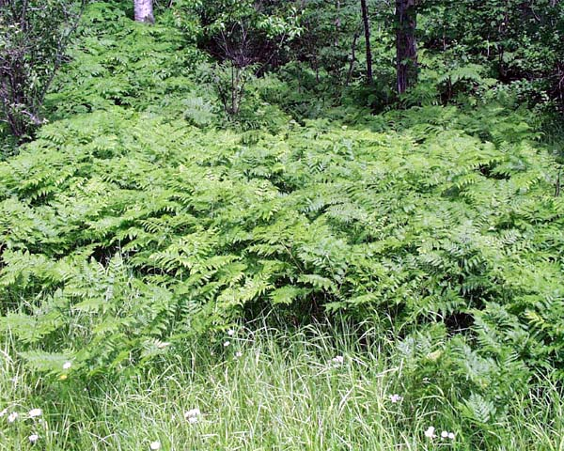
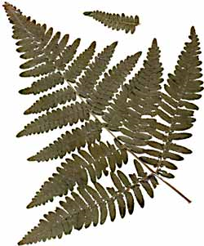
Possible niche differentiation in bracken – Pteridium aquilinum
Cosmopolitan species / splitters do not think it is a single species

Slide 33
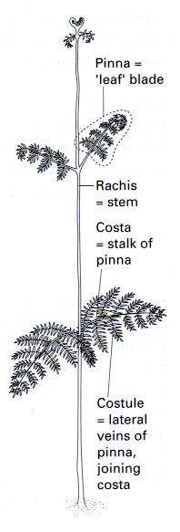
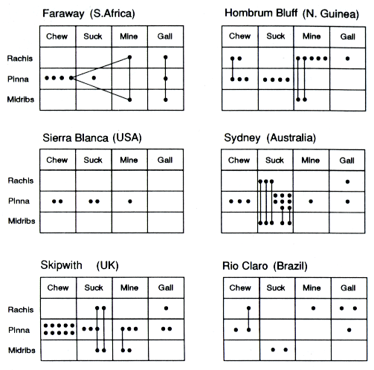
Community composition based on two niche dimensions: part of the plant, and a guild -
Part of the plant: Rachis=stem, Pinna=leaf blade, Costa
Type of usage/guild: Chew, Suck (could be phloem, xylem), mine, gall
Each species is a dot, species using more niches are connected dots
Begon Harper Townsend: Ecology on the basis of John Lawton’s papers

Slide 34
Niche differentiation is stabilizing
The more abundant population, the less resources are available
The rarer I am, the more resources I have

Slide 35
In plants
Various rooting depth
Various seasonal niches (phenological differences)
Usually, trait differences are interpretted as niche differentiation - however, they can also cause differences in fitness – which might finally lead to competitive exclusion (e.g. differences in height – differences in competitive success)

Slide 36
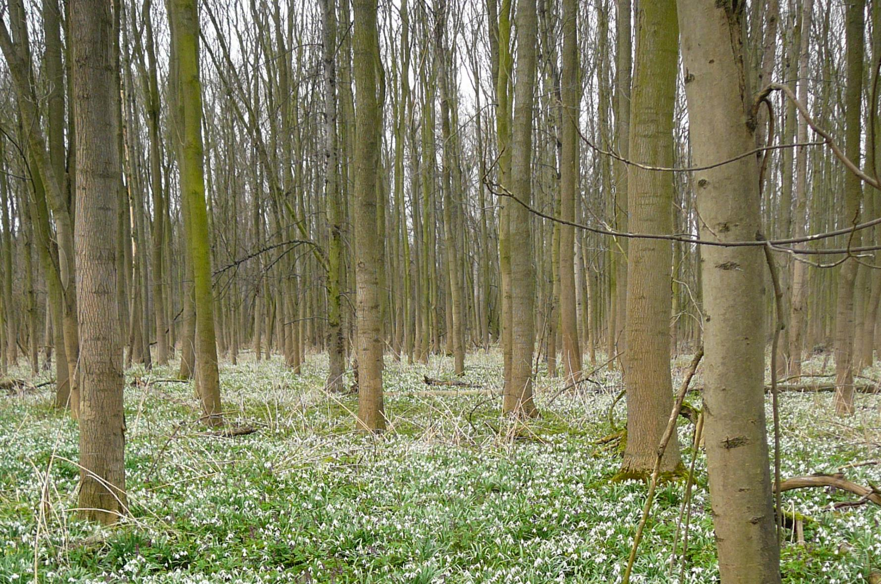

Slide 37
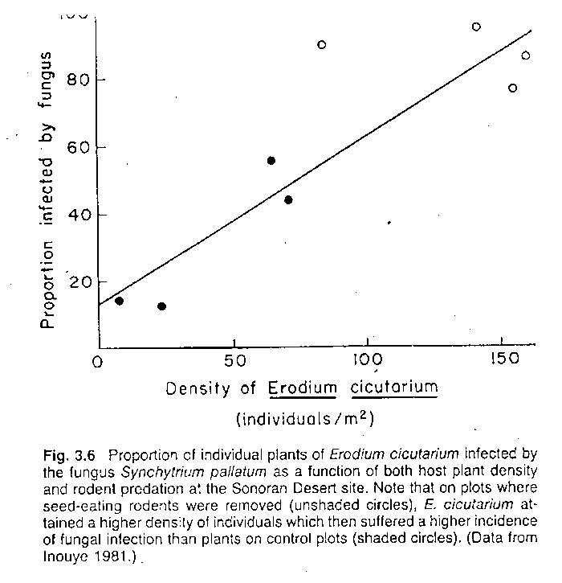
Density dependent mortality (depending more on density of conspecifics) pathogens, predators etc.
1. Time has been sufficient to allow exclusion
2. Environment temporarily constant
3. No spatial variation
4. One limiting resource
5. Rarer species are not favoured (includes also niche differentiation)
6. Species have the opportunity to compete
7. No immigration
Generalization of Janzen-Connell hypothesis

Slide 38
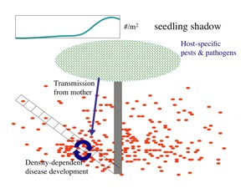
http://people.ucsc.edu/~ggilbert/Research_GilbertLab.html

Slide 40
Janzen-Connell mechanisms
Janzen originally focused on insects in tropical forest
It seems today, that fungi (or generally, soil pathogens) are (more?) important for plants
Petermann, J. S., Fergus, A. J., Turnbull, L. A., & Schmid, B. (2008). Janzen‐Connell effects are widespread and strong enough to maintain diversity in grasslands. Ecology, 89(9), 2399-2406.
Nice summarizing paper (for tropical forest): Terborgh, J. (2020). At 50, Janzen–Connell has come of age. BioScience, 70(12), 1082-1092.

Slide 41
Evidence (examples)
Spatial pattern analyses of age/size classified individuals (ForestGeo dynamnic plots)
seedling survival in vicinity and in absence of conspecific adults; plus experiment with fungicide/insecticide applications
“Soil memory” – the soil where a species was grown is less favourable for transplants of its own species

Slide 42
Classical mowing – the tallest individuals are competitively superior, and are the most harmed.
1
1. Time has been sufficient to allow exclusion
2. Environment temporarily constant
3. No spatial variation
4. One limiting resource
5. Rarer species are not favored
6. Species have the opportunity to compete
7. No immigration

Slide 43
Randomly appearing habitats – the species (particularly the sedentary ones) do not meet at all “preemptive”competition (Grubb 1977 theory of regeneration niche)
“Lotteries”
1. Time has been sufficient to allow exclusion
2. Environment temporarily constant
3. No spatial variation
4. One limiting resource
5. Rarer species are not favored
6. Species have the opportunity to compete
7. No immigration

Slide 44
1. Time has been sufficient to allow exclusion
2. Environment temporarily constant
3. No spatial variation
4. One limiting resource
5. Rarer species are not favored
6. Species have the opportunity to compete
7. No immigration
Transitional populations
(Metapopulation theory)

Slide 45
Comments on some popular theories

Slide 46
Hubbell’s neutral theory
Hubbell, S. P. (2001). The unified neutral theory of biodiversity and biogeography (MPB-32) (Vol. 32). Princeton University Press.
All species are equal, and thus the richness is just a matter of speciation, immigration, and extinction

Slide 47
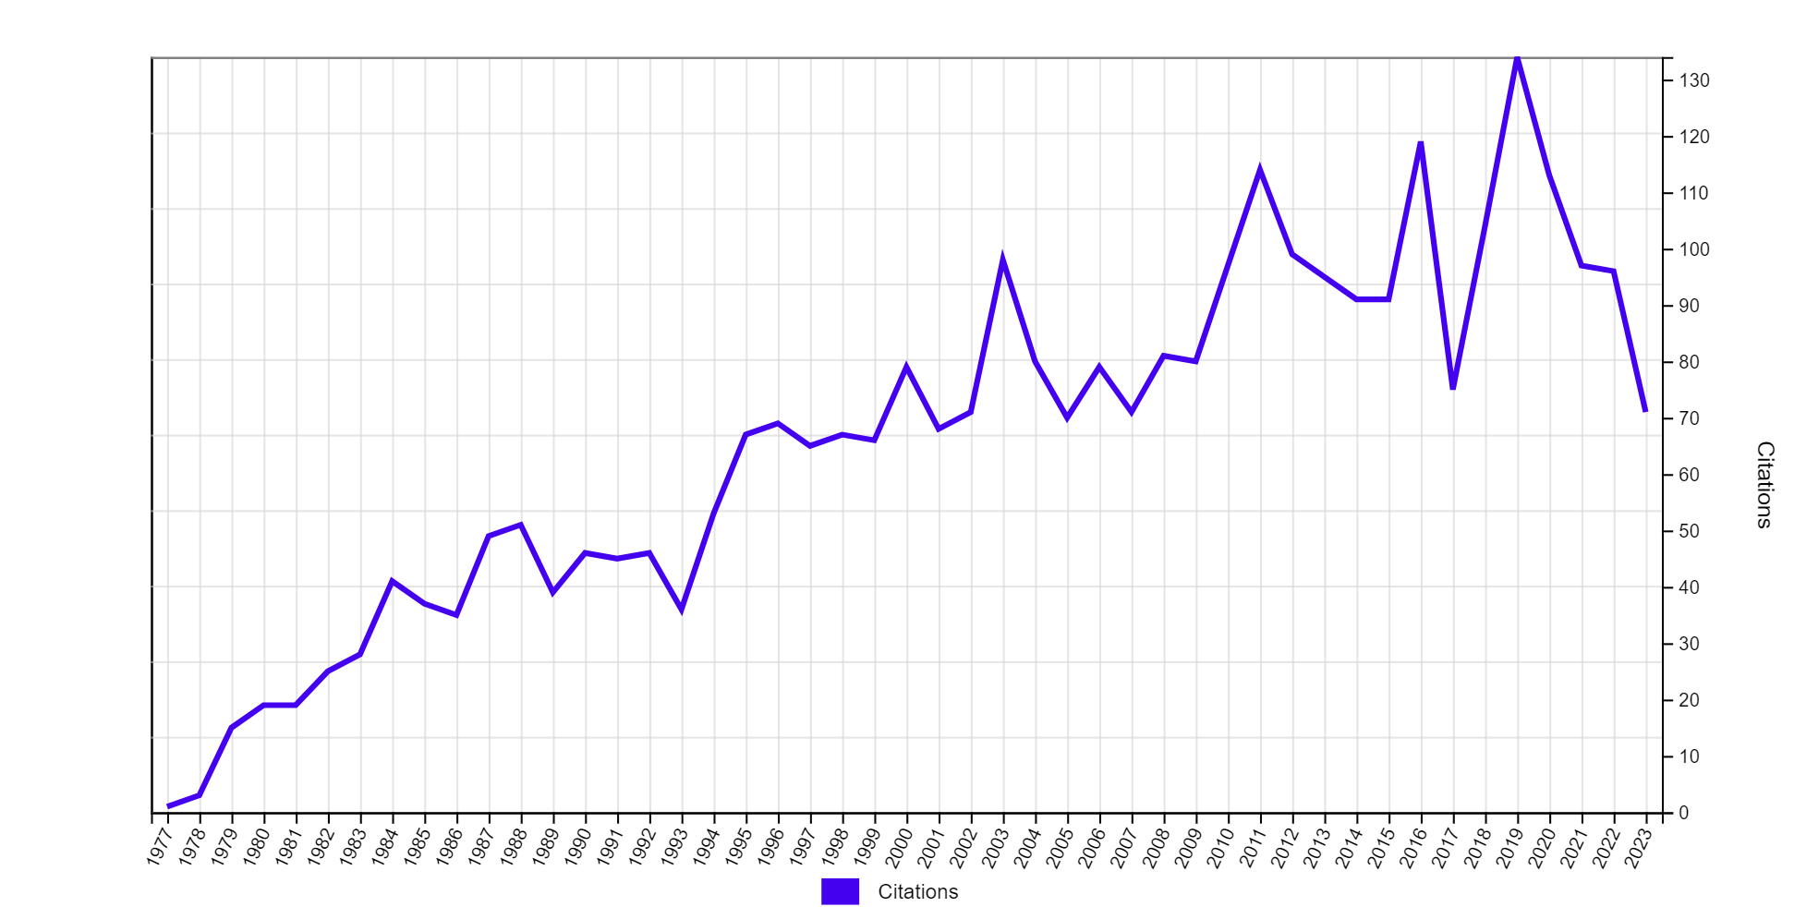
Grubb 1977: Regeneration niche (Biol. Rev.)
Seed regeneration: Need of “safe site” (e.g. gap)
Gap unpredictable resource – first come first served – the fast species have competitive advantage – pre-emptive competition. Trade-off between dispersal and competitive ability.
Seedling are much more sensitive to variation in environment than established plants
Gaps – different among seasons, but also among individual years

Slide 48
Špačková Lepš 2004

Slide 49
Importance of spatial and temporal scale
Some species do not persist in a locality, but persist on the landscape scale (e.g. Lycopodiella inundata)

Slide 50
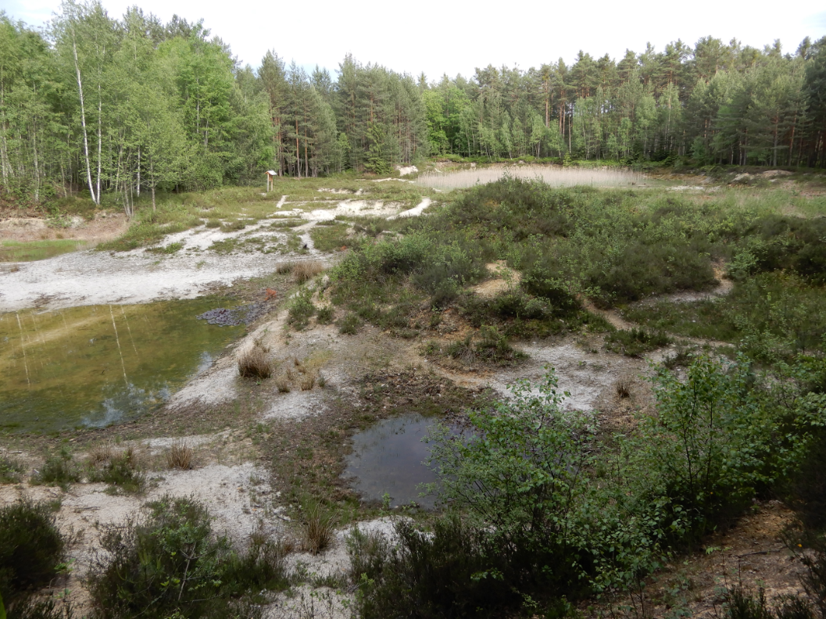
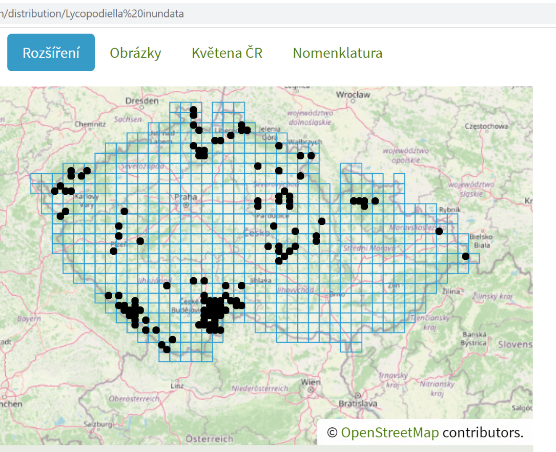
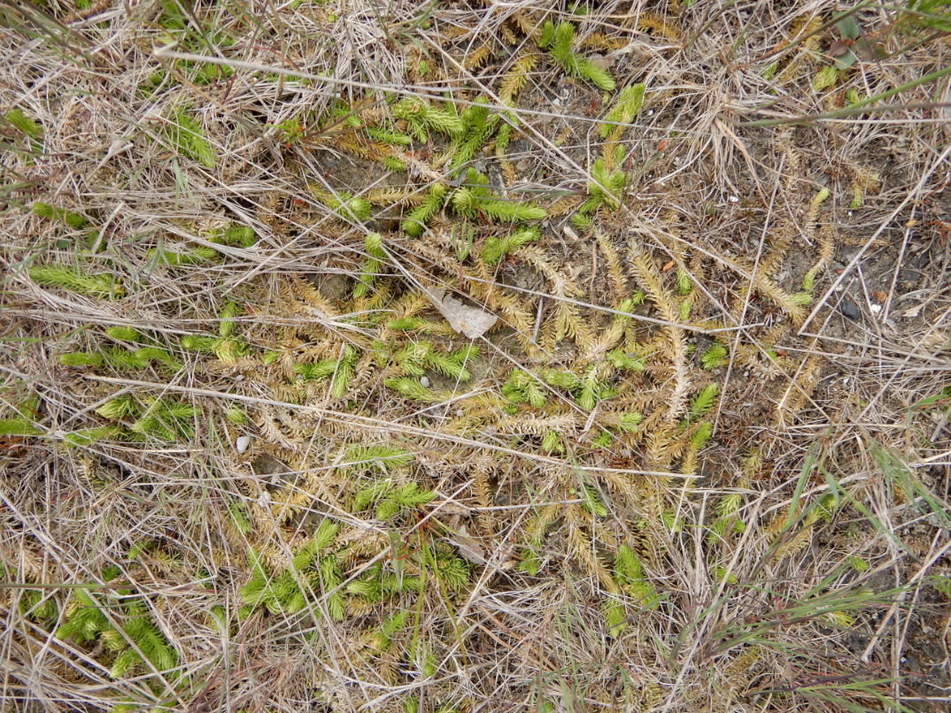

Slide 51
Traits and testing for mechanisms
Limiting similarity concept – basic idea: the more similar the species are, the larger is the niche overlap, and the stronger competition (and resulting competitive exclusion) -> will lead to trait divergence
Trait convergence as “proof” of environmental filtering
Tests using the trait divergence / convergence

Slide 52
Environmental filtering
Environment selects species with similar traits
E.g. Dry environment species with low SLA
Consequently, we expect underdispersion, i.e. trait convergence

Slide 53
Obr. 5.9.
Character displacement – Darwin finches –
On evolutionary scale, but here ITV – intraspecific trait variability caused by evolution

Slide 54
Animals
Beak shape is often good indicator of the food type
Size? Niche differentiation, but also competitive superiority

Slide 55
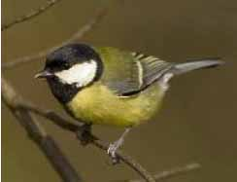
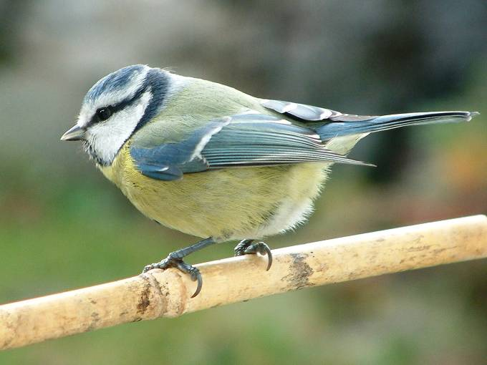
Great tit (Parus major), 20 g, not able to fit its nest in small cavities, but in direct contact with blue tit, it wins
Blue tit (Parus caeruleus), 10 g – fits into small cavities, but in direct interference and in larger cavities, looses with great tit
To which extend does the difference support the coexistence, and to which increases difference in fitness

Slide 56
Even more problematic with plants
Is the difference in potential height
Niche differentiation (and thus stabilizing mechanism)
Difference in fitness (higher plants will win in competition) – and thus mechanisms promoting inequality, and speeding competitive exclusion
Thus, in some cases, the trait convergence might be result of selection of winners in competitive hierarchy.
But, what is significant? Null models

Slide 57
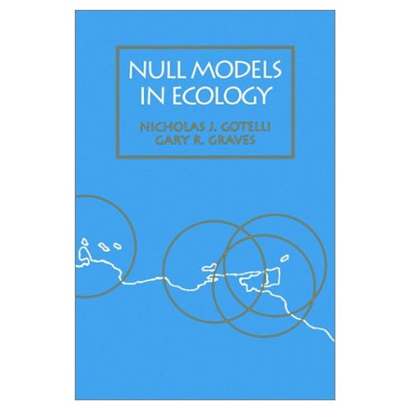
Tests using the null models
The idea: lets simulate the composition of null communities (i.e. communities where the tested factor is absent), construct the envelope and check, whether the real communities fall into this envelope
Note: we need the species pool
Smithsonian

Slide 58
Trait convergence vs. trait divergence – in theory
Environmental filter will probably select species with similar traits – > trait convergence
Competition (limiting similarity concept) will select species with differing traits -> trait divergence
But, the weaker competitor exclusion will also lead to trait convergence

Slide 59
Data needed
Species by site matrix (quantitative or presence absence)
Species by trait matrix
Various possibilities of null models: what to randomize?
And what is species pool?

Slide 60
Importance of spatial scales Grain and extent
Grain - size of the sampling units - determines the area, at which ithe individuals interact
Scale – generally determines the species pool, from which the species are assembled
Case study: Backhaus, L., Albert, G., Cuchietti, A., Jaimes Nino, L. M., Fahs, N., Lisner, A., ... & Garcia Medina, N. (2021). Shift from trait convergence to divergence along old‐field succession. Journal of Vegetation Science, 32(2), e12986.

Slide 61
Removal and transplant experiments
How will be the structure of the community changed by a removal of an (important) species. Will the species be replaced by a similare species? Will the dominance structure of the community change?
And what will happen with transplants with and without competition – atreficial gaps

