Slide 1
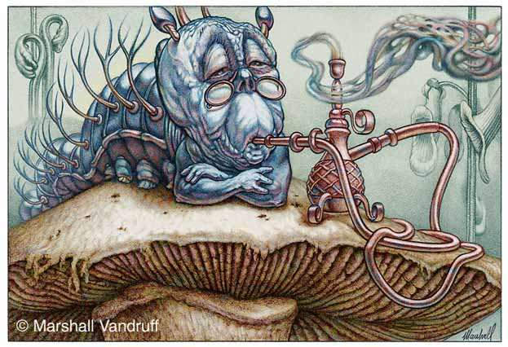
Plant – herbivore relationships
VOJTECH NOVOTNY:
COMMUNITY ECOLOGY,
LECTURE NO 2
University of S. Bohemia

Slide 2

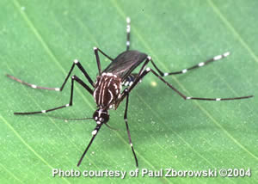
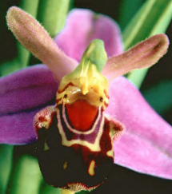

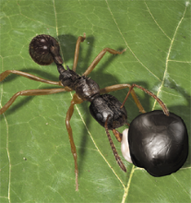
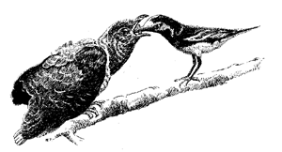
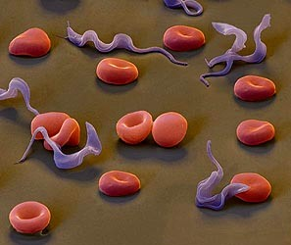
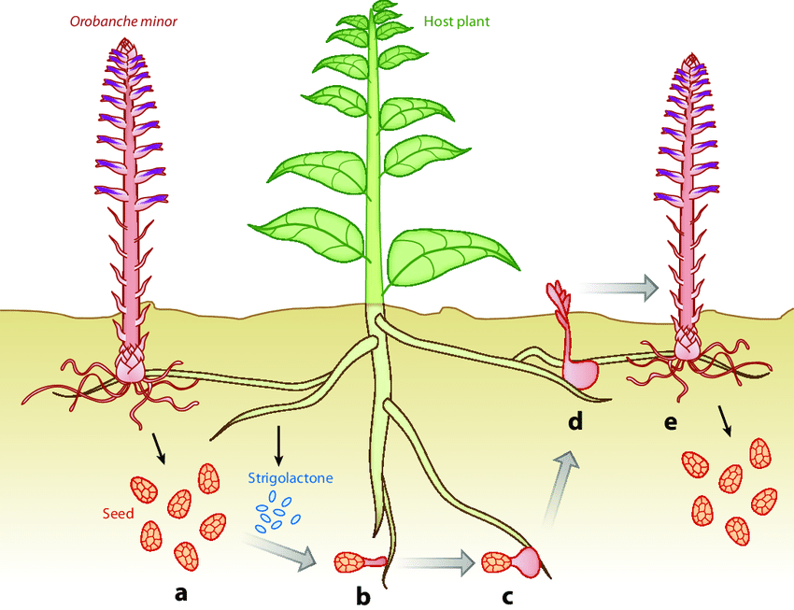
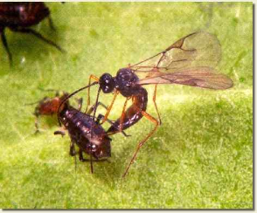
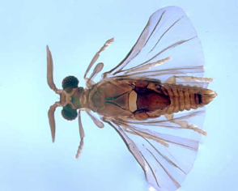
Modes of exploitation:
Grazers: one grazer negatively impacts many individuals
Predators: one predator kills many individuals
Parasites: one parasite impacts one individual
Parasitoids: one parasitoid kills one individual
many herbivores (also flower nectar robbers ...)
many carnivores, also seed-eating herbivores …
macroscopic parasites, pathogens incl. plants…
insect parasitoids Hymenoptera…

Slide 3
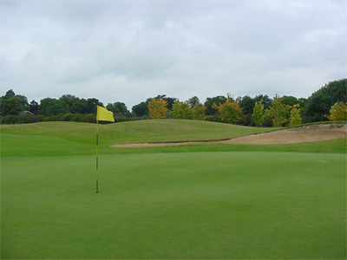
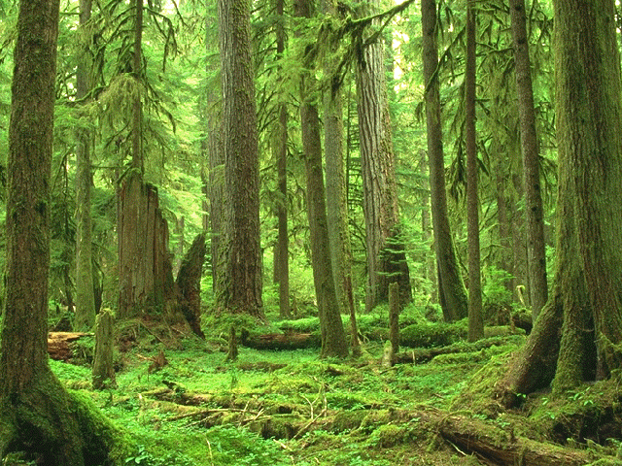
Why is the world green?
Herbivores are controlled by
their enemies (top-down control): “world is green”
their plant resources (bottom-up control): “world is green but the greens taste awful”

Slide 4
Herbivory is rather old…
Furstenberg-Hagg et al. Int. J. Mol. Sci. 2013, 14, 10242

Slide 5
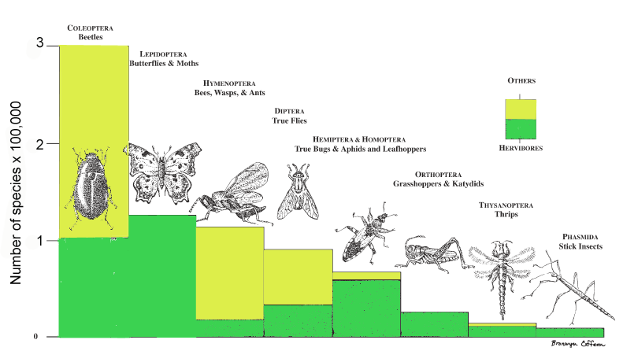
Insects herbivores: the most species-rich herbivore group
(although recent DNA barcoding may boost parasitoid Hymenoptera and sarcophagous Diptera numbers)

Slide 6
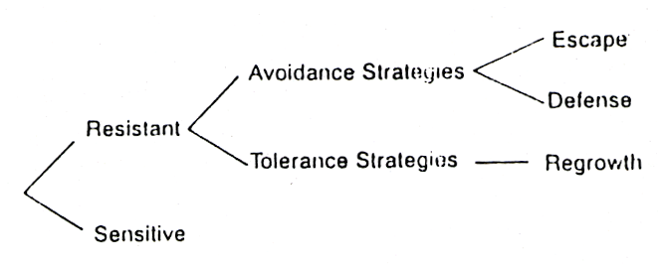
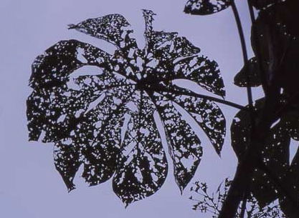
Plant defense strategies

Slide 7
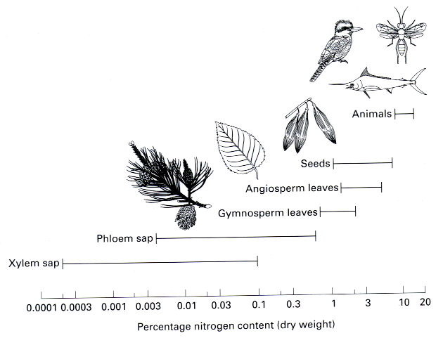
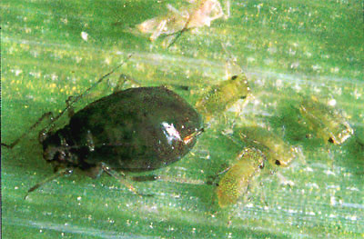
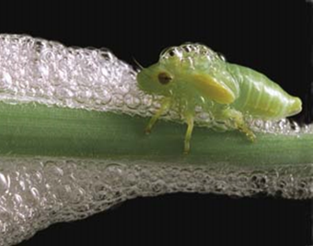
First line of defense:
plant body is constructed from very different materials than that of their herbivores

Slide 8

Relative consumption rate of caterpillars vs. leaf water & nitrogen

Slide 9
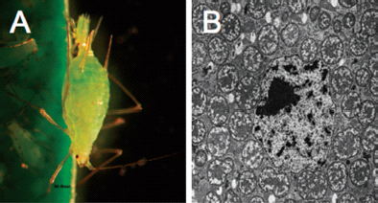
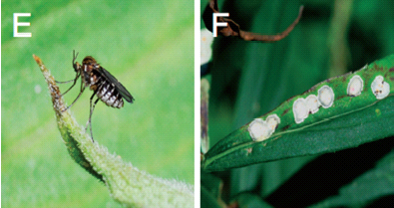
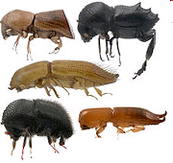
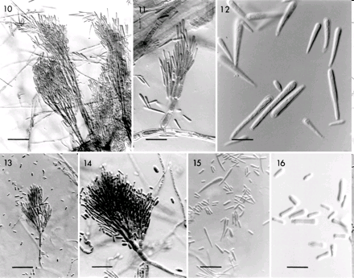
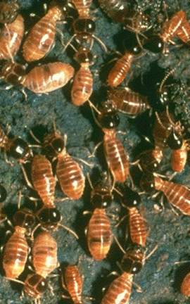
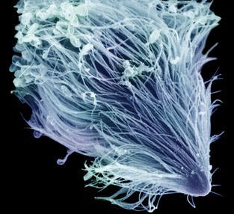
Aphid Acyrtosiphon pisum and bacterium Buchnera aphidicola from its mycetocyte
Poor quality of plants leads to various mutualisms with fungi, bacteria and protozoans, helping herbivores to digest plant matter
Cecidomyid fly Asteromyia carbonifera and galls with Bostryosphaeria fungus
Termites and a protozoan Trichonympha flagellate from their guts, decomposing cellulose
Ambrosia beetles and Ophiostoma clavigerum, one of fungi from their galleries
Janson et al. 2008, Evolution 62:997

Slide 10
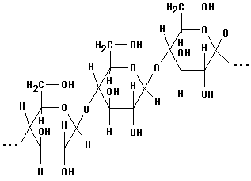
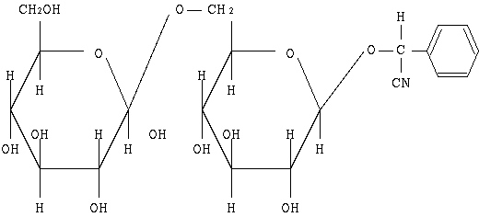
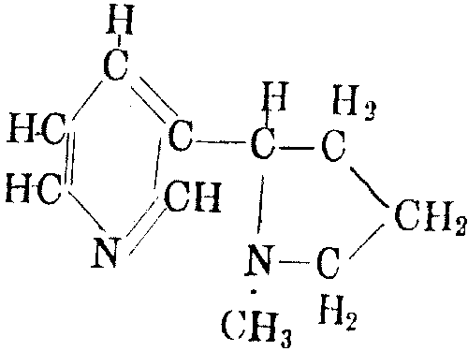
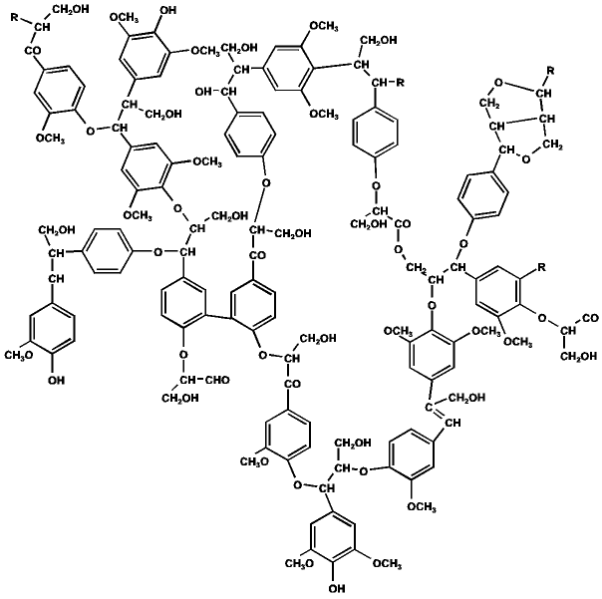
Chemical defense compounds:
quantitative vs. qualitative
cellulose
amygdalin
(cyanogenic glycosides)
nicotine
(alkaloids)
lignin

Slide 11
Cardenolide sequestration in Asclepias herbivores
Tetraopes tetraophthalmus
Labidomera clivicollis
Euchaetes egle
Danaus plexippus
Lygaeus kalmii
Oncopeltus fasciatus
Agrawal et al. New Phytologist (2012) 194: 28

Slide 12
Ecological correlates of qualitative x quantitative mode of defense
 | quantitative | qualitative
Examples | cellulose hemicellulose lignins tannins silica | alkaloids toxic amino acids cyanogens glucosinolates terpenoids
Ecological traits | large polymer molecules immobile costly to produce effective in large doses present in long-lived tissues present in apparent plants effective against most herbivores | small toxic molecules mobile cheap to produce effective in small doses present in growing tissues present in unapparent plants effective against generalists

Slide 13
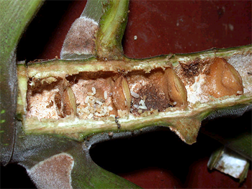
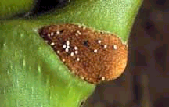
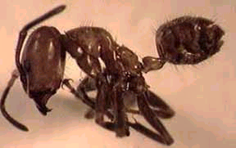
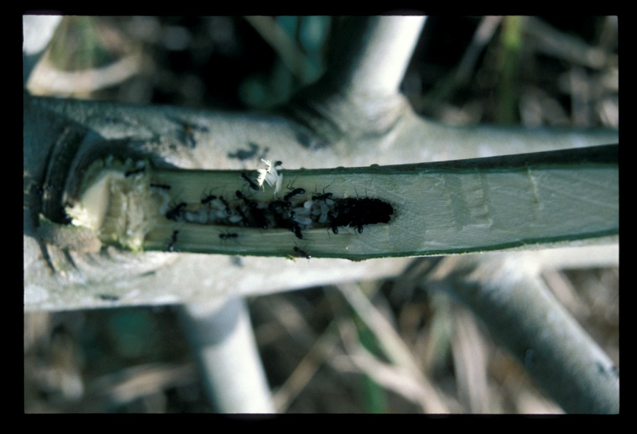
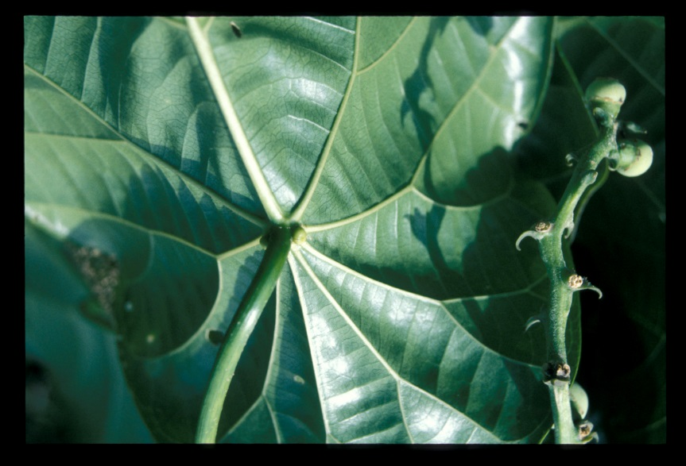
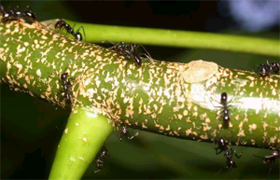
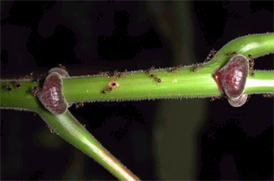
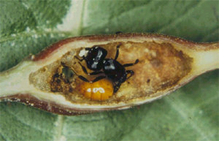
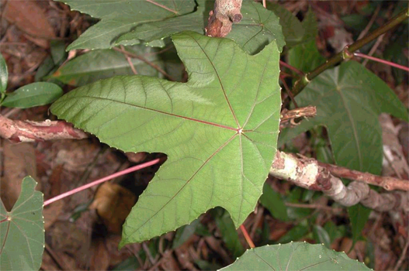
Cecropia plants - Azteca ants, America; plants produce glykogen rich muellerian bodies
Endospermum plants - Camponotus ants, New Guinea
Mutualistic ants:
biological defense
Macaranga plants - Crematogaster ants, South East Asia

Slide 14
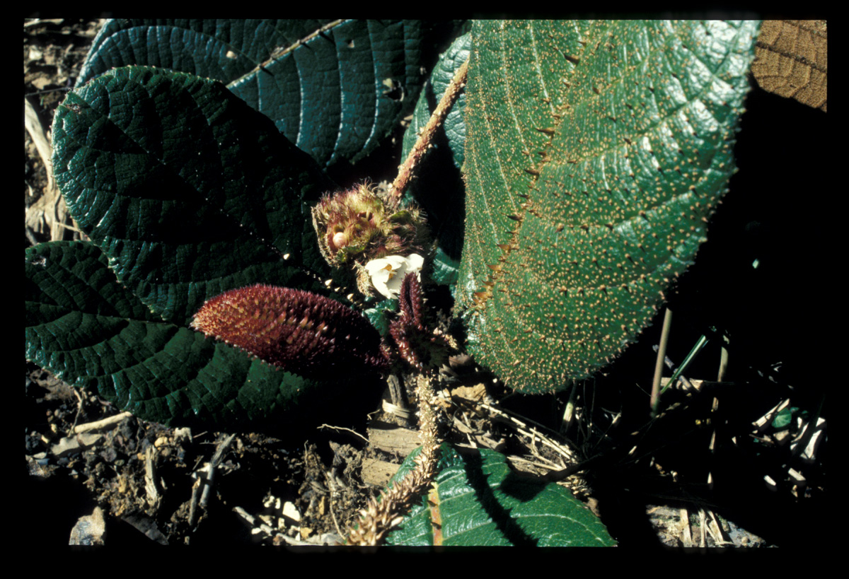
Thorns – mechanical defense

Slide 15
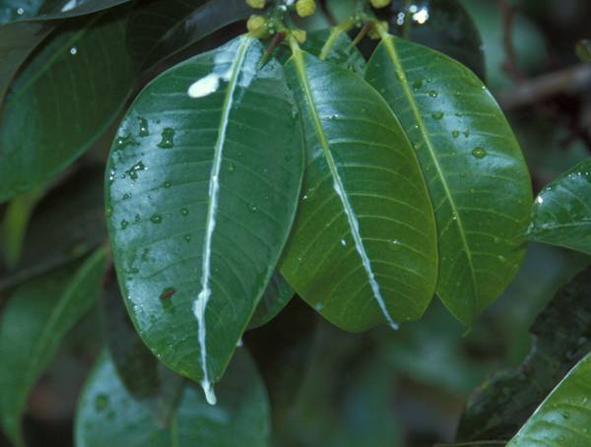
Latex – mechanical and/or toxic defense

Slide 16
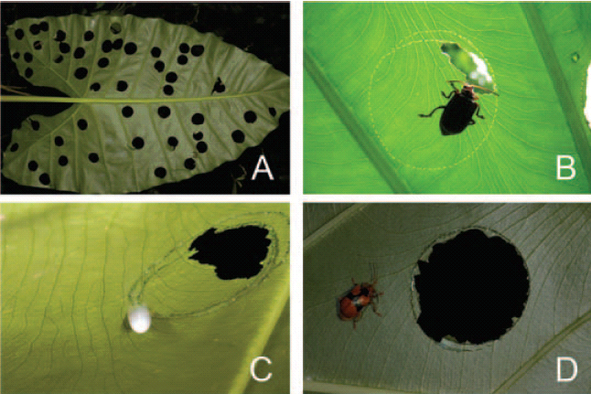
How to circumvent latex defence: leaf trenching
Trenching of aroid leaves [Alocasia, Colocasia] by chrysomelid beetle [Aplosonyx ancora]
Darling, 2007. Biotropica 39: 555–558

Slide 17
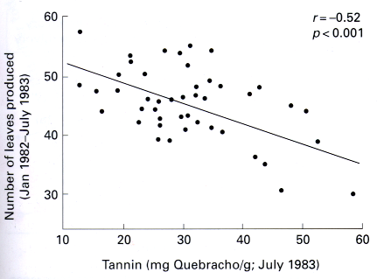
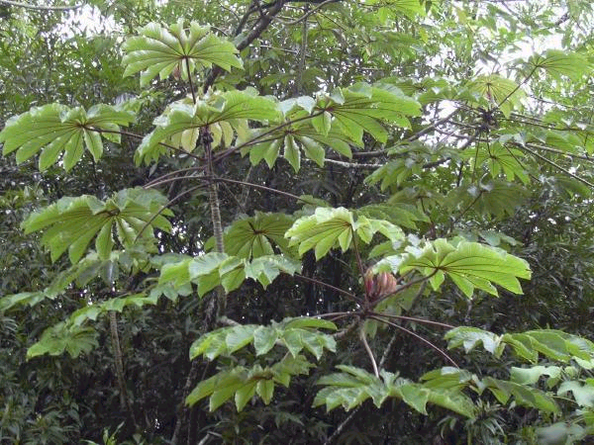
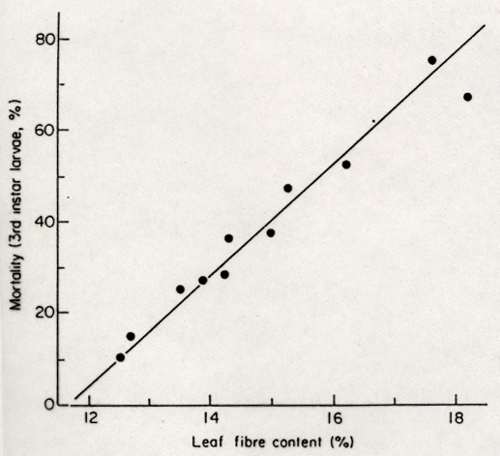
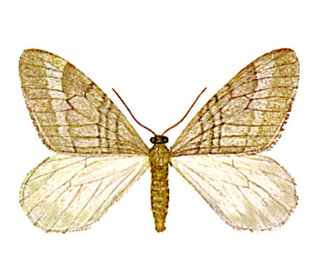
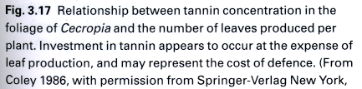
Production of secondary metabolites is costly…
Cecropia
… but it works (sometimes)
Operophtera brumata

Slide 18
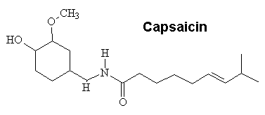
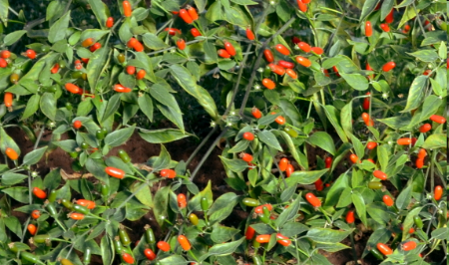
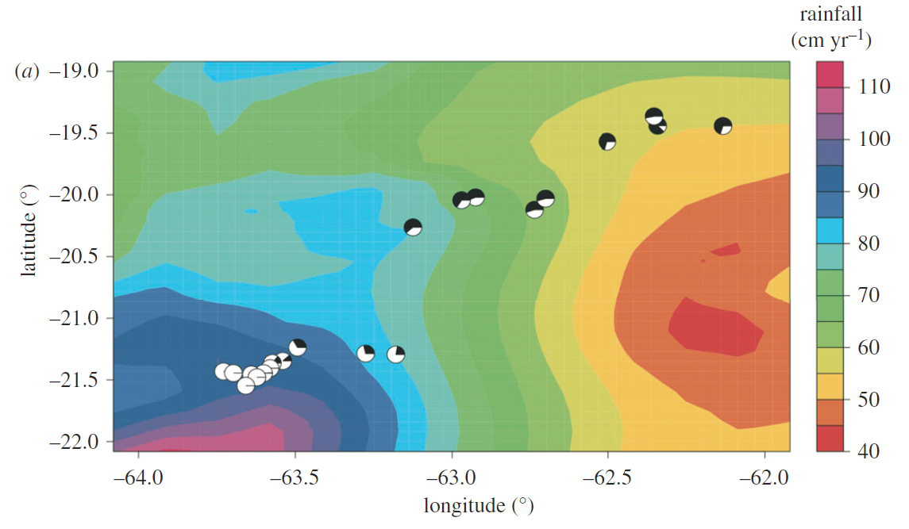
Why are not all chilies hot?
Area in Bolivia with proportion of pungent (white) and non-pungent (black) chilies
Capsicum chacoense
non-pungent
Production of capsaicinoids is costly in dry environment where its costs are apparently higher than benefits from protection against herbivory
pungent
Haak et al. Proc. R. Soc. B (2012) 279, 2012–2017

Slide 19
Three plant strategies:
high investment in growth and low in defense in resource-rich environment
-- apparent plants: tolerance to herbivory
-- unapparent plants: escape from herbivory in time or space
low investment in growth and high in defense in resource-poor environment

Slide 20
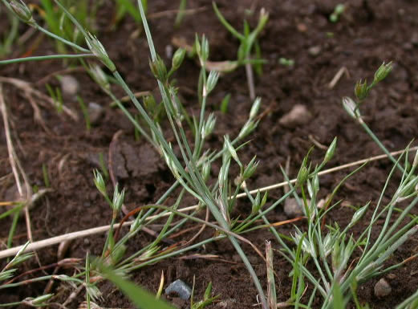
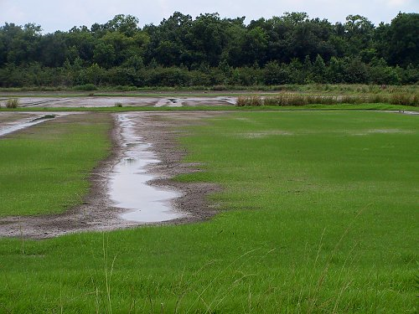
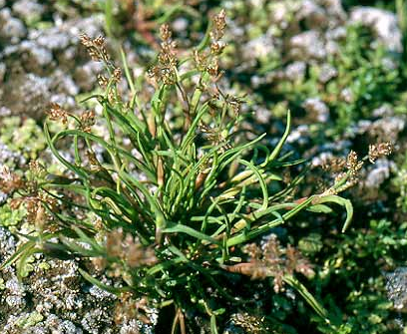


Apparent vs. unapparent plants
Juncus bufonius
Coleanthus subtilis
Phragmites communis
Carex bohemica

Slide 21




Finding a rare host plant: difficult in diverse vegetation
Acalymna vittate on cucumber plants

Slide 22




Are aphids unable to find their hosts in diverse vegetation?

Slide 23





Mass fruiting and seed predator saturation:
Quercus robur and cynipid wasp Andricus quercuscalicis in UK
Acorn production highly variable between years
% of galled acorns decreases with acorn production
Andricus
quercuscalicis
Crawley & Long Journal of Ecology 1995, 83, 683-696

Slide 24



Mass fruiting and seed predator saturation:
Larix trees and Strobilomyia flies in the French Alps
Heavy crop = lower % predation
Strobilomyia
Annual fluctuation of cone production in the European larch in in the French Alps (bars) and of global predation rates by Strobilomyia species
Poncet et al. Oecologia (2009) 159:527–537

Slide 25

Pioneer apparent plants: the main enemy is other plants;
the herbivores are thus “ignored” (and tolerated)

Slide 26
Resource availability hypothesis
(i) species adapted to resource-rich environments have intrinsically faster growth rates than species adapted to resource poor environments
(ii) fast-growing species have shorter leaf lifetimes than slow-growing species
(iii) fast-growing species have lower amounts of constitutive defences than slow-growing species
(iv) fast-growing species support higher herbivory rates than slow-growing species
Meta-analysis of effects on plant growth rate [50 studies]
Endara & Coley 2011:
Functional Ecology, 25, 389

Slide 27


… although herbivory is still costly.

Slide 28

Epiphytic orchids & bromeliads:
extremely well-defended plants
in low-resource environment
Tillandsia punctulata
Winkler et al. 2005

Slide 29
Leaf economics spectrum: one-dimensional trend in correlated traits
Herbivory
Leaf mass per area (LMA)
Leaf lifespan (LL)
Photosynthetic capacity (A_{mass})
Dark respiration rate (R_{mass})
Leaf nitrogen (N_{mass})
Leaf phosphorus (P_{mass})
return on investments of nutrients and dry mass in leaves
SLOW QUICK
Intsia
Macaranga
J. Wright et al. 2004, Nature 428, 851

Slide 30
And now for something completely different

Slide 31




Induced defense
Epirrita autumnata
Betula pubescens
Induced defence can be advantageous, as investment takes place only when there is a real risk of herbivory, but sometimes can come too late

Slide 32


How plants cry for help: signalling herbivory to predators
METHYL
JASMONATE
CONTROL
methyl jasmonate
E. MÄNTYLÄ, K. SAM , A. HUMLOVA
Mrazova & Sam 2017. Arthropod-Plant Interactions DOI 10.1007/s11829-017-9558-9

Slide 33
Discoveries of the effects of herbivore induced
volatile organic compounds
Discovery of the herbivore induced volatile organic compound (HI-VOC) receivers:
other plants
predatory mites
parasitoid wasps
predatory bugs
predatory lady beetles
herbivorous moths, which are repelled
parasitic plants
nematodes
systemic parts of the same plant
predatory birds
resistance to pathogens
Heil, New Phytol. (2014) 204: 297

Slide 34




Leaf damage increases attack rate on caterpillars
by birds and ants along altitudinal gradient in tropical forest
Tvardikova & Novotny 2012 J Trop Ecol.

Slide 35


Costs of mobile and immobile defenses: mobile defenses have to be produced constantly, immobile last for long time

Slide 36
Defended vs. non-defended plants: a game
 | Defended p | Non-defended 1-p
Defended | hB-hH-C | hB-hH-C
Non-defended | hB-hH-C | hB-hH-C
h = probability of herbivory, H = fitness cost of herbivore damage, C = cost of defence, B = competitive benefit from the opponent being damaged by herbivores; orange terms are zero;
p = frequency of defended plants in the population
-pC + (1-p)(hB-C) = -phH + (1-p)(hB-hH)
-pC+hB-C-phB+pC = -phH+hB-hH-phB+phH
C = hH

Slide 37





Caffeine: one of the ecologically most successful alkaloids enabling Coffee arabica, via a mutualistic relationship with a vertebrate species, to outcompete hundreds of plant species

Slide 38
And now for something completely different

Slide 39

Young vs. mature leaves:
unapparent high-quality vs. apparent low-quality resources

Slide 40





Slide 41


Defense of maturing bracken fern leaves
Pteridium aquilinum, UK

Slide 42


Feeding on young leaves is costly for the plant
Photosynthetic production of a population of leaves that
(a) has no mortality
(b) mortality risk increases with leaf age
[usual physiological pattern]
(d) mortality risk is constant
(e) mortality decreases with leaf age
[high herbivory pattern]
ZERO INCREASES
WITH AGE
CONSTANT
DECREASES
WITH AGE
ABUNDANCE
TIME
TIME
TIME
TIME

Slide 43
Young leaf: a precious resource difficult to defend
Kursar & Coley 2003

Slide 44




Slide 45



Delayed greening:
faster expansion with
lower N concentrations
Inga spp: defense vs. escape strategy
Kursar & Coley 2003
Kursar et al. PNAS 2009;106:18073-18078

Slide 46




Leaf:
damage
toughness
nitrogen
chlorophyll
Tropical herbivory:
young leaf is the critical stage
Ouratea
Desmopsis
Connarus
Xylopia
Kursar & Coley 2003

Slide 47
And now for something completely different

Slide 48


Herbivores determine
plant competitive hierarchy
reciprocal transplants of plants between clay and white sands in tropical forest
clay plants do better on clay
than white-sand plants
but
white-sand plants do better on white-sand only when insect herbivores are present
Fine et al. 2004, Science 305: 663

Slide 49

Top-down control:
birds and bats control arthropods on tropical foliage
(A) Mean number of arthropods per m2. (B) Mean herbivory as percent of total leaf area.
(C) Micronycteris microtis consuming a katydid. Barro Colorado Island, Panama.
Kalka et al. 2008. Science 320: 71

Slide 50

Responses of arthropods to lizard removal:
rainforest in Puerto Rico
In arthropods >2 mm, predatory (spiders), parasitic (Hymenoptera), and nonpredatory (Diptera, Coleoptera, Orthoptera, and Blattaria) spp. responded to lizard removal.
Dial & Roughgarden 1995. Ecology, 76: 1821-1834

Slide 51


Removal of predators: birds and bats in rainforest:
effect on herbivore abundance positive, declines with elevation
Predator exclusion:
Herbivore abundance increases (to 120-180% of original abundance)
In arthropod communities, % of predators increases (compensation)
In plants, damage of leaves increases (trophic cascade)
Katerina Sam Bonny Koane

Slide 52





Biological control of plants by herbivores:
the success story of Cactoblastis cactorum controlling Opuntia (Australia)

Slide 53





Salvinia molesta
and
Cyrtobagous salviniae

Slide 54
And now for something completely different

Slide 55





Does the host selection follows optimality rules?
Peucedanum palustre
Papilio machaon
Levisticum officinale
Pastinaca sativa

Slide 56

Herbivore host ranges are variable...

Slide 57
Why are there host specific herbivores?
genetically based trade-offs in performance between host species
interspecific competition for food or enemy-free space
increased resistance to generalist predators on some host plants
similarity of some hosts to unsuitable hosts
facilitated mate finding
facilitated defence against enemies [sequestering plant metabolites]
ability to aggregate and overwhelm plant defences
Why are there generalists?
hosts are rare, unpredictable, unapparent
small plants favouring larval grazing
risk spreading strategies due to temporal/spatial variability in host quality
intraspecific competition
predator and pathogen functional/numerical response
Jaenike, J. 1990. Annu. Rev. Ecol. Syst. 21:243-73

Slide 58



Why are there host specific herbivores?
genetically based trade-offs in performance between host species
simultaneous specialization to multiple hosts decreases fitness on any host plant species

Slide 59
Why are there host specific herbivores?
interspecific competition for food or enemy-free space
Fitness of herbivore X can be reduced on some plant species by competition from herbivore Y
Jaenike, J. 1990. Annu. Rev. Ecol. Syst. 21:243-73

Slide 60
Why are there host specific herbivores?
increased resistance to generalist predators on some host plants
Specialists are better protected on their host plant species from generalist predators
Jaenike, J. 1990. Annu. Rev. Ecol. Syst. 21:243-73

Slide 61

Why are there generalists?
hosts are rare, unpredictable, unapparent
small plants favouring larval grazing
risk spreading strategies due to temporal/spatial variability in host quality
Total supply of plant species A + B + C more abundant and less variable than for individual plant populations
Jaenike, J. 1990. Annu. Rev. Ecol. Syst. 21:243-73

Slide 62
Why are there generalists?
intra-specific competition
predator and pathogen functional/numerical response
optimum host selection:
N[herbivores] = 1
1A
N=2
1A, 1B
N=3
2A, 1B
Jaenike, J. 1990. Annu. Rev. Ecol. Syst. 21:243-73

Slide 63



Multiple meaning of host specificity

Slide 64



Host specificity mostly relatively narrow in insects and wide in vertebrates

Slide 65



alien plant
Herbivores on aliens:
Cytisus
scoparius
Memmott et al. 2000, Acta Oecol. 21:23

Slide 66
“Four ways towards tropical herbivore megadiversity”
Lewinsohn and Roslin (2008)

Slide 67










Latitudinal gradients in host specificity:
no plant standardization included
Low – high specificity
Low – high specificity
Lepidoptera host range

Slide 68


Standardising phylogenetic diversity among food webs
along latitudinal gradients
Temperate trees
Tropical trees
Novotny et al. 2006, Science 313:1115

Slide 69
Higher host specificity in the tropics: a naturally standardized
Curculio – Quercus system
Quantitative Quercus-Curculio trophic web for California and Nicaragua. Green and red color shows oak species affiliation to Quercus or Lobatae genus sections respectively
host range (a) and interaction strength (b) between weevil species (Curculio sp.) from California and Nicaragua. Host range = the number of oak hosts per weevil species, interaction strength = the number of larval emergences from the main host relative to all emergences
Peguero et al., Ecology, 98(8), 2017, pp. 2180

Slide 70
Oak leaf defenses:
higher in the tropics, and this gradient follows the climate.
Undefended -- Defended
Pearse & Hipp, Evolution 2012
Temperate -- Tropical

Slide 71



Vertebrate herbivores: mostly generalists, but with preferences
Generalists’ plant choice: minimizing time or maximizing energy

Slide 72
And now for something completely different

Slide 73

Niche structure of herbivorous communities:
ecological optimization or accidents of evolution?
Herbivores on bracken (Pteridium aquilinum):
replicated food web assemblage from different species pools

Slide 74


Regional species – area curve for bracken insects
Regional species pools vs. local communities

Slide 75



Community niche structure

Slide 76




Taxonomic composition of replicated herbivore communities on bracken
Noctuidae, Tortricidae, Pyralidae, Psychidae, Cosmopterigidae, Tineidae, Geometridae, Lyonettidae, Limacodidae, Gelechiidae, Lymantriidae, Lasiocampidae, Arctiidae
Cbo - Colembolla, Ort - Orthoptera, Het - Heteroptera, Hom - Homoptera, Thy - Thysanoptera, Dip - Diptera, Lep - Lepidoptera, Col - Coleoptera, Hym - Hymenoptera, Aca - Acarina

Slide 77








Lepidium draba

Slide 78








Frankliniella occidentalis
Colaphellus sophiae
Bryobia
praeticea
Lygus
elisus

Slide 79

Herbivore guild structure:
is it predictable?
is there between-guild compensation?
beetles and aphids highlighted just to illustrate general point of variability in guild composition among host tree species

Slide 80














Guilds differ in their host specialization

Slide 81





Specialized guilds tend to be species poor
generalists
specialists
low diversity high diversity

Slide 82


Island biogeography:
trees are “habitat islands”

Slide 83



Wilson and Simberloff (1970): experimental tests of the theory, monitoring arthropod immigration and extinction after complete defaunation of small mangrove islands offshore Florida
Experimental test of the effect of island area on species richness

Slide 84





Assembly of local communities from regional species pool
Cynipid species
England
Ant species
Australia
Hugueny & Cornell 2000
Soares et al. 2001

Slide 85



Species richness of herbivore communities: determined by plant abundance
same plant host
different locations
Leaf-miners on oaks, California
Leafhoppers on trees, UK
same geographic location
different host species

Slide 86






Plant evolution in real-time: changes after insect exclusion for 5 years
Oenothera biennis
Agrawal et al. 2012 SCIENCE 338
Mompha brevivitella
X
ambient insects
insects suppressed
Lower resistance to seed-eating insects
Higher competitive ability (with Taraxacum officinale)

Slide 87





Tannins (Oenothein A): decreased in fruits in the absence of insects
Lifetime seed production: correlated with oenothein but only when insects are present
Early flowering: advantageous response in the absence of insects
Agrawal et al. SCIENCE VOL 338 5 OCTOBER 2012

Slide 88

THE END

