Slide 1
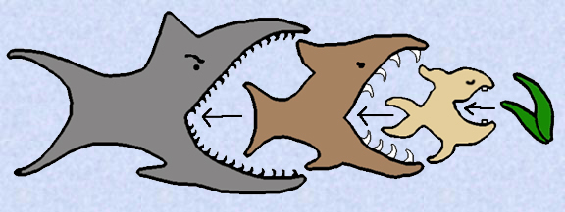
Food webs
VOJTECH NOVOTNY: COMMUNITY ECOLOGY LECTURE NO 4, University of S. Bohemia

Slide 2
ODE ordinary differential equations, MTE metabolic theory of ecology
Dormann & Bruthgen in “Food Webs: Science for Impact”, Moore et al Eds

Slide 3
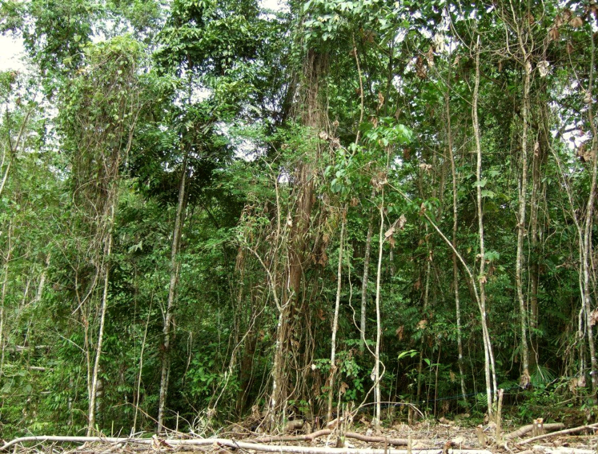
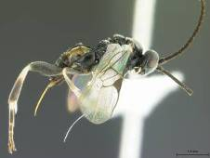
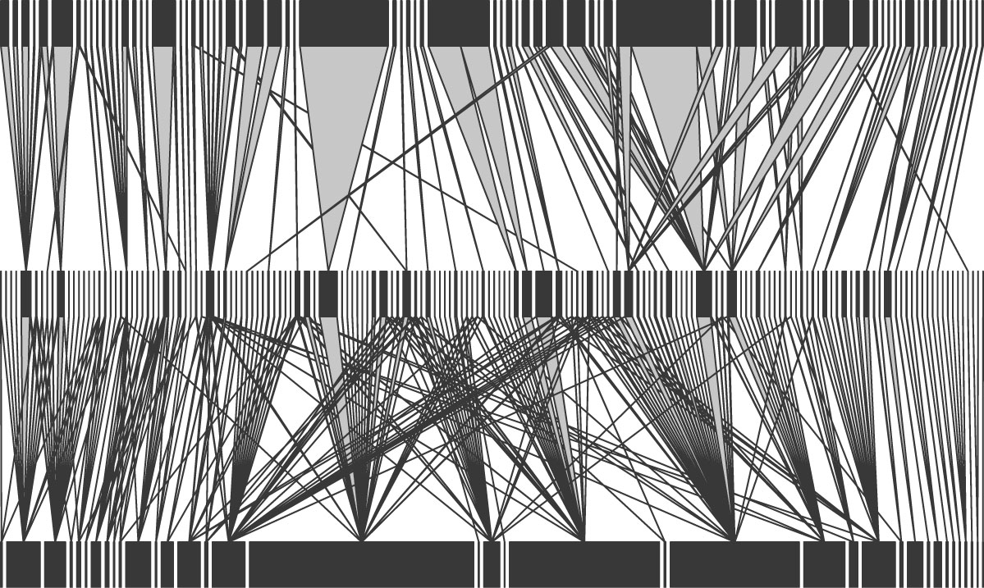

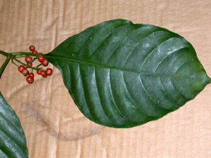
Tripartite food webs
1,523 parasitoids from 166 spp.
11,621 caterpillars from 267 spp.
38 tree spp.
Lowland secondary rainforest vegetation in Papua New Guinea
Jan Hrcek et al. 2013 Oecologia 173: 521

Slide 4
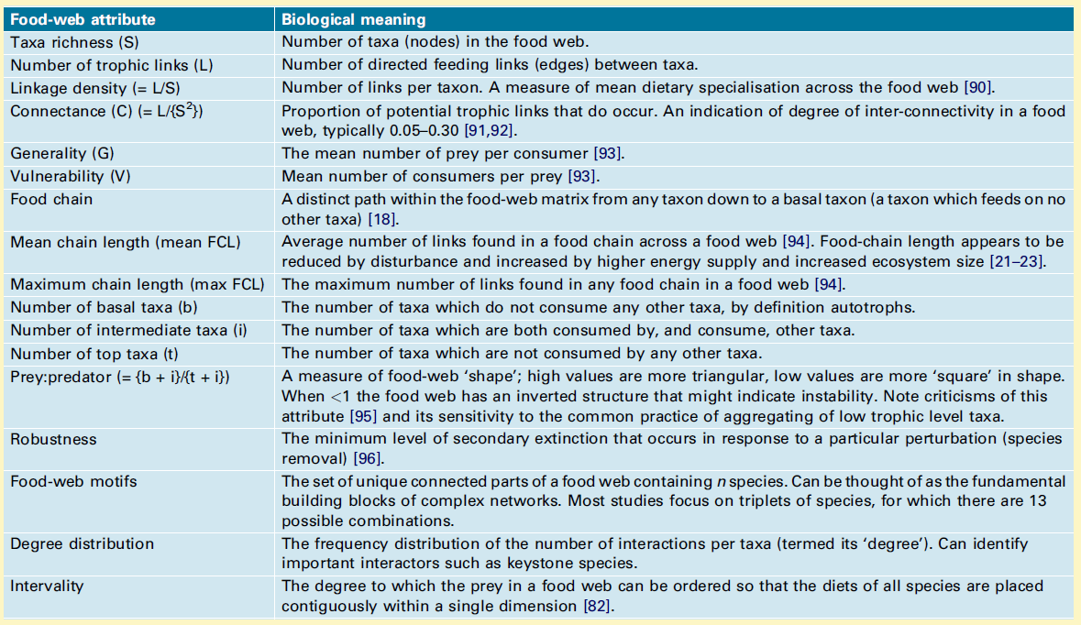
Lv3
Lv2
Lv1
S = 9
L = 10
Robustness = 2.5
L/S = 10/9 = 1.1
C = 10/9² = 0.12
G = (1+1+1+1+1+2+3)/7= 1.4
V = (2+3+3+1+1+0)/6 = 1.7
FCL = (2+2+2+2+2+2+1)/7 = 1.9
FCL_{max} = 2
b,i,t = 2,4,3
Prey:predator (2+4)/(4+3) = 0.9
Thompson et al. 2012, TREE 7, 689

Slide 5
Why are trophic chains limited to 3-4 trophic levels?
Energy flow hypothesis: 90% of energy lost in every trophic transfer [but more prodictive environments do not have longer chains]
Stability hypothesis: trophic chains integrate population variability of all their component species so that long chains can become unstable, with the extinction of the top species
Design constraints hypothesis: it is difficult to come with a predator capable of feeding on the existing top predators [have to be big, therefore low population density] or parasitising the existing hyperparasites
D. M. Post 2002. TREE 17: 269

Slide 6
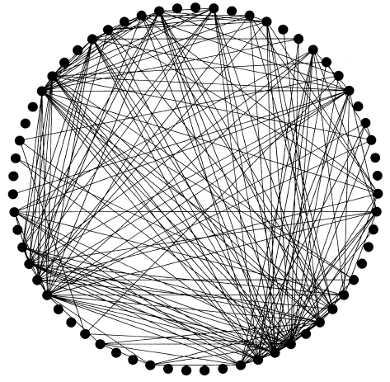
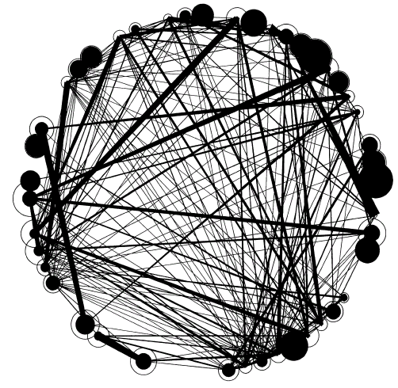
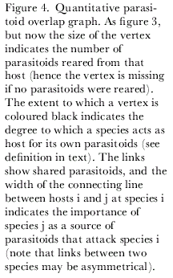
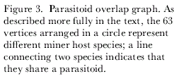
Leaf-miner species (dots) connected by shared parasitoids:
qualitative and quantitative description of reality

Slide 7
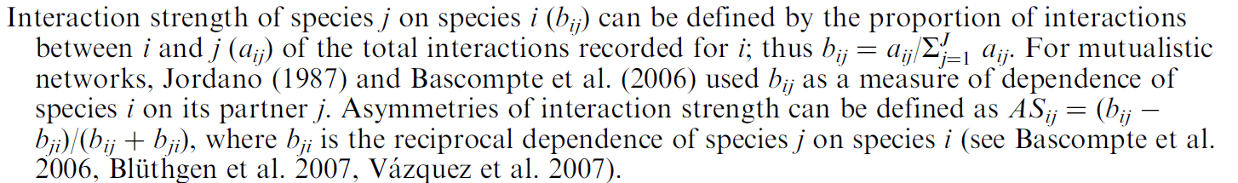
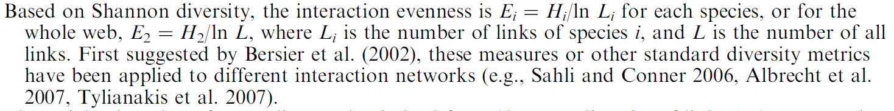
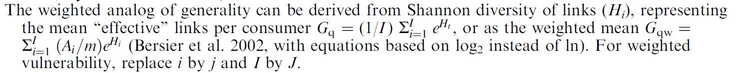
Bipartite network metrics: weighted links
Interaction strength
Interaction diversity
Interaction evenness
Weighted generality and vulnerability
Bluthgen et al. Ecology, 89(12), 2008, pp. 3387–3399

Slide 8
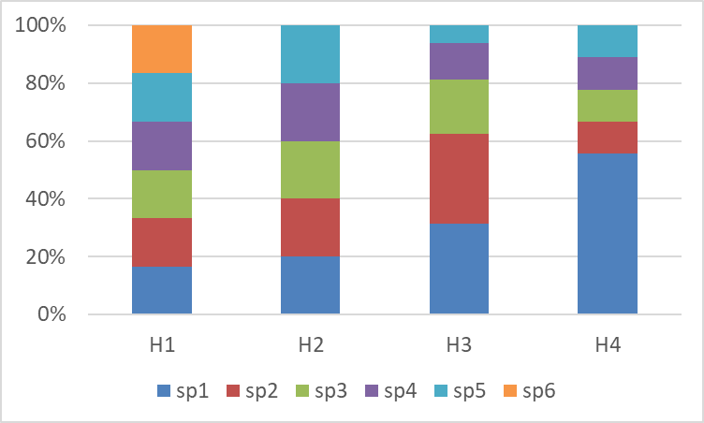
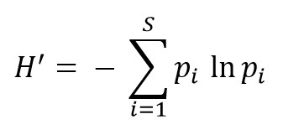
Shannon diversity
Quantitative food web descriptors
H1 > H2 > H3 > H4
Generality G1>G2 < G3
V1 < V2<V3 Vulnerability
Interaction diversity

Slide 9
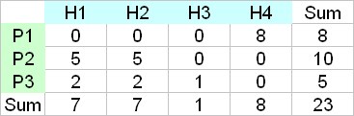




Quantitative plant - herbivore matrices and their uses
Diversity of host plants
plant-herbivore matrix
Diversity of host plants for herbivore H1:
H: - [(5/7)*log₂(5/7)+(2/7)*log₂(2/7)] = 0.863
2^{H} = 1.82 = the number of interactions occurring
in equal proportion that would produce the same value
of H.

Slide 10
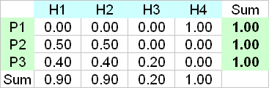
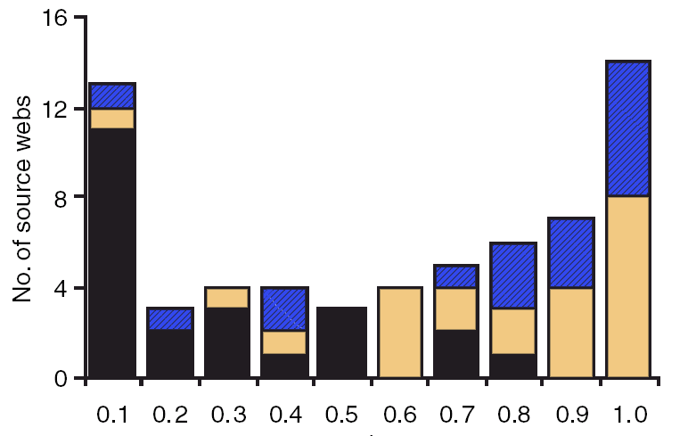
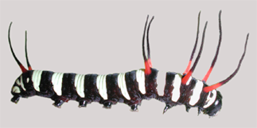
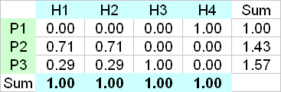
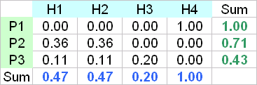
Quantitative plant - herbivore matrices and their uses
dominance of herbivores on each plant
Leaf chewing rainforest herbivores
New Guinea
dominance of plants in herbivore's diet
plant-herbivore matrix
two matrices multiplied:
x
=
Isolation of herbivore community
Host plant isolation: Probability that a randomly selected conspecific herbivore feeds on the same plant species
plants:
from locally monotypic families
coexisting with confamilial species
coexisting with congeneric species

Slide 11
Nestedness:
the extend to which are species-poor communities subsets of species-rich ones

Slide 12
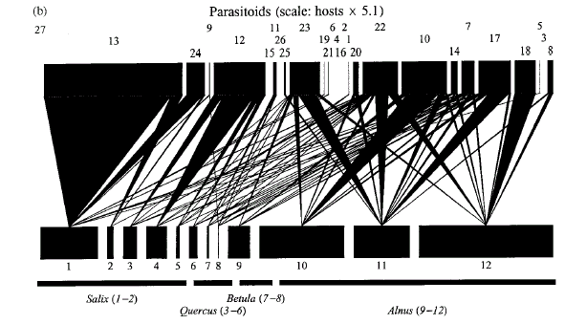
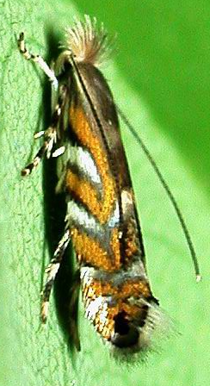
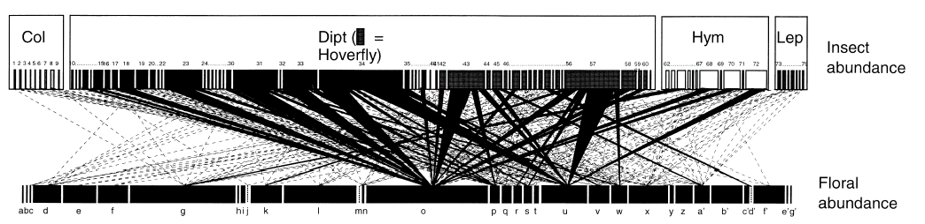

Parasitoids of a leaf-mining genus Phyllonorycter in England
Memmott J. 1999. Ecol. Letters 2: 279.
Pollinators in England
Rott & Godfray 2000, J. Anim. Ecol. 69:274

Slide 13
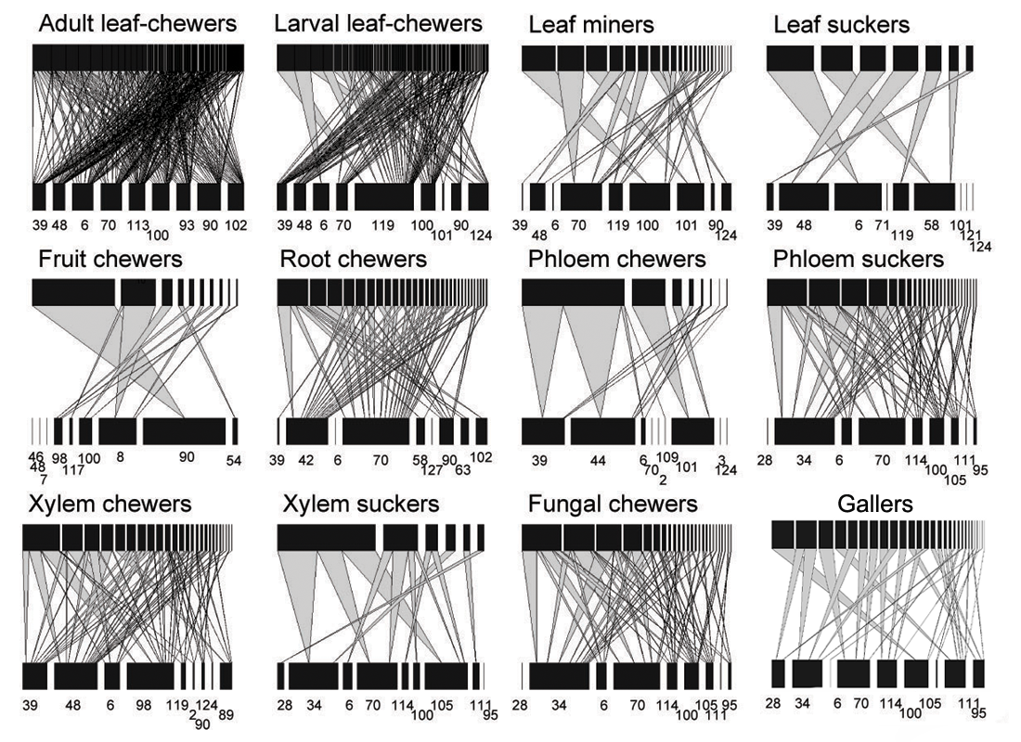













Herbivore guilds in tropical rainforest New Guinea
Novotny et al. 2010 J Anim Ecol

Slide 14
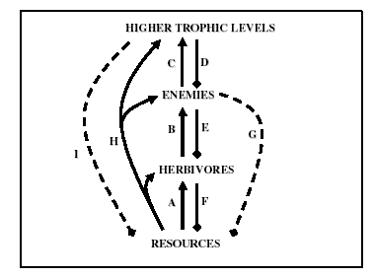
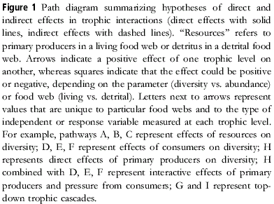
Indirect interactions:
in a well-connected food web, the potential for interaction between any two species via intermediate species is almost endless:
“the enemy of my enemy is my friend” principle

Slide 15
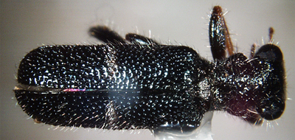
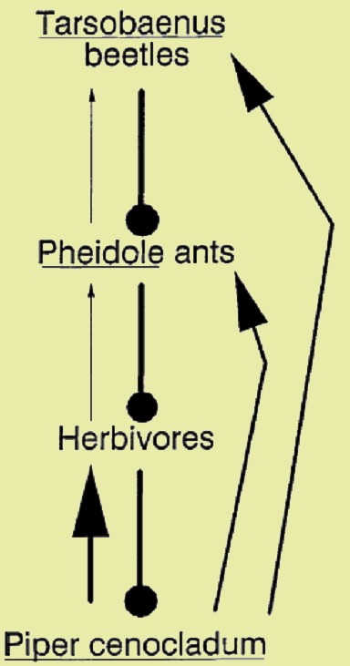
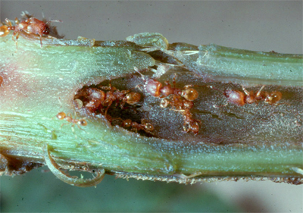
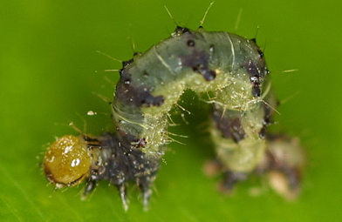
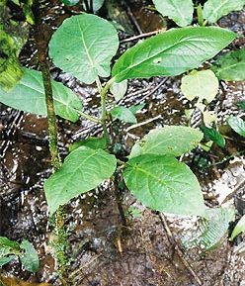
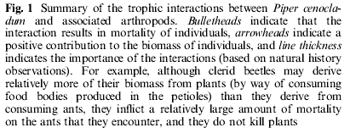
Indirect interactions along a rainforest food chain
Tarsobaenus added
Fewer ants
More herbivores
in a well-connected web, the potential for interaction between any two species via intermediate species is almost endless
“the enemy of my enemy is my friend”
Smaller plants
Dyer et al. 1999. Oecologia 119:265

Slide 16
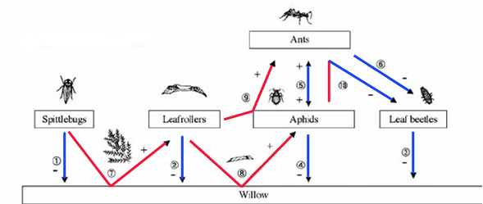
Direct and indirect interactions in a simple food web
Direct [blue] and indirect [red] interactions between willows and insects in Japan.
Plus and minus signs indicate effect on the target species.
Ohgushi, Annu. Rev. Ecol. Evol. Syst. 2005. 36:81–105

Slide 17
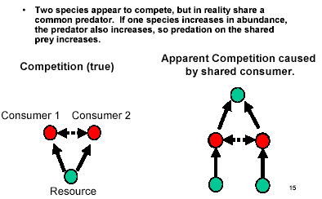
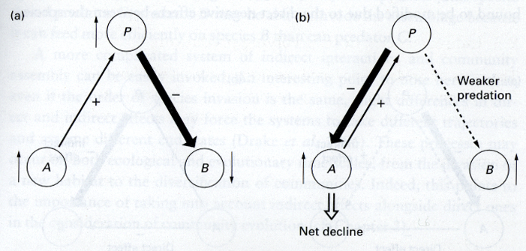

Apparent competition
Indirect interaction: an effect of one species on another, mediated through the action of shared natural enemies.

Slide 18
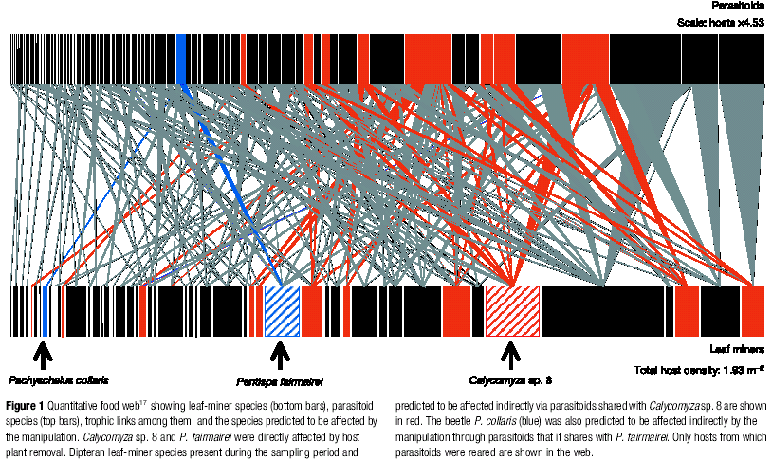
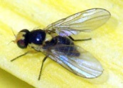
Plant-leaf miner-parasitoid food web in a forest understorey in Belize
Removal of a single host plant species eliminated its specialist leaf-miners (hatched) but also caused an increase in abundance and lower parasitism of other spp. (red, blue) connected via shared parasitoids
Morris et al. 2004. Nature 428:30

Slide 19
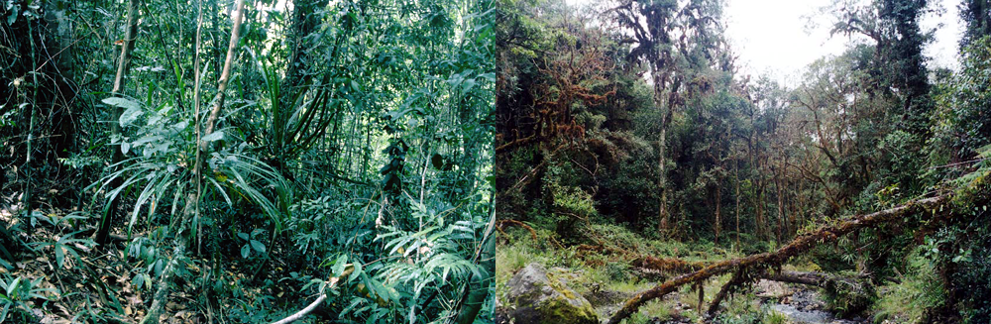
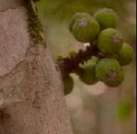
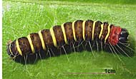

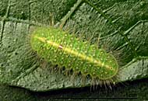
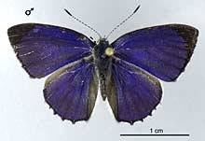

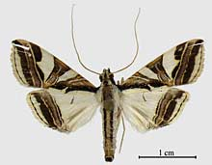

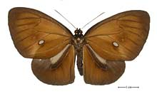
Ficus
Lowland rainforest 100 m asl.
Montane rainforest 1800 m asl.
F. pachyrrhachis
Asota
plana
F. iodiotricha
F. pachyrrhachis
Phyliris
moira
F. dammaropsis
Talanga
excelsalis
F. wassa
Euploea
leucosticos
F. wassa
Novotny et al. 2005, J. Biogeogr. 32:1303

Slide 20
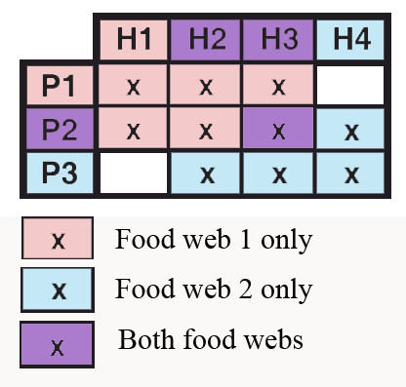
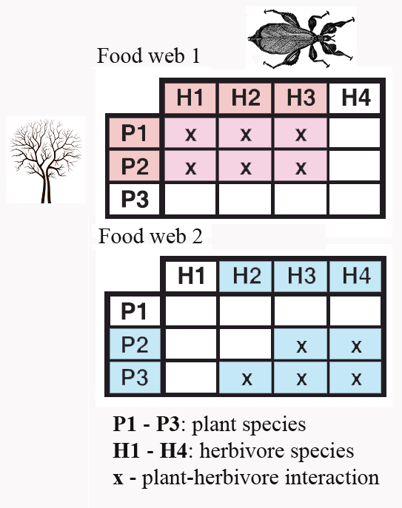
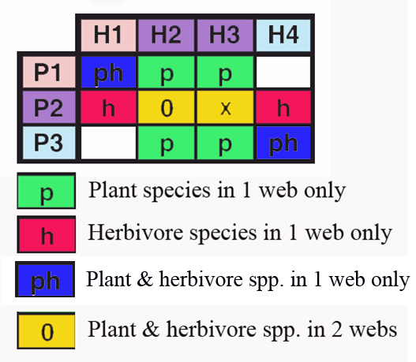
Novotny 2009, Insect Conservation & Diversity 2:5-9

Slide 21
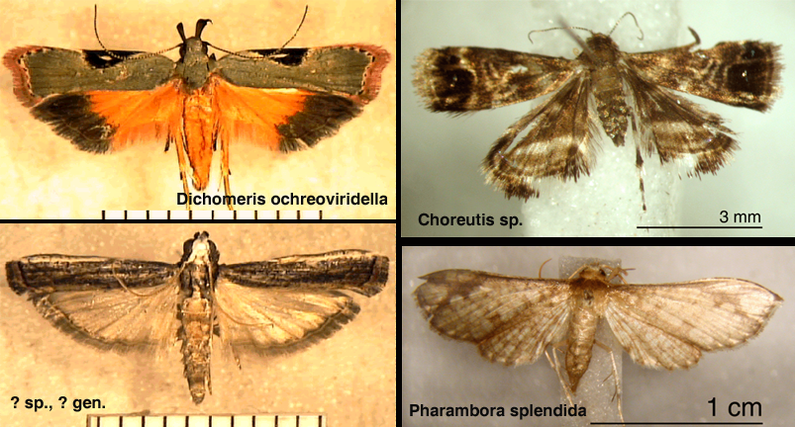
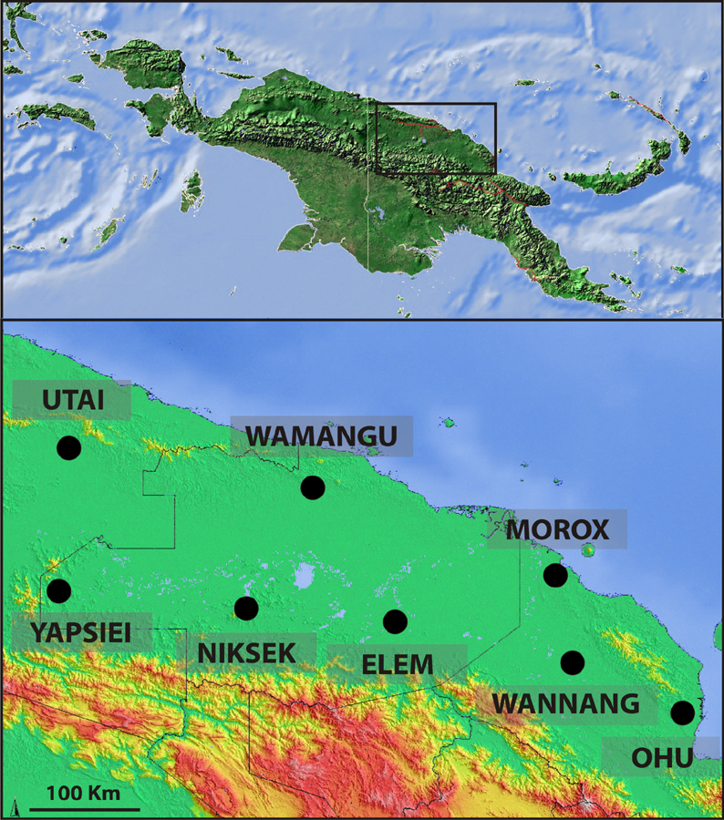
Caterpillars on
Macaranga trees
Novotny et al. 2007, Nature 448:692

Slide 22



Predators can reduce
inter-specific competition among their prey species
Paine's intertidal zone experiment: Removal of starfish predator Pisaster resulted in one Mytilus species competitively dominating the system and driving other species to extinction
Robert Paine
1933-2016

Slide 23
Top 10 from the top 100 papers in ecology:
Authors all UK/USA, nine papers published between 1957 and 1978. Hutchinson authored 3 papers! Average 1.4 authors per paper.

Slide 24






Top-down regulation: introduction of rats on polar islands caused decrease in marine birds, increase in molluscs, decrease in algae and thus increase in anemones and barnacles
rat:
present
absent
No. of gulls
introduction of rats
decrease of birds
increase of molluscs
decrease of algae
increase of anemones and barnacles
Algae cover
Barnacles cover
direct interactions
indirect interactions
Kurle et al. 2008, PNAS 105:3800

Slide 25





Trophic cascades across ecosystems
More pollinators visited Hypericum plants near ponds with fish, which reduced larval density of dragonflies, predatory in their adult stage on the pollinators

Slide 26

Food webs: the end

