Slide 1
Herbivory
Essentially predation, the prey is plant
Plant is predator:
parasites, mycoheterotophs, carnivorous plants
+ “Weirdly“ feeding plants

Slide 2
Herbivory
grazers – typically cow on a pasture, deer in a forest,
but also birds or mobile invertebrates, also mowing
  not much specialized –> pairwise interactions irrelevant
  Community ecology studies the effect of grazing
  on community of competitors,
    competition of plants via shared grazer – adaptations to grazing
    competition of grazers for resources (in general)
  More complex relationships
    frugivorous birds, pollinators: herbivory or dispersal?
  predators – seed predators (kill whole individual)
    Similar effect as grazers

Slide 3
Herbivory
parasites – a tree infected by caterpillars
(or various other small herbivores, galls, aphids...)
  Usually called just invertebrate herbivores, distinction from grazers often not clear, depends on mobility, size, level of specialization, research focus…
  The term may sound strange,
  but it may really be useful to quantify number of infected trees (like in models of epidemy) rather than number of individual herbivores.

Slide 4
Herbivory
Different consequence for individual and population
Killing a seedling
  Fatal for individual
  Negligible for population – it would most likely die anyway
Partial defoliation of adult plant
  Individual can recover
  Seed production of population can be significantly reduced
The importance of losses depends on the life cycle and life history characteristics of the eaten species
  remember sensitivity and elasticity analysis in matrix models
In many cases, the adverse effect is larger than proportional to the removed biomass (e.g. trunk damage, infection)

Slide 5
Herbivory and mutualism
Seed dispersal and pollination (detailed in next lecture on mutualism)
Consumed biomass is a cost for the service
  Dispersal can be haphazard or targeted to suitable sites / flowers
  Many seeds, but just one successful is enough to keep stable population
Clear adaptations – fleshy fruits, elaiosomes, nectar
Dubious adaptations
– seeds and other parts are eaten, but some seeds are dispersed far
  Quite high cost, but may still be worth for the dispersal
  Seedlings germinated in cattle excrements may have an advantage
  Squirrel always forgets some nuts (post-dispersal seed predation)
Pre-dispersal seed predation
  efficient for herbivore (seeds are the best before ripening), very bad for plant

Slide 6
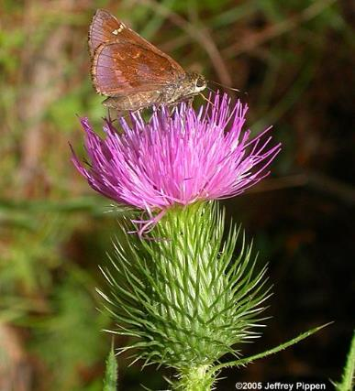
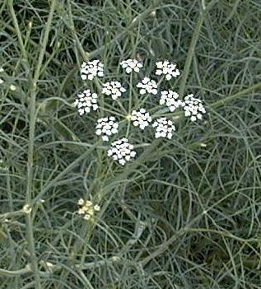
Herbivory and mutualism
Seed dispersal and pollination
Plant needs pollinators to find the flowers,
but not those which would eat the seeds.
Consequences on compactness of inflorescence:
Asteraceae Apiaceae

Slide 7
Seed predation
Mostly harmful, especially invertebrate seed predators.
  Escape in time – seed production just in some years
  Escape in space – Janzen-Connel hypothesis

Slide 8
Herbivory
Plant mostly survives, but the fitness is decreased
Eating can be accompanied with trasmission of patogens
– as well as „grazers“ of animals
Herbivory is almost always harmful for plants. If species is harmed less than its competitors, the effect can be positive. Also positive effects on dispersal.

Slide 9
What and how can be eaten
Roots, rhizomes (e.g. aphids, rodents)
Leaves and/or stems
  Large herbivores
  Guilds of invertebrate herbivores
  – chewers
  – suckers (phloem, xylem)
  – skeletonizers
  – miners
  – galls
Reproduction structures (flowers, ovaries, seeds)
Seedlings

Slide 10
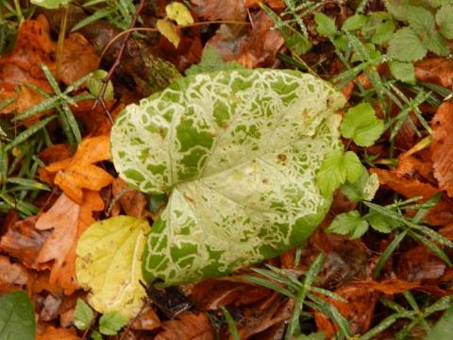
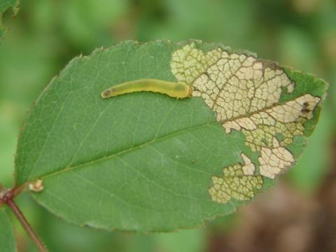
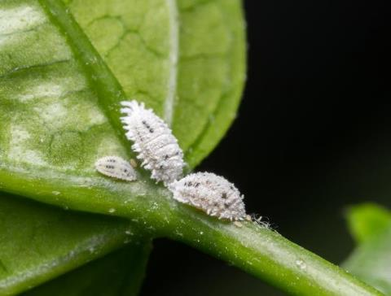
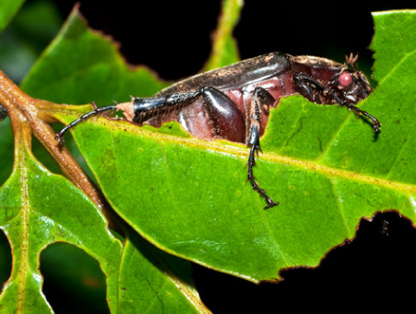
https://bugguide.net/node/view/51362
https://www.beefcentral.com/production/the-small-sap-sucking-insect-that-could-be-causing-pasture-dieback/
https://news.psu.edu/story/314397/2014/05/02/research/leaf-chewing-links-insect-diversity-modern-and-ancient-forests

Slide 11
How to study food specialization
Observations in nature:
  Data of Vojtěch Novotný from Papua New Guinea
    Food webs
Experiments:
  Each individuum gets just one type of food and record fitness
  Cafeteria experiments – offer more kinds of food
Various indices of food specialization

Slide 12
How to study food specialization
Food web: links of herbivores and plants:
  chewers – generalists
  miners and gallers – specialists
herbivore sp.
plant sp.
Volf et al. 2017

Slide 13
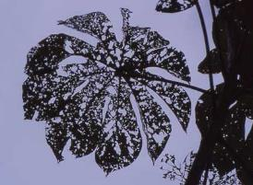
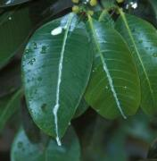
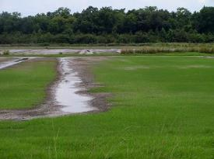
Plant response
Tolerance – compensation, regrowth
    Some leaves are eaten, but other grow up fast
Avoidance
  Defense
    costly – trade-off
    always present (depends on herbivorous pressure)
    permanent vs. plastic – produce more thorns only if eaten
  Escape in space or time
    population level, not individual
    get seeds beond (current) reach of herbivore
    Seed or biomass production in certain years only

Slide 14
Tolerance – compensation
In resource rich environment, high competition for light
Storage sugars are mobilized after biomass removal
Dormant buds can be activated (trees or clonal plants)
Eaten leaves reduce shading
– the rest of „leaf population“ photosynthetizes more (intra-individual competition for light).
Controversy: is there overcompensation?
  if so, then only at the cost of storage

Slide 15
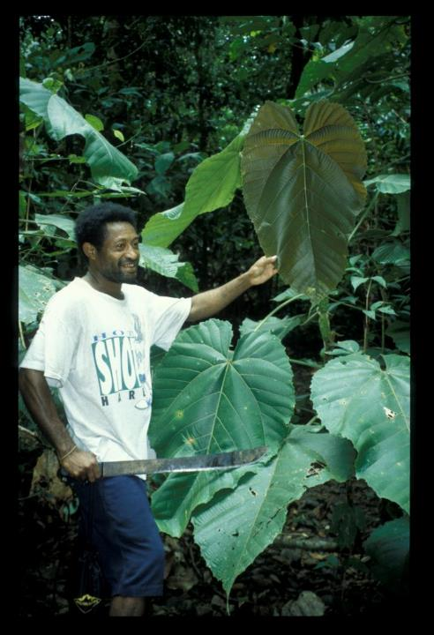
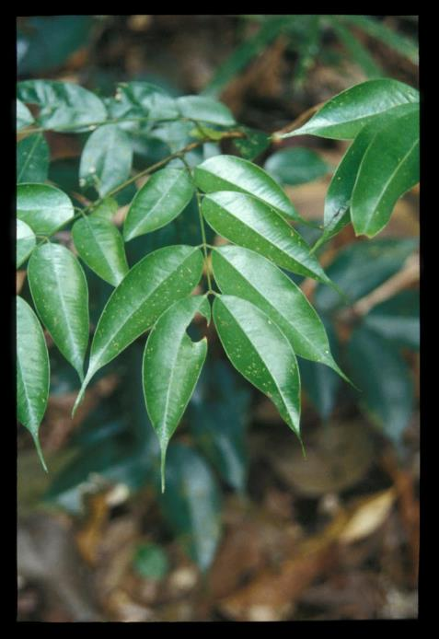
Apparent pioneers: tree species
leaves are large, thin, designed for maximum photosynthesis, short-lived and palatable to herbivores.
Macaranga sp., Euphorbiaceae, New Guinea, pioneer species
Mora gonggrijpii, Fabaceae, Guyana, primary species

Slide 16
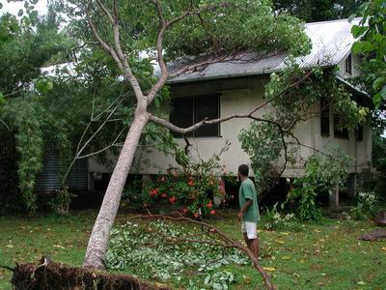
Pioneer trees: fast growth is what matters, and they grow VERY fast
Homalantus novoguineensis 4 years after planting a 1.5 m sapling (New Guinea)

Slide 17
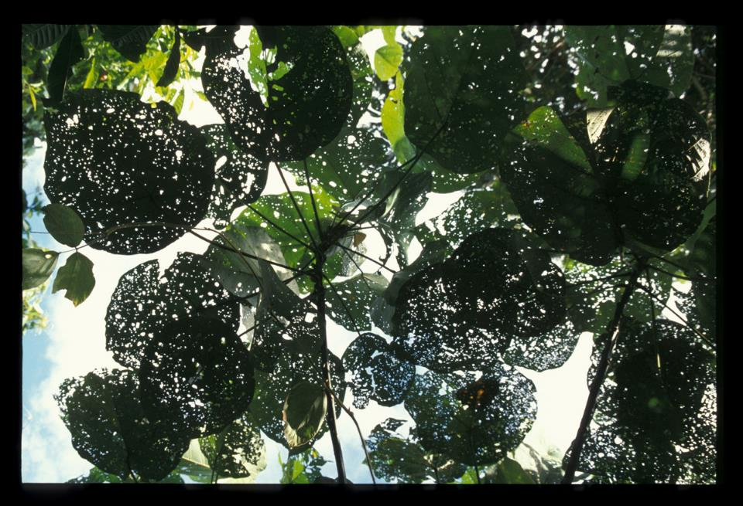
Pioneer apparent plants: the main enemy is other plants;
the herbivores are thus “ignored” (and tolerated)

Slide 18
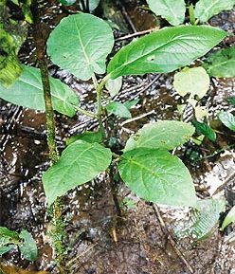
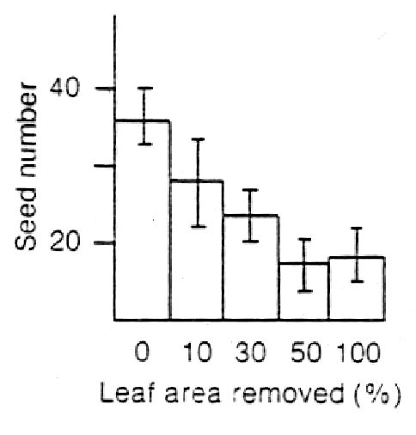
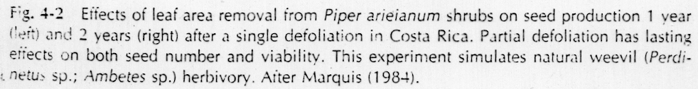
… although herbivory is still costly.

Slide 19
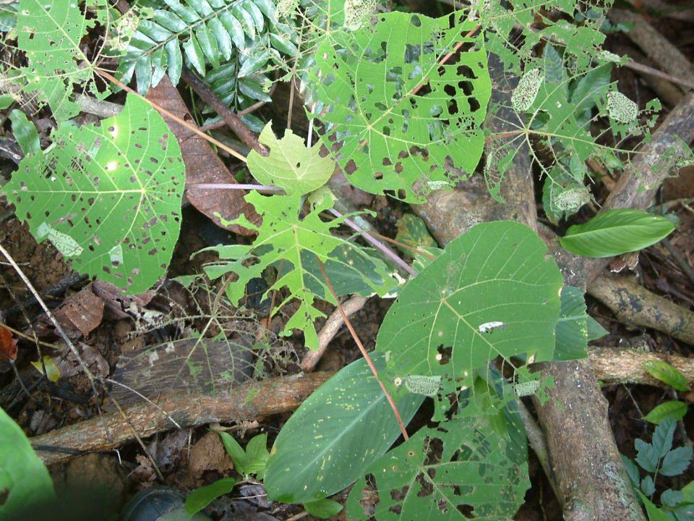

Slide 20
Plant defense
Mechanical
Tough leaves (monocots may be less eaten due to dense venation)
Thorns (against large herbivores)
Hairs (against invertebrates)
Chemical
Crystals (calcium oxalate, calcium carbonate, silicon dioxide)
Latex
Poisons (non-protein aminoacids, alcaloids, phenolic acids, terpenes, cyanogenic compounds)
Stingy hairs (againts vertebrates)
Biological
Mutualism with ants (domatia, extrafloral nectaria)
Plant volatile compounds (attract predators of herbivores)

Slide 21
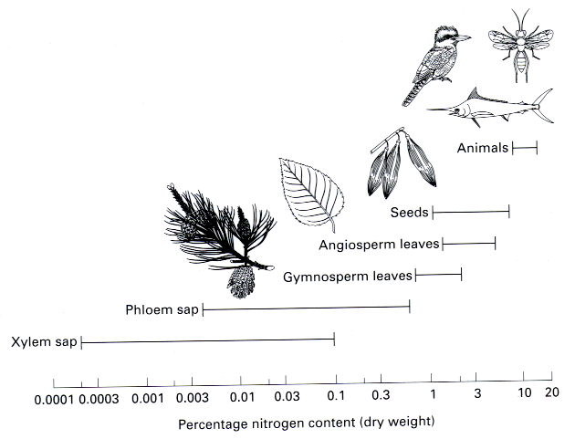
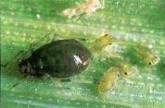
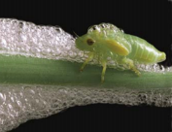
First line of defense:
plant body is constructed from very different materials than that of their herbivores

Slide 22
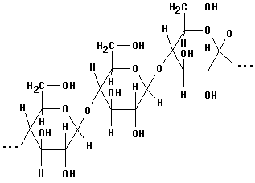
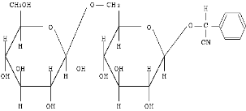
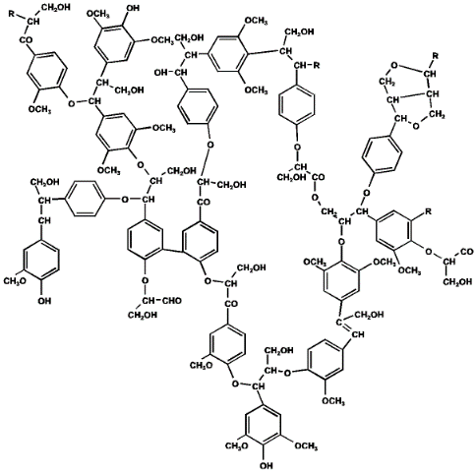
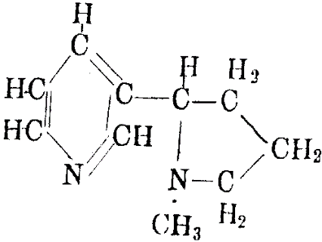
Chemical defense compounds:
quantitative vs. qualitative
amygdalin
(cyanogenic glycosides)
cellulose
nicotine
(alkaloids)
lignin

Slide 23
Ecological correlates of qualitative x quantitative mode of defense
quantitative
qualitative
Examples
cellulose
hemicellulose
lignins
tannins
silica
alkaloids
toxic amino acids
cyanogens
glucosinolates
terpenoids
Ecological traits
large polymer molecules
immobile
costly to produce
effective in large doses
present in long-lived tissues
present in apparent plants
effective against most herbivores
small toxic molecules
mobile
cheap to produce
effective in small doses
present in growing tissues
present in unapparent plants
effective against generalists

Slide 24
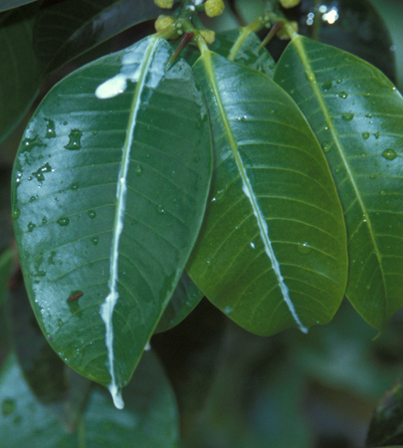
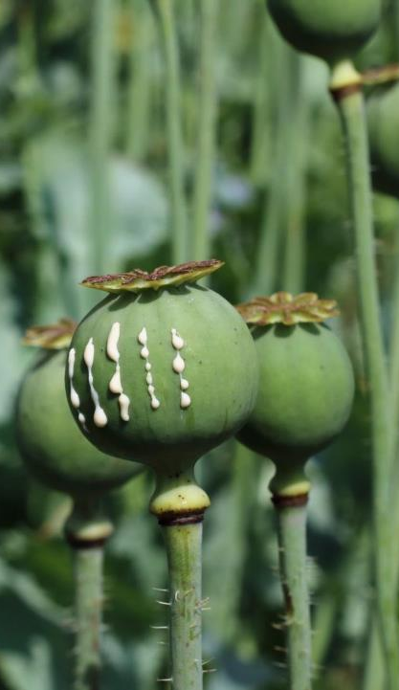
Latex – mechanical and/or toxic defense

Slide 25
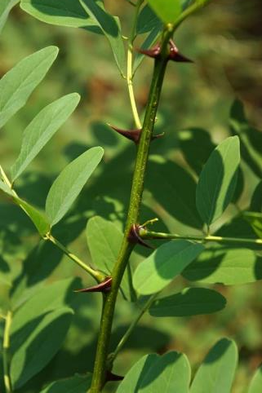
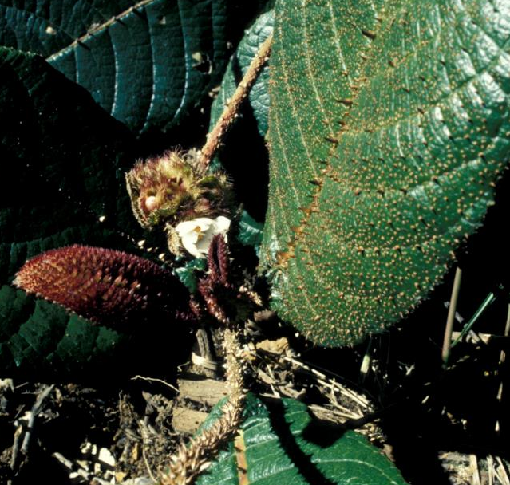
Thorns – mechanical defense

Slide 26
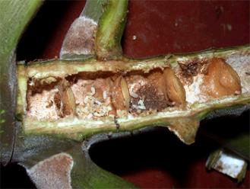
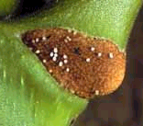
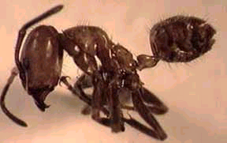
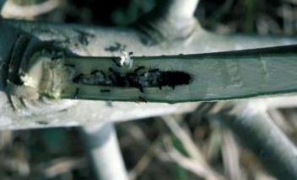
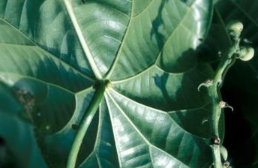
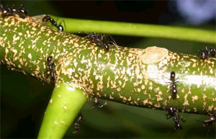
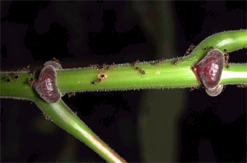
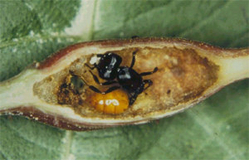
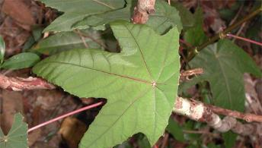
Cecropia plants - Azteca ants, America; glykogen-rich Müllerian bodies
Endospermum plants - Camponotus ants, New Guinea
Macaranga plants - Crematogaster ants, South East Asia
Mutualistic ants: biological defense

Slide 27
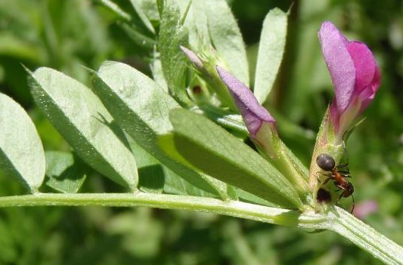
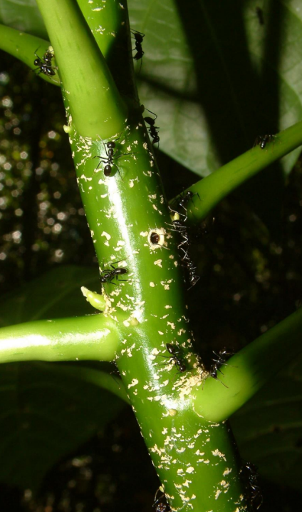
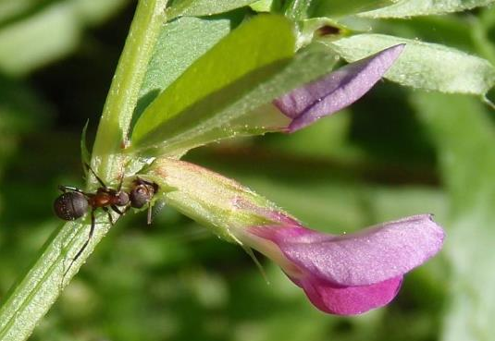
Mutualistic ants: biological defense
www.blanokridlivpraze.cz

Slide 28
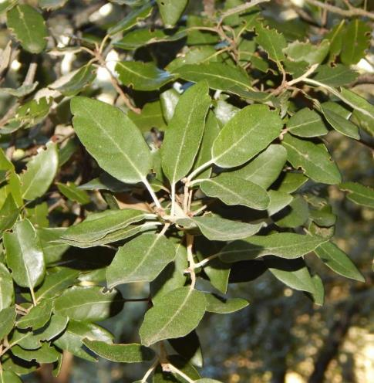
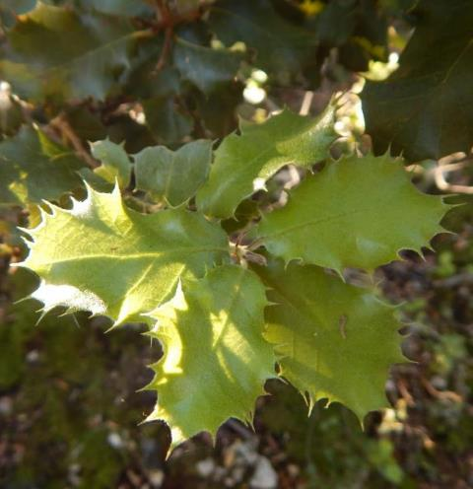
Plastic response
Quercus ilex – photo of the same individual
  Lower branches with thorns (within the reach of herbivores)
  Upper branches without thorns

Slide 29
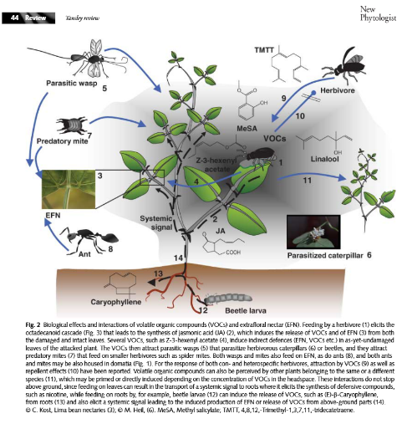
Volatile organic compounds (VOC)
VOC produced when plant is attacked
Not much is known,
experimental results
are inconsistent
Likely function:
  Directly suppress
  microbial activity
  Attract herbivore‘s predator
  (parasitoids, birds)
  Inform other branches,
  individuals or species

Slide 30
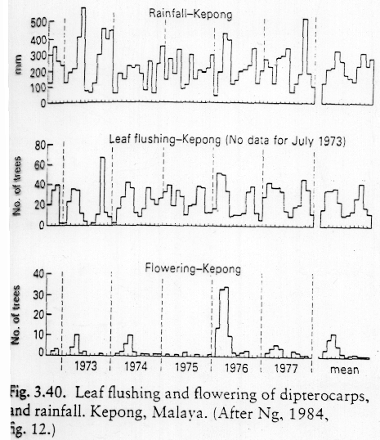
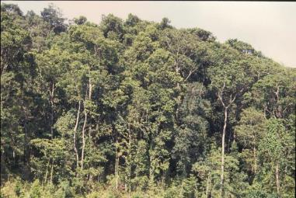
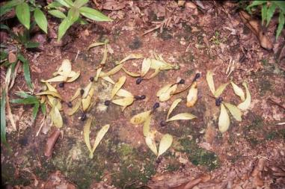
Escape in time Defense by
herbivore saturation
Dipterocarpus: mass flowering at irregular intervals of 2-10 years

Slide 31
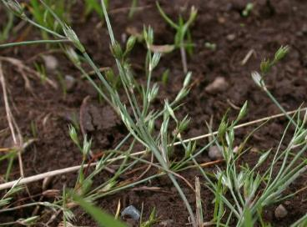

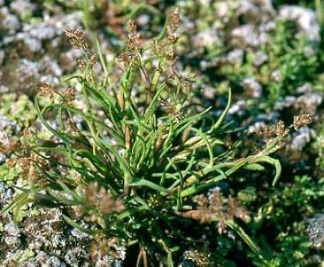
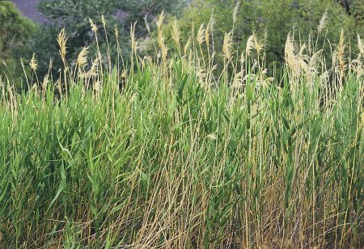
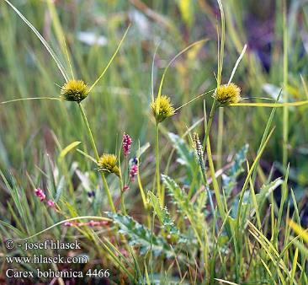
Apparent vs. unapparent plants
Juncus bufonius
Coleanthus subtilis
Phragmites communis
Carex bohemica

Slide 32

Three plant strategies:
high investment in growth and low in defense in resource-rich environment
-- unapparent plants: escape from herbivory in time or space
-- apparent plants: tolerance to herbivory
low investment in growth and high in defense in resource-poor environment

Slide 33
“Weirdly“ feeding plants vascular plants which feed on other organisms
(hemi-)parasites,
mycoheterotrophs,
carnivorous plants

Slide 34

Parasitic plants
Even vascular plants can parasitise

Slide 35
Types of plant parasites
Holoparasites – no photosynthesis,
get all resources from host, including asimilates
Hemiparasites – perform photosyntesis,
gain mainly water and mineral nutrients
(but a bit of asimilates as well)
Both types can be connected (using haustoria) to vascular bundles in roots or stems.
Stem vs. root parasites – canopy or ground

Slide 36

It is difficult to recognize hemiparasites in the field
– they are green, just their roots are very small.
Root hemiparasite
Rhinanthus minor Orobanchaceae

Slide 37

Root hemiparaistes
Rhinanthus, Melampyrum (Orobanchaceae)

Slide 38


Root hemiparaistes
Pedicularis (Orobanchaceae)
Root hemiparaistes
Bartsia
(Orobanchaceae)

Slide 39


Mistletoes - woody stem hemiparaistes
Viscum
(Santalaceae)
Root hemiparasites
Thesium (Santalaceae)

Slide 40

Mistletoes
woody stem hemiparaistes
Dendrophthoe curvata (Loranthaceae)

Slide 41
Host specificity
Holoparasites
Usually specialists – difficult to attack phloem
  Necessary to convince phloem cells
Usually need chemical clue to find out
that host is nearby,
so that it is worth for the seed to germinate

Slide 42
Host specificity
Hemiparasites
Usualy generalists (it is easier to connect to xylem), but there are hosts of different quality
It is more efficient to steel to a rich one – bests hosts are legumes (good source of nitrogen) and grasses (extensive root system), but there are exceptions.
It is possible to attach conspecific individuals – intraspecific interaction
– usually by chance

Slide 43




Defense
Functional haustorium
Mechanical defense (lignification, lysis…) at contact with new haustoria
Cameron & Seel (2007) New Phytologist

Slide 44


Effect on community
Specialization leads to different effect on hosts
– can change competitive ballance in community
If dominants are preferred hosts (and thus most suppressed), it is supposed to increase diversity
Rhinanthus is used in grassland restoration:
no parasite with parasite after two years

Slide 45
Root hemiparasites
Belowground – parasites – gain water and nutrients from xylem of host
Aboveground – competitors – light
Also gain organic carbon from host
(there is a bit of it in xylem),
as well as secondary metabolites

Slide 46
Parasites vs. productivity
Hadač 1969: data from Dolina siedmich prameňov (Slovakia)
Community biomass and abundance of parasites is often correlated
Do parasites decrease productivity of community?
Or are they outcompeted in productive communities?

Slide 47

Parasites vs. diversity
Study based on about 180.000 vegetation plots across Europe
Parasites tend to occurr in rich and even communities
Těšitel et al. 2024

Slide 48

Parasites vs. productivity
It is worth to steal only resource which is in shortage
Host should be strong enough so that it is possible to steal from him, but not too strong to outcompete me for light.

Slide 49

Parasites vs. productivity
Holoparasites are not limited by competition – no need to photosynthesize
(Orobanche on Petasites)
http://parasiticplants.org/i3m5a2g8e/ipps_photos/Photo_Orobanche_flava_Toth.jpg

Slide 50

Root holoparasite Cystanche cf. tubulosa (Negev desert)

Slide 51


Root hemiparasites
Mostly herbs
Can be shrubs or large trees, larger than host
Santalum acuminatum, Nuytsia floribunda
http://www.parasiticplants.siu.edu/Santalaceae/images/SantalumAcuminatum1RH.jpg
https://www.australiangeographic.com.au/topics/wildlife/2017/05/australias-giant-parasitic-christmas-tree/

Slide 52

Root hemiparasites
Okoubaka aubrevillei (Santalaceae) – 40 m tall tree
http://www.parasiticplants.siu.edu/Santalaceae/images/OkoubakaHabit1.jpg

Slide 53

Luxury use of resources
If parasites have surplus of stolen resources,
they can affor unusual behaviour.
Permanently open stomata
Plants normally close stomata to save water
during dry spells and at night
Hemiparasites often do not close stomata
  gain water permanently
  transpiration keeps cool
  – resistence to overheating
Total biomass (incl. hemiparasite)
is usually lower compared to
non-parasitised community
Rhinanthus pulcher

Slide 54
Luxury use of resources
Xylem contains not just water, but also
organic carbon (only very little, but when lot of xylem is stolen, quite a lot of carbon can be accummulated)
secondary metabolites from host
mineral nutrients – more than needed,
accumulated in biomass, produce
nutrient-rich fast-decomposable litter
  Enhance nutrient cycling (substantial in tundra)
  Inoculates litter of other species,
  which also decomposes faster
  supports establishment of (host) seedlings
Rhinanthus pulcher

Slide 55

Luxury use of resources
Endothermy
Raflesiaceae parasites display warm flower
(by up to 9°C than surrounding air),
increased CO₂ concentration, smell.
Simulate excrements
or fresh carcases and attract
insects to lay eggs.
Partial endothermy
(high respiration)
is demanding,
only parasites can afford it.
Rhizanthes –
even hairy like a carcase
http://www.parasiticplants.siu.edu/Rafflesiaceae/images/Rhizanthes.flw1.JPEG

Slide 56



How to model hemiparasites
Interesting model
  Dual relationship with host
    below ground – parasitism
      partially selective – change competition equilibria of hosts and non-hosts
    above ground – competition for light
  Fast population dynamics
    most of our species are annual
    short-lived seed bank – heavily rely on seed production
Rhinanthus minor

Slide 57
How to model hemiparasites
Fibich P., Lepš J. & Berec L. (2010). Modelling the population dynamics of root hemiparasitic plants along a productivity gradient. Folia Geobotanica 45: 425-442.
Parasite + host
Parazitism (parasite harms)
+ competition (host is stronger)
Model based on model of predation,
with added competition
Can lead to stable cycles
High host density may
lead to eradication of
hemiparasite
(unlike in predator-prey model)

Slide 58
How to model hemiparasites
Cameron D.D., White A. & Antonovics J. (2009). Parasite–grass–forb interactions and rock–paper–scissor dynamics: predicting the effects of the parasitic plant Rhinanthus minor on host plant communities. Journal of Ecology 97: 1311-1319.
Parasite,
grass (host,
strongest competitor),
other herbs (resistant,
weaker competitor than grass but stronger than parasite)
No winner –> cycles
Several flaws in model,
but appealing behaviour
Notes:
The model leads to extremely fast exponential growth, therefore they present relative abundance only („the superscript indicates that the frequencies are corrected by the total“).
The time scale is irrelevant.
The wPG parameter is calculated as ratio of parasite biomass with and without grass (without grass, the biomass is very low, so the ratio is very high), but is used to multiply parasite's biomass in previous time step with host.

Slide 59
How to model hemiparasites
Cameron D.D., White A. & Antonovics J. (2009). Parasite–grass–forb interactions and rock–paper–scissor dynamics: predicting the effects of the parasitic plant Rhinanthus minor on host plant communities. Journal of Ecology 97: 1311-1319.
+ spatial structure
+ stochasticity
Stochasticity leads to differenciation between cells, prevents complete stabilisation. Spread to neighbouring cells leads to spatial clusters and overall stabilisation (if some group goes extinct, it can disperse back)

Slide 60


Mycoheterotrophic plants
hosts – fungi
Typical for non-green orchids – gain organic carbon from fungi (which likely gets it from other plants)
Gradient from mutualists to parasites
Limodorum abortivum
Neotia
nidus-avis
www.lublin.lasy.gov.pl/image/

Slide 61
Carnivorous plants
never classified as parasites
  formally – classical predation
Catch animals using various kinds of traps
Do not get energy from the prey,
but mainly nitrogen compounds
  similar as in hemiparasites
Photosynthetize on their own
Advantageous where nutrients are not available
– peatbogs, epifytes…

Slide 62


Pinguicula alpina
(Lentibulariaceae)
Pinguicula vulgaris

Slide 63

Drosera rotundifolia
Foto Vladimír Šimek

Slide 64


Nepenthes
- Papua New Guinea
Utricularia australis
(Lentibulariaceae)

Slide 65




Non-consumer „parasitisms“
Services are provided for free
  energy is not obtained but saved
Nesting parasites
Structural parasites (epiphytes, climbers)
  do not consume the host, but harm it
Exozoochory
  beneficial for plants, annoying for animals
Deceptive flowers
  colourful flowers without nectar
…

Slide 66
(partly) omitted aspects of predation
Spatial structure
Selectivity, specialization, food preference, switching, optimal foraging
Competition of predators and prey
(competition of prey can be affected by predation)
will be in Community Ecology

