Slide 1
Matrix population models
(Matrix projection models, MPM)
Models of (age- or stage-) structured populations

Slide 2


Chapter 4.7.3 and 14.3.2
Czech translation

Slide 3
Matrix models
Individuals are classified to categories by:
  Age (usually animals)
  Size or stage (usually plants)
Known probability of transitions between classes
  age/stage specific natality and survival or growth.
Assume constant parameters

Slide 4
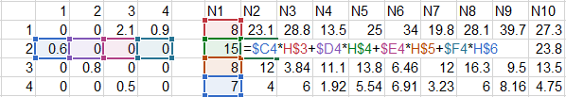
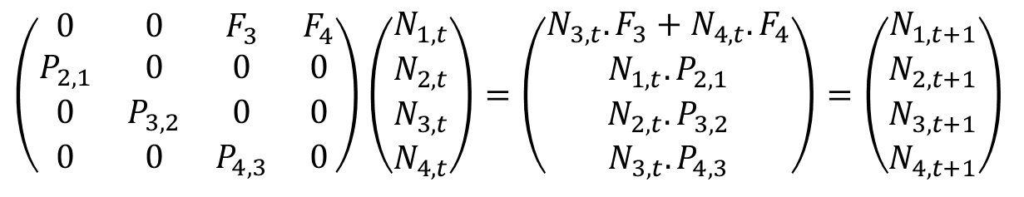
Age classes – Leslie matrix
Size of each class is the same as one time step (usually 1 year)
P – Probability of survival
F – Fertility
Number of offspring per one 3 years old individual.
(usually, just females are modelled)
from class
1 2 3 4
to class
4 3 2 1
$$\left(\begin{matrix}0 & 0 & F_{3} & F_{4} \\ P_{2,1} & 0 & 0 & 0 \\ 0 & P_{3,2} & 0 & 0 \\ 0 & 0 & P_{4,3} & 0\end{matrix}\right)\left(\begin{matrix}N_{1,t} \\ N_{2,t} \\ N_{3,t} \\ N_{4,t}\end{matrix}\right)=\left(\begin{matrix}N_{3,t}.F_{3}+N_{4,t}.F_{4} \\ N_{1,t}.P_{2,1} \\ N_{2,t}.P_{3,2} \\ N_{3,t}.P_{4,3}\end{matrix}\right)=\left(\begin{matrix}N_{1,t+1} \\ N_{2,t+1} \\ N_{3,t+1} \\ N_{4,t+1}\end{matrix}\right)$$
(zero items omitted)
Proportion of 2 years old individuals which survive to the 3rd year.

Slide 5
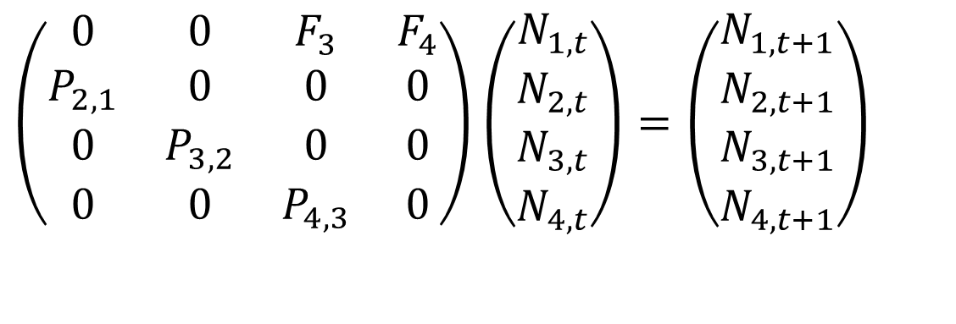
Age classes – Leslie matrix
$$\left(\begin{matrix}0 & 0 & F_{3} & F_{4} \\ P_{2,1} & 0 & 0 & 0 \\ 0 & P_{3,2} & 0 & 0 \\ 0 & 0 & P_{4,3} & 0\end{matrix}\right)\left(\begin{matrix}N_{1,t} \\ N_{2,t} \\ N_{3,t} \\ N_{4,t}\end{matrix}\right)=\left(\begin{matrix}N_{1,t+1} \\ N_{2,t+1} \\ N_{3,t+1} \\ N_{4,t+1}\end{matrix}\right)$$
Can be simplified to: n_{t+1} = A * n_{t}
Multiplication of matrix and vector is noncomutative, i.e. A*n ≠ n*A

Slide 6
Eigenvectors and eigenvalues
n_{t+1} = An_{t}
n_{t+2} = An_{t+1}
…
n_{t+k} = A^{k}n_{t} or n_{t} = A^{t}n₀
If you repeat A*n many times (or multiply A^{k}*n with large k)
you will get right eigenvector (w) of A (with exceptions).
If n = w, you can replace A by its eigenvalue λ:
n_{t+1} = λn_{t}
And for the sum of all individuals N = Σn_{i}
N_{t+1}= λN_{t}
I.e. the matrix model stabilizes at the usual exponential growth

Slide 7
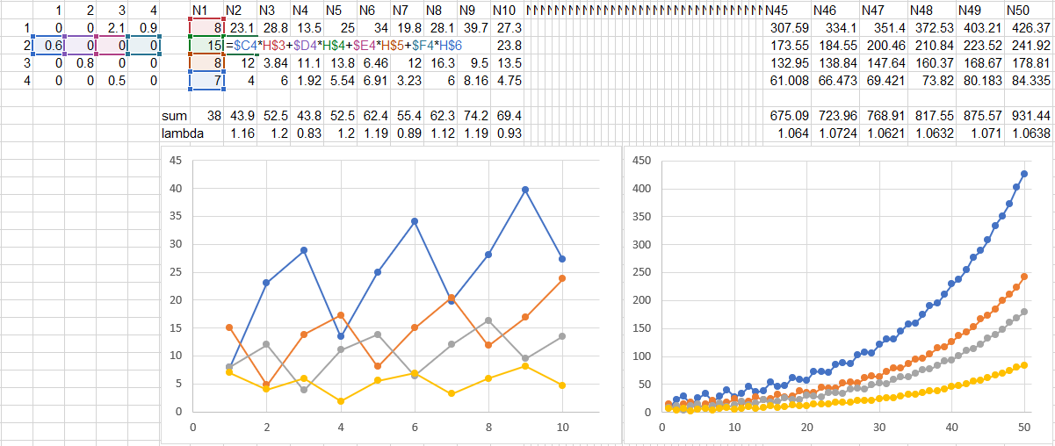
Translated to population ecology:
If you repeat A*n many times,
the proportion of age classes will stabilize
at a stable age structure (the eigenvector).
And the population (each class or sum) will grow exponentially
with growth rate = eigenvalue = λ
Fluctuations of age classes
at the beginning…
…but finally
smooth exponential growth
with stable age structure

Slide 8
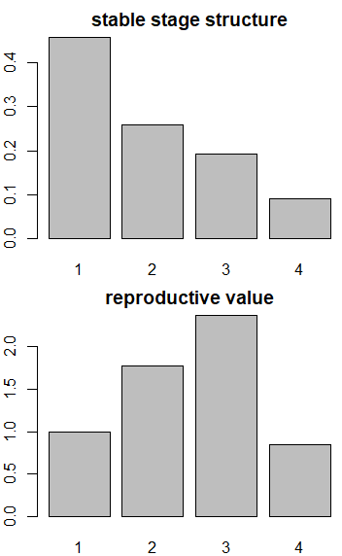
Reproductive value
Relative impact of each age class on reproduction of population.
Stable age distribution (w): A*w = λ*w
Reproductive value (v, left eigenvector)
v*A = transposed(A)*v = λ*v
– scaled to one for the youngest age class
– (current and) future reproduction,
accounting for future mortality
– 1 – they may reproduce later
but they likely die early
– 2 – they still do not reproduce
but there is higher chance
they will survive till reproduction
– 3 – they reached reproduction age and will
likely reproduce next year as well
– 4 – they still reproduce, but will die soon

Slide 9
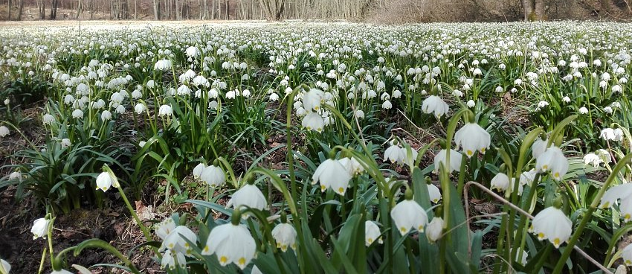

Timing of census
It is important to know which time of year is modelled,
and if the reproduction is seasonal or continuous.
In case of continuous reproduction, three processes take place:
– adults are dying
– new individuals are born
(but only to mothers which survived untill giving birth)
– youngs are dying
Affects calculation of fertility (F values).
– easier if breeding is in pulses
Leucojum vernum
www.turistika.cz
tadpoles
www.nasezahrada.com

Slide 10
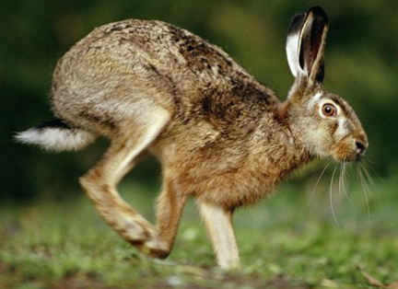
Timing of census
Meaning of individual parameters depends on the timing of census
As one step is one year, only a single timepoint in each year can be considered.
Example:
Hares give birth mostly in April.
Census is done in early spring
before youngs are born
(prebreeding census)
or in summer
after youngs are born
(postbreeding census)

Slide 11
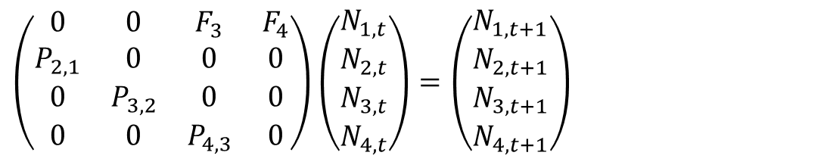
Prebreeding census
$$\left(\begin{matrix}0 & 0 & F_{3} & F_{4} \\ P_{2,1} & 0 & 0 & 0 \\ 0 & P_{3,2} & 0 & 0 \\ 0 & 0 & P_{4,3} & 0\end{matrix}\right)\left(\begin{matrix}N_{1,t} \\ N_{2,t} \\ N_{3,t} \\ N_{4,t}\end{matrix}\right)=\left(\begin{matrix}N_{1,t+1} \\ N_{2,t+1} \\ N_{3,t+1} \\ N_{4,t+1}\end{matrix}\right)$$
N_{i} – number of females at the age of 1 to 4 years
(in March, the youngest ones are almost 1 year old)
P_{i,j} – probability of survival from class j to i
F_{j} – number of female offspring, which will be recorded next spring
F₃ is estimated as mean female offspring per 3 years old mother *
probability of survival of newborns untill next census (i.e.
newborns which die before 1st census will not appear in the model)
4 years old females will have offspring,
but will not survive untill next census.

Slide 12
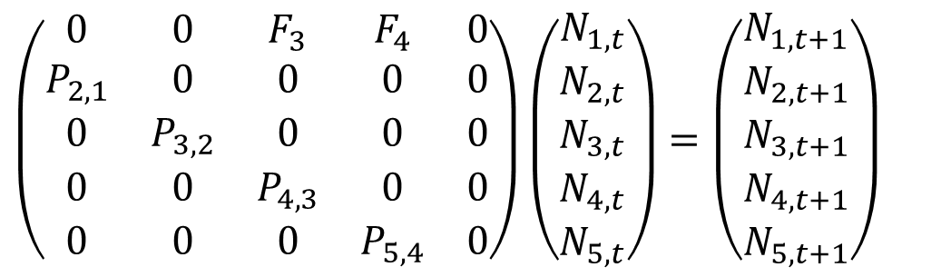
Postbreeding census
$$\left(\begin{matrix}0 & 0 & F_{3} & F_{4} & 0 \\ P_{2,1} & 0 & 0 & 0 & 0 \\ 0 & P_{3,2} & 0 & 0 & 0 \\ 0 & 0 & P_{4,3} & 0 & 0 \\ 0 & 0 & 0 & P_{5,4} & 0\end{matrix}\right)\left(\begin{matrix}N_{1,t} \\ N_{2,t} \\ N_{3,t} \\ N_{4,t} \\ N_{5,t}\end{matrix}\right)=\left(\begin{matrix}N_{1,t+1} \\ N_{2,t+1} \\ N_{3,t+1} \\ N_{4,t+1} \\ N_{5,t+1}\end{matrix}\right)$$
N₁ – number of newborn females, N₂ – number of 1 year old females. N₅ – number of 4 years old females (they will not reproduce any more).
P_{i,j} probability of survival.
P_{2,1} is survival of newborns until the next census.
F_{j} is estimated as mean number of newborn females per mother * probability of survival of mother (!) as they give birth a year after census. Thefore, F₃ is fertility of 3 years old mothers (i.e. of 4th age class) * probability that 2 years old mother will survive her third year (i.e. P_{4,3}).

Slide 13
How to estimate the parameters
from field data?

Slide 14
Life tables – úmrtnostní tabulky
A single cohort is observed for several years
Unknown in prebreeding census
P_{x} – age-specific probability of survival: P_{x} = N_{x}/N_{x-1}
  1-P_{x} – age-specific mortality
m_{x} – age-specific fertility; same sex of m and N (usually all females)
F_{x} – prebreeding: F_{x} = m_{x}P₁ (rather conceptual); postbreeding: F_{x} = P_{x}m_{x}
  essential to know the age of mothers and age-specific number of offspring, difficult to obtain in prebreeding census if offspring mix in a herd.

Slide 15
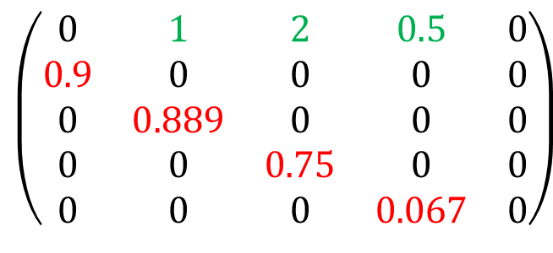
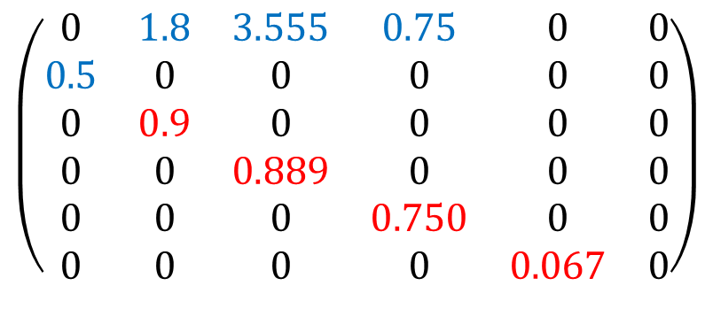
Life tables
Prebreeding census,
class 1 are one year olds
Postbreeding census,
class 1 are newborns
$$\left(\begin{matrix}0 & 1 & 2 & 0.5 & 0 \\ 0.9 & 0 & 0 & 0 & 0 \\ 0 & 0.889 & 0 & 0 & 0 \\ 0 & 0 & 0.75 & 0 & 0 \\ 0 & 0 & 0 & 0.067 & 0\end{matrix}\right)$$
$$\left(\begin{matrix}0 & 1.8 & 3.555 & 0.75 & 0 & 0 \\ 0.5 & 0 & 0 & 0 & 0 & 0 \\ 0 & 0.9 & 0 & 0 & 0 & 0 \\ 0 & 0 & 0.889 & 0 & 0 & 0 \\ 0 & 0 & 0 & 0.750 & 0 & 0 \\ 0 & 0 & 0 & 0 & 0.067 & 0\end{matrix}\right)$$

Slide 16
Life tables
A single cohort is observed for several years
– long-term observation needed,
– P and F affected by year-specific conditions (jagged survival curve)
Age structure in two subsequent years
– short-term observation is sufficient
– all age classes have the same environmental conditions,
but the model is affected by conditions in single year
Best to combine approaches
– several cohorts followed for several years
– census several times per year (more precise estimate of P and F)
– marked individuals (possibly, sum in age class may be sufficient)
– difficult to assign offspring to particular cohort if they mix

Slide 17
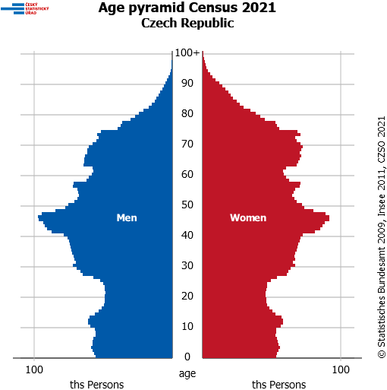
Life tables
Age pyramid
Age structure of a popualtion at a single year.
Size classes combine unknown
past survival and fertility
Deviations can be caused by
historical excesses or defficits
in fertility or mortality
Cannot be used for reliable
estimates of P and F

Slide 18
Stage classes
Population is divided into size or stage classes – mostly in plants, e.g. for trees:
Seedling, sapling, small adult tree, tall adult tree
But also animals: social status or size may be more important for breeding and survival (and easier to determine) than age.
Unlike in age-based matrix, the individuals can:
- grow fast and skip some class
- stay in the same class
- become smaller.
Consequently, the matrix is filled more densely (less zeros)
Marking of the individuals is essential
Notes:
„u věku je možné vystačit si s počty“ naivní botanikova představa že zoolog pozná věk

Slide 19
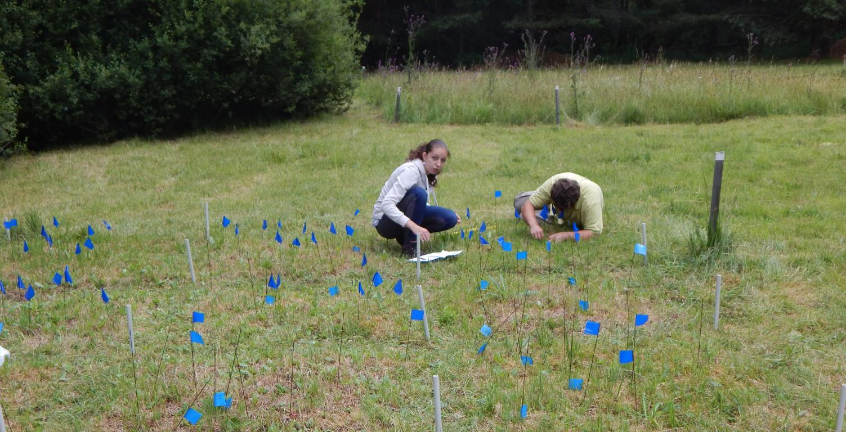
Stage classes
Marking can be easier for plants (pinflags), than animals

Slide 20
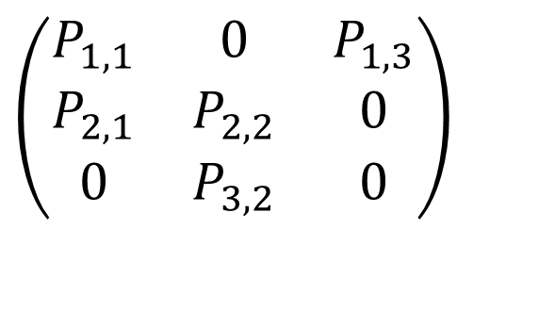
Example
Monocarpic perennial plant
census at the time of flowering
P_{1,3} – mean count
of new small rosettes
produced by one
flowering individual
SR-small rosette
LR-large rosette
FL-flowering
P_{2,1}
P_{3,2}
1-SR
2-LR
3-FL
P_{1,1}
P_{2,2}
$$\left(\begin{matrix}P_{1,1} & 0 & P_{1,3} \\ P_{2,1} & P_{2,2} & 0 \\ 0 & P_{3,2} & 0\end{matrix}\right)$$
We assume here that each flowering individual will die, only large rosettes can flower next year, and there is no seed bank.
Notes:
P1,3? Proč ne F? Musí být větší než 1

Slide 21
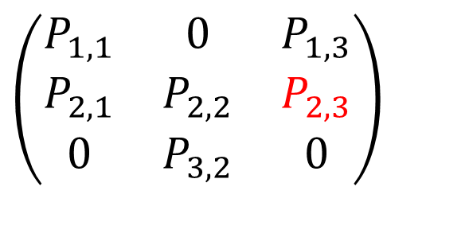
Example
Modification: some seeds germinate immediately and grow fast so that they are recorded as large roset in next census
P_{2,3}
P_{2,1}
P_{3,2}
1-SR
2-LR
3-FL
P_{1,1}
P_{2,2}
$$\left(\begin{matrix}P_{1,1} & 0 & P_{1,3} \\ P_{2,1} & P_{2,2} & P_{2,3} \\ 0 & P_{3,2} & 0\end{matrix}\right)$$
Potential seed bank would appear as first row and column
Other links are also possible

Slide 22
Estimate of parameters
How wide classes? Arbitrary.
Should be homogenous within class, different between classes.
Wide classes: may be too heterogenous – non-realistic values.
Narrow classes: too many individuals needed to get reliable estimates. If some probabilities are close to 0 or 1, we need really many individuals.
Probabilities of survival and transition – marked individuals.
Fertility – newly appeared individuals relative to count of breeding individuals (flowering plants) in last year (combines number of seeds per plant with seedling recruitment)

Slide 23
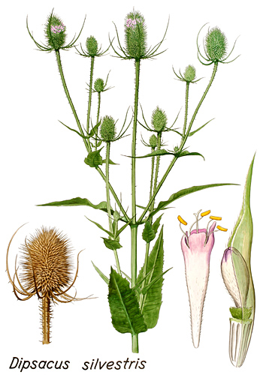
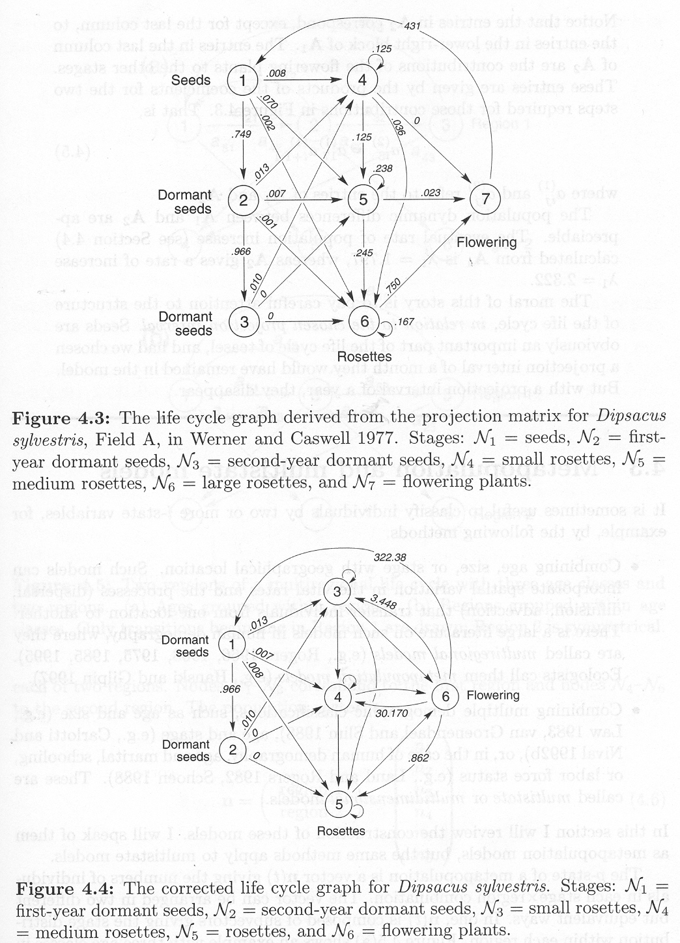
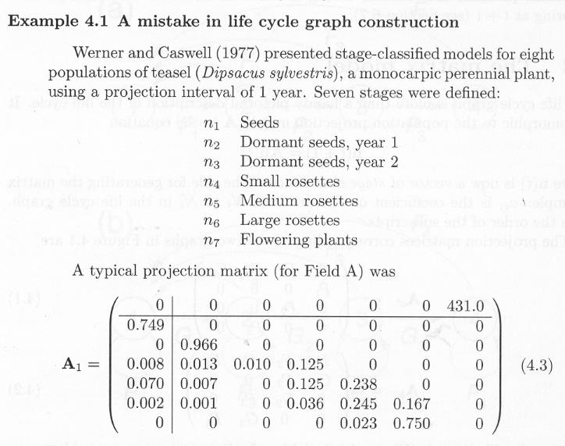
Example
Classical example of wrong matrix.
Next year after flowering, seeds are either dormant one year, or seedlings. Fresh seeds should not be in the model.
λ=1,797

Slide 24

Example
Corrected by the same authors
Multiple processes within a year can be estimated separately, but must be combined into single value for the matrix model
λ=1,797
λ=2.322

Slide 25
Assumptions
If parameters are constant, then both age and stage matrix lead to exponential model (unlimited growth or extinction), λ can be estimated.
There is no density dependence in the model

Slide 26
Use
Model parameters can be relatively easily and reliably estimated, even from just two years of observation
Models provide:
Growth rate λ – tells us if the population grows or declines.
Stable age (or size) structure – can be compared to reality
– search for reasons of discrepancies
– think of consequences of discrepancies
Long-term survival of population („Population viability analysis“)
– the assumption of constant parameters is important
Short-term consequence of non-stable age structure
– how big fluctuations?
– how long do the fluctuations persist?
– damping ratio – resilience to deviation
https://link.springer.com/article/10.1007/s10144-018-0620-y

Slide 27
Prediction?
Prediction – what will happen
Projection – what would happen under constant (present) conditions
Therefore „projection“ matrix

Slide 28
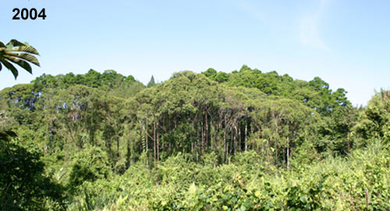
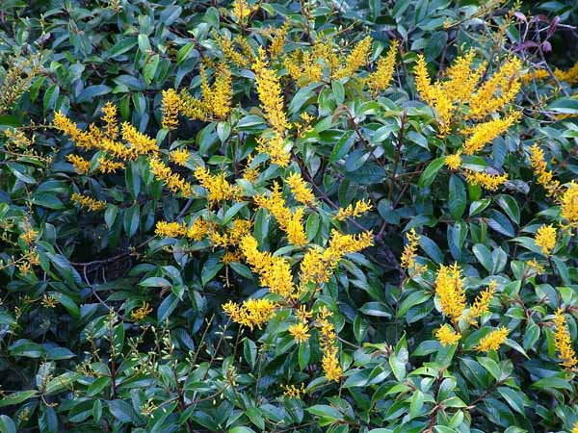
Sensitivity and Elasticity
Example
Boucher D.H., Mallona M.A. (1997): Recovery of the rain forest tree Vochysia ferruginea over 5 years following Hurricane Joan in Nicaragua: a preliminary population projection matrix. Forest Ecology and Management 91: 195-204. https://doi.org/10.1016/S0378-1127(96)03890-X

Slide 29
Sensitivity and Elasticity
Sensitivity – effect of absolute change in a parameter
transition matrix
sensitivity
Extremely high sensitivity of Seedling –> Adult (>10)
– potentially large effect on the model, but biologically impossible
Extremely low sensitivity of Adult –> Seedling (<0.01)
– increasing number of seedlings per adult
by about the same amount as P (i.e. by <1) is in fact negligible,
much larger variation is expected
Indicates cells more sensitive to absolute error of measurement

Slide 30
Sensitivity and Elasticity
Elasticity – effect of relative change in a parameter
transition matrix
elasticity
Sum of elasticity values equals 1
High elasticity of survival of Large adult:
a change from 0.997 to 0.994 seems like a little change in the original value, but it is in fact an increase in mortality by 100%.

Slide 31
Sensitivity and Elasticity
When reporting these values, it must be specified what they refer to:
Usually λ, but may be stable age structure, damping ratio in oscilating populations...
What was changed in matrix – single cells or e.g. all fertilities together.

Slide 32
Sensitivity and Elasticity
What is it good for?
Each parameter is estimated with a certain error. Parameters which largely affect the outcome should be estimated especially precisely
– If the model is most sensitive to survival of adults 0.997,
how many individuals are needed for reliable estimate?
N=333; resolution=0.003; CI=[0.983; 1.000]
N=1000; resolution=0.001; CI=[0.991; 0.999]
N=7500; resolution<0.001; CI=[0.9955; 0.998]
Management implications
– which parameter should be targeted (considering reality,
i.e. no management will convert seedlings to adults,
but increased survival of seedlings or adults will have large effect)
Ideas on evolutionary pressure on particular life stages

Slide 33
Sensitivity and Elasticity
Management implications
  suppress pests
  support endangered organisms
Life stages with high elasticity should be targeted:
  change of their parameters is supposed to impact the population dynamics more than change in other parameters
  however, there is usually little variability in these parameters
    high evolutionary stability
    difficult to manipulate them
Management measures should aim at transitions which largely affect the population dynamics (high elasticity)
as well as are feasible to manipulate (high variability).

Slide 34
Modification of matrix models
Several matrices for several years can be compiled,
e.g. for dry and wet season
or just to estimate variability of each parameter
Parameters in model can change stochastically, or based on climate forecast...
Density dependence can be included, but reliable estimates are difficult (which parameters change with higher density? infant mortality, adult mortality, or fertility?)
Matrices for several parts of season, test which parameters are important at which time.
Limiting factor – collect field data to estimate all parameters reliably (and more matrices mean more work)

Slide 35
Integral projection models

Slide 36
Integral projection models
Description: Merow, C., Dahlgren, J. P., Metcalf, C. J. E., Childs, D. Z., Evans, M. E., Jongejans, E., ... & McMahon, S. M. (2014): Advancing population ecology with integral projection models: a practical guide. Methods in Ecology and Evolution 5: 99-110.
Tutorial: https://cmerow.github.io/RDataScience/21_Intro_IPMs.html
R package: https://cran.r-project.org/web/packages/IPMpack/vignettes/IPMpack_Vignette.pdf
This package seems not managed any more,
but the idea is important.
Package developed 2012-2014 and removed from CRAN repository in Feb2020
Even on website of this package are no references after 2014, and the link for code is not working.
https://ipmpack.r-forge.r-project.org/
Link for tutorial is from 2017
These has written their own code for IPM in 2018
https://besjournals.onlinelibrary.wiley.com/doi/full/10.1111/2041-210X.13085
Book 2016
https://link.springer.com/book/10.1007%2F978-3-319-28893-2

Slide 37
Problems of matrix models
Age or size are continuous variables,
but we need categories in matrix models
few classes – low resolution, heterogenous within classes, problems of estimates from short-term data
many classes – high resolution, but we need a lot of data not to increase the error of parameter estimates
For reasonably precise estimate,
we need at least 50 individuals per class
  If 40 out of 50 survived: P = 0.8, s.e. = 0.057, conf.int. = 0.68 – 0.92 (still not very precise)
  We need much more idividuals for transitions with P close to 0 or 1, as the sensitivity is high.

Slide 38
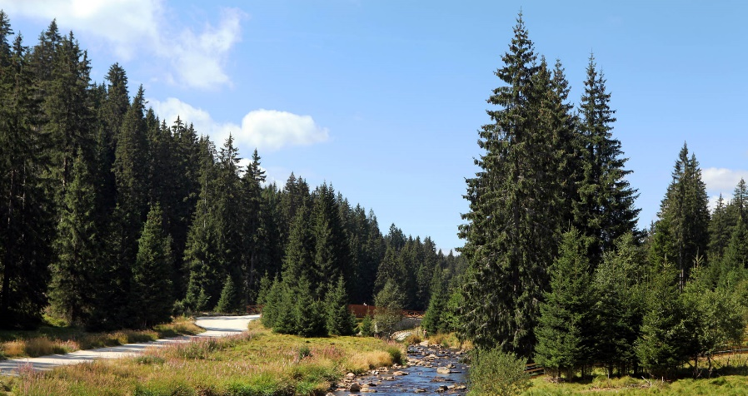
Example
Probability of survival of spruce
tree, max age >160 years
8 classes by 20 years:
50 × 8 = 400 individuals – feasible,
– large heterogeneity within categories
(survival in 1 year may be different from 19 years),
– difficult to say from few years of observation
how many individuals will get to next class in 20 years.
160 classes by 1 year:
50 × 160 = 8000 trees
– high resolution, estimates are sufficiently age-specific,
– too many trees needed
– most P are close to 1 –> even more trees needed
– the model will have too many poorly estimated parameters.

Slide 39
Solution – IPM
In continuous variables, we do not need independent estimates of P for each age class.
Neighbouring age classes will have similar P.
  Survival of trees in the age of 118, 119 and 120
  is likely to be very similar
We can use regression of survival and age.
Polynomial logistic regression (GLM) or smoothing (e.g. GAM) – instead of 160 parameters we need just a few.

Slide 40
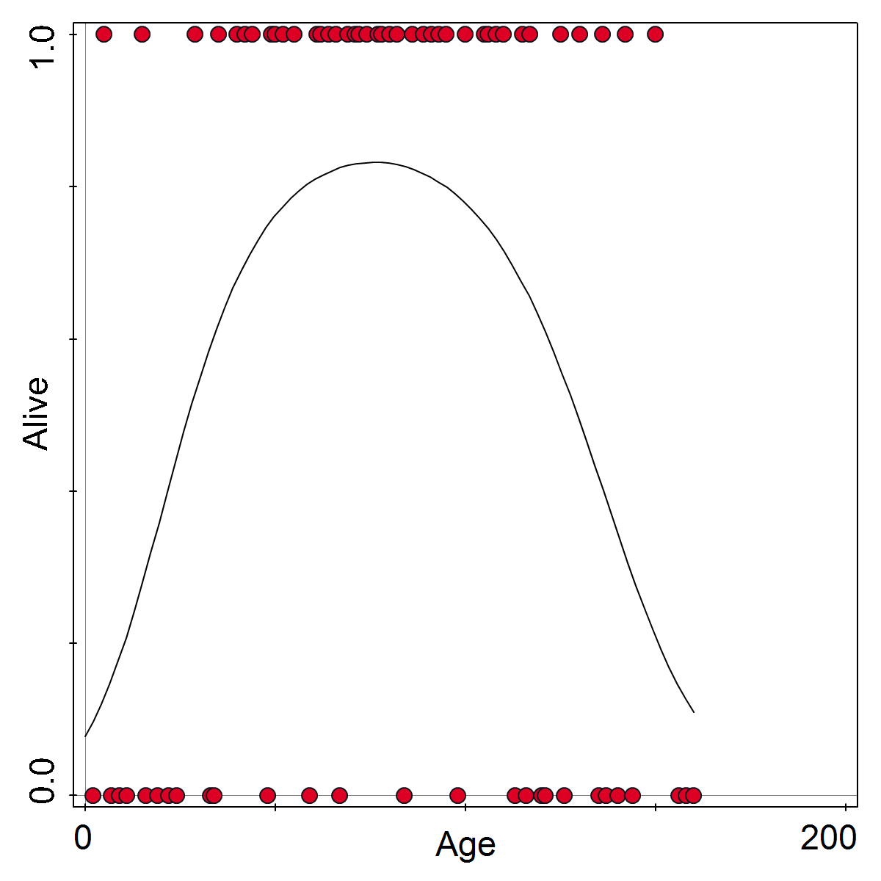
Even with single tree in each age class, we can regress survival (1/0) on age to estimate continuous probability of survival in each age class.
We need more trees than in this figure for higher precision, but the total number will be feasible.

Slide 41
Solution – IPM
Similar approach for:
  size (instead of age)
  estimates of fertility
Everything can be expressed and solved using integrals, but numeric solutions are used in practice:
  From regression, the (smooth) parameters for each (narrow) class are obtained and used in basic matrix models
As IPM use matrix algebra, you can calculate:
  eigenvalue (λ), eigenvector (stable age structure)
  sensitivity and elasticity (e.g. of particular regression parameter)

Slide 42
IPM – extension
Use of regression models enables:
  fill the matrix with
    high resolution of age/size classes
    high accuracy of survival and fertility estimates
    lower sampling effort
  add environmental variables (covariates)
    e.g. estimate survival ~ age + rainfall
    (or herbivore density...)
    you need more data, but it is feasible unlike in MPM.
Despite the IPM package seems to be outdated,
you can perform the regressions manually

Slide 43
IPM – extension
Basic IPM do not account for density dependency – lead to exponential growth.
Density dependency can be added using simulation approach:
  a measure of population size (which changes dynamically) is used as covariate, which will impact negatively suvival and/or fertility.
  again, you need enough data to describe the negative effect of its own population size

Slide 44
MPM and IPM
Neither difficult theory, nor elegant math (numeric solutions), but their parameters are easily estimable from data and have direct use in empirical studies.
Can be easily used by field ecologists.

Slide 45
Individual based models
Models based on behaviour of individuals
IBM

Slide 46
Individual based models
Each individual is described by (a) state variable(s)
- At each step, growth and probability of survival of an individual depends on its size and competition
Deterministic (a rule decides who survives), or stochastic (based on probability of survival, Monte Carlo simulation decides)
Spatially explicit (position of individuals is described), or non-spatial (JABOWA type models)
Botkin, D. B., J. F. Janak, and J. R. Wallis. 1972. Rationale, limitations, and assumptions of a northeastern forest growth simulator. IBM J. Res. Dev., 16:101-116.
https://www.sciencemag.org/site/feature/data/deutschman/forest_model.htm
Single species or more species (species identity can be an attribute of individual)
Practical application in forest management
Compare several scenarios
with different parameter settings or initial conditions

Slide 47
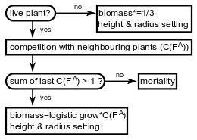
Individual based models
„Fibich“ model

Slide 48
Individual based models
Simulation methods:
Size _{i (t+1)} = Size _{i (t)} + Growth
Probability of survival = function₁ (Size _{i (t)}, Competition)
Growth = function₂ (Size _{i (t)}, Competition)
Growth
Growth
Size
Competition
max. size

Slide 49
Individual based models
Individual can be described by single variable
or by multiple variables – more realistic
e.g. height and width in trees
Estimate increment of individual biomass
Based on competition, assign which part will be invested to vertical or horizontal growth
growth (height)
growth (width)
Competition
Competition
Trees in mild competition grow faster to height, but not to width

Slide 50
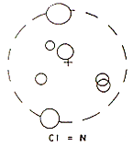
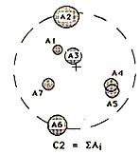
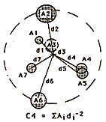
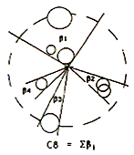
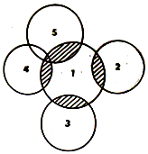
Individual based models
Estimate of competition:
Based on the density of all individuals in simulated area
(including their properties like age, biomass…)
Based on the size and distance of nearby individuals
(in spatially explicit models for sedentary organisms only)
Competitors: count, size (area, volume), distance
Properties combined using: max radius, weighting by distance, occupied angle, overlapping area…

Slide 51
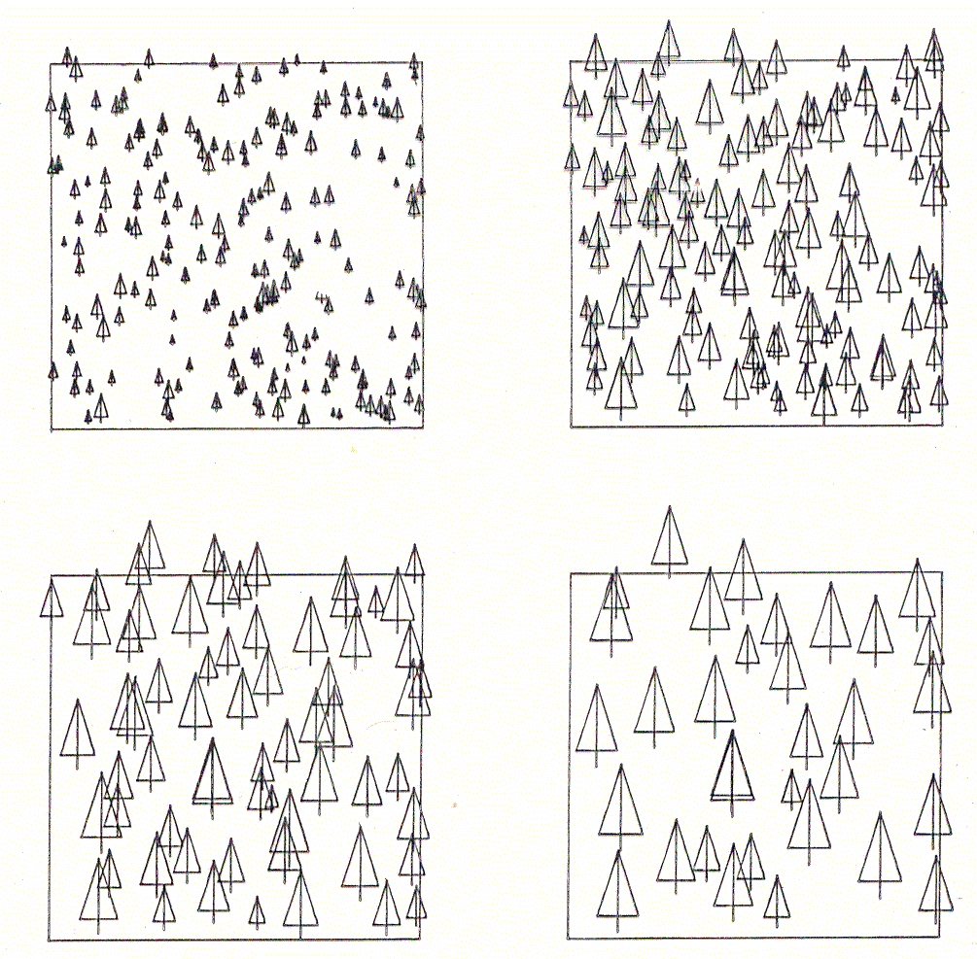
Lepš J. & Kindlmann P. (1987) Models of the development of spatial pattern of an even-aged plant population over time. Ecological Modelling 39: 45-57.

Slide 52
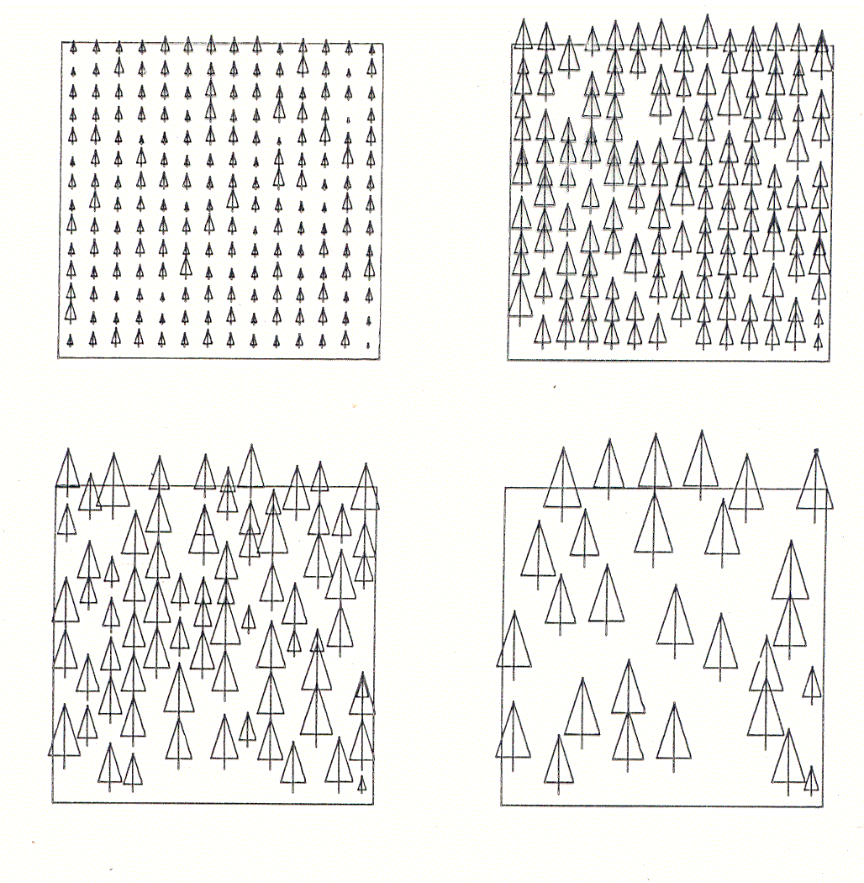
Lepš J. & Kindlmann P. (1987) Models of the development of spatial pattern of an even-aged plant population over time. Ecological Modelling 39: 45-57.

Slide 53
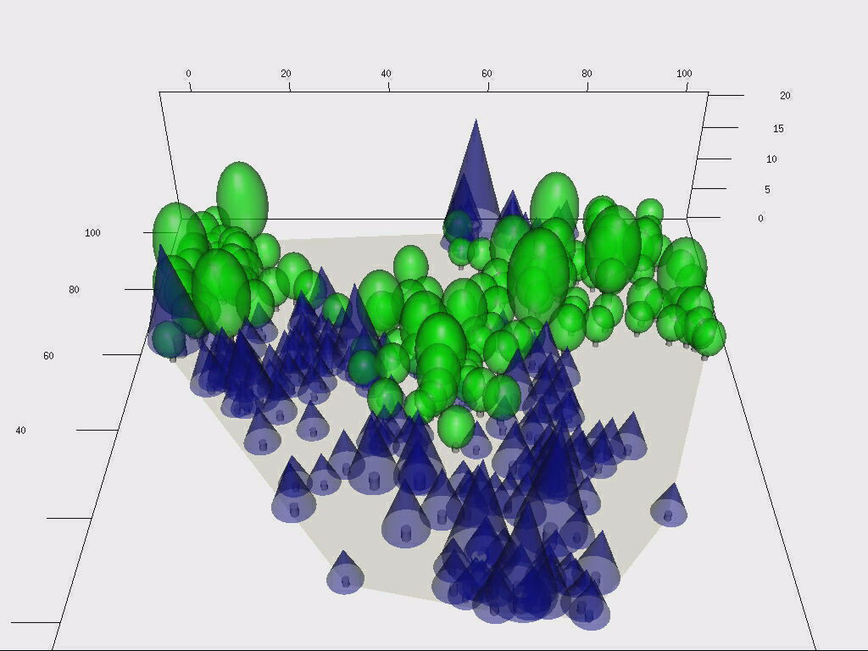
Example for two species

Slide 54
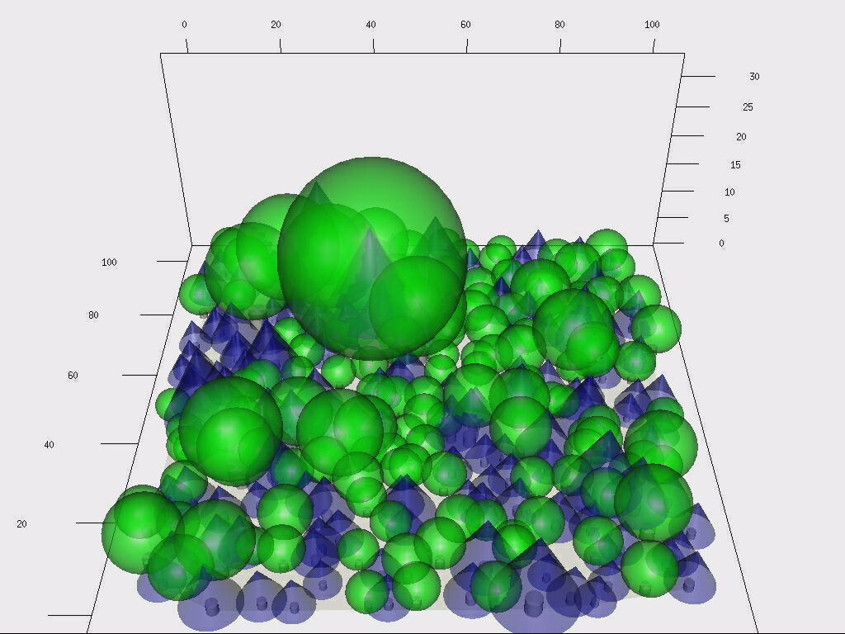
Example for two species

Slide 55
Problem with reproduction
Easier for those spatially non-explicit
  no need to decide where to place seedlings
Problem with high seedling mortality
  each seedling is a new individuum, which is described separately in IBM, but with reasonably large area and realistic high number of seeds and high mortality, there are milions of seeds each year
Combine approaches
  seedligs and young stages simulated using MPM with density-dependent survival
  older stages using IBM.

