Slide 1
Population variability in space and time
Spatial pattern
Temporal variability

Slide 2
Spatial pattern why it is useful to care

Slide 3
Classical dichotomy
Pattern and process
Could spatial pattern say something about mechanisms?
I used to be very skeptical
Leps J. (1990): Can underlying mechanisms be deduced from observed patterns? In: Krahulec F. Agnew A.D.Q. Agnew S. & Willems J.H. [eds.]: Spatial processes in plant communities. SPB Publ. pp. 1-11.
But the methods developed considerably since 1990, so I am less (but still) skeptical.

Slide 4
Spatial pattern analysis makes sense for
Sedentary organisms (mostly plants)
Mobile organisms (animals), which can be characterized by their location (burrow, nest)
In most analytical methods, the location is represented by a point (so, used for trees, and usually not for tussock grasses)

Slide 5
Population is spaced
In discrete units (parasites in [on] individual hosts, fruitfly larvae in individual fruits, etc.)
(considerably more frequent) in continuous space (usually two-dimensional, i.e. in an area)
General problem – individuals represented by points – but they have some size

Slide 6
Point spatial pattern in continuous space
Random
Completely regular (in a grid)
Regular, uniform, homogeneous
Aggregated, clumped

Slide 7
The classical basic tool for spatial pattern analyses
Poisson distribution
Describes distribution of counts of independent events in units

Slide 8
Poisson distribution - model

Slide 9
Poisson distribution rozdělení
Model: I have many cups, and also many small balls. I drop the balls, and each ball falls into one cup (each cup has the same probability). The probability is not affected whether the cup already contains a ball, or not. Number of balls per cup will be a random variable with Poisson distribution. This distribution is characterized by a single parameter, λ, which is the ratio of total number of balls to the total number of cups (and thus average number of balls per cup). The variance of the distribution also equals λ.
Good null model for organisms – plants are found in a quadrat independently whether the quadrat is empty or contains already some individual(s) (or ectoparasites independently whether there is another ectoparasite on the host).

Slide 10
Poisson distribution
Both, mean and variance = λ

Slide 11
To do the comparison with Poisson distribution
I need counts of individuals in sampling units (either natural, or artificial)

Slide 12
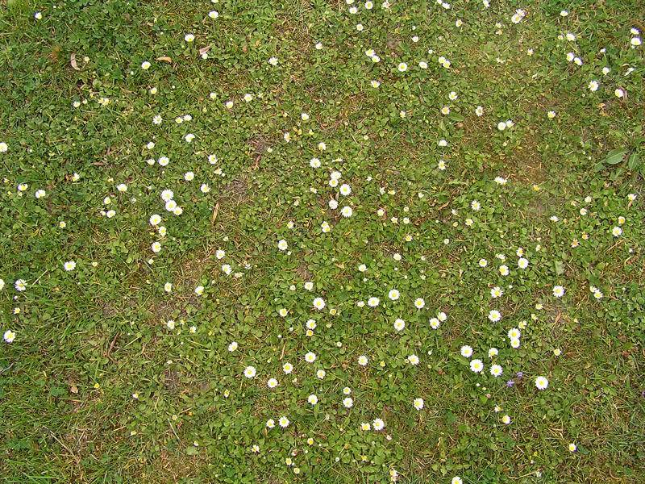
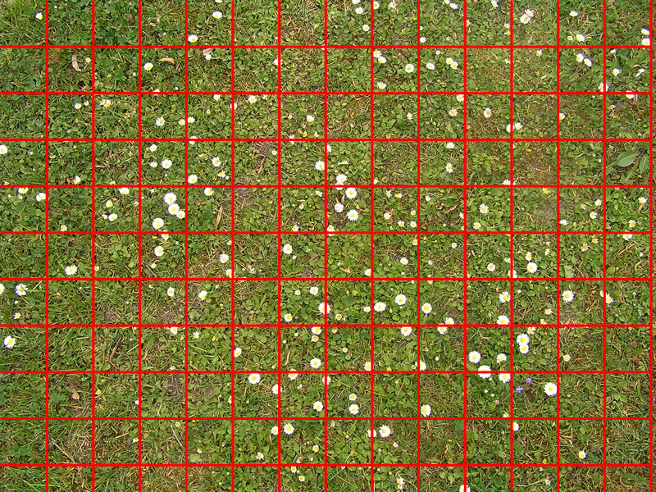
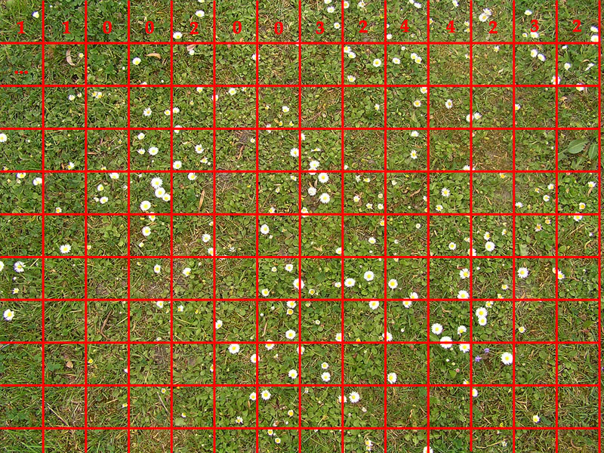
In continuous space
Are the inflorescences located randomly?
Locate quadrats over the space of interest (randomly or regular grid) and count the inflorescences in each unit
Calculate mean and variance. For the Poisson distribution, the values should be the same.

Slide 13
Basic analysis is the same, whether the units are natural or defined by a researcher
I have counts of individuals in units, i.e.
x₁, x₂, x_{3, ..} Etc..
In the case of random spatial pattern of individuals, the counts of individuals have the Poisson distribution, for mean = var = λ
Mean and $\overline{x}$is the same, similarly, s² and var is the same
Variance/mean ratio as in index of clumping (aggregation)
(var/$\overline{x}$ <1 - regularity, var/$\overline{x}$>1 aggregation)

Slide 14
Poisson distribution is positively skewed, skewness decreases with increasing λ. For large λ Poisson distribution approaches normal distribution.

Slide 15
If the individuals have random spatial pattern
Counts of individuals in quadrats have Poisson distribution
Presence of an individual in a unit does not change the chance that I will find another individual there

Slide 16
Aggregated, clumped spatial pattern
Counts of individuals in quadrat:
Presence of an individual in a unit increases the chance that I will find another
Note the potential effect of quadrat size

Slide 17
Tendency to regularity, regular
Presence of an individual decreases the chance that I will find another one

Slide 18
You will get never exactly var = $\overline{x}$ How large difference matters?
1. Classical goodness of fit tests (χ² – test, Kolmogorov-Smirnov)
2.
has roughly χ² distribution with df = n-1 in the case, when the null hypothesis of Poisson distribution is true.

Slide 19
Null model is not realistic, its rejection is often just a formality
I need a measure of intensity of clumping (of aggregation, of patchiness)
The most popular one, variance:mean ratio is not ideal, because its maximum value is positively dependent on density, and its value decreases if the individuals die randomly

Slide 20
Lloyd index – does not change its value, if the individuals die randomly
Useful for density detection of density dependence in repeated observations, or for comparison of clumping of populations differing in their density

Slide 21
Nevertheless, instant value does not tall too much
Changes in time are more useful
Perhaps also comparison in space (and time)
For changes in time, permanent plots are optimal

Slide 22
Causes of aggregation (clumping)
Environmental heterogeneity (higher density in spots with favourable conditions [sometimes legacy of favourable spots for establishment])
Dispersal – Individuals / seeds do not travel independently, but in clusters (and more so in the case of clonal spreading)
Positive relationships among individuals (nurse plants – presence increases the chance to establish / survive)

Slide 23
Causes of regularity
Negative density dependence – local density decreases the probability of establishment or survival
In parasitology (aggregation of parasites on host individuals) – the most infested host does not survive (and with them their parasites)

Slide 24
Consequences of aggregation / regularity
Aggregation increases and regularity decreases the intensity of competition (among neighbours) (both in continuous space and in natural units). Typically in orchards etc. / ideal is hexangular grid
In multispecies community – intraspecific clumping leads to increase of intraspecific and decrease of interspecific competition.

Slide 25
Practical consequences
Classical competition experiments overestimate the effects of weeds on crops because
In experiments, the weed are sown randomly, or planted in regular design
In real field, they are clumped, and thus the intraspecific competition is higher (weed individuals compete among themselves) and smaller interspecific (i.e. effect on the crop).

Slide 26
Experimental proof
Lamošová, T., Doležal, J., Lanta, V., & Lepš, J. (2010). Spatial pattern affects diversity–productivity relationships in experimental meadow communities. Acta Oecologica, 36(3), 325-332.

Slide 27
Weed – crop competition experiments and reality [exaggerated]
Reality
Experiment
w
w
w
w
w
w
w
w
w
w
w
w
w
w
w
w
w
w
w
w
w
w
w
w
w
w
w
w
w
w
w
In reality, weeds are clumped – and thus compete mostly among themselves; in experiments, weeds compete mainly with the crops

Slide 28
Point spatial pattern in continuous space – importance of spatial scale
Completely regular (in a grid)
Random
Regular, uniform, homogeneous
Aggregated, clumped

Slide 29
Individuas in a continuous area historical methods [historical significance only]
Clark & Evans index - comparison of average distance between neighbor with that expected for completely random pattern. (In clumped population, the neighbours are closer)
Hopkins & Skellam index – comparison of distance between a random point and closest individual and distance of two neighbours (in random pattern, should be the same)

Slide 30
Individuas in a continuous area historical methods [historical significance only] – but can be used directly in the field, without mapping of all the individuals
Clark and Evans, and Hopkins and Skelam – generally, not used any more – there are better methods
In the field, it is difficult to select a random individual – it is not an individual closest to a random point

Slide 31
Clumpping characteristics – scale and intensity
Two examples of clumps, differing in intensity and size

Slide 32
Classical “spatial pattern analysis”
1. Based on sampling a grid or a transect (usually done in the field)
Dale, M. R. (2000). Spatial pattern analysis in plant ecology. Cambridge university press.

Slide 33
Analysis is type of hierarchical ANOVA, when I sum up counts (or other quantitative characteristics) in blocks
The intensity of aggregation is characterized by ‘Mean Square’ (analogy with ANOVA), where for each Block size (BS) I take into account the aggregation on the closest lower hierarchical level.
Lepš, J. (1990). Comparison of transect methods for the analysis of spatial pattern. Spatial processes in plant communities, 71-82.

Slide 34
MS ploted agains Block Size
The peak of the line signifies the size of that clumps
If we have more species, or a species and some environmental characteristics, we cas also study the relationship (covariance) in dependence on the block size.

Slide 35
Recently usually – the population is mapped in the field – so we have the position (and usually some characteristics, e.g. size) of each individual in the population.

Slide 36
Mapped populations – (Ripley’s K-function – R package spatstat)
Position of each individual is a point
Use one individual after another, and for each individual count number of neighbours, and then calculate the average over all the individuals (more individuals than expected clumping, less – regularity (at given spatial scale)

Slide 37
I the individual are located randomly then: the number of neighbours = area of the circle × population density.
more neighbours than expected clumping, less – regularity (at given spatial scale)
.
h – distance (perimeter of the circle)
n(h) – number of neighbours in distance < h
L – standardized form, positive values mean clumping, negative regularity
Today various modifications - „pair correlation function“, derivative of K.

Slide 38
Problem for calculations: The edge effect and its correction
Statistical tests -- “null models”.

Slide 39
(Null models – tool for testing)
More and more popular in ecology (not only for spatial pattern)
We will simulate (generate) various null patterns (e.g. random spatial pattern) – for each simulation of the null model, I will calculate the statistics of interest (e.g. K-funkction)
I will do usually 1000 simulations
Then, I will construct an envelope (usually 95%), so the values excluding 25 highest and 25 lowest values. Values out of envelope are “significantly different” from the null model (it is more complicated, we have global test, and then tests on individual spatial scales, but this is the principle.

Slide 40
Null models for spatial pattern
The simplest null model – complete randomness
Various more complicated models, including possible environmental heterogeneity etc.

Slide 41
Null models
For repeated observations, I can take as the basis the previous state, and let the individuals “to die” randomly.

Slide 42
Application: forest dieback in Krkonse mountains (Vacek & Lepš 1996)
Vacek, S., & Lepš, J. (1996). Spatial dynamics of forest decline: the role of neighbouring trees. Journal of Vegetation Science, 7(6), 789-798.

Slide 43
Frequent application
Whenever I can characterize the position of an individual as a point (methods for cushions would be interesting, but I am not aware that they would be available).
Frequently used for forests (FORESTGEO (tree as a point in the area of forest)
Potential use – anthills, nests, borrows.

Slide 44
Deducing processes from observed (spatial) patterns what I can learn from the observed spatial pattern
One observation on a single spatial scale – close to nothing
Pattern is a result of many processes with often contradictory effect on the clumping
Usefulness of repeated observations, particularly on more spatial scales ( K-function for repeatedly observed plots)

Slide 45
Deducing processes from observed (spatial) patterns
Decrease of clumping – increase of regularity is reliable indication for local negative density dependence, particularly on fine spatial scales
Other cases are more complicated

Slide 46
Application: forest dieback in Krkonse mountains (Vacek & Lepš 1996)
Vacek, S., & Lepš, J. (1996). Spatial dynamics of forest decline: the role of neighbouring trees. Journal of Vegetation Science, 7(6), 789-798.

Slide 47
Marked point patterns
Each tree (individual) is not only characterized by its position, but also by one or more characteristics – Wannag plots in PNG – for each tree we have coordinates, species identity, dbh, height, etc.
Dependence of spatial pattern on size (of individual, of neighbours), spatial relations of species (diversity attractors vs. diversity repellers),

Slide 48
Interpretations
E.g.
Small individual in clumps (dispersal, regeneration in gaps), large individuals regularly – probably effect of neighbours competition.

Slide 49
Interpretations
Heterospecific neighbours are more common than in the null model
We can think about mechanisms of coexistence (e.g. Janzen Connell)
Example of the use: Fibich, P., Lepš, J., Novotný, V., Klimeš, P., Těšitel, J., Molem, K., ... & Weiblen, G. D. (2016). Spatial patterns of tree species distribution in New Guinea primary and secondary lowland rain forest. Journal of Vegetation Science.

Slide 50
Variability in time – population stability
Stability can be characterized as response to perturbation (resistance, resilience = recovery), [usually need experimental approach, or good luck with extreme weather fluctuations when we need them.
Variability (as opposite to constancy)

Slide 52
Measures of variability Some analogy with the spatial variability
Data used: time series of:
- Number of breeding pairs of birds (census)
- Number of moths in a light trap per year (index)
- Plant biomass at the top of vegetation season
Typically, interannual variability (for seasonal variability, methods of phenology)

Slide 53
Methods of the analysis might be similar, but distinguish
Stability / constancy / variability
Of yearly (aboveground) production
Of standing biomass
For herbs in seasonal climate, both can be similar, for trees very different

Slide 54
Measures of variability – variance, resp s.d. (standard deviation]
Both, var and s.d. are usually positively dependent on the mean
2, 3, 2, 5, 4
The same variance (s.d.) as
102,103,102,105,104
The second is clearly more stable
The first is comparable to
20, 30, 20, 50, 40

Slide 55
s.d. is usually linearly dependent on mean
CV= s.d./mean
s.d. log (x)
Value of both is identical for
2, 3, 2, 5, 4
20, 30, 20, 50, 40

Slide 56
But
s.d. log(x) - cannot be used for data with zeroes (what is zero - real absence, or just low abundance for index or estimate)
sometimes s.d. log(x+1) - problematic
Emprically is known that CV decreases with the mean
For individuals, the Lloyd index works well

Slide 57
All the above ignore the order of observations
But there might be a trend, cyclic changes etc.
Methods for spatial pattern analysis using transects might be useful
And also, the difference between extreme positive (dangerous for pest management) and extreme negative (endangered populations) deviations – importance of skewness

Slide 58
Why this might be useful?
The stability of individual populations should be dependent on life history strategies, on traits
Populations of conservative strategy species should be more stable
Majeková, M., de Bello, F., Doležal, J., & Lepš, J. (2014). Plant functional traits as determinants of population stability. Ecology, 95(9), 2369-2374.

Slide 59
