Slide 1
Life history strategies
Functional classification (sometimes also ordination) of organisms

Slide 2
Classification phylogenetic vs. functional
Common evolutionary history does not necessarily mean functional similarity
Convergent evolution under similar selection pressure (functional analogies in various taxonomic groups)
Long history of attempts: Functional description of vegetation in various biogeographic areas

Slide 3
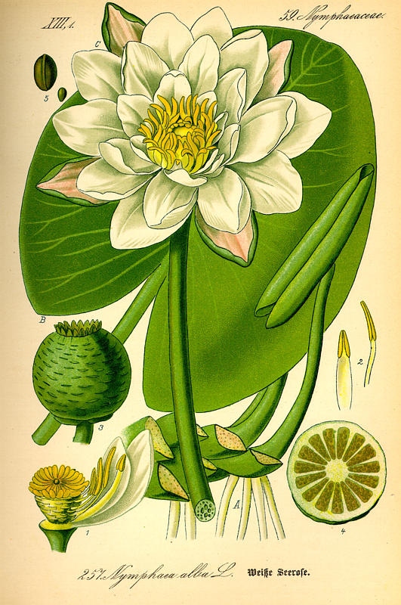
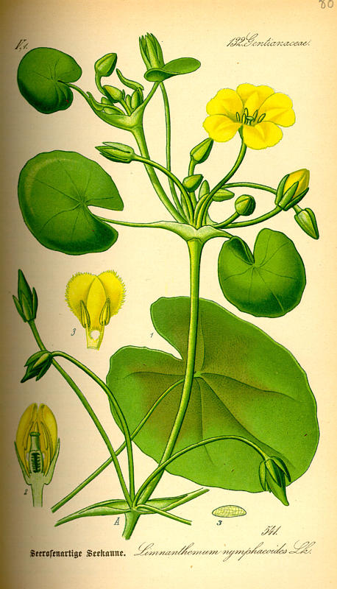
Nymphaea (Nymphaeaceae), basal angiosperms
Nymphoides (Menyanthaceae)
asterids
Phylogenetically distant (common ancestor ca 280 millions years) – functionally similar

Slide 4
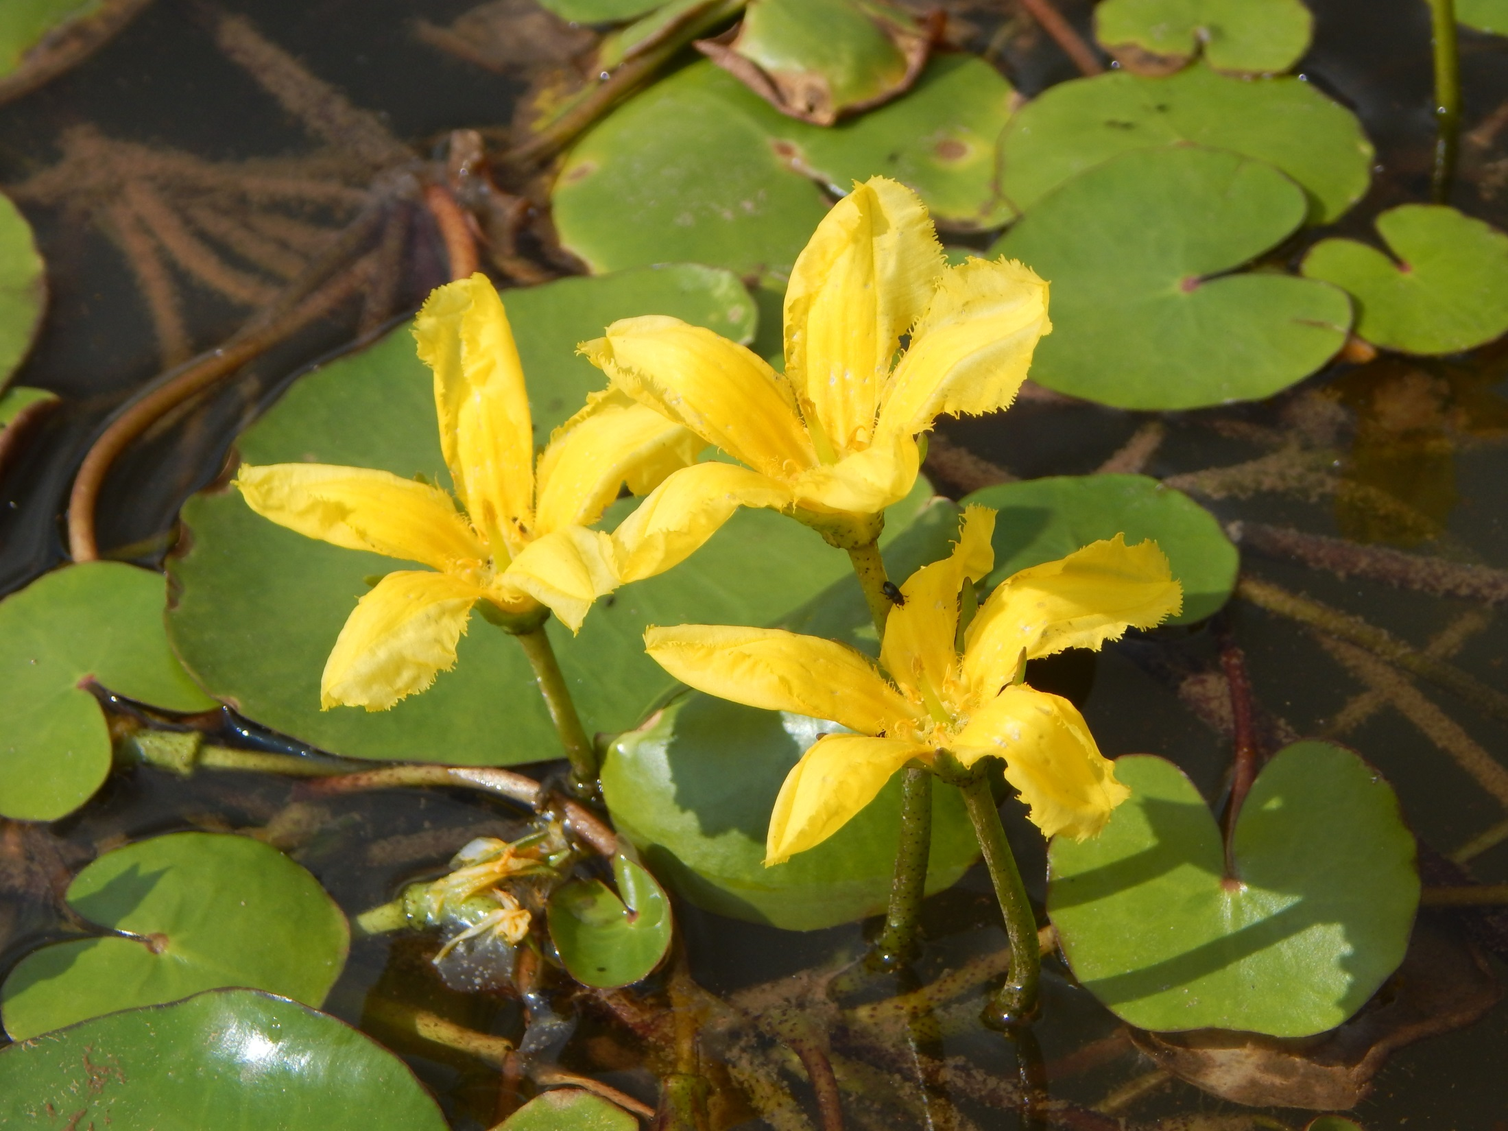
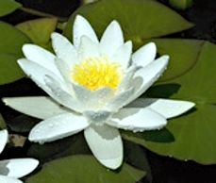
The resource capture traits (type of leaves) correspond to the environments, whereas the reproductive traits are more phylogenetically conservative

Slide 5
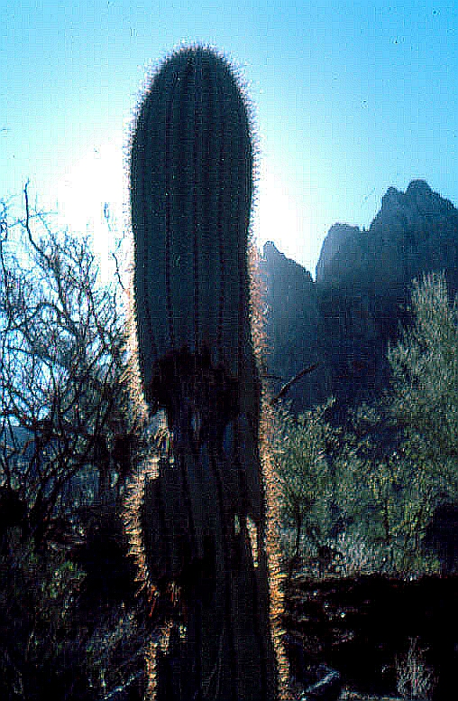
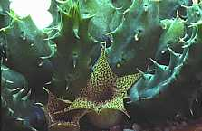
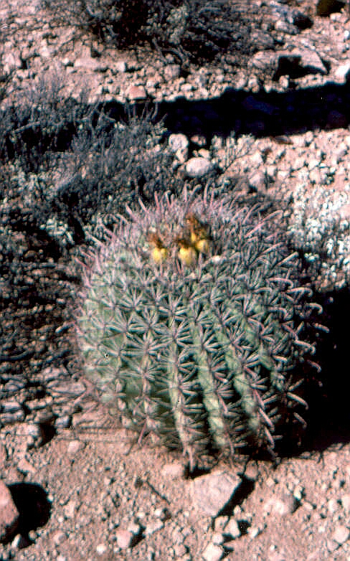
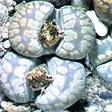
Cactaceae
Opther succulents:
Euphorbiaceae
Mesembryanthemaceae

Slide 6
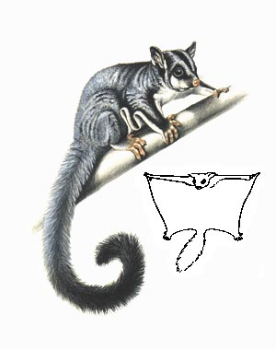
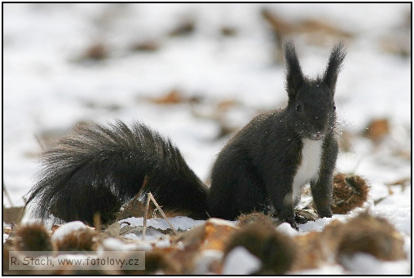
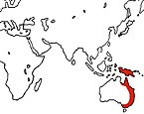
Analogical forms in Laurasian and Gondwana fauna
Sugar glider
(marsupial)
Squirrel (placental)
http://www.ludvici.cz/vako/index.php

Slide 7
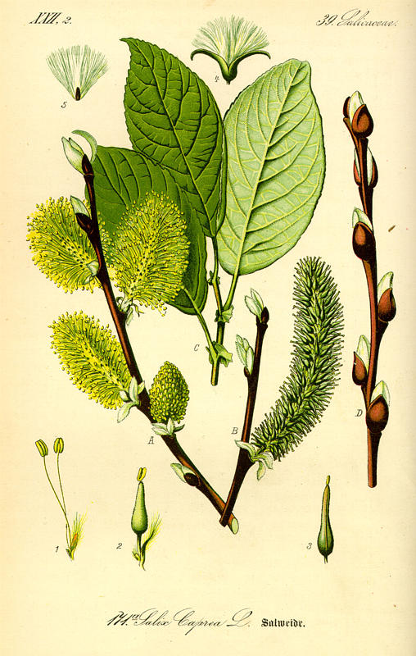
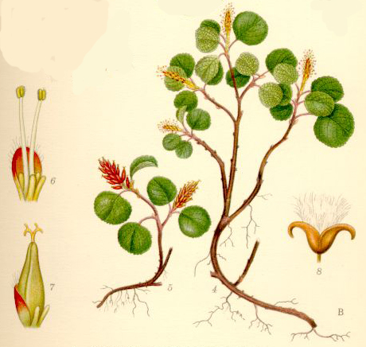
Salix herbacea
Salix capraea
Two willows (common ancestor 500 000 years) – completely different ecological role (but see the similarity of flowers)

Slide 8
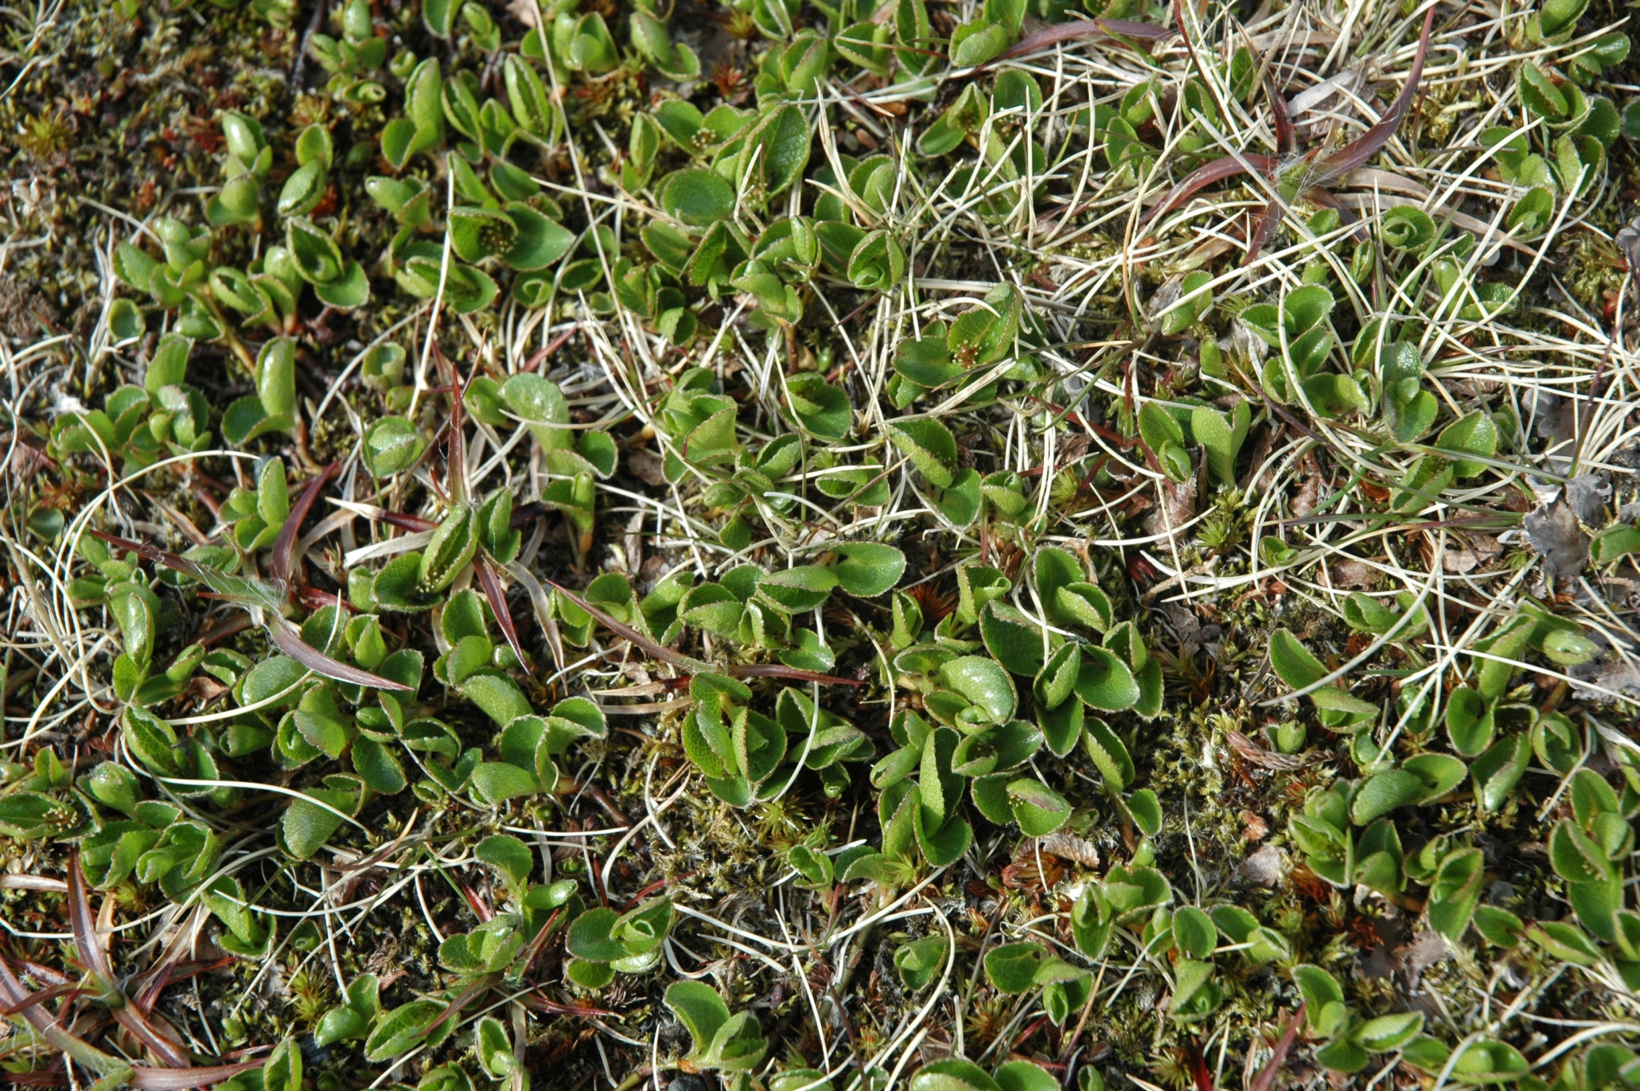
Salix herbacea - species that competes with mosses

Slide 9
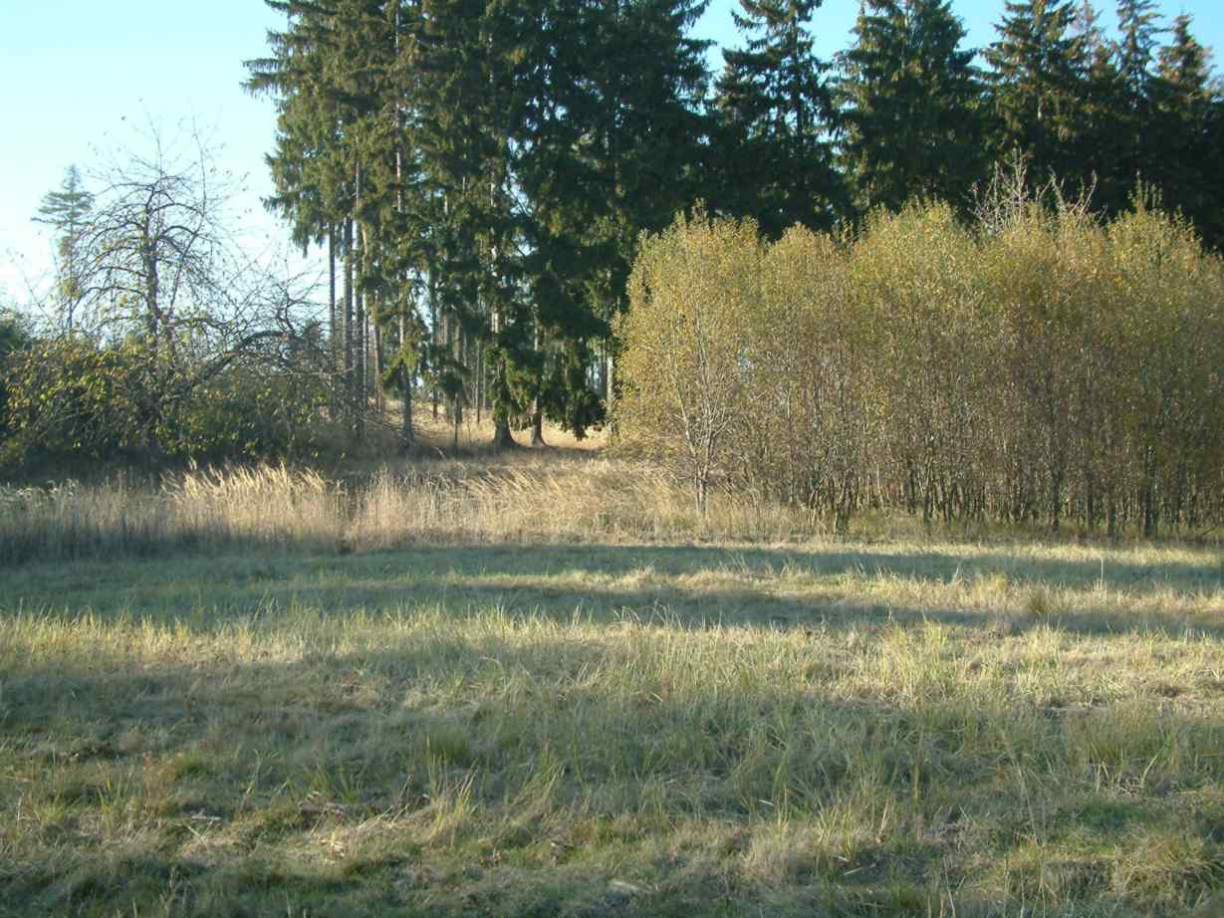
Salix caprea – a tree able to form a canopy

Slide 10
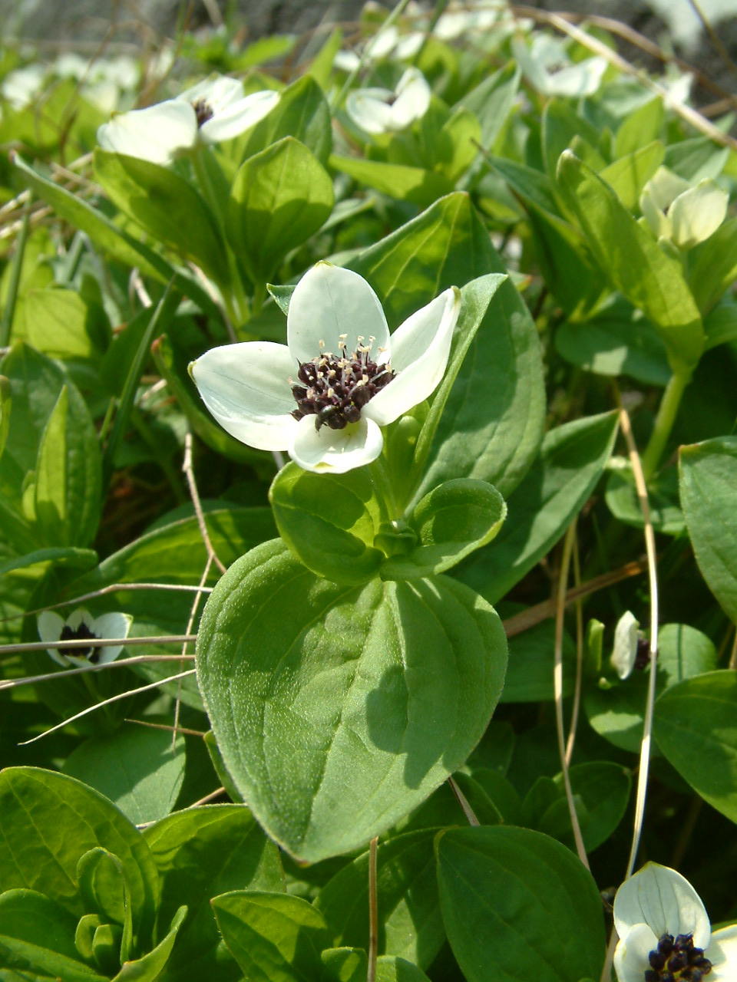
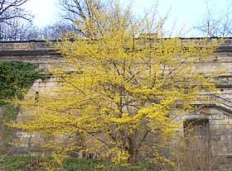
Cornus suecica
Cornus mas

Slide 11
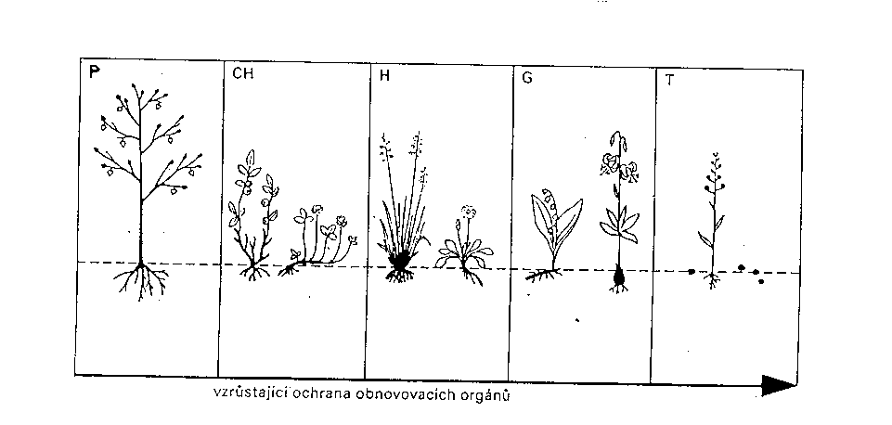
Raunkier life forms (defined according to where are the meristes located during the unfavourable season)
Raunkiær, C. C. 1934ː The Life Forms of Plants and Statistical Plant Geography. Oxford University Press.
Phanerophytes
Chamaephytes
Hemicryptophytes
Geophytes
Therophytes
(plus Epiphytes, Hydrophytes etc.)
Remember - composition of life forms determines biomes, taxonomic compositions (families etc.) determines the biogeographic area

Slide 12
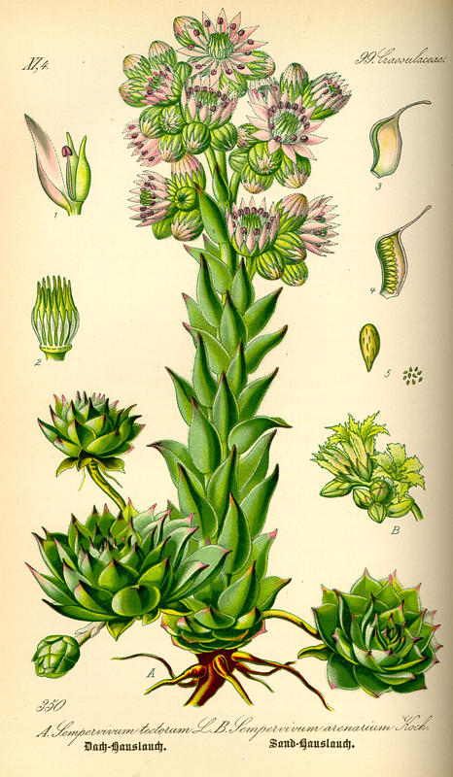
“Trade-off “ principle
Defined as evolutionary dilemma, where genetic changes increasing the fitness in one direction lead to a decrease in fitness in another direction. (Grime 2001).
Sempervivum:
Succulent leaves – advantageous under water deficiency stress, but in productive conditions, species looses in competition with more acquisitive species (with efficient photosynthesis)

Slide 13
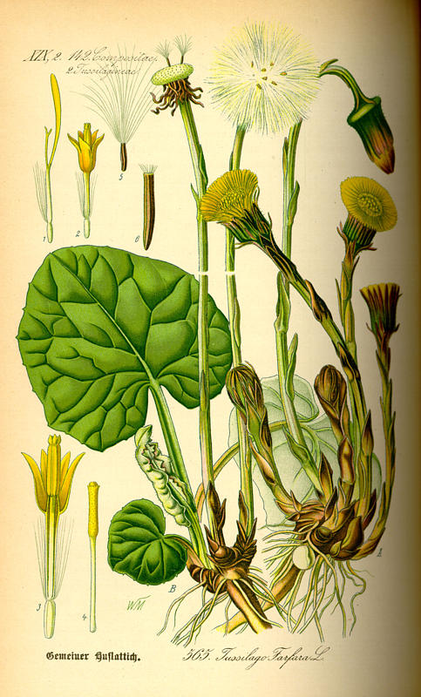
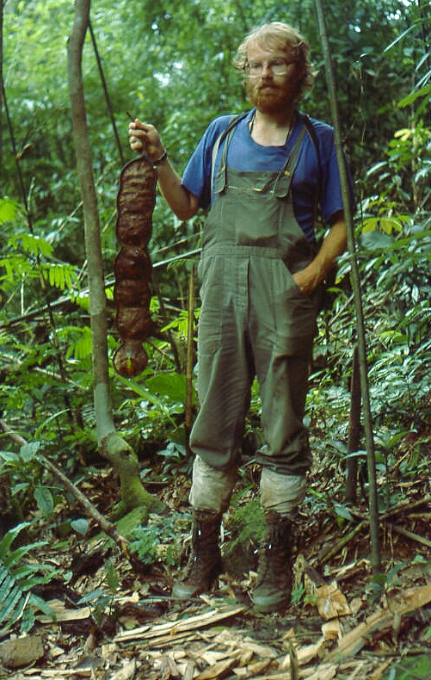
Tussilago:
Low seed mass – advantage for dispersal, but the species pays the price by having not sufficient energy for recuiting seedlings, limiting particularly in closed vegetation.
Entada – seeds are very heavy (and ca 8 cm in diameter) - lot of initial energy for germination in dark forest floor, but problem for dispersal.

Slide 14
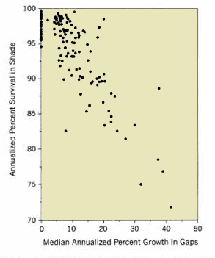
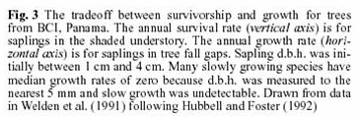
Trade-off
Negative correlation (trade-off) between in gaps and survival in shade. Because of physiological constraints, it is impossible to be superior in both aspects.
There are generally two strategies – either survival in shade or growth in gap (and slow growth in gap means death because of competition of faster growing neighbours.
Each point is one tree species from a forest in Panama

Slide 15
Amount of fat for survival of winter (if I am a bird) [adapted from Southwood]
I will be fatty – I will have storage to survive starvation, and well isolated for low temperatures, but I will loose agility and maneurability – and thus ability to escape predators.
I will be slim, just muscles – perfect ability to escape, but in the case of starvation and cold, I will not survive too long.
Which strategy is better? Depends on how will be the weather in winter and what will be the predation pressure (which might also depend on the weather).

Slide 16
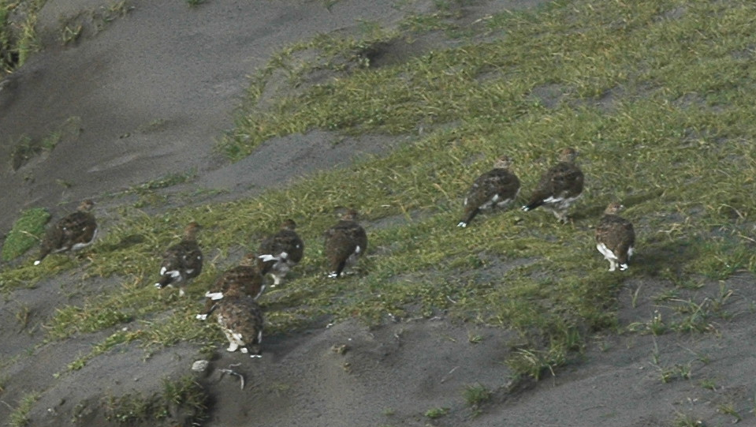
Ptarmigans in Iceland – nicely fatty, well protected from cold, good storage of energy, but ideal prey.

Slide 17
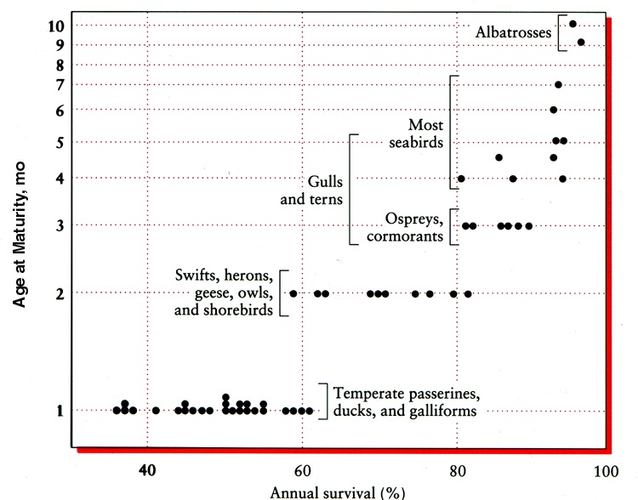
Trade-off – positive correlation between annual survival and age at maturity for birds.
Note that high age at maturity means long generation time, and thus low growth rate – so this corresponds to negative correlation between two fitness components, survival and reproduction
Nice page: http://ecology.botany.ufl.edu/ecologyf02/LifeHistory.html

Slide 18
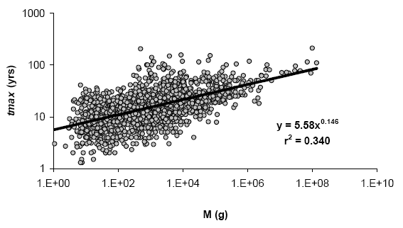
Many traits are correlated with body mass (M on the picture, note the log scale). To form a large body needs time [and thus needs long prae-reproduction period], but enables higher and longer survival (tmax – maximum age, also log scale). Generally, large body is usually correlated with K-strategy. But note, R²=0,340 – two thirds of variability is caused by other factors than body size.

Slide 19
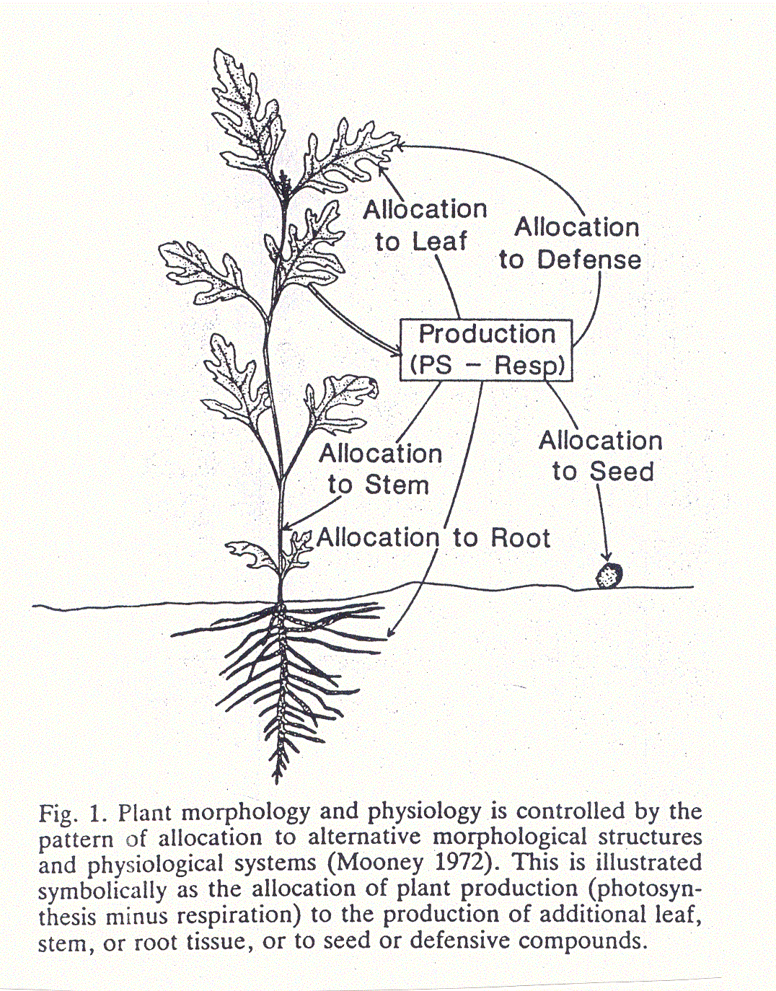
“Constraints”
Organisms cannot invest more (energy) than they are gaining (e.g., the plant cannot investment into individual functions more than it is able to obtain from the photosynthesis).
Physiological constraints (in excess of resources, organism is limited by its physiological ability of their uptake).
Phylogenetic constraints

Slide 20
Clonal plants: is there a trade-of between clonal and sexual reproduction? Chaloupecká, E., & Lepš, J. (2004). Equivalence of competitor effects and tradeoff between vegetative multiplication and generative reproduction: case study with Lychnis flos-cuculi and Myosotis nemorosa. Flora-Morphology, Distribution, Functional Ecology of Plants, 199(2), 157-167.
Lychnis flos-cuculi

Slide 21
Myosotis nemorosa

Slide 22
Trade-off is expressed as negative correlation only if the total amount of resources (energy) is roughly constant (Lychnis). If the amount changes pronouncedly (Myosotis), the “traits” might be even positively correlated.
(My own interpretation of results, not from a textbook.)

Slide 23
Which “trade-off” is important?
Selection due to mortality
Density independent m. vs. density dependent m.
Catastrophic events
r-selection
Competition
K-selection
Disturbance
High
Low

Slide 24
Assumes: investment either into r, or into K; there is a trade-off: increasing r (e.g. shortening the generation time) will decrease the survival.

Slide 25
Trade-offs in plants

Slide 26
Another example (mainly animal)
r-selection supports | K-selection supports
high population growth rate, population size usually deeply below K | population size close to K
Early reproduction | Postoponed reproduction
Short life span | Long life span
Natality and mortality is high | Natality and mortality is low
No or limited parental care | Well developed parental care
Investment into large amoung of progeny, often without any further protection | Small amount of progeny, but efforts to protect and support it

Slide 27
r-startegists have higher r, but are more sensitive to environmental fluctuations – higher variability (i.e. lower constancy) of population size
Predictable environment,
High population constancy
Unpredictable environment,
Low constancy

Slide 28
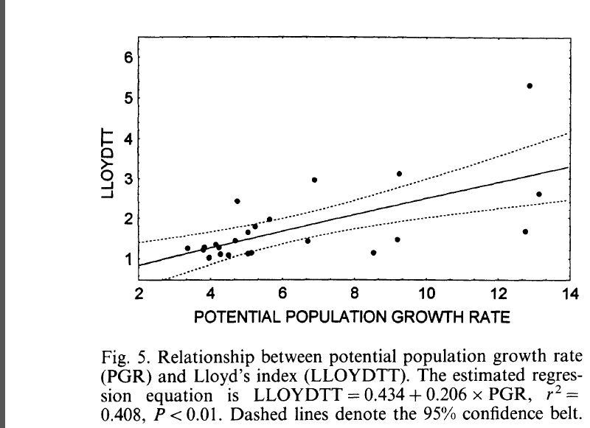
Species with high potential growth rate (calculated on the basis of number of eggs/female and voltinism) have higher population variability (expressed as Lloyds index) . (Lepš et al. 1998 Oikos)

Slide 29
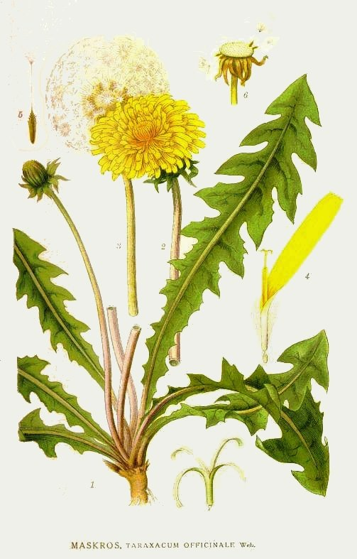
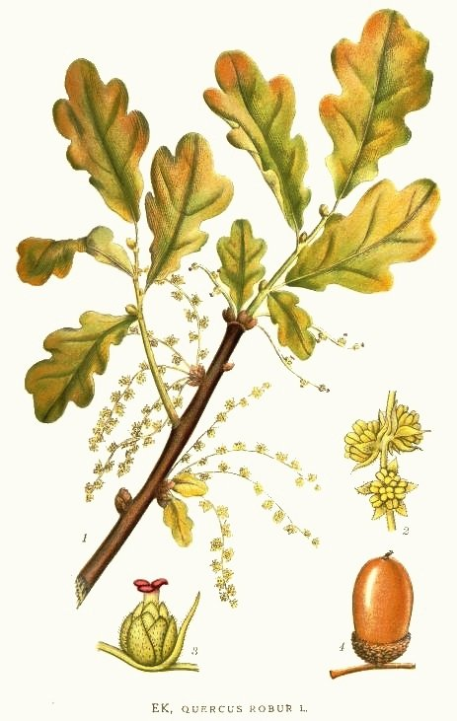
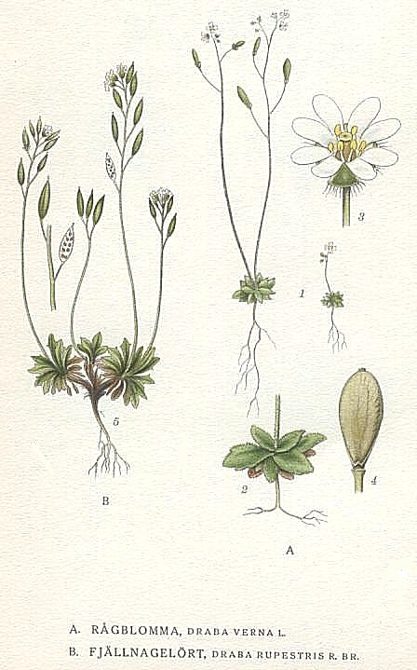
r-K continuum – strategies are just relative
McArthur & Wilson (1967), Pianka (1971)
but MacLeod (1894) Capitalists and proletarians (in Dutch)

Slide 30
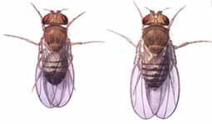
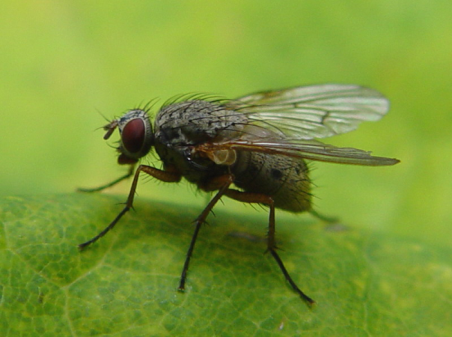
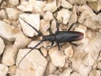
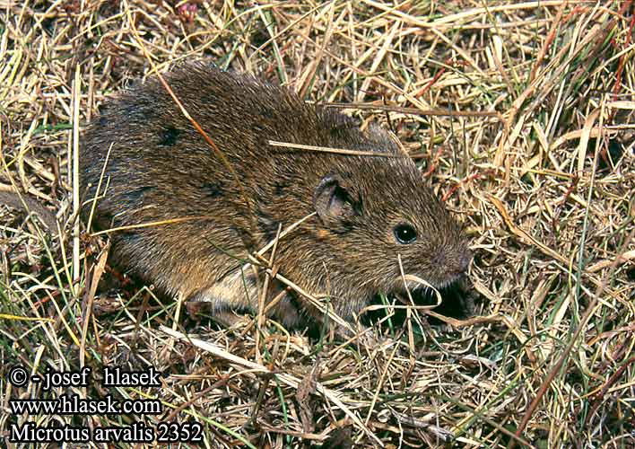
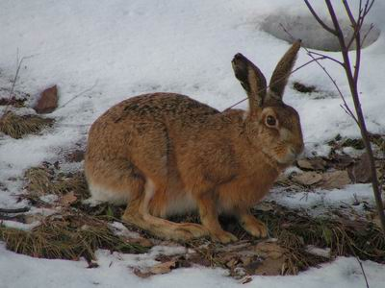
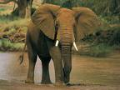
r-K continuum in insects
Drosophila
Cerambix cerdo
In mammals
But generally – insects are more r startegists than mammals
Concept r-K strategy is comparative

Slide 31
Remember
The r-K strategy is most frequently used as a descriptive concept (e.g. for description of community composition)
However, it is derived from the Darwinian concept of r-K selection
It is intended to be as general as possible, generally for all organisms
Unpredictable mortality as a result of catastrophic events = density independent mortality -> r-selection
Mortality as a result s (mostly) competition -> density dependent mortality -> K-selection
I možnost experimentů: Mueller, L. D., & Ayala, F. J. (1981). Trade-off between r-selection and K-selection in Drosophila populations. Proceedings of the National Academy of Sciences, 78(2), 1303-1305.

Slide 32
Is one axis sufficient?
If not, which should be the next one?
Grime: productivity / stress [for plants]
Competitors – C-strategists; Ruderals - R-strategists
Note: r-strategists refers to r-K continuum; R-strategists: to Grime’s system
But both are roughly the same

Slide 33
Definitions
Stress: phenomenon, constraining the photosynthetic production, e.g. shortage of light, water, nutrients, sub-optimal temperatures
Disturbance: partial or complete destruction of plant biomass; activity of herbivours, pathogens, people (trampling, mowing, ploughing) and other factors as wind, frost, drought, soil erosion, fire…

Slide 34
Problems:
The same factor might be perceived as stress and disturbance depending on circumstances and also on plant types:
Extreme drought is probably disturbance for competitors (C-strategists), but only stress for stress tolerators (S-strategists)
Where is the threshold from which the drought is not stress, but disturbance?

Slide 35
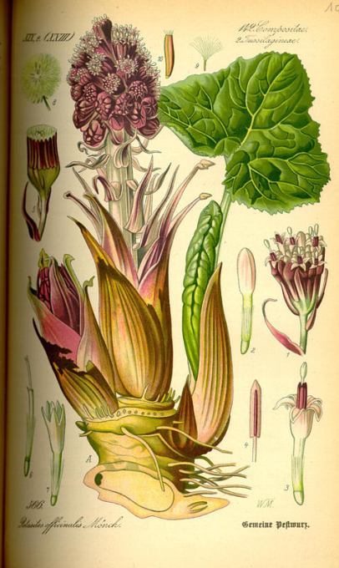
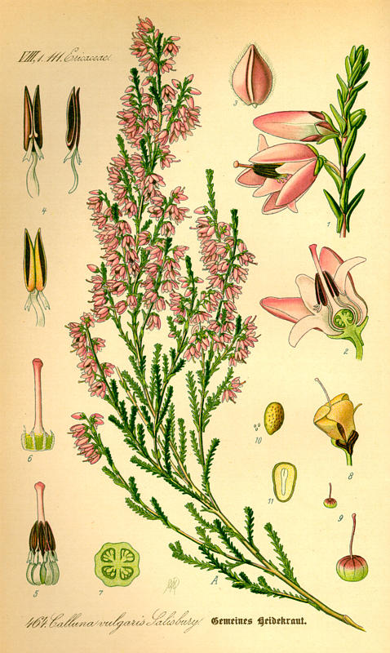
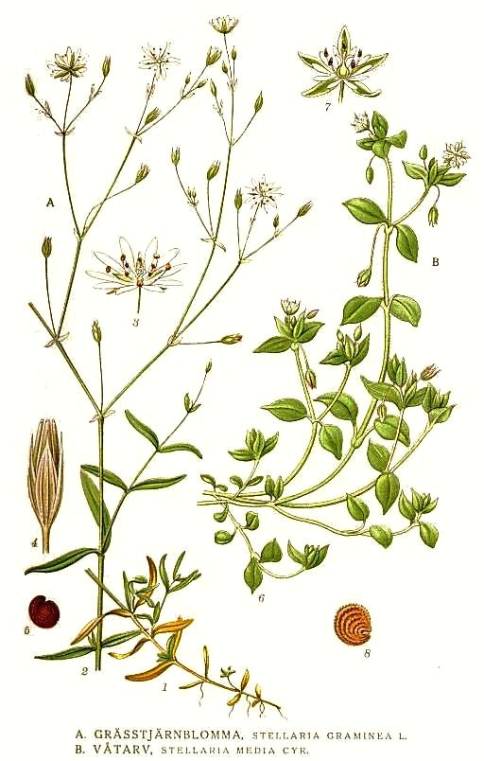
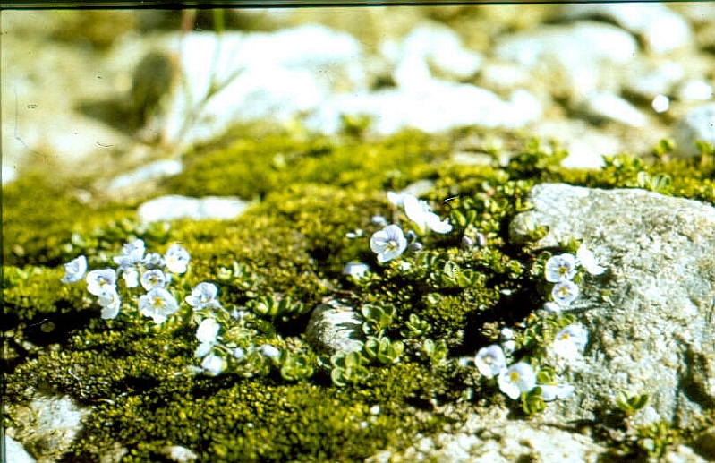
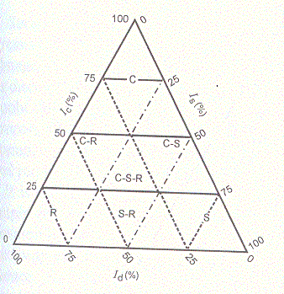
Secondaary strategists (e.g.C-R) are combinations of the primary strategies

Slide 36
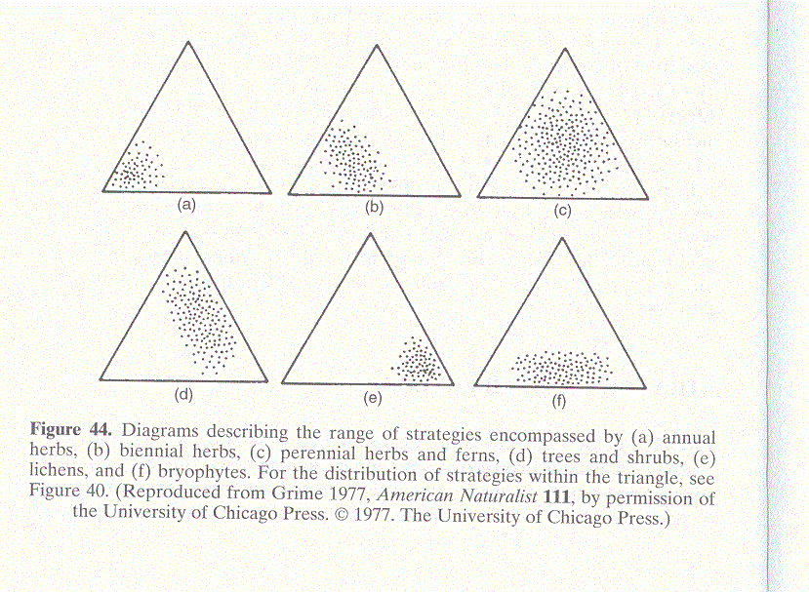
annuals
biennials
perennial herbs
trees and shrubs
lichens
bryophytes

Slide 37
Whereas the r- K-strategy is basically comparative concept - birch (Betula) is r-strategist within trees, but K-strategist when compared with all the vascular plants in the bopg vegetation, Grime was able to assign each species in his British vascular plant list on strategy within the C-S-R system.

Slide 38
Ramenskij (1938)
“explorenty” = jackals ~ Ruderals
“violenty” = lions ~ Competitors
“patienty” = camels ~ Stress-tollerators
Published in Russian

Slide 39
Use of CSR strategies in community ecology

Slide 40
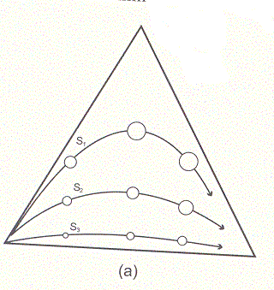
Succession
Relationship between r-K and C-S-R stratégy (according to Grime)
Productive environment
Unproductive environment

Slide 41
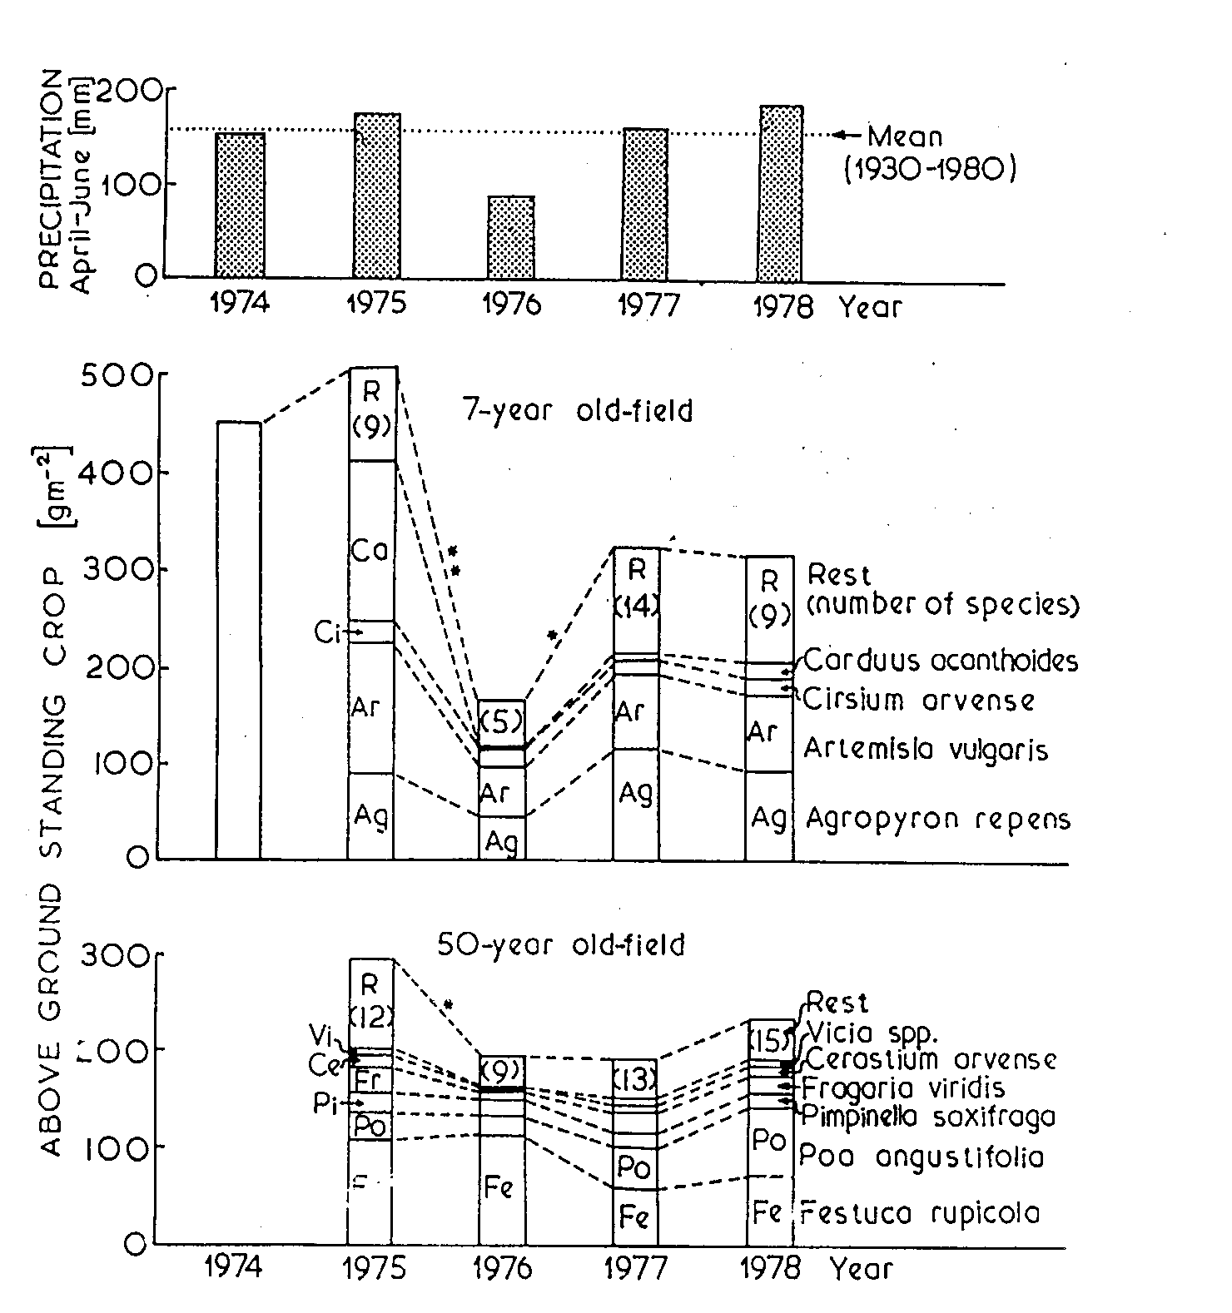
Application of Grime strategies – explaining the stability of old-fields:
Stability is determined by prevailing strategy
C-R strategy
S-strategy

Slide 42
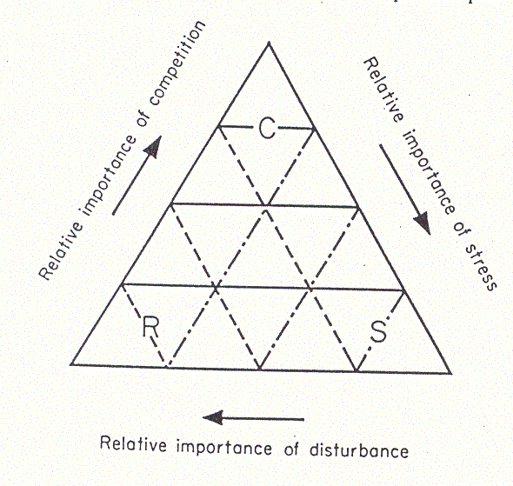
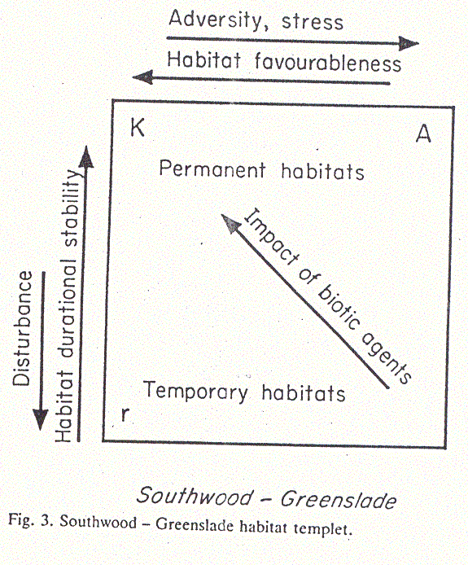
habitat templet - 3 strategies in animal ecology
Grime (plants)

Slide 43
Strategies of regeneration phase:
Compare – regeneration niche of Peter Grubb

Slide 44
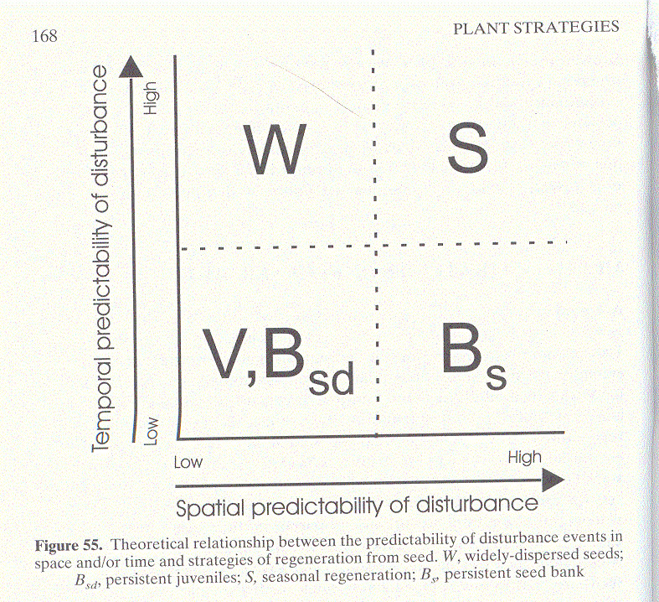
Strategies of regeneration phase:
V - Vegetative expansion
S – Seasonal regeneration in vegetation gaps
B_{s} – Regeneration including the permanent seed bank
W – Regeneration including the dispersal of many widely dispersed seeds
B_{sd} – Regeneration including the seedling bank (persistent juveniles)

Slide 45
How to make the concept of strategies operational?
“Species traits”
Measurable characteristics of species (SLA, LDMC, Beak depth)

Slide 46
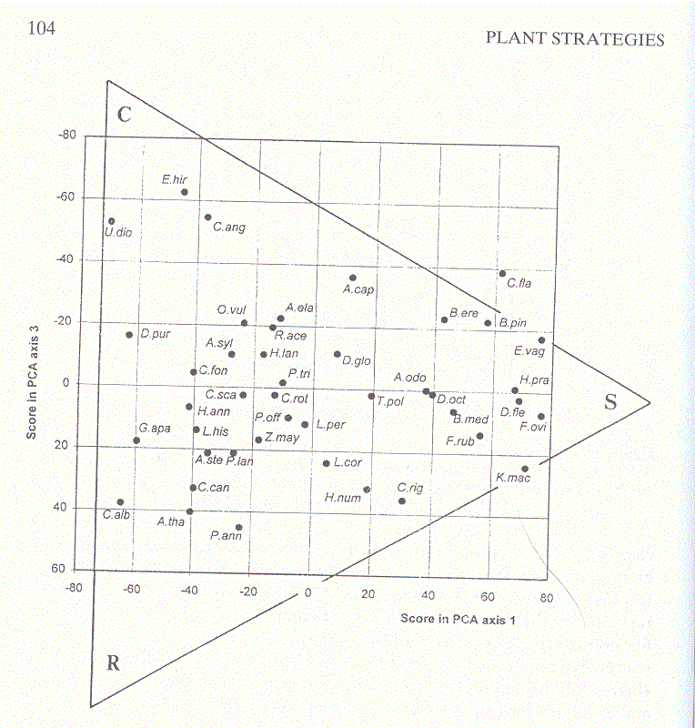
Verification of CSR using multivariate analysis PCA of data from Grime ISP (integrated screening program)
Epilobium hirsutum
Festuca ovina, Deschampsia flexuosa
Poa annua
Arabidopsis thaliana

Slide 47
Westoby (1998) - LHS
Leaf-height-seed
Concept: Three easily measurable characteristics[soft traits] determine:
SLA (Specific leaf area) – leaf area per mass unit – ability of fast photosynthesis, positively correlated with RGR (Leaf economic spectra – acquisitive vs conservative)
Height – reflects the competition for light, but also age at the maturity (and thus +- life span)
Seed mass – trade-off dispersability vs. resources for the seedlings

Slide 48
acquisitive
conservative
As explanatory variables, use always independently measured characteristics – not subjective categories

Slide 49
Advantages, disadvantages
Grime – concepts – difficult to quantify, but see
Pierce S., et al. (2017): A global method for calculating plant CSR ecological strategies applied across biomes world-wide. – Funct. Ecol. 31: 444–457.
Westoby – no further calculations are needed, and clear and simple straightforward method

Slide 50
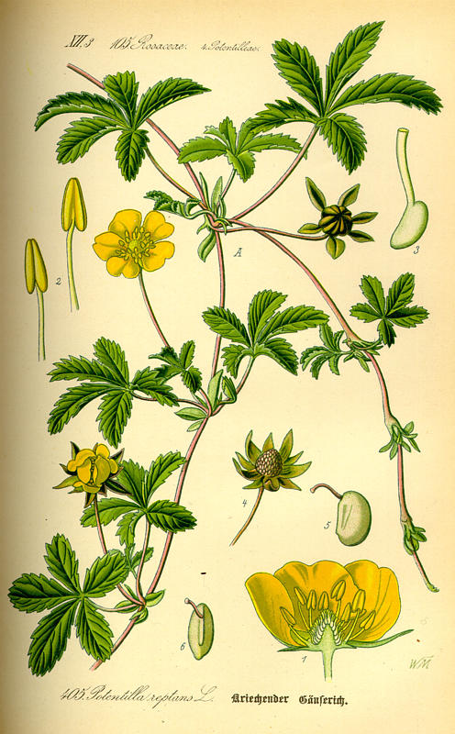

“Guerrilla” vs. “Phalanx” strategies of clonal plants
Potentilla reptans
Nardus stricta

Slide 51



Life history strategies
Testing of evolutionary strategies – particularly r- K- as Darwinian concept with density (in) dependent selection
Possibility of comparisons across biogeographical regions

