Slide 1
Photo Album
by suspa

Slide 2
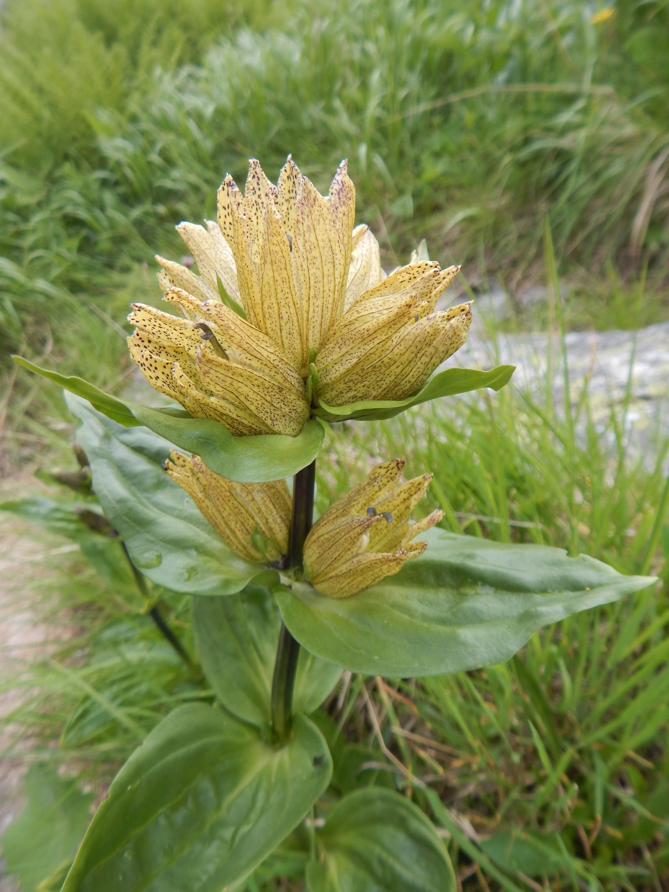
Gentiana puctata

Slide 3
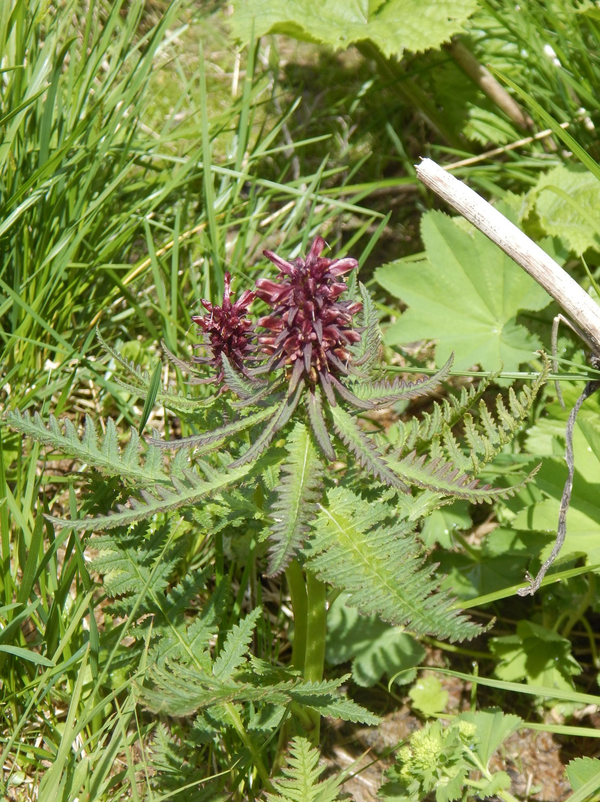
Pedicularis recutita

Slide 4
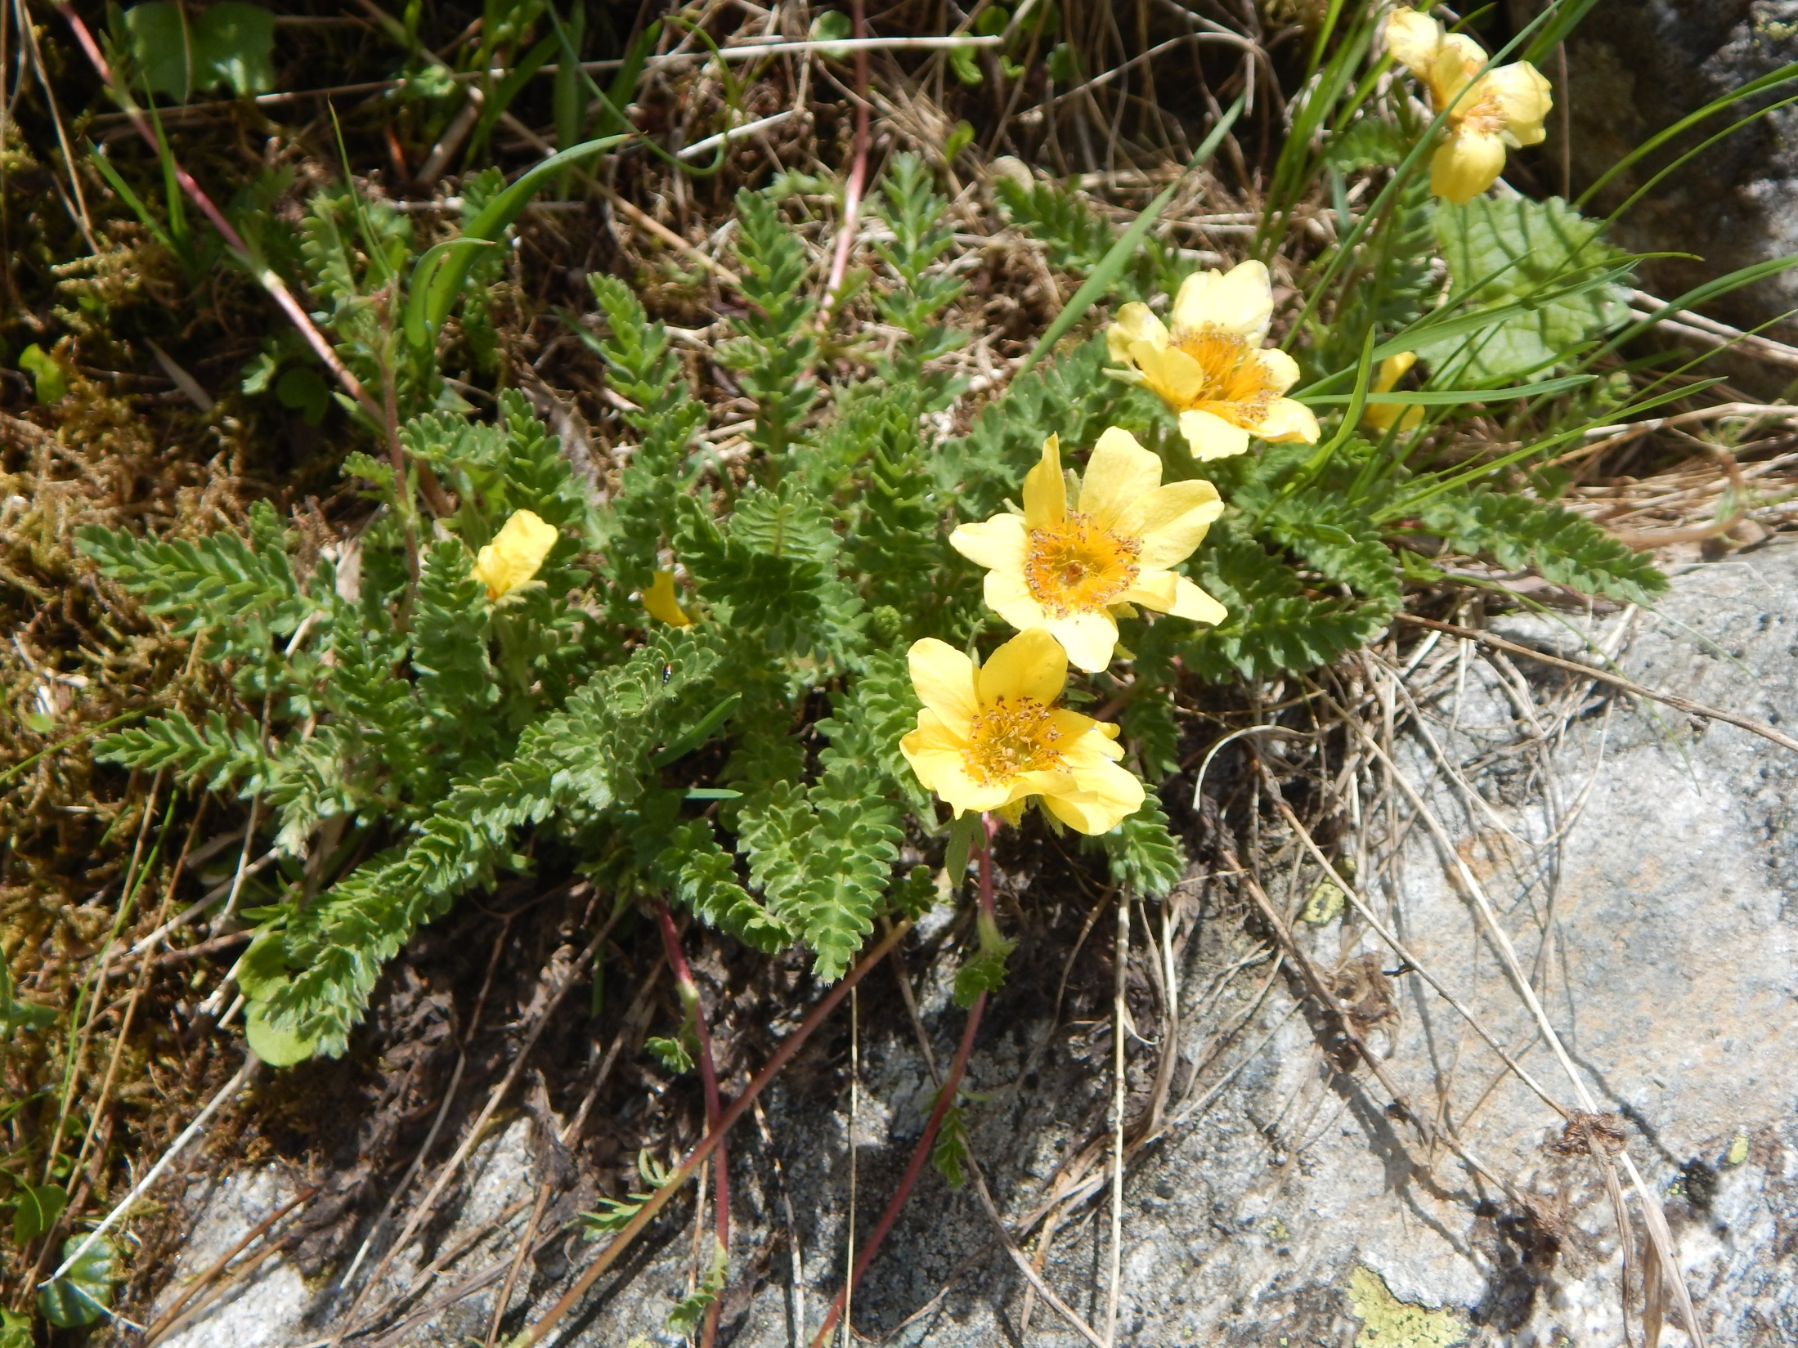
Sieversia reptans (Geum s.)

Slide 5
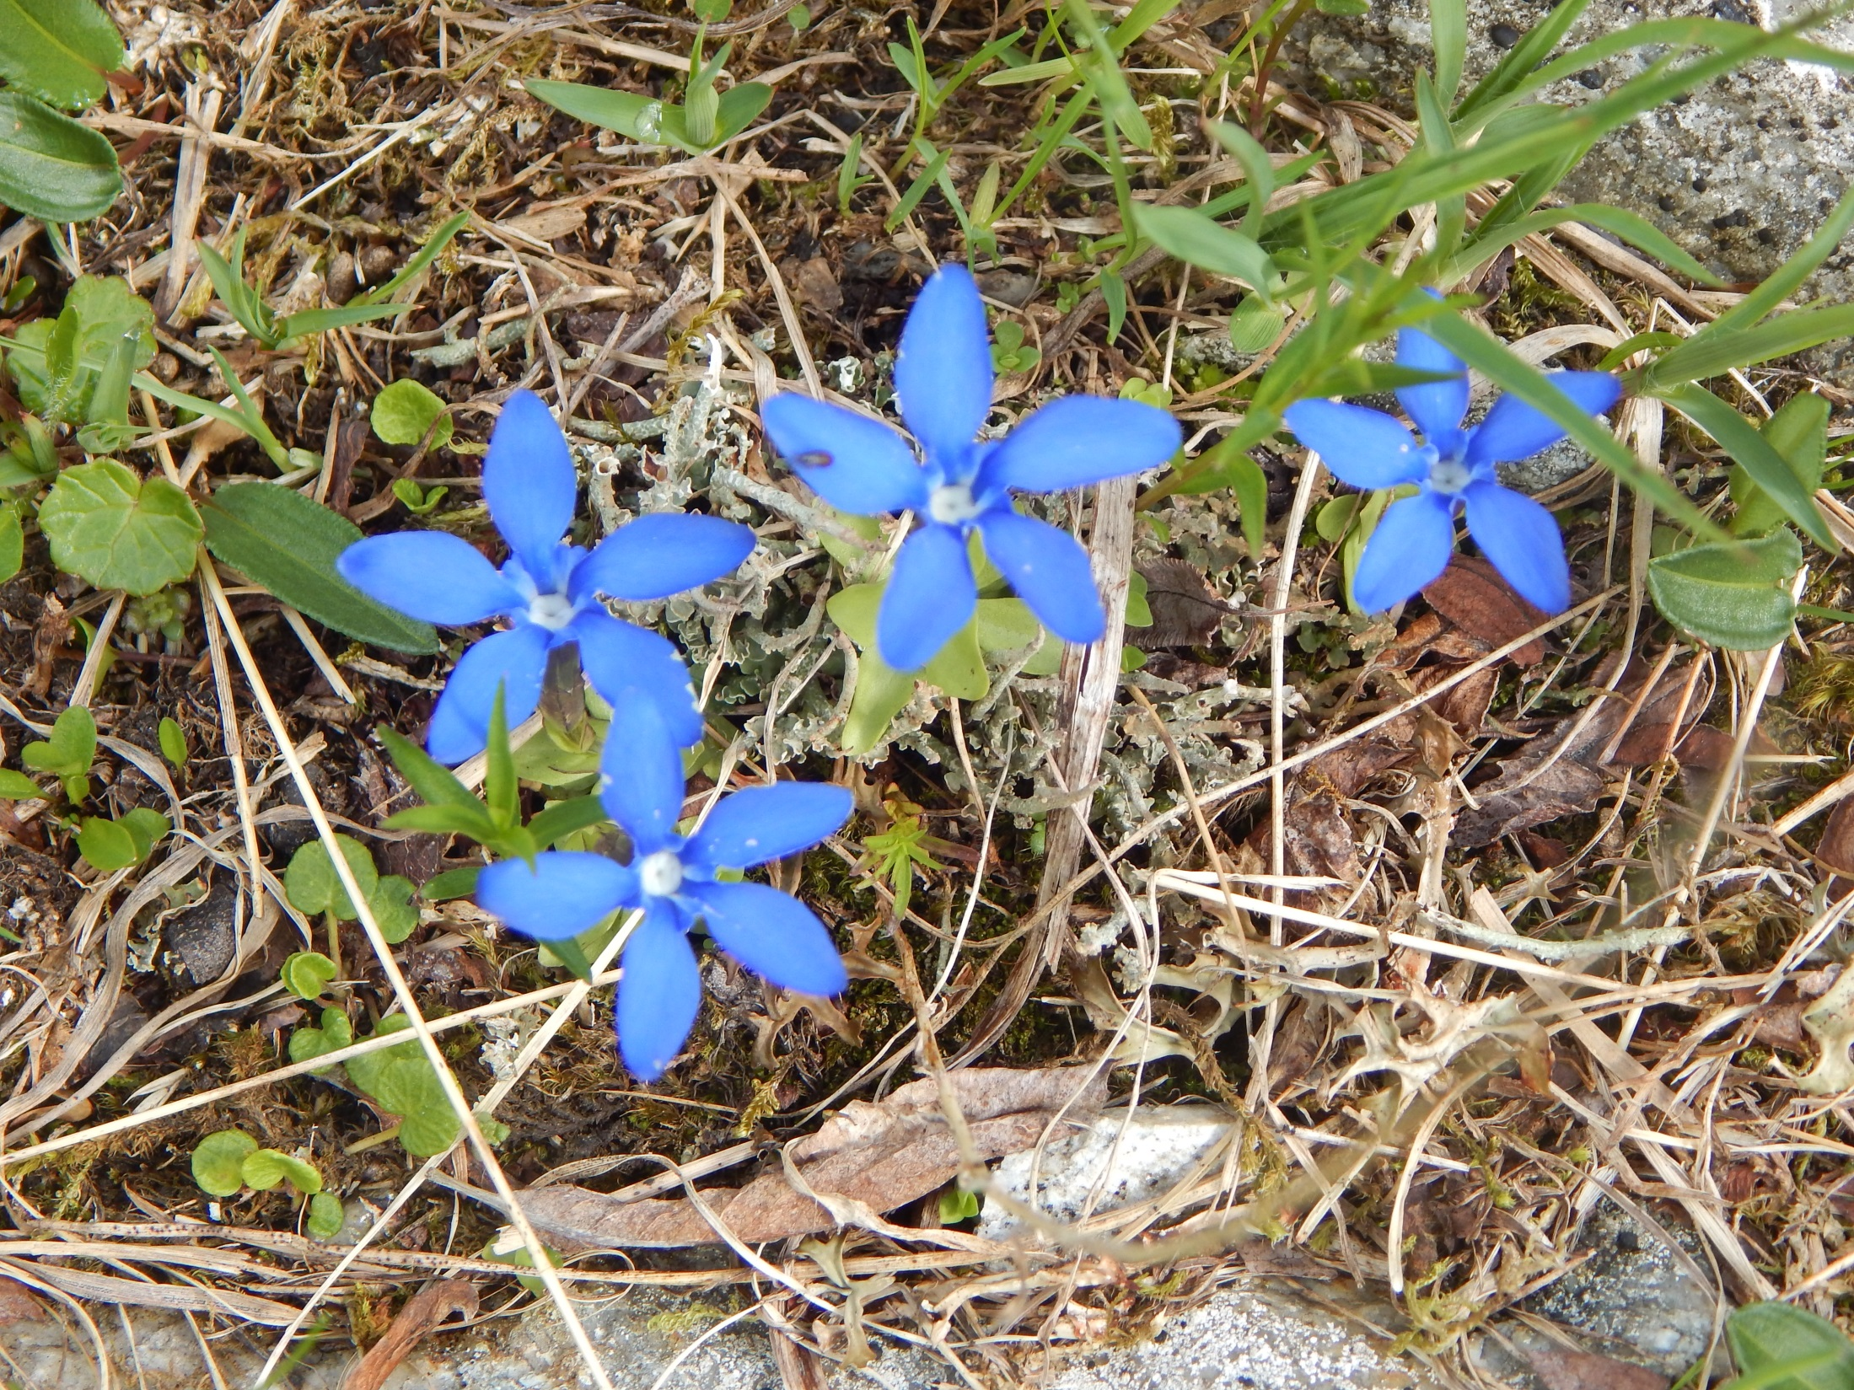
Gentiana verna agg. – asi bavarica

Slide 6
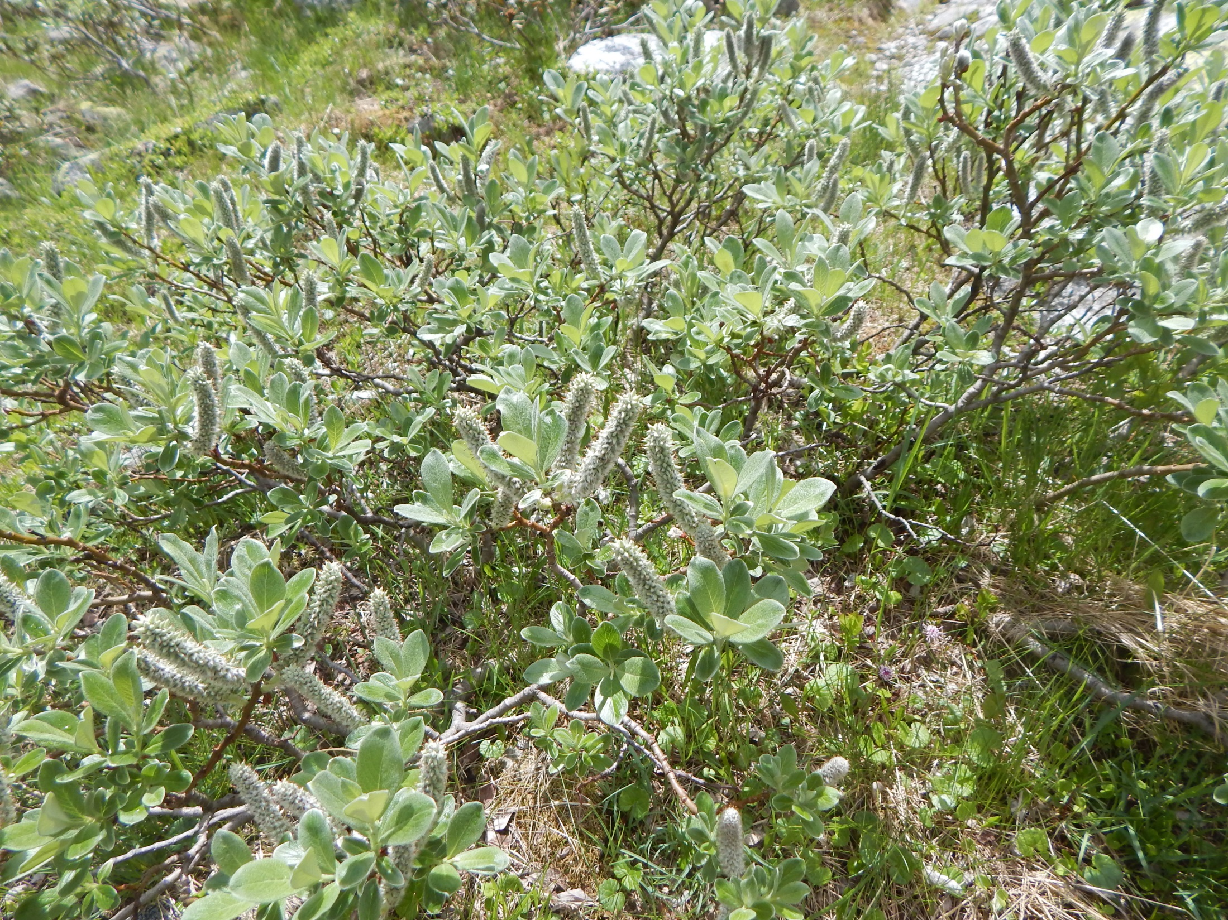

Slide 7
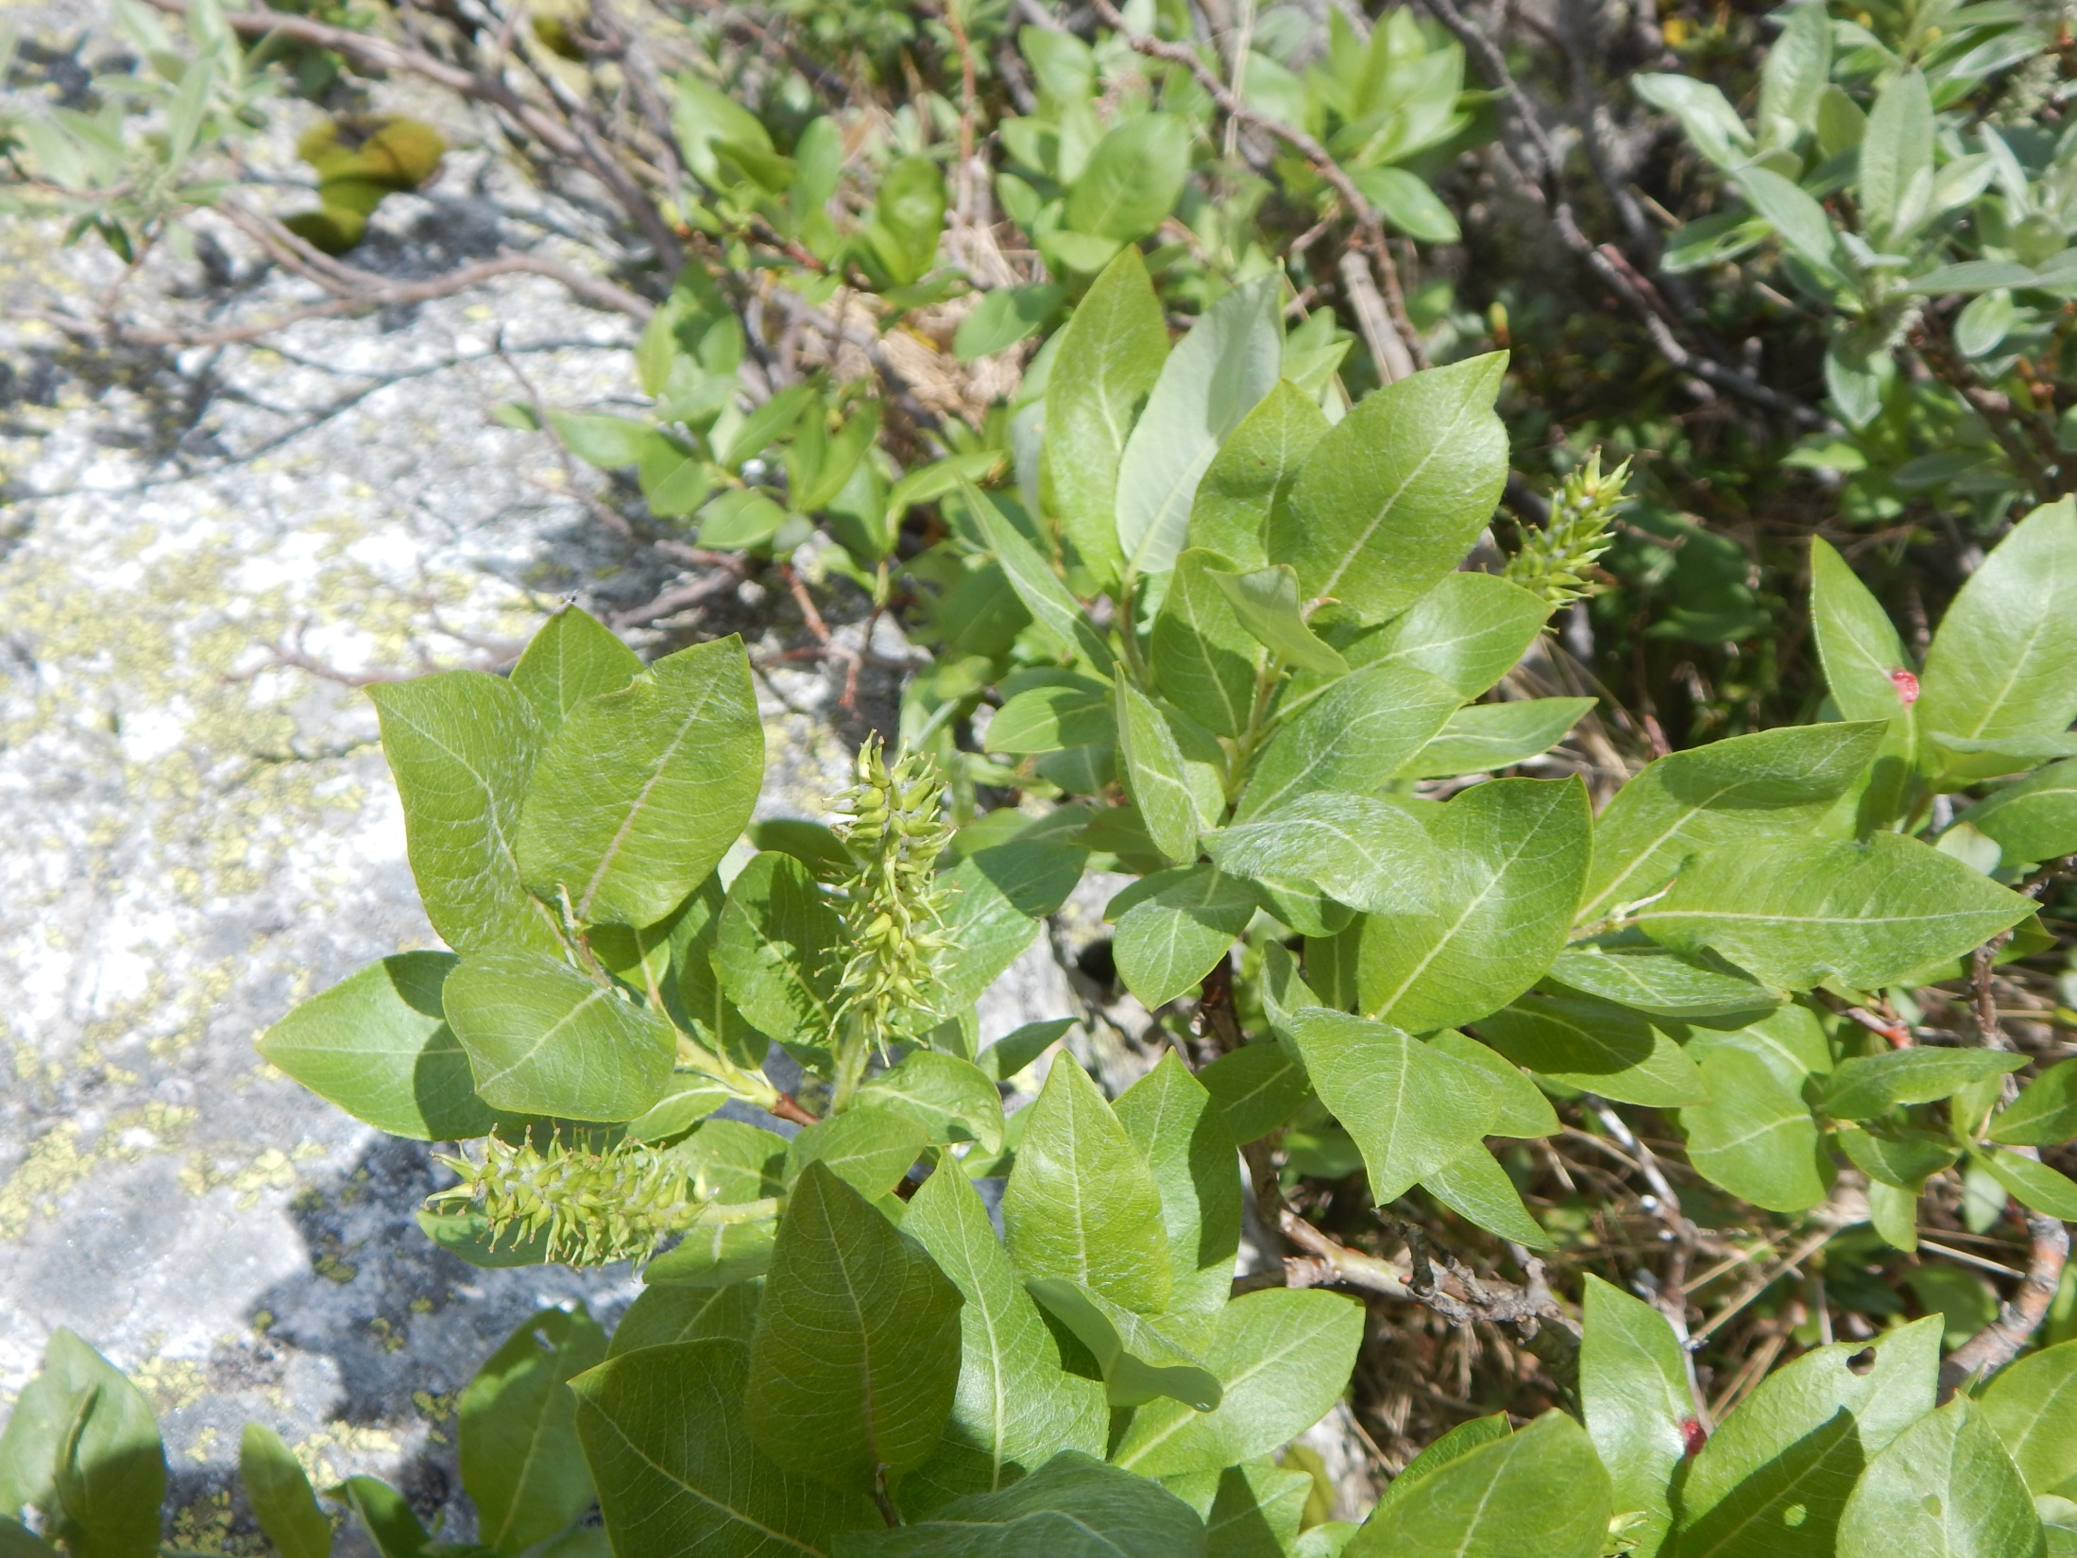

Slide 8
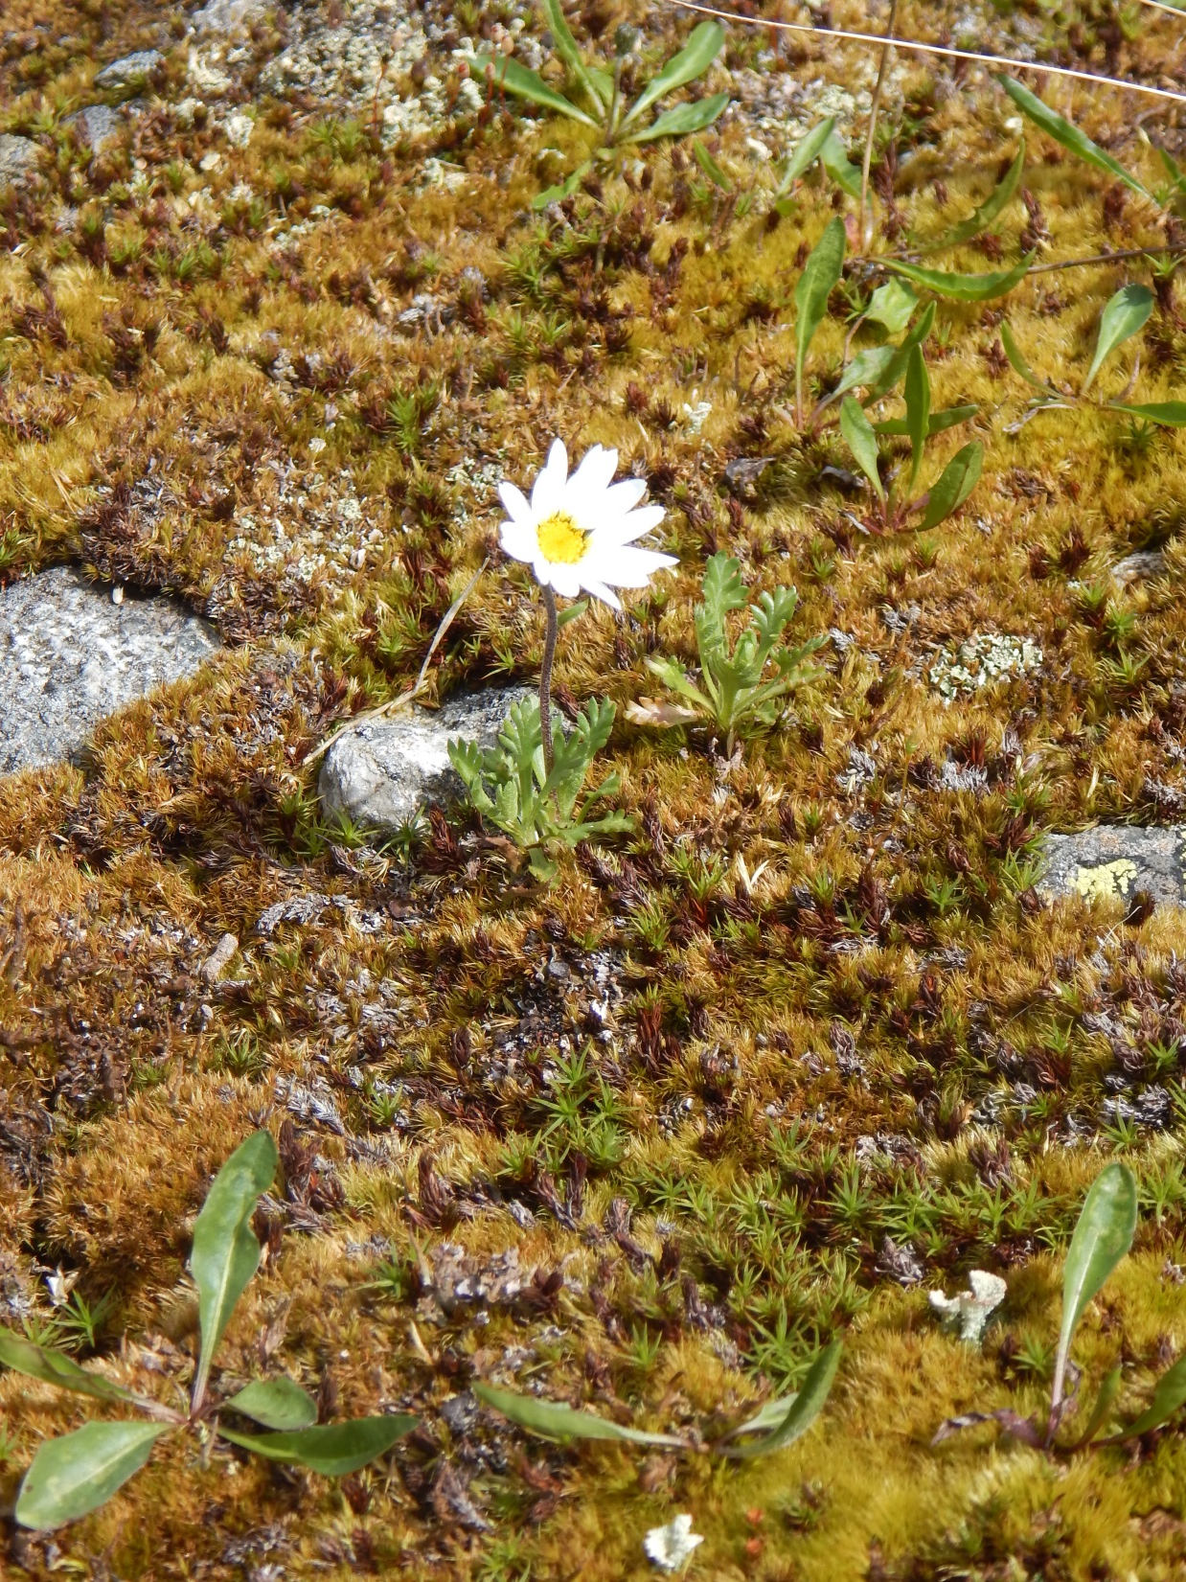
Chrysanthemum/Leucanthemopsis alpinum

Slide 9
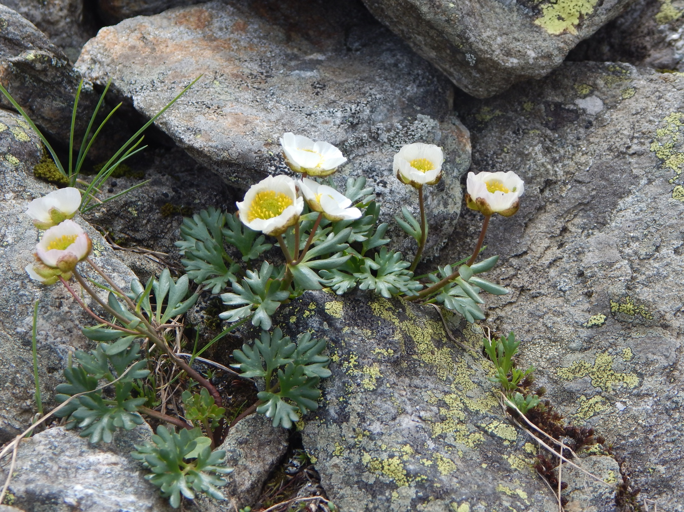
Ranunculus glacialis

Slide 10
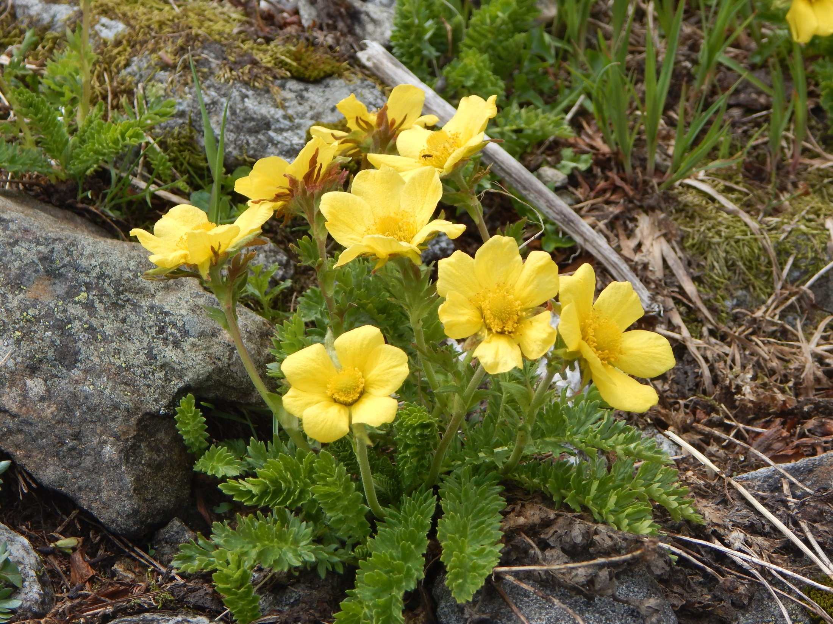
Sieversia reptans

Slide 11
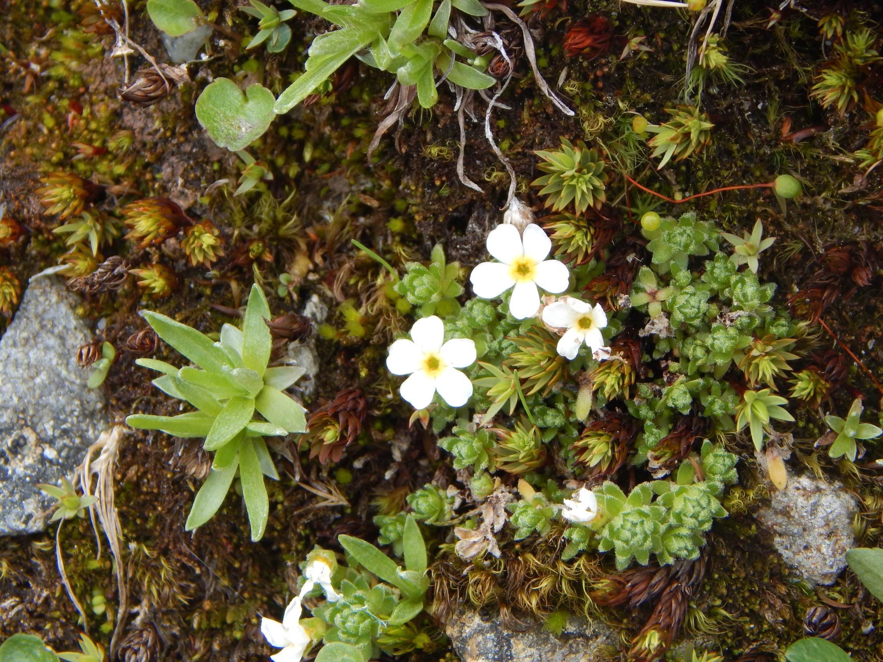
Androsace

Slide 12
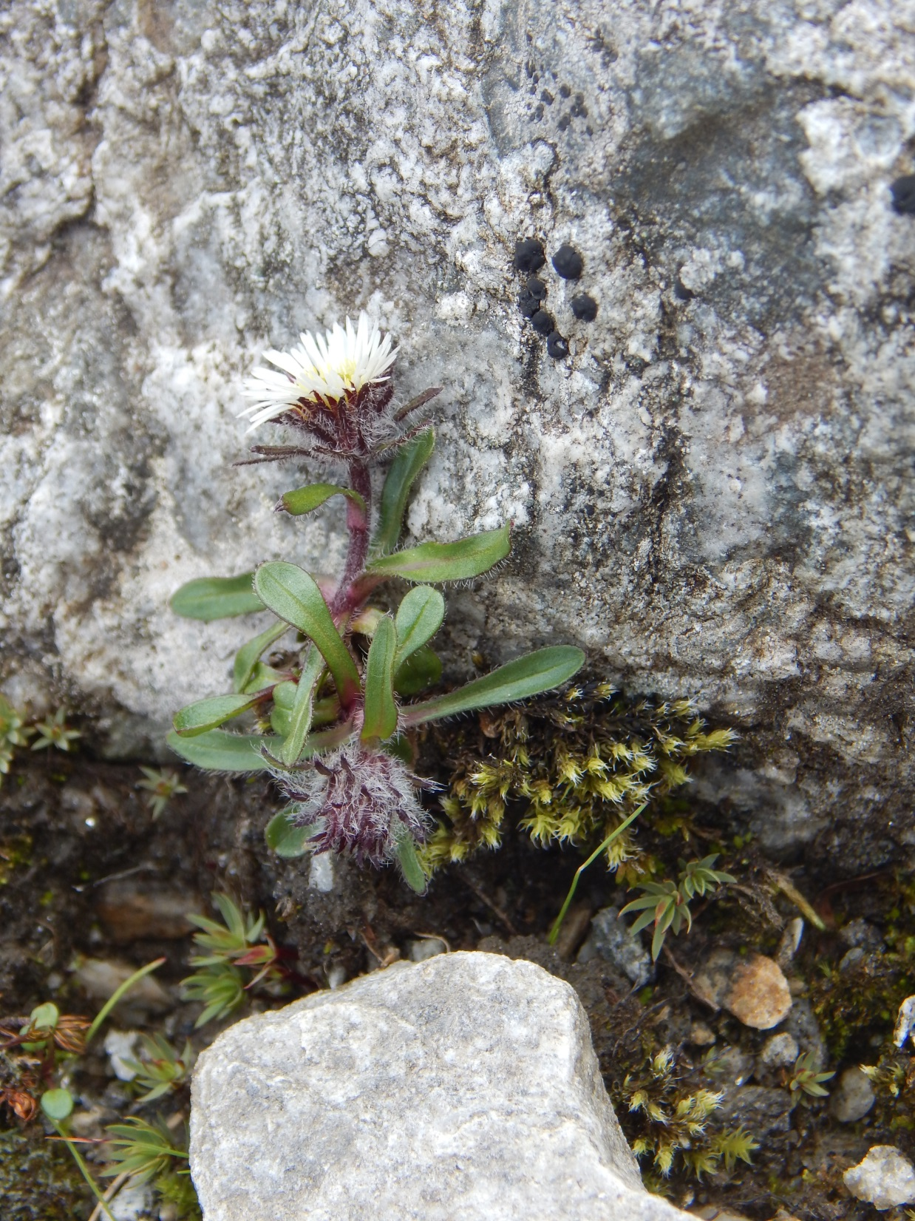
Erigeron uniflorus agg.

Slide 13
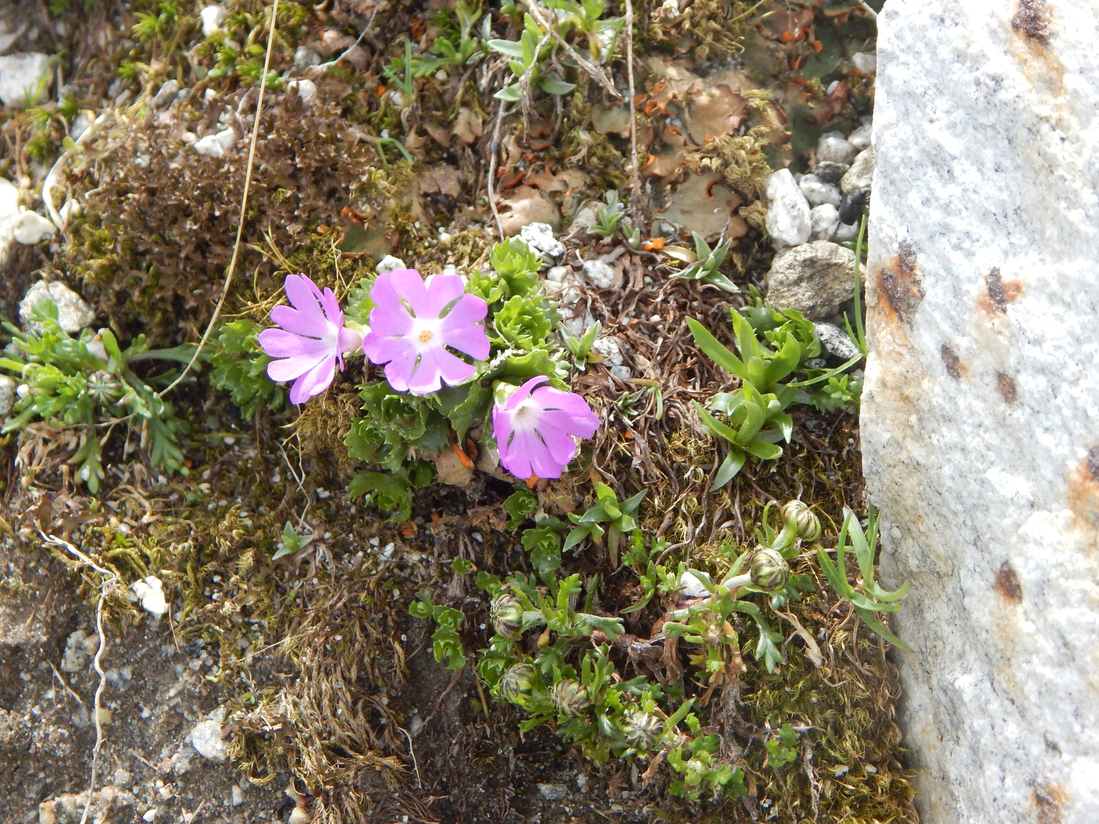
Primula minima

Slide 14
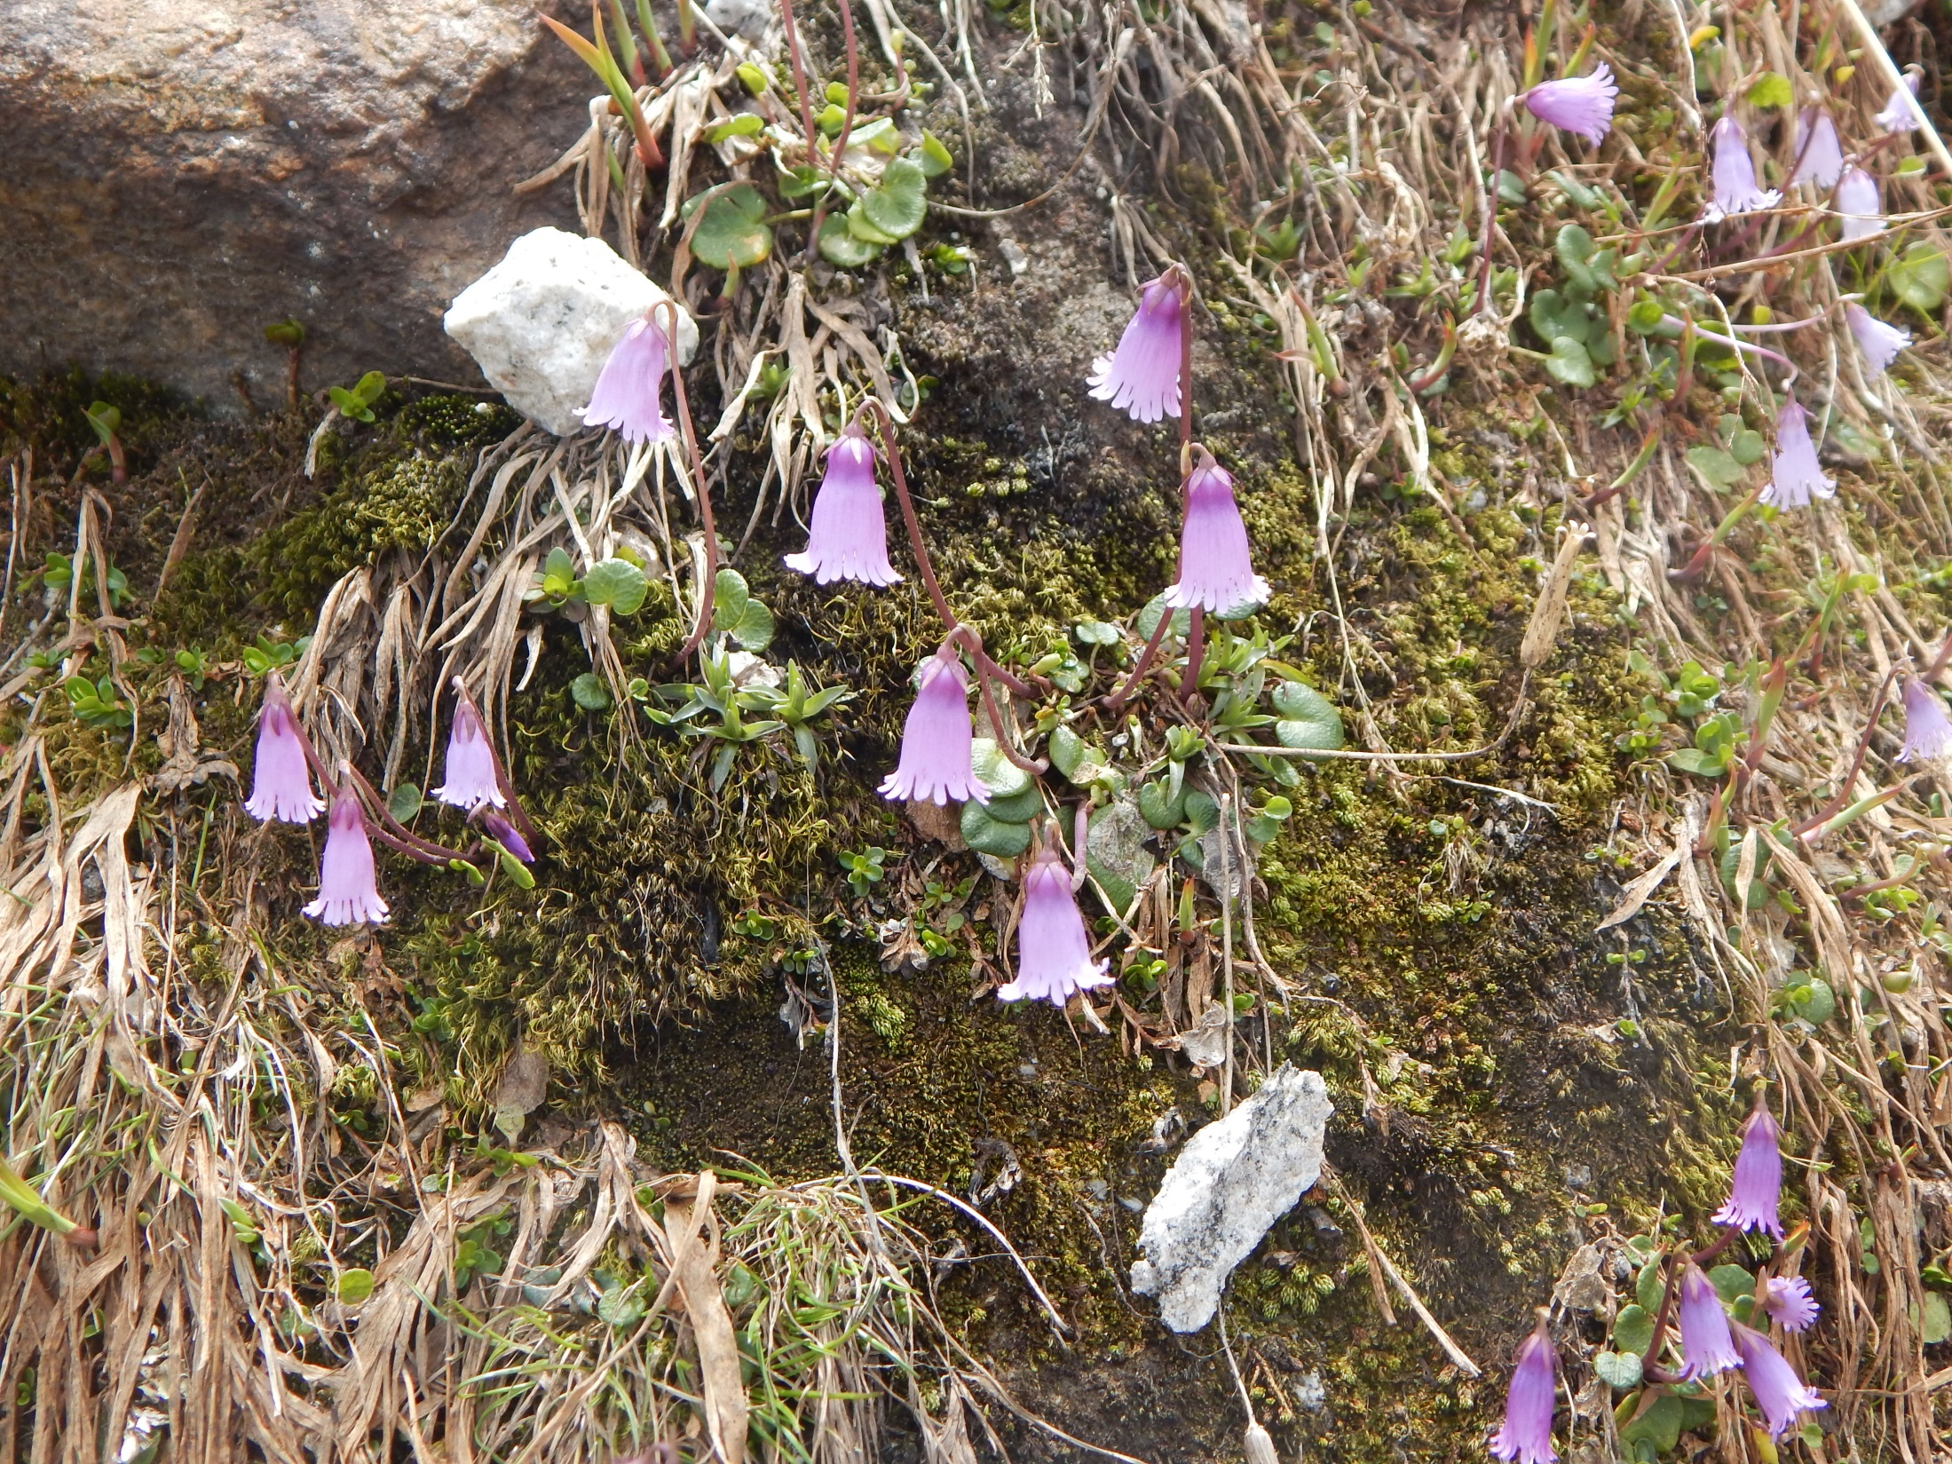
Soldanella pusila

Slide 15
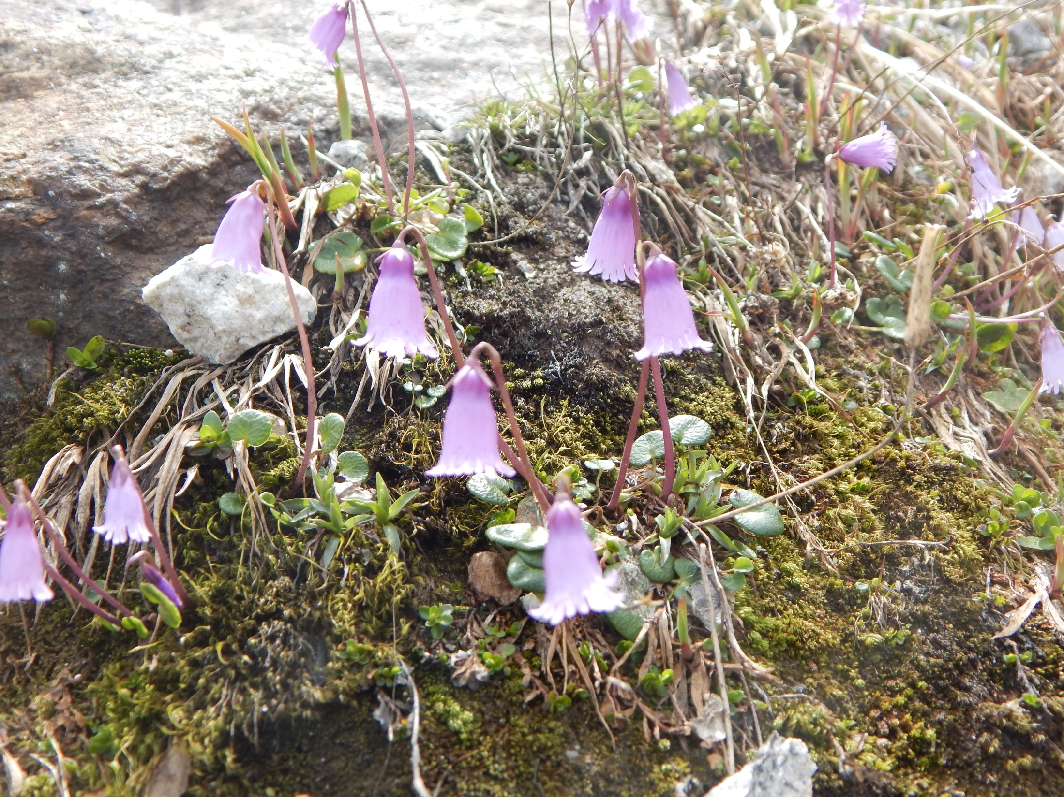

Slide 16
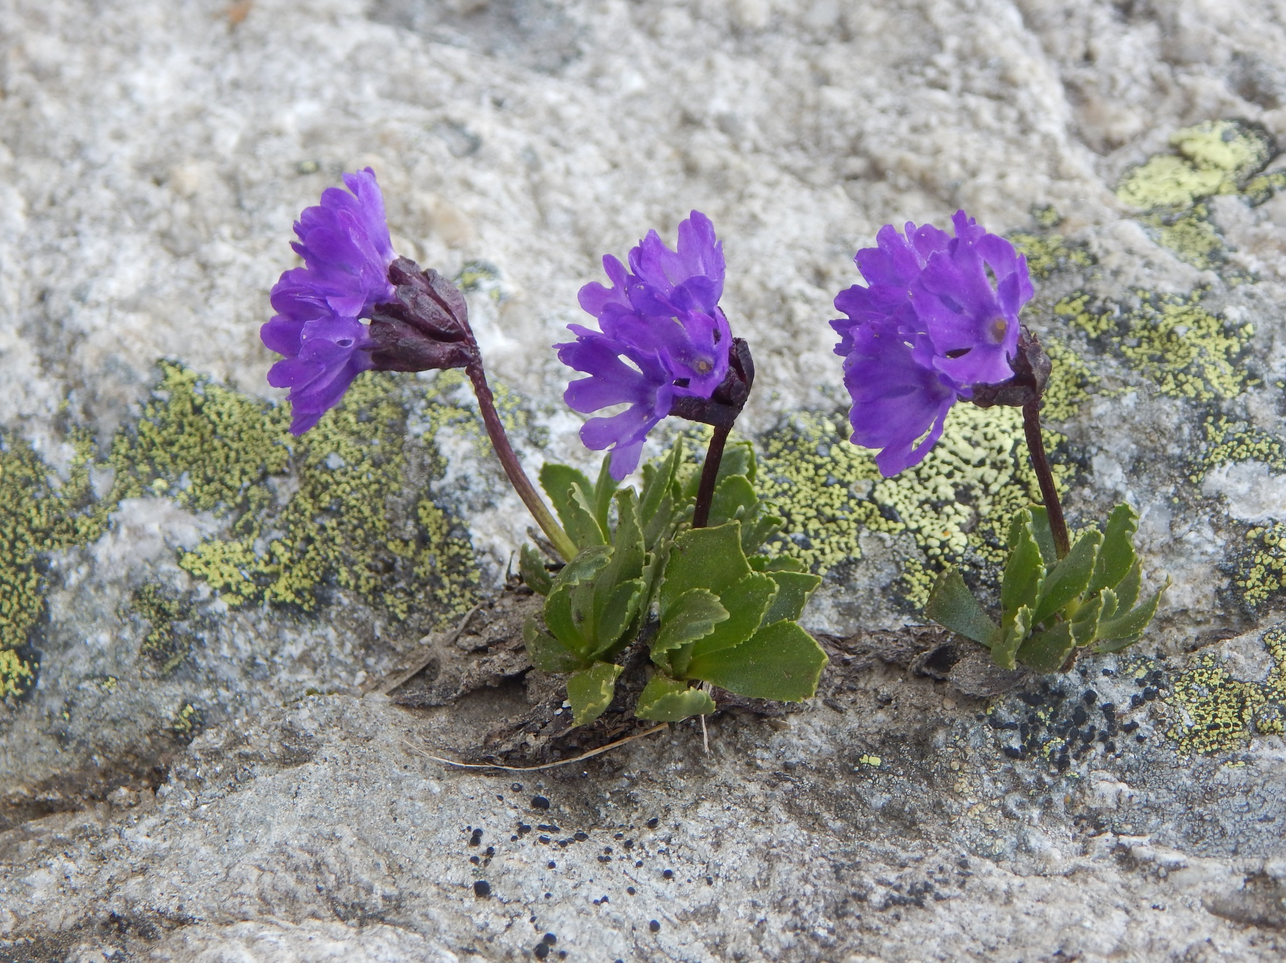
Primula glutinosa

Slide 17
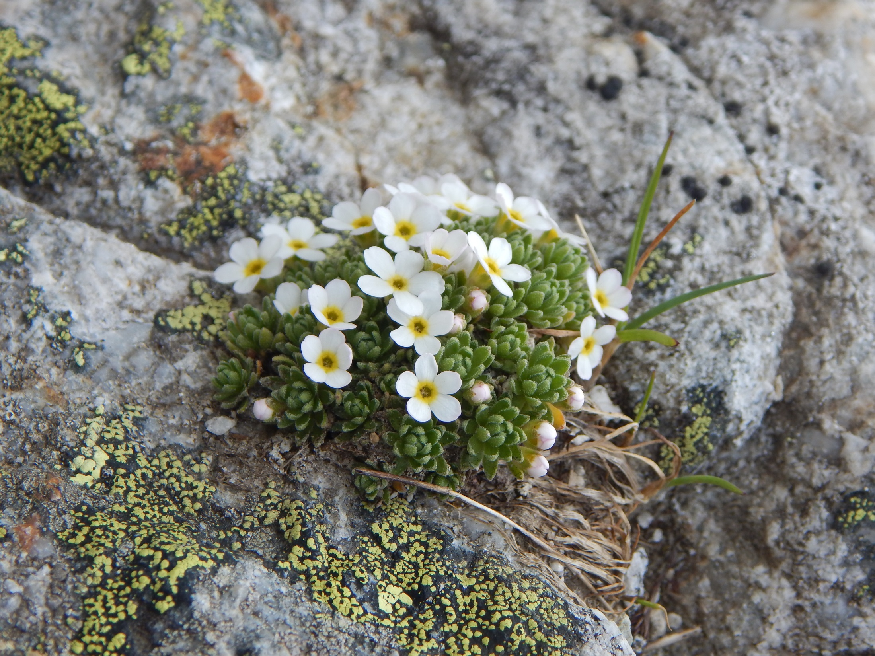
Androsace cf. helvetica

Slide 18
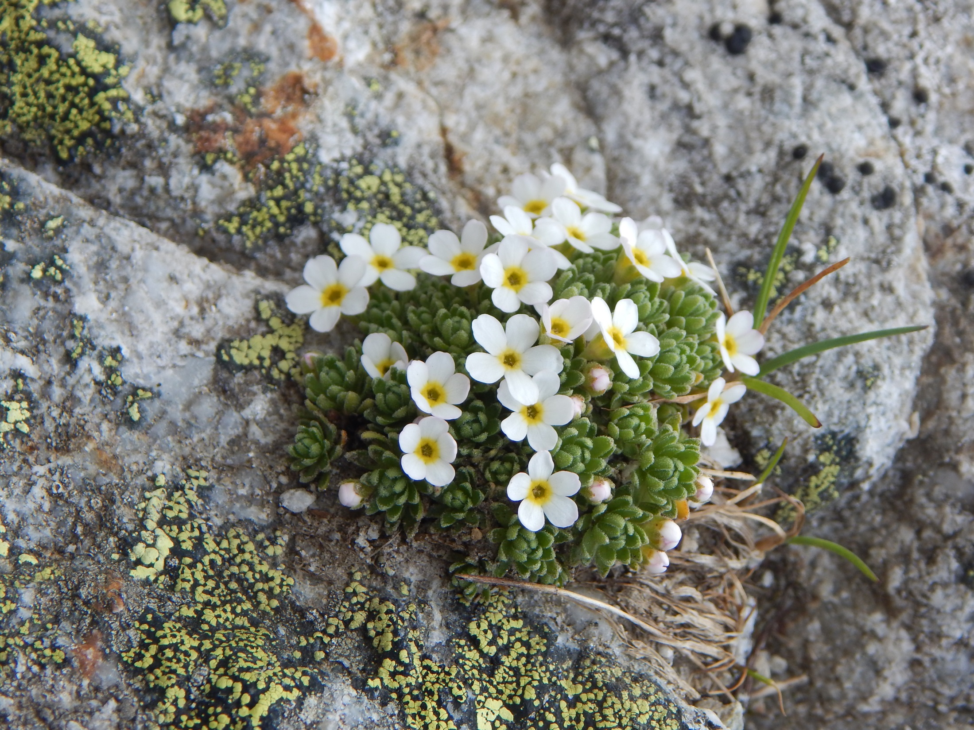

Slide 19
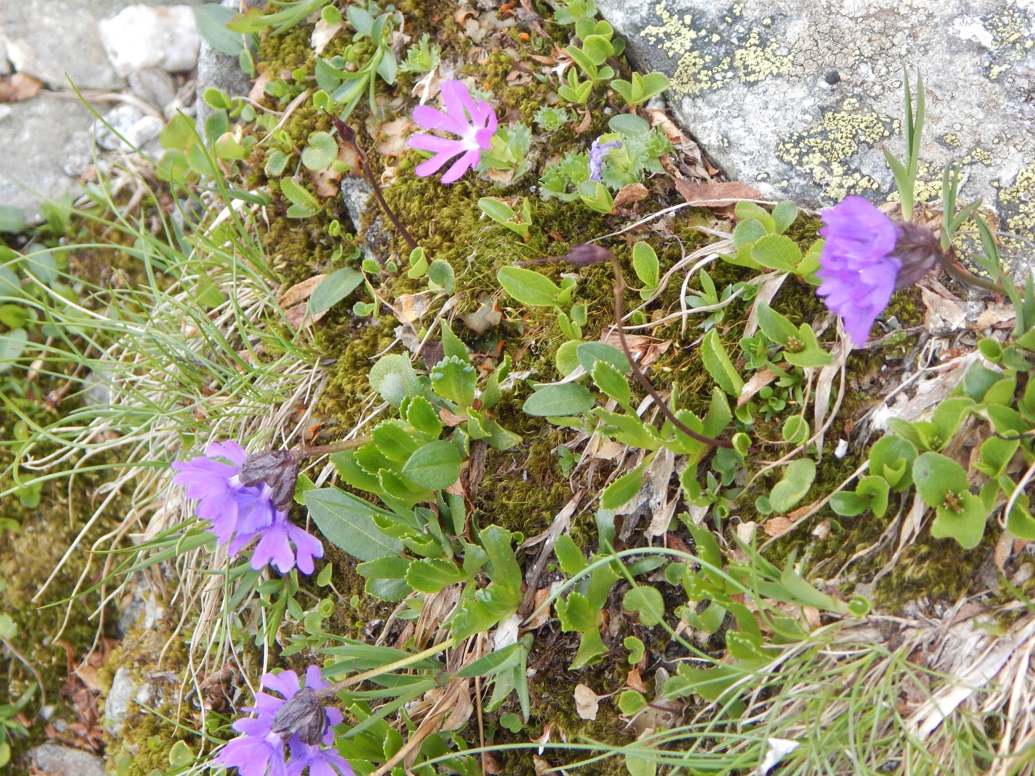

Slide 20
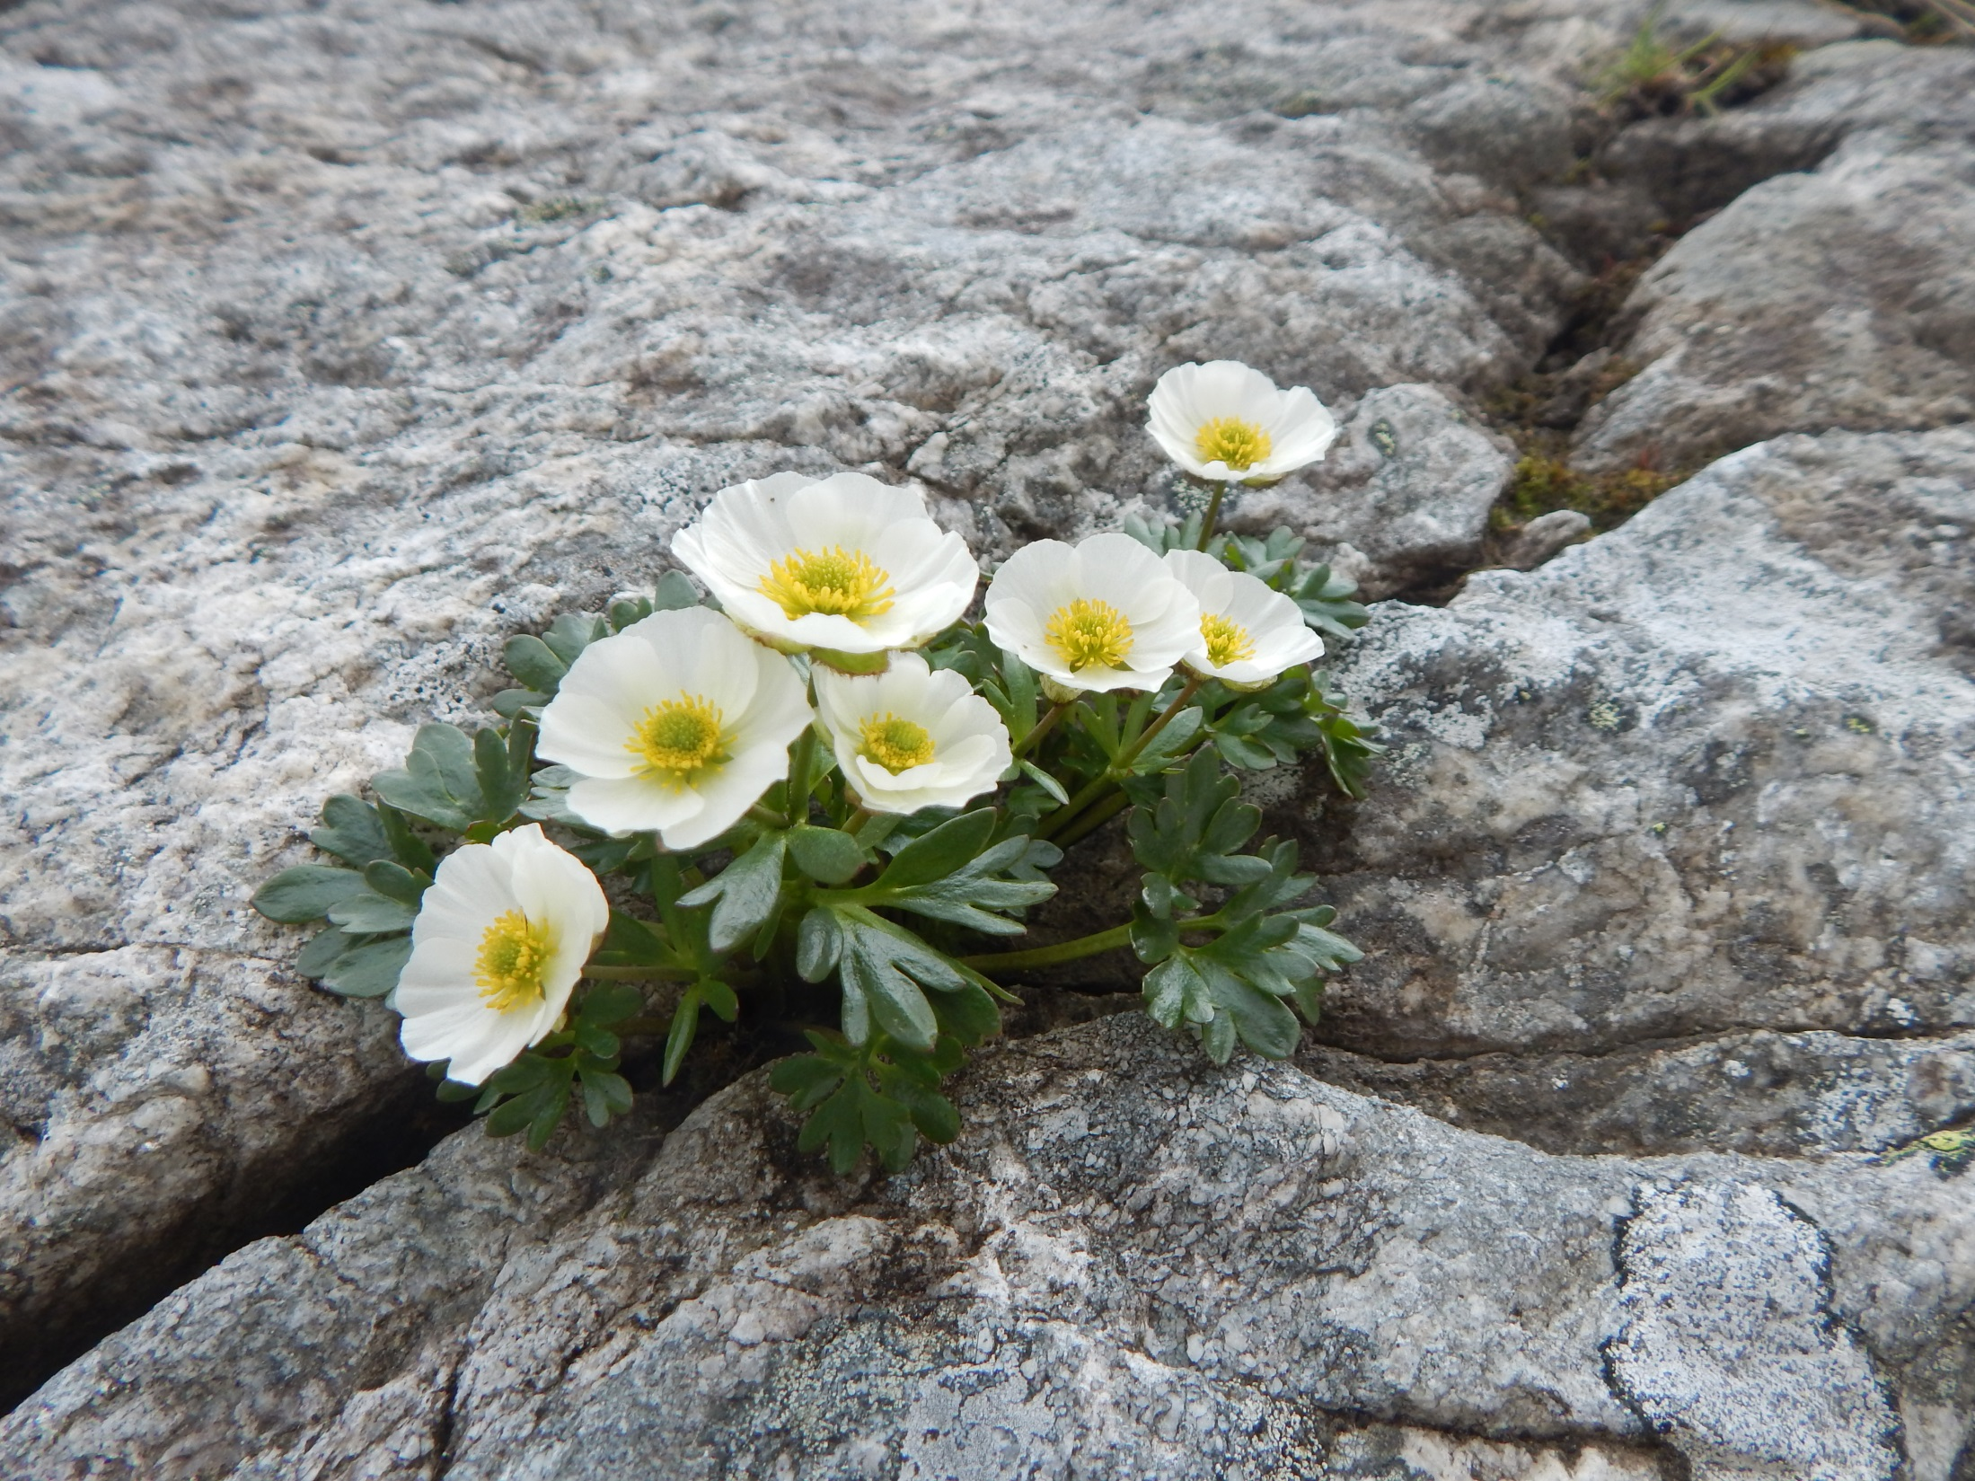
Ranunculus glacialis

Slide 21
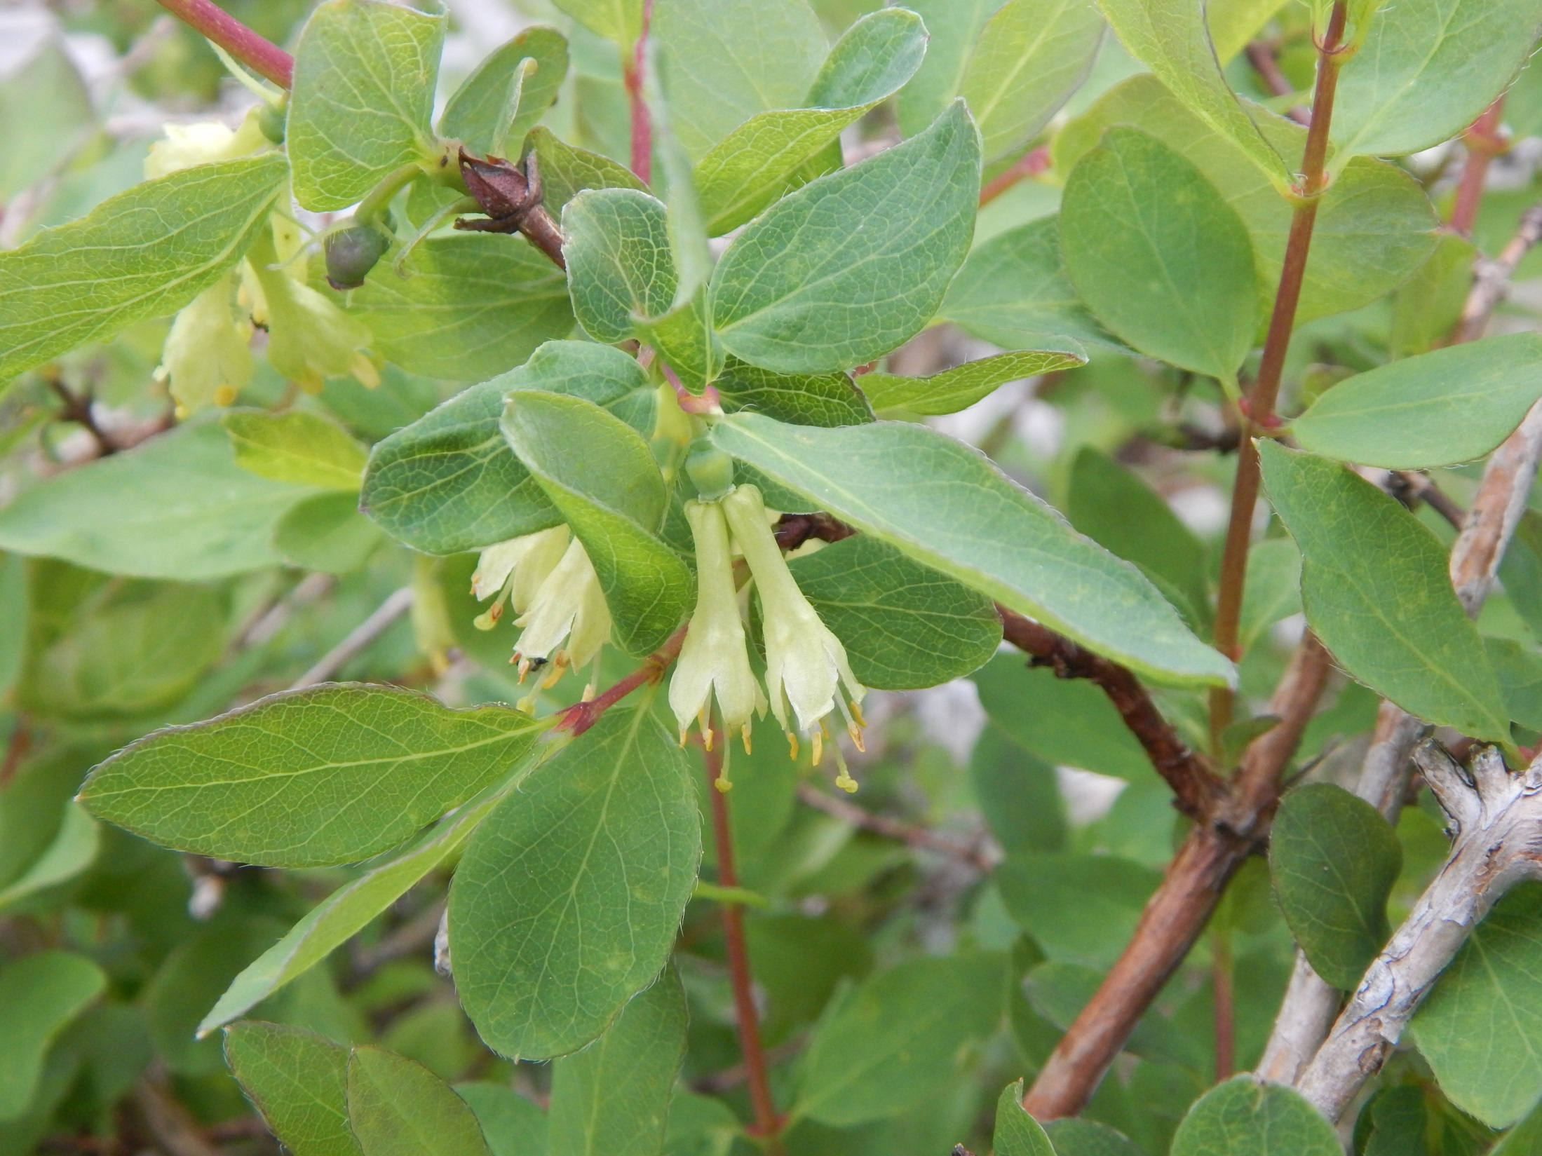
Lonicera caerulea

Slide 22
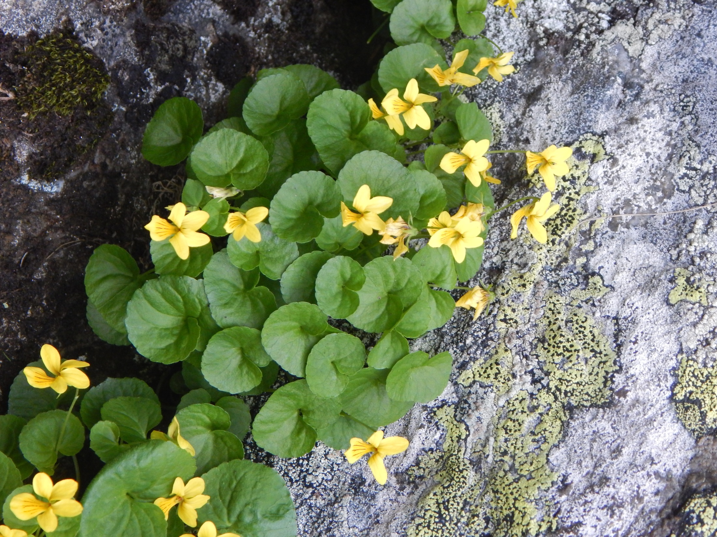
Viola biflora

Slide 23
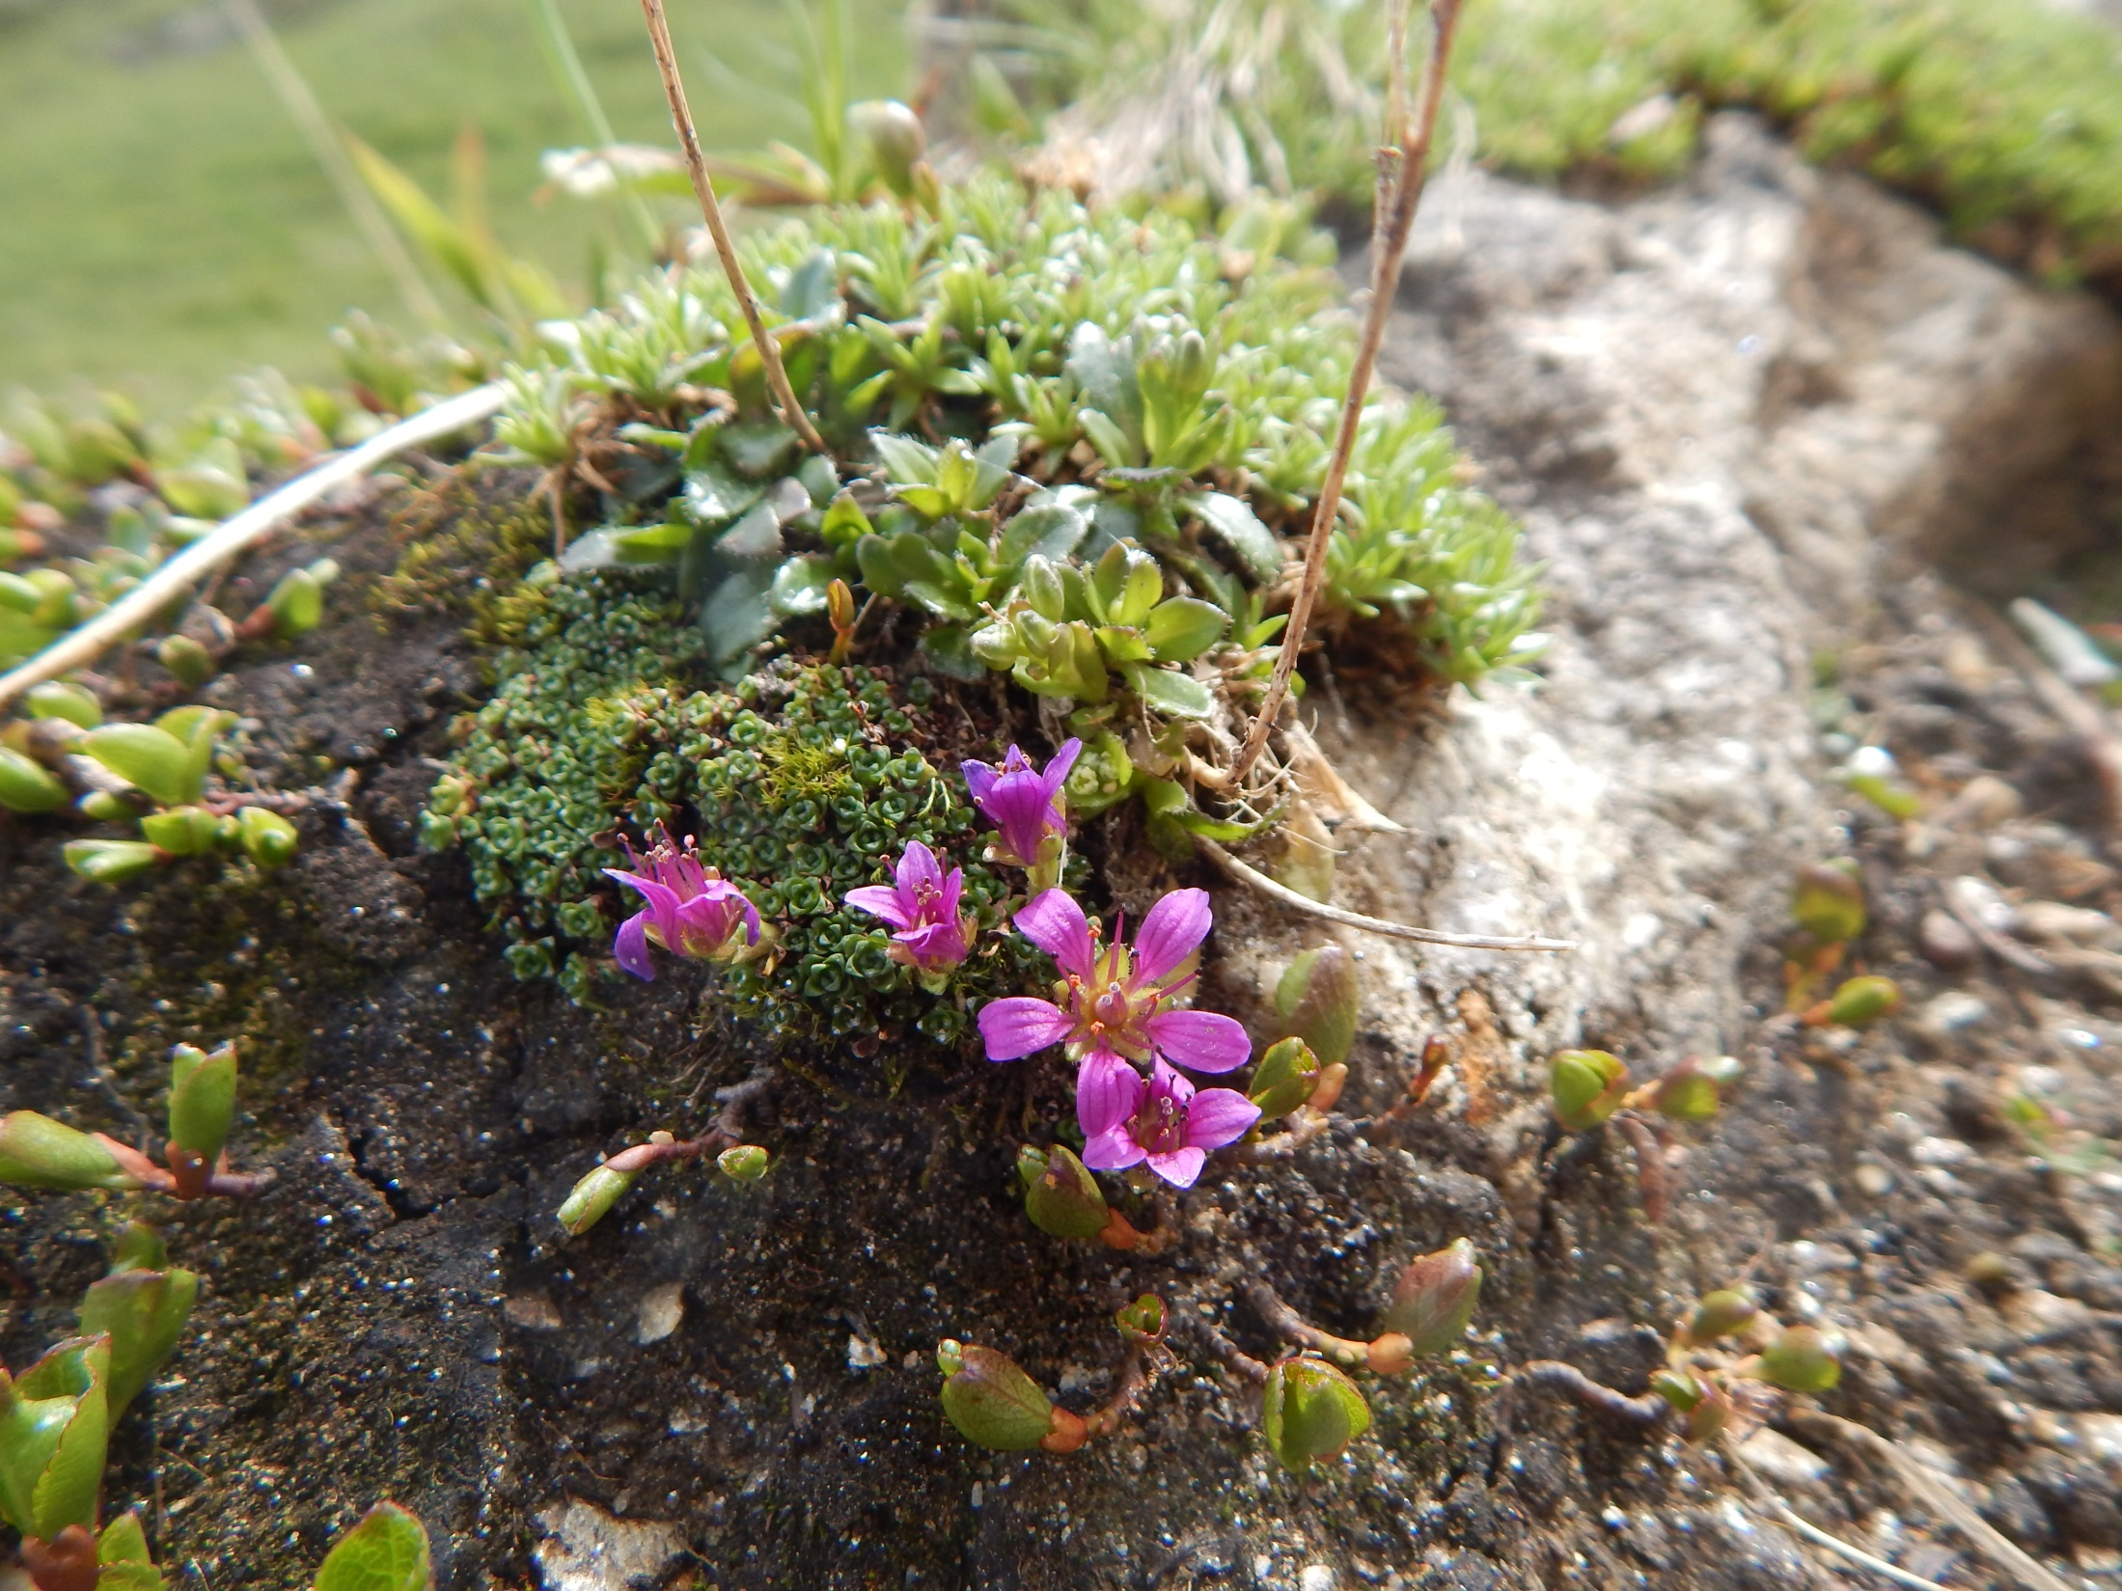
Saxifraga rudolphiana (oppossitifolia group)

Slide 24
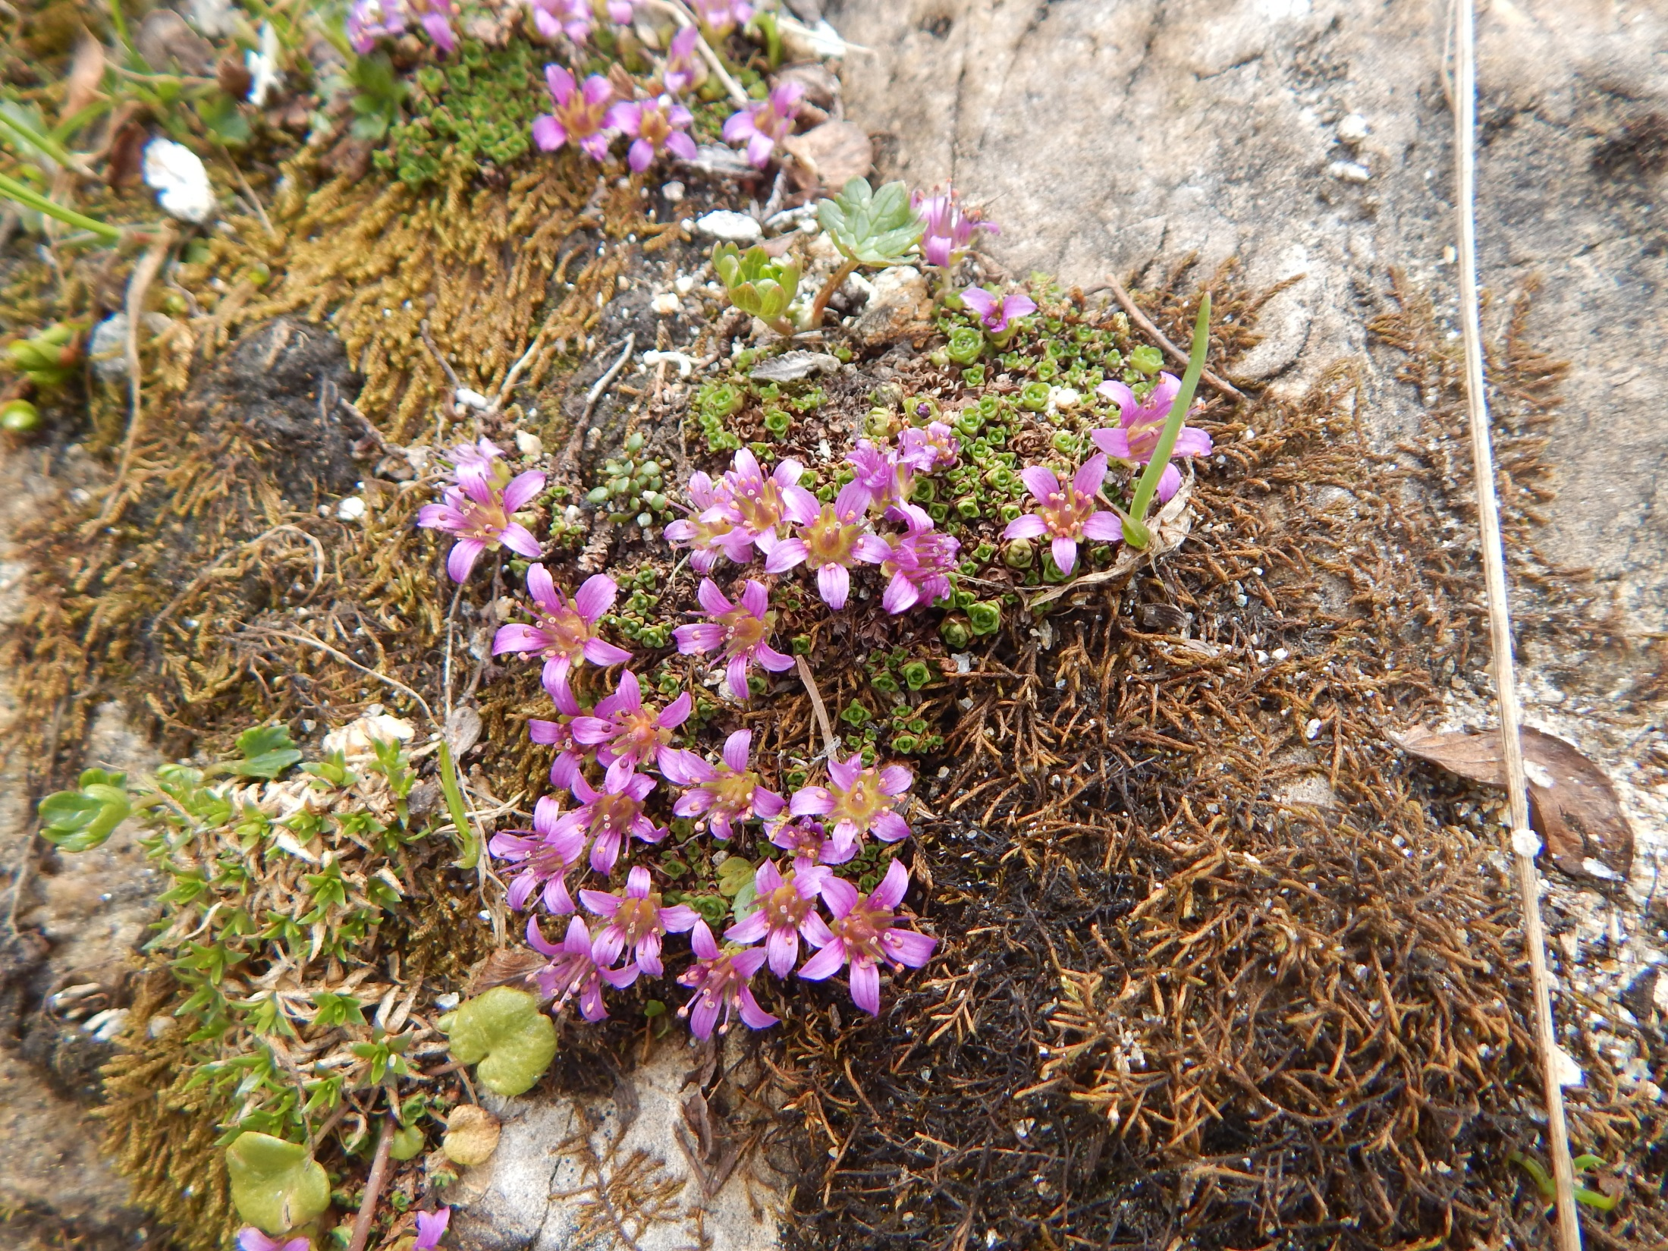
Saxifraga rudolphiana (oppossitifolia group)

Slide 25
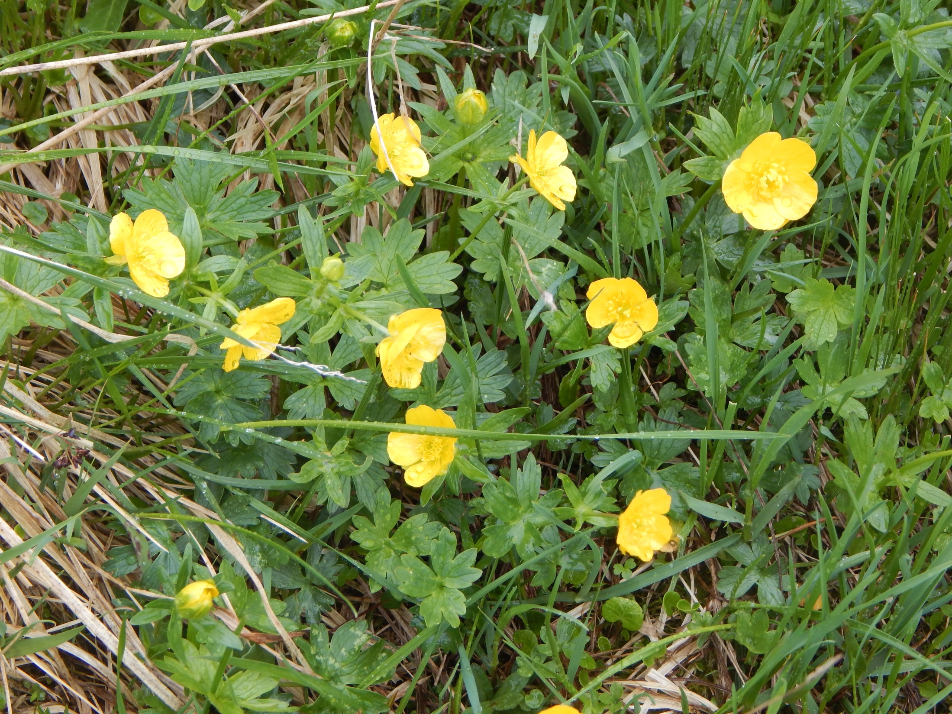
Ranunculus montanus agg.

Slide 26
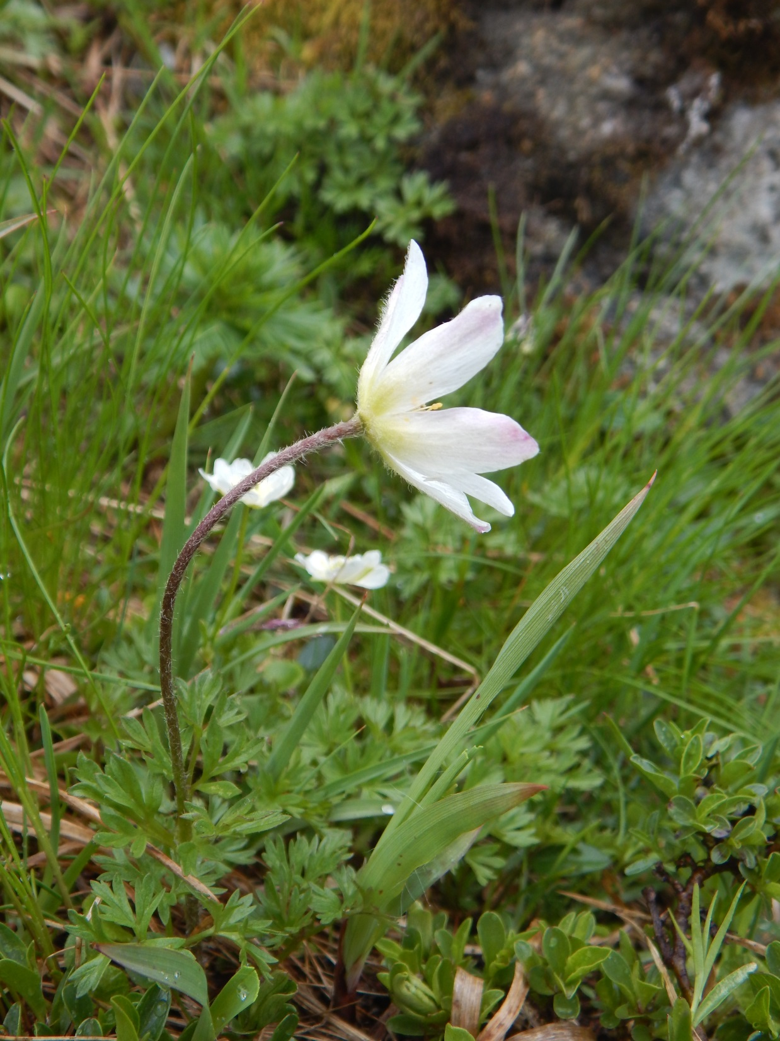
Pulsatilla alpina (group)

Slide 27
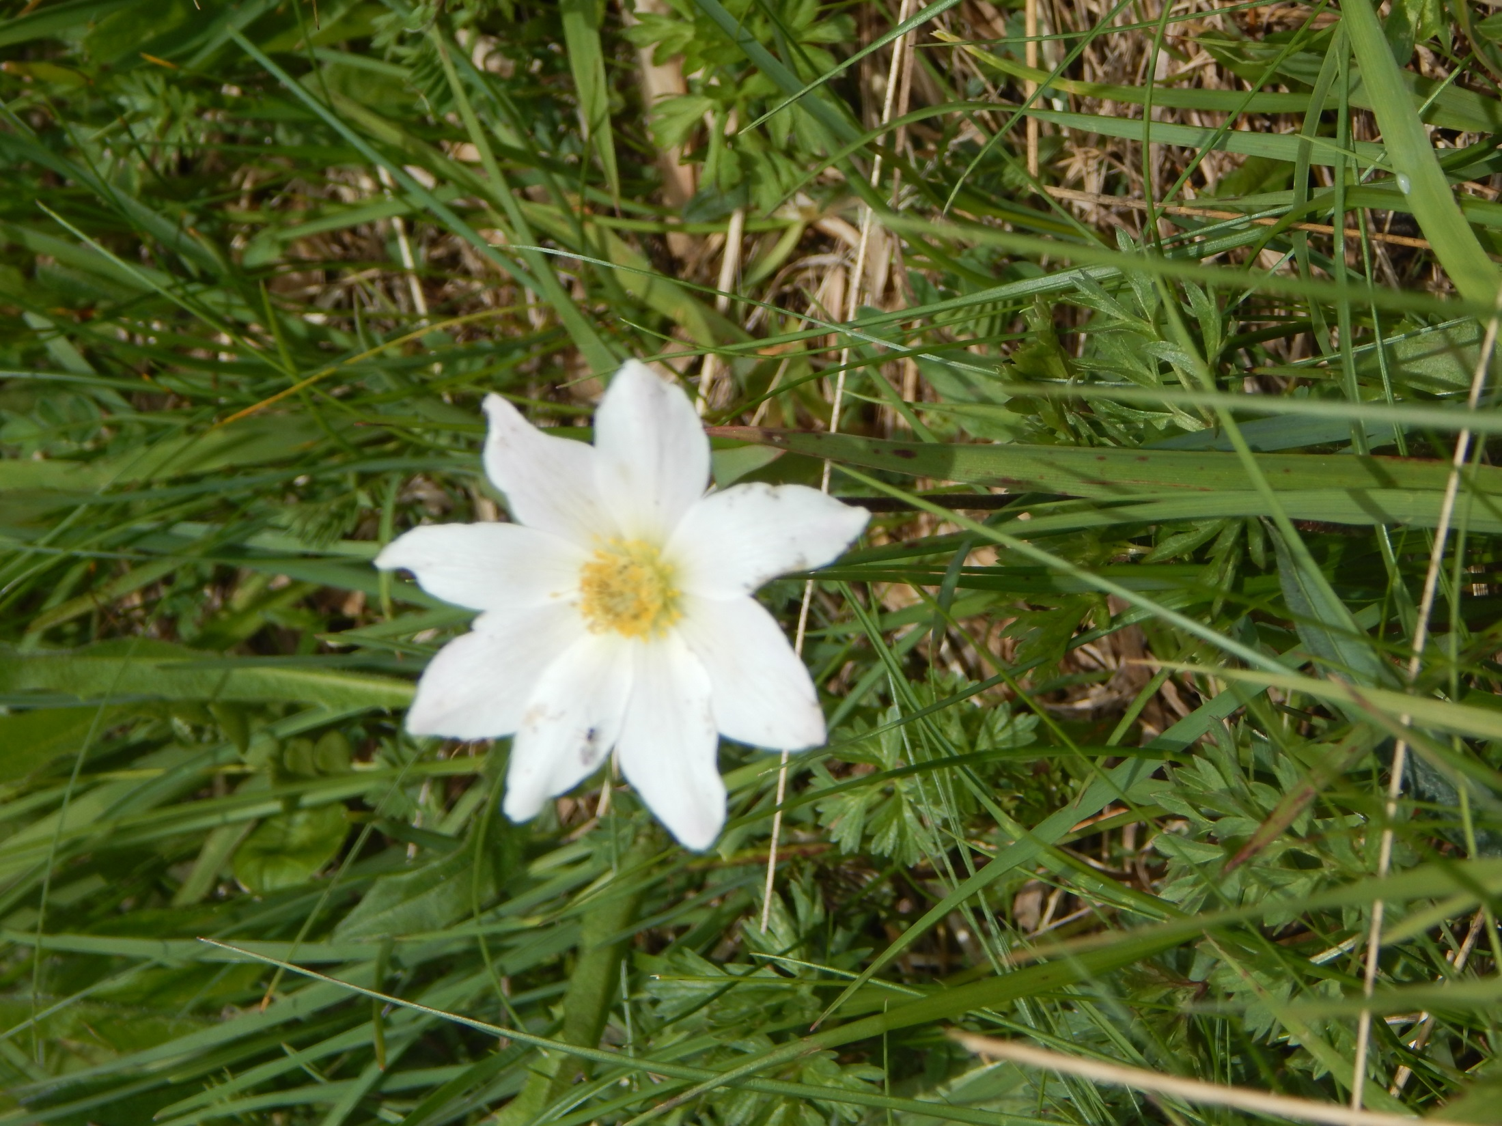

Slide 28
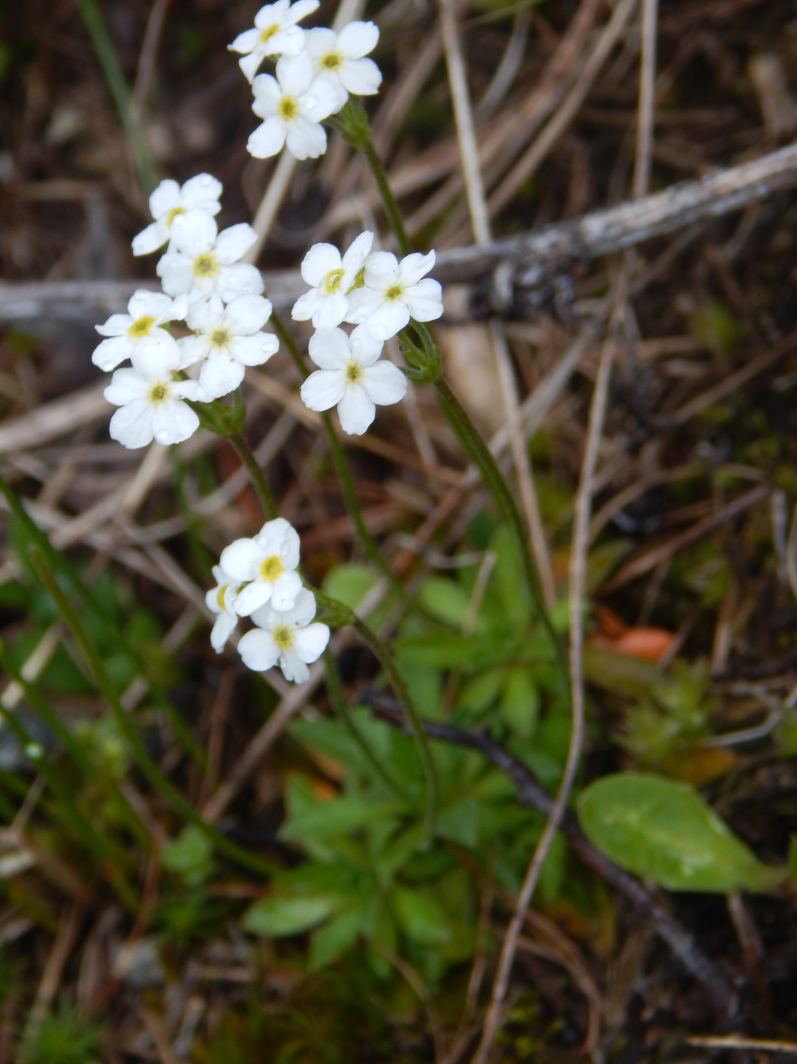
Androsace ?chamaejasme

Slide 29
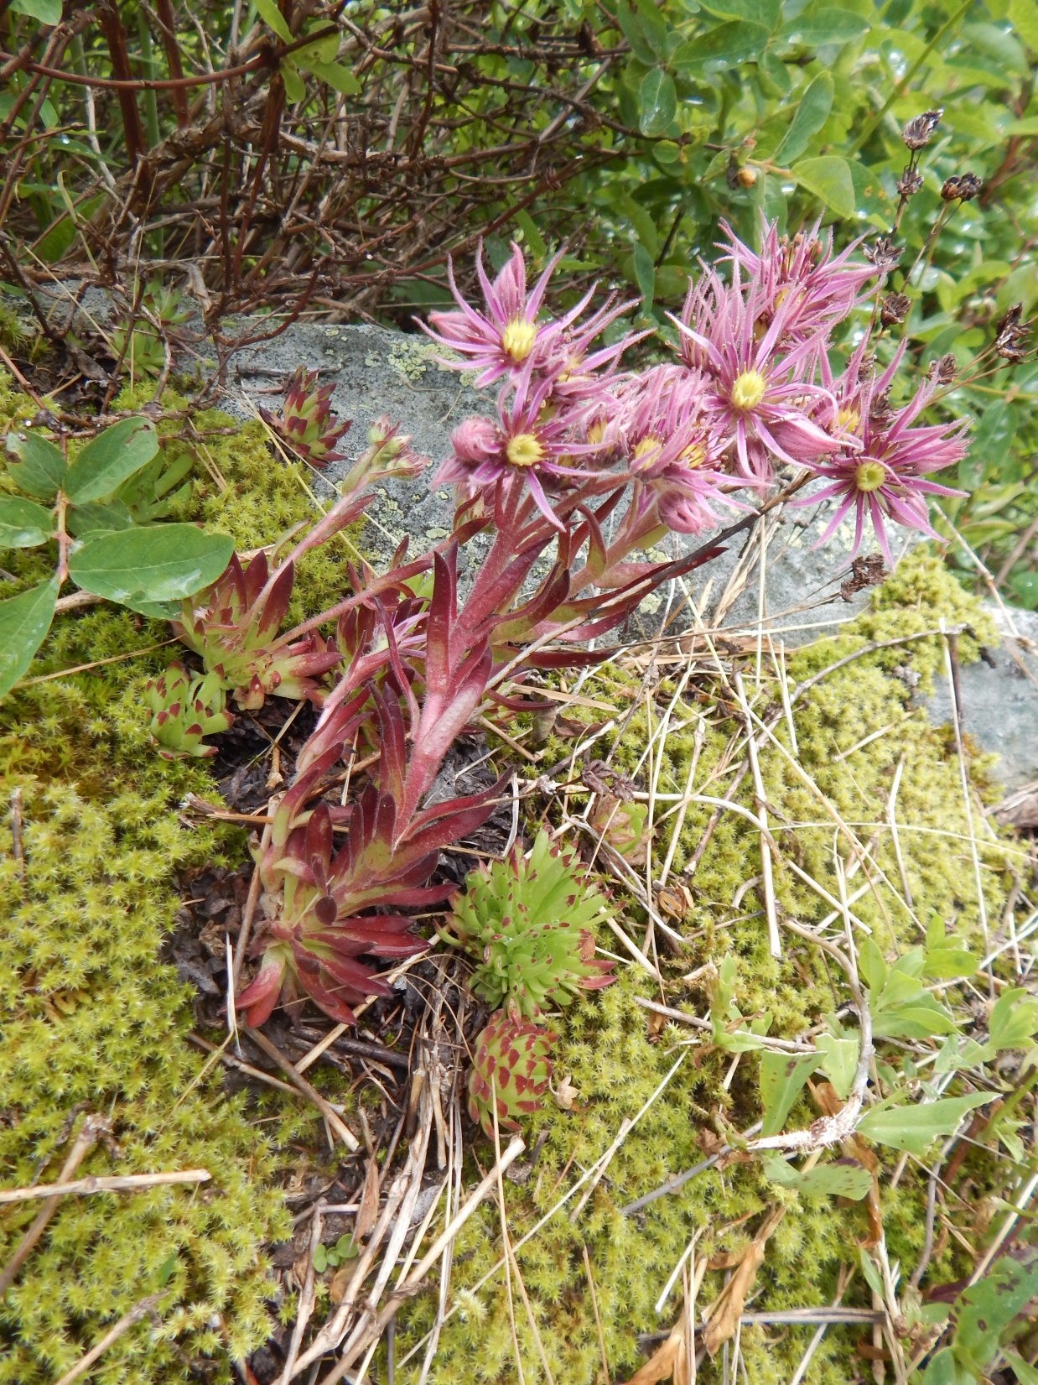
Sempervivum montanum agg.

Slide 30
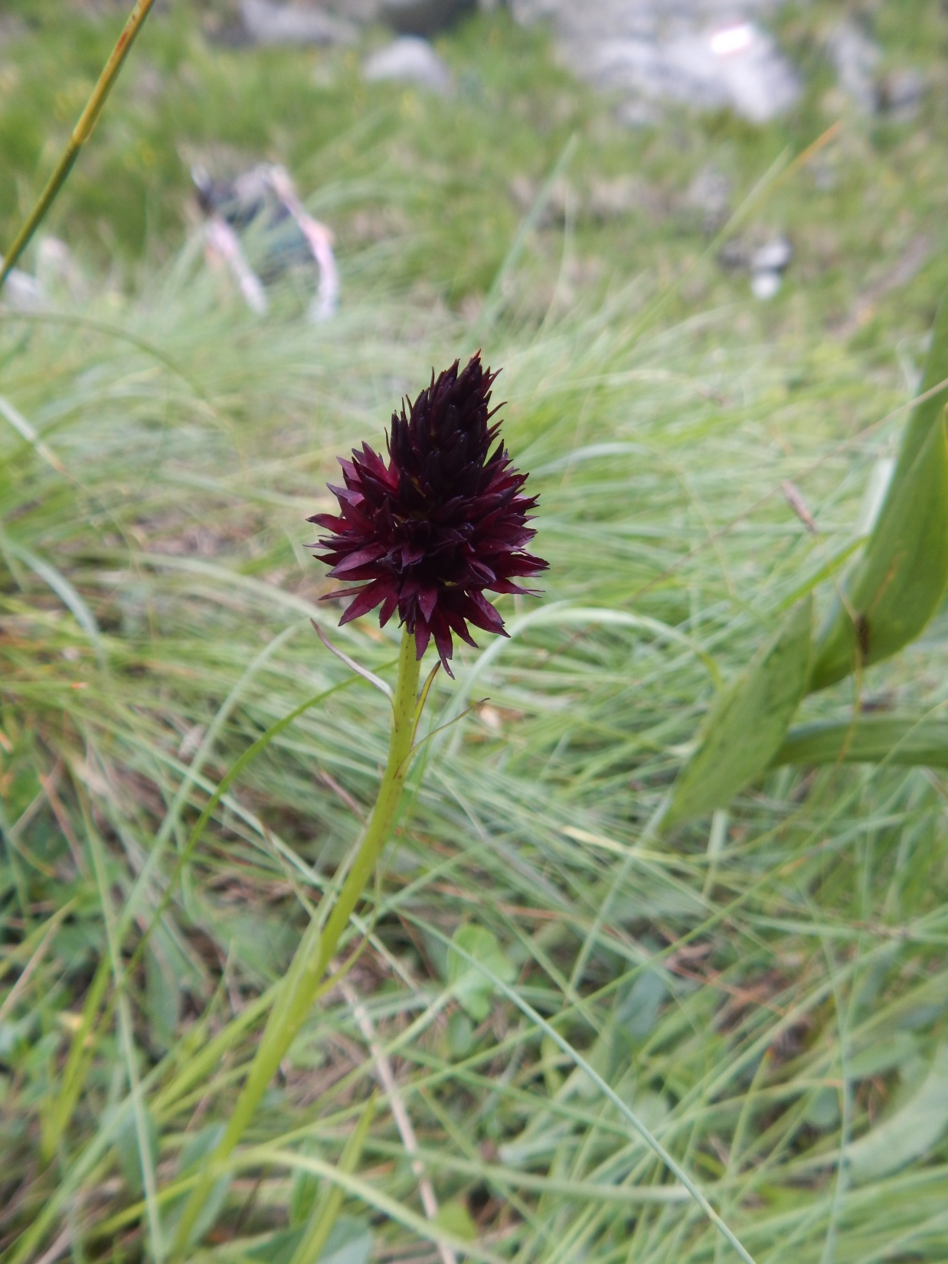
Nigritella rhellicani

Slide 31
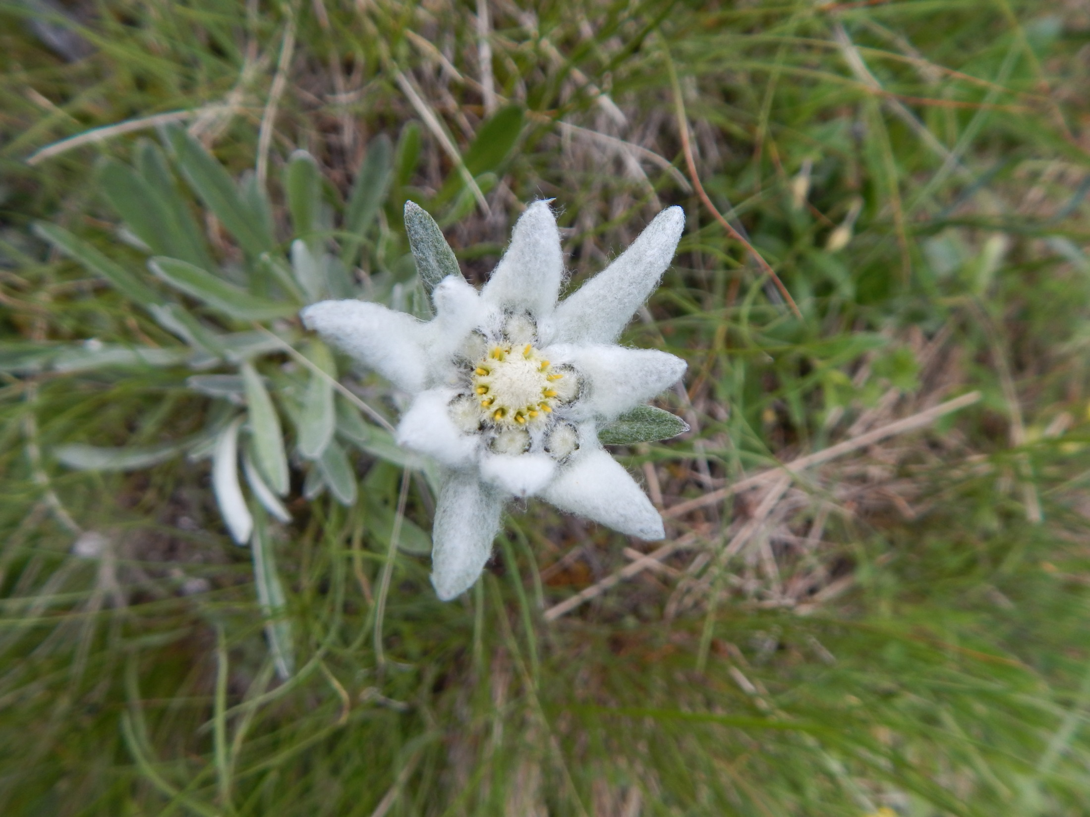
Leontopodium alpinum

Slide 32
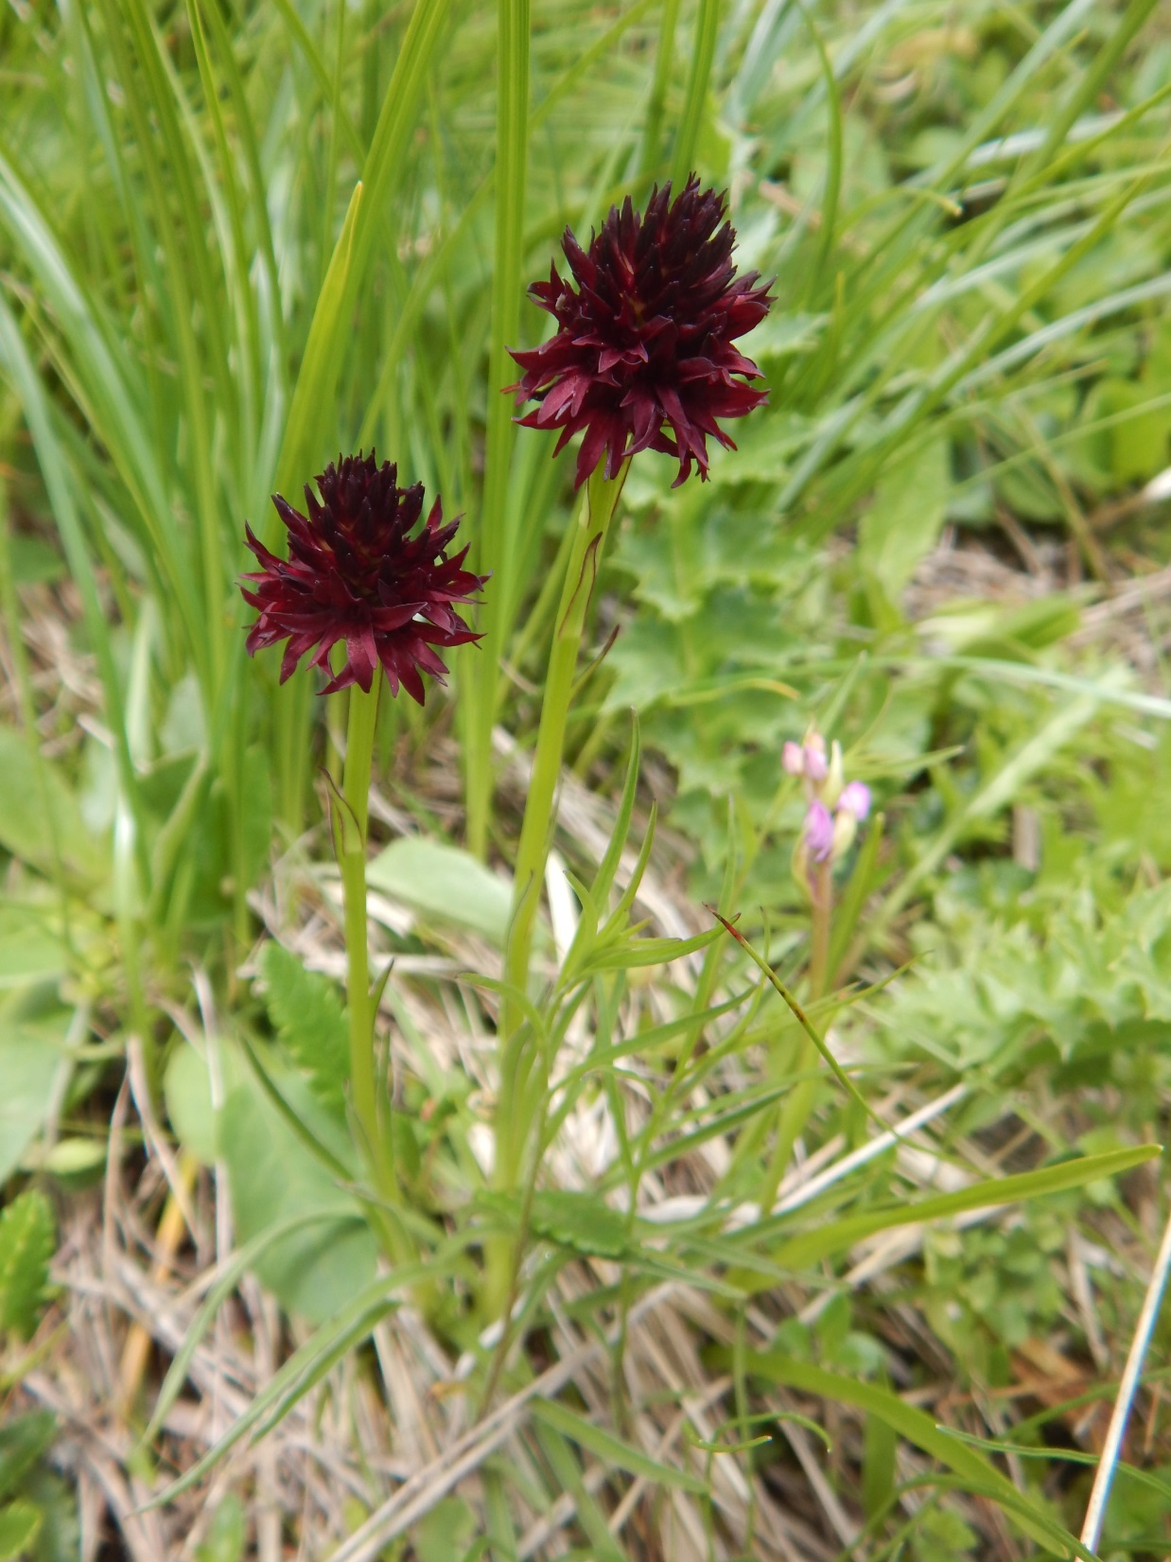
Nigritella rhellicani

Slide 33
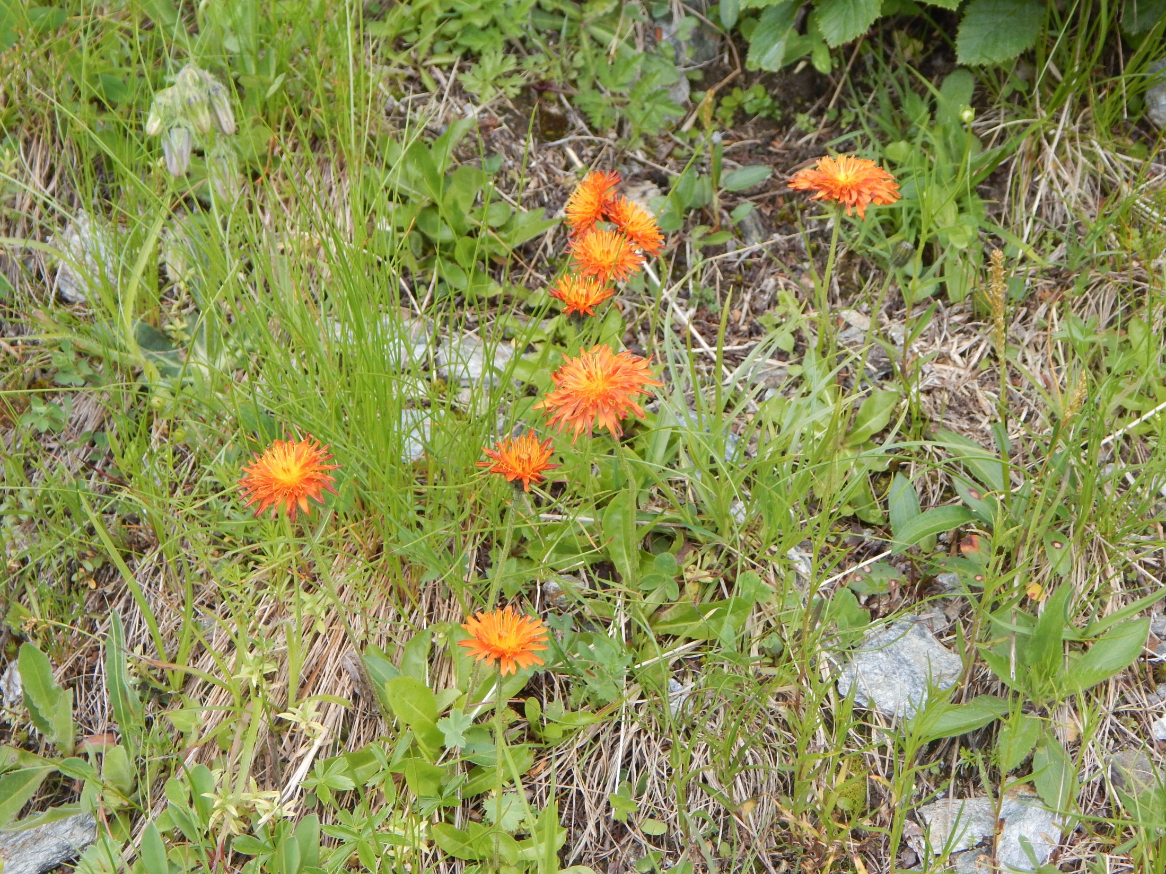
Crepis aurea

Slide 34
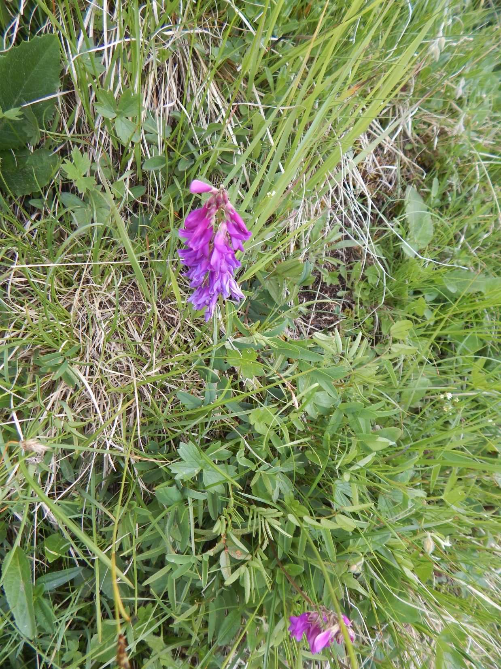
Hedysarum obscurum

Slide 35
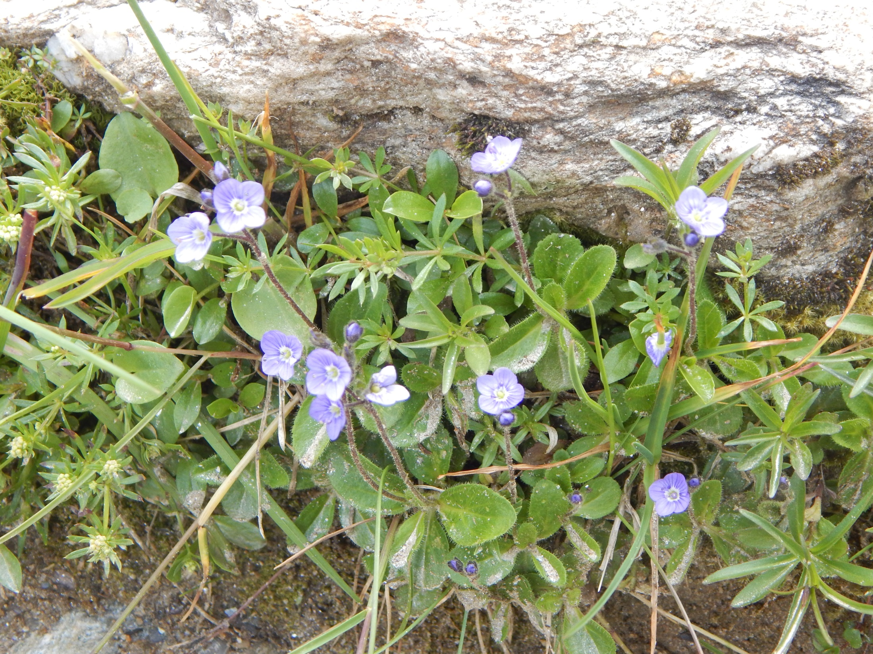
Veronica aphyla

Slide 36
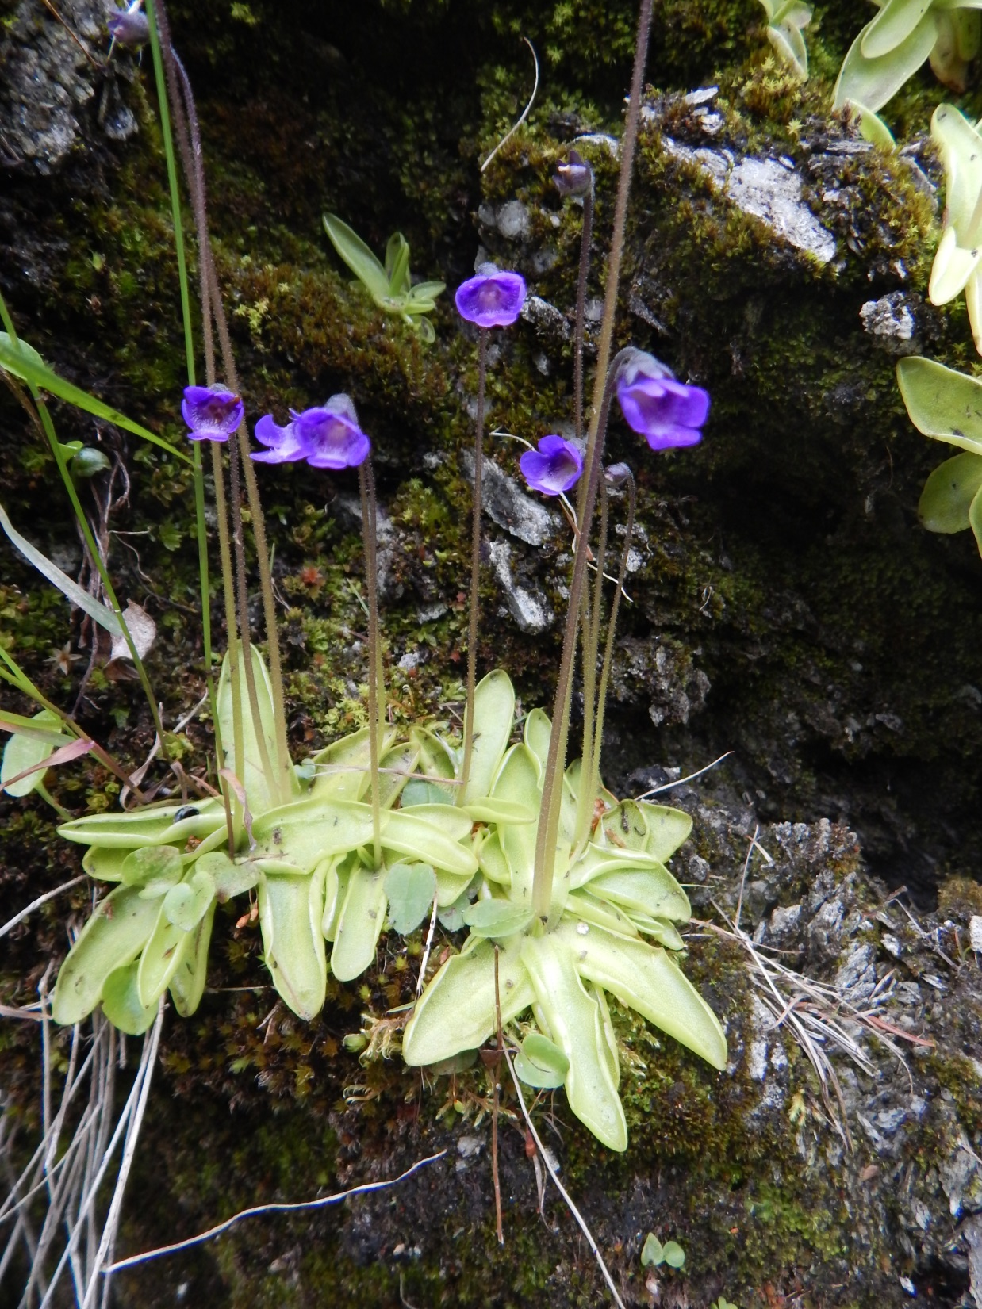
Pinguicula vulgaris

Slide 37
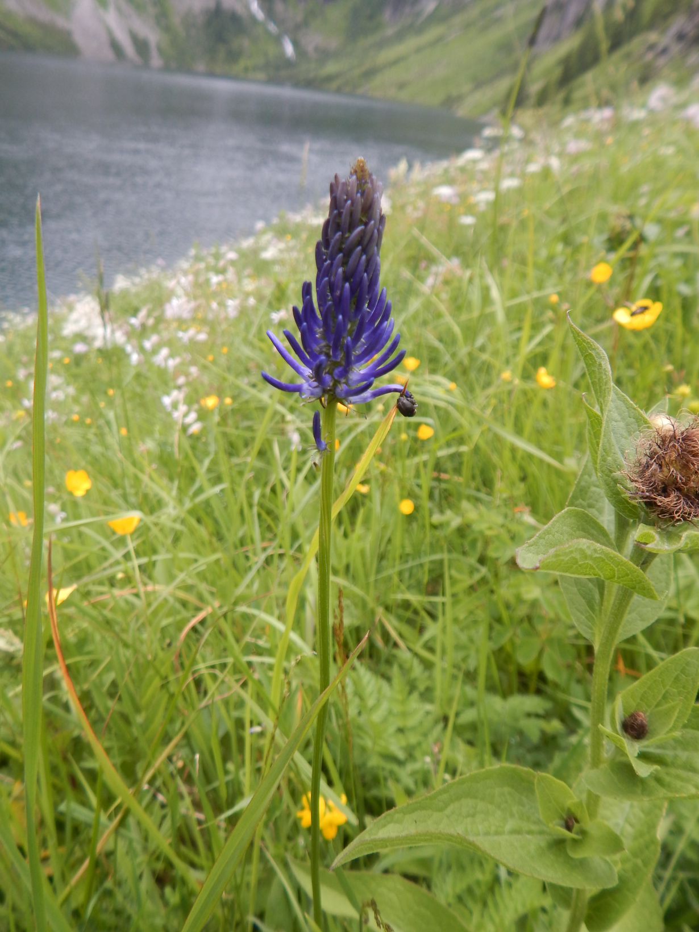
Phyteuma betonicifolia agg.

Slide 38
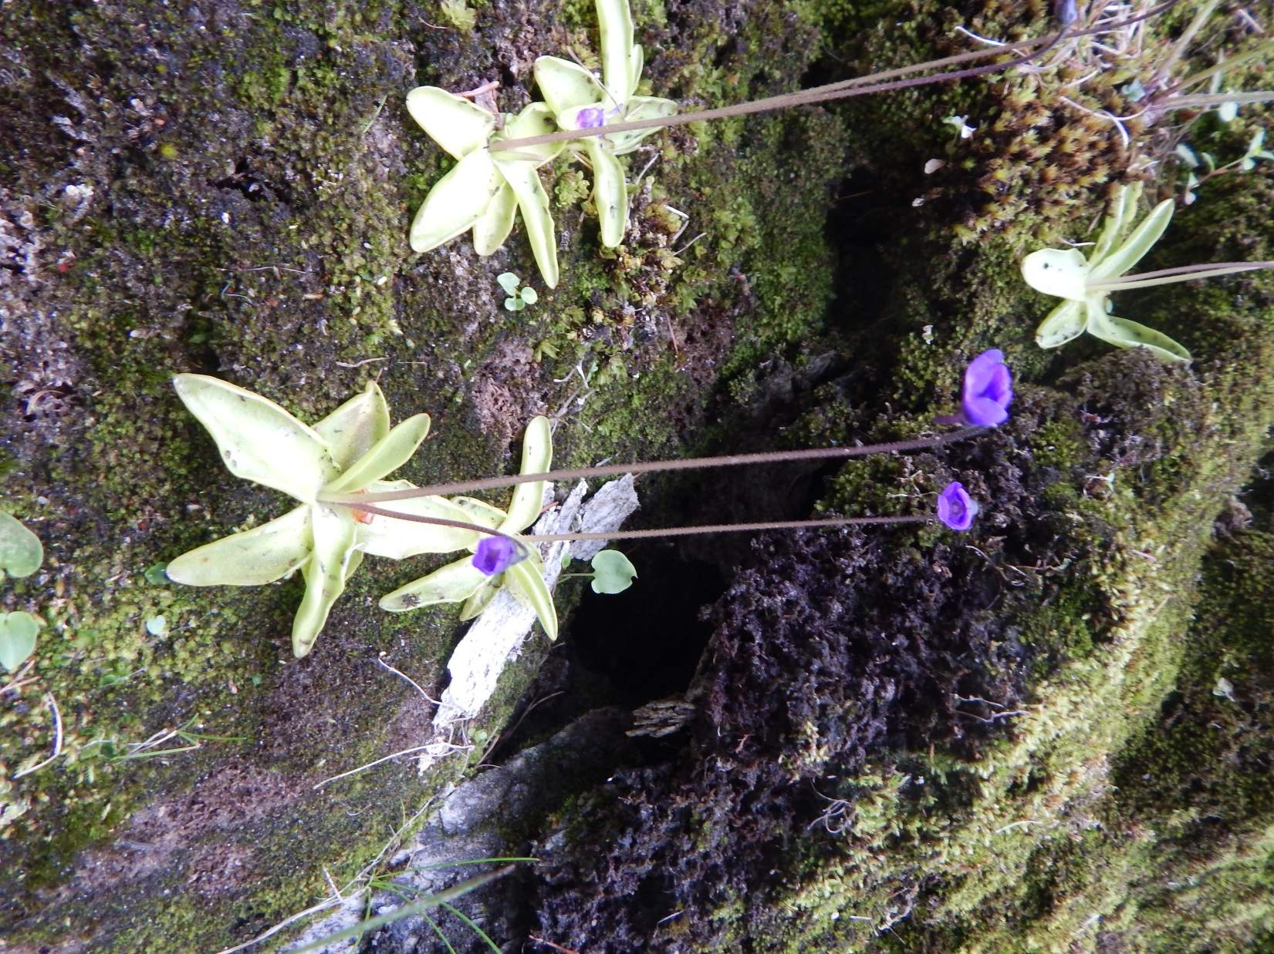
Pinguicula vulgaris

Slide 39
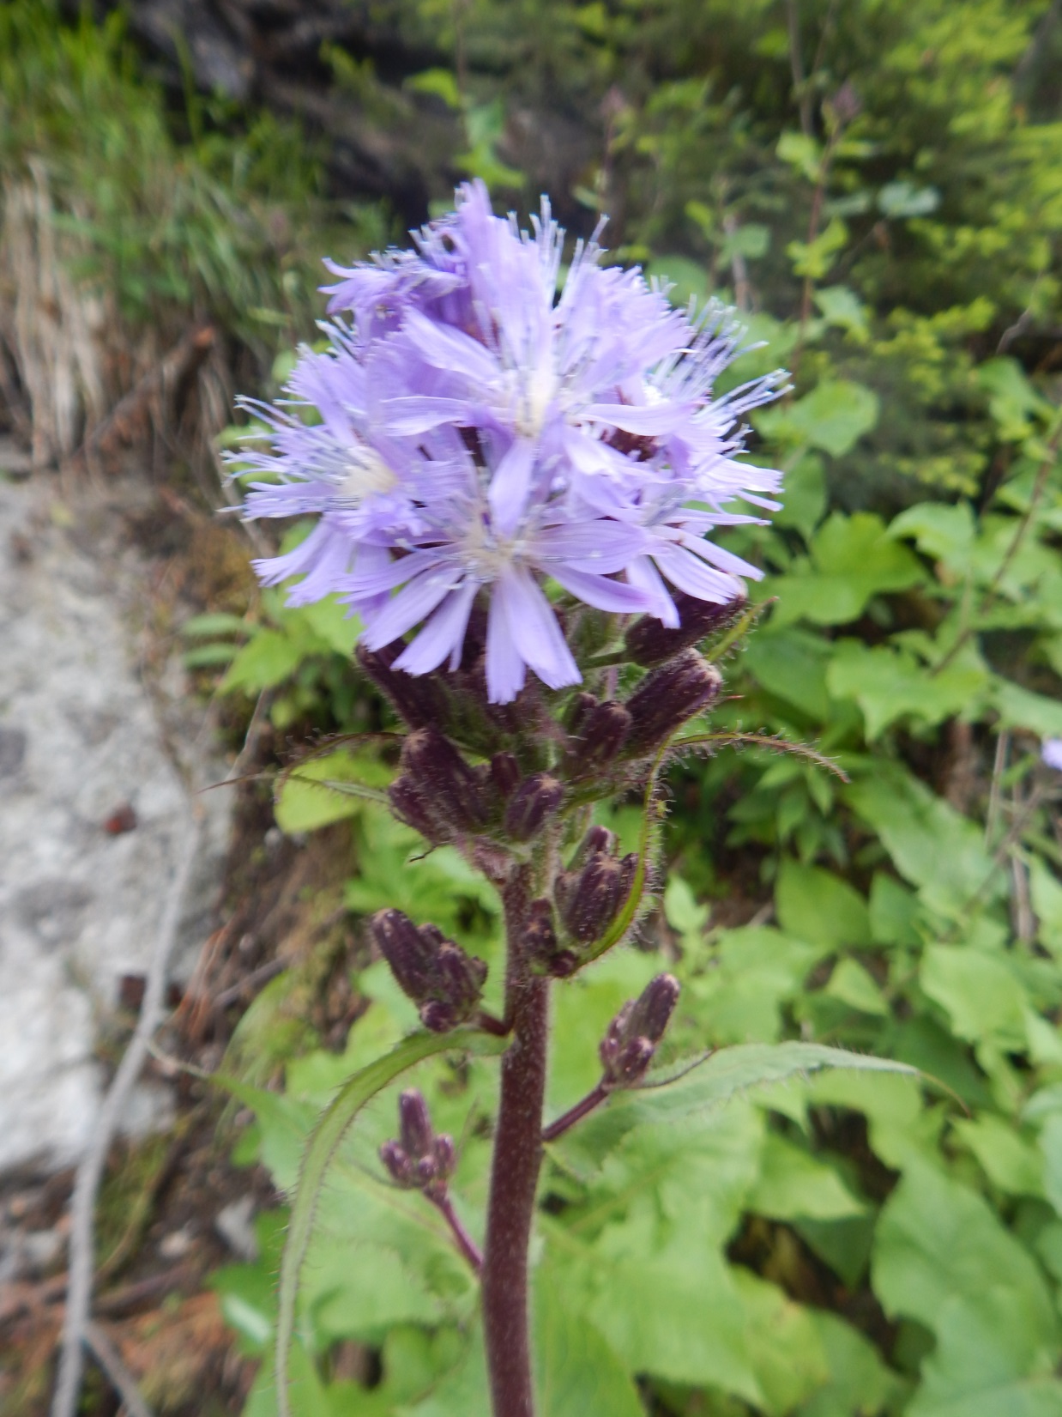
Cicerbita alpina

Slide 40
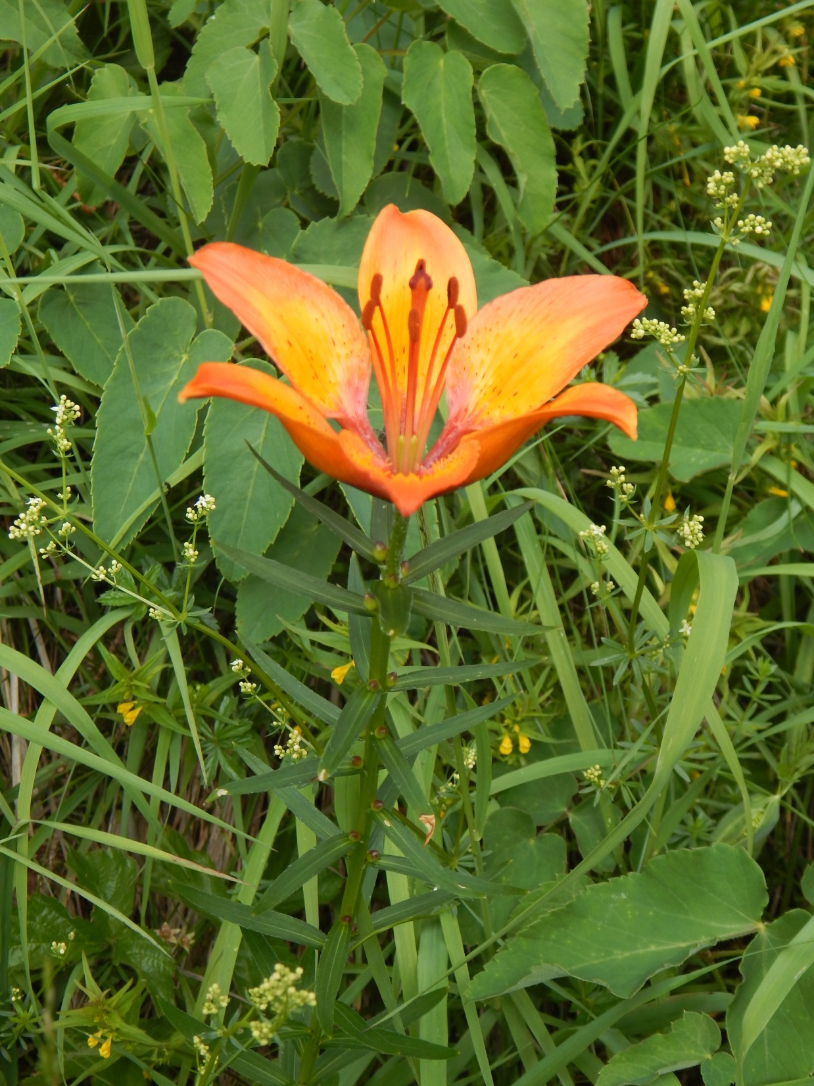
Lilium bulbiferum

Slide 41
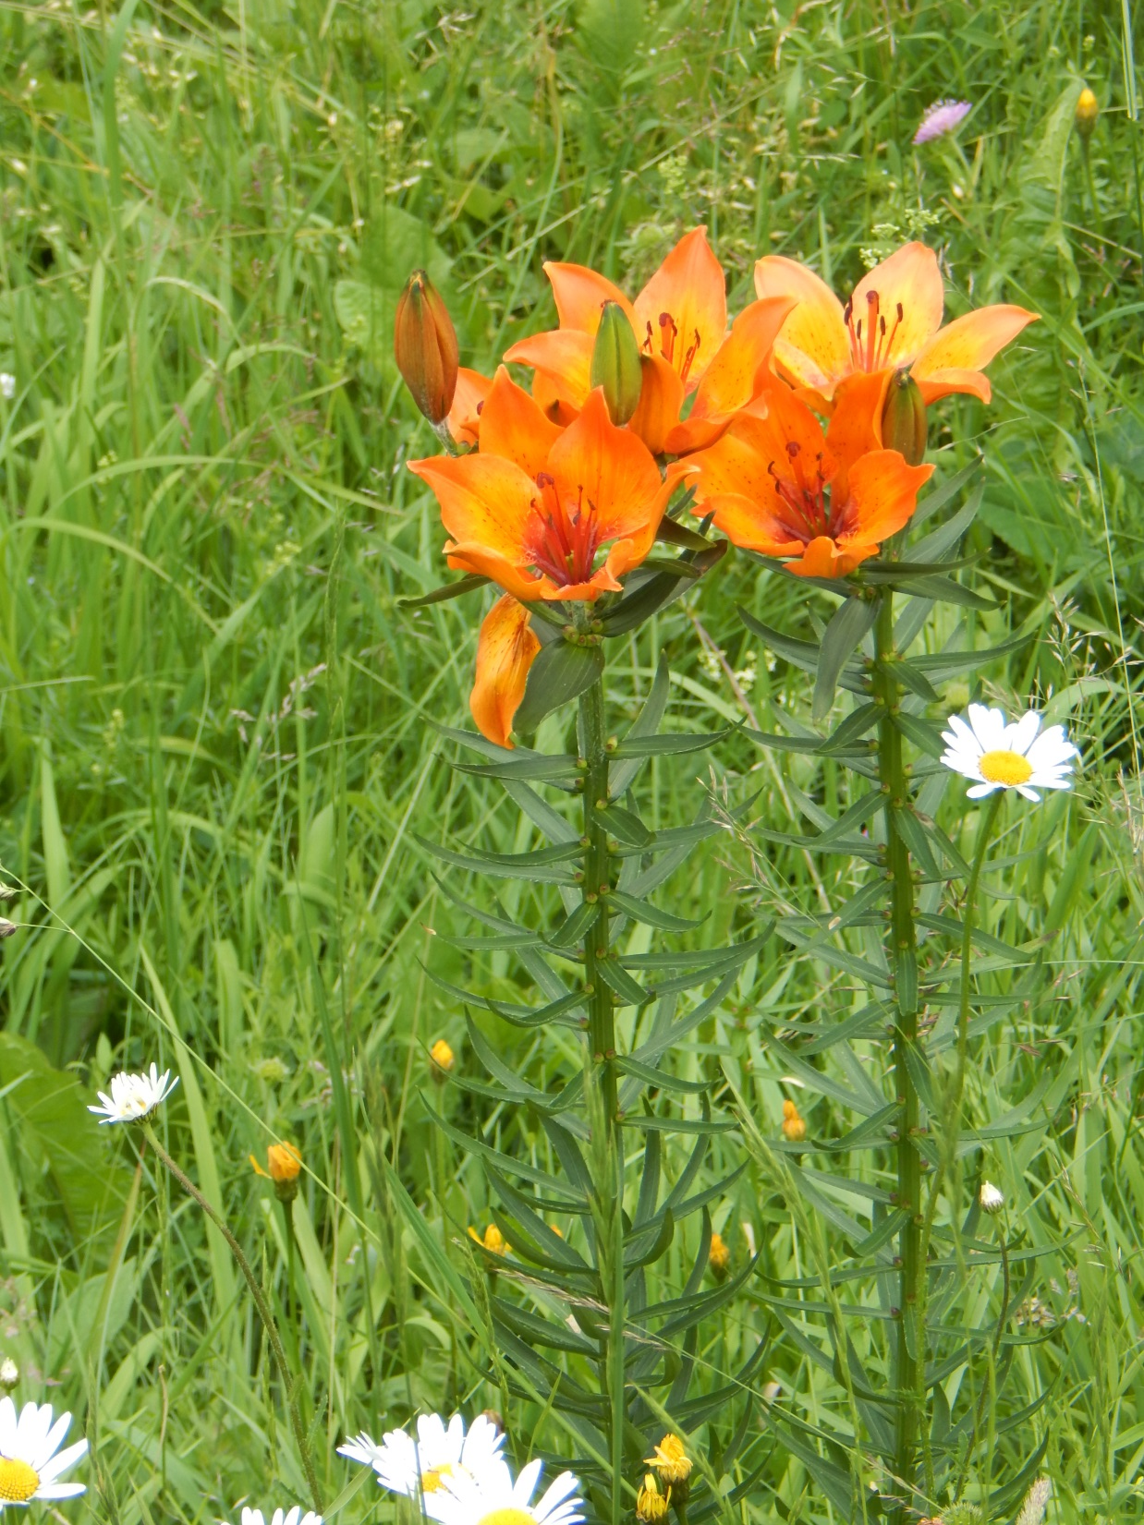

Slide 42
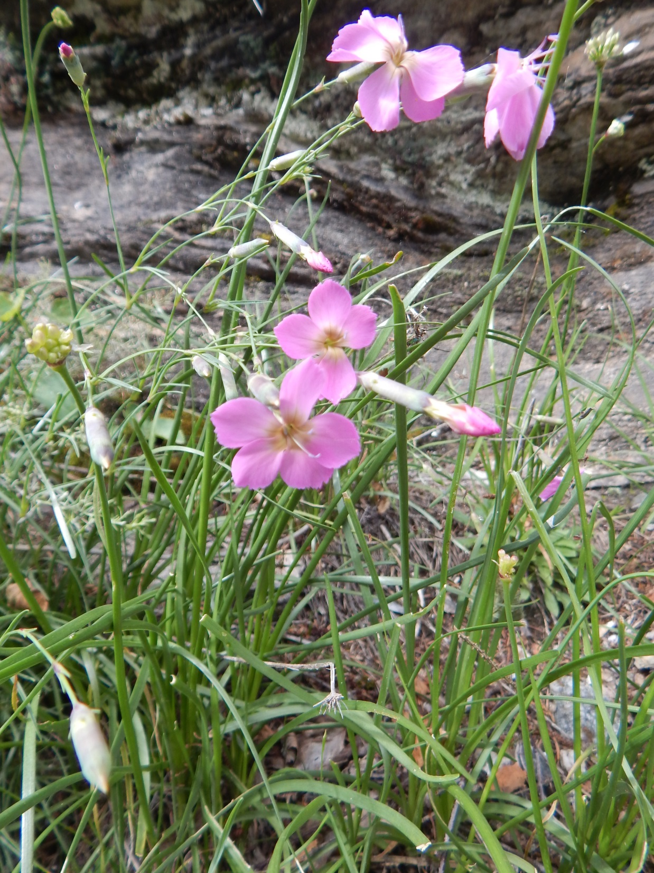
Dianthus sylvaticus

Slide 43
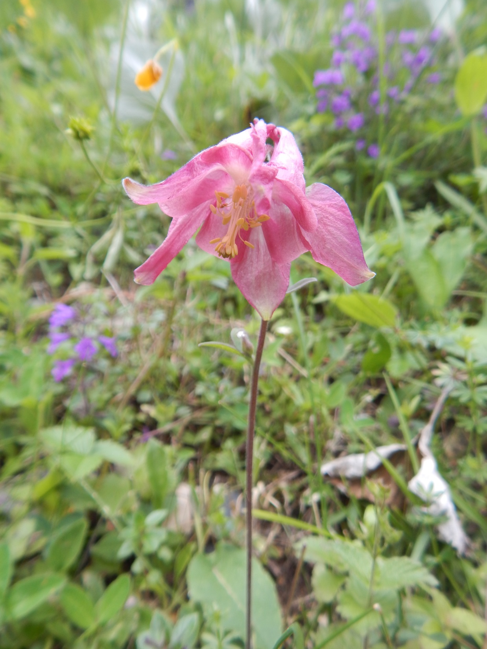
Aquilegia

