Slide 1
Inspirations for botanical excursions II. Rottenmanner Tauern - Rottenmanner Hütte (end of June)
Jan Lepš, Jiří Hadinec, Věra Hadincová

Slide 2
Around Rottenmanner hütte
Rottenmanner hütte -- 47°29'24.844"N, 14°22'31.900"E – good place to start several round trips and overnight – from parking place, you climb ca 400 elevational meters
Only acidic rock, no limestone, so the species richness is relatively low
When you go up to the ridges, there are nicely developed Loiseleurietea (small ericaceous carpets, dominated by Loiseleuria procumbens)
Pictures are from excursions to Stein an Mandl and round trip to Hochheide and back through the valley (path 944c)

Slide 3
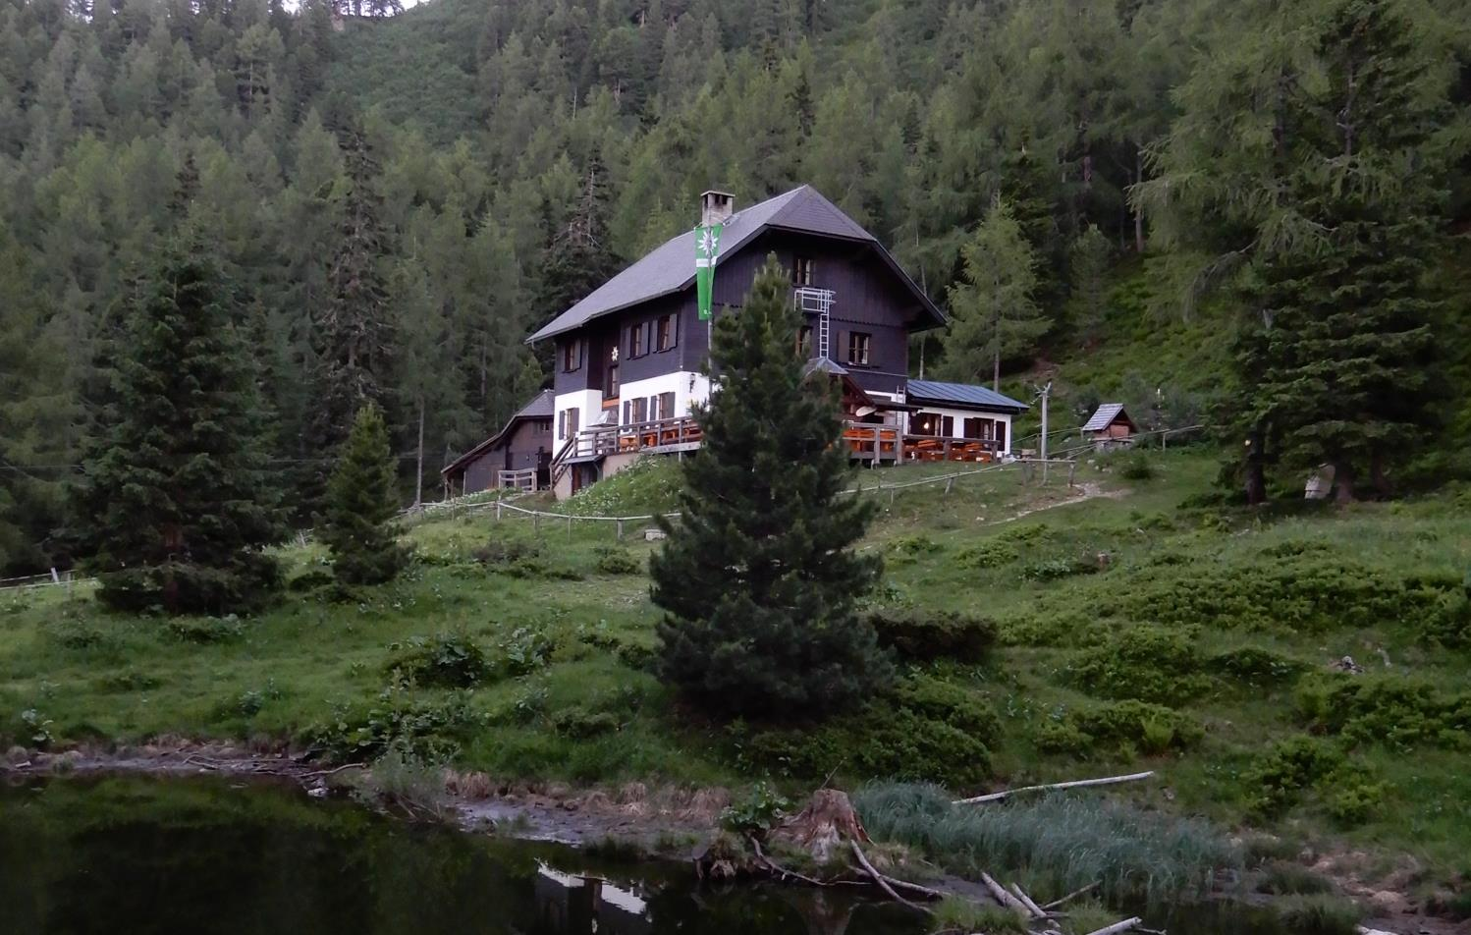

Slide 4
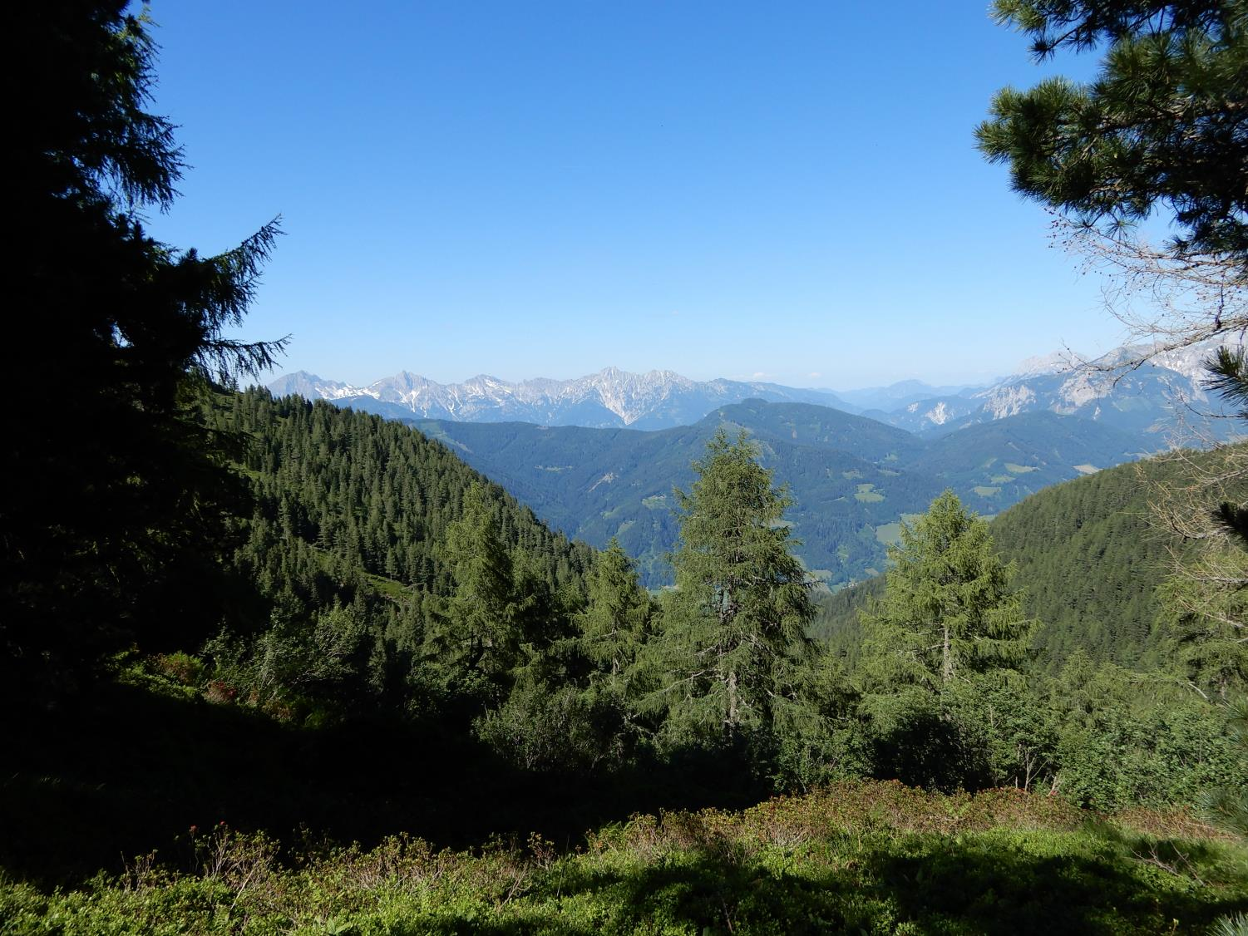

Slide 5
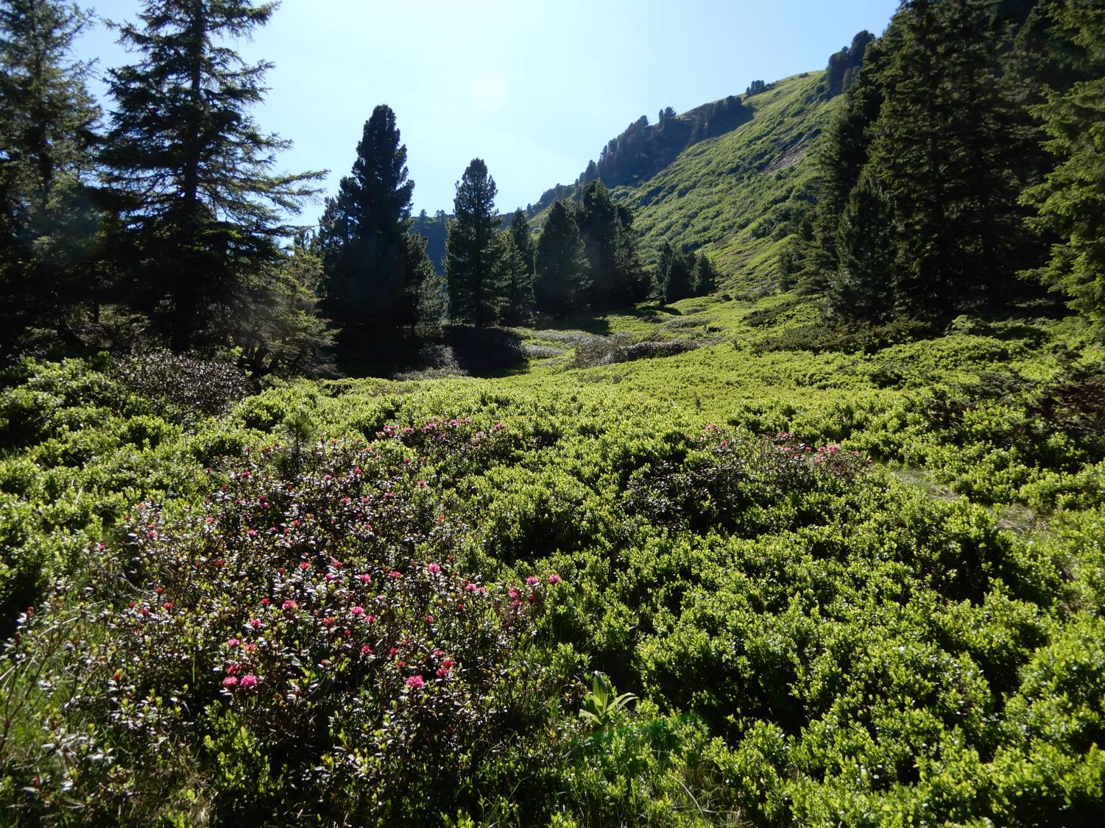

Slide 6
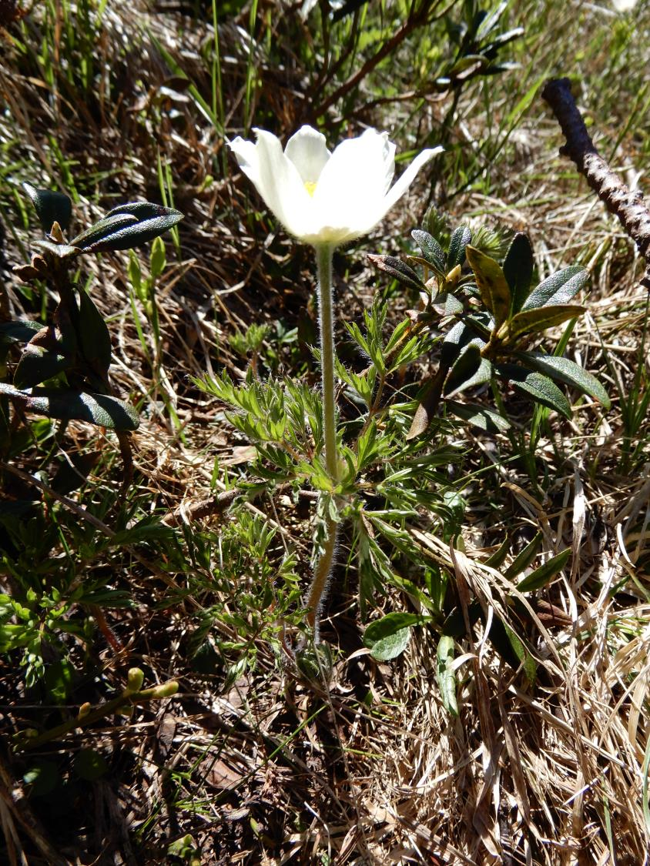
Pulsatilla alpina

Slide 7
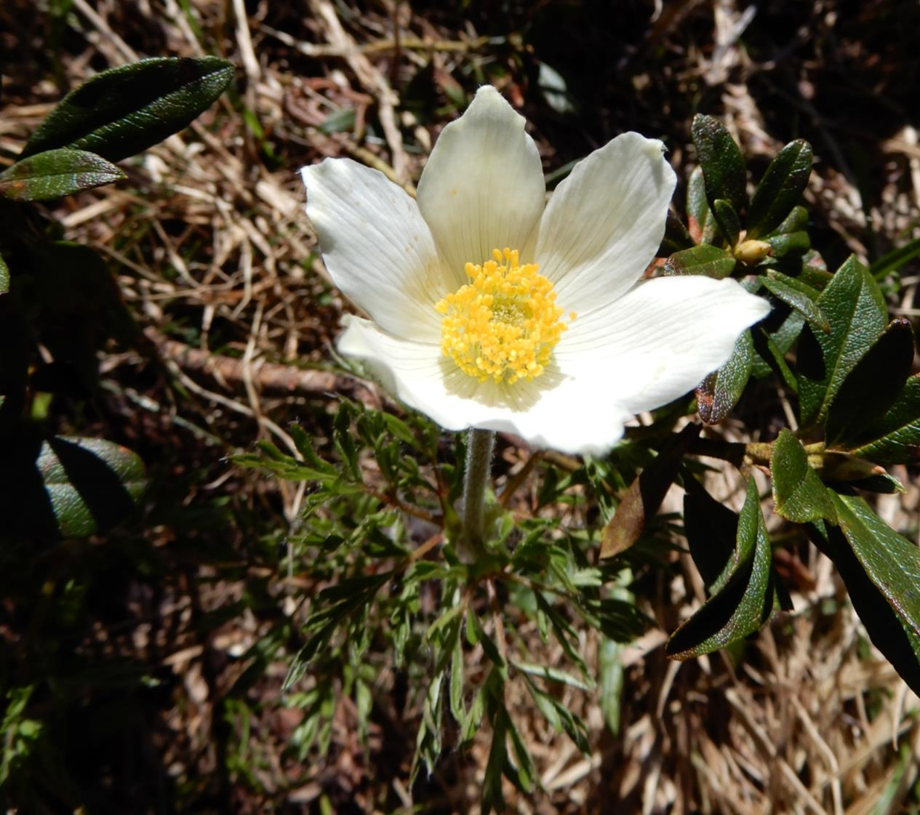

Slide 8
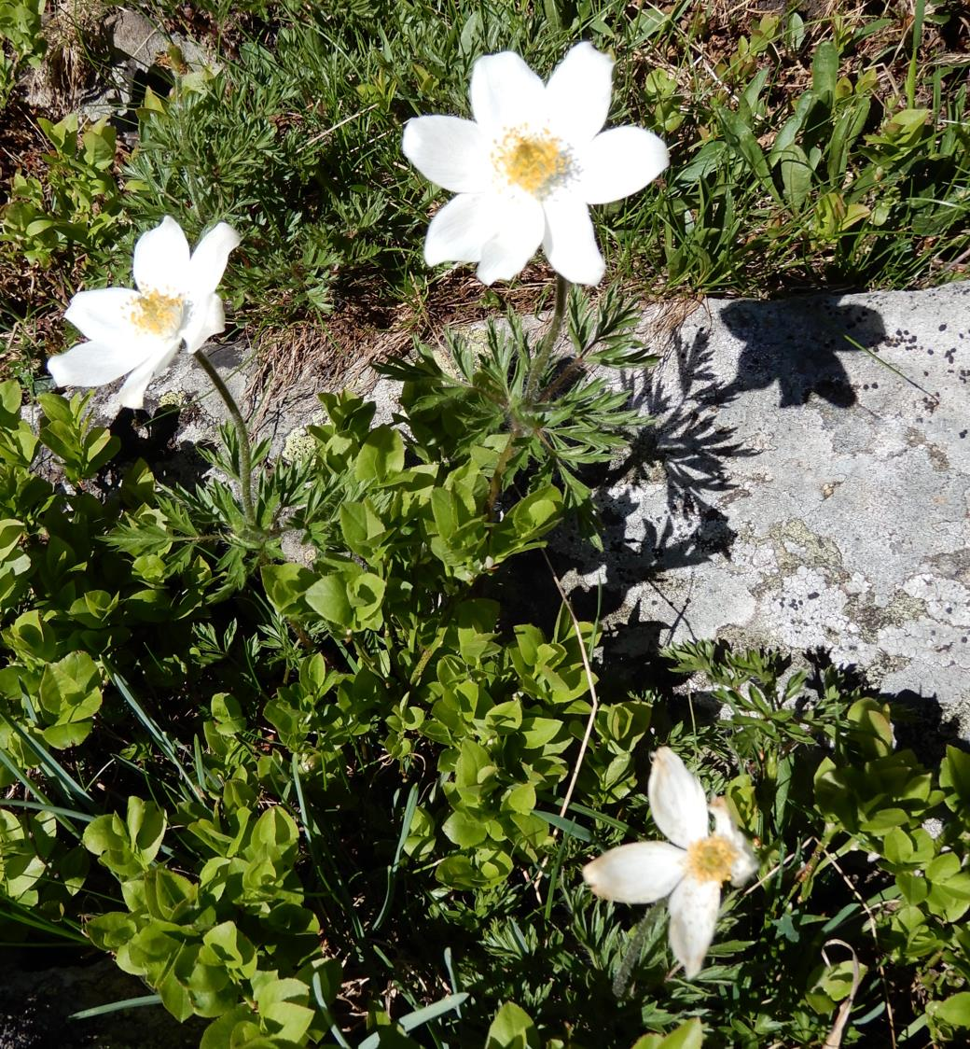

Slide 9
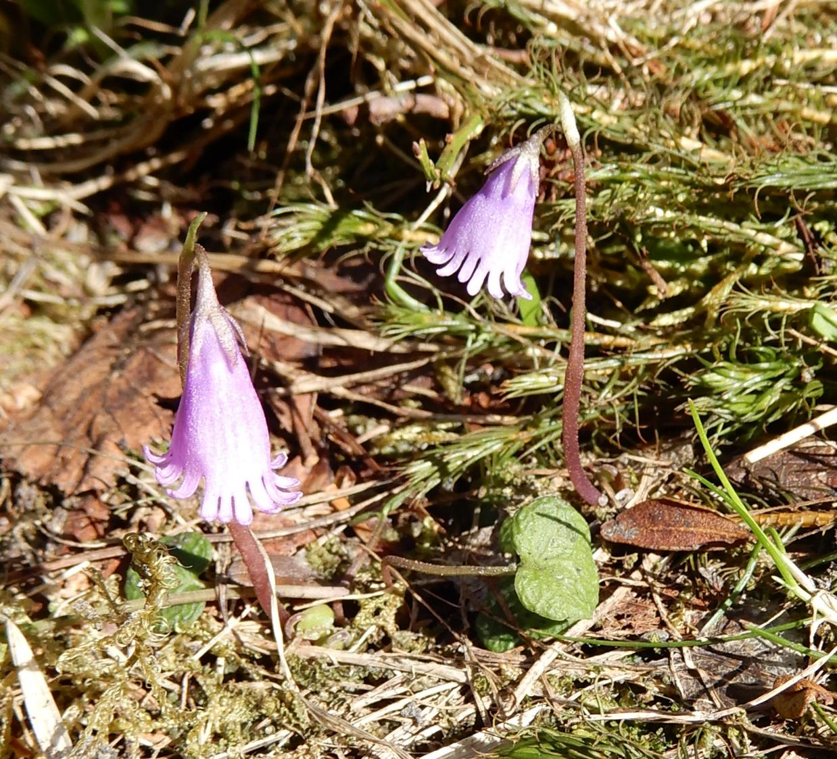
Soldanella pusilla

Slide 10
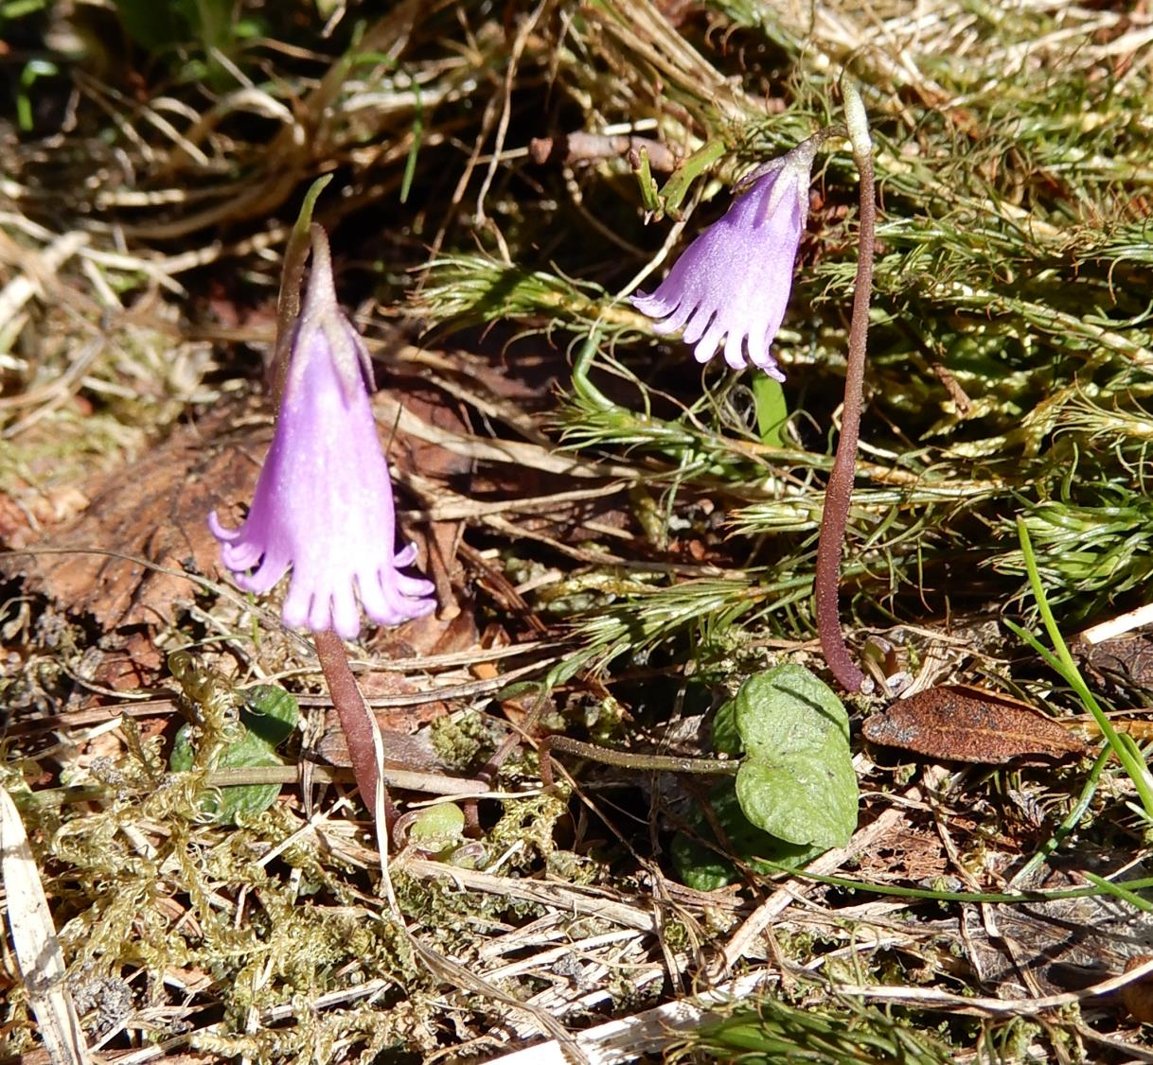

Slide 11
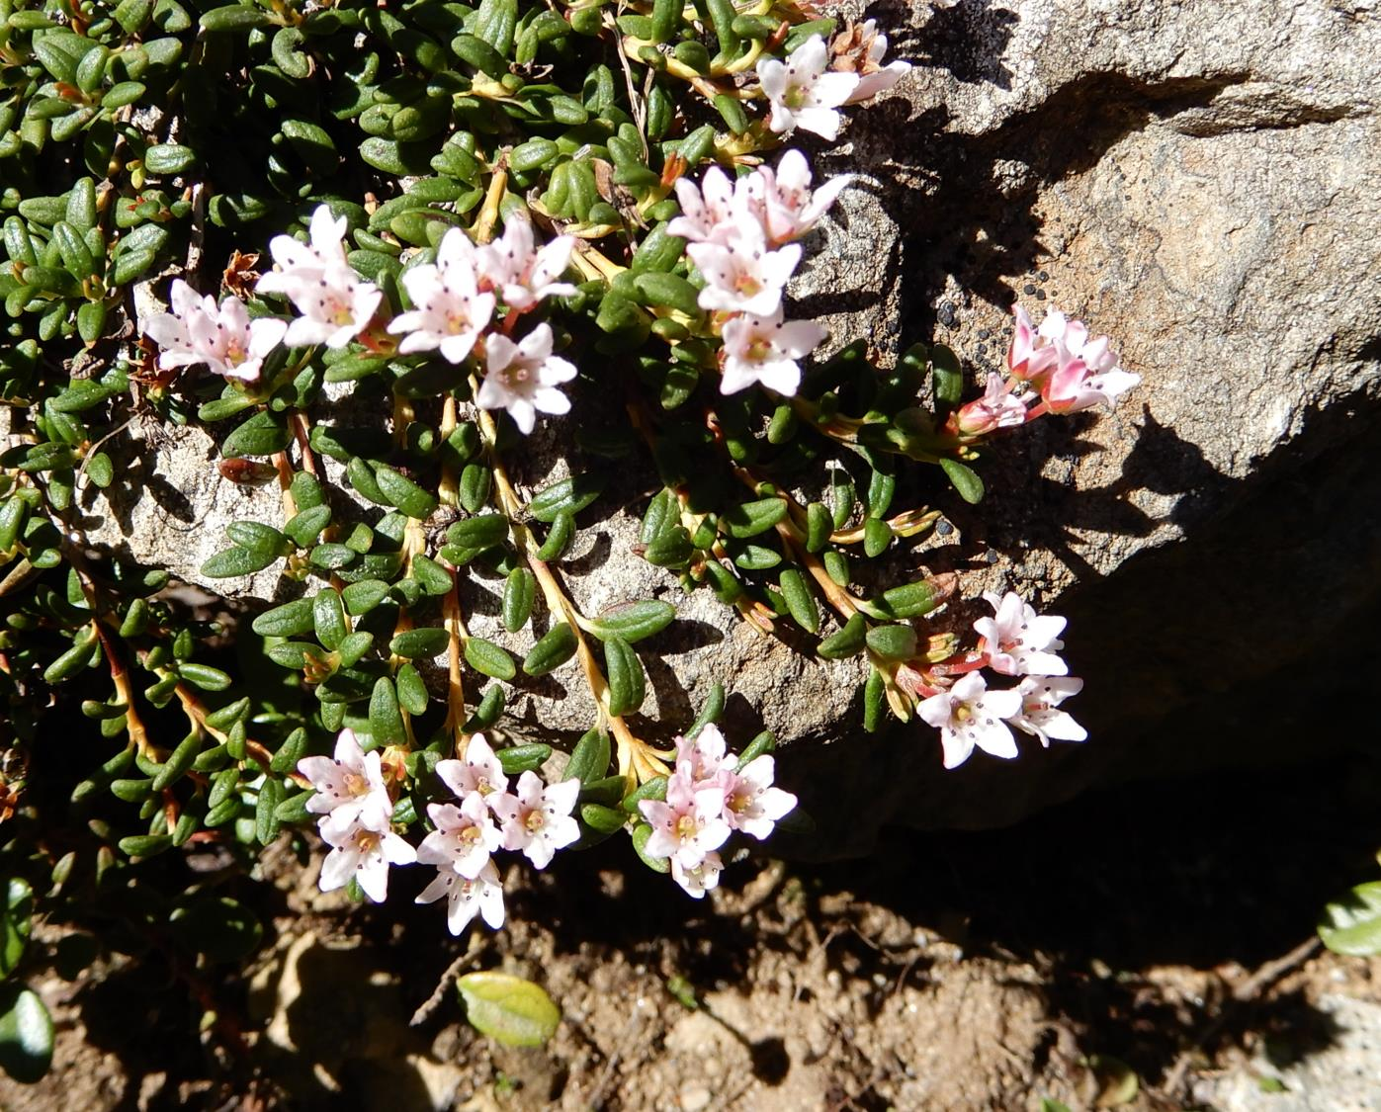
Loiseleuria procumbens

Slide 12
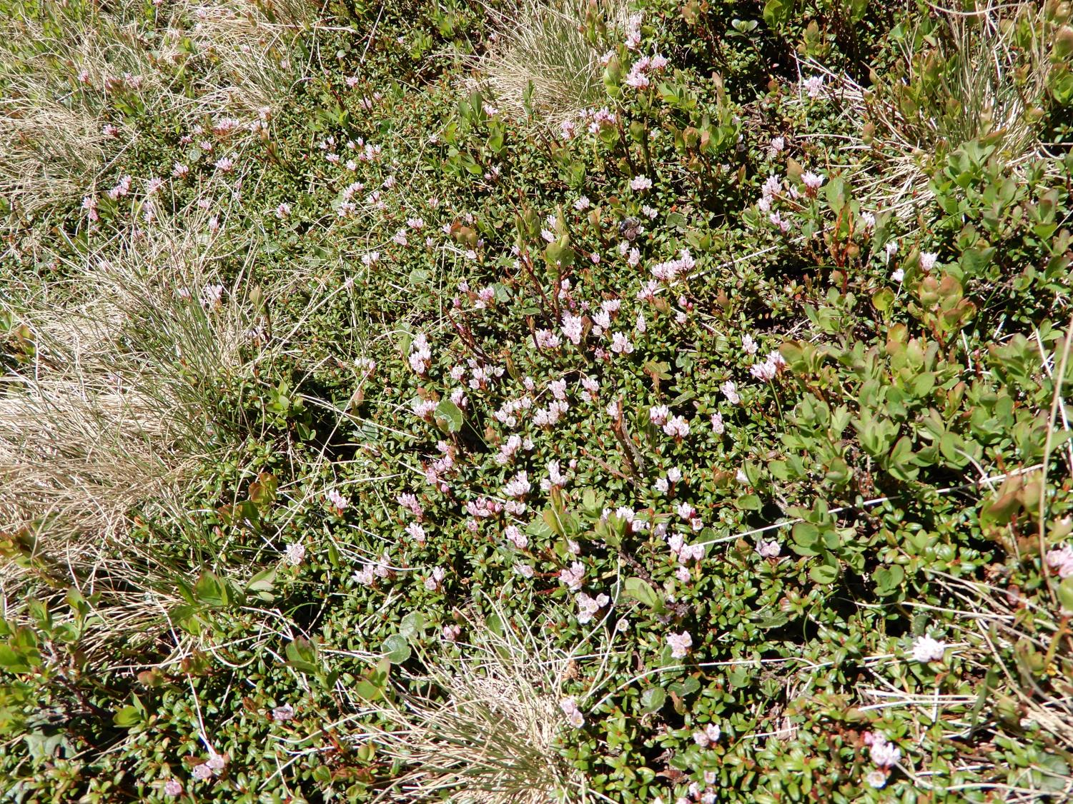

Slide 13
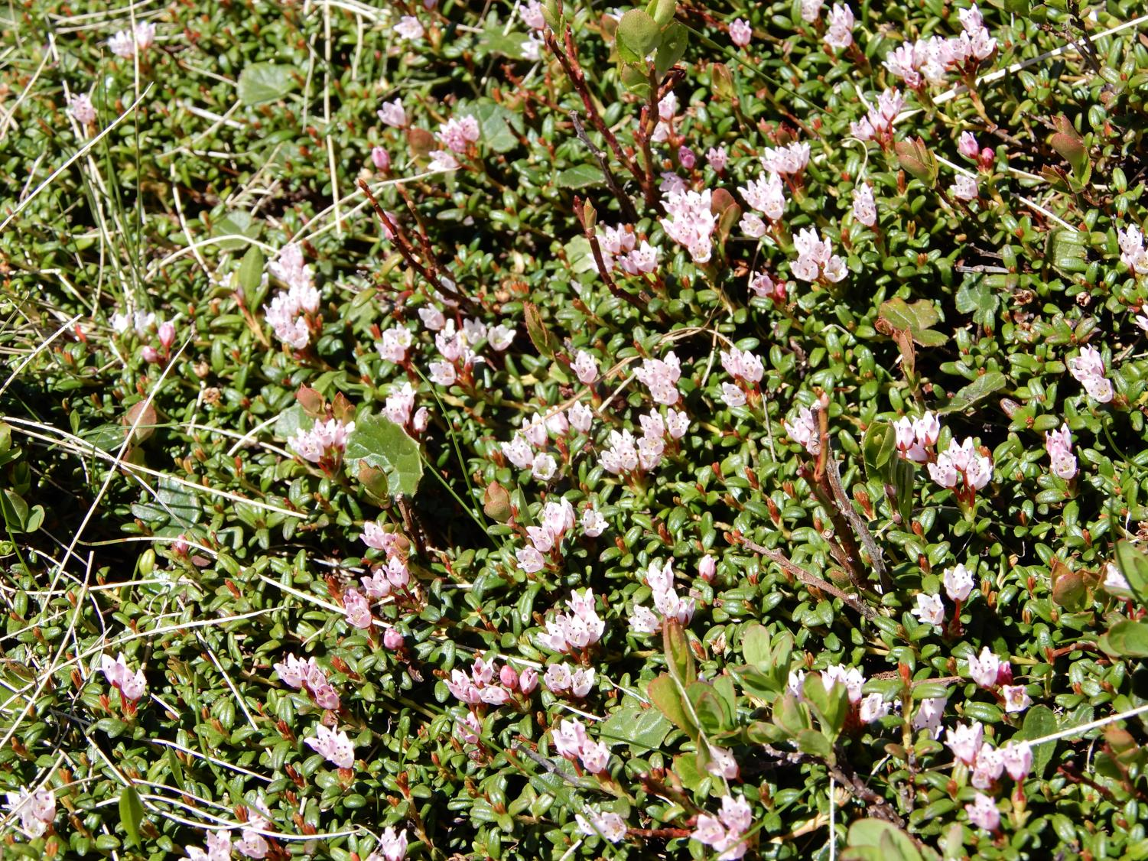

Slide 14
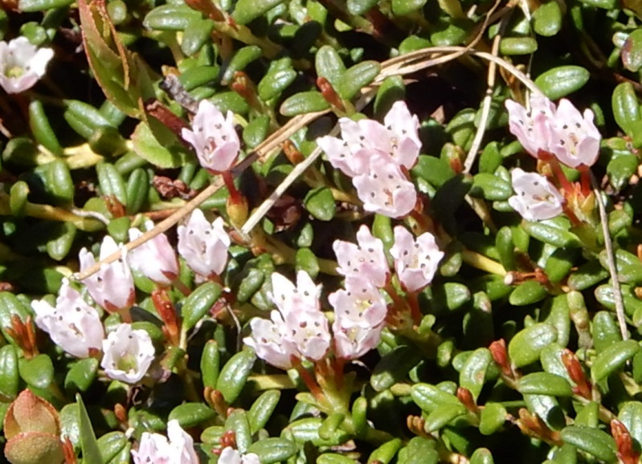

Slide 15
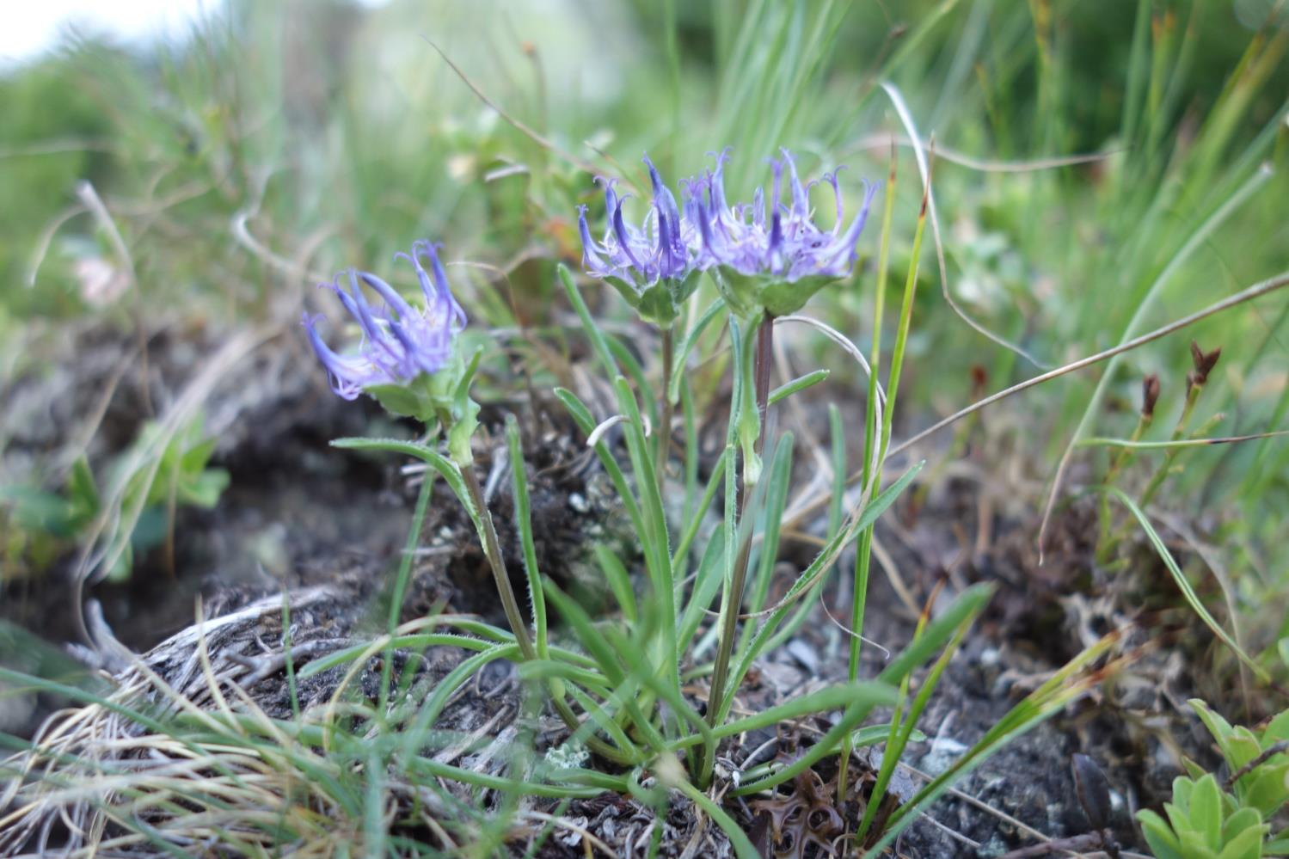
Phyteuma hemisphaerica

Slide 16
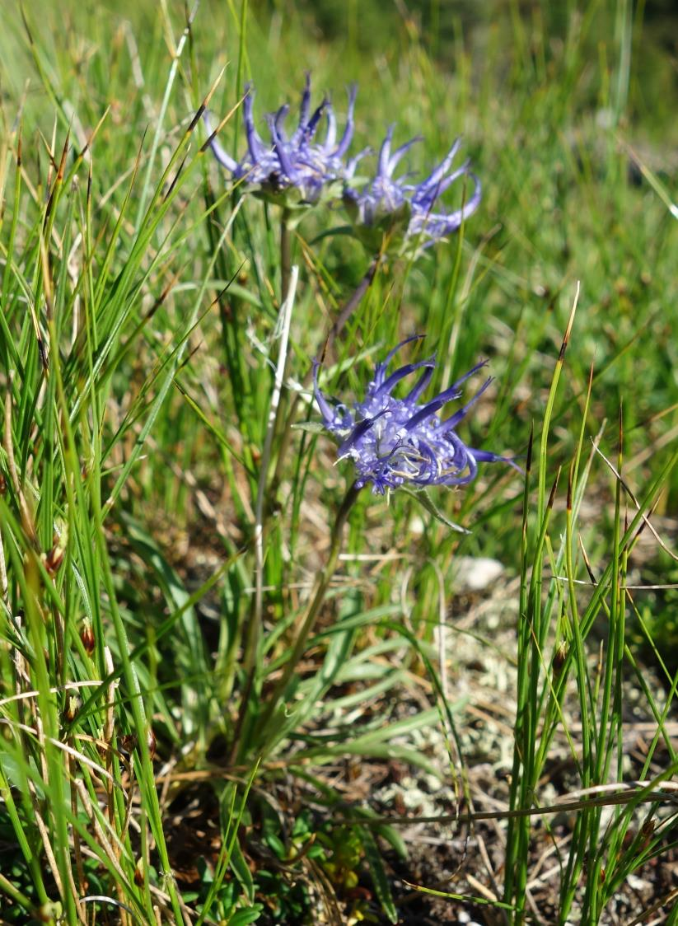

Slide 17
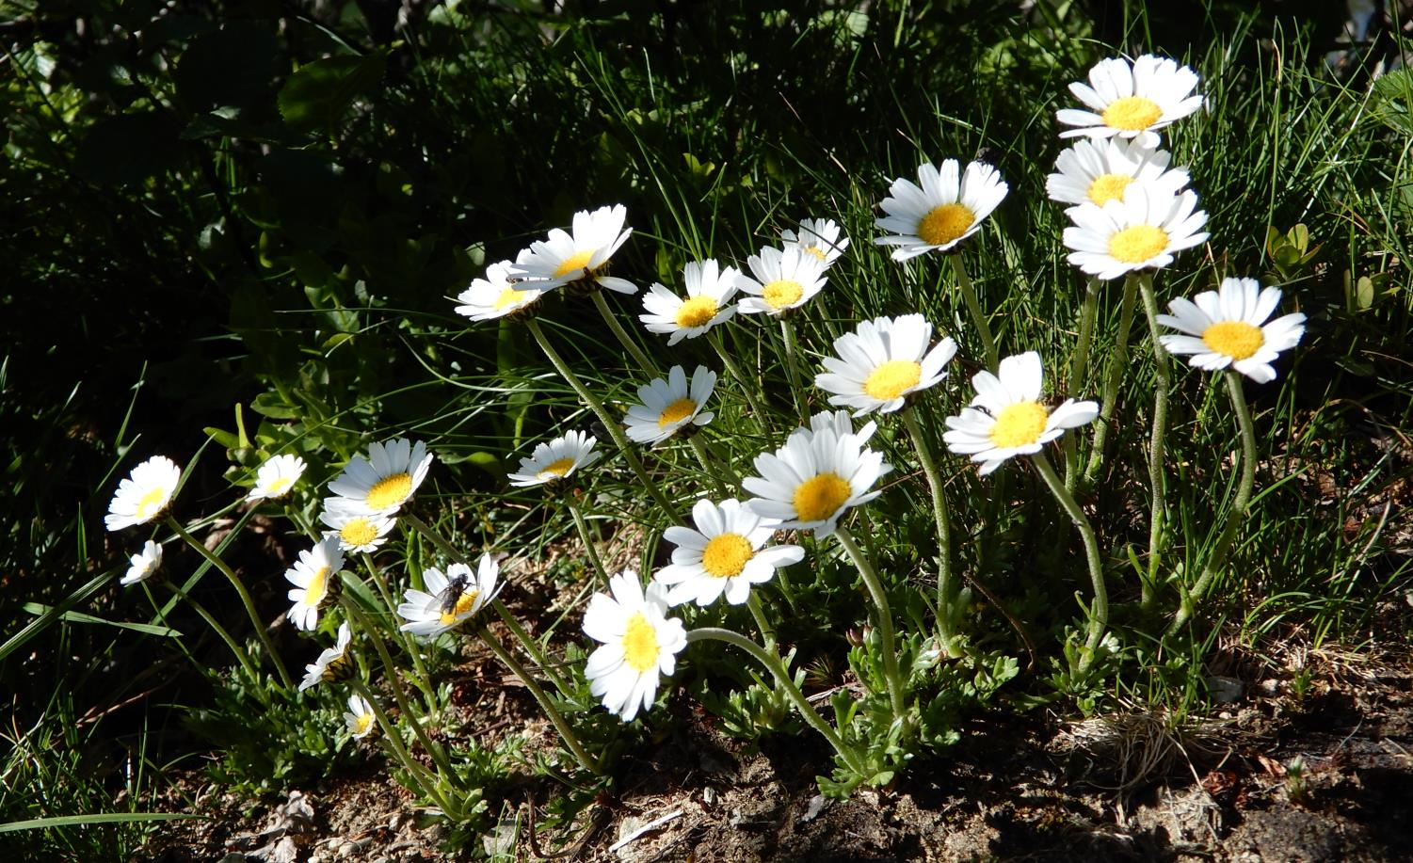
Leucanthemopsis alpina

Slide 18
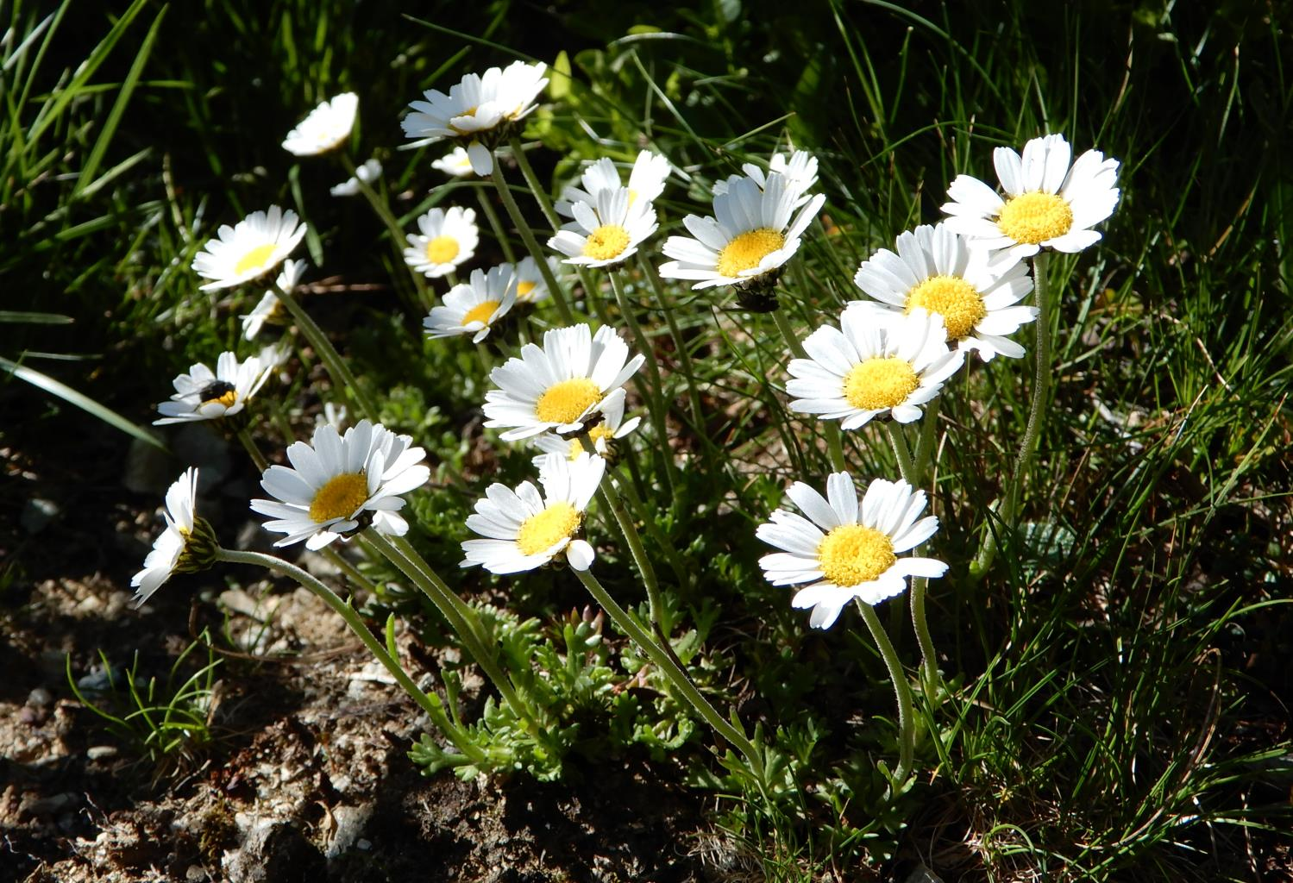

Slide 19
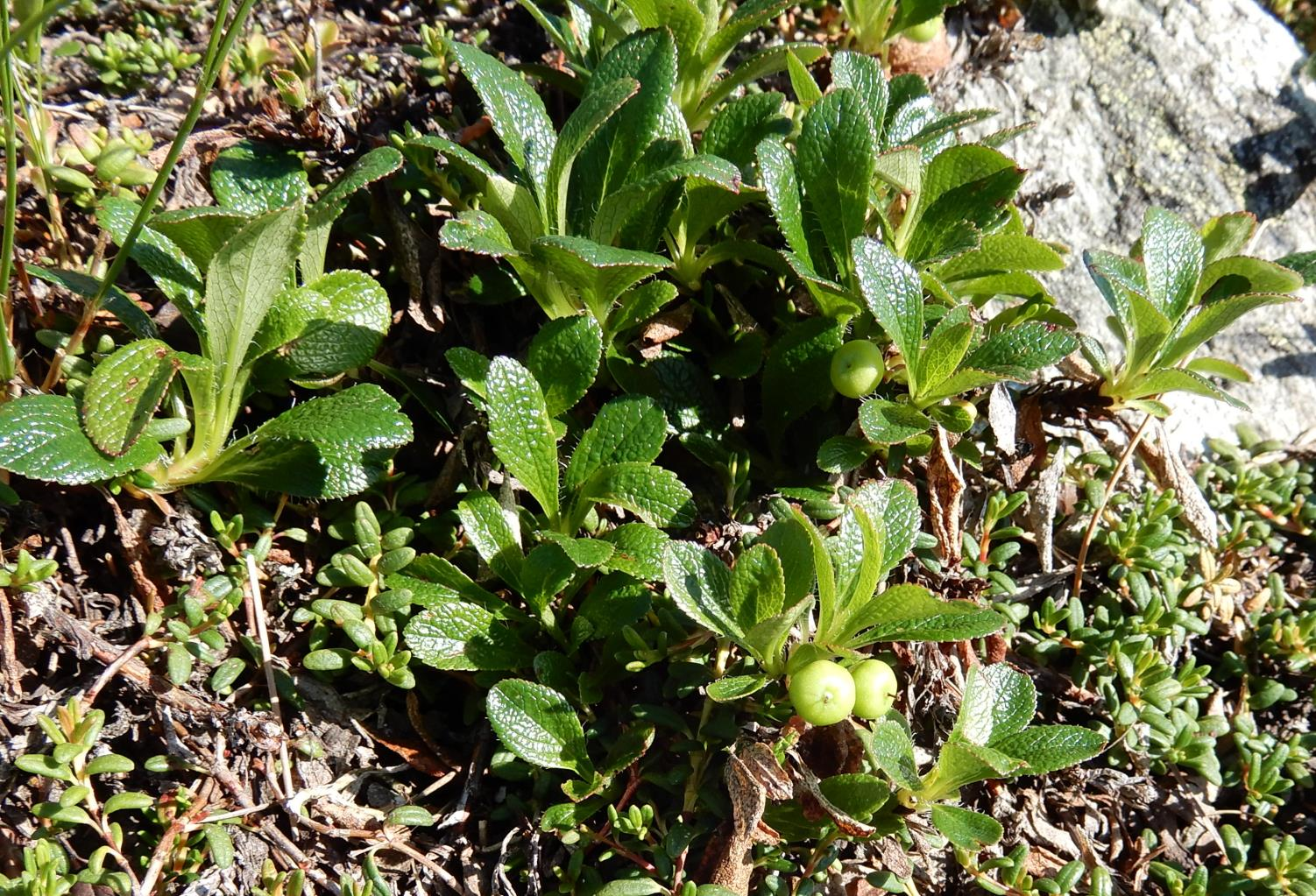
Arctous alpina

Slide 20
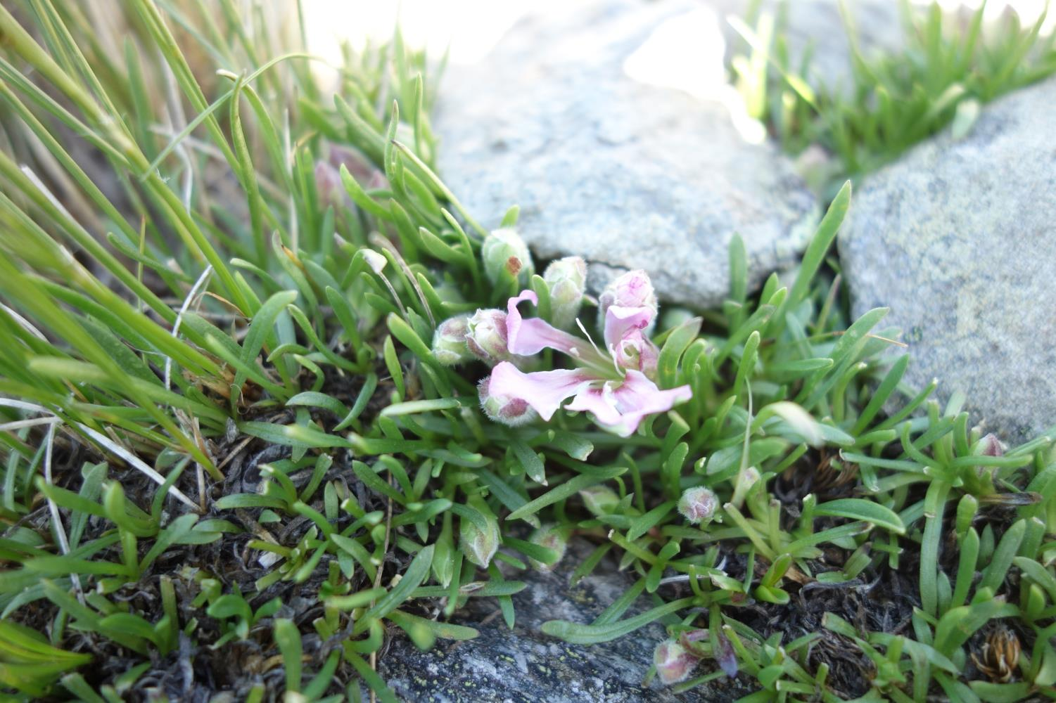
Saponaria pumila

Slide 21
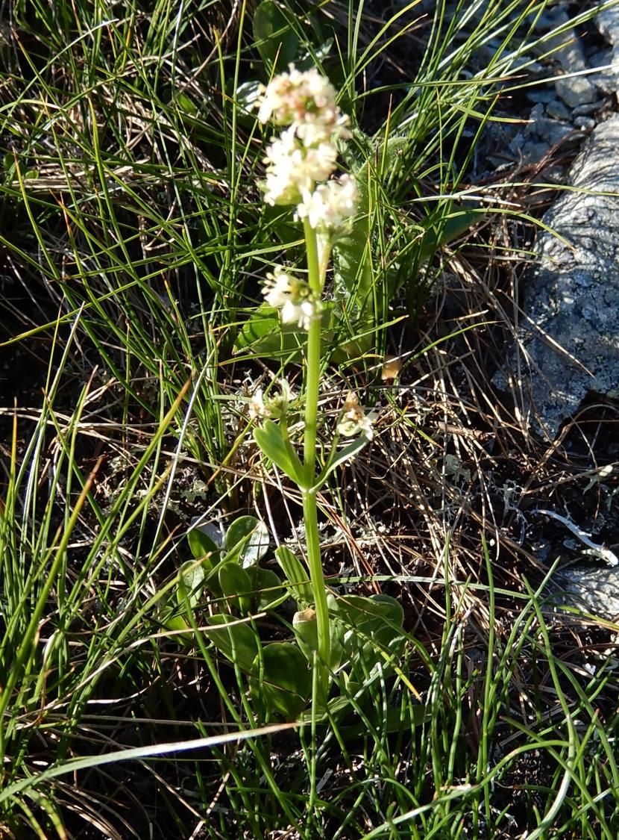
Valeriana celtica subsp. norica

Slide 22
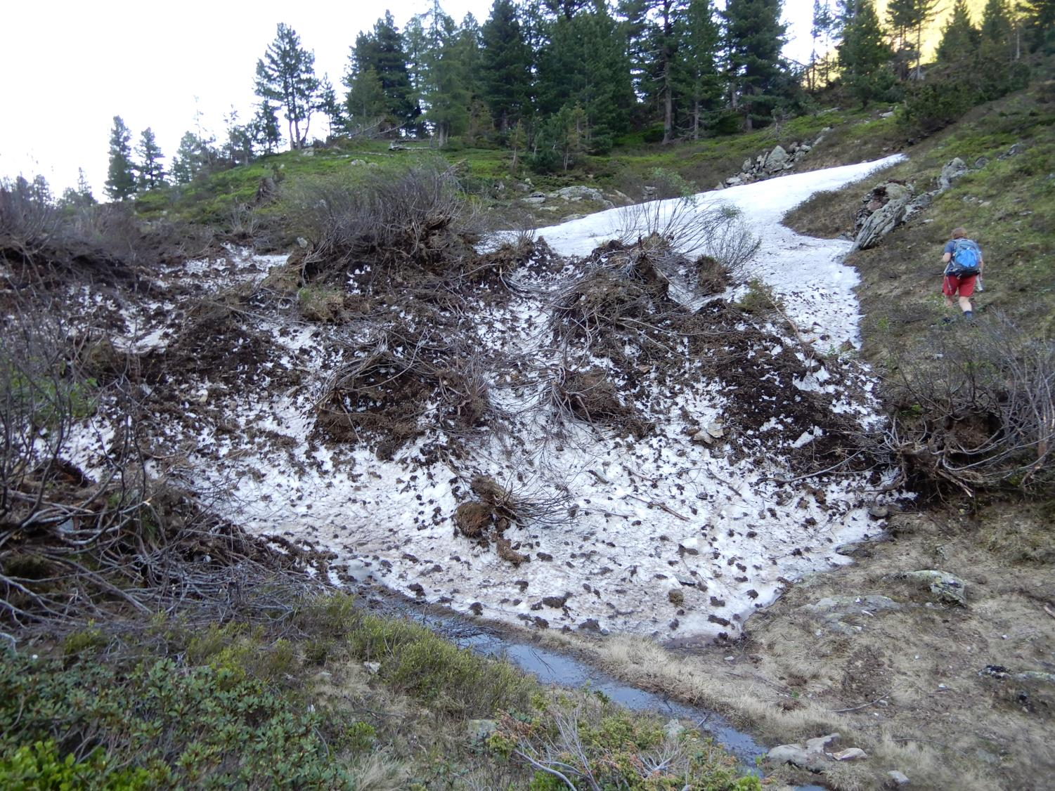
Avalanches are able to move the whole shrubs of Alnus viridis down, some of them still surviving

Slide 23
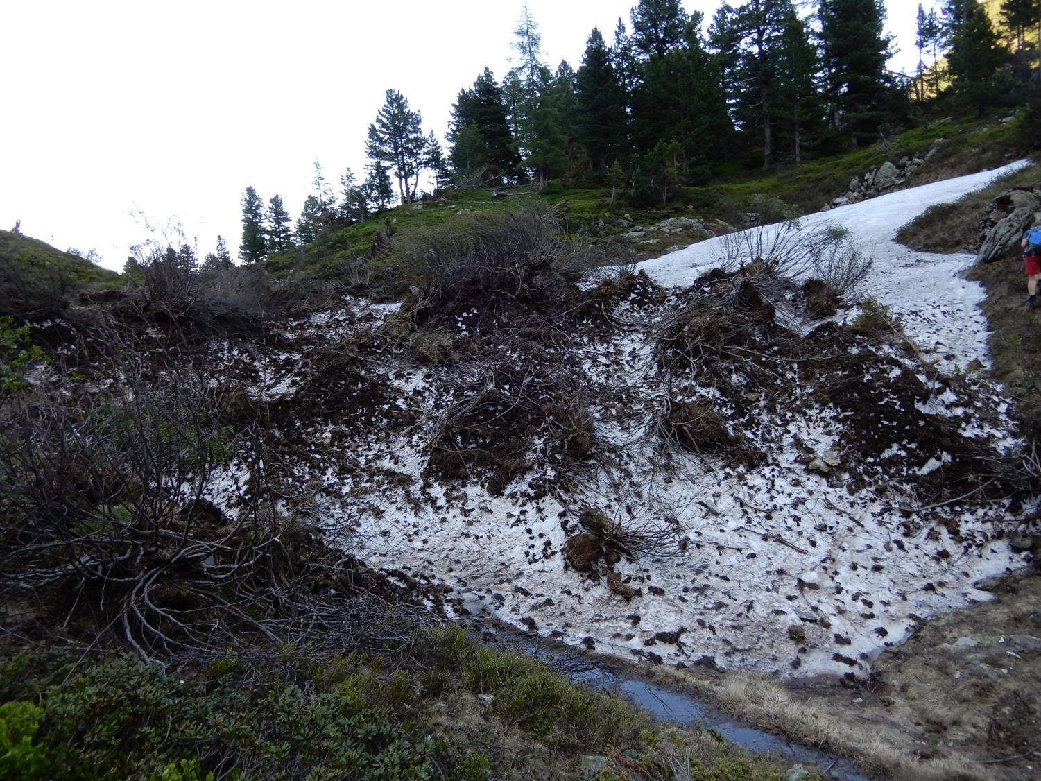

Slide 24
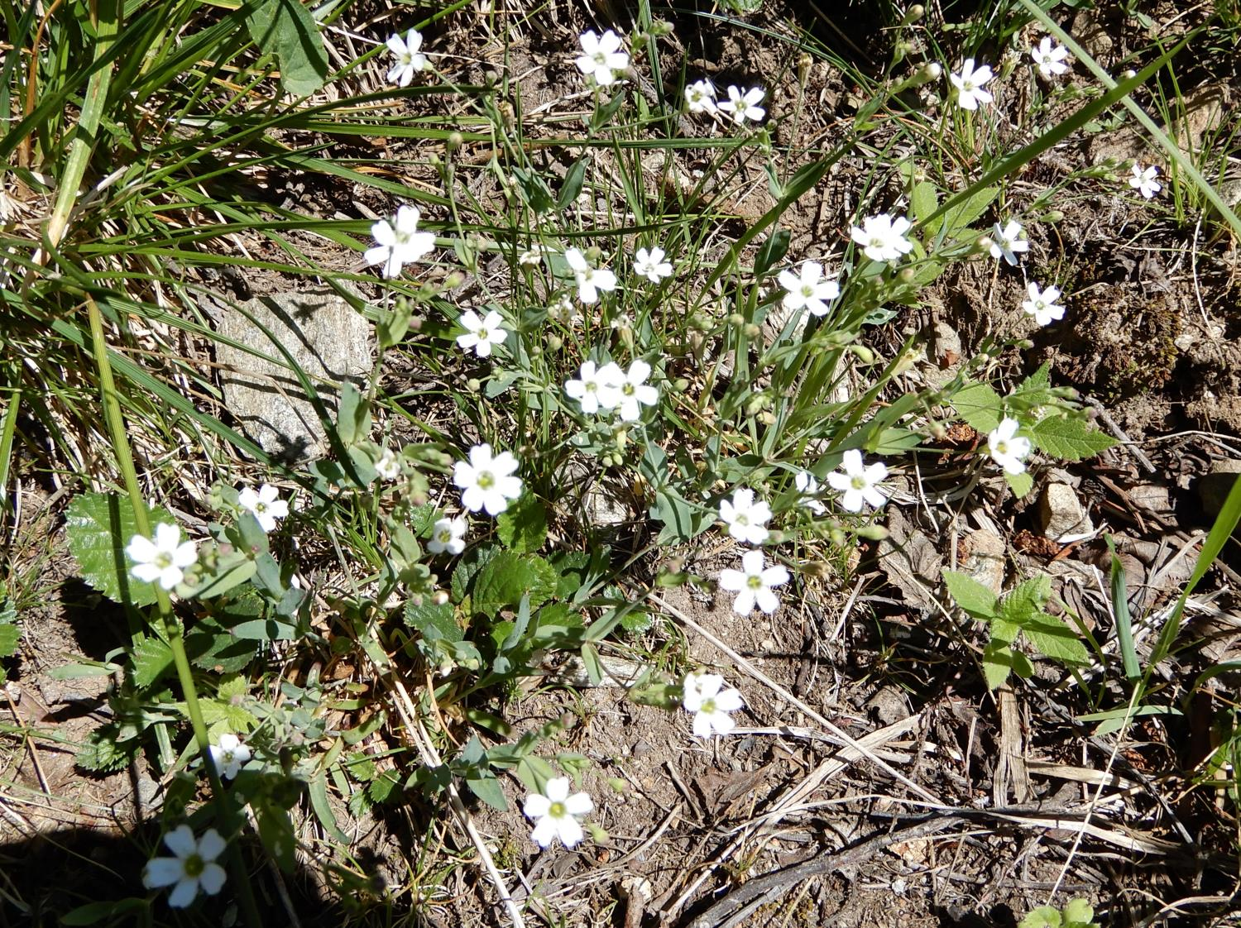
Silene rupestris

Slide 25
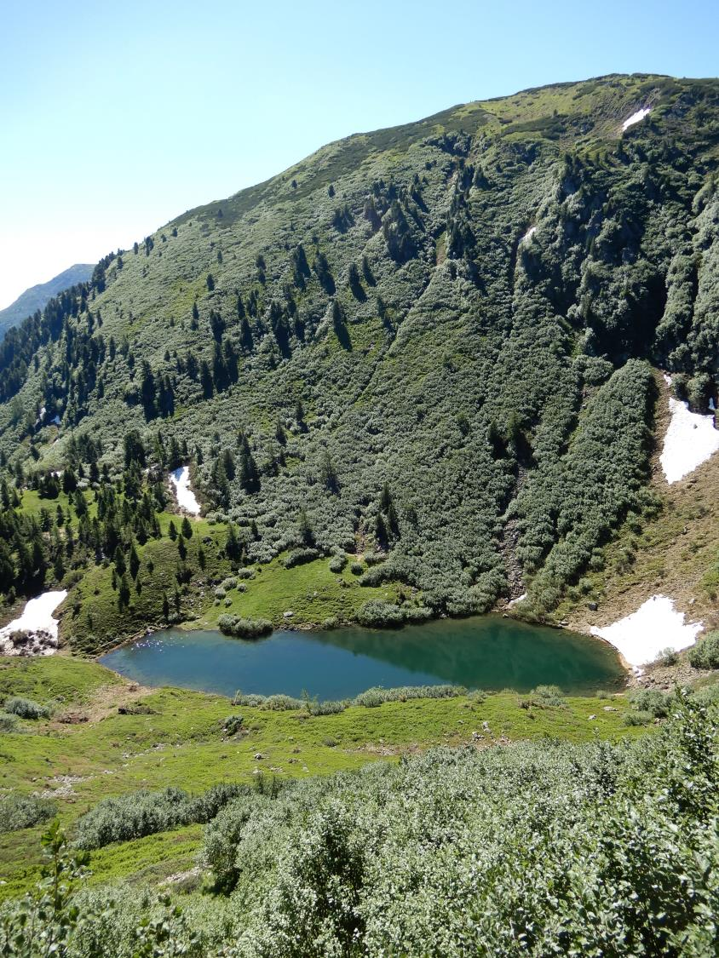
Globuckensee – growths of Alnus viridis above it

Slide 26
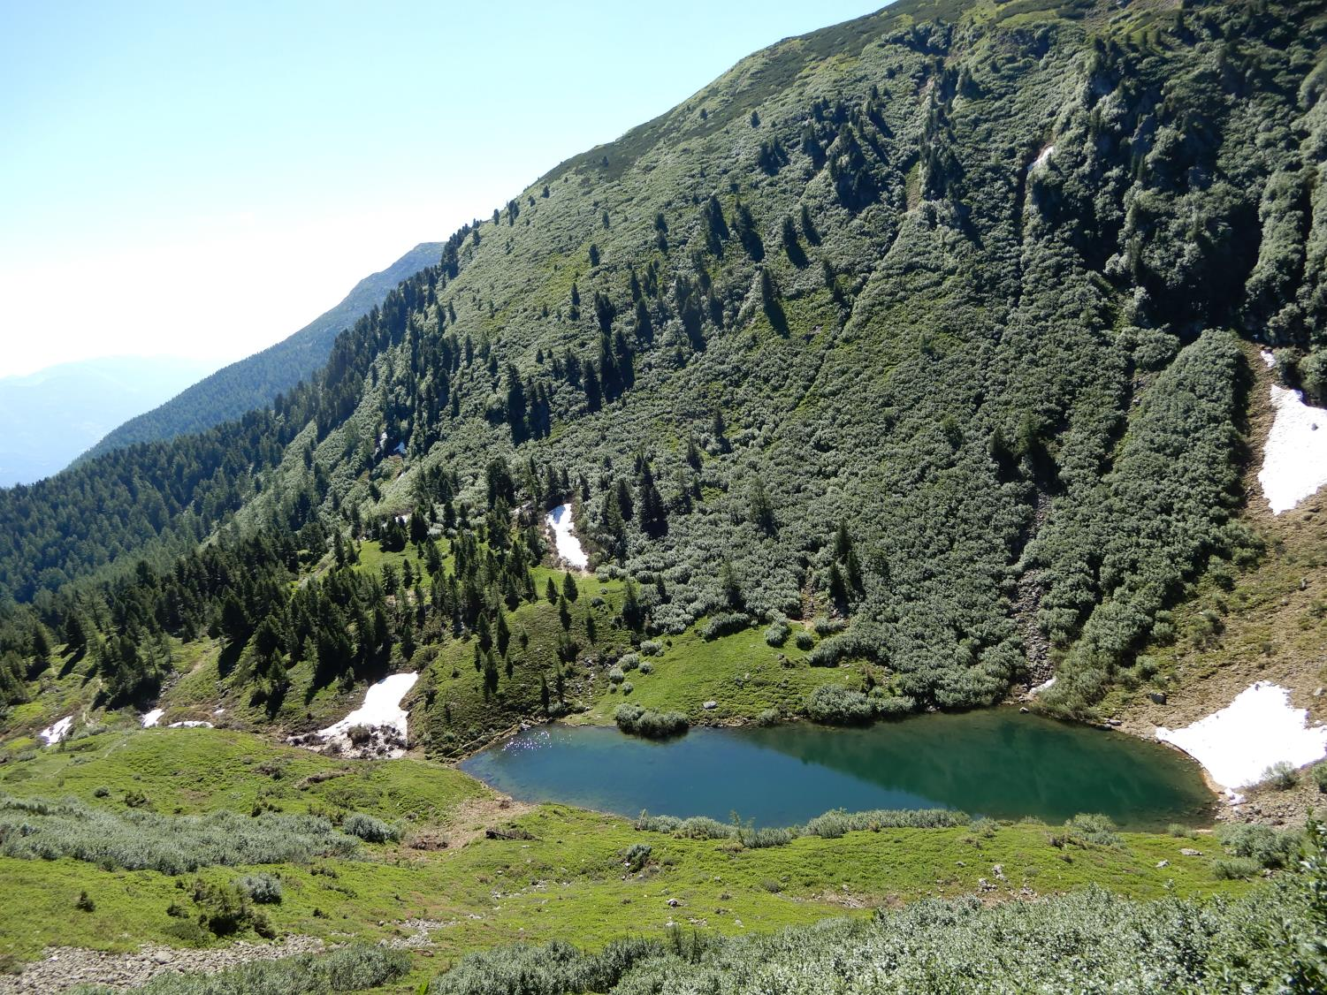

Slide 27
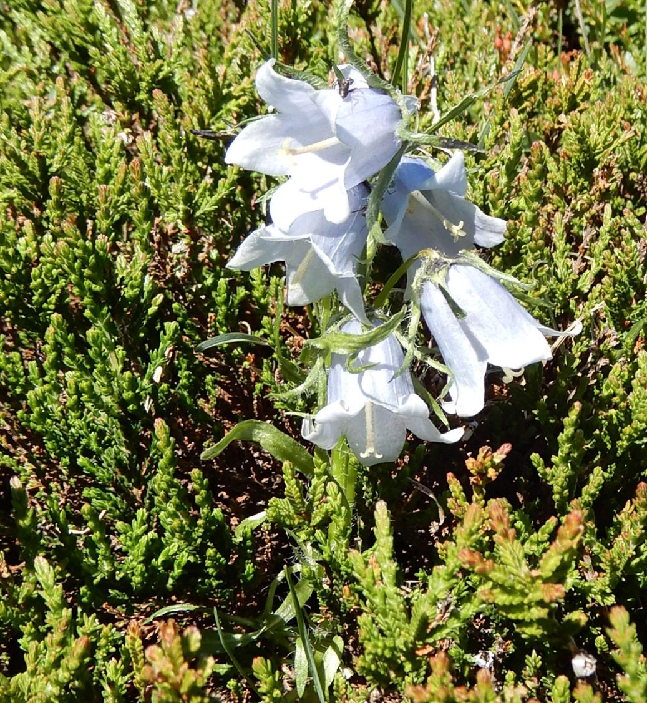
Campanulla alpina

Slide 28
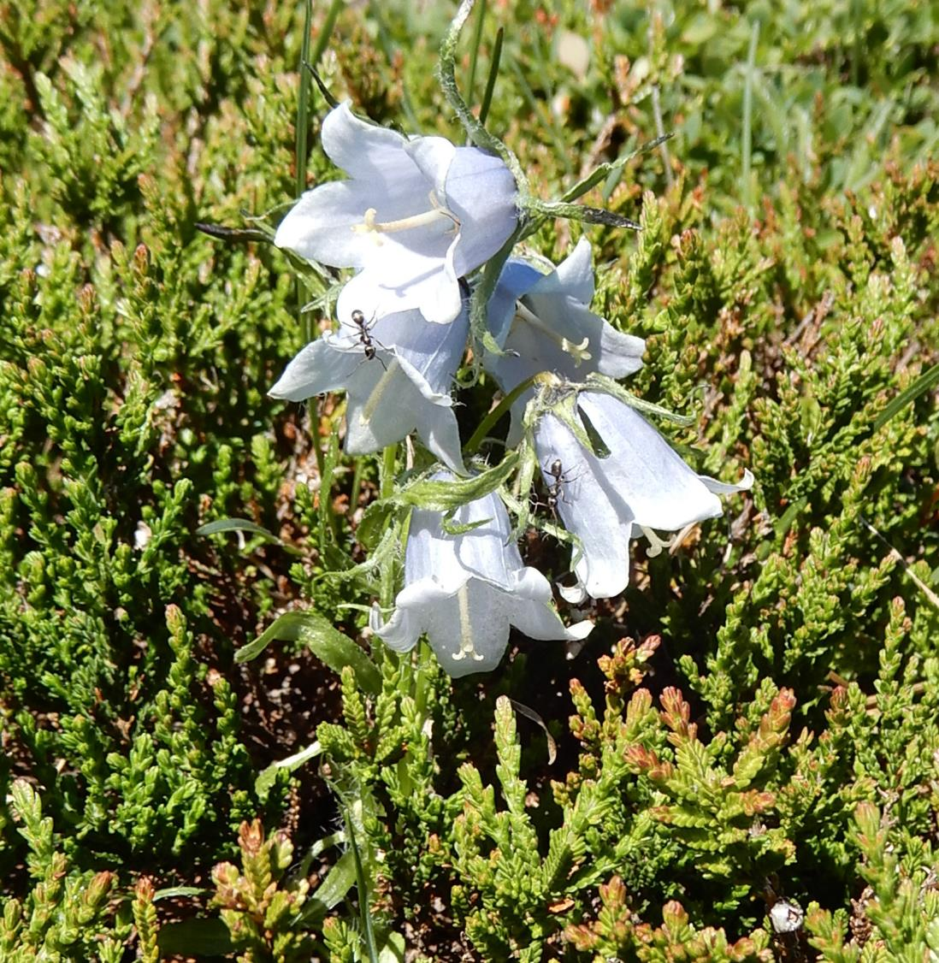

Slide 29
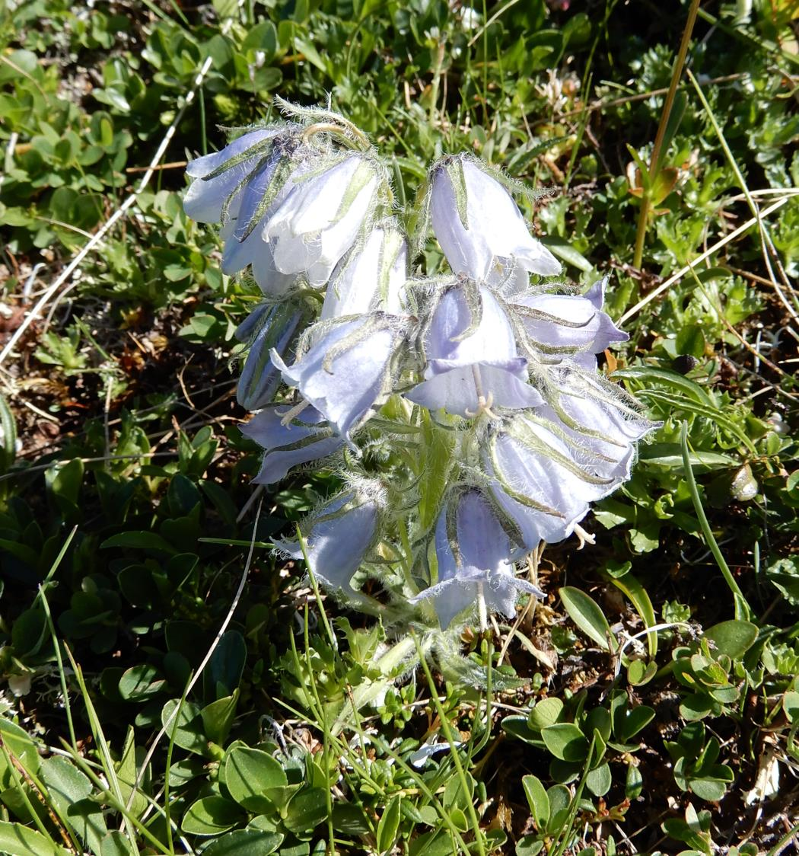

Slide 30
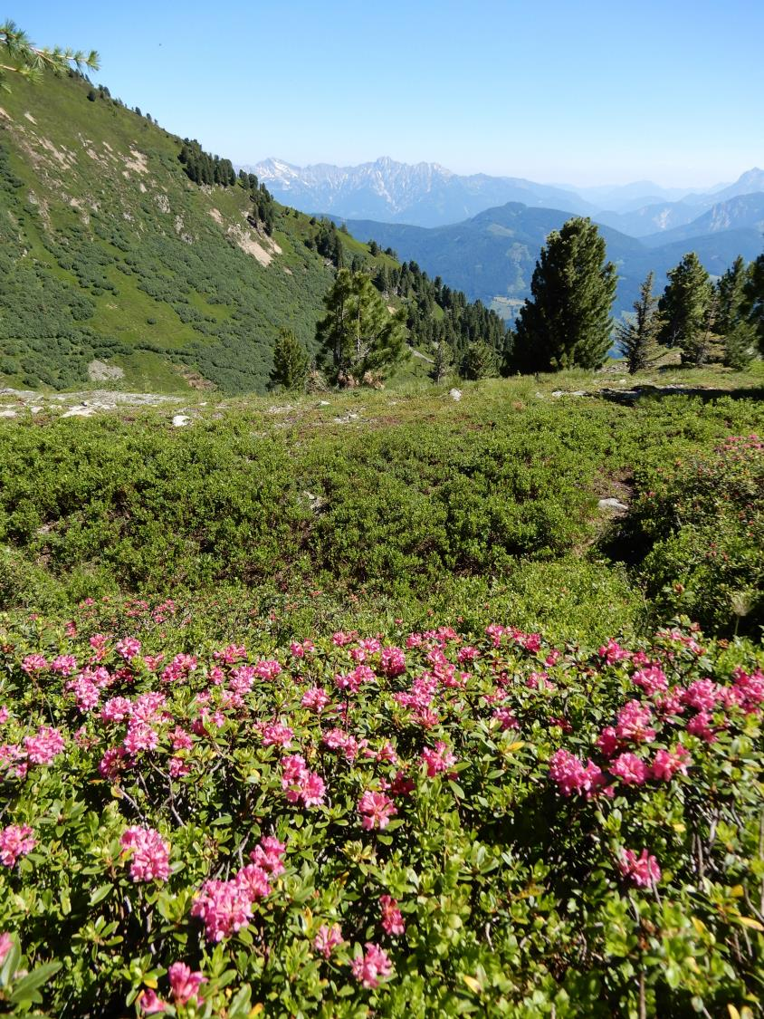
Rhododendron ferrugineum

Slide 31
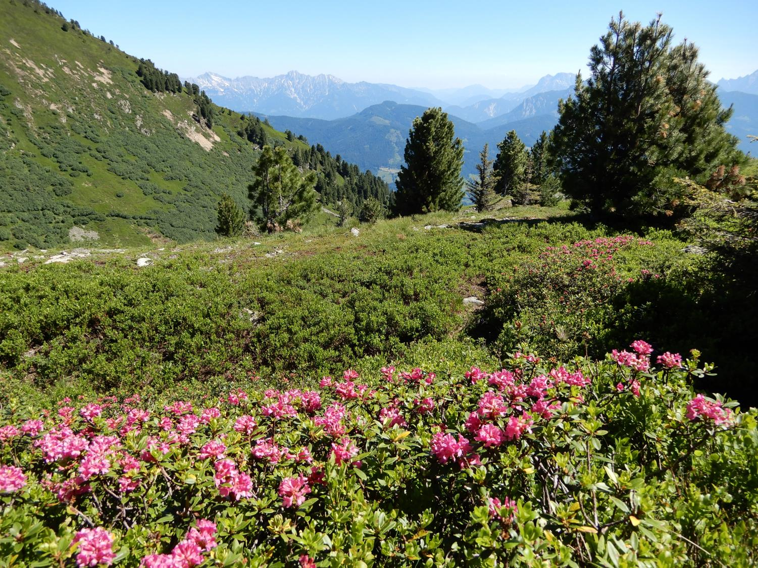

Slide 32
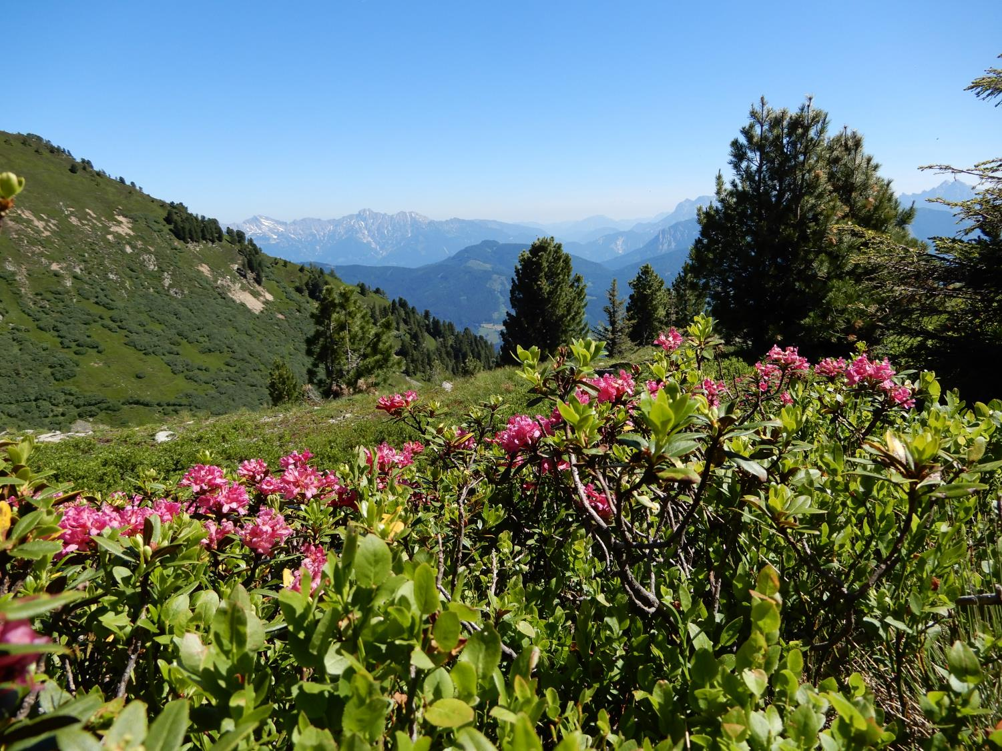

Slide 33
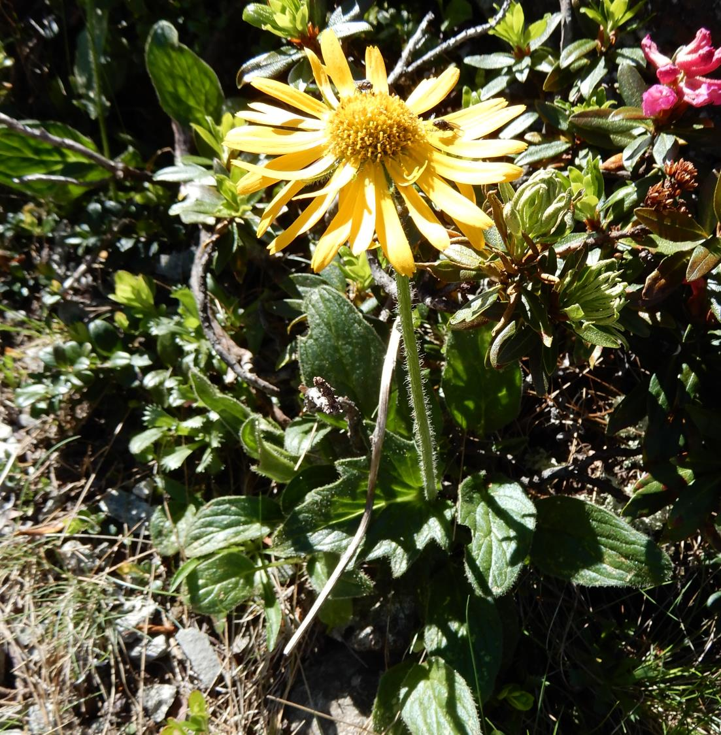
Doronicum stiriacum

Slide 34
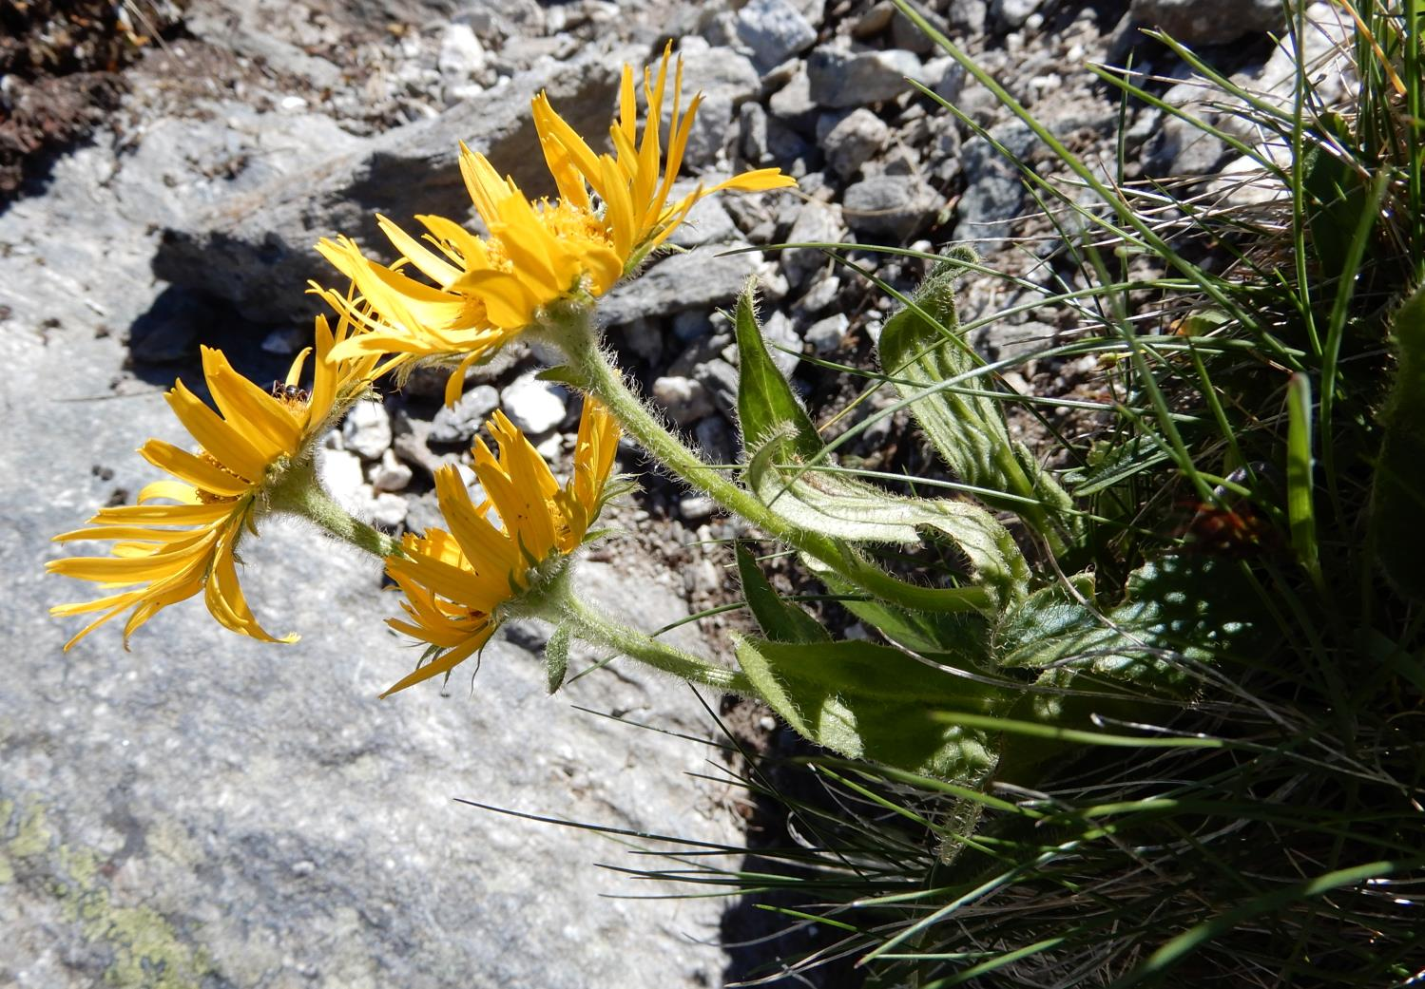

Slide 35
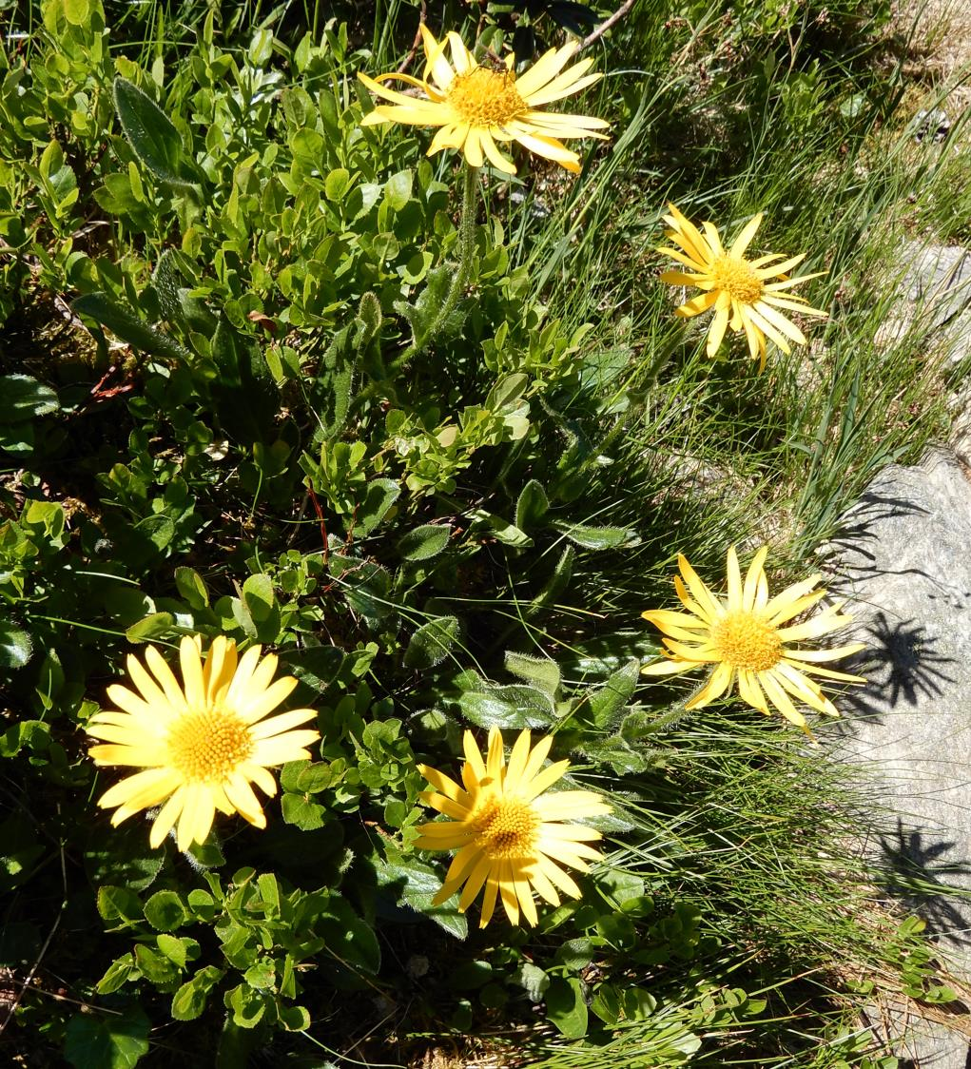

Slide 36
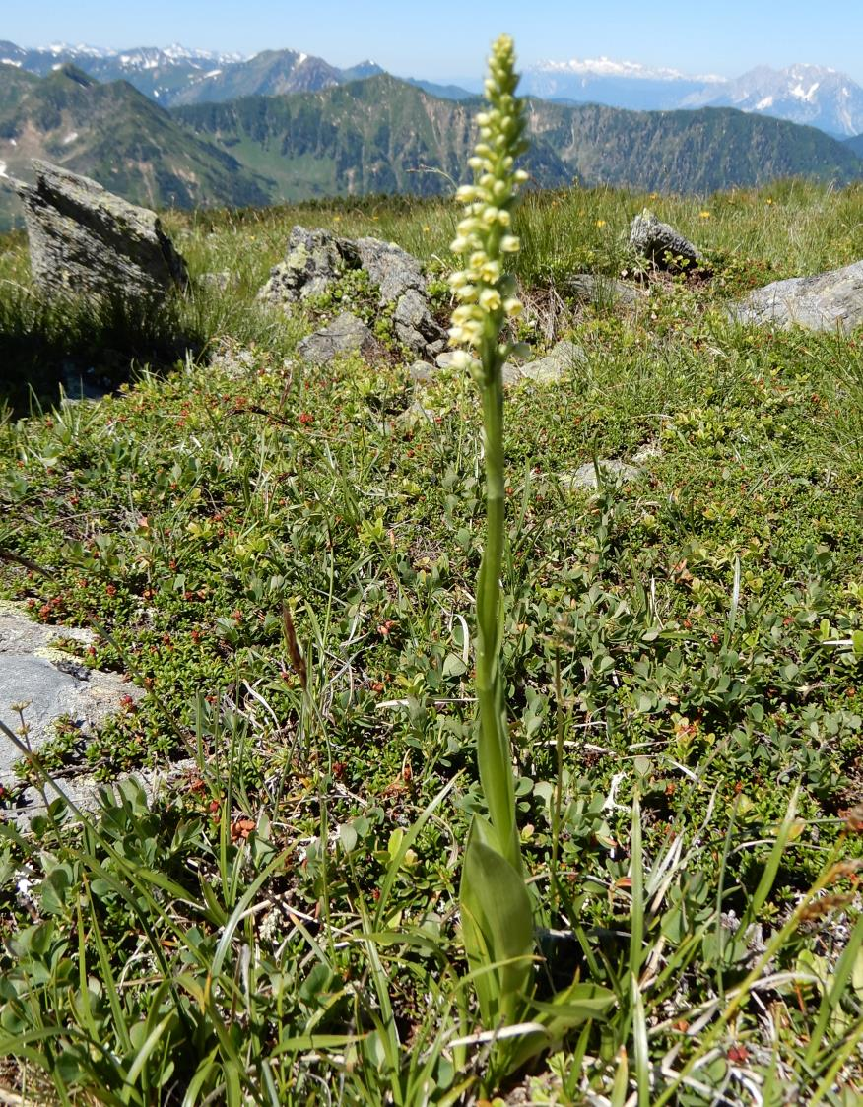
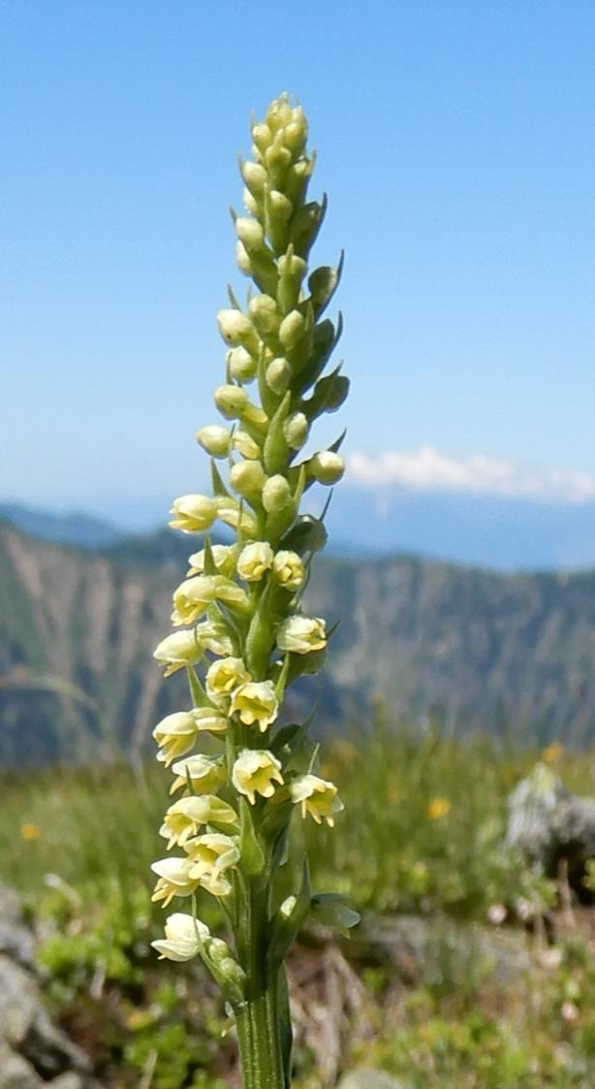
Leucorchis albida

Slide 37
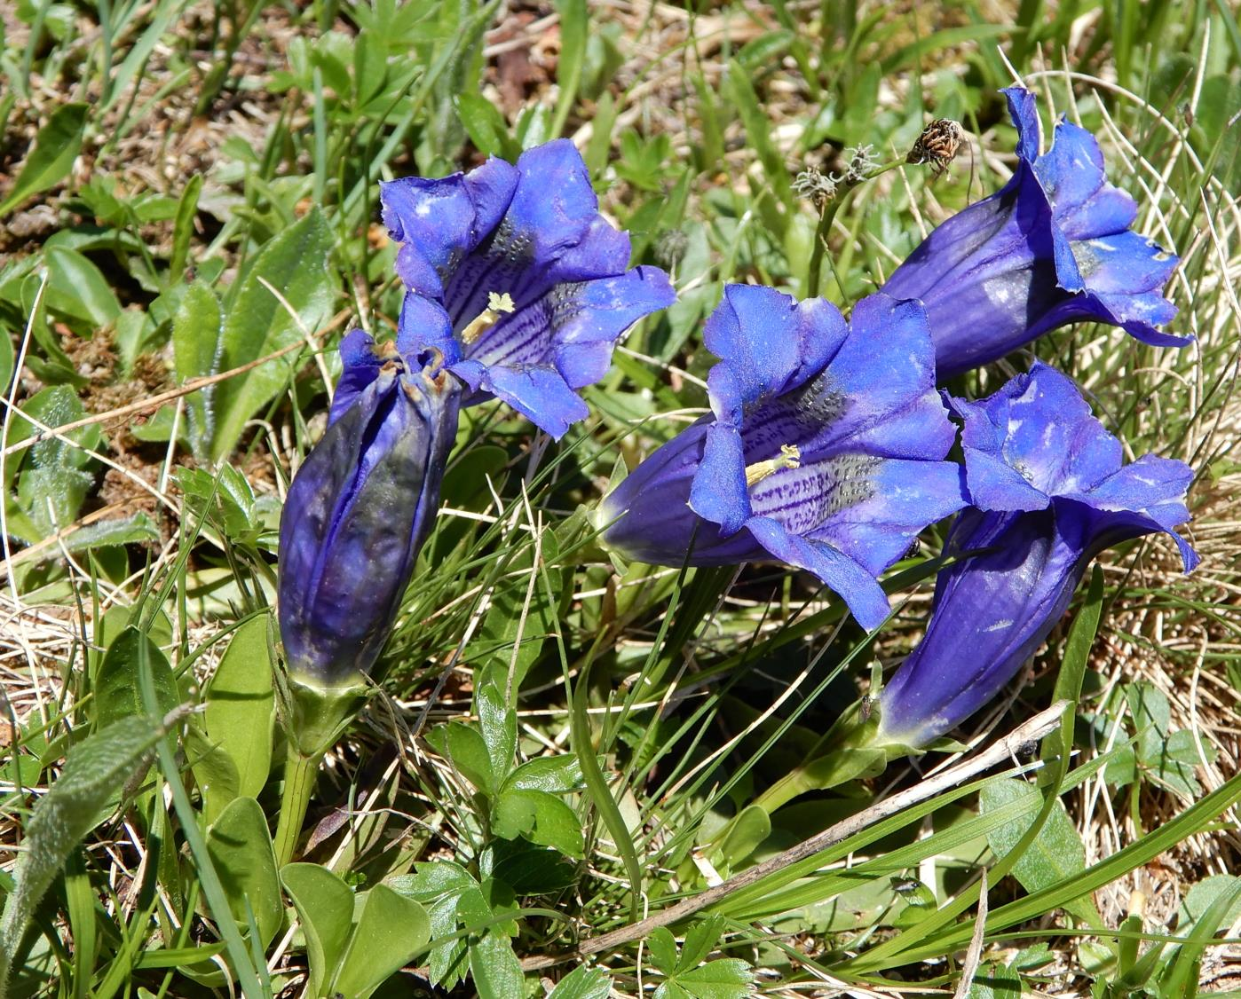
Gentiana kochiana

Slide 38
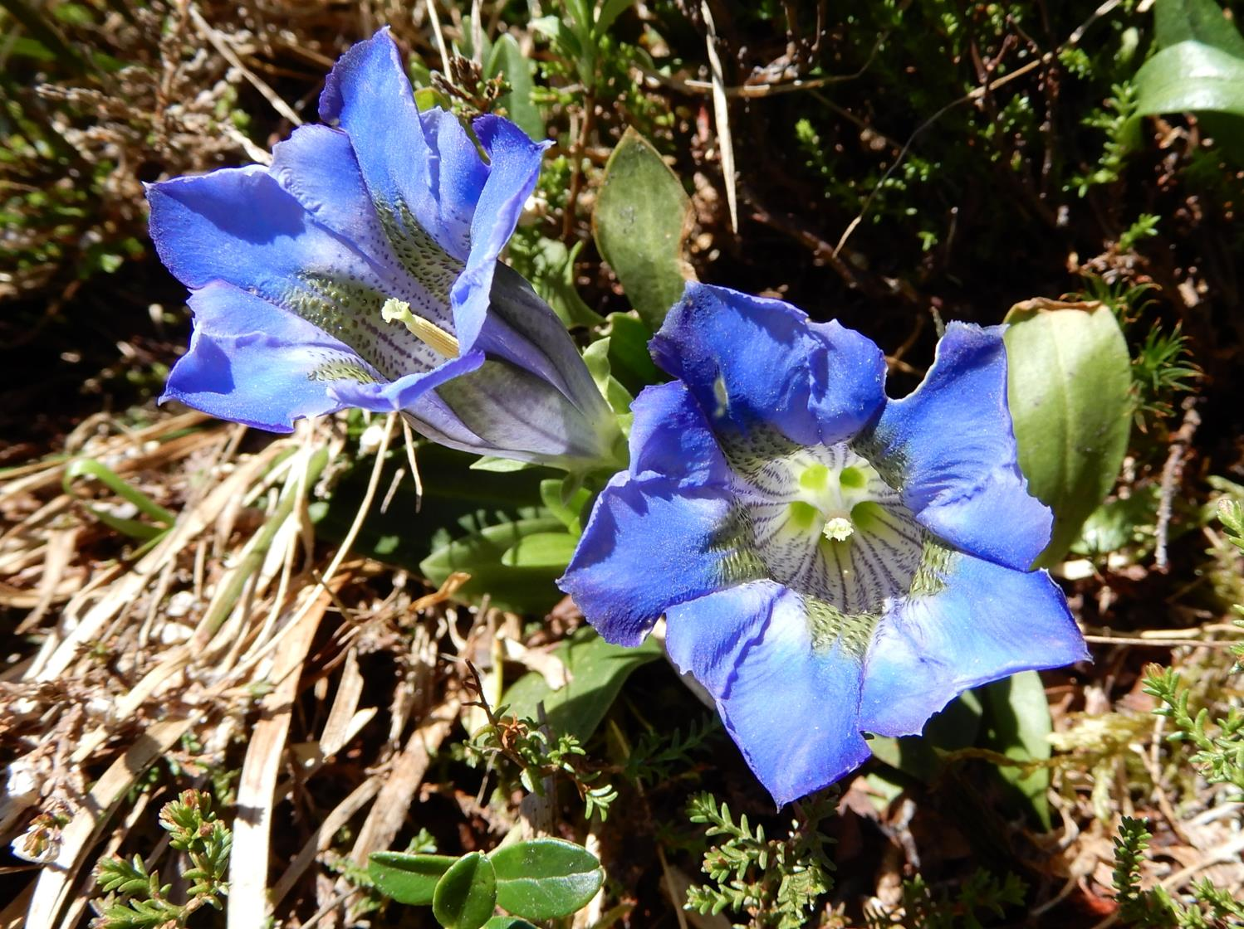

Slide 39
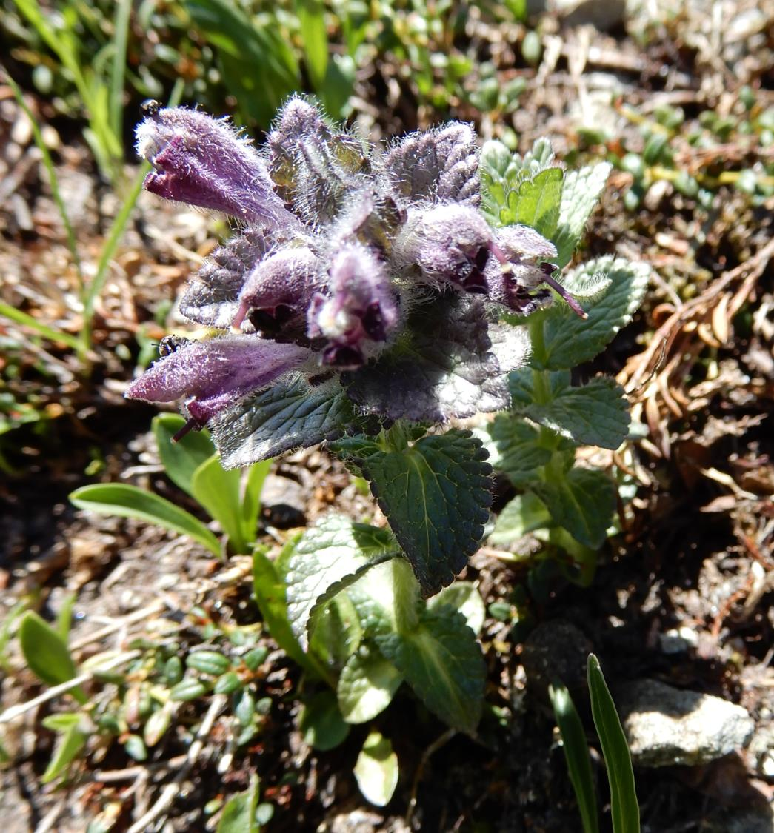
Bartsia alpina

Slide 40
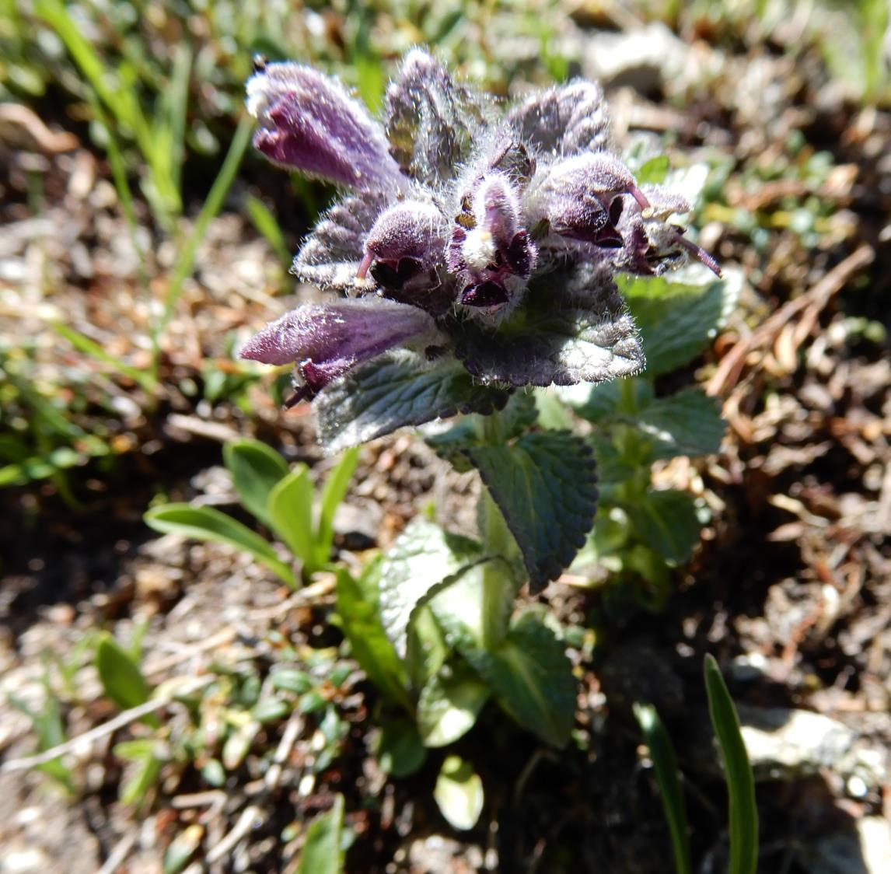

Slide 41
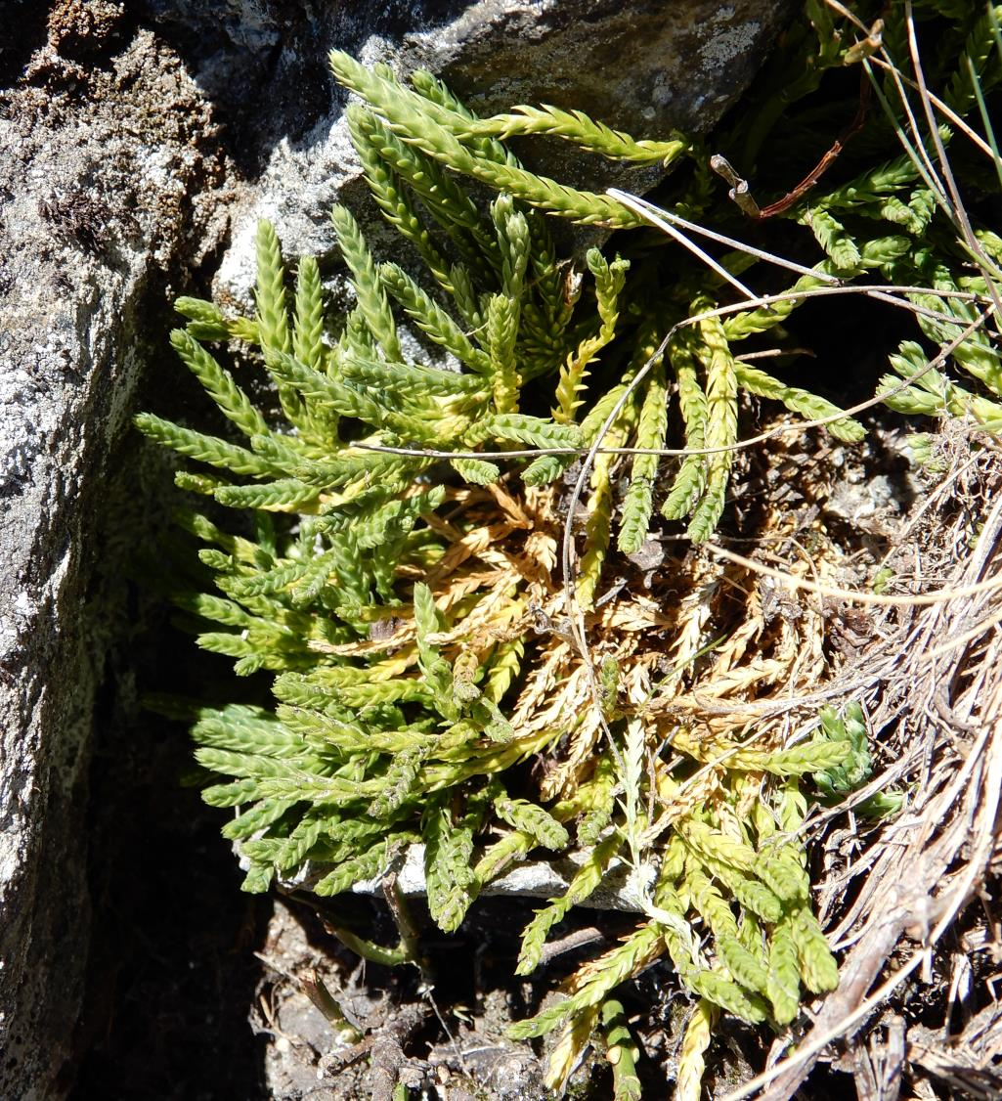
Diphasiastrum alpinum

Slide 42
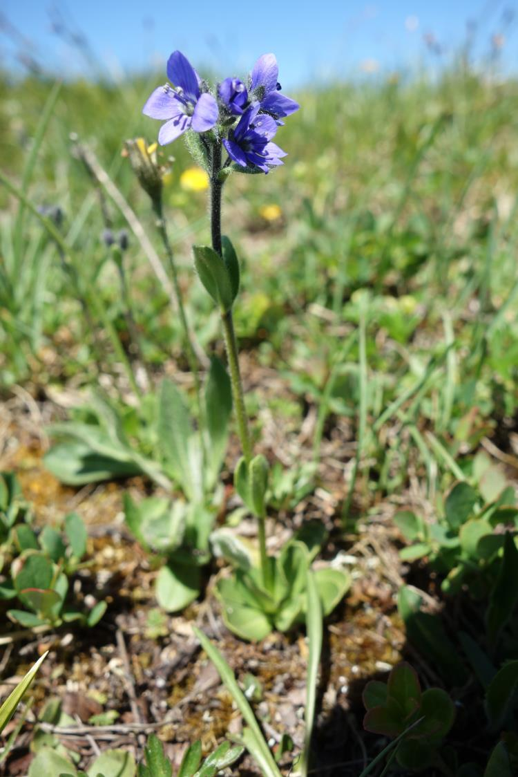
Veronica belidioides

Slide 43
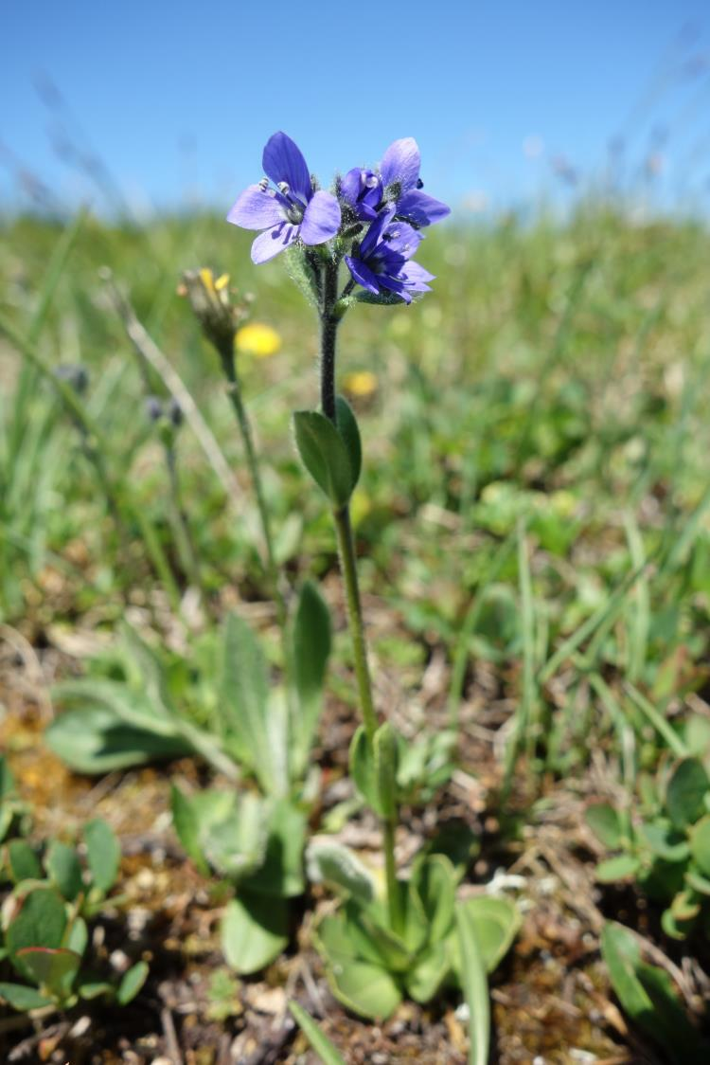

Slide 44
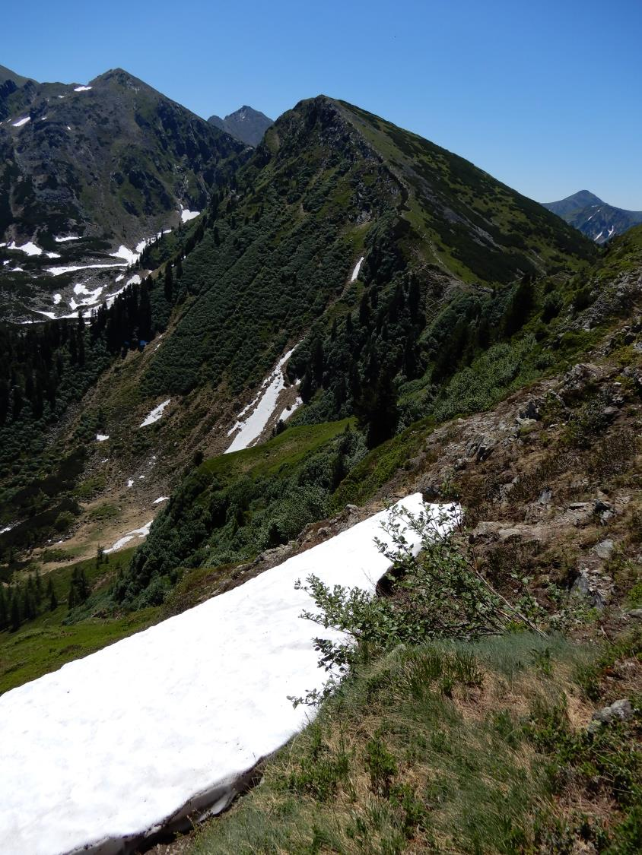

Slide 45
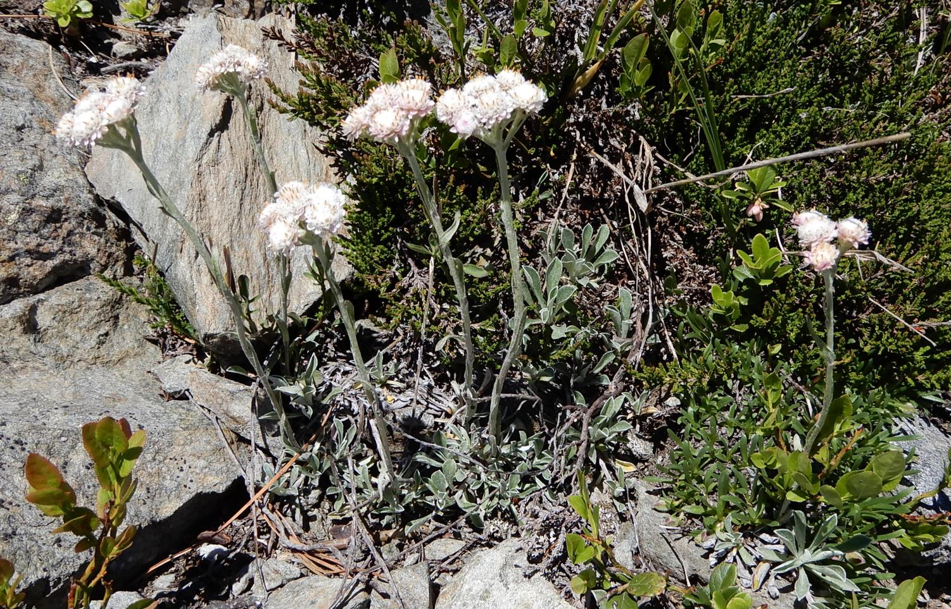
Antennaria dioica

Slide 46
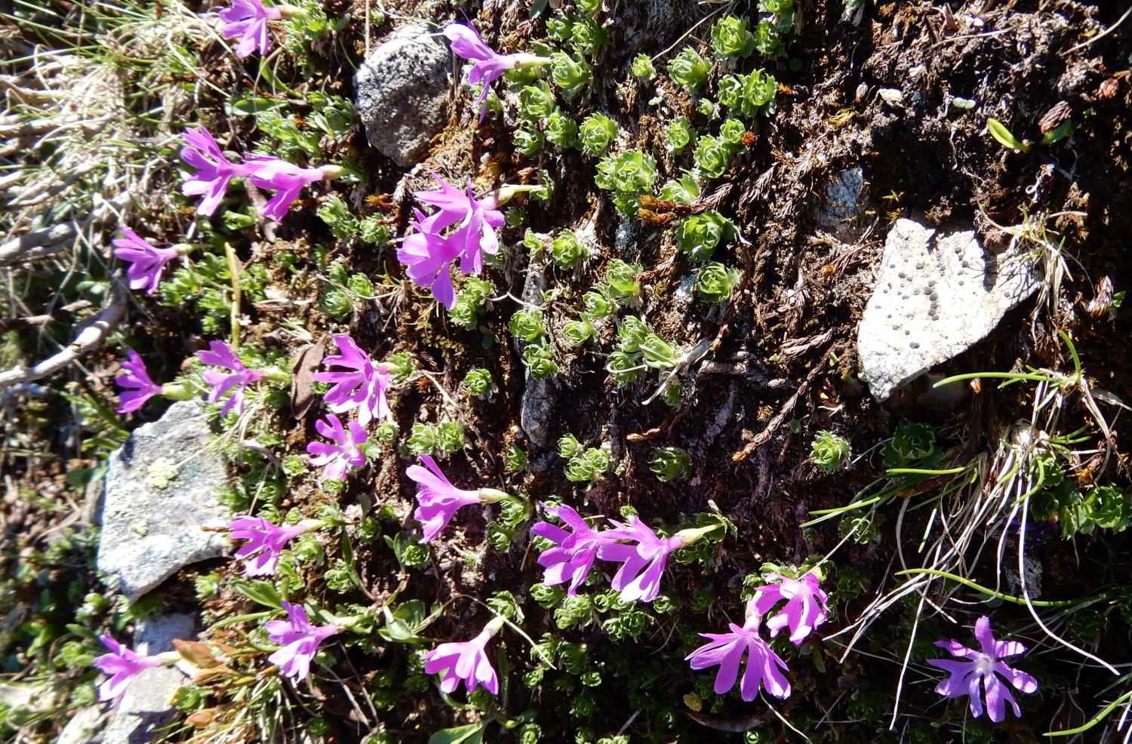
Primula minima

Slide 47
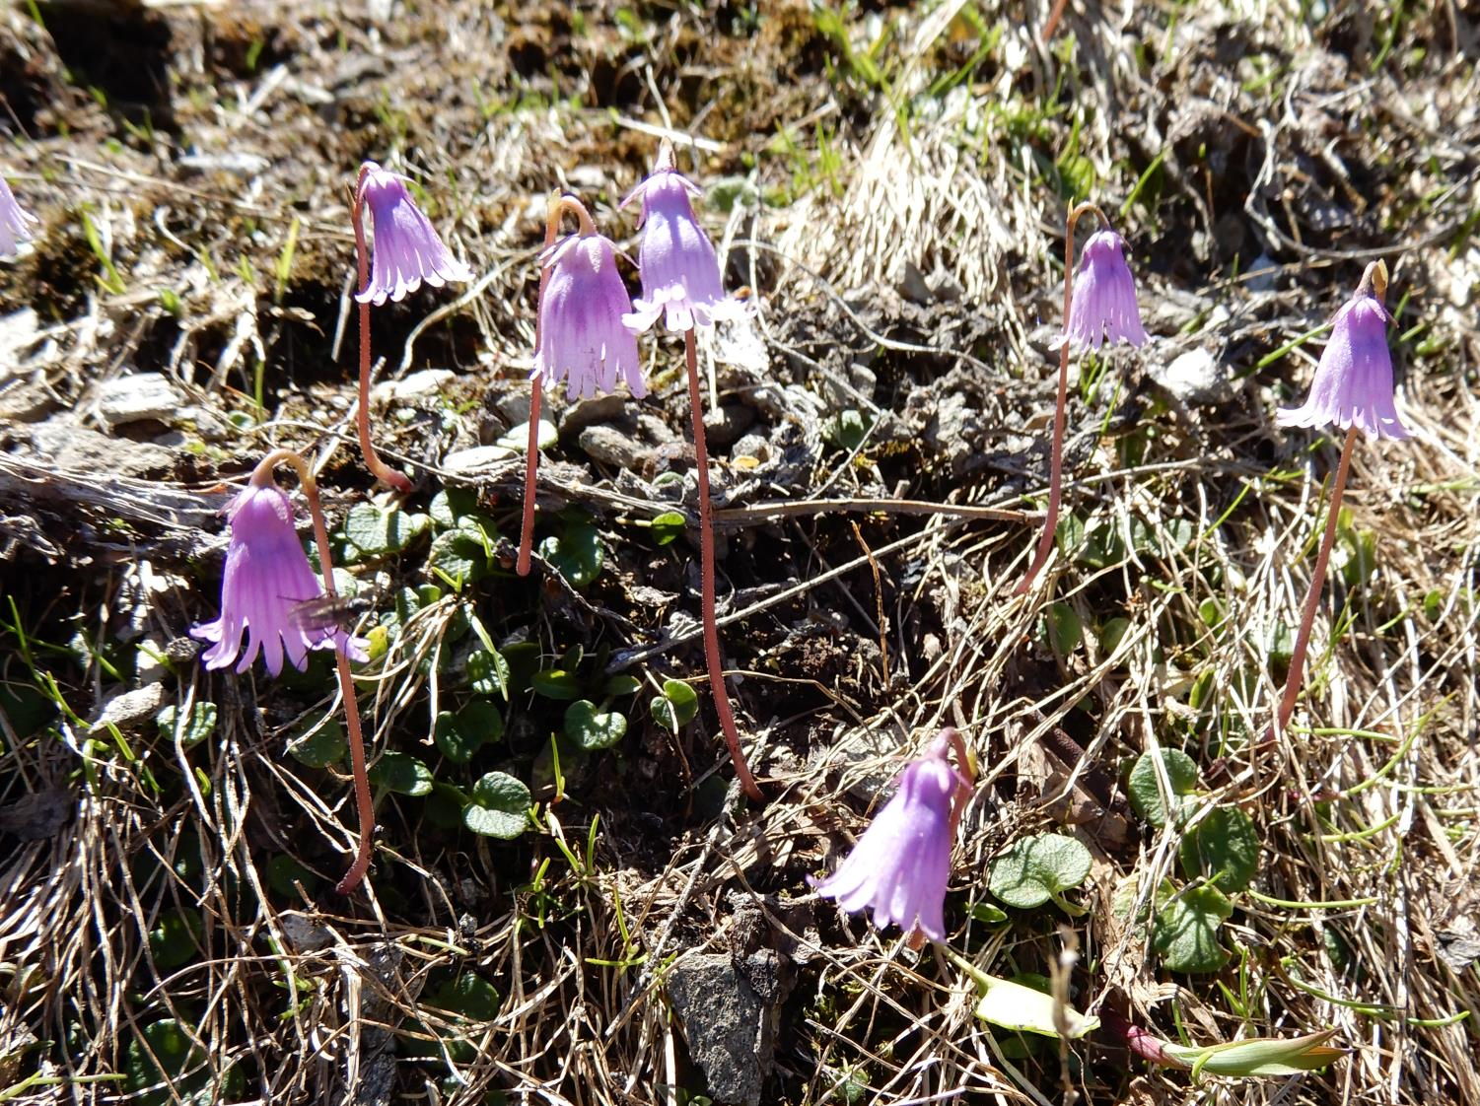
Soldanella

Slide 48
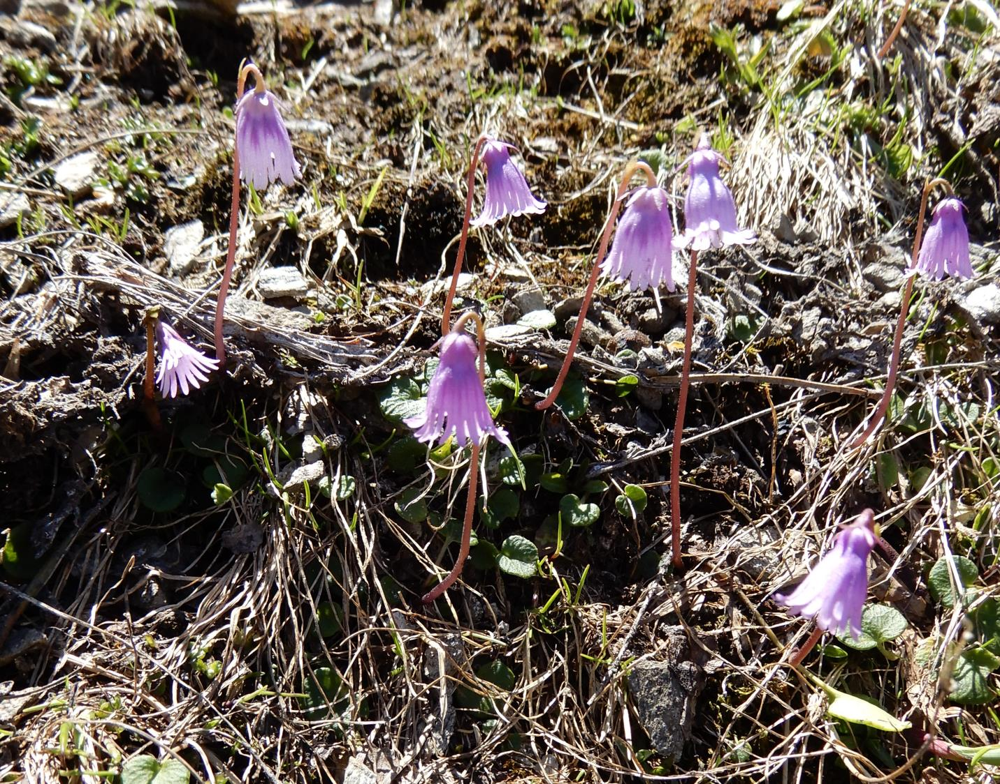

Slide 49
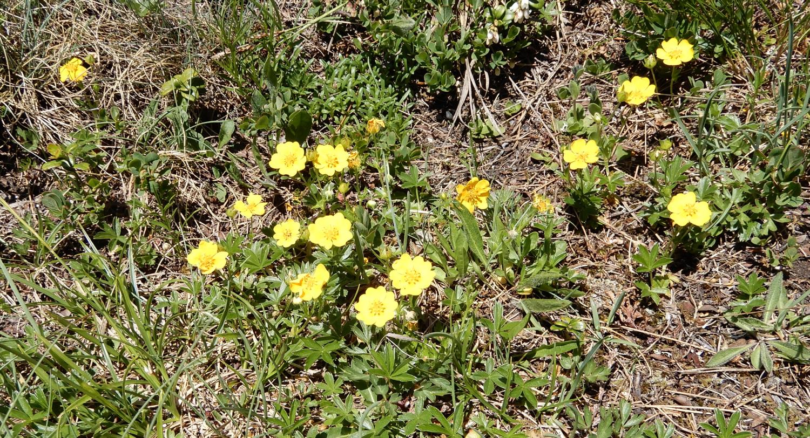
Potentilla aurea

Slide 50
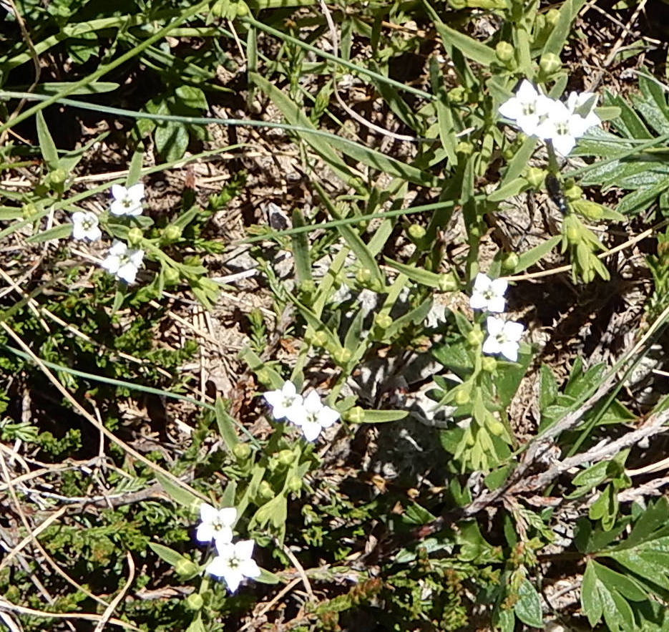
Thesium alpinum

Slide 51
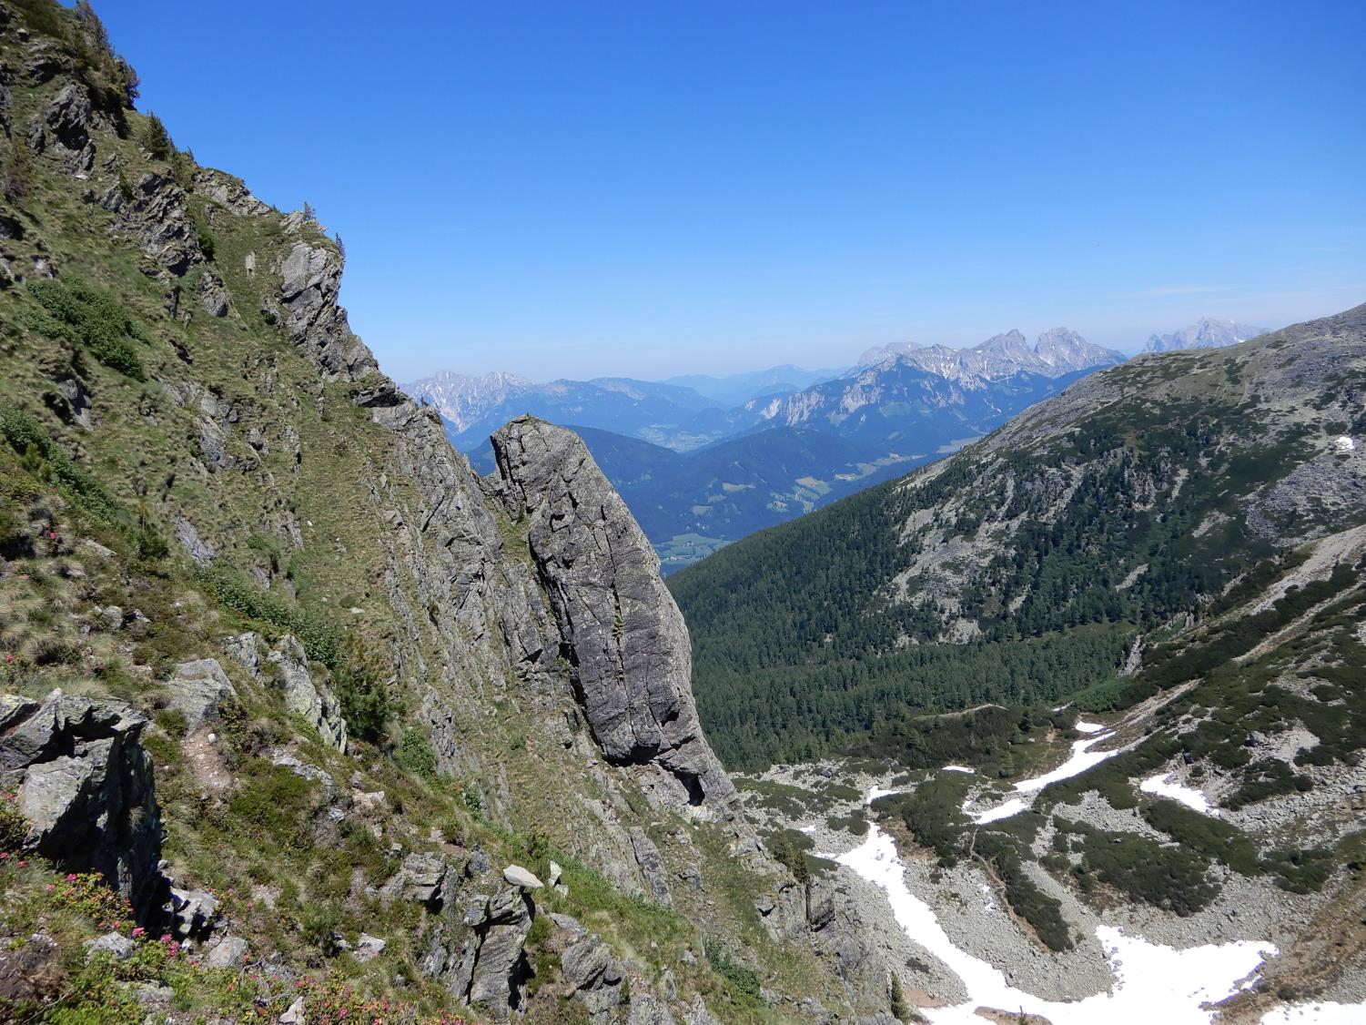

Slide 52
Pedicularis portenschlagi

Slide 54
Primula glutinosa

Slide 56
Blechnum spicant down in the spruce forest

Slide 57
Gentiana punctata

