Slide 1
Inspirations for botanical excursions 1: Totes Gebirge (Eastern Alps)
by Jan Lepš, Department of Botany, University of South Bohemia, Ceske Budejovice, Czech Republic

Slide 2
This is the first part of a series
I just want ot show interesting places for possible botanical excursions - thus they wuill include location, some plants, and possibly ecological comments, what is interesting.
Also, they are dates, so that you know, when you can see these plants.
As there is no serious science, please, take all my identification, as if they are with cf. – it is, I believe that it is this speciečs, but i am not sure

Slide 3
Part I – Around the Almsee early June 2019 We visited first the wet meadows on the shore, and then walked through the valley in direection Puhringer hutte (to the fork of the two roads), through the forests with gravel bars caused by melting water flows

Slide 4
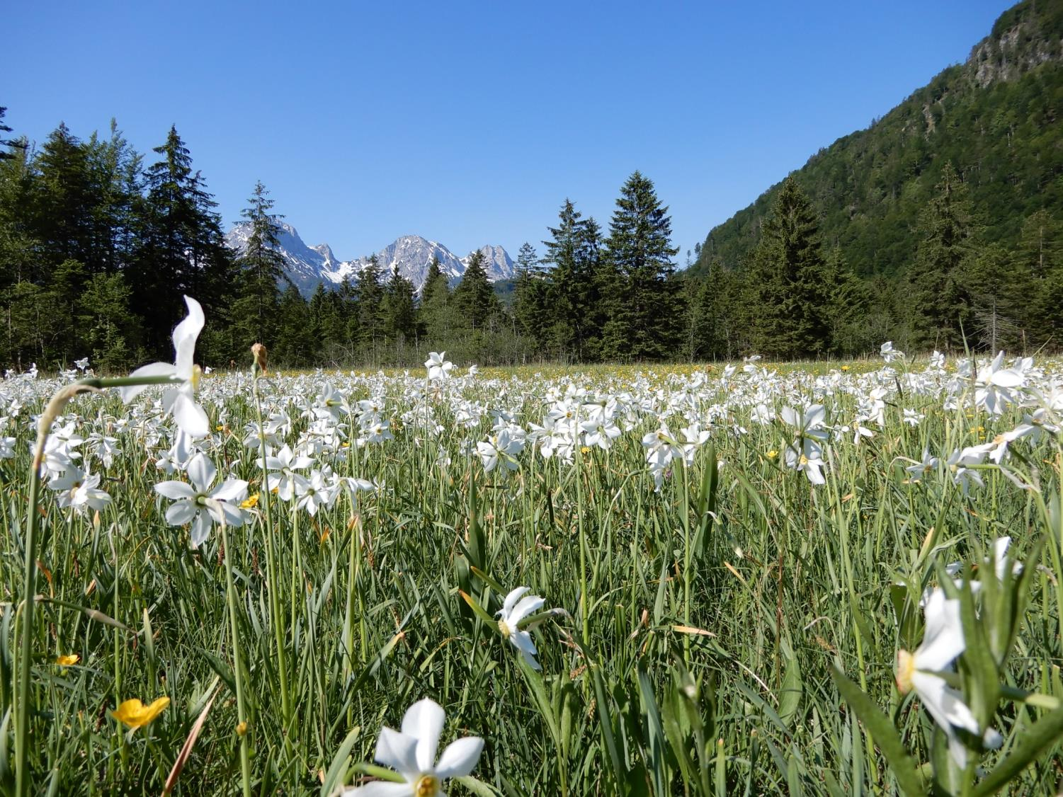
When you approach the Almsee (from A9, before reaching the parking place at the Almsee, you pas nice wet meadows – with nice growth of Narcissus poeticus s.l.

Slide 5
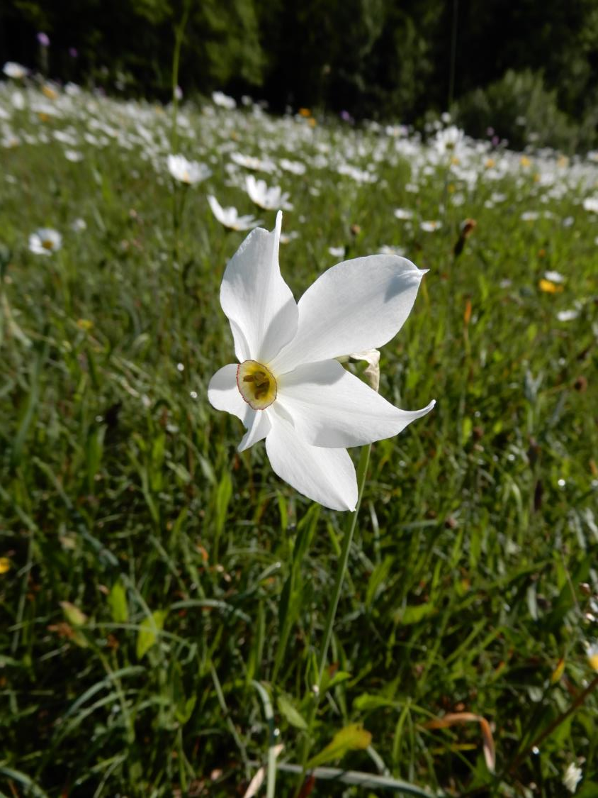

Slide 6
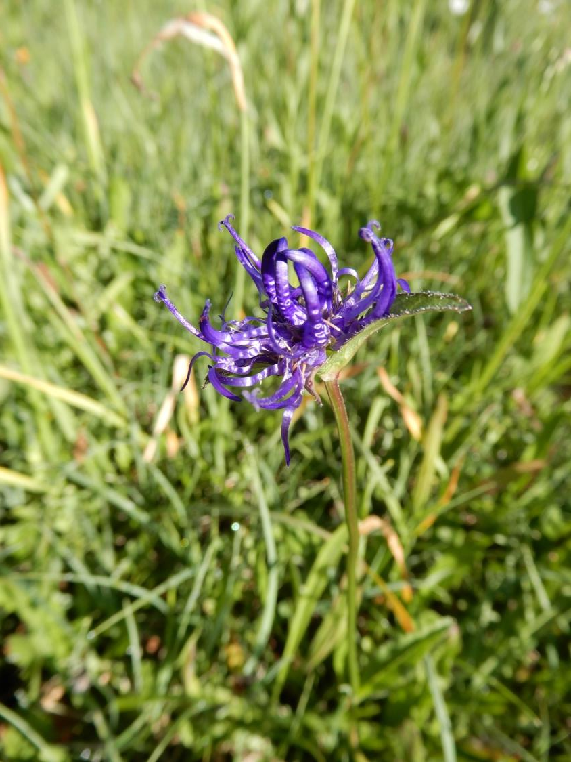
Phyteuma orbiculare

Slide 7
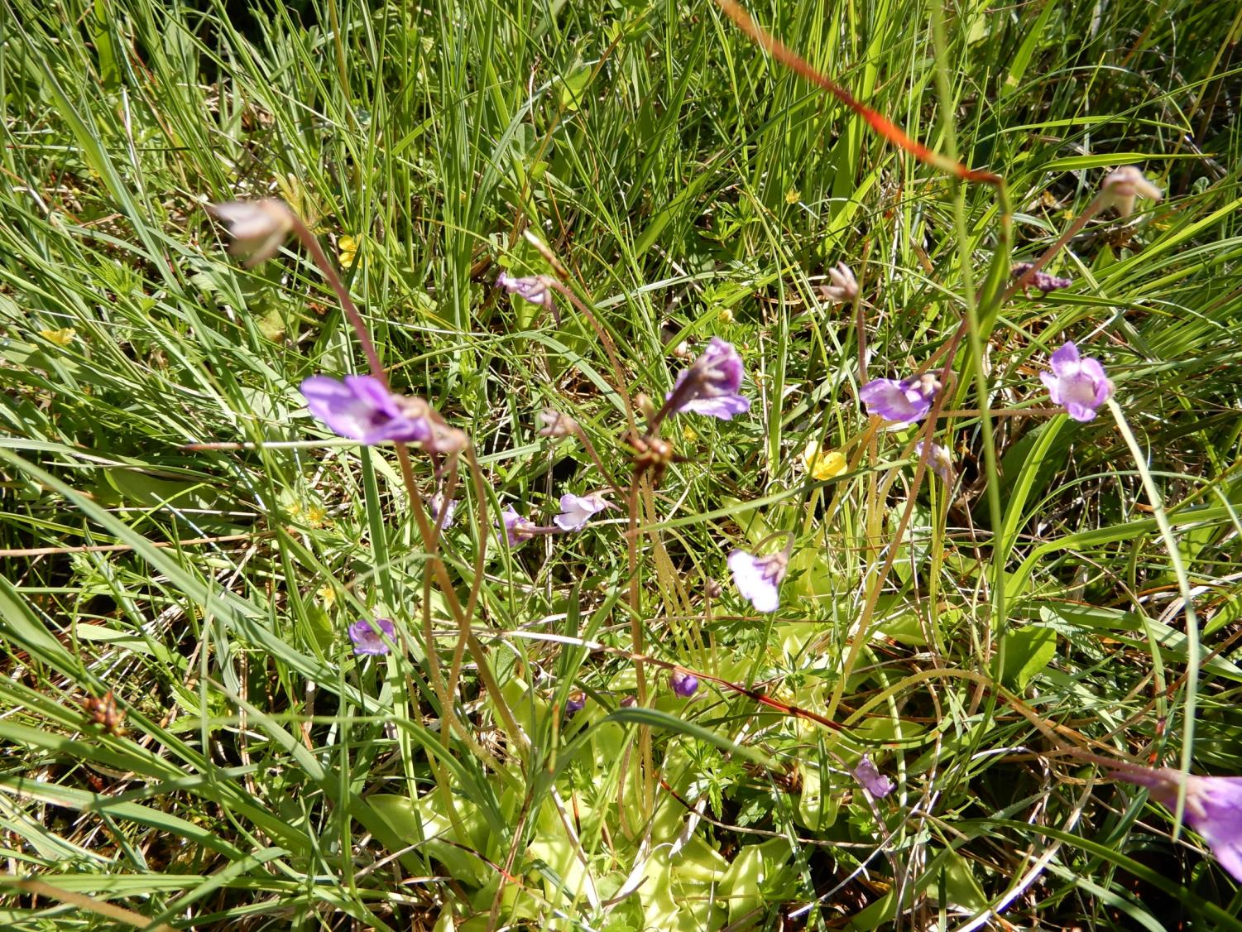
Pinguicula vulgaris

Slide 8
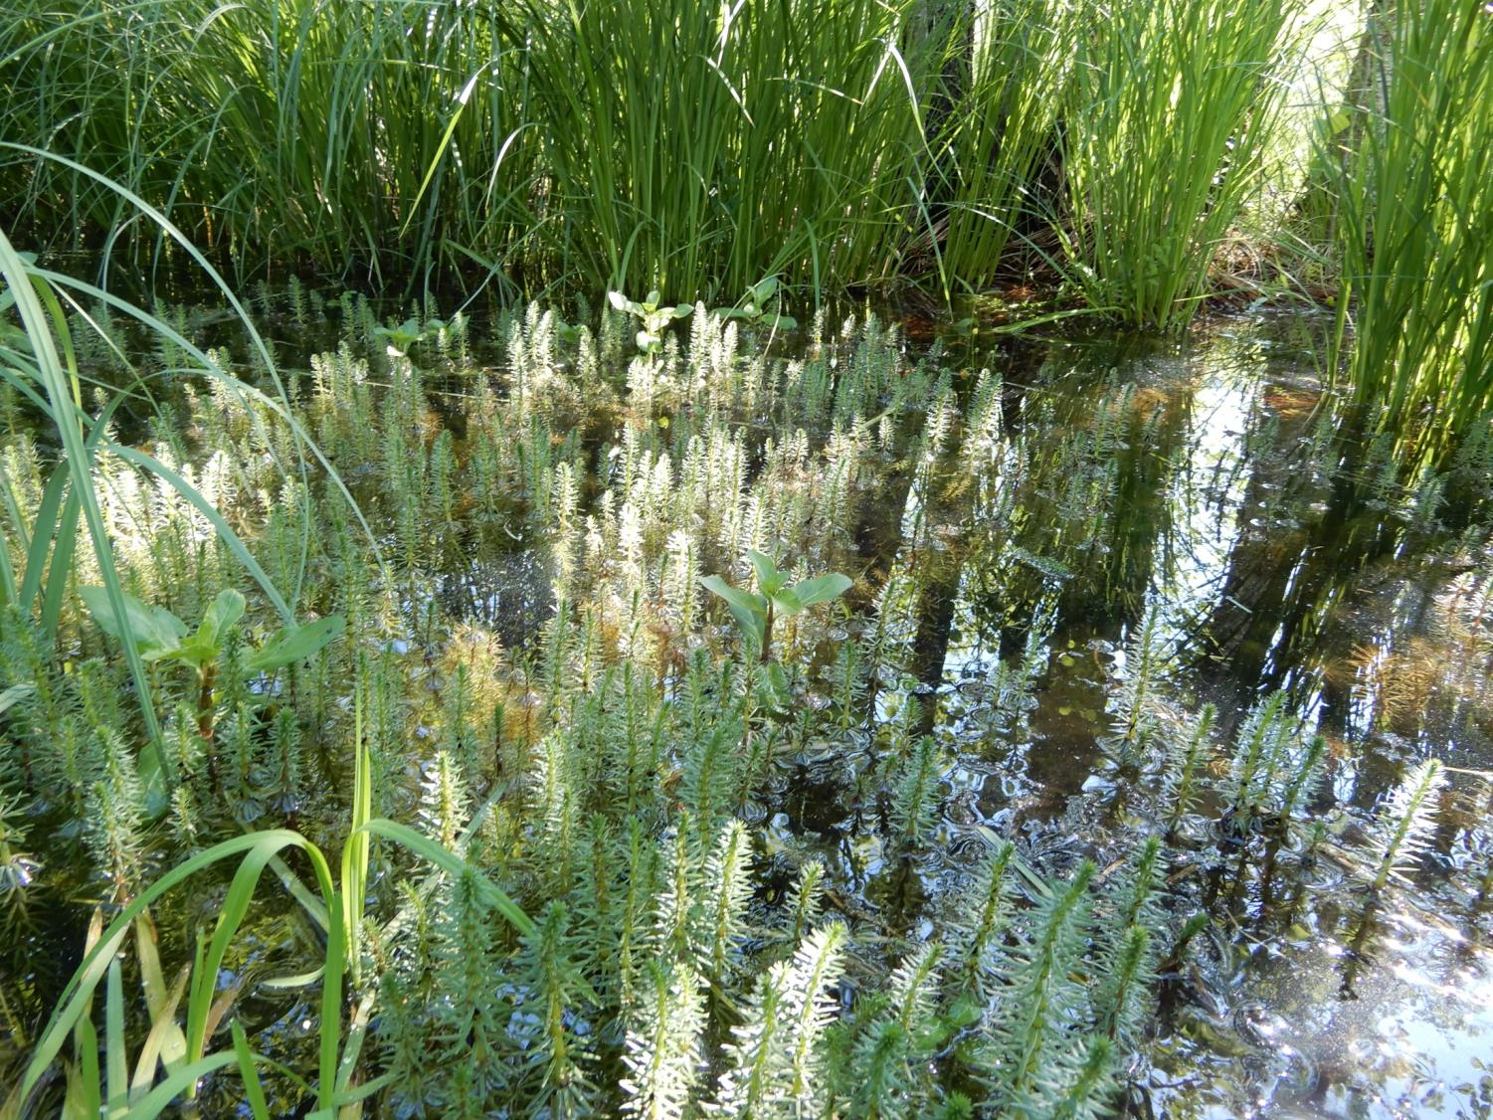
In the ditches of the lake Almsee, Hippuris vulgaris

Slide 9
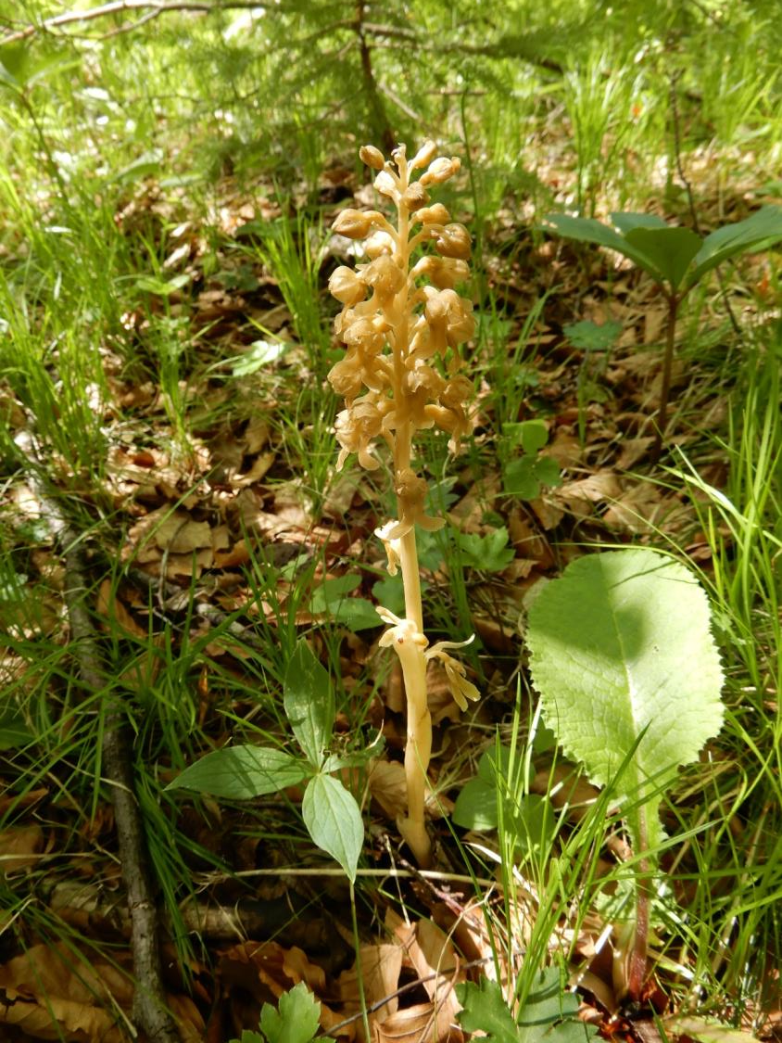
Forest above the lake are full of orchids
Neotia nidus-avis

Slide 10
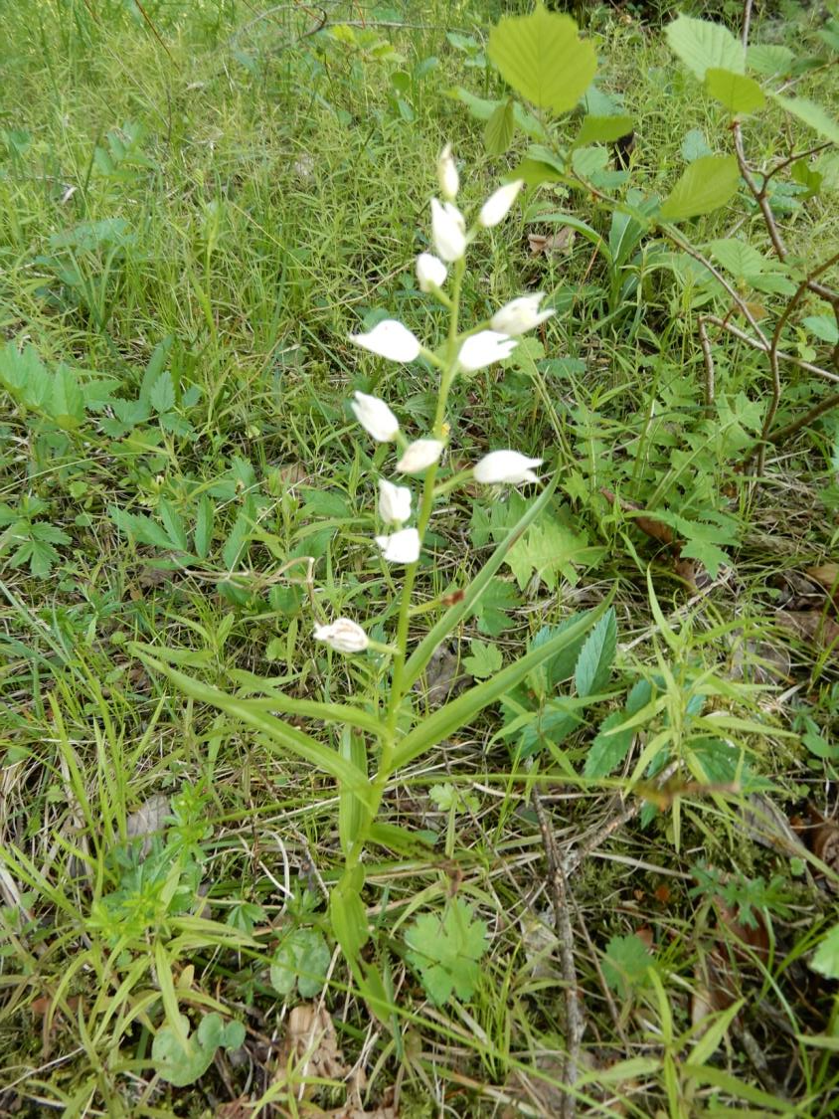
Cephalanthera ensifolia

Slide 11
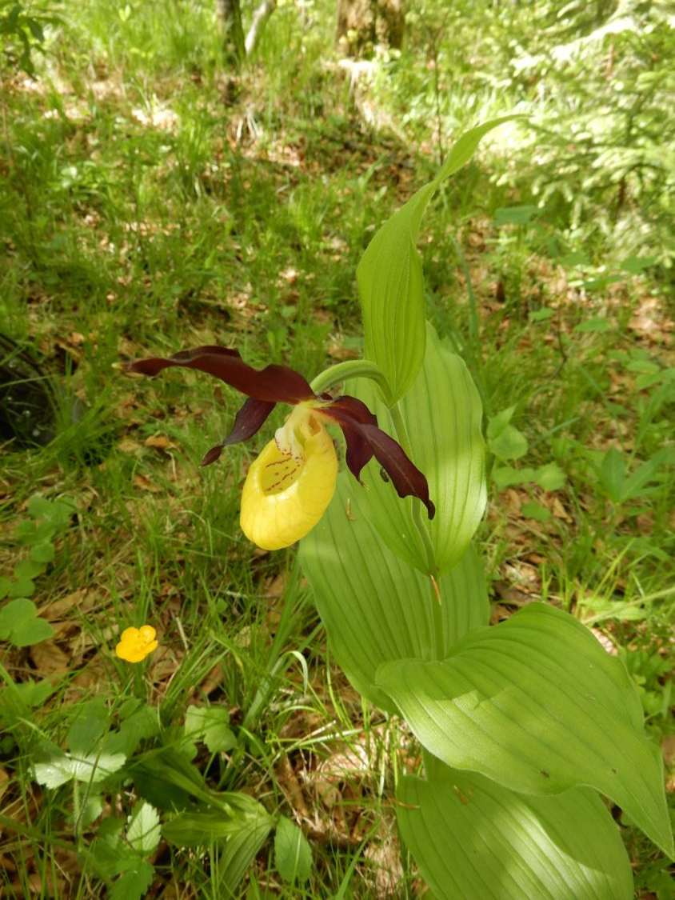
Common Cypripedium calceolus

Slide 12
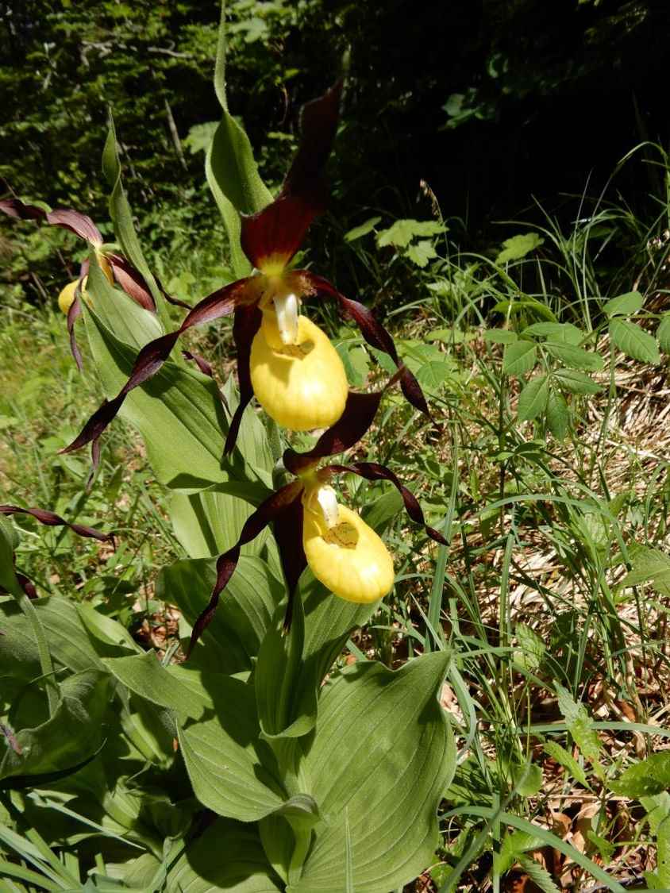

Slide 13
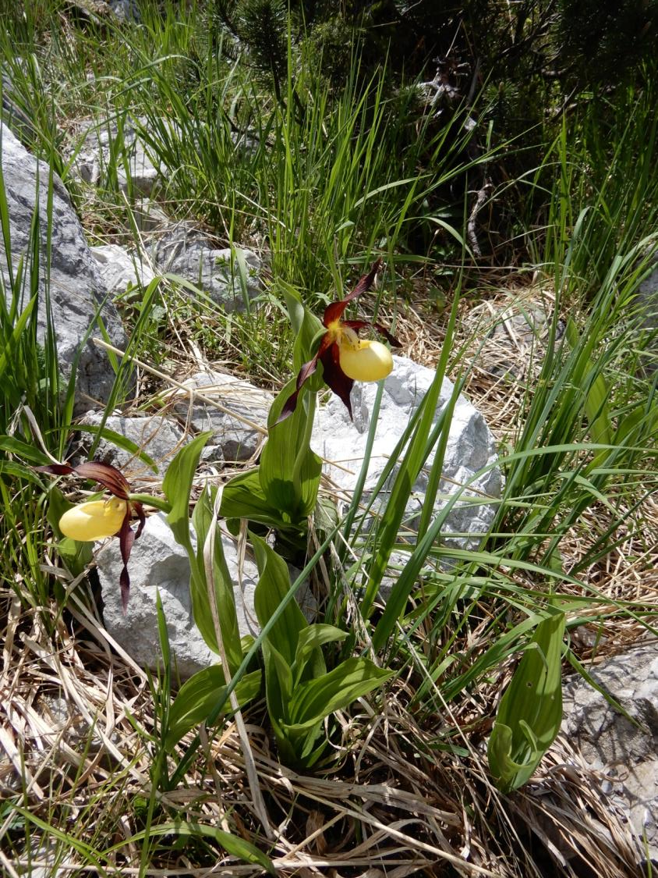
Growing even in gravel bars in the periodic river bad

Slide 14
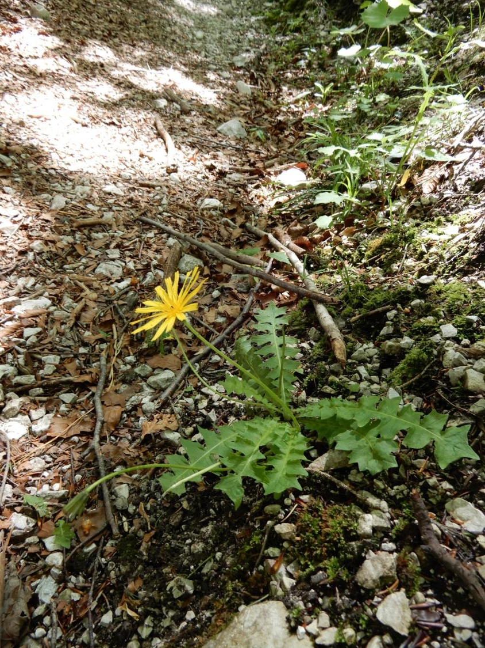
Aposeris foetida

Slide 15
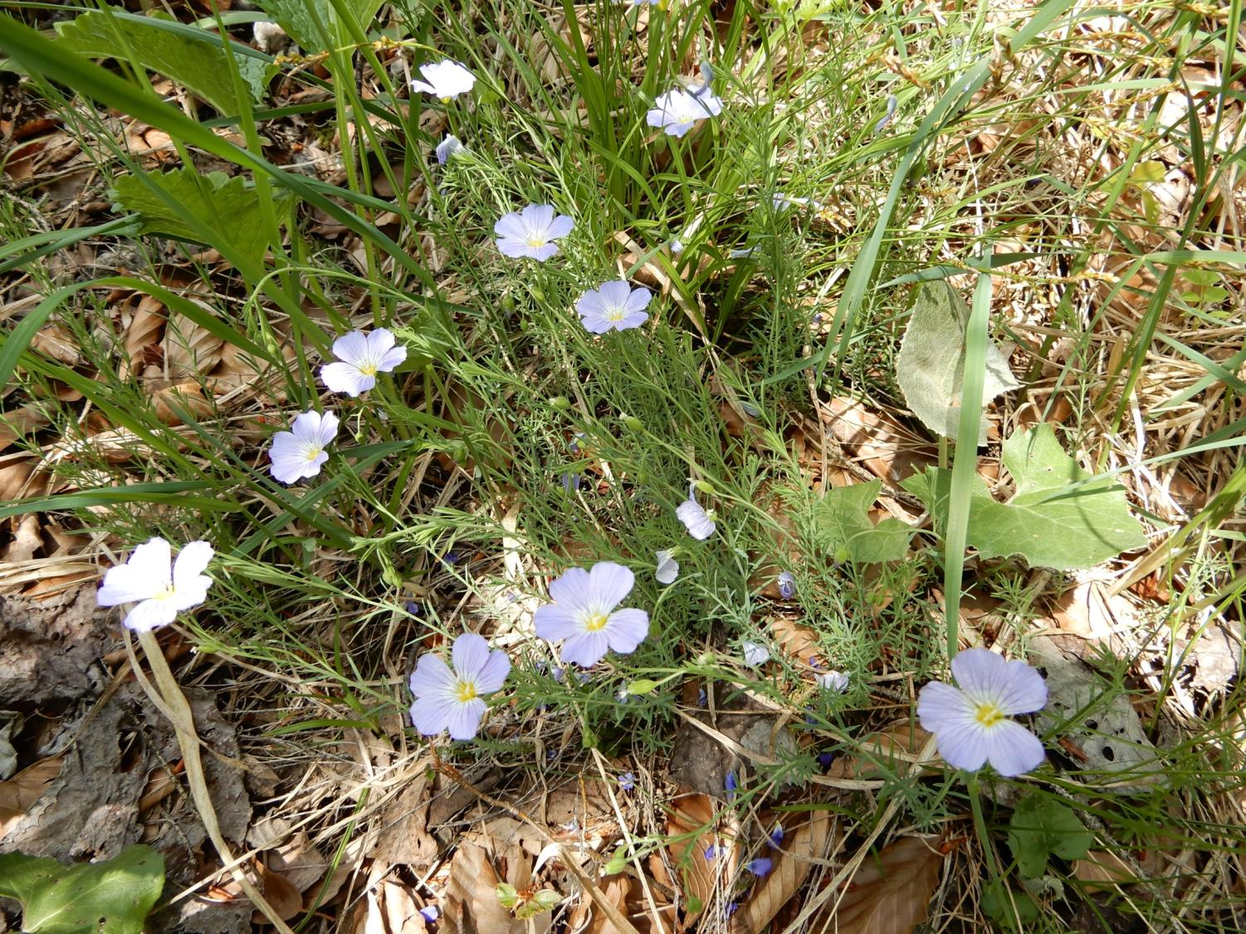
Linum extraaxilare (perenne subsp. Extraaxilare)

Slide 16
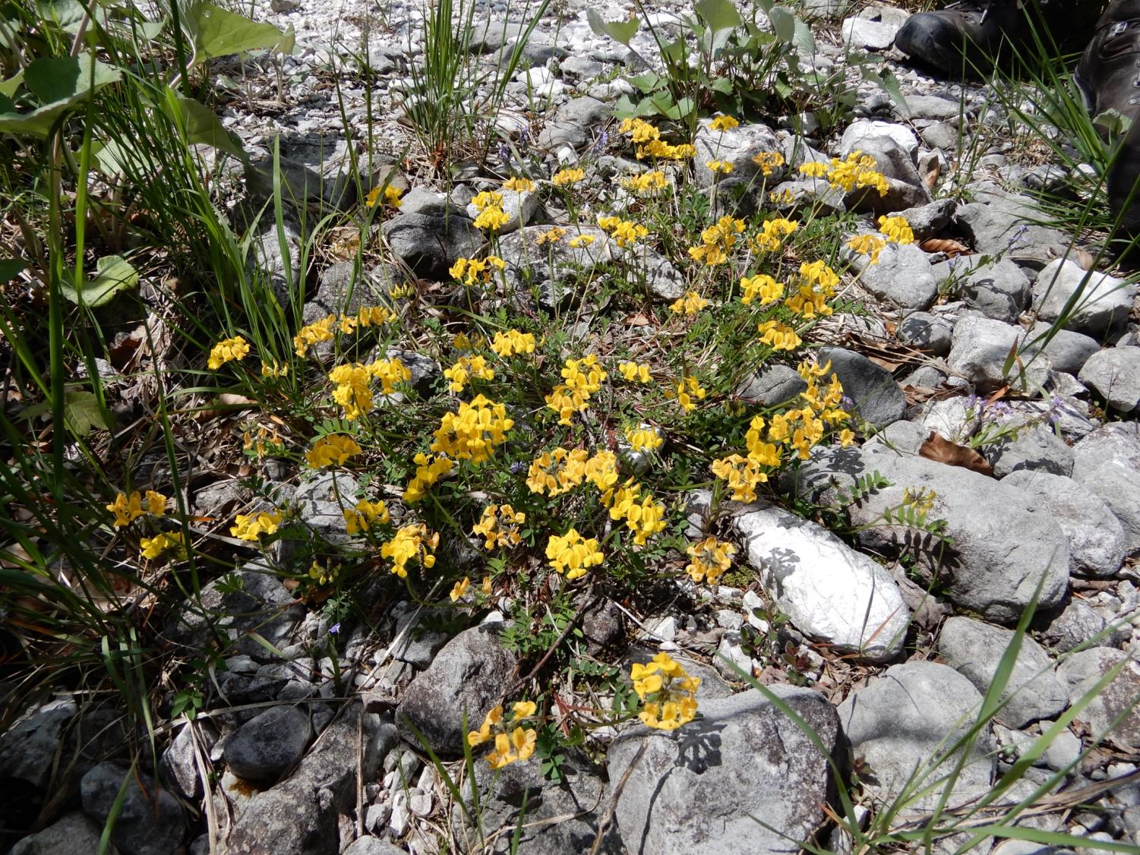
Hippocrepis comosa

Slide 17
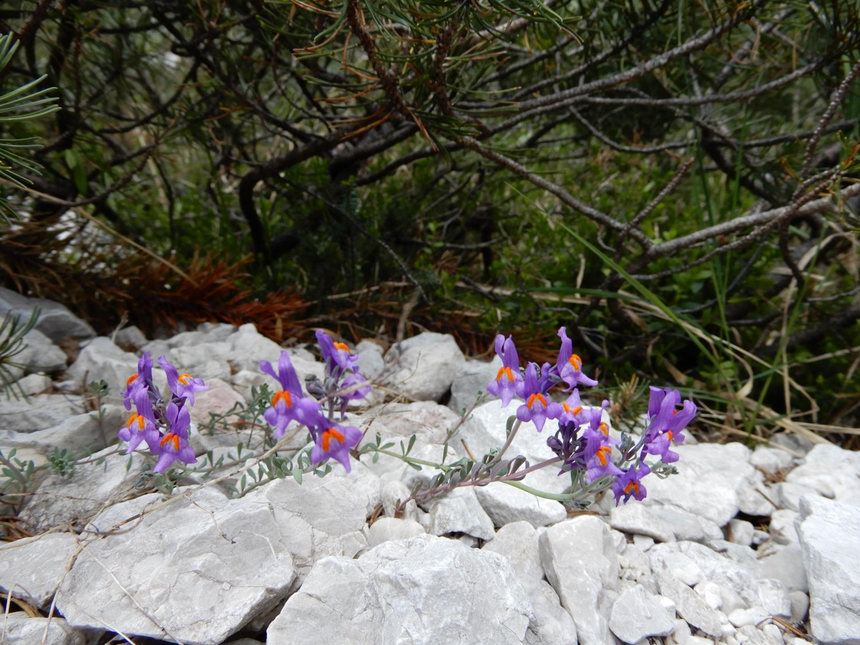
Linaria alpina

Slide 18
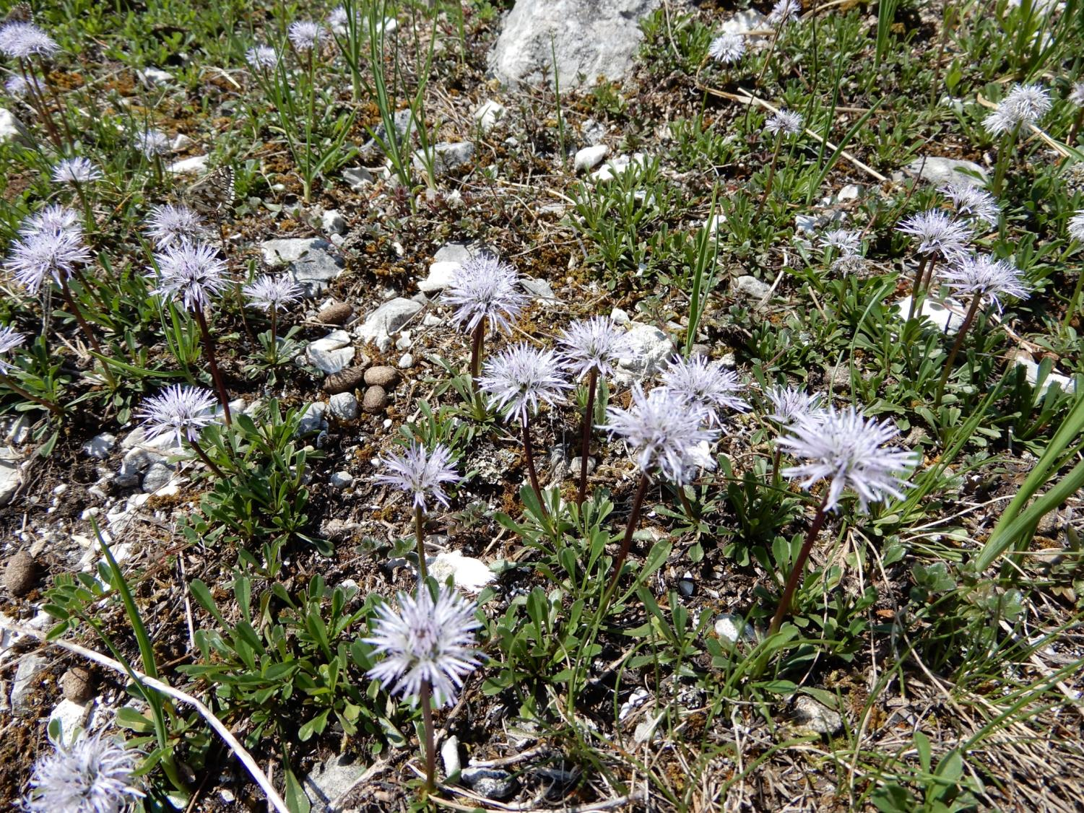
Globularia cordifolia

Slide 19
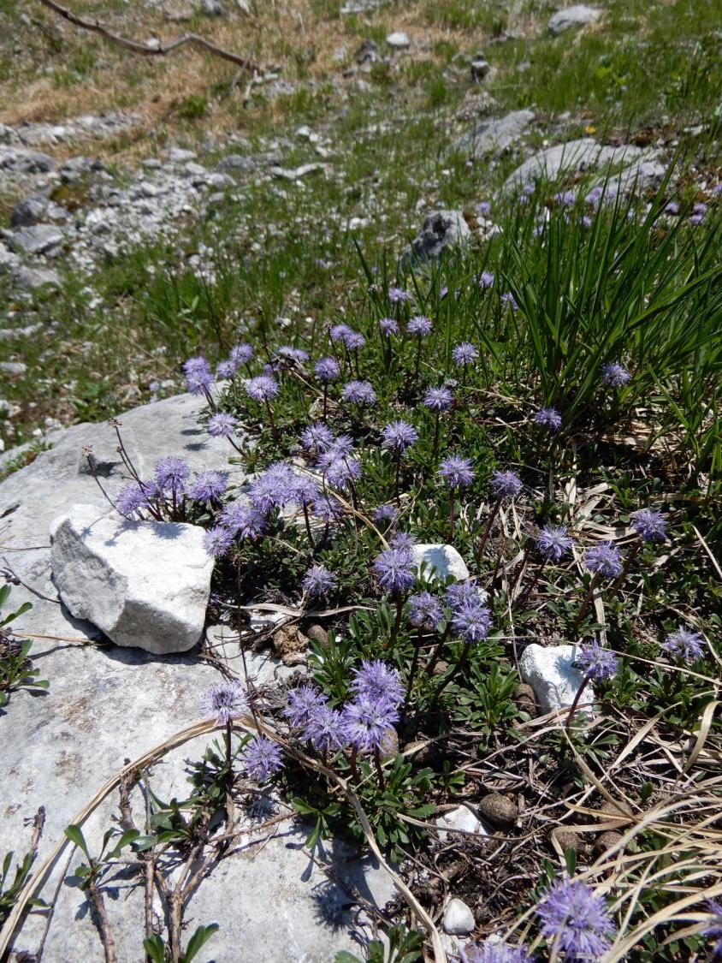

Slide 20
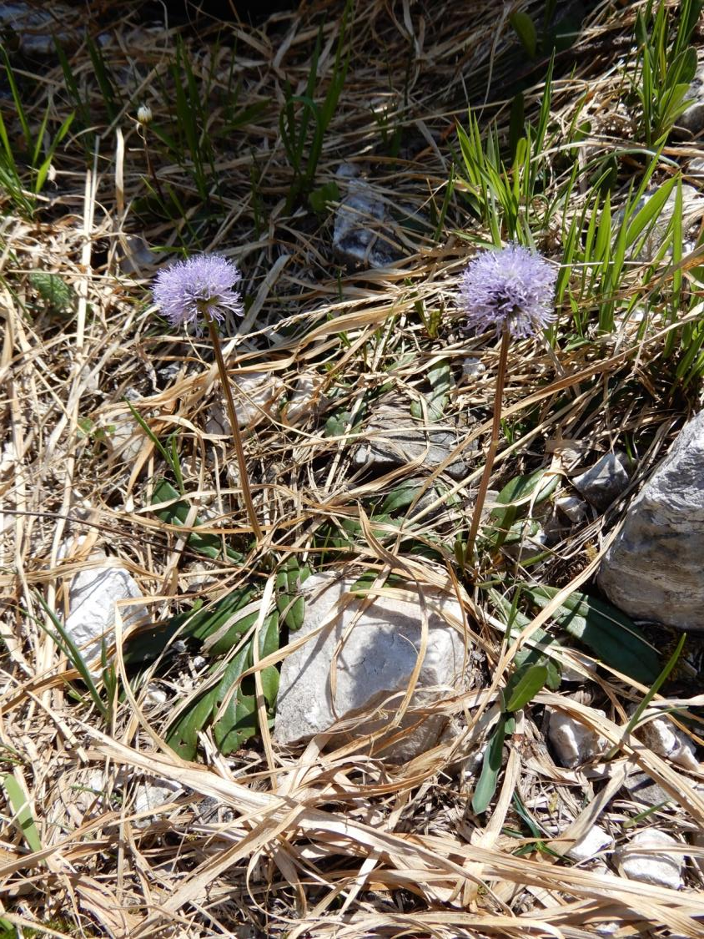
Globularia nudicaulis

Slide 21
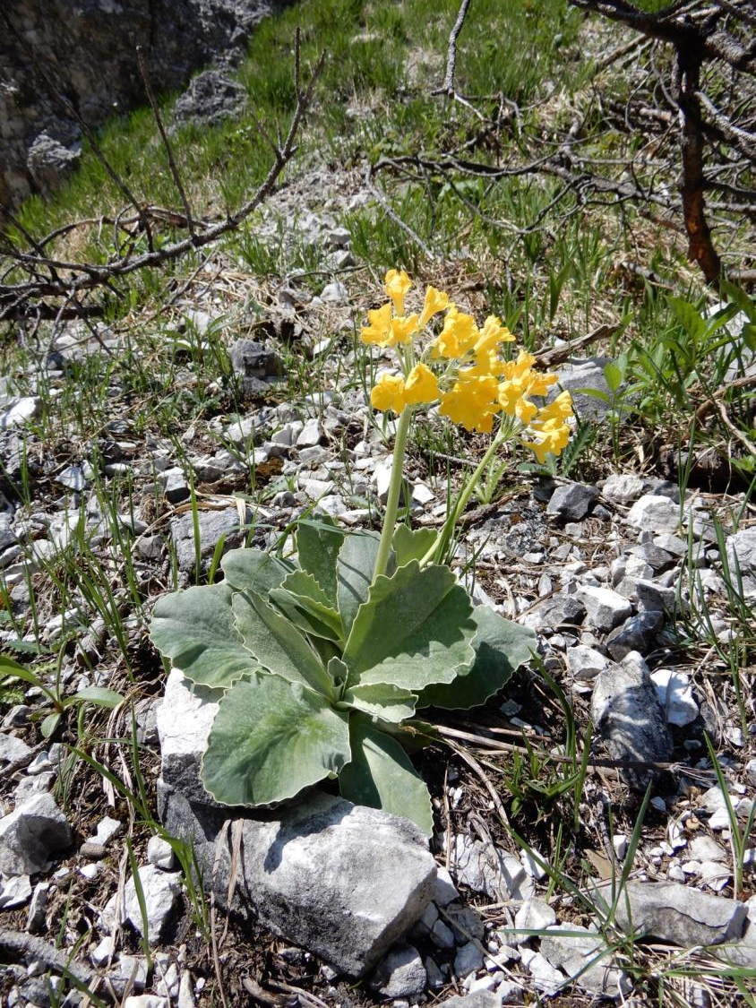
Primula auricula

Slide 22
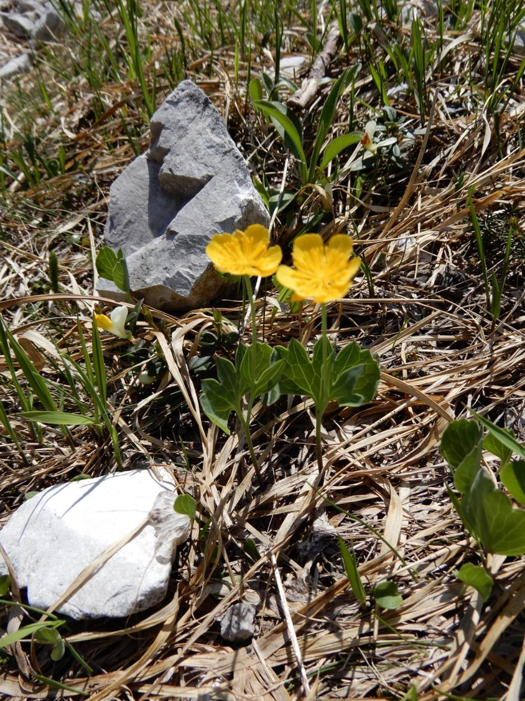
Ranunculus hybridus

Slide 23
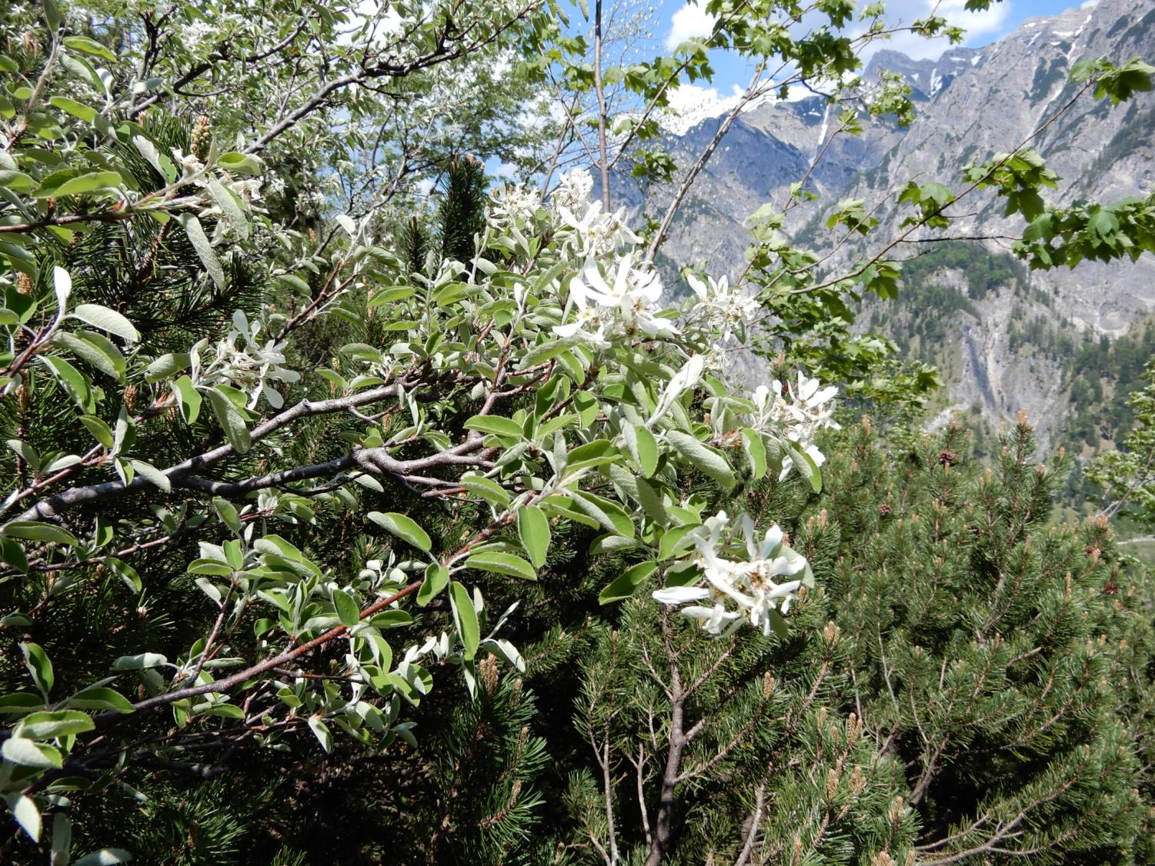
Amelanchier ovalis

Slide 24
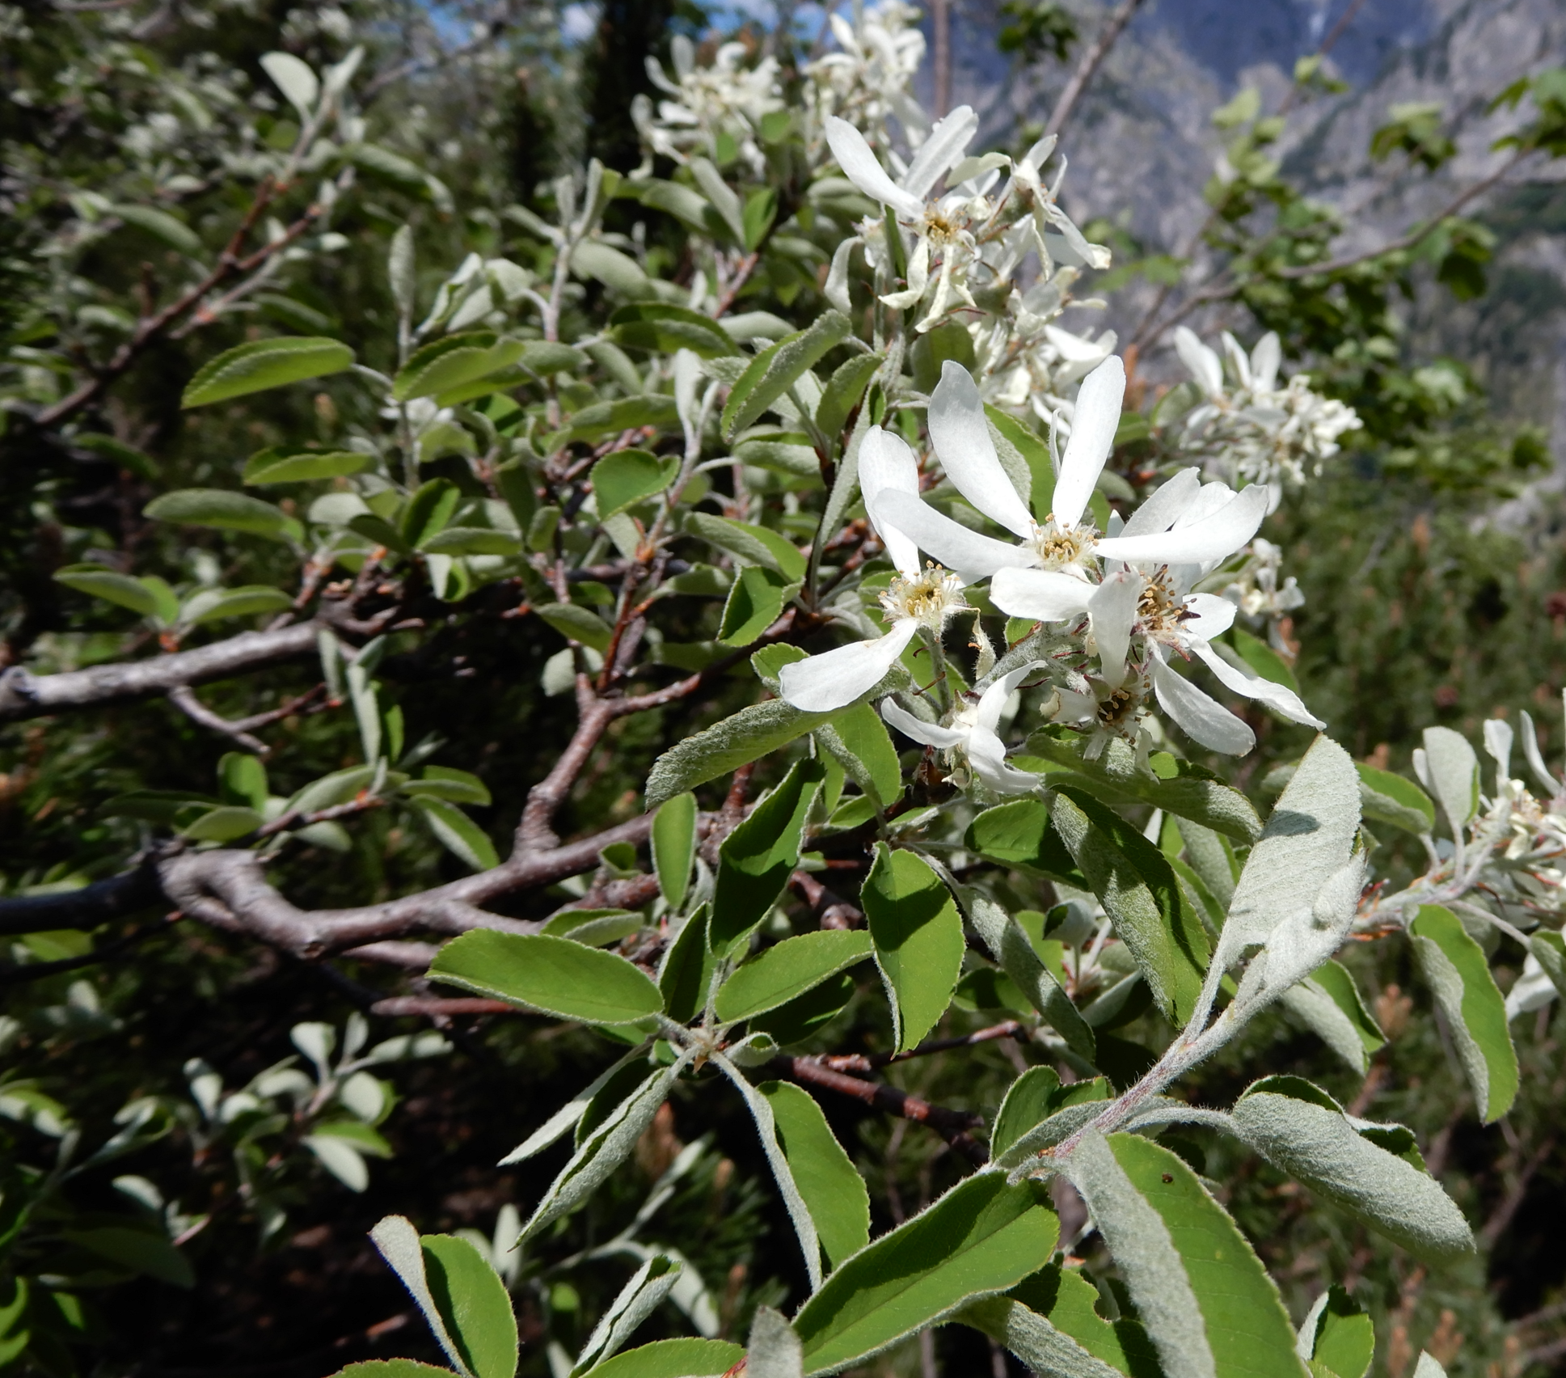

Slide 25
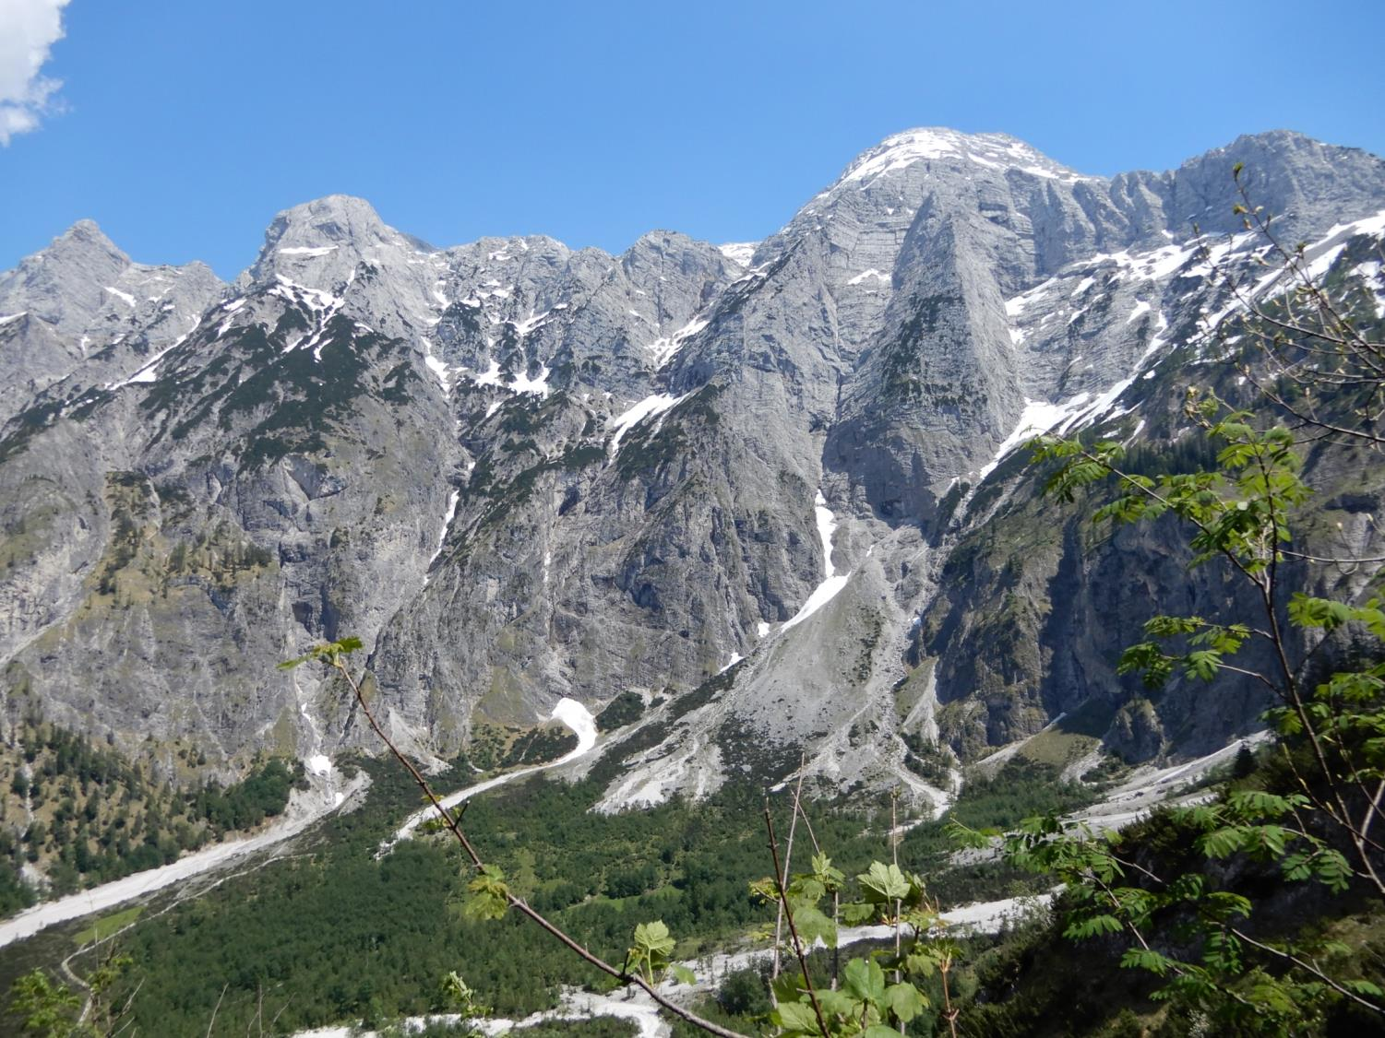

Slide 26
Part II
From Hinterstoder to Prielschutzhaus and back (early June)

Slide 27
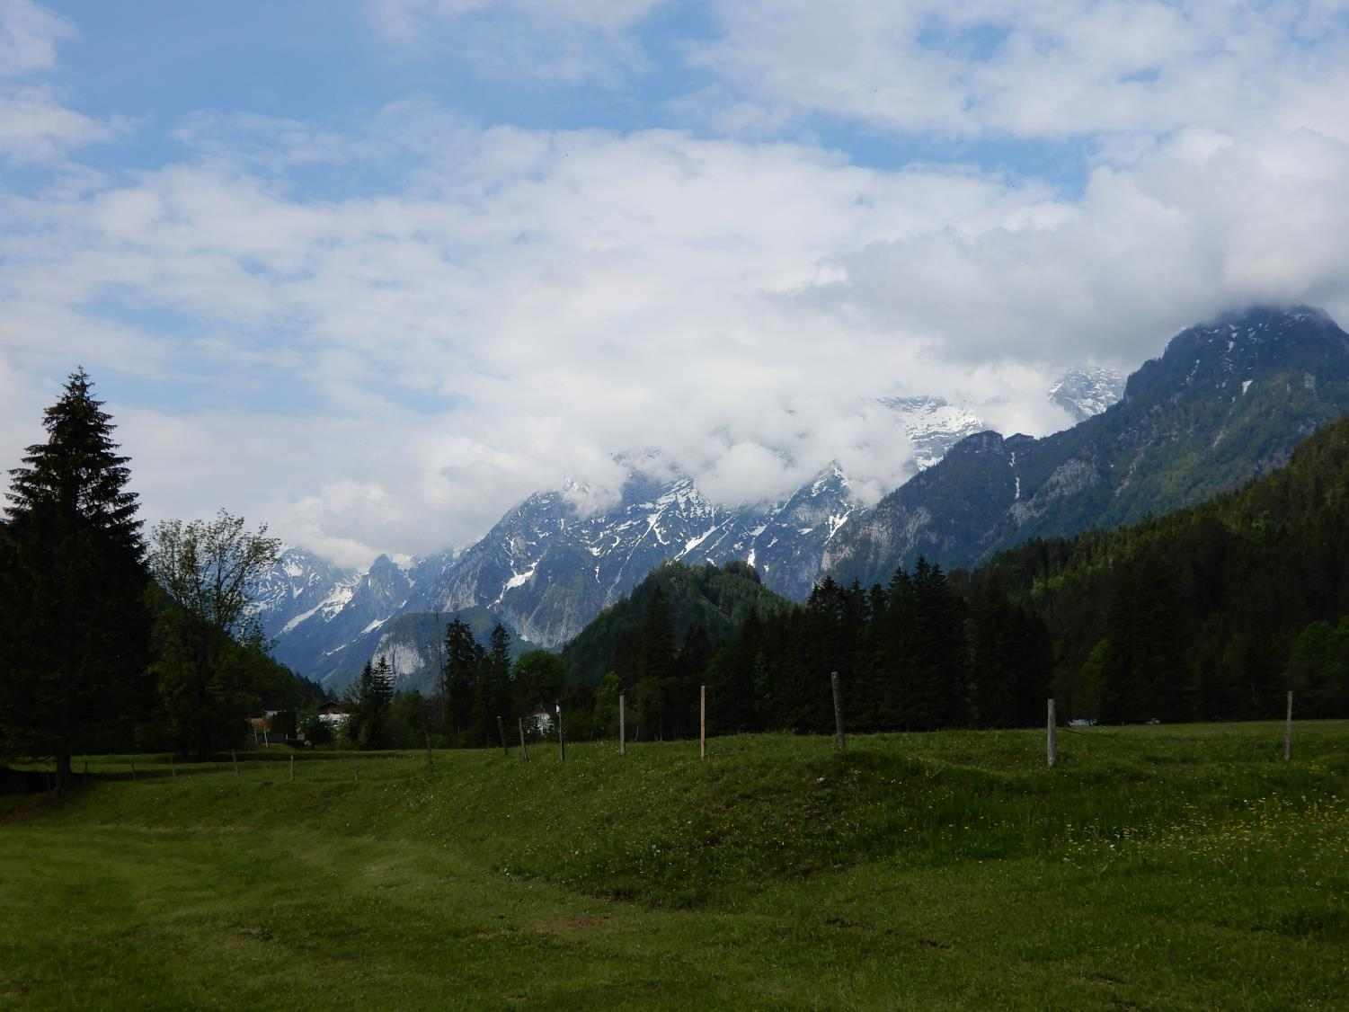

Slide 28
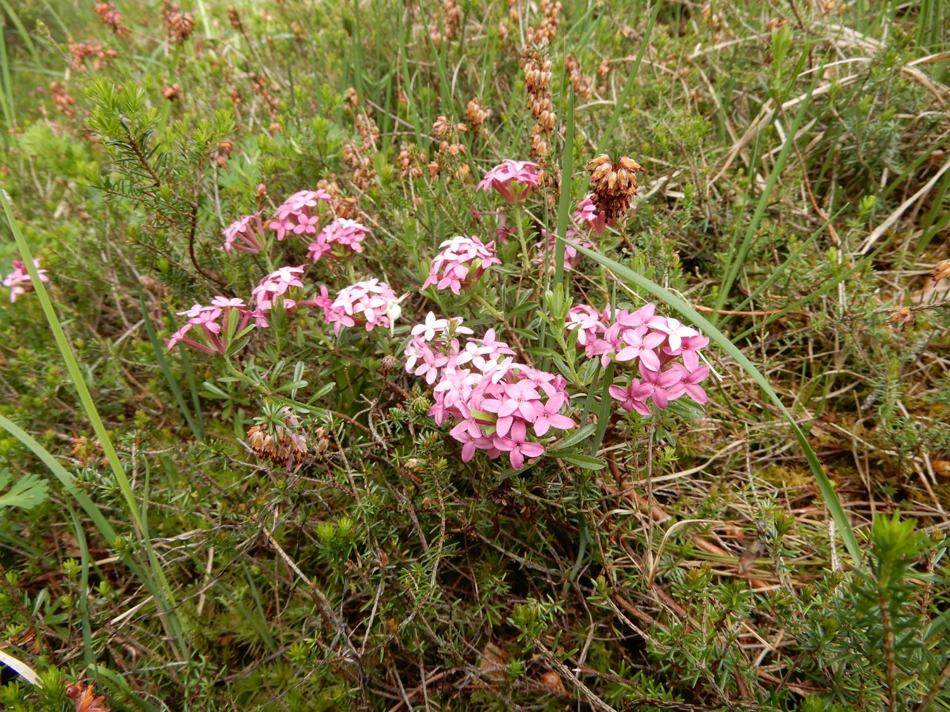
Daphne cneorum

Slide 29
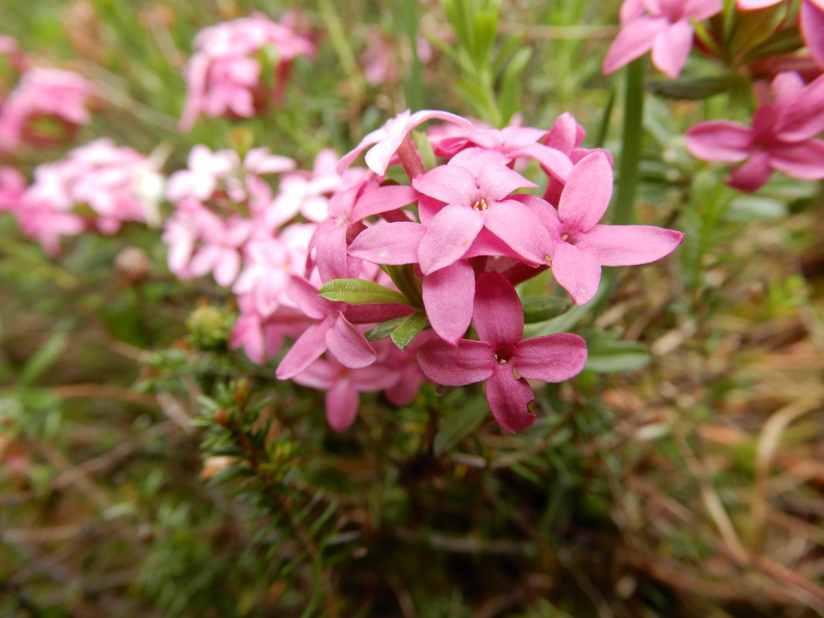

Slide 30
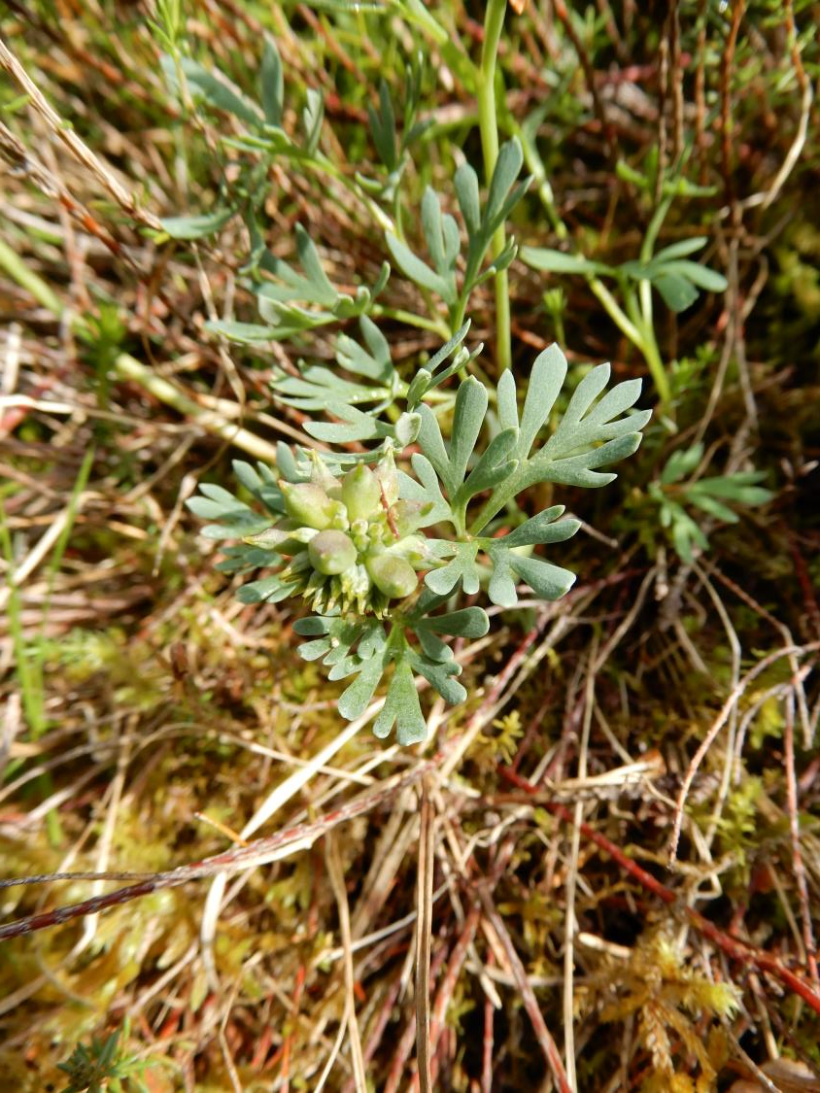
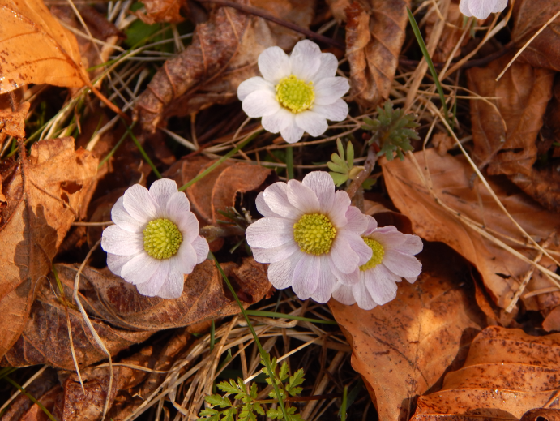
Callianthemum anemonoides
Picture from April

Slide 31
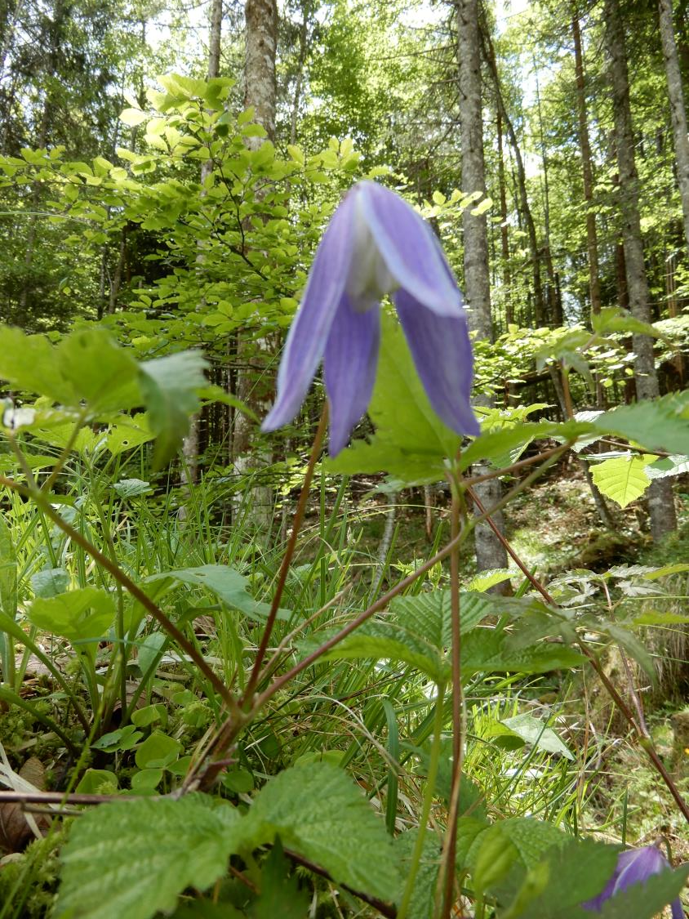
Clematis (Atragene) alpina

Slide 32
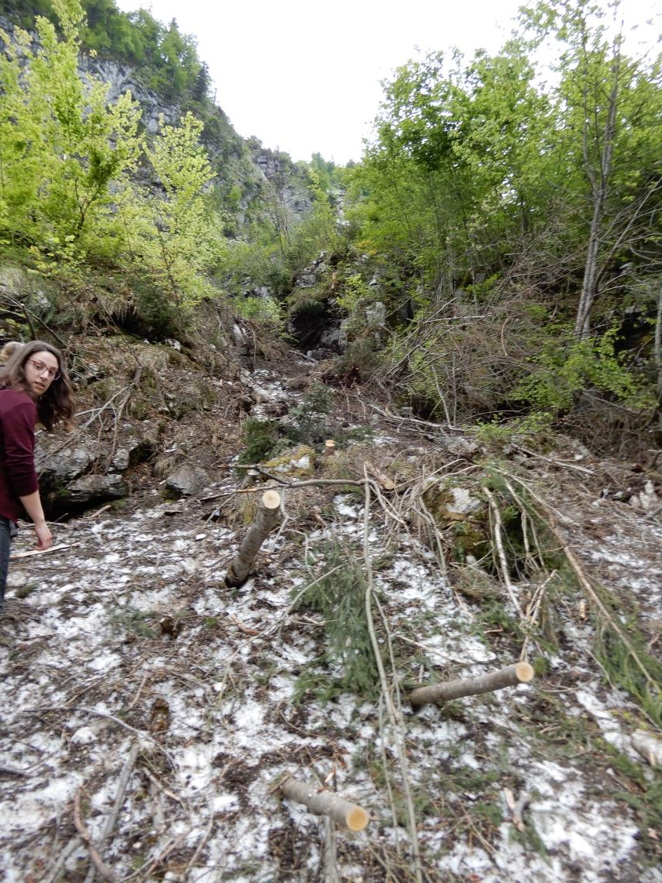
When you go to the Prielschutzhaus, you will pass remnants of several large avalanches, with large amount of snow remaining in the valleys. This would be ideal place for placing permanent plots to follow the successional dynamic of vegetation. In few next slides, you see the damage by these avalanches.

Slide 33
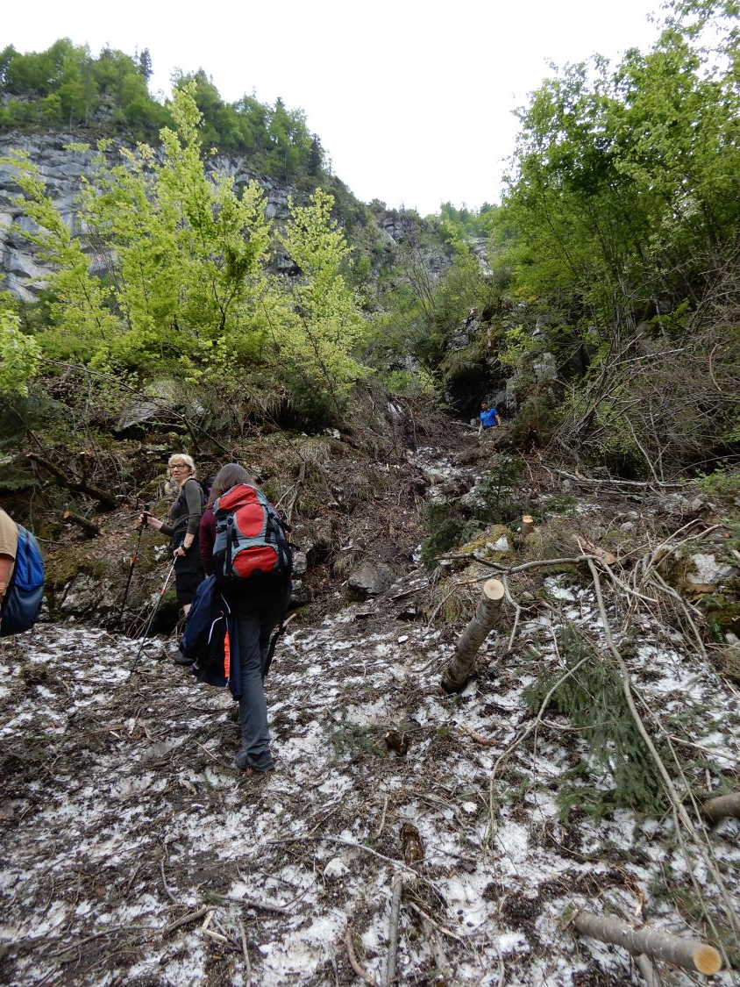

Slide 34
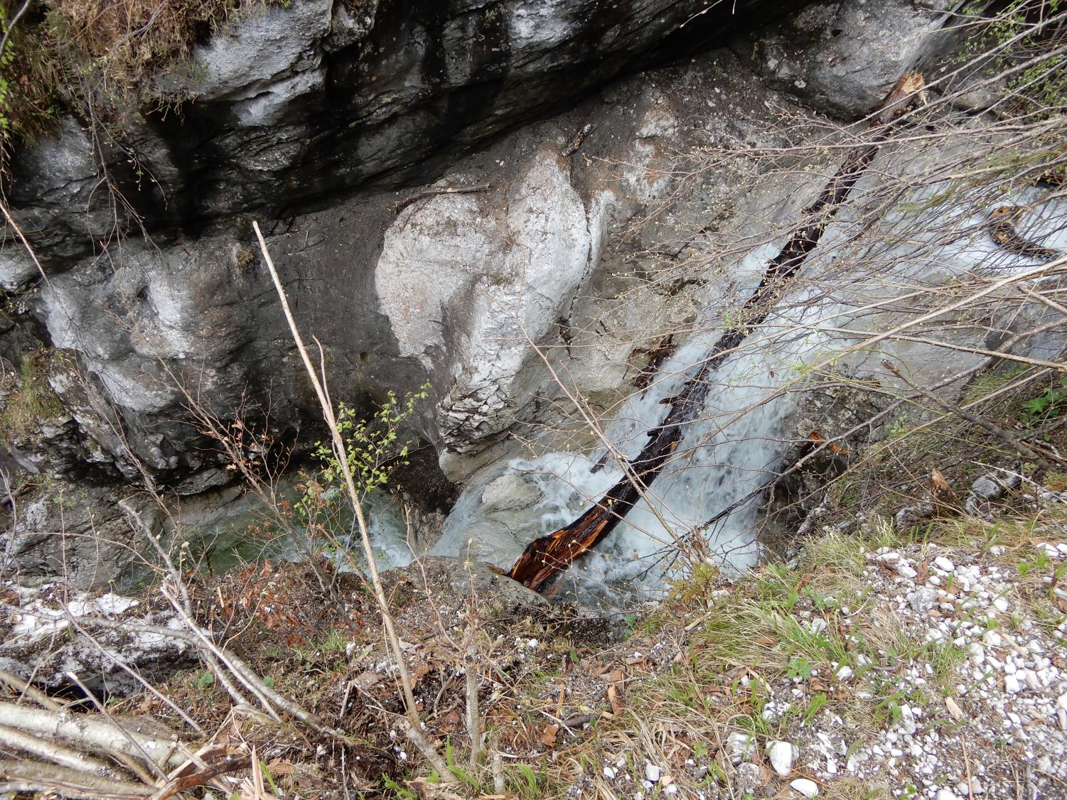

Slide 35
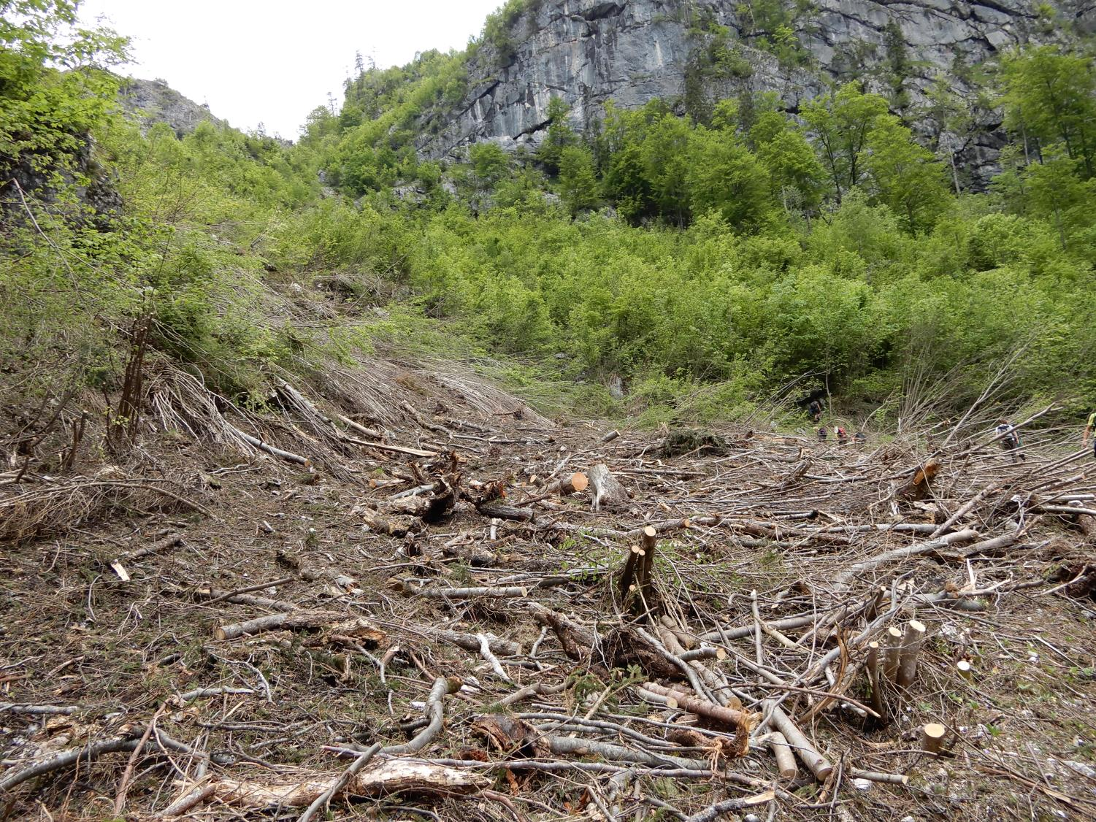

Slide 36
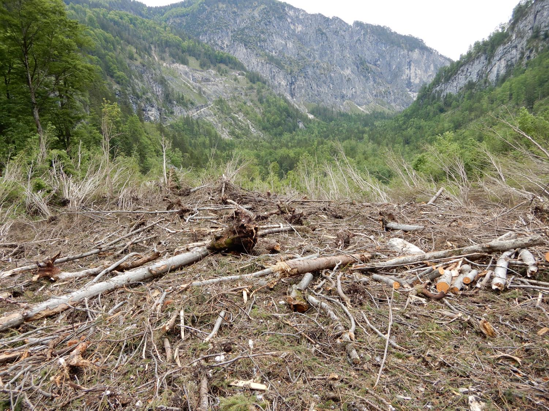

Slide 37
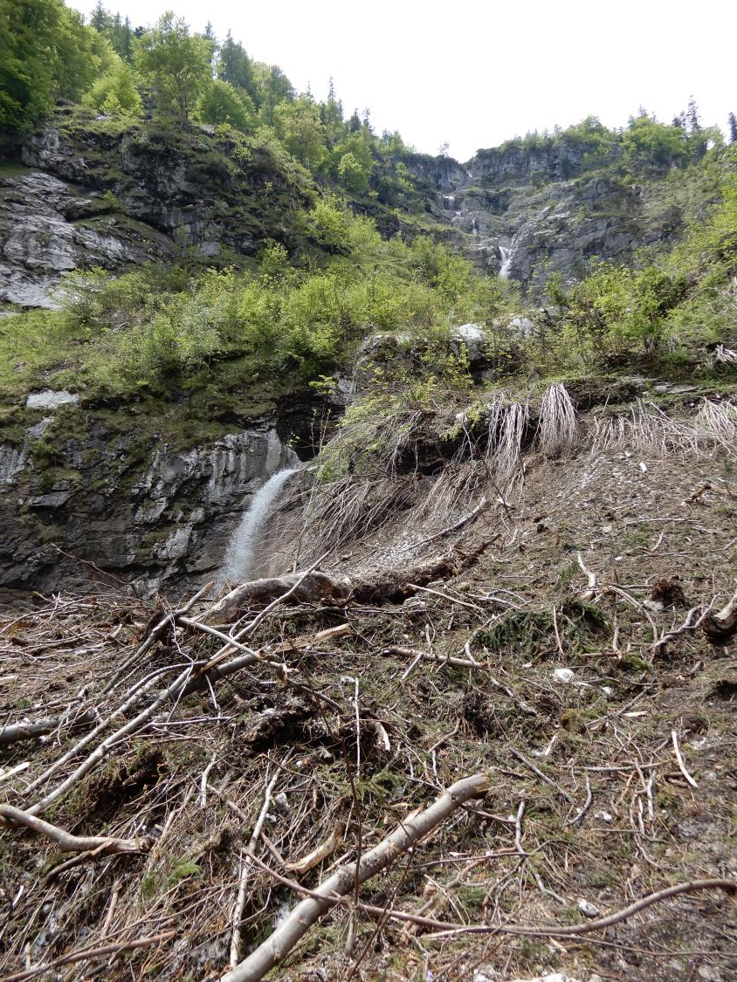

Slide 38
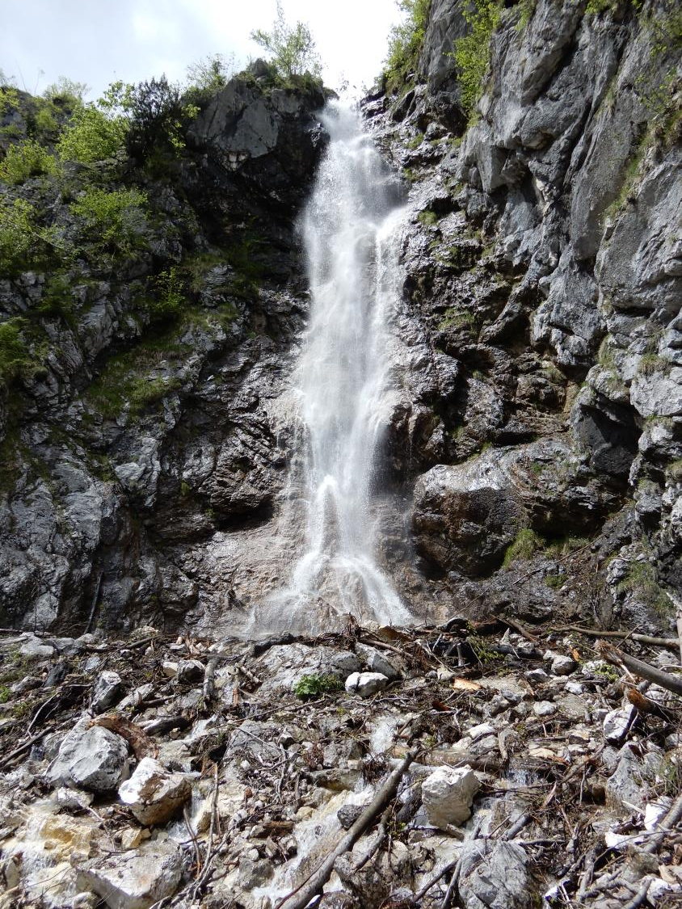

Slide 39
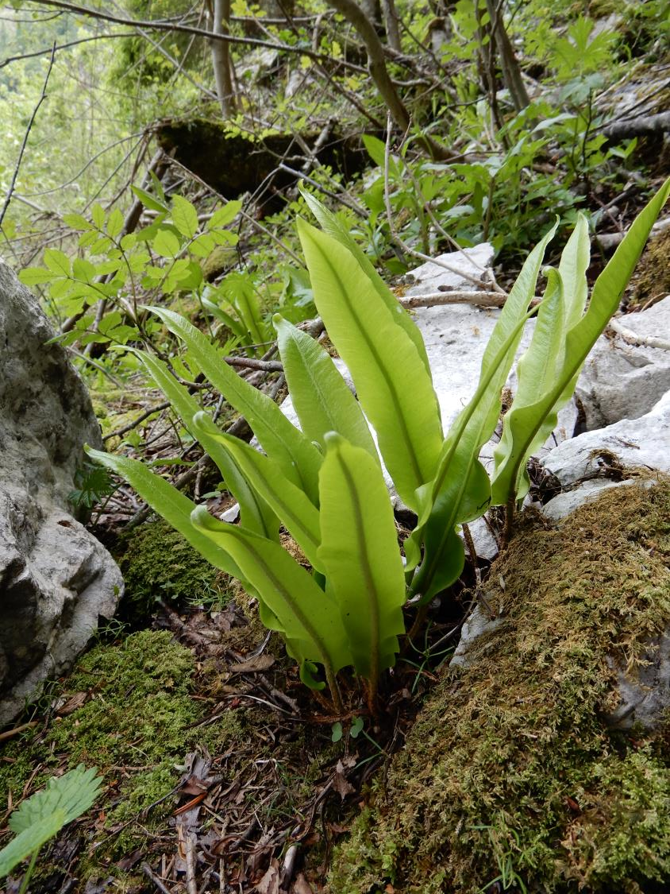
Phyllitis scolopendrium

Slide 40
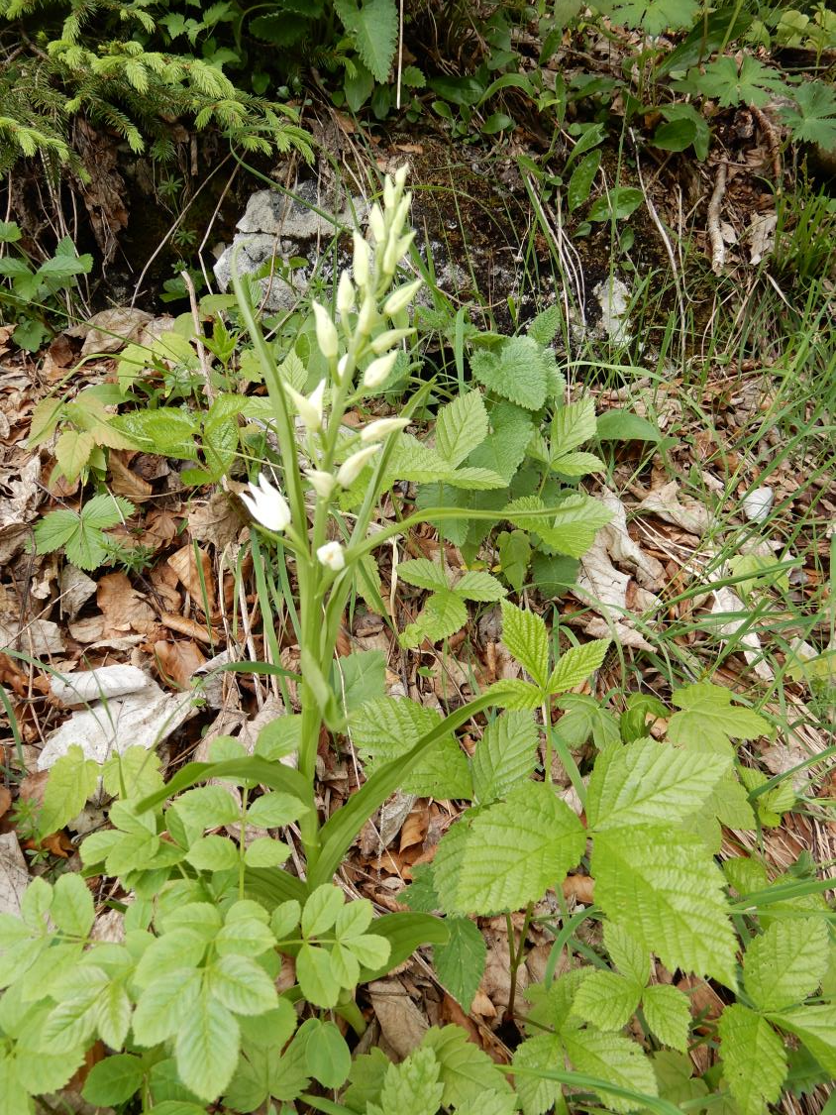
Cephalanthera ensifolia (and leaves of Rubus saxatilis)

Slide 41
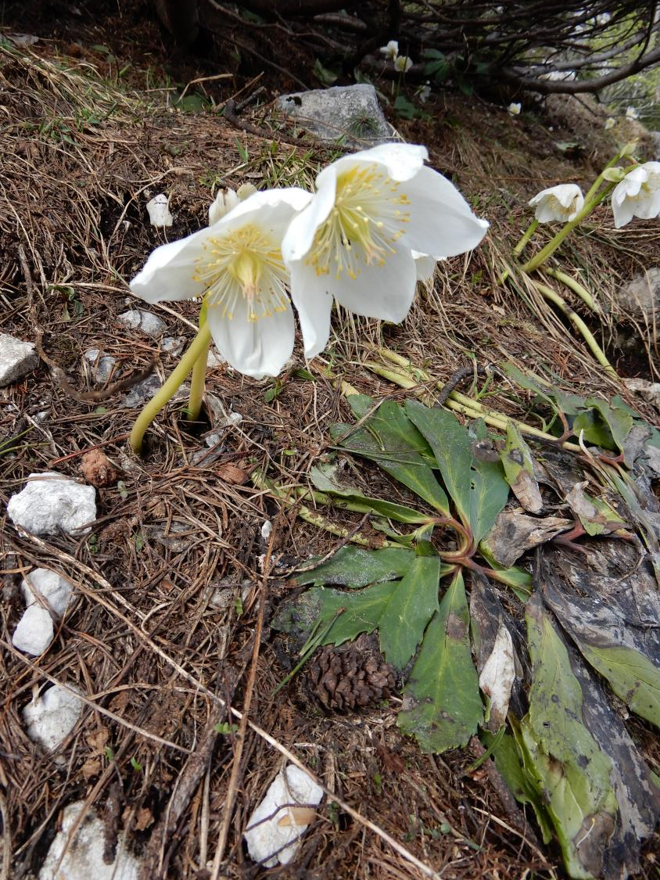
Helleborus niger

Slide 42
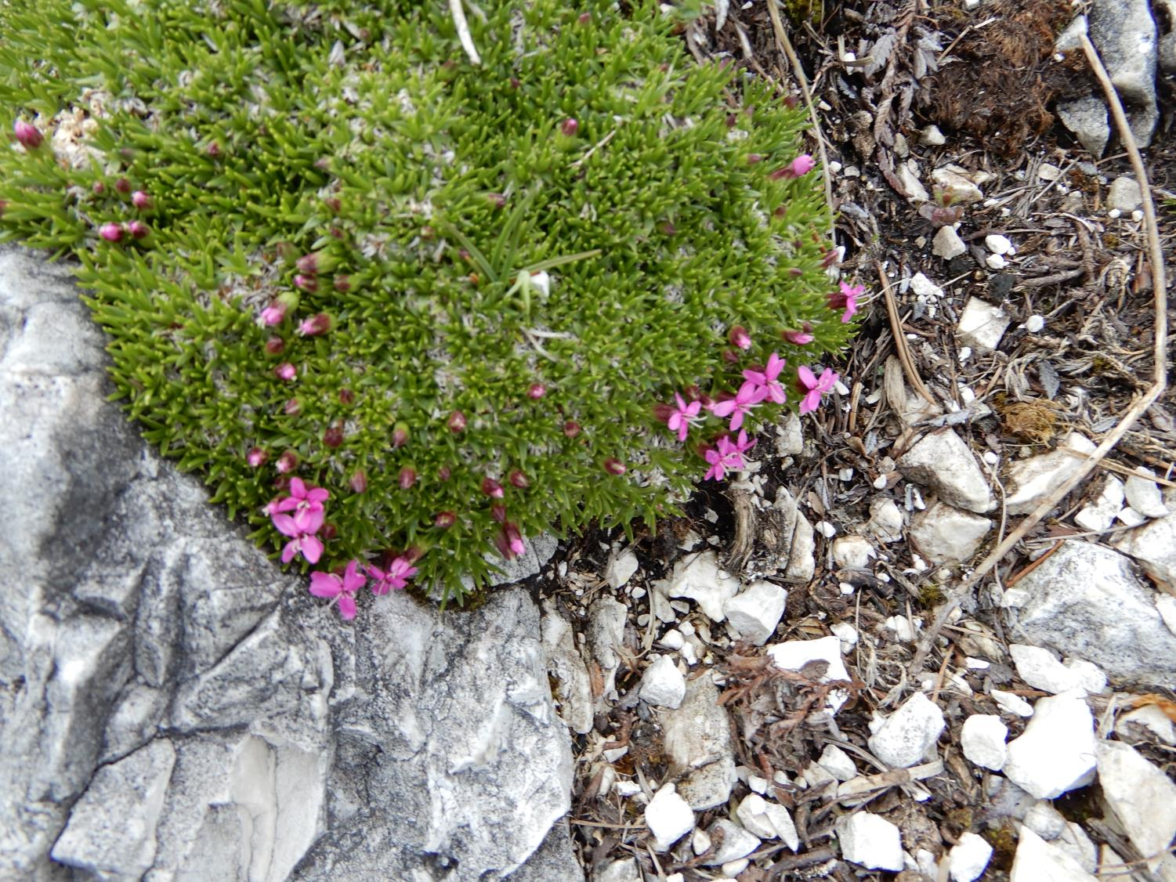
Silene acaulis

Slide 43
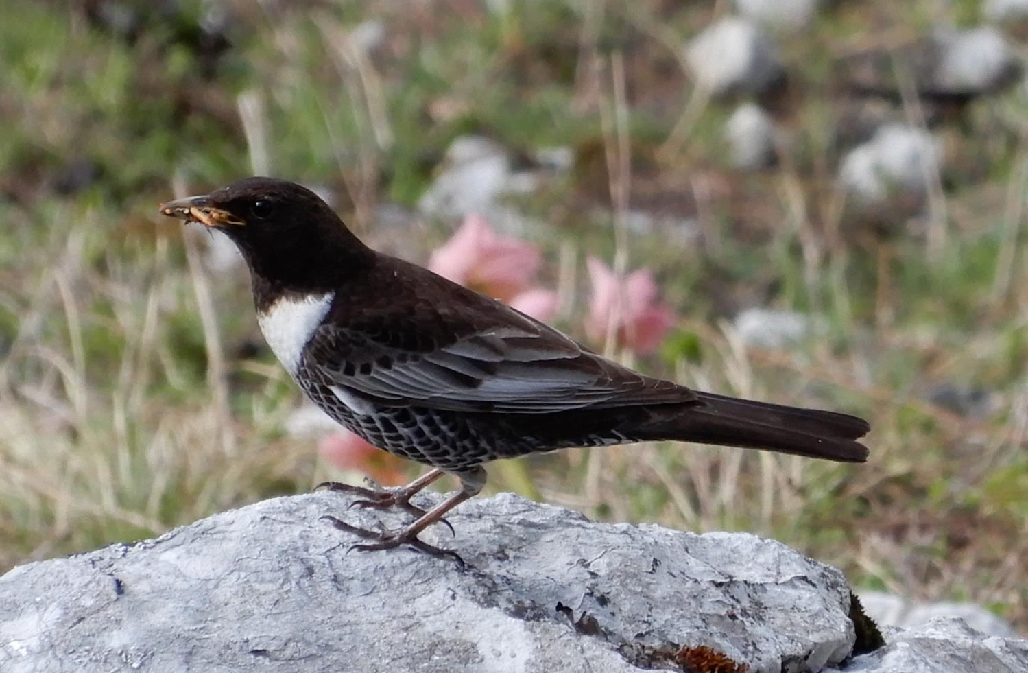
The ring ouzel (Turdus torquatus)

Slide 44
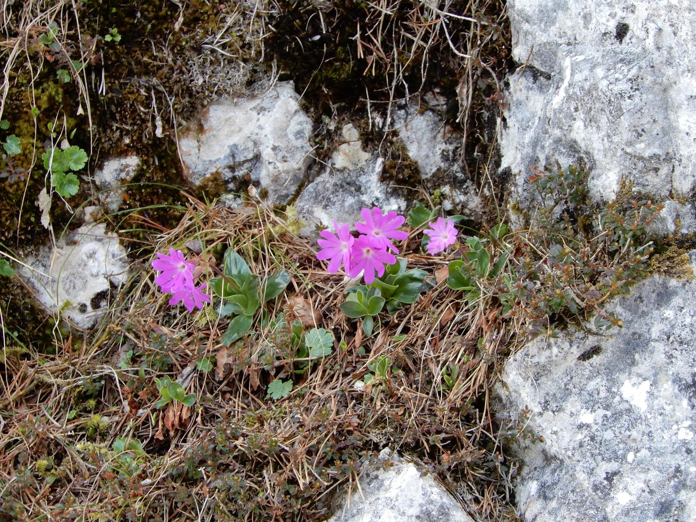
Primula clusiana

Slide 45
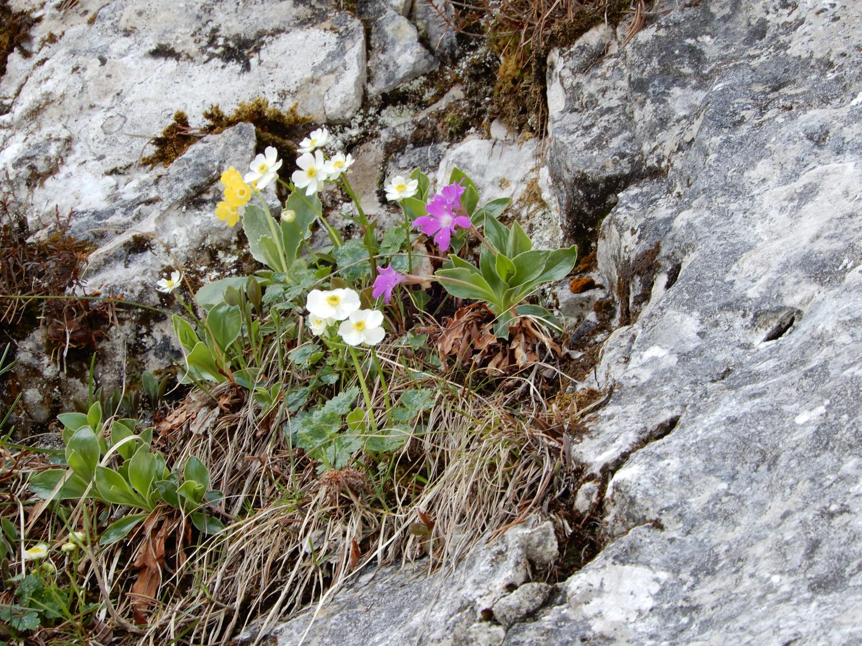
Primula clusiana, Ranunculus alpestris and Primula auricula

Slide 46
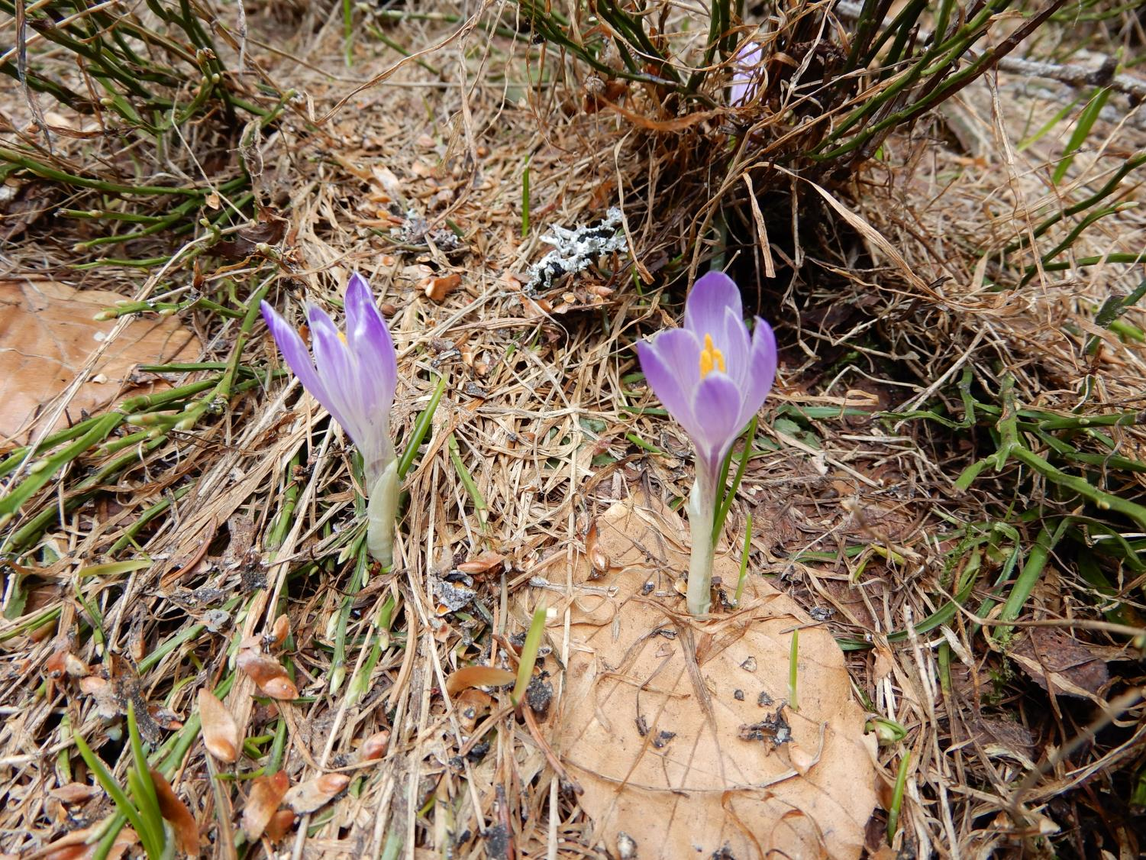
Crocus albiflorus

Slide 47
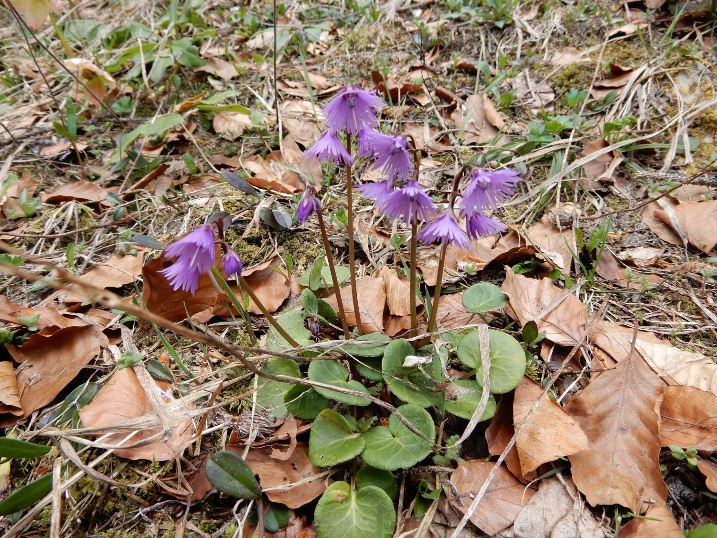
Soldanella montana

Slide 48
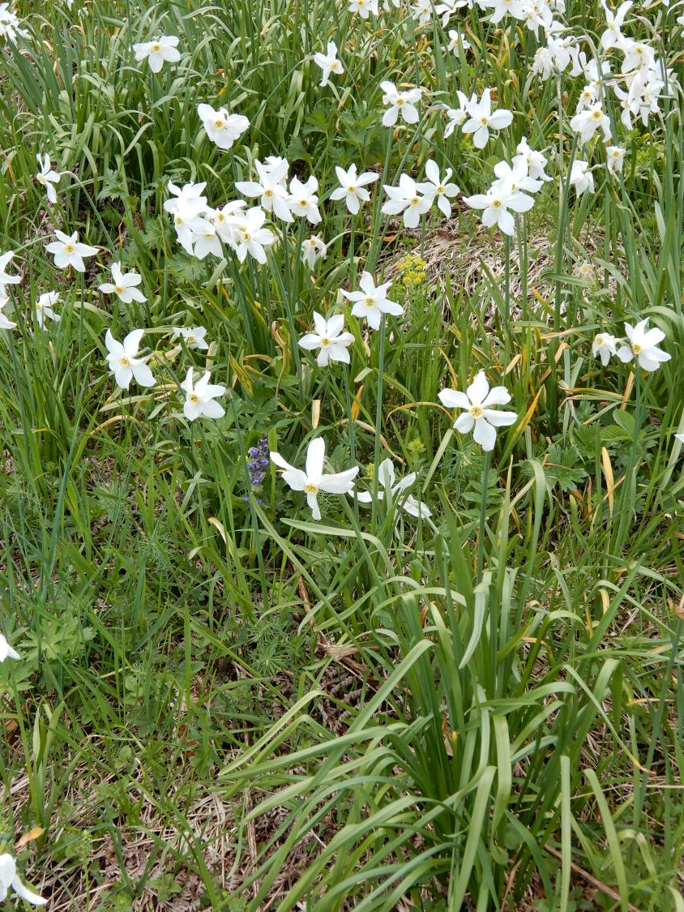
Narcissus poeticus

Slide 49
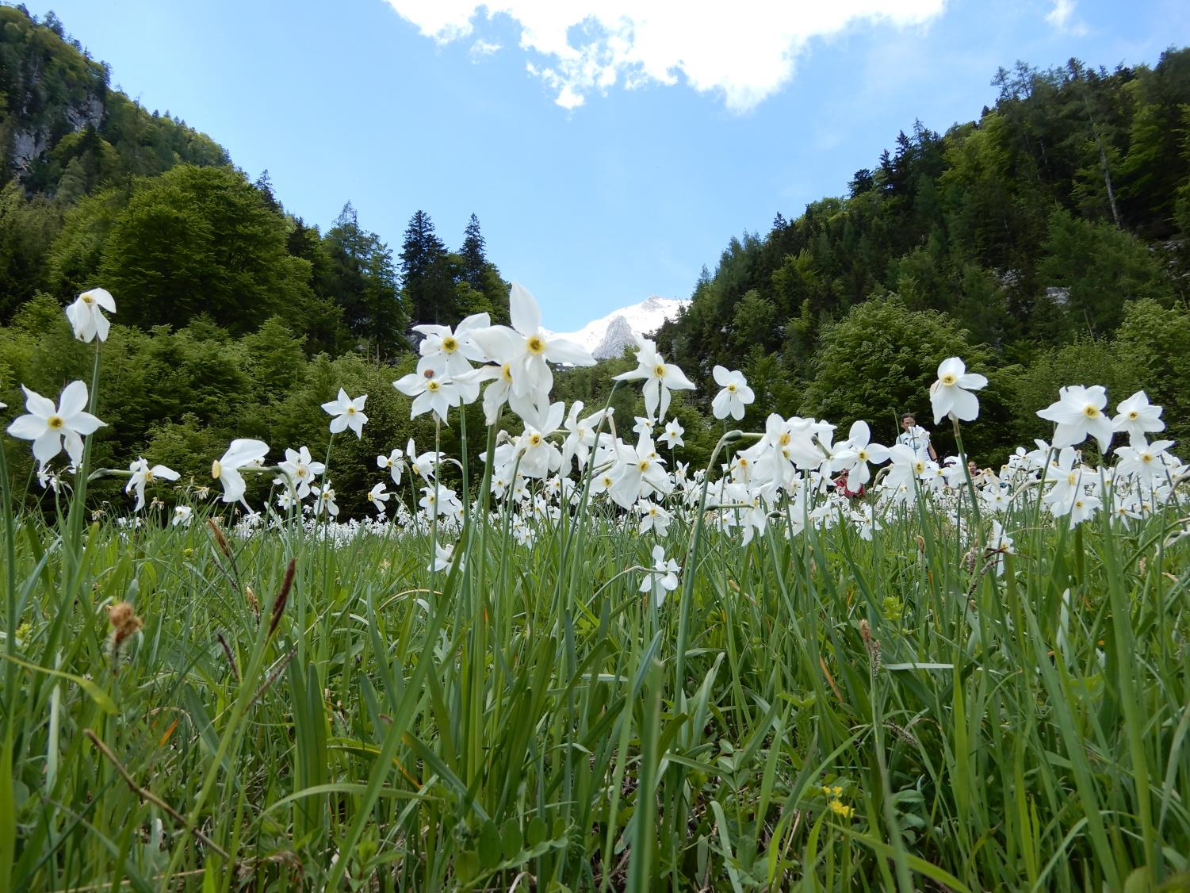

Slide 50
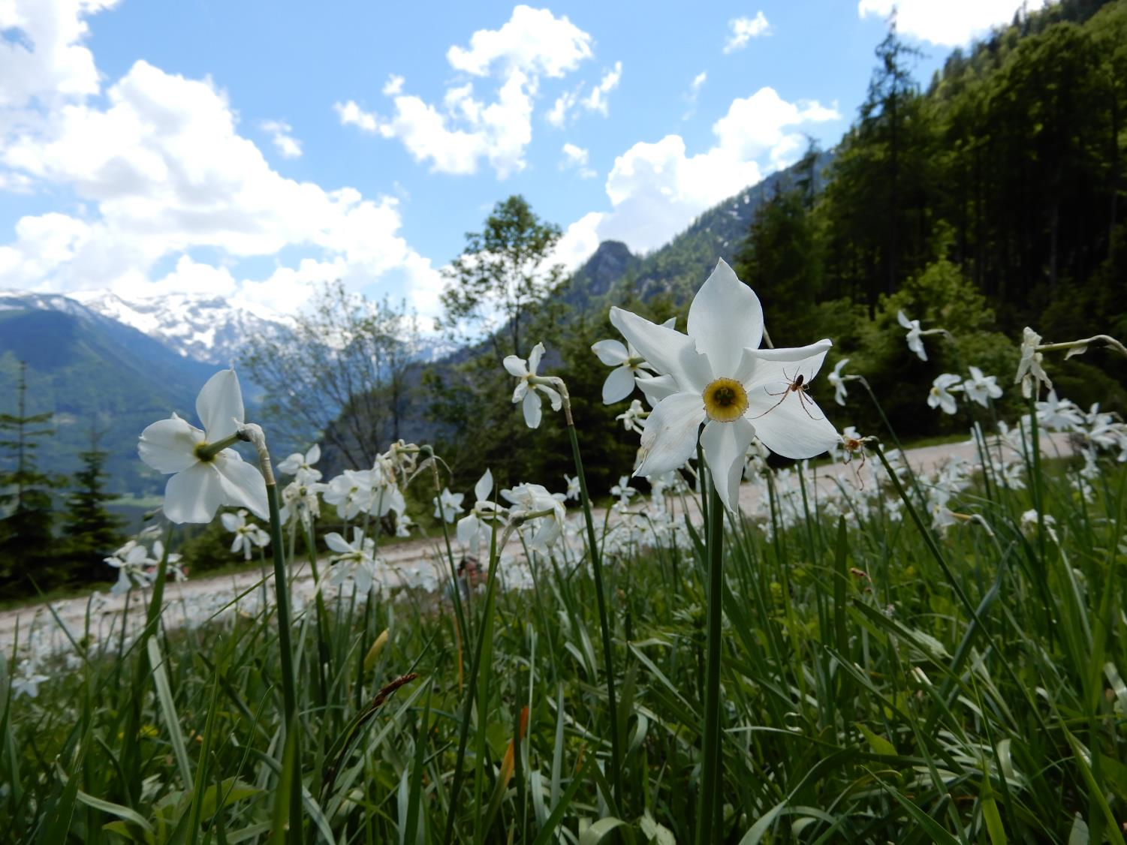

Slide 51
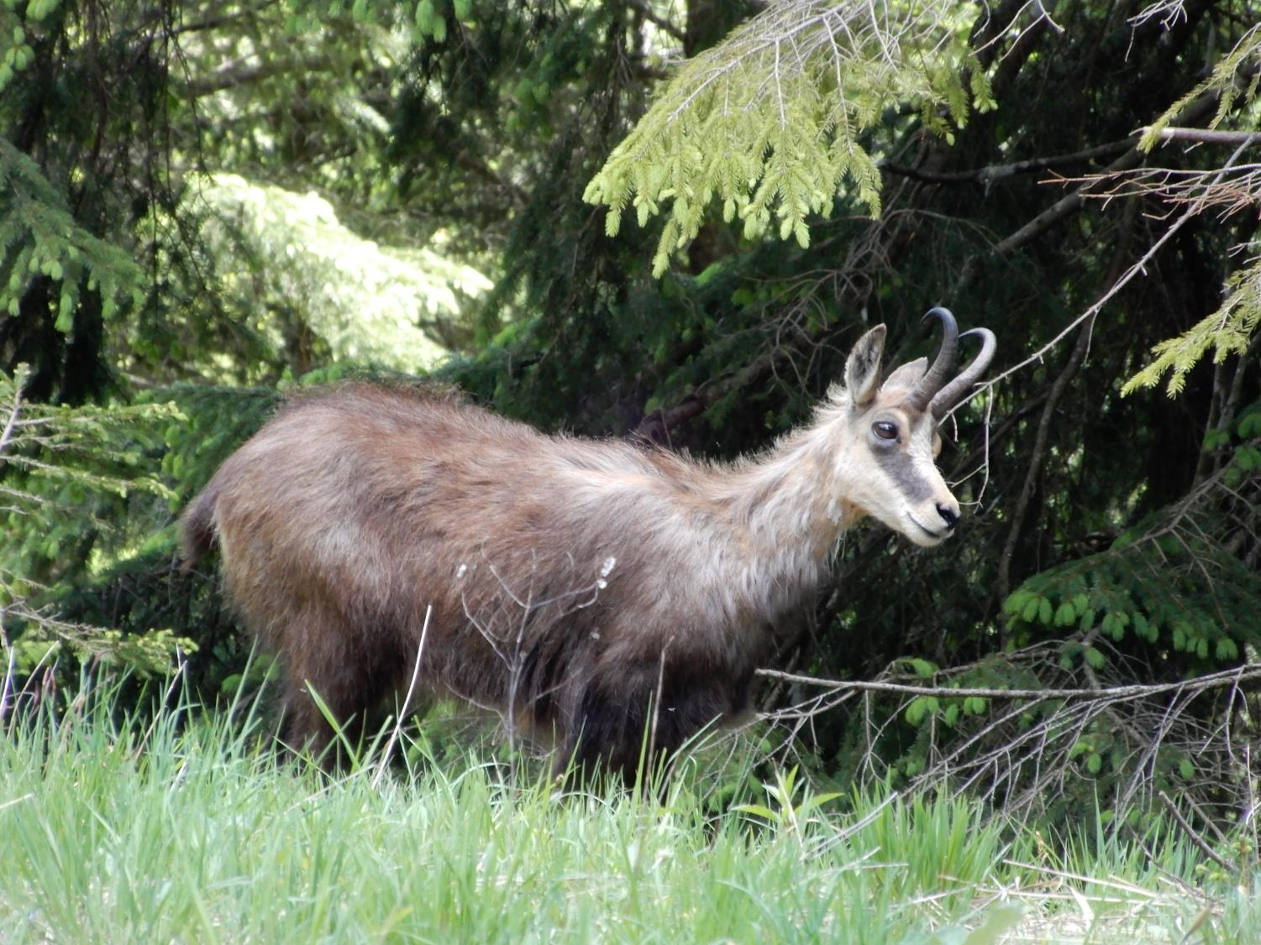
The chamois (Rupicapra rupicapra)

Slide 52
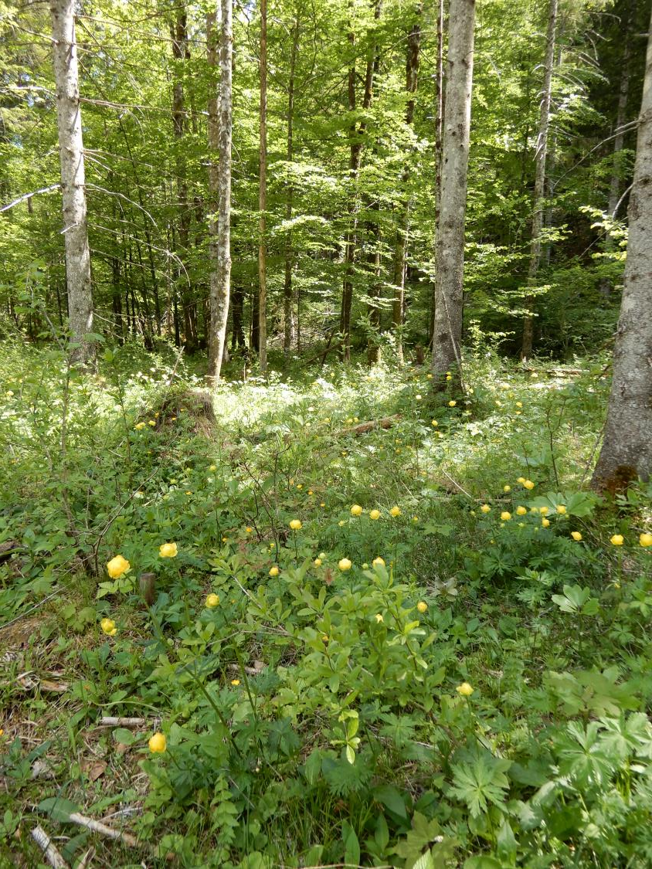
Forest with Trollius europaeus

