Slide 1
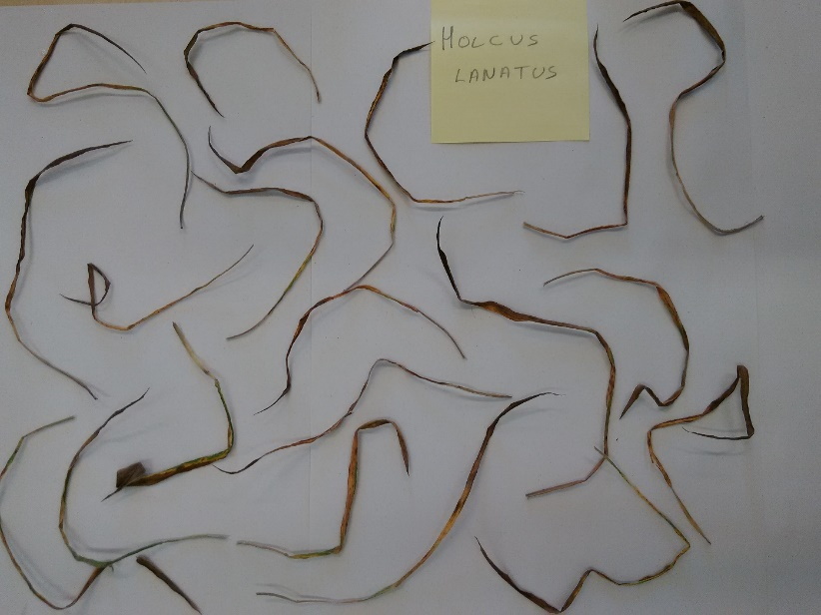
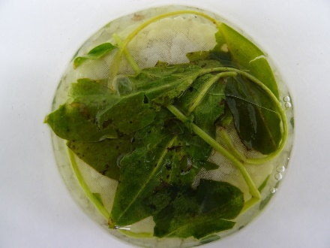
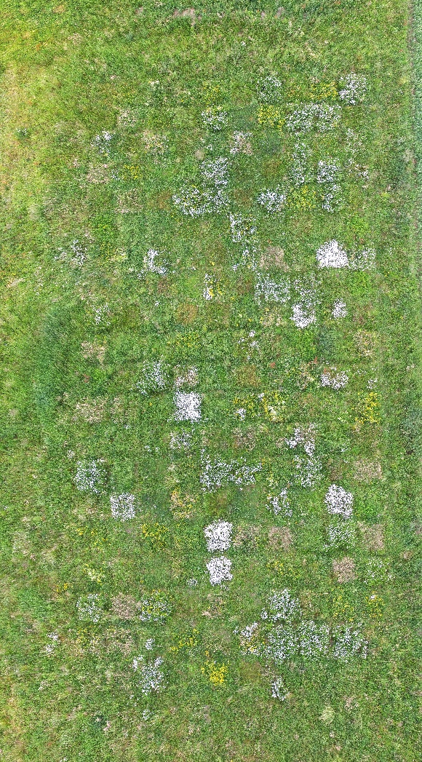
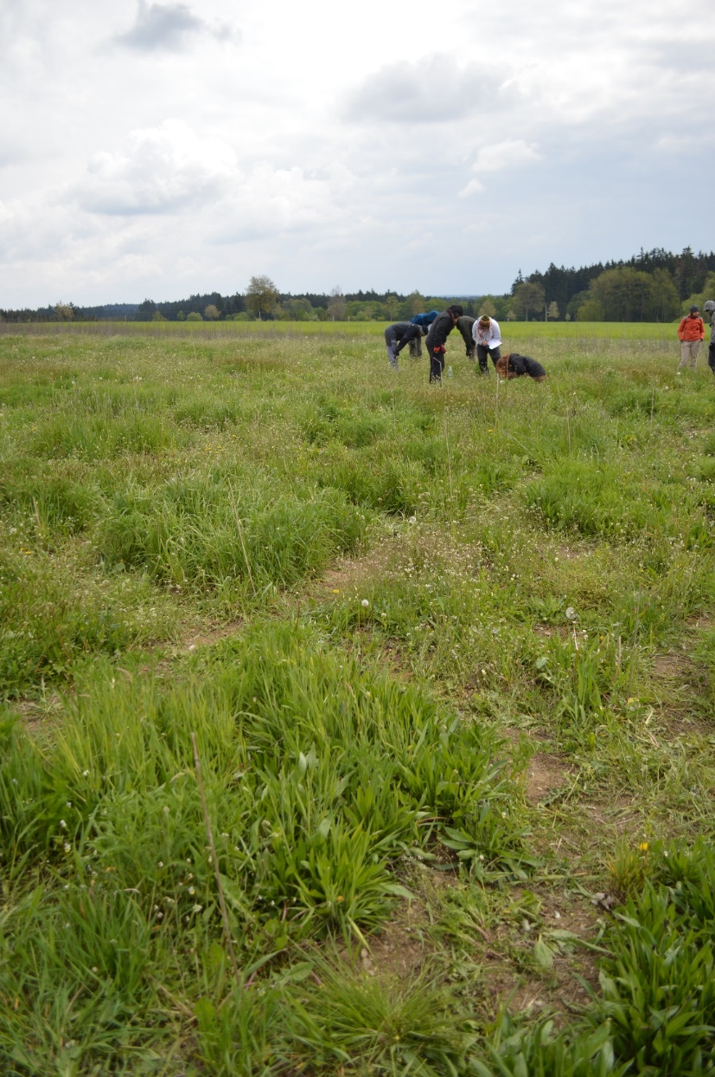
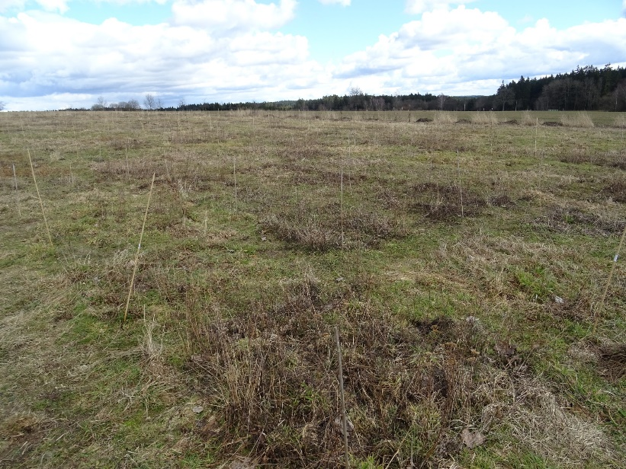
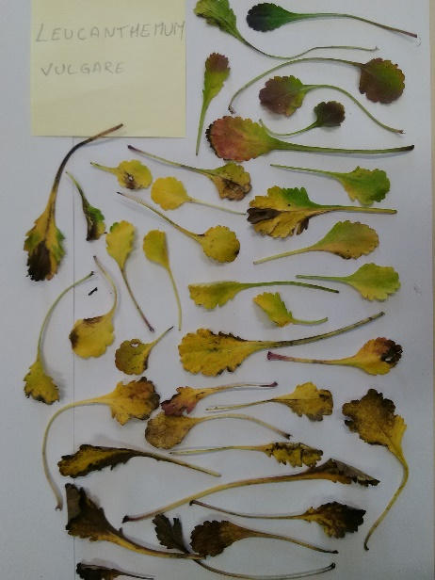
Leaf litter decomposition
of single species and mixtures
from a biodiversity experiment

Slide 2
Leaf litter decomposition
of single species and mixtures
from a biodiversity experiment

Slide 3
Biodiversity experiments
Biodiversity-Ecosystem Functioning (BEF) Experiments

Slide 4
Biodiversity experiments
Biodiversity-Ecosystem Functioning (BEF) Experiments
Manipulate species richness to establish diversity as driver of ecosystem processes/properties

Slide 5
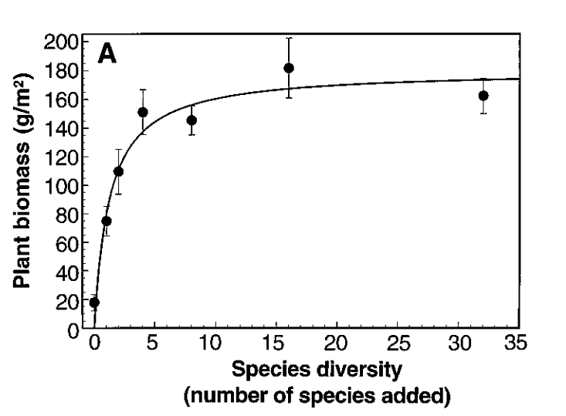
Biodiversity experiments
Biodiversity-Ecosystem Functioning (BEF) Experiments
Manipulate species richness to establish diversity as driver of ecosystem processes/properties
Tilman et al. 1996

Slide 6
Biodiversity experiments
More species do use available resources in a more complementary way.
There is a limit to how many species can add to this complementarity.
Tilman et al. 1996

Slide 7
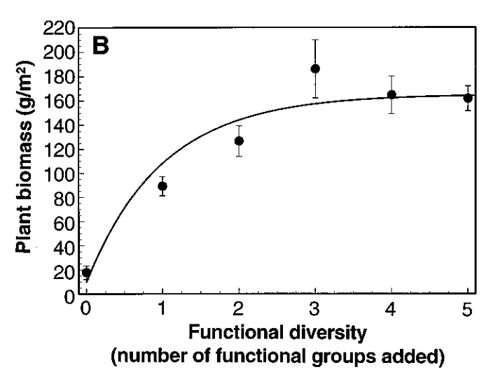
Biodiversity experiments
Complementarity might be addressed better by using trait diversity instead of species richness.
Tilman et al. 1996

Slide 8
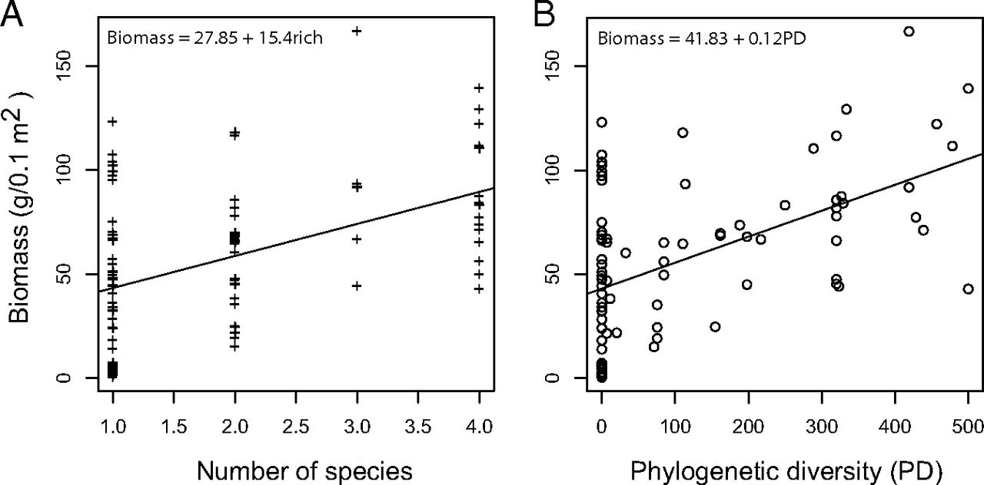
Biodiversity experiments
Complementarity might be addressed better by using phylogenetic diversity instead of species richness.
Cadotte 2013

Slide 9
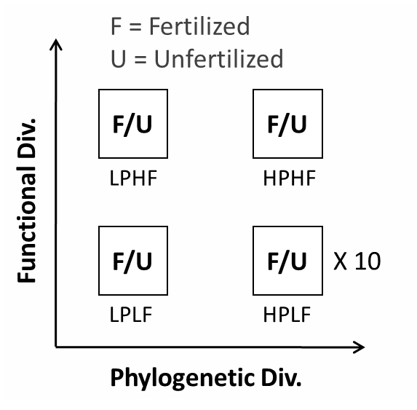
Benešov field experiment
Artificial communities of 6 species with different phylogenetic and functional diversity.
+ Monocultures

Slide 10
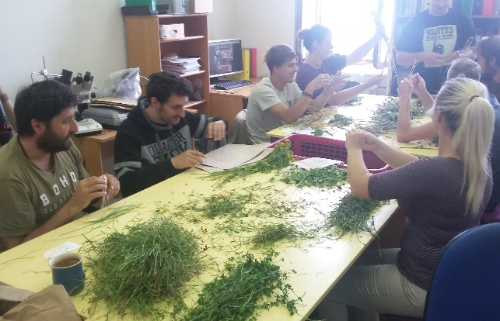
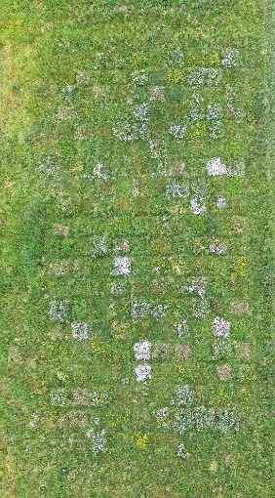
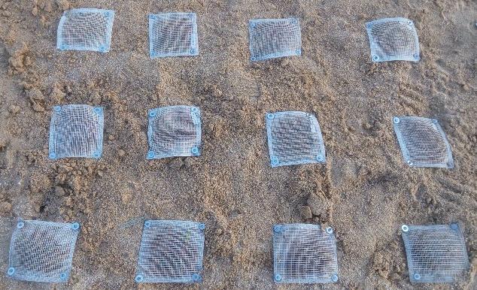
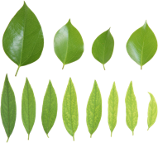
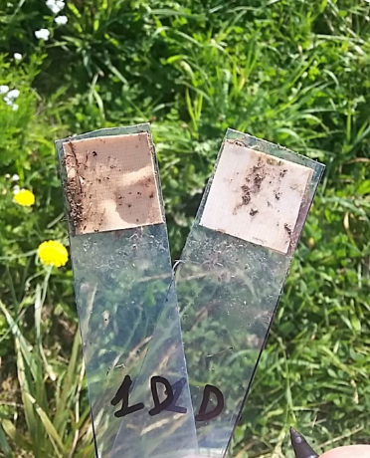
Plants Biomass
and cover
Plants traits
(H, SLA, LDMC, C/N/P, etc.)
Decomposition
Experiment
Soil characteristics:
Fertility
Microorganism diversity

Slide 11
Leaf litter decomposition
of single species and mixtures
from a biodiversity experiment

Slide 12
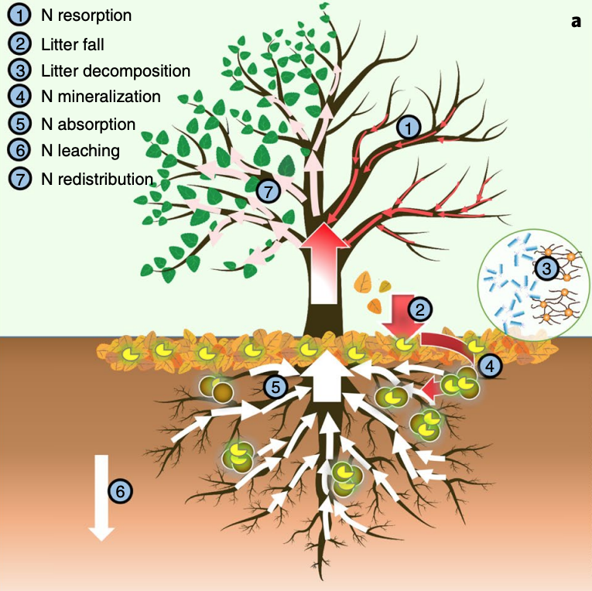
Leaf litter decompostion
Litterfall is the main pathway for nutrients, especially N and P, to return to the soil.
Decomposition is the process by which microfauna, bacteria, and fungi transform litter into CO2, water, nutrients and humus.

Slide 13
Decomposition is an important component of the nutrient cycle.

Slide 14
Leaf litter decomposition
of single species and mixtures
from a biodiversity experiment

Slide 15
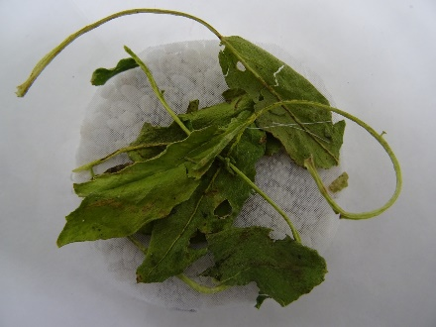
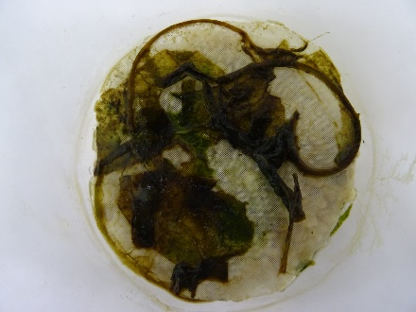
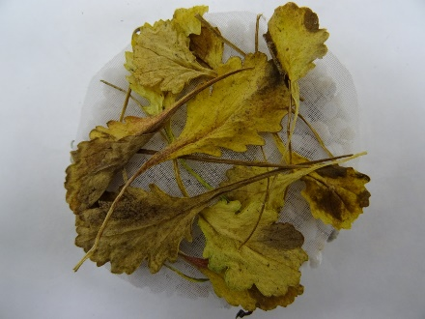
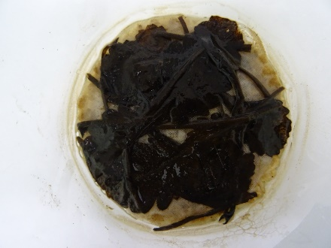
How fast a leaf decomposes is largely dependend on leaf “quality”, i.e. various chemical and physical properties of the leaf like C and N and their ratio, physical strength, etc.
45 days

Slide 16
Because species differ in their leaf traits, different species have different decomposability.
45 days

Slide 17
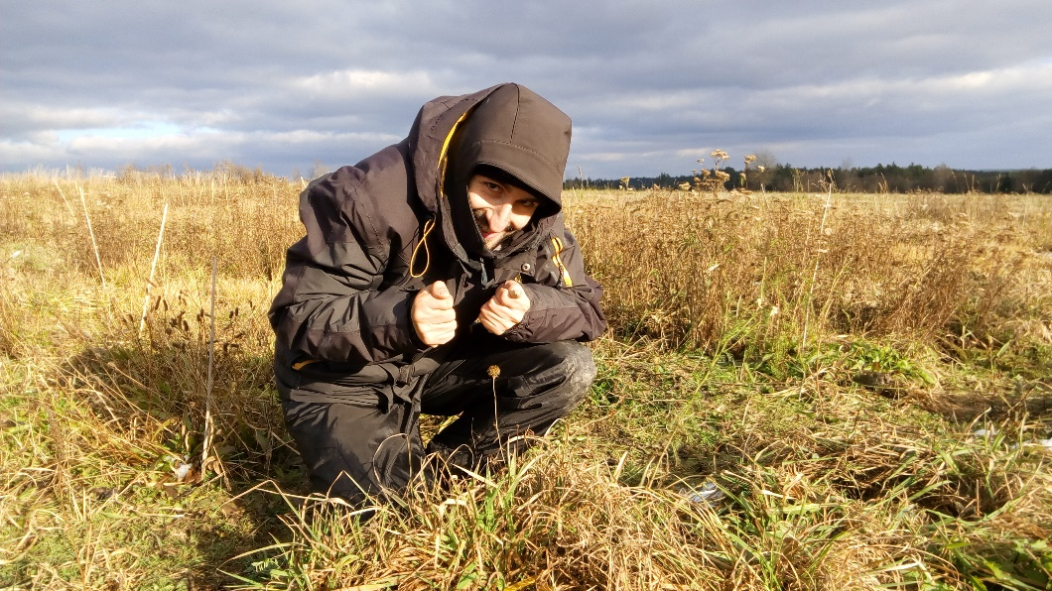
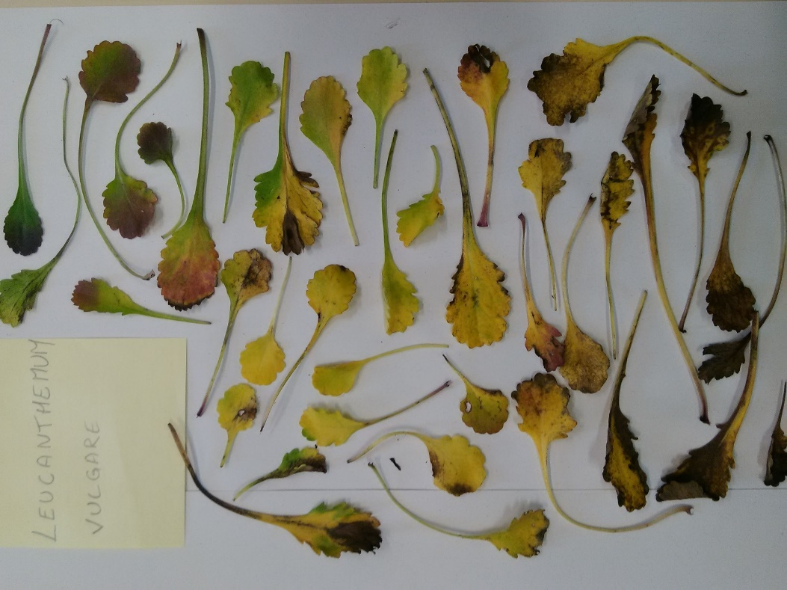
Leaf litter decomposition experiment
 | F | U
Anthyllis vulneraria | 8 | 10
Achillea millefollium | 13 | 13
Alopecurus pratensis | 11 | 11
Holcus lanatus | 13 | 13
Leucanthemum vulgare | 13 | 13
Trifolium pratense | 13 | 13
Lotus coniculatus | 13 | 13
Control | 6

Slide 18
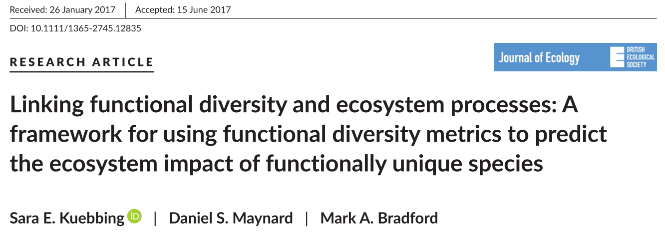
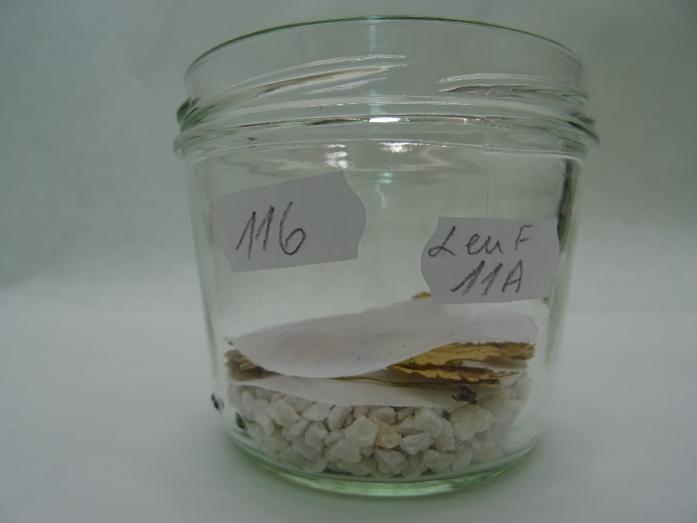
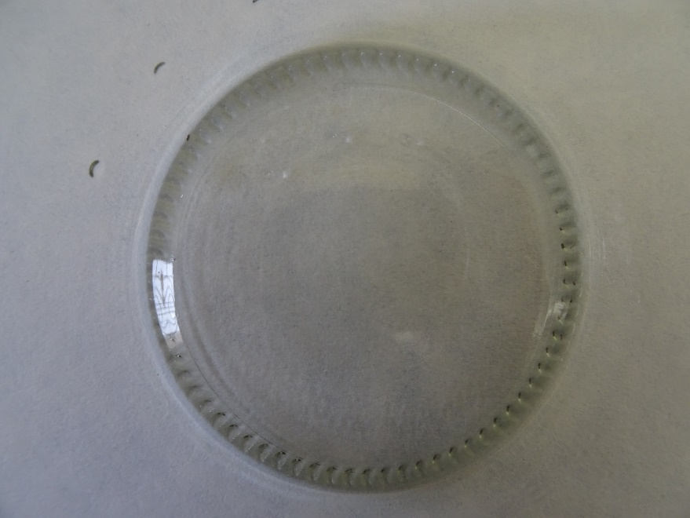
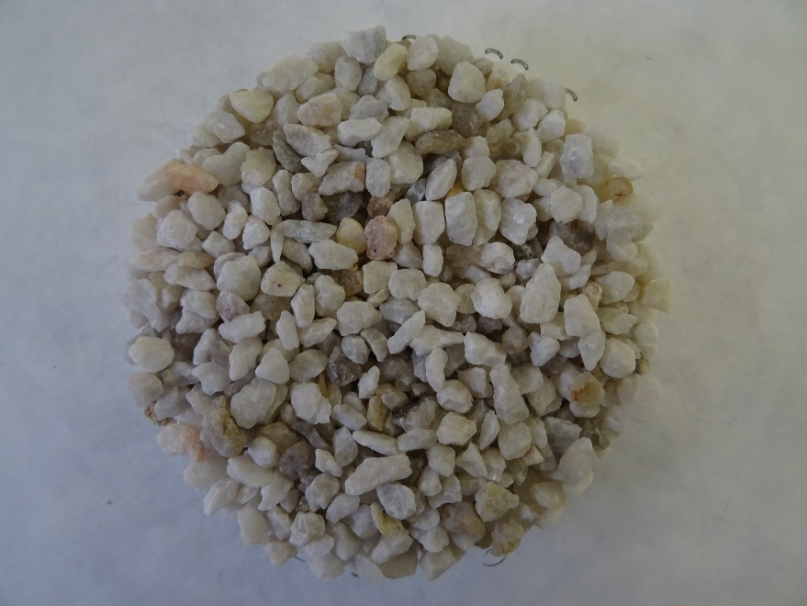
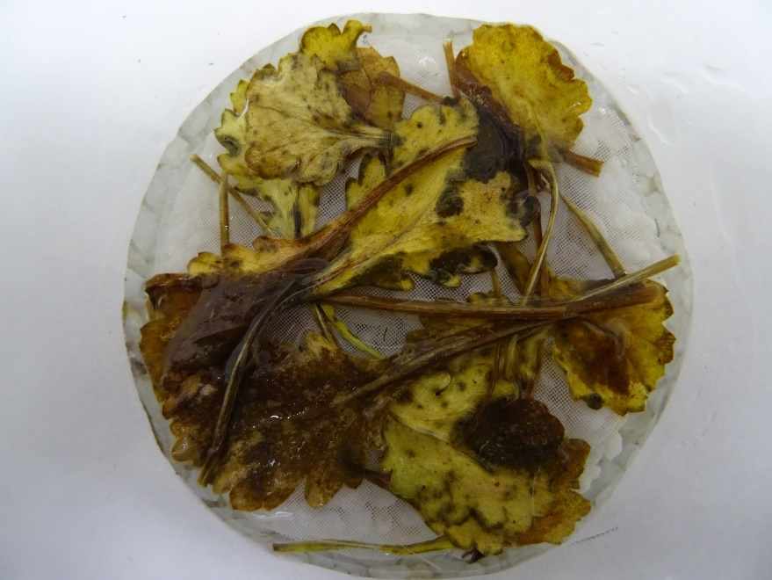
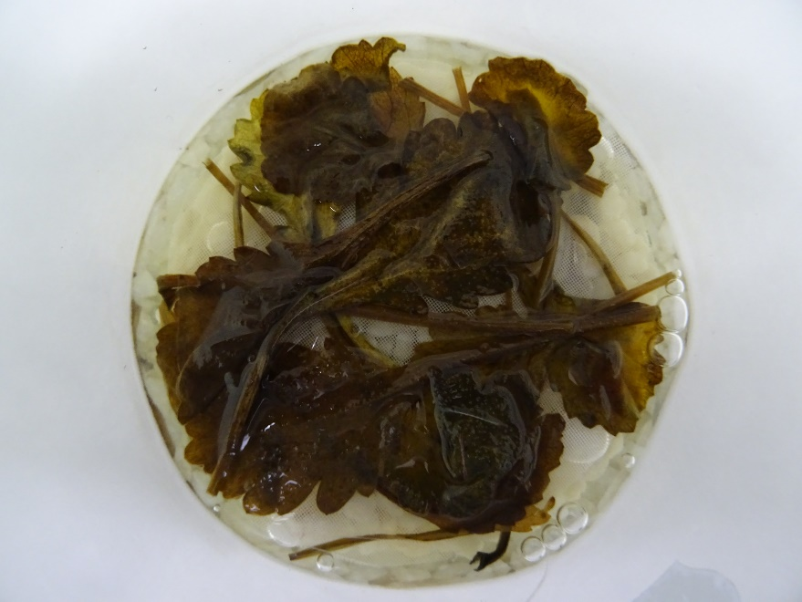
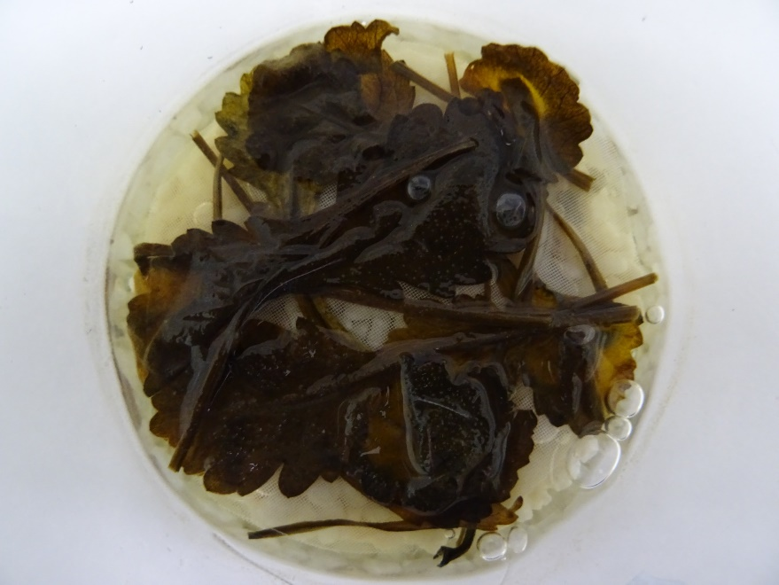
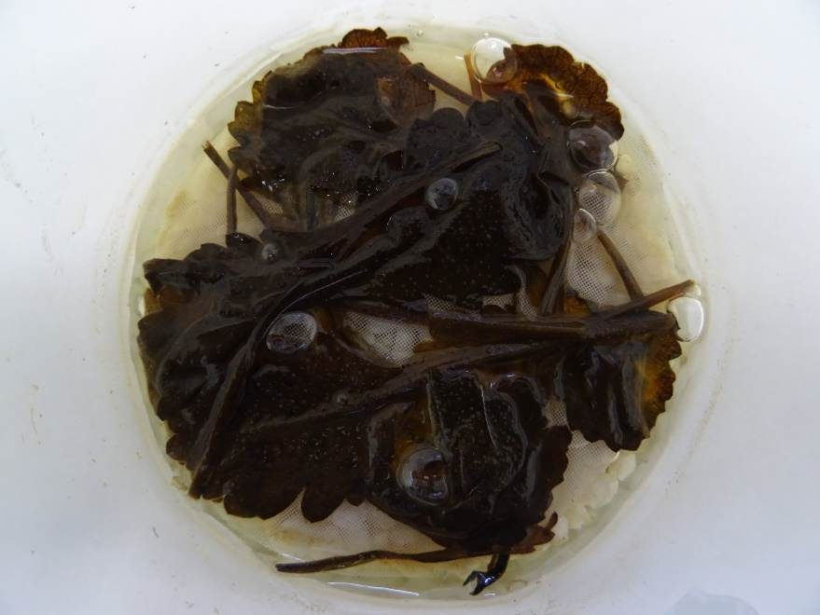
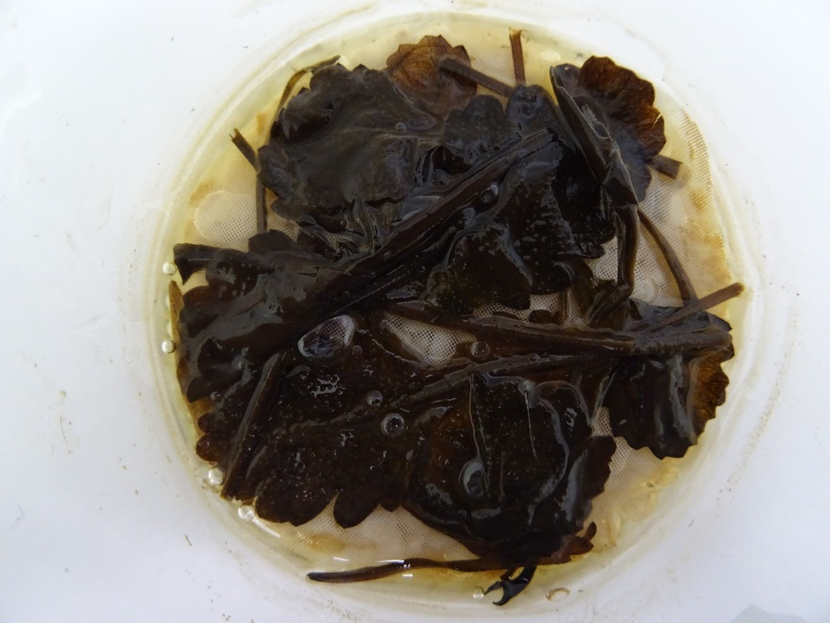
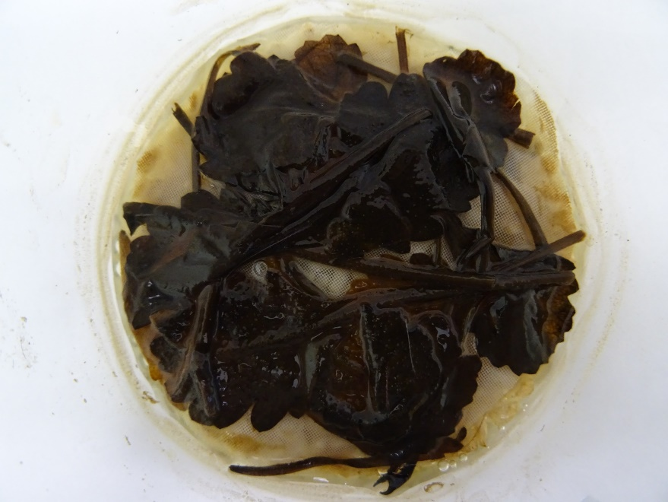
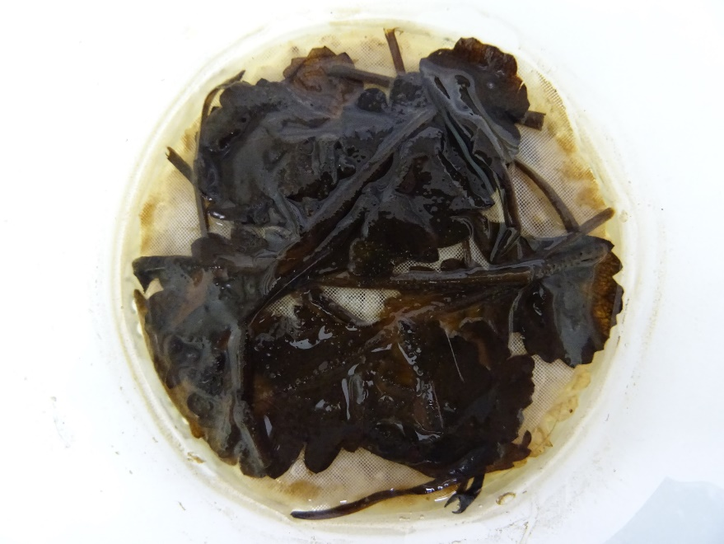

Slide 19
Biomass loss
Initial mass
Final mass/Initial mass
Final mass

Slide 20
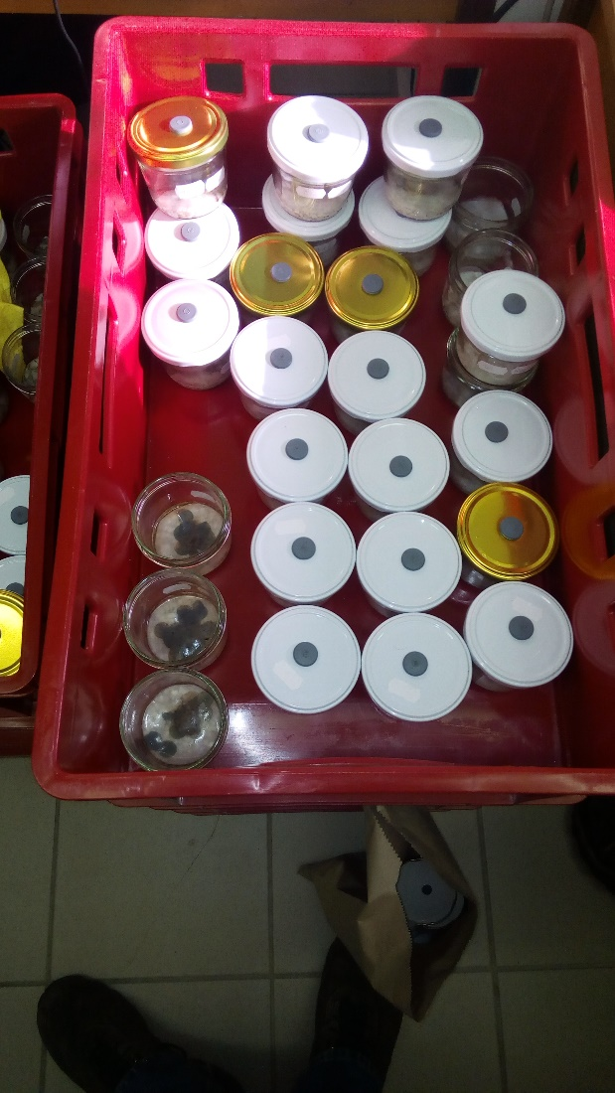
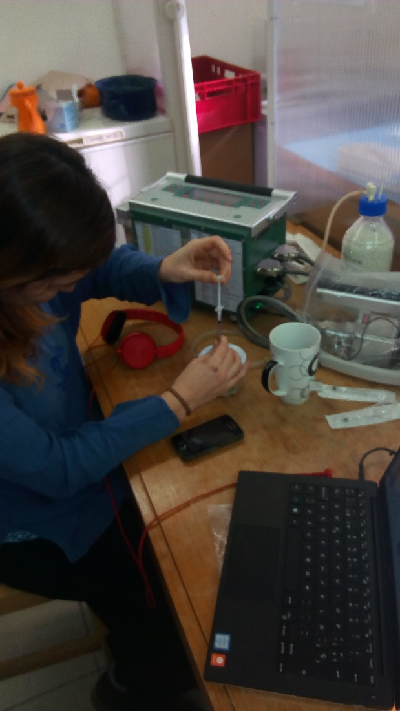
Respiration rate
Infra-red gas analysis
(μmolCO2.ml-1.s-1)
Remove CO2
2h incubation

Slide 21
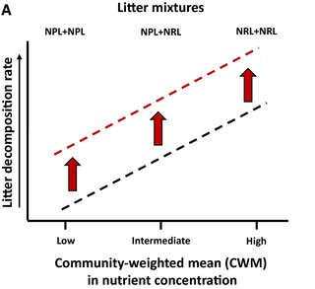
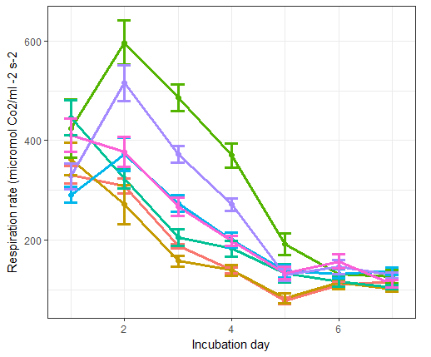
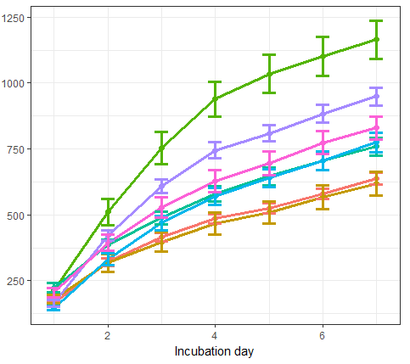
Respiration rate
Cumulative respiration rate
1
3
6
10
17
31
45
1
3
6
10
17
31
45

Slide 22
Leaf litter decomposition experiment
Single species + mixtures that were composed from the single species (from monocultures)
Single species (7) from different diversities

Slide 23
Data
Information on decomposition of single species and mixtures (biomass loss, respiration rate)
Information on “background” diversity of leaf samples (monocultures, combinations of 2 phylogenetic and 2 functional diversity levels)
(Trait data of the species)

Slide 24
Questions
How does diversity influence composability of species and mixtures?

