Slide 1
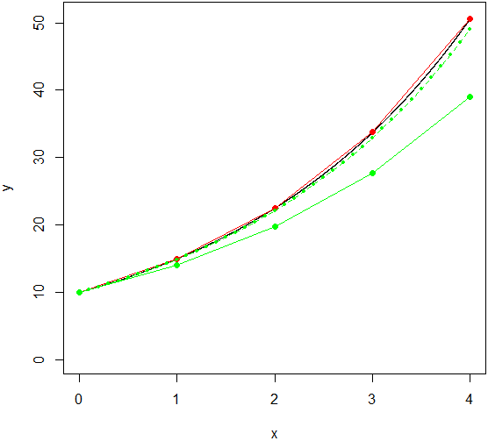
Math
Equation of exponential growth
y_{x}=y₀*λ^{x}
Differential equation
dy/dx = y*r
r = ln(λ)
In theory, it is continuous
In practice, it is simulated by discrete steps in difference equation:
y_{x+1} = y_{x}*λ
If we need r instead of λ in the equation, we must use compatible conversion:
Either: r = ln(λ): λ = e^{r}
y_{x+1} = y_{x}*e^{r}
or: r = λ-1; λ = 1+r
y_{x+1} = y_{x}*(1+r)
Combining„mathematically correct“ r = ln(λ)
with simplified formula λ = 1+r cummulates bias. The bias disappears when tiny time step is used, and has no impact on the behaviour of the models.
Example
λ = 1.5
dx = 1
r = λ-1 = 0.5
λ = 1+r = 1.5
y_{x+1} = y_{x}*(1+r)
r = ln(λ) = 0.405
λ = e^{r} = 1.5
y_{x+1} = y_{x}*e^{r}
r = ln(λ) = 0.405
λ = 1+r = 1.405
y_{x+1} = y_{x}*(1+r)
dx = 1 (solid line), 0.1 (dashed line)
Interpretation
λ is ratio of N in subsequent times (population grows 1.5×)
r = λ-1 express growth in percent
(population grows by 50%)
Geometry: r = λ-1 is
relative slope of secant
in subsequent times
r = ln(λ) no intuitive interpretation
Geometry: relative slope o tangent
in each time point.
If tangent is broken frequently enough, the line fits continuous growth

Slide 2
λ (finite rate of increase)
It is in equation of exponential growth
y_{x} = y₀*λ^{x}
as well as in simple difference equation
y_{x+1} = y_{x}*λ
It has intuitive interpretation as multiple
λ = 1.2 population grows 1.2×
or percentage (it is actually r = λ-1)
λ = 1.2 population grows by 20%,
λ = 0.95 population declines by 5%
Further use is hindered by log-normal distribution
– asymetric distribution (valid also for r = λ-1)
multiplicative
stable population at λ = 1
–> must be taken into account
(e.g. use of geometric mean
for calculation of mean λ)
–> log transformation can be used:
ln(λ) = r
r (intrinsic rate of increase)
It is in differential equation
dy/dx = y*r
Uninterpretable value r = ln(λ)
Advantages in further use:
– symmetric distribution, additive
(valid only for r=ln(λ))
– mean growth rate can be obtained using arithmetic mean
– in stochastic models, random numbers from normal distribution can be generated
– stable population at r = 0
(valid for both versions of r)
– logistic growth: multiplication by zero stops the growth
y_{x+1} = y_{x}*λ
y_{x+1} = y_{x}*exp(r)
y_{x+1} = y_{x}*exp(rnorm(mean.r, sd.r))
y_{x+1} = y_{x}*exp(r*((K-y_{x})/K))

